Slide 1
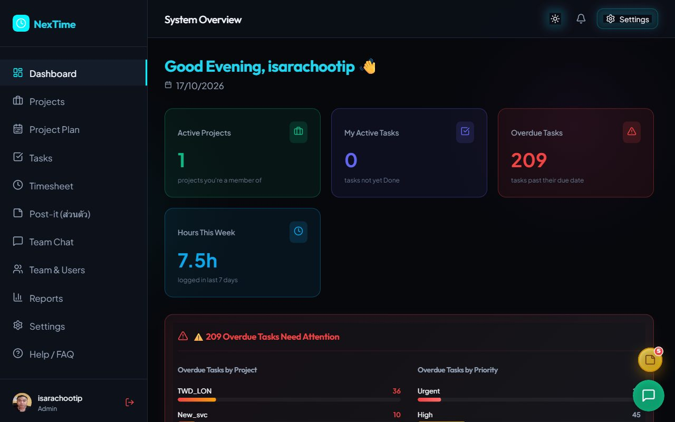
NexTime
Project & Timesheet
Management System
System overview and usage · 17 October 2026
Notes:
Introduce NexTime, the project and timesheet management system, available on the web at vibeproject.online.

Slide 2
One system from planning to project cost
NexTime connects plans, tasks, time logging, approvals and cost in one place. Managers see project status and budget instantly; teams log time easily against the work they actually do.
12
18
477
1,707
Projects
Users
Tasks
Hours logged
Live system data as of 17/10/2026
Notes:
All figures come from the live system on 17 October 2026: 12 projects, 18 users, 477 tasks and 1,707 hours logged.

Slide 3






Key capabilities
Agile Task Management
Project Plan & Gantt
Timesheet & Approval
Kanban board, backlog, sprints, releases and story points
Auto-generated milestones, saved baselines and plan comparison
Drag-to-log time, proof-of-work images, approval workflow
Resource & Cost
Team Collaboration
AI Assistant & Integration
Labor rates per role, man-days and cost against budget
Project chat, Post-it notes, WFH schedule, alerts
Gemini chatbot, LINE login, GitHub/GitLab webhooks

Slide 4






Data flows from plan to report
1
2
3
4
5
6
Configure
Create project
Plan work
Log time
Approve
Report
Admin sets templates, permissions, rates
Add members; plan is generated
PM organizes tasks, sprints, releases
Team logs daily timesheets
PM / Manager / Admin review and approve
Progress, cost and budget
Automation: Moving a task to In Progress creates a Draft timesheet instantly, and commits that mention a task ID update its status.

Slide 5
Role-based access
Admin
Permission | Admin | Manager | PM | Employee | User
Create task / bug | Yes | Yes | Yes | Yes | No
Log timesheet | Yes | Yes | Yes | Yes | No
Approve team timesheets | Yes | Yes | Yes | No | No
Edit approved timesheets | Yes | Yes | No | No | No
Manage sprints / baselines | Yes | Yes | Yes | No | No
System settings | Yes | No | No | No | No
Full access, including system settings
Manager
Manages projects, plans and all approvals
PM (project)
Manages members, sprints, team approvals
Employee / Tester
Own projects only; logs time, creates tasks
User (external)
Source: the system’s Help / FAQ page
Can chat but cannot create or edit tasks

Slide 6
Dashboard: every project at a glance
Four summary cards
Projects, my tasks, overdue tasks, hours this week
Overdue tasks
Broken down by project and priority
Project Health
Progress %, members and days left or overdue

Slide 7
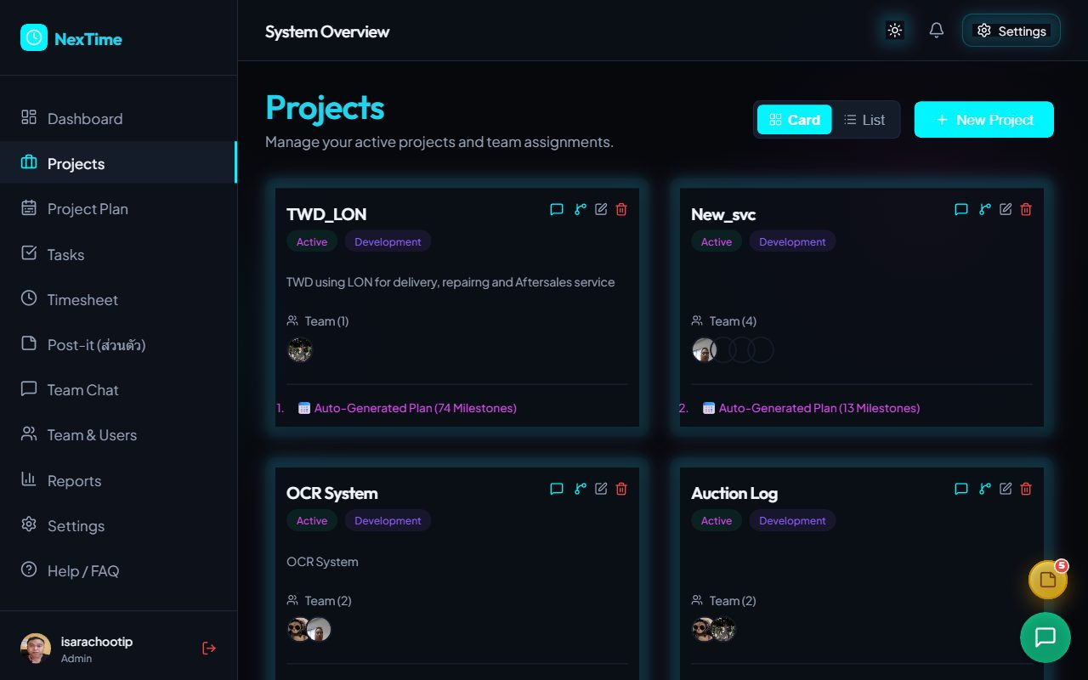
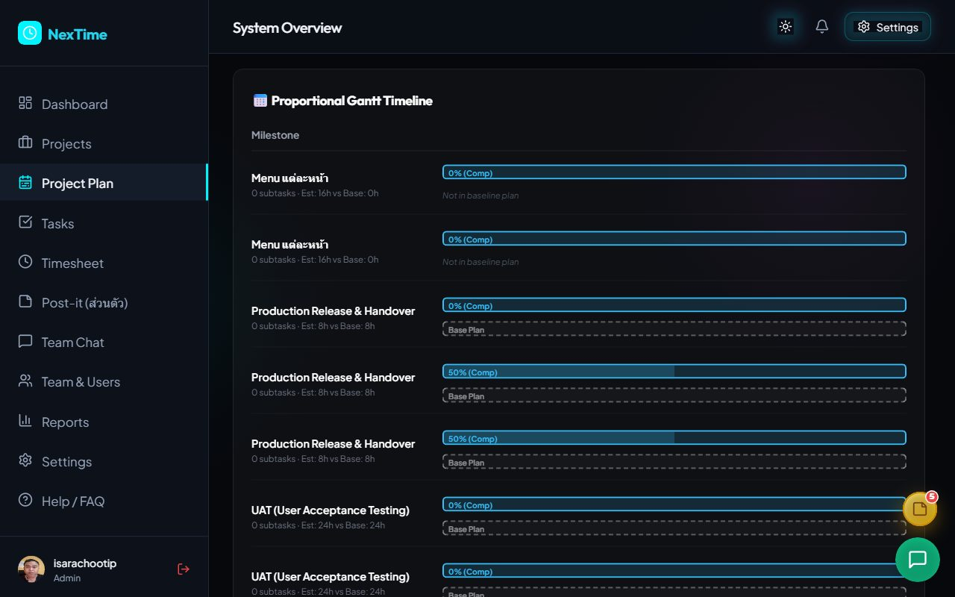
Projects and Project Plan: automatic, comparable plans
Projects create a project, add members with roles and rates; milestones are generated from templates across the project dates
Project Plan proportional Gantt, saved plan versions, and drift in schedule, hours and story points

Slide 8
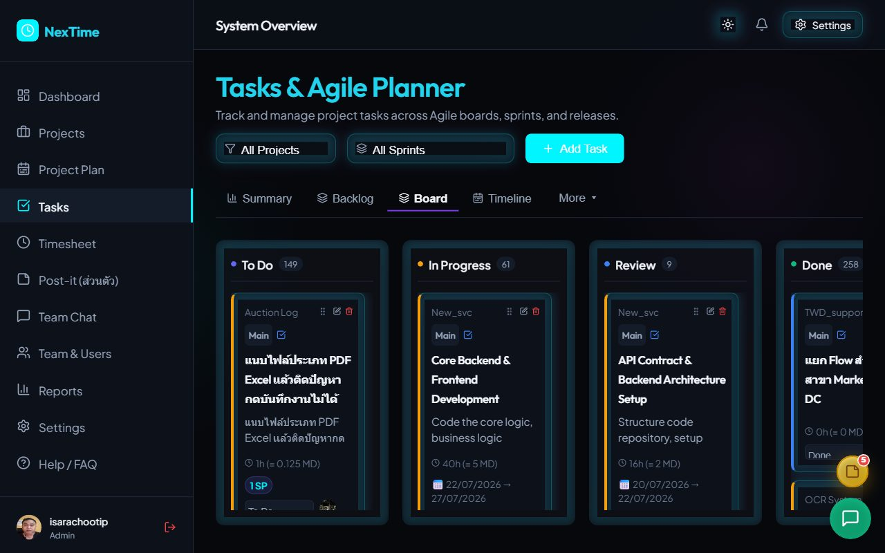
Tasks: agile work management with Kanban
Tabs on the Tasks page
Summary – sprint progress and team workload
Backlog – fill a sprint, then Start
Board – drag cards to change status
Timeline – Gantt of tasks
Releases / Backlog Grooming
How progress is calculated
No subtasks: In Progress 50% · Review 90% · Done 100%
With subtasks: share of subtasks done

Slide 9
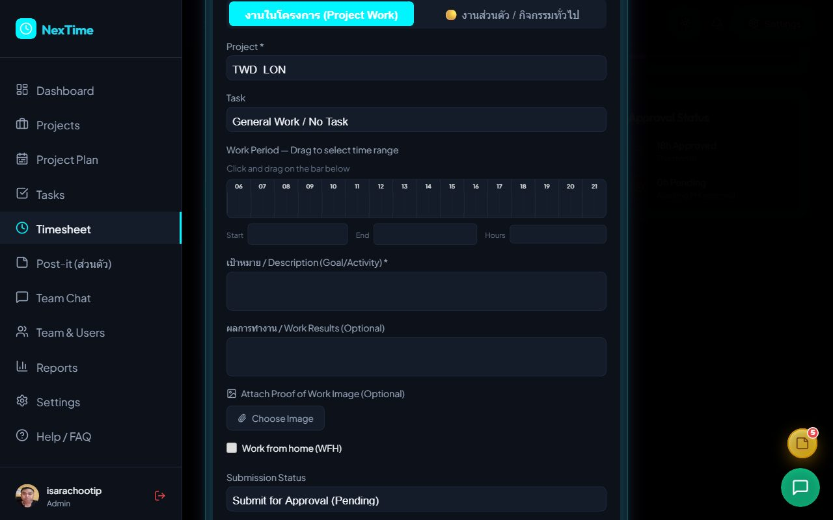
Timesheet: log time by dragging a range
1
Pick a date and click + Log Time
2
Choose the project and task
3
Drag on the 06:00–22:00 bar; hours are calculated
4
Enter goal and results, attach proof
5
Submit for approval or save as Draft

Slide 10
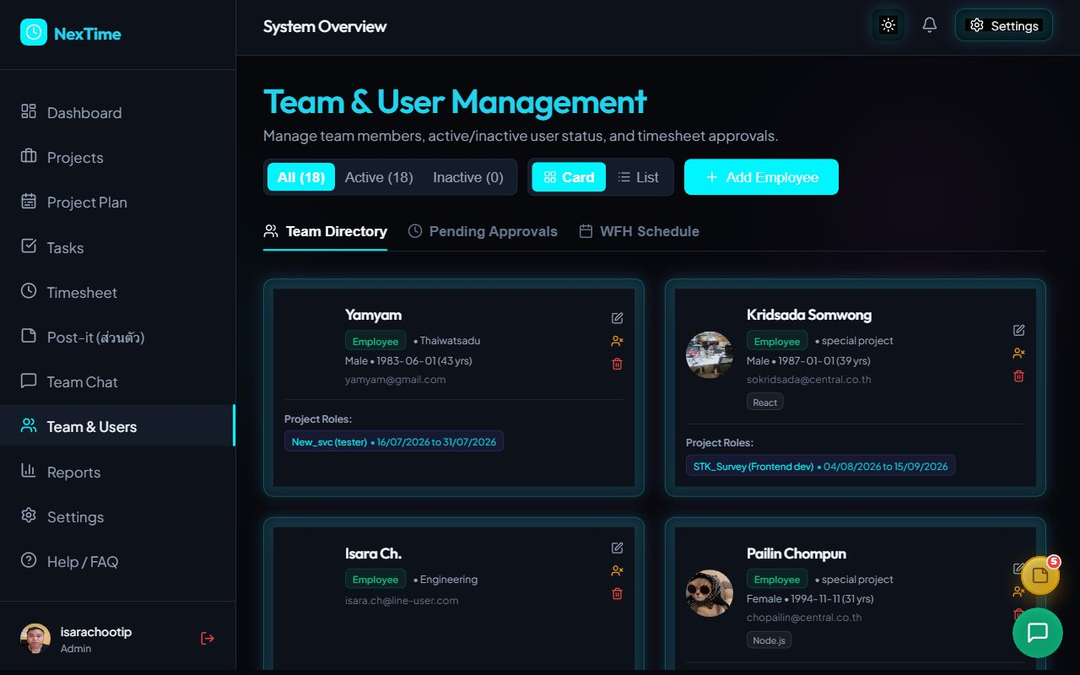
Team & Users: approvals and team management
Draft
Not yet submitted
Pending
Awaiting approval
Approved
Counted in cost
Team Directory
Employee details, skills and project-role history
Pending Approvals
PM / Manager / Admin approve or reject
WFH Schedule
Weekly work-from-home planning

Slide 11
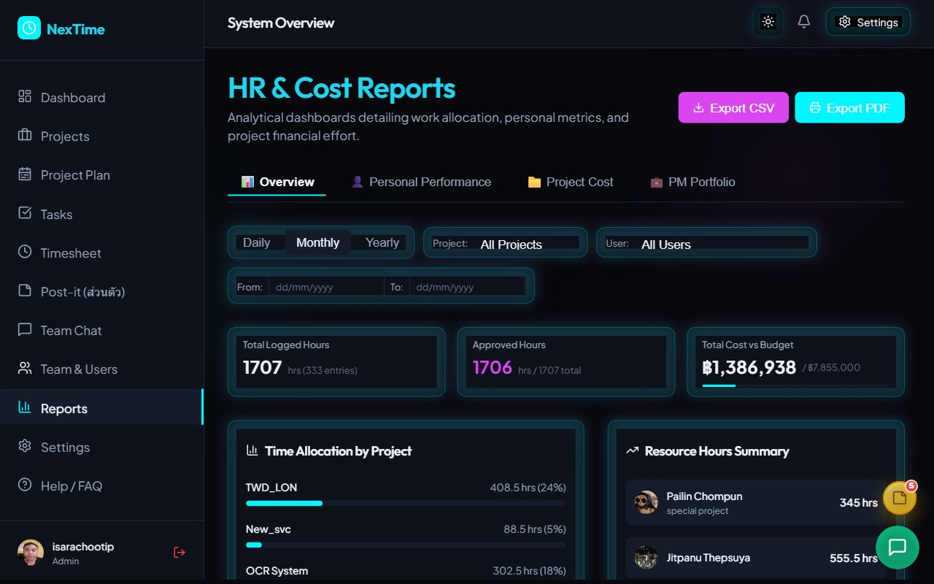
Reports: actual cost against budget
1,707 h
Hours logged (1,706 approved)
฿1.39 M
Actual cost, of ฿7.86 M total budget
4 views
Overview · Personal · Project Cost · PM Portfolio
Export to CSV, PDF and per-person Excel

Slide 12





Settings and integrations
Milestone Templates
Permission Schemes
11 standard stages spread by % of project duration
Project-level permission sets
Labor Rates
Git Webhook
Daily/hourly rates per role (THB/USD)
GitHub/GitLab commits move tasks
AI (Gemini)
LINE OA Login
Chatbot answers usage questions
Sign in with a LINE account

Slide 13
Findings from the system review
Issue | Details | Severity
Tasks › Timeline blank page | Opening Timeline with a project selected blanks the whole page (React error #310) until refresh | High
End date before start | TWD_LON: 10/06/2026 → 29/05/2026 gives a 0-day duration; the form should validate | Medium
Over budget | helpdesk at 1010% and TWD_LON at 133% of budget | Medium
Large backlog | 209 overdue tasks; 180 tasks have no assignee | Medium
Currency mismatch | Project form says Budget ($) but reports use Thai baht | Low

Slide 14




Next steps
Fix the Timeline bug
Review the backlog
Review budgets
Train users
Check hook order in Tasks and add project date validation
Assign unowned tasks and update due dates
Re-baseline over-budget projects or alert management
Use the Word user manual for team training
https://vibeproject.online

