Slide 1
Final Presentation
Isabelle Rennenberg

Slide 2
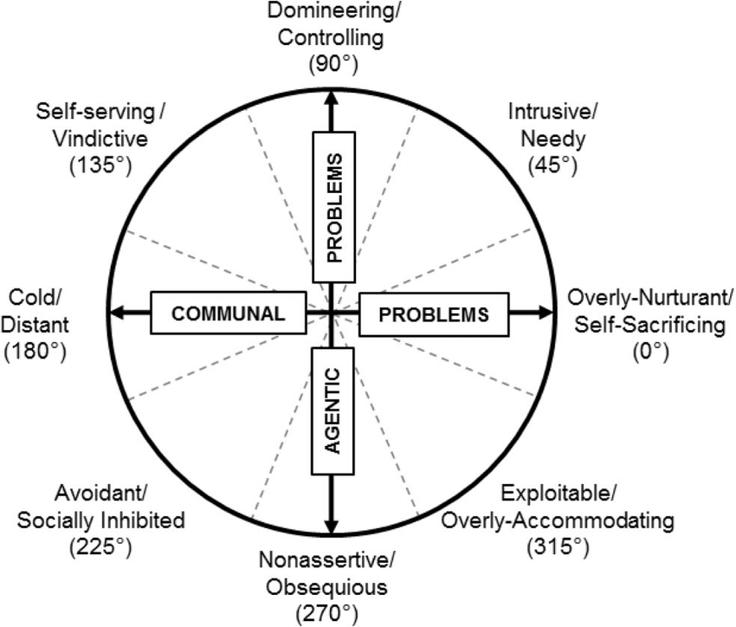
Background- THE NIDA COCAINE TRIAL
The purpose of this trail was to look at cocaine dependency and which treatments were most effective
This trial assigned treatments (1-4)
In this analysis, the response variable was COLD
Analysis of the 3- and 6-month cross section in this presentation
Extensive training and attention was paid to the therapists chosen for the study
There are 2697 observations in this data set and 76 variables

Slide 3
Variables of Interest
RESPONSE Variable
“COLD”; inventory of interpersonal problems- the cold subscale
This subscale looks at trouble with affection & sympathy
Explanatory variables
Treatment (1=Individual Drug Counseling, 2=Cognitive Therapy, 3=Support Expressive Psychodynamic Therapy, 4=Group Drug Counseling)
Explanatory Two-way interaction
TREATMENT and JOB(0=Unemployed 1=Employed)
Explanatory Three-way interaction
TREATMENT, JOB and GENDER (0=Male, 1=Female)

Slide 4
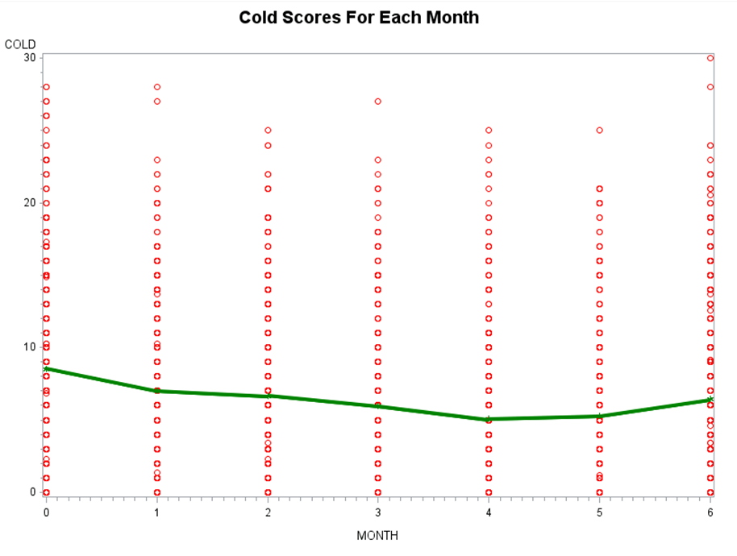
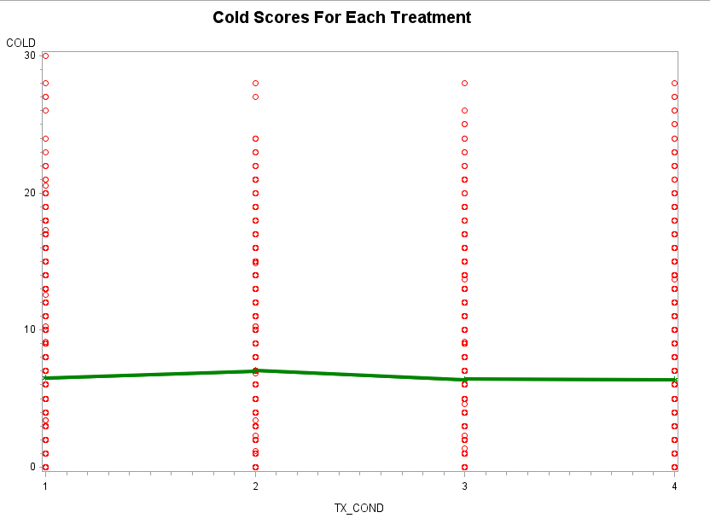
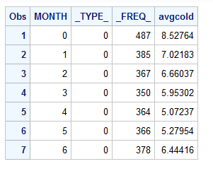
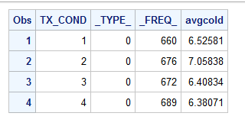
Cold Over Time & Cold over Treatment- ALL TIME
Our Timepoints of Interest

Slide 5
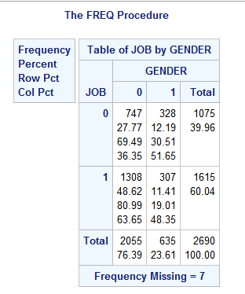
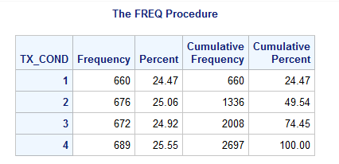
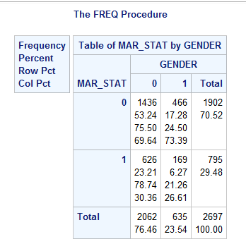
Explanatory Variables
Here we see treatment 1 had 660 values, treatment 2 had 676 values, treatment three had 672 values and treatment 4 689.
The majority of those that were married were males (626). More were unmarried than married (1902 unmarried, 795 married).
A total of 1075 were unemployed, and a total of 1615 were employed. A total of 2055 were males, and a total of 635 were females.

Slide 6
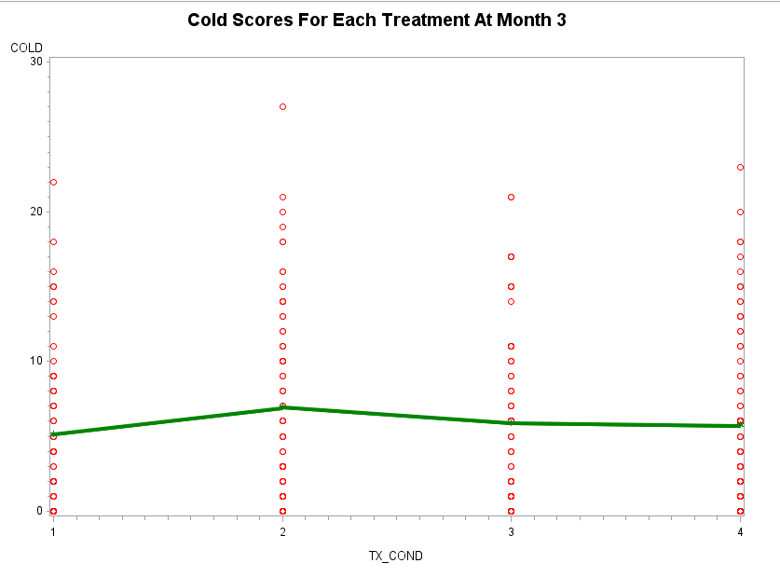
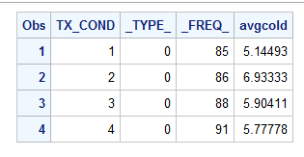
Month 3 Visual

Slide 7
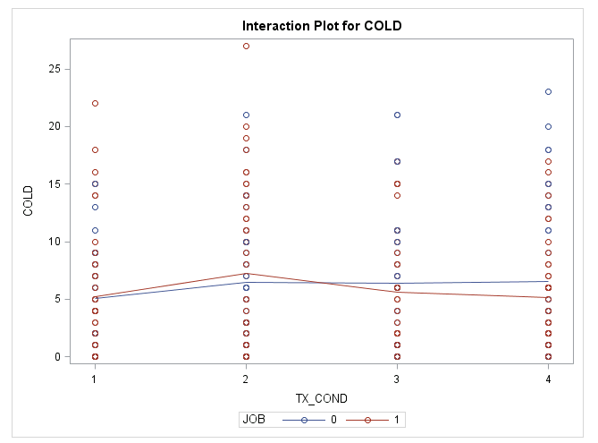
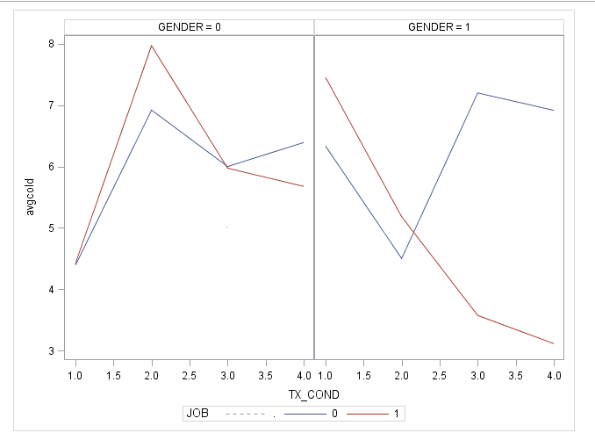
INTERACTION TERMS Visual- MONTH three
TREATMENT and JOB
TREATMENT, JOB, and GENDER

Slide 8
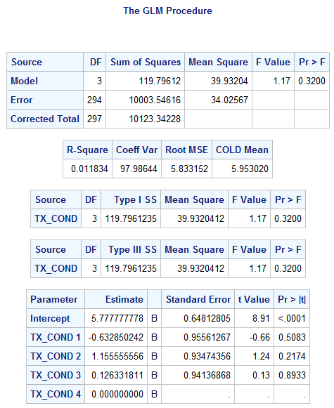
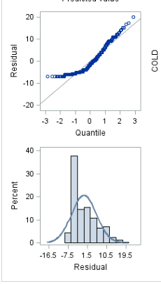
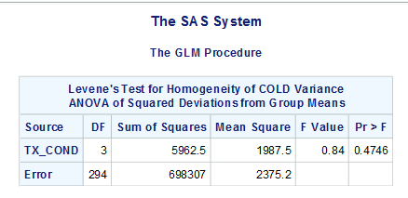
Model at month 3: treatment only
MODEL USED: ONE WAY ANOVA MODEL
As this is just looking at month three, there are no repeated measures.
We are only considering the single explanatory variable of interest
Treatment is run as a fixed variable
The overall test showed that our response variable is not affected by at least one of the explanatory variables
With TX_COND=4 as the reference, none of the levels of treatment were significant at the 0.05 level. Overall, TX_COND was nonsignificant with a p value of 0.32.
Model Fit

Slide 9
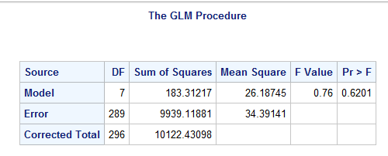
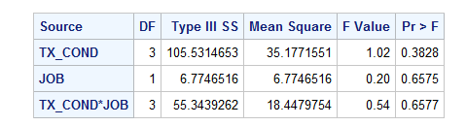
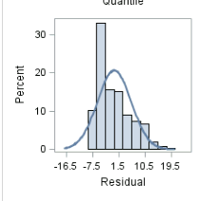
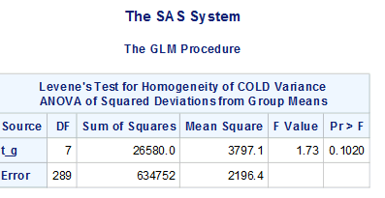
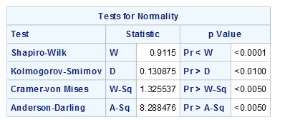
Model at month 3: treatment and job only
MODEL USED: TWO-WAY ANOVA
As this is just looking at month three, there are no repeated measures.
All variables ran as fixed
The overall test showed that our response variable is not affected by at least one of the explanatory variables
None of the explanatory variables, including the interaction term tx_cond*job were significant. The interaction term was highly non-significant at the alpha level of 0.05 with a p value of 0.6577.
Model Fit

Slide 10
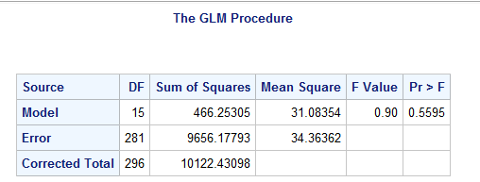
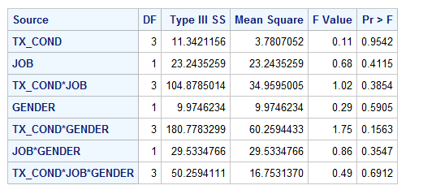
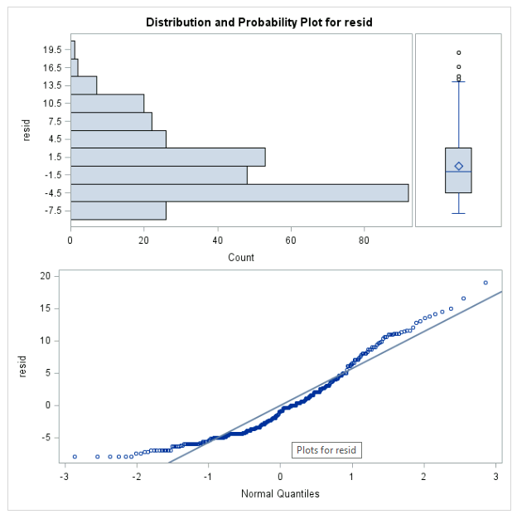
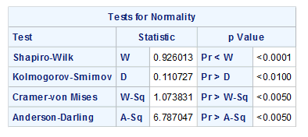
Model at month 3: treatment, JOB and GENDER
MODEL USED: THREE-WAY ANOVA
As this is just looking at month three, there are no repeated measures.
All variables ran as fixed
The overall test showed that our response variable is not affected by at least one of the explanatory variables
None of the explanatory variables, including the interaction term tx_cond*job*gender were significant. The interaction term was highly non-significant at the alpha level of 0.05 with a p value of 0.6912.
Model Fit

Slide 11
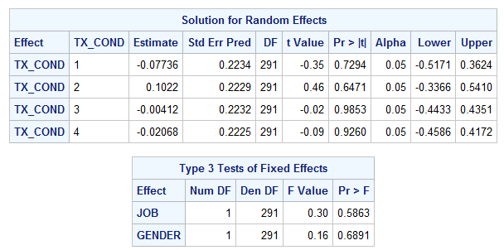
Month 3 Conclusion
None of the explanatory variables, treatment job and gender aid in the explanation of the variability of cold.
Across the four treatment arms, we failed to reject that the means were different for cold scores.
The model was also run with treatment being random in an ANCOVA model, which showed no significance as well.
The data for all models satisfied requirements for homogeneity of variance.
However, all models did not satisfy the requirement for normality. Despite attempts to transform the data, the normality was not being fixed. Therefore, analysis was interpreted with caution.

Slide 12
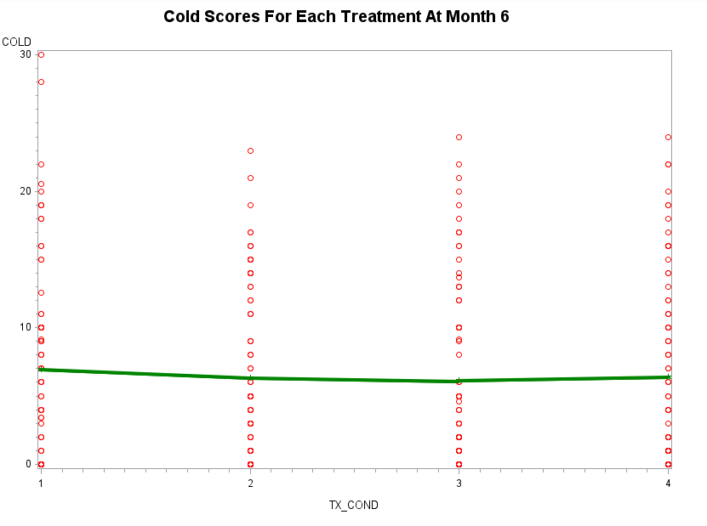
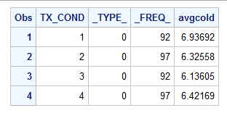
Month 6 Visual

Slide 13
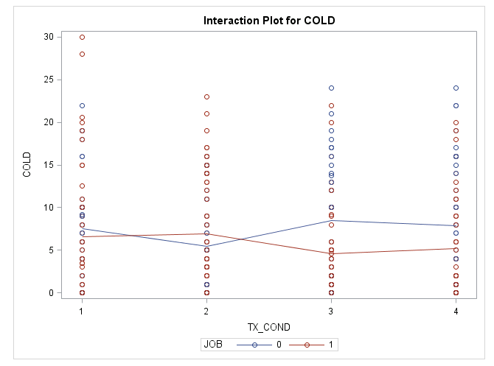
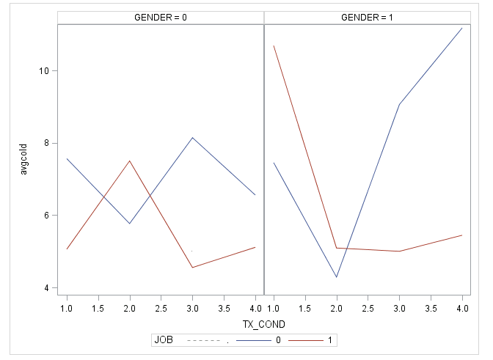
INTERACTION TERMS Visual- MONTH three
TREATMENT and JOB
TREATMENT, JOB and GENDER

Slide 14
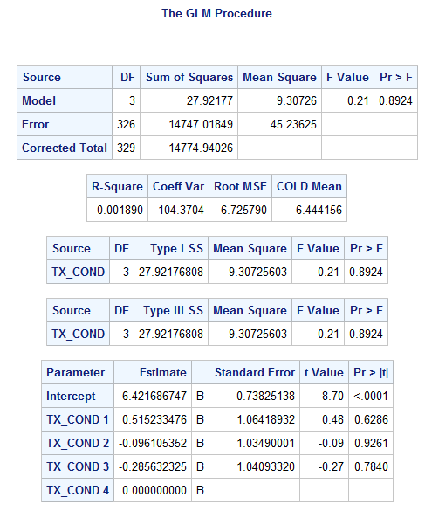
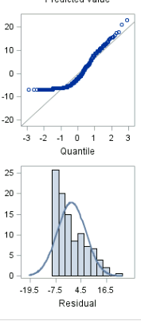
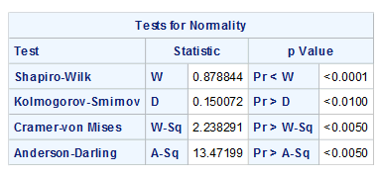
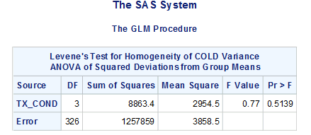
Model at month 6: treatment only
MODEL USED: ONE WAY ANOVA MODEL
As this is just looking at month six, there are no repeated measures.
We are only considering the singly explanatory variable of interest
Treatment is run as a fixed variable
The overall test showed that our response variable is not affected by at least one of the explanatory variables
With TX_COND=4 as the reference, none of the levels of treatment were significant at the 0.05 level. Overall, TX_COND was nonsignificant with a p value of 0.8924
Model Fit

Slide 15
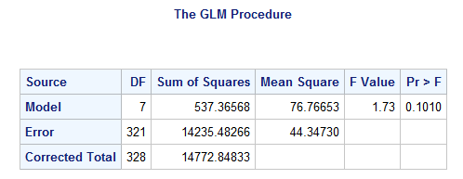
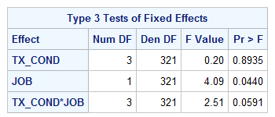
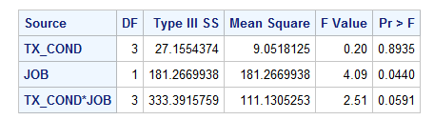
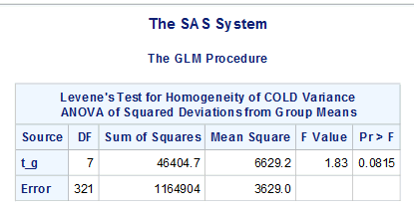

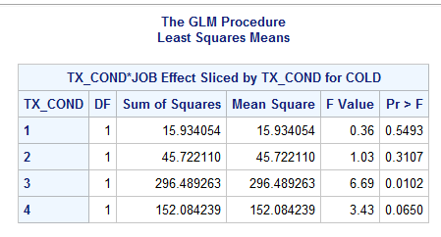
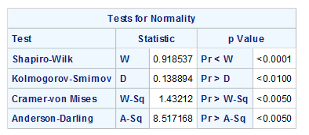
Model at month 6: treatment and job only
MODEL USED: TWO WAY ANOVA
As this is just looking at month three, there are no repeated measures.
All variables ran as fixed
The overall test showed that our response variable is not affected by at least one of the explanatory variables
One explanatory variable was significant in this model! The term, job was significant at the 0.05 alpha level with a p value of 0.044. However, the overall model was nonsignificant. The interaction term was just barely nonsignificant. The interaction term when treatment is 2 and job is 0 was significant!
Model Fit
The slice of the three-way interaction for treatment found significance for treatment 3 with a pvalue of 0.01.

Slide 16
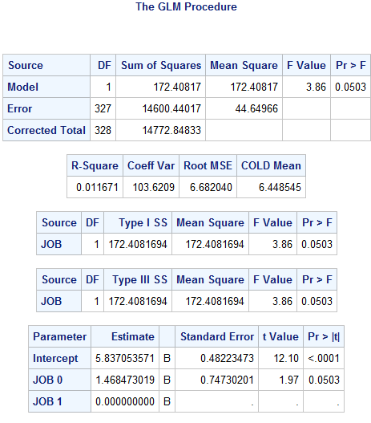
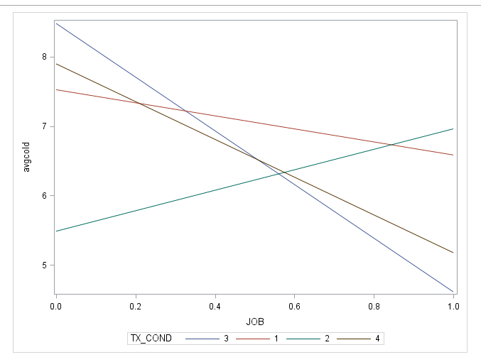
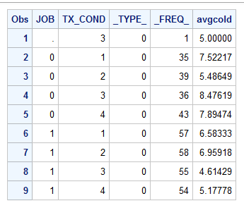
Looking at the Means considering job

Slide 17
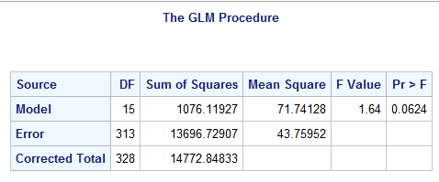
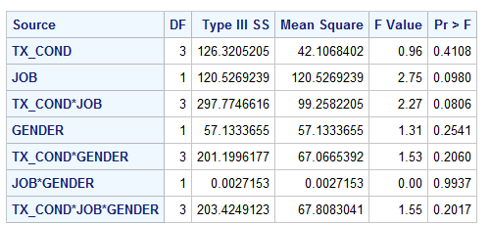
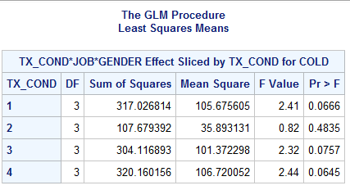

Model at month 6: treatment, JOB and GENDER
The overall test showed that our response variable is not affected by at least one of the explanatory variables
MODEL USED: THREE WAY ANOVA
As this is just looking at month three, there are no repeated measures.
All variables ran as fixed
None of the explanatory variables, including the interaction term tx_cond*job*gender were significant. The interaction term was highly non-significant at the alpha level of 0.05 with a p value of 0.2017. Here, job is not significant.
Significance?
Model Fit

Slide 18
Month 6 Conclusion
None of the explanatory variables, treatment job and gender aid in the explanation of the variability of the mean of cold score, except for job in the two-way interaction model. This model was not significant overall.
Across the three treatment arms, there is not a significant difference in the means for the cold score.
The data satisfied requirements for homogeneity of variance.
However, all models did not satisfy the requirement for normality. Despite attempts to transform the data, the normality was not being fixed. Therefore, analysis was interpreted with caution.

Slide 19
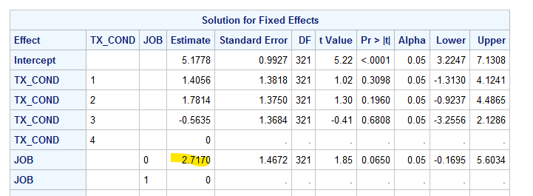
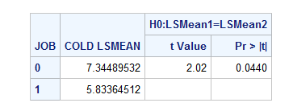





FINAL CONCLUSIONS
For month three and month six, the treatment arms do not explain any of the variability in cold score means. In almost all cases, we can not reject the null that the means are equal among scores of cold.
The averages of cold scores across the two timepoints were not significant in difference.
Of the variables looked at, it is most likely that the explanatory variable job would be significant in cold score. This was only observed in the month=6 cold scores. It is possible that over time, having a job could affect the scores for having trouble with affection and sympathy.
We can’t say overall that job has a large impact on cold score, but we can say it has more of an impact on mean cold score at month 6 versus month 3.

