Slide 1
FAST-NUCES | Cyber Security Lab
Activity 4
CTI Pipeline: Extracting & Structuring
Cyber Threat Intelligence using LLMs & STIX 2.1
Name: Sarmad Farooq
Roll No:
25i-7722
Activity:
Activity 4
Instructor:
Dr. Zafar

Slide 2
Overview
CTI Pipeline Overview
This activity implements a full Cyber Threat Intelligence (CTI) pipeline in Google Colab:
PDF ingestion → Text extraction → Chunking → LLM entity extraction → STIX 2.1 structuring → JSON export.
1. Install Libs
2. Upload PDF
3. Extract Text
4. Clean & Chunk
5. OpenAI Setup
6. GPT-4o Extract
7. STIX Convert
8. Export JSON
Phase 1 Environment Setup
Phase 2 Intelligence Extraction
Install PyMuPDF (fitz), stix2, antlr4, and OpenAI libraries inside Google Colab runtime before beginning the pipeline.
GPT-4o processes cleaned text chunks and returns structured JSON with threat actors, malware, indicators, and relationships.
Phase 3 STIX 2.1 Output
Extracted entities are converted to STIX 2.1 SDOs (IntrusionSet, Malware, Indicator, AttackPattern) and SROs (Relationship), then serialized to a STIX Bundle JSON.
Sarmad Farooq | 25i-7722 | Activity 4 | Dr. Zafar

Slide 3
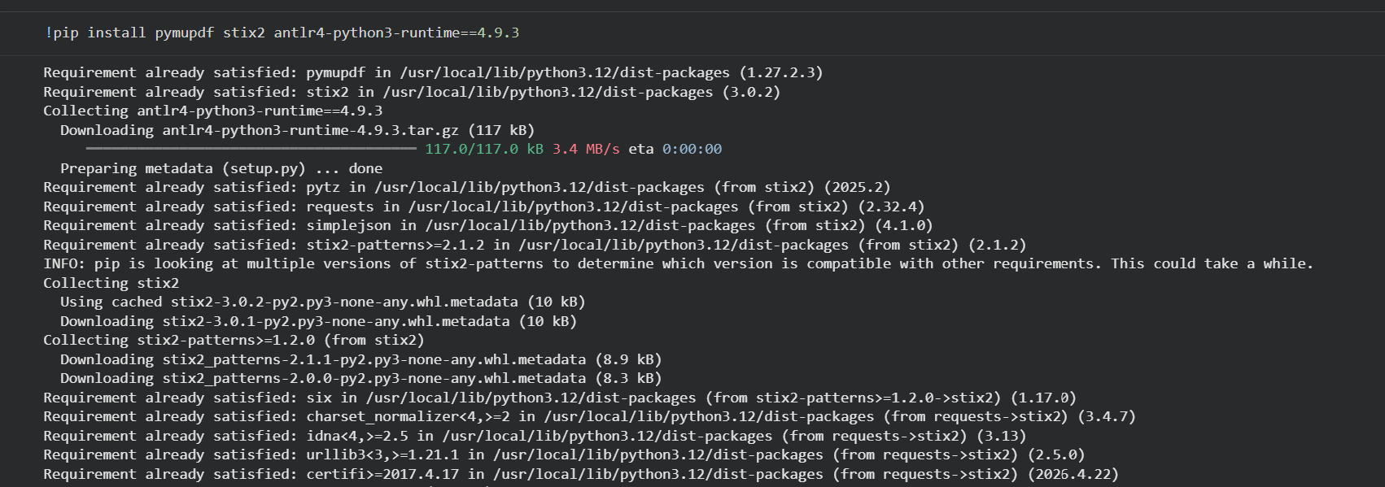
Step 1
Step 1 Install Libraries (PyMuPDF, STIX2, antlr4)
Install all required Python libraries: PyMuPDF for PDF text extraction, stix2 for threat intelligence structuring, and antlr4 as a dependency.
Sarmad Farooq | 25i-7722 | Activity 4 | Dr. Zafar

Slide 4
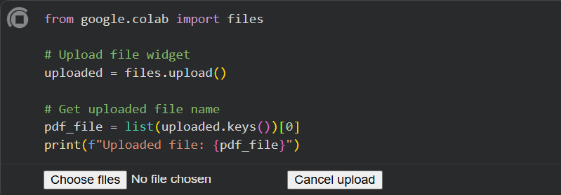
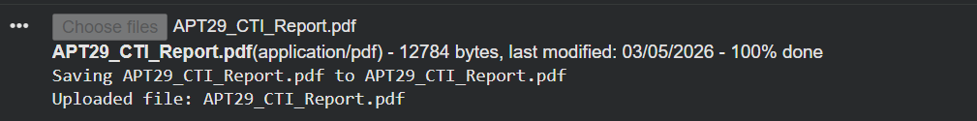
Step 2
Step 2 Upload PDF via Google Colab File Widget
Use Colab's files.upload() widget to upload the APT29 CTI Report PDF. The filename is captured for downstream processing.
Sarmad Farooq | 25i-7722 | Activity 4 | Dr. Zafar

Slide 5
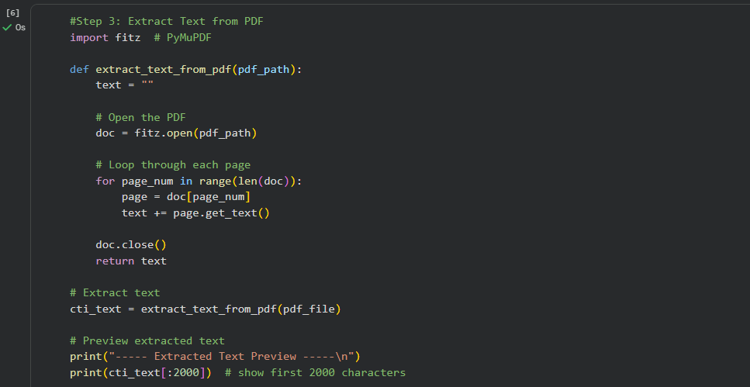
Step 3
Step 3 Extract Text from PDF using PyMuPDF
PyMuPDF (fitz) opens the uploaded PDF and iterates through each page to concatenate the raw text content for later processing.
Sarmad Farooq | 25i-7722 | Activity 4 | Dr. Zafar

Slide 6
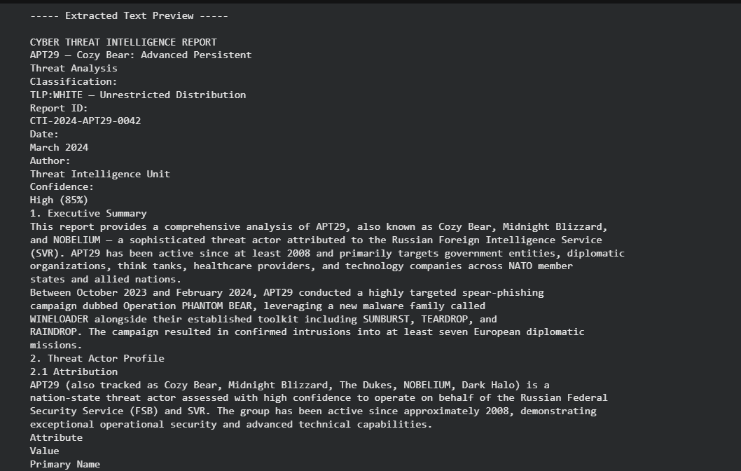
Step 3
Step 3 Extracted Text Preview (APT29 CTI Report)
The extracted raw text from the APT29 CTI Report is previewed showing Threat Actor profile, Campaign details, and attribution data.
Sarmad Farooq | 25i-7722 | Activity 4 | Dr. Zafar

Slide 7
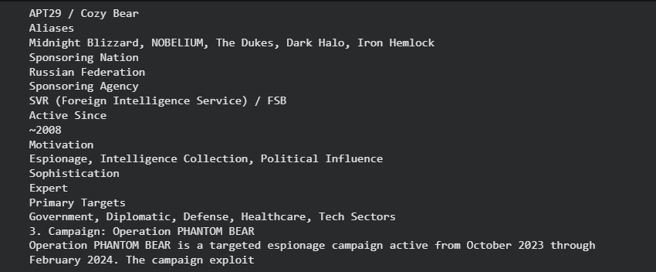
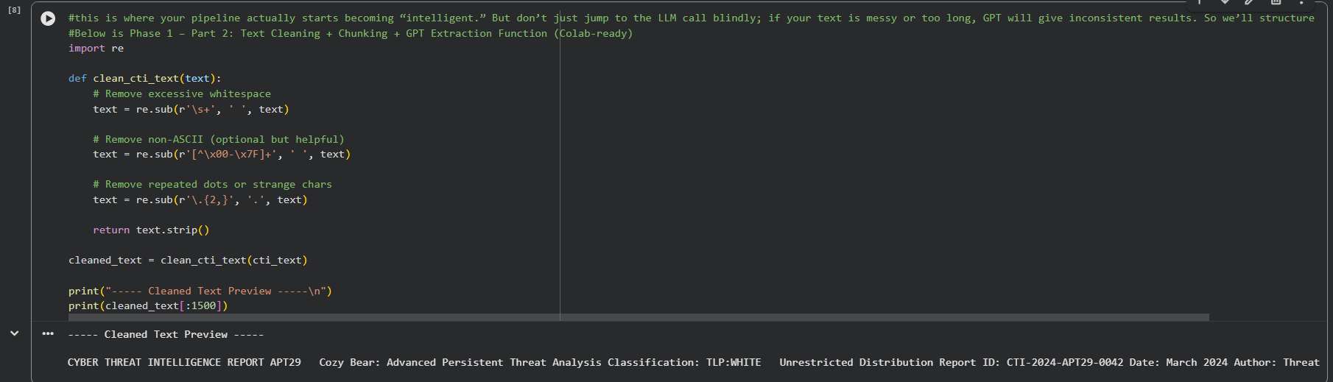
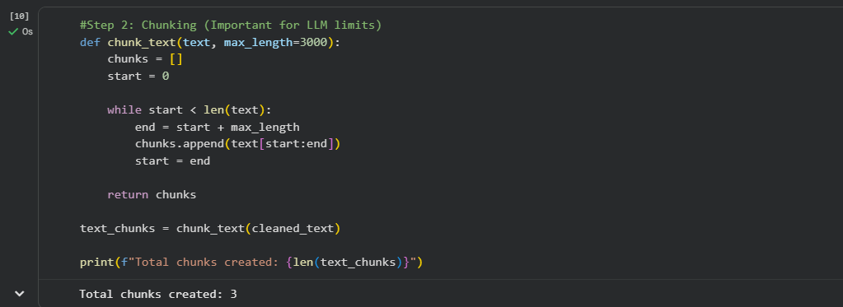
Part 2
Part 2 Text Cleaning & Chunking for LLM
Raw text is cleaned (whitespace removal, non-ASCII filtering) then split into 3000-character chunks. Total chunks created: 3. This prepares text for LLM context window limits.
Sarmad Farooq | 25i-7722 | Activity 4 | Dr. Zafar

Slide 8
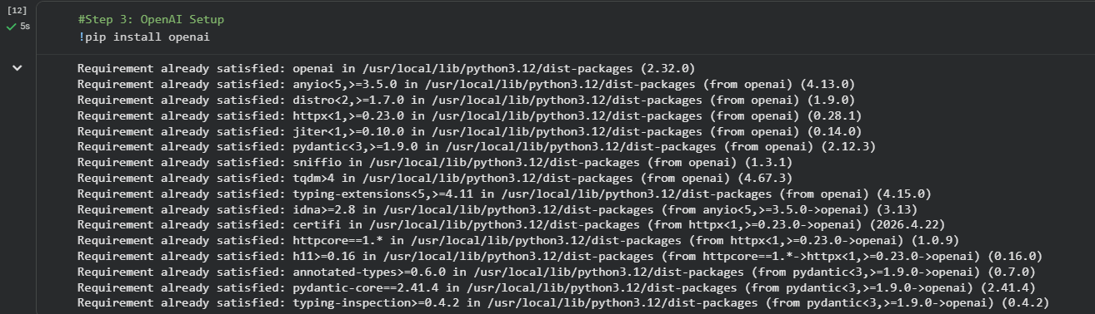
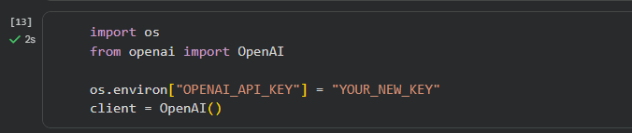
Step 3
Step 3 OpenAI API Setup
Install the OpenAI Python library and configure the API client with the key. The GPT-4o model will be used for CTI entity extraction.
Sarmad Farooq | 25i-7722 | Activity 4 | Dr. Zafar

Slide 9
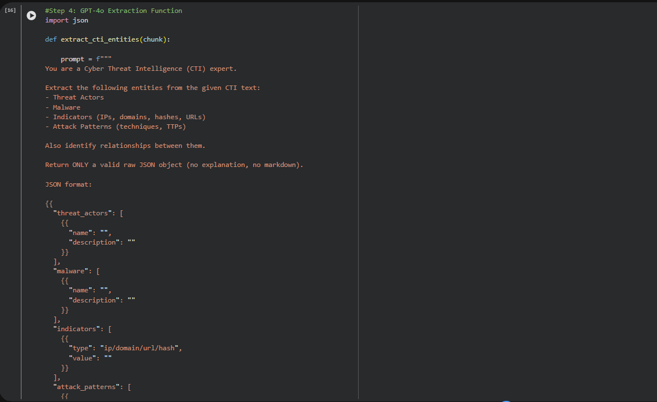
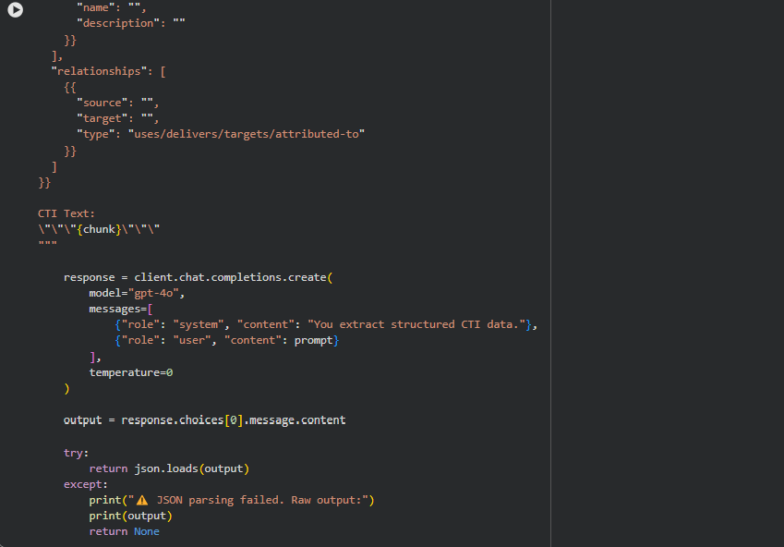
Step 4
Step 4 GPT-4o CTI Extraction Function
A prompt instructs GPT-4o to extract threat actors, malware, indicators, attack patterns, and relationships from CTI text, returning a raw JSON object.
Sarmad Farooq | 25i-7722 | Activity 4 | Dr. Zafar

Slide 10
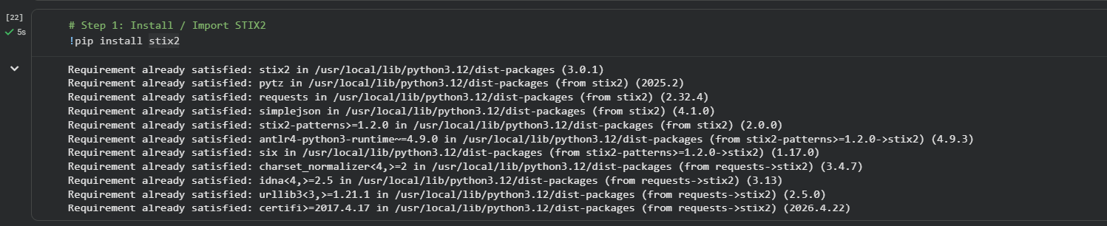
Part 2
Part 2, Step 1 Install & Import STIX2
Install the stix2 Python library which provides STIX 2.1 SDO and SRO classes for structuring threat intelligence data.
Sarmad Farooq | 25i-7722 | Activity 4 | Dr. Zafar

Slide 11
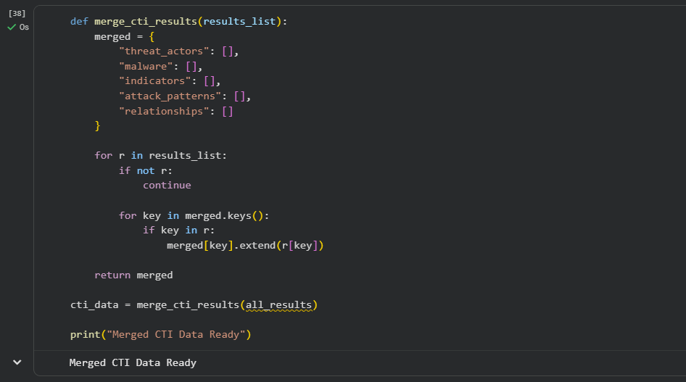
Part 2
Merge CTI Results from All Chunks
Results from all 3 text chunks are merged into a single dictionary, combining threat_actors, malware, indicators, attack_patterns, and relationships lists.
Sarmad Farooq | 25i-7722 | Activity 4 | Dr. Zafar

Slide 12
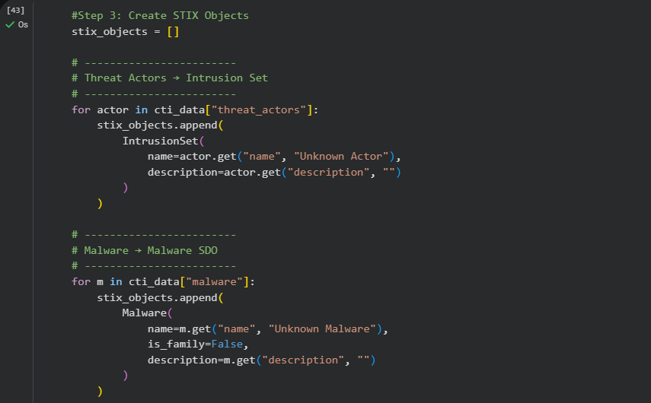
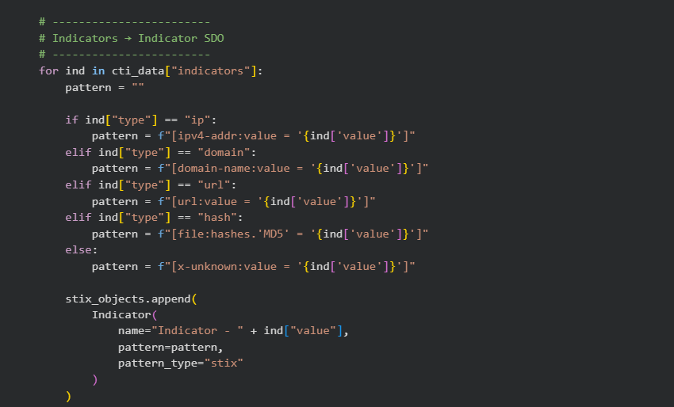
Step 3
Step 3 Create STIX 2.1 SDOs from Extracted Data
Each extracted entity is converted into a STIX 2.1 SDO: IntrusionSet (threat actors), Malware, Indicator, and AttackPattern objects are created.
Sarmad Farooq | 25i-7722 | Activity 4 | Dr. Zafar

Slide 13
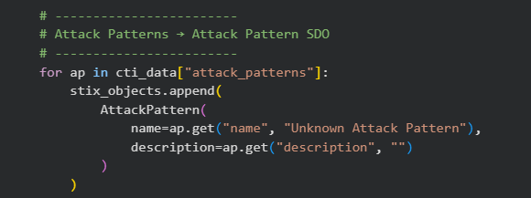
Step 3
Step 3 STIX Attack Patterns SDO
AttackPattern SDOs are created from extracted attack pattern entities, mapping MITRE ATT&CK techniques identified by the GPT-4o extraction function.
Sarmad Farooq | 25i-7722 | Activity 4 | Dr. Zafar

Slide 14
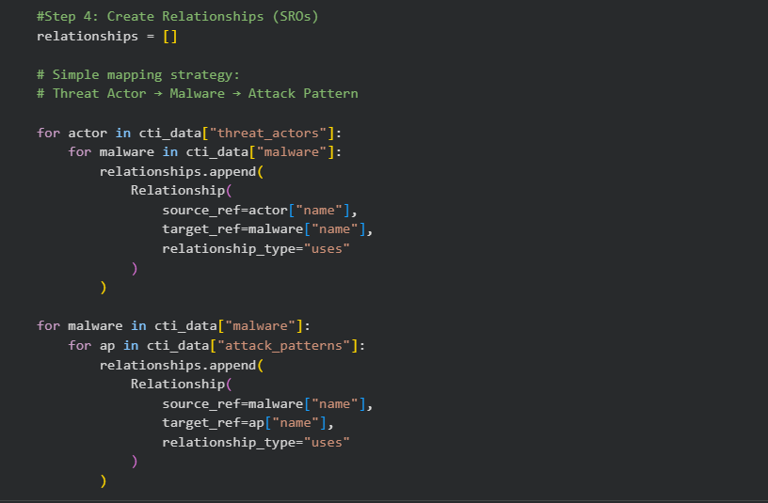
Step 4
Step 4 Create STIX 2.1 SROs (Relationships)
Relationship SROs link threat actors to malware (uses) and malware to attack patterns (uses), creating a graph structure for the threat intelligence knowledge base.
Sarmad Farooq | 25i-7722 | Activity 4 | Dr. Zafar

Slide 15
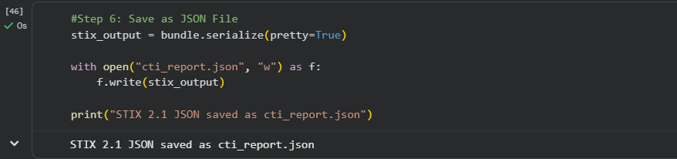
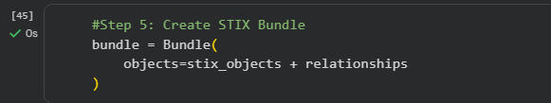

Step 5-6
Steps 5 & 6 Create STIX Bundle & Export JSON
All SDOs and SROs are combined into a STIX Bundle and serialized to cti_report.json using bundle.serialize(pretty=True). The file is then downloaded via Colab.
Sarmad Farooq | 25i-7722 | Activity 4 | Dr. Zafar

Slide 16
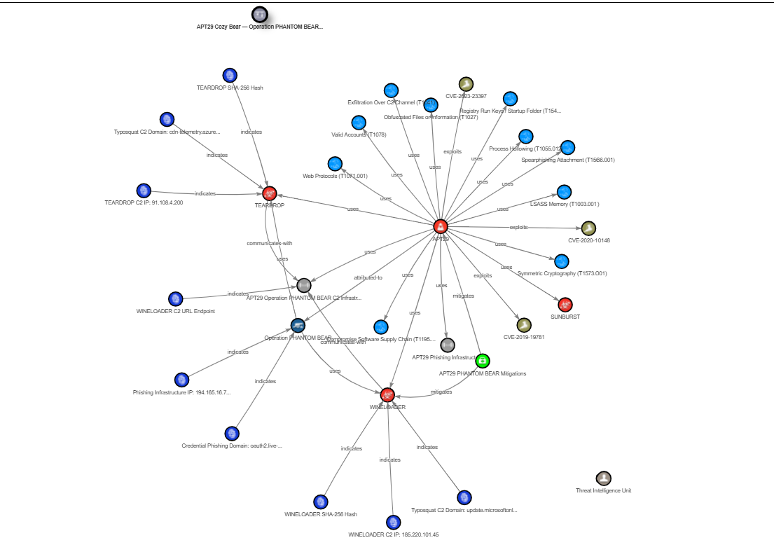
Step 7
Step 7 STIX 2.1 Relationship Graph Visualization
The generated cti_report.json is visualized as a STIX relationship graph showing APT29/Cozy Bear Operation PHANTOM BEAR connections to malware, indicators, vulnerabilities, and attack patterns.
Sarmad Farooq | 25i-7722 | Activity 4 | Dr. Zafar

Slide 17
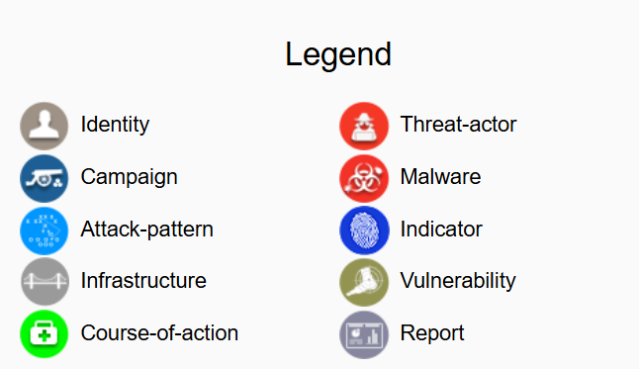
Output
STIX 2.1 Object Type Legend
The STIX 2.1 legend explains each node type in the relationship graph from Threat Actors and Malware to Indicators, Vulnerabilities, and Course-of-Action objects.
Sarmad Farooq | 25i-7722 | Activity 4 | Dr. Zafar

Slide 18
Summary & Key Takeaways
CTI Pipeline
Built an end-to-end pipeline from PDF ingestion to structured STIX 2.1 JSON output.
LLM Extraction
GPT-4o extracted threat actors, malware, indicators, attack patterns and relationships from APT29 CTI report.
STIX 2.1 Structuring
Entities converted to SDOs (IntrusionSet, Malware, Indicator, AttackPattern) and SROs (Relationship).
Graph Visualization
Generated a STIX relationship graph showing APT29/Cozy Bear Operation PHANTOM BEAR threat landscape.
Tools Used
Google Colab, PyMuPDF, OpenAI GPT-4o, stix2 Python library, STIX Visualization Tool.
Sarmad Farooq | 25i-7722 | Activity 4 | Dr. Zafar

