Slide 1
RNAseq request 6176
Dr. Xin Lu

Slide 2
Motivation
We hypothesize that the mutant FOXA1 could inhibit the immune infiltration in tumor through certain mechanisms or pathways.

Slide 3
Sample information
RNAseq: 272 samples, 136 tumor, 136 normal samples
Mutation: 208 Tumor samples with mutation information, of those, 96 samples has FOXA1 mutation
134 Tumor samples have both RNAseq and mutation information
With FOXA1 mutation: 67 tumor samples
Without FOXA1 mutation: 67 tumor samples

Slide 4
Differential analysis
Comparison | logFCcutoff | FDRcutoff | Number of Up regulated genes | Number of Down regulated genes
Tumor sample with FOXA1 mutation vs without FOXA1 mutation | |logFC| > 0 | FDR < 0.05 | 1123 | 2106
Normal vs Tumor sample with FOXA1 mutation | |logFC|>1 | FDR<0.05 | 1384 | 437

Slide 5
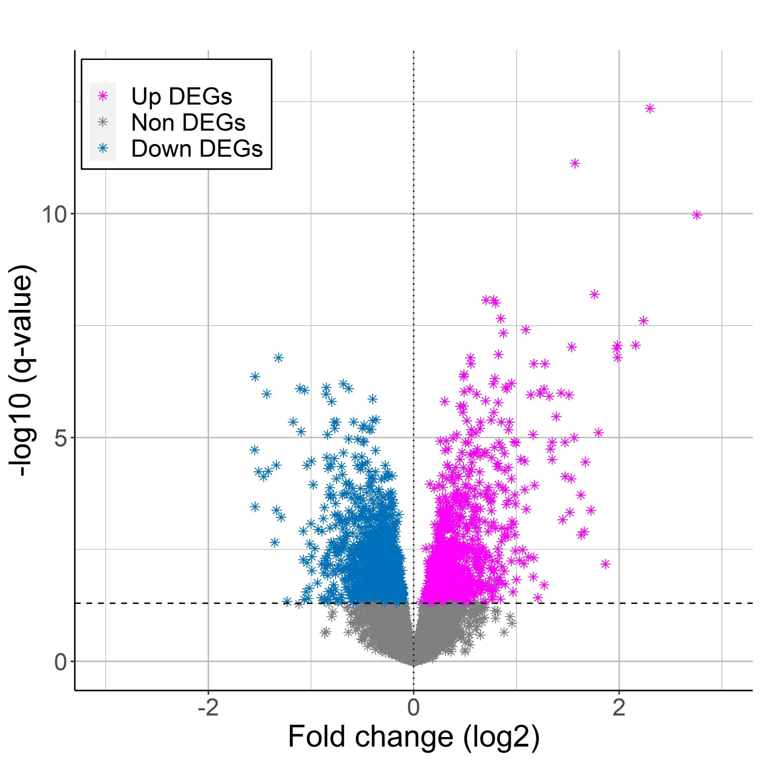
Volcano plot – with FOXA1 mutation vs without FOXA1 mutation
Tumor samples

Slide 6
Detailed differential results and functional analysis of differential expression genes are at accompanying excel file

