Slide 1
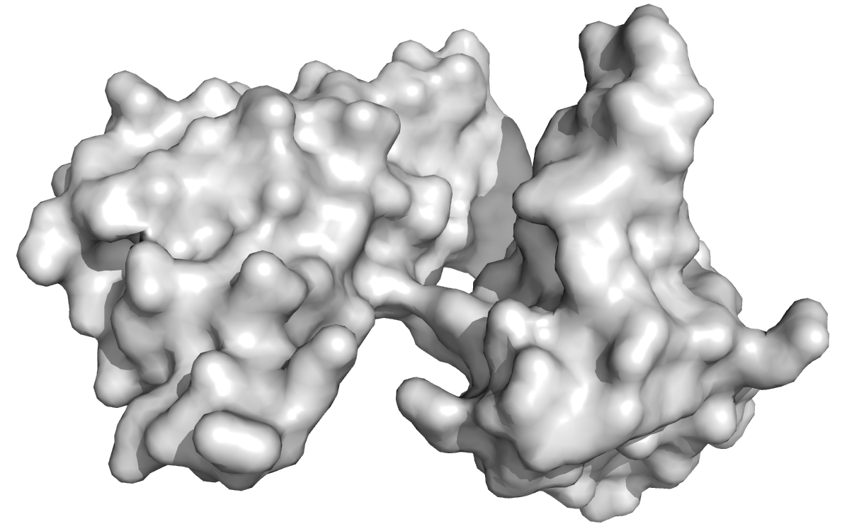
Fragment-based Docking
RNA sequence
Fragments library
Protein structure
A U G G U C
Fragments docking
A U G
U G G
G G U
Chains assembling
AUG UGG GGU ...

Slide 2
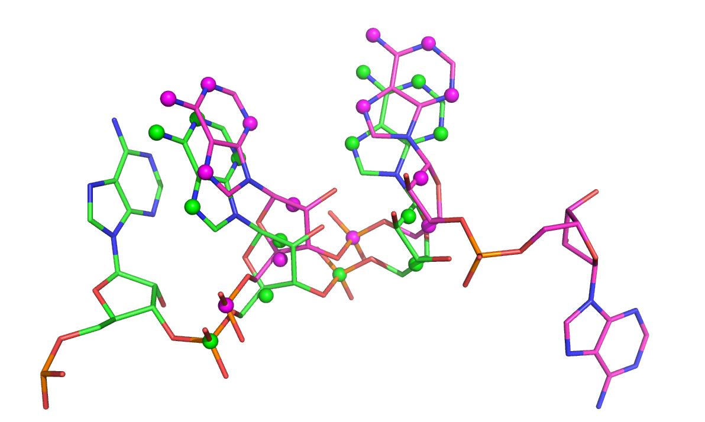
Chains assembling
Frag 1 Frag2 Frag3 Frag4
UUU UUU UUU UUU
U U U U
pose 1
pose 2
…
…
pose 8.e5
U U U
U U U
Overlap criteria
RMSD ~2 Å
Example with a degenerated sequence: all pools of poses are identical
:D Compute only once the pairwise connection
:( Some poses could be taken twice in the chain => clash !

Slide 3
Pose connectivity
Postatoms:
First 2 nucl
Upstream frag
A U G
U G G
Downstream frag
Preatoms:
Last 2 nucl
Step 1: dock the fragments (ATTRACT)
  collect the preatoms and the postatoms
Step 2: List the pairs of compatible poses (connect.py)
Step 2b: Filter the connections (filter_meanrank.py)
Step 3: Build the chains (make_chains.py)

Slide 4
Pose connectivity
Postatoms:
First 2 nucl
Upstream frag
A U G
U G G
Downstream frag
Preatoms:
Last 2 nucl
Step 1: dock the fragments (ATTRACT)
  collect the preatoms and the postatoms
Step 2: List the pairs of compatible poses (connect.py)
Step 2b: Filter the connections (filter_meanrank.py)
Step 3: Build the chains (make_chains.py)
README.txt

Slide 5
Connect.py : List the pairs of compatible poses
Part 1 : initial connection
downstr frag
U U U
preatoms
U U U
postatoms
U U U
upstr frag
Frag 2
postatoms
Frag 2
preatoms
Frag 1
postatoms
Frag 1
preatoms
Frag 3
postatoms
Frag 3
preatoms
Root cluster
(~10⁵ poses)
Root
cluster
Root
cluster
Root
cluster
A root cluster contains coordinates of the postatoms of all poses of the considered 3-nucl (corresponding to the position in the total sequence)
Root clusters have infinite radius* .
So they are automatically connected to every neighbor poses and clusters
Each even fragment is represented by 2 flat trees.
For each pose, preatoms and postatoms are connected
* clustering RMSD cutoff
singleton
Intra-frag connectivity
(not empty intersection)
Inter-frag connectivity
( best RMSD < overlap-cutoff)

Slide 6
Connect.py : List the pairs of compatible poses
Part 2 : clustering
downstr frag
U U U
preatoms
U U U
postatoms
U U U
upstr frag
Frag 2
postatoms
Frag 2
preatoms
Frag 1
postatoms
Frag 1
preatoms
Frag 3
postatoms
Frag 3
preatoms
Each odd fragment is represented by 2 hierarchical trees.
Sub-clustering is done with different radius*
* clustering RMSD cutoff
Given in CLUSTERING list
singleton
Intra-frag connectivity
(not empty intersection)
Inter-frag connectivity
( best RMSD < overlap-cutoff)

Slide 7
Connect.py : List the pairs of compatible poses
Part 2 : clustering
downstr frag
U U U
preatoms
U U U
postatoms
U U U
upstr frag
Frag 1
postatoms
Frag 1
preatoms
Frag 3
postatoms
Frag 3
preatoms
reorganize
For speed purpose, sub-clustering is done until at least MINCHILD children are found for each tree (for now MINCHILD = 100).
They are then re-connected to the root
singleton
Intra-frag connectivity
(not empty intersection)
Inter-frag connectivity
( best RMSD < overlap-cutoff)

Slide 8
Connect.py : List the pairs of compatible poses
Part 2 : clustering
downstr frag
U U U
preatoms
U U U
postatoms
U U U
upstr frag
Frag 1
postatoms
Frag 1
preatoms
Frag 3
postatoms
Frag 3
preatoms
reorganize
For speed purpose, sub-clustering is done until at least MINCHILD children are found for each tree (for now MINCHILD = 100).
They are then re-connected to the root
singleton
Intra-frag connectivity
(not empty intersection)
Inter-frag connectivity
( best RMSD < overlap-cutoff)

Slide 9
Connect.py : List the pairs of compatible poses
Part 2 : clustering
downstr frag
U U U
preatoms
U U U
postatoms
U U U
upstr frag
All trees of odd fragments are fully clustered
ClustID
(2)
ClustID
(1002)
Frag 3
postatoms
Frag 3
preatoms
Frag 1
postatoms
Frag 1
preatoms
ClustID
1
ClustID
(3)
ClustID
(1003)
ClustID
(1)
ClustID
(1001)
(1,1)
(1,2)
(1,2, 2)
singleton
Intra-frag connectivity
(not empty intersection)
Inter-frag connectivity
( best RMSD < overlap-cutoff)

Slide 10
Connect.py : List the pairs of compatible poses
Part 3 : decomposition
downstr frag
U U U
preatoms
U U U
decompose
postatoms
U U U
upstr frag
For each cluster of each tree alternately, both intra-frag and inter-frag connections are propagated to the children and tested. The upper-layer connection is destroyed.
Frag 3
postatoms
Frag 3
preatoms
singleton
Intra-frag connectivity
(not empty intersection)
Inter-frag connectivity
( best RMSD < overlap-cutoff)

Slide 11
Connect.py : List the pairs of compatible poses
Part 3 : decomposition
downstr frag
U U U
preatoms
U U U
decompose
postatoms
U U U
upstr frag
For each cluster of each clustering level, in each tree alternately, both intra-frag and inter-frag connections are propagated to the children and tested. The upper-layer connection is destroyed.
Frag 3
postatoms
Frag 3
preatoms
singleton
Intra-frag connectivity
(not empty intersection)
Inter-frag connectivity
( best RMSD < overlap-cutoff)

Slide 12
Connect.py : List the pairs of compatible poses
Part 3 : decomposition
downstr frag
U U U
preatoms
U U U
decompose > check_delete
postatoms
U U U
upstr frag
Each cluster (=pose if singleton) that was connected to the decomposed cluster is checked. If it lacks connections either fwd or bwd, it gets discarded
Frag 3
postatoms
Frag 3
preatoms
singleton
Intra-frag connectivity
(not empty intersection)
Inter-frag connectivity
( best RMSD < overlap-cutoff)

Slide 13
Connect.py : List the pairs of compatible poses
Part 3 : decomposition
downstr frag
U U U
preatoms
U U U
decompose > check_delete
postatoms
U U U
upstr frag
Connections of the discarded clusters are destroyed
Frag 3
postatoms
Frag 3
preatoms
singleton
Intra-frag connectivity
(not empty intersection)
Inter-frag connectivity
( best RMSD < overlap-cutoff)

Slide 14
Connect.py : List the pairs of compatible poses
Part 3 : decomposition
downstr frag
U U U
preatoms
U U U
decompose > check_delete
postatoms
U U U
upstr frag
Connections of the discarded clusters are destroyed. Clusters to which they connected are checked …
Frag 3
postatoms
Frag 3
preatoms
singleton
Intra-frag connectivity
(not empty intersection)
Inter-frag connectivity
( best RMSD < overlap-cutoff)

Slide 15
Connect.py : List the pairs of compatible poses
Part 3 : decomposition
downstr frag
U U U
preatoms
U U U
decompose
postatoms
U U U
upstr frag
Decomposition is done for one entire level
Frag 3
postatoms
Frag 3
preatoms
singleton
Intra-frag connectivity
(not empty intersection)
Inter-frag connectivity
( best RMSD < overlap-cutoff)

Slide 16
Connect.py : List the pairs of compatible poses
Part 3 : decomposition
downstr frag
U U U
preatoms
U U U
decompose
postatoms
U U U
upstr frag
Decomposition is done for one entire level
Frag 3
postatoms
Frag 3
preatoms
singleton
Intra-frag connectivity
(not empty intersection)
Inter-frag connectivity
( best RMSD < overlap-cutoff)

Slide 17
Connect.py : List the pairs of compatible poses
Part 3 : decomposition
downstr frag
U U U
preatoms
U U U
decompose
postatoms
U U U
upstr frag
Decomposition is done for one entire level
Frag 3
postatoms
Frag 3
preatoms
singleton
Intra-frag connectivity
(not empty intersection)
Inter-frag connectivity
( best RMSD < overlap-cutoff)

Slide 18
Connect.py : List the pairs of compatible poses
Part 3 : decomposition
downstr frag
U U U
preatoms
U U U
decompose
postatoms
U U U
upstr frag
Decomposition is done for one entire level
Frag 3
postatoms
Frag 3
preatoms
singleton
Intra-frag connectivity
(not empty intersection)
Inter-frag connectivity
( best RMSD < overlap-cutoff)

Slide 19
Connect.py : List the pairs of compatible poses
Part 3 : decomposition
downstr frag
U U U
preatoms
U U U
decompose
postatoms
U U U
upstr frag
Decomposition is done for one entire level
Frag 3
postatoms
Frag 3
preatoms
singleton
Intra-frag connectivity
(not empty intersection)
Inter-frag connectivity
( best RMSD < overlap-cutoff)

Slide 20
Connect.py : List the pairs of compatible poses
Part 3 : decomposition
downstr frag
U U U
preatoms
U U U
decompose
postatoms
U U U
upstr frag
Decomposition is done for one entire level ; then for the same level of the next tree of the same fragment
Frag 3
postatoms
Frag 3
preatoms
NB : Poses that are connected to a cluster are not necessarily connected to any of its children. The connectivity to the parent cluster correspond to a lower-bound of the pose-pose RMSD, based on the RMSD to the representative + the cluster radius
Frag 1
postatoms
Frag 1
preatoms
singleton
Intra-frag connectivity
(not empty intersection)
Inter-frag connectivity
( best RMSD < overlap-cutoff)

Slide 21
Connect.py : List the pairs of compatible poses
Part 3 : decomposition
downstr frag
U U U
preatoms
U U U
decompose > check_delete
postatoms
U U U
upstr frag
Decomposition is done for one entire level ; then for the same level of the next tree of the same fragment
Frag 3
postatoms
Frag 3
preatoms
Frag 1
postatoms
Frag 1
preatoms
singleton
Intra-frag connectivity
(not empty intersection)
Inter-frag connectivity
( best RMSD < overlap-cutoff)

Slide 22
Connect.py : List the pairs of compatible poses
Part 3 : decomposition
downstr frag
U U U
preatoms
U U U
decompose > check_delete
postatoms
U U U
upstr frag
Decomposition is done for one entire level ; then for the same level of the next tree of the same fragment
Frag 3
postatoms
Frag 3
preatoms
NB : Inter-frag connectivity does not take into account any scores of the poses, but only their overlapp RMSD. A bad score for a pair of poses can be compensated by the other poses in the chain.
singleton
Intra-frag connectivity
(not empty intersection)
Inter-frag connectivity
( best RMSD < overlap-cutoff)

Slide 23
Connect.py : List the pairs of compatible poses
Part 3 : decomposition
downstr frag
U U U
preatoms
U U U
decompose > check_delete
postatoms
U U U
upstr frag
Decomposition is done for one entire level ; then for the same level of the next tree of the same fragment ; then for the next odd fragment
Frag 3
postatoms
Frag 3
preatoms
singleton
Intra-frag connectivity
(not empty intersection)
Inter-frag connectivity
( best RMSD < overlap-cutoff)

Slide 24
Connect.py : List the pairs of compatible poses
Part 3 : decomposition
downstr frag
U U U
preatoms
U U U
decompose > check_delete
postatoms
U U U
upstr frag
Decomposition is done for one entire level ; then for the same level of the next tree of the same fragment ; then for the next odd fragment
Frag 2
preatoms
Frag 2
postatoms
Frag 3
postatoms
Frag 3
preatoms
Frag 1
postatoms
Frag 1
preatoms
Finally, all remaining connection are written in the json output file
singleton
Intra-frag connectivity
(not empty intersection)
Inter-frag connectivity
( best RMSD < overlap-cutoff)

Slide 25
Extra-slides

Slide 26
Chains propensity filtering
Frag 1 Frag2 Frag3 Frag4 Frag5
UUU UUU UUU UUU UUU
pose 1
pose 2
…
…
pose 8.e5
4
4
6
2
12
6
3
12
4
5
10
2
8
8
6
6
6
1
4
4
2
4
2
3
6
2
5
5
3
3
Heuristic considering that the best chains are probably made of poses that participate in many chains (for probabilist and/or entropic reasons)
Use forward-backward algo to count the number of chains in with each pose participates, then select for each fragment the most connected poses and assemble only those.
=> to combine with color coding if necessary

Slide 27
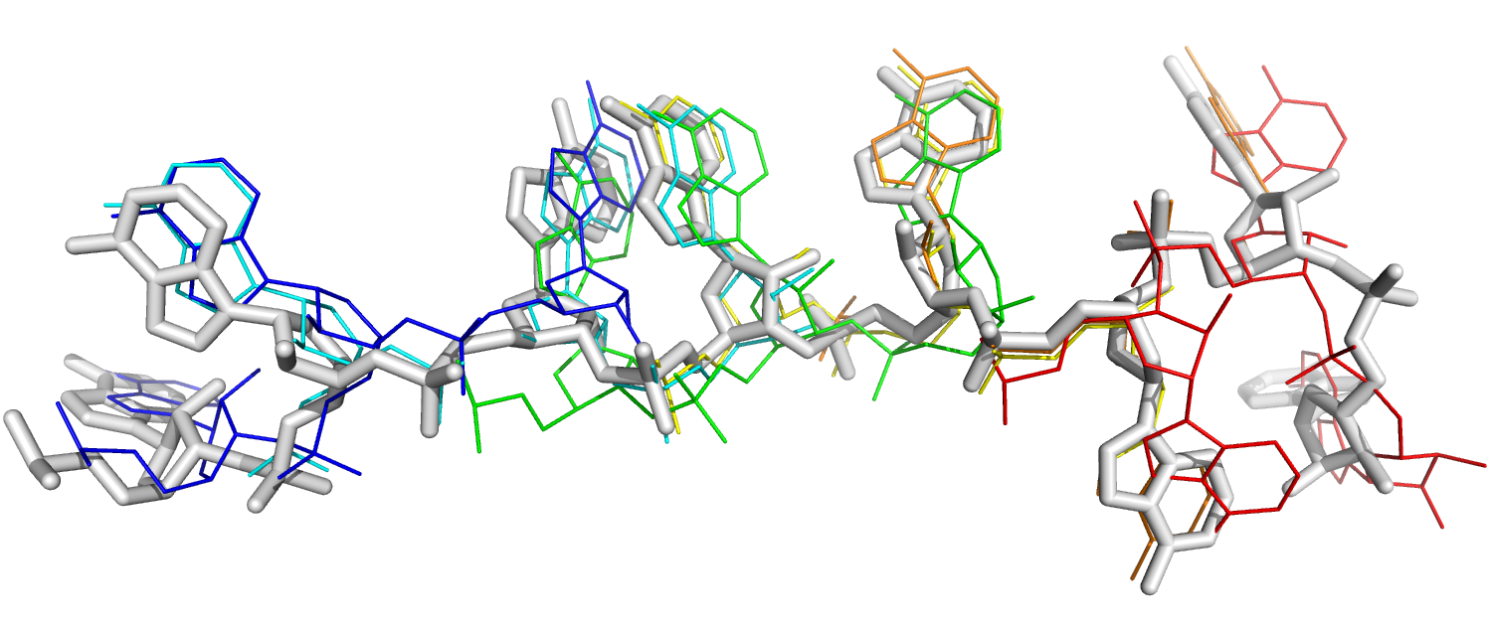
Chains scoring
Score(chain) = ( ∏ rk_{i})^{1/N}
= e ^{1/N ∑ ln(rki)}
Rk 6 Rk 100 Rk 5.600 Rk 1 Rk 12.000
The current scoring of chains considers the ATTRACT ranking of the poses in each pool.
One could instead sum the ATTRACT score (~ estimation of binding energy) over the poses,
With corrections for the positions in sequence that are represented by 1, 2 or 3 overlapping nucleotides in the chain of poses.

