Slide 1
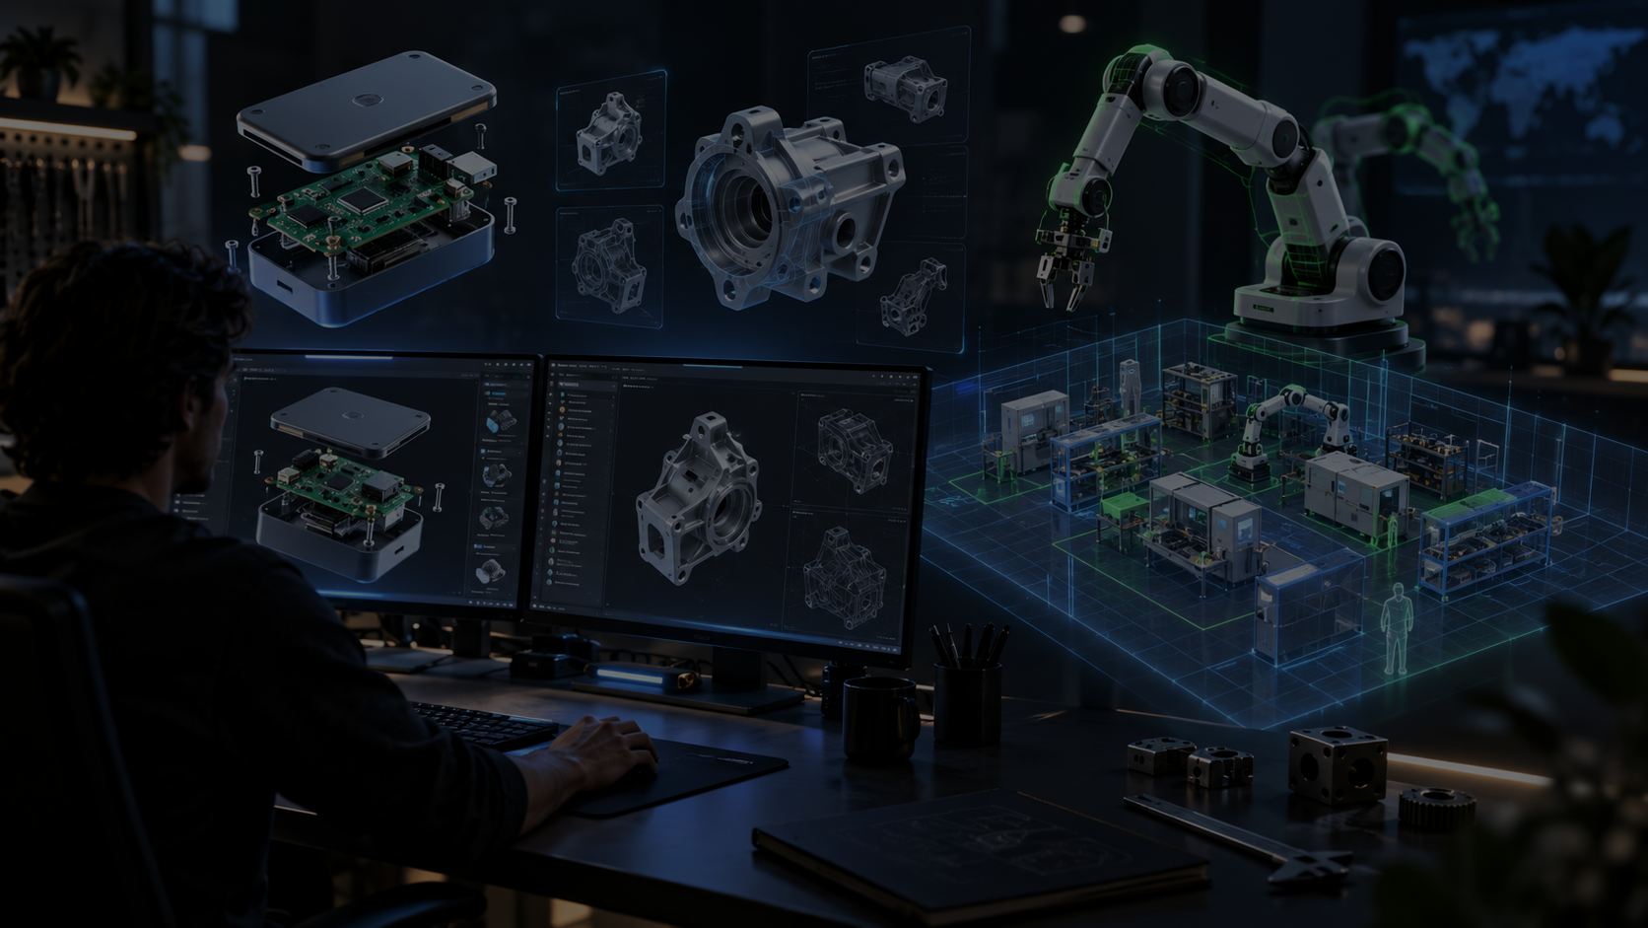
GPT-6 ASTRA HACKATHON NYC
Astra Industries
Open-core spatial hardware service
A hosted and local deployment layer for Forma-OSS: import hardware projects and STEP models, arrange them in rooms, animate workflows, and turn prototype chaos into reviewable physical plans.
Forma makes machines computable.
Astra makes their environment computable.
CAID Technologies • Astra Industries • Service deck • September 10, 2026

Slide 2
BUSINESS MODEL
An open-source engine with paid deployment paths
Free local use builds trust. Hosted infrastructure and expert deployments turn it into a business.
Forma-OSS core
Open hardware design engine: prompts, Hardware IR, BOMs, wiring, validation, generated assets.
Free local
Astra Cloud
Private deployment
Makers, students, and labs can self-host and keep full control of data.
Hosted compute, collaboration, storage, asset libraries, project history, and no setup friction.
On-prem/local server setup, CAD/PLM/data integration, custom agents, training, support.
Revenue comes from convenience, compute, collaboration, integrations, and consulting — not from blocking the open-source path.
Positioning: Astra Industries is the commercial service layer around Forma-powered spatial hardware workflows.

Slide 3
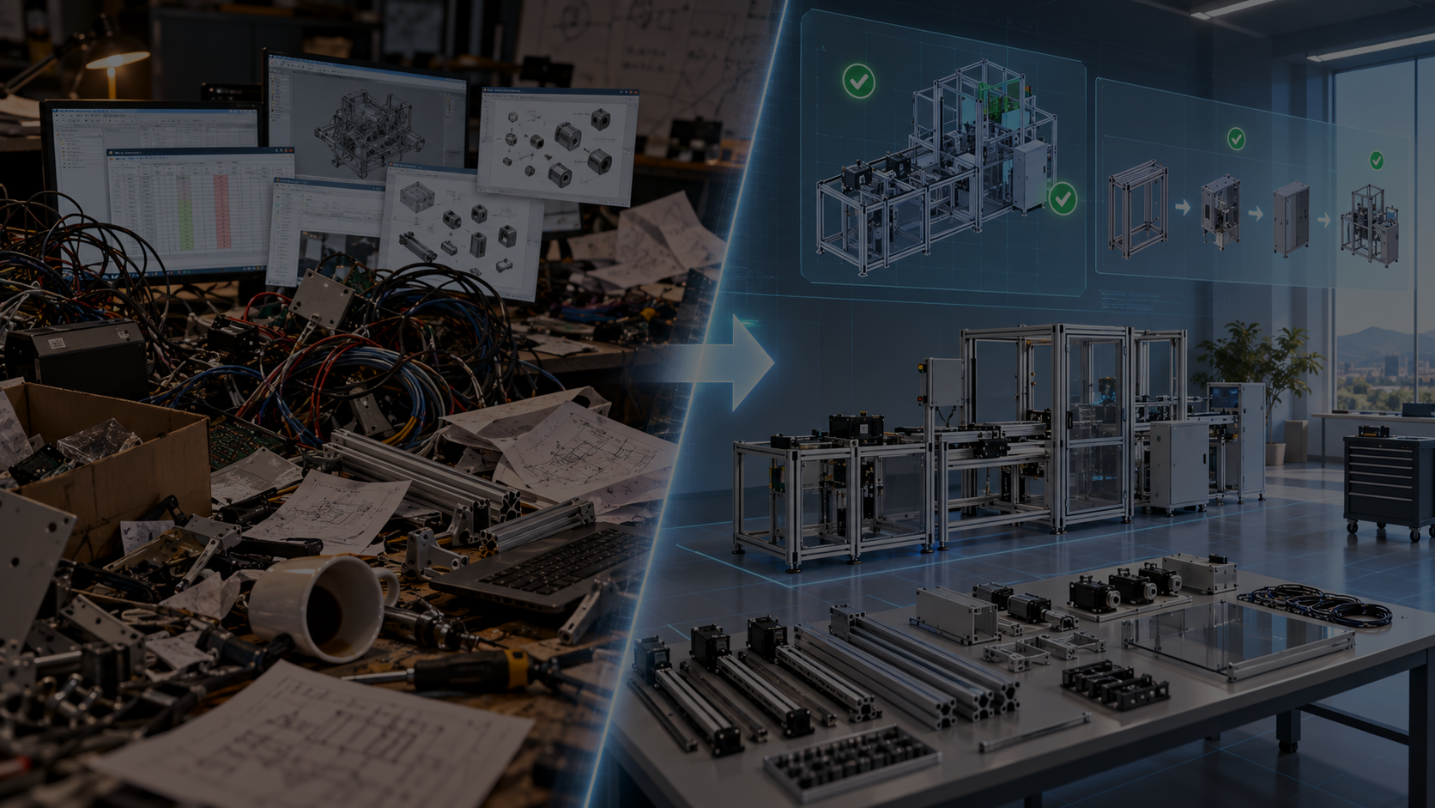
Problem
Hardware teams pay for fragmented context
Artifacts are scattered
CAD, BOMs, supplier notes, wiring, photos, floor plans, and tribal knowledge do not live in one computable system.
Space is checked too late
Teams discover clearance, routing, workflow, and safety issues after parts are ordered or equipment is moved.
Expertise does not scale
A small shop often needs a mechanical engineer, fabricator, facilities planner, and teacher in the same room.
Astra turns those fragments into a spatial plan people can inspect before physical work begins.
Value claim: reduce invisible handoff risk between digital design and real fabrication spaces.

Slide 4
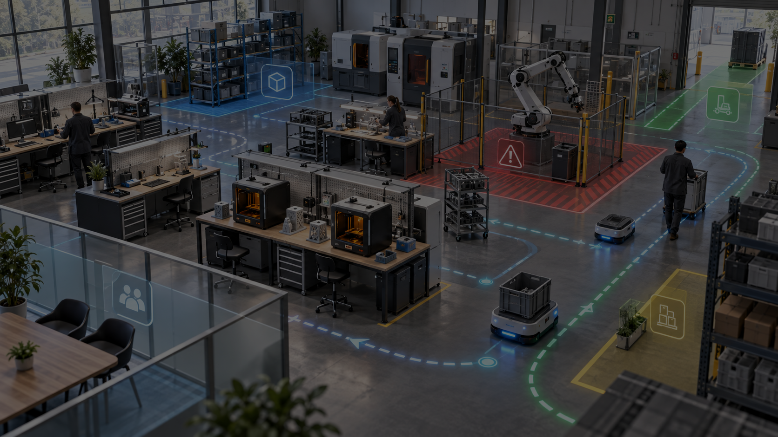
SERVICE
What customers actually buy
The software is the wedge. The durable value is an organization-specific physical knowledge layer.
Hosted workspaces
No setup: project import, scene storage, collaboration, and exportable review packages.
Local deployments
Run on a lab workstation, mini-server, or private infrastructure when data cannot leave the building.
Consulting + configuration
Encode approved parts, suppliers, lab equipment, floor plans, safety constraints, and workflows.
Custom integrations
Connect CAD/STEP libraries, internal docs, PLM habits, tickets, and future agent workflows.
Consulting is not “installation help.” It is converting a customer’s real fabrication environment into reusable, agent-ready context.
Service framing: open core for adoption, cloud for speed, private deployments for trust and enterprise fit.

Slide 5

TARGET DEMOGRAPHIC
Beachhead: small hardware teams without industrial engineering staff
They build real things, but their planning stack is still spreadsheets, screenshots, CAD files, and people explaining context verbally.
Robotics startups
University + research labs
Makerspaces + STEM programs
Prototype shops
Need fast cell layouts, robot reach reviews, and investor/demo visuals.
Need reusable lab knowledge, training, and safer equipment planning.
Need teachable build plans that new users can understand visually.
Need low-cost layout review before ordering fixtures or moving tools.
Beachhead wedge: teams that must explain physical systems quickly, safely, and repeatedly.

Slide 6
PRODUCT WORKFLOW
From generated hardware to deployed workspace
Astra is a service workflow, not just a viewer. Each step creates customer-locking knowledge assets.
1
2
3
4
5
Import
Context
Arrange
Animate
Export
Forma project
+ STEP assets
Rooms, tools,
parts, constraints
Work zones,
reach, clearance
Motion preview
+ process flow
Review package
+ revision input
The repeatable asset is the customer’s physical context: approved components, room geometry, equipment positions, safety rules, supplier choices, and operating assumptions.
Demo storyline: generated hardware does not stop at files; it becomes a spatial operating plan.

Slide 7
Why this matters
Software has an IDE. Hardware needs one too.
AI coding agents work because repositories are structured: files, dependencies, tests, builds, runtime. Hardware agents need the equivalent for the physical world.
Astra creates that missing context layer: machine → components → room → process → feedback.
The result is not just prettier CAD. It is a shared, computable workspace for designing physical systems.
Long-term thesis: an operating system for designing the physical world.

Slide 8
GO-TO-MARKET
Win pilots that prove the service loop
The hackathon demo should sell the first pilot: bring us your machine, room, and constraints; we return a working spatial plan.
Pilot 1: lab / makerspace
Map one room, import existing machines, create reusable training scenes, export build reviews.
Pilot 2: robotics team
Import robot/project assets, arrange a test cell, preview motion, capture clearance and safety feedback.
Pilot 3: prototype shop
Encode preferred components and fixtures, plan a small manufacturing cell, produce customer-facing visuals.
Ask: introductions to NYC labs, robotics programs, makerspaces, small manufacturers, and hardware teams that need spatial planning now.
Pilot metric: one customer-specific environment running locally or hosted, with a reusable asset library and exportable review package.

Slide 9
Demo close
Astra Industries turns hardware design into a serviceable physical-world workflow.
For builders
free local open-source path
For teams
hosted cloud workspace
For organizations
private deployments + consulting
The pitch: bring us your hardware system. We make it computable, spatial, and reviewable.
Astra Industries • Built on Forma-OSS • CAID Technologies

