Slide 1

Simply Voting Website Conversion
Proposal by Chris Banci
Date: April 3, 2017

Slide 2
Overview
Investigation
What is Simply Voting?
Comparison
UI Prototypes
Budgeting
Planning
Work breakdown structure (WBS)

Slide 3
Investigation
A small private school of 800 students needs assistance in moving to using a new voting system.
Current system is out-of-date and aging.
School is considering moving to using a cloud-based voting system called Simply Voting.
Simply Voting has all the features the current voting system has and more.
School lost its technical resource and current system will cost three times the cost of the cloud-based system.

Slide 4
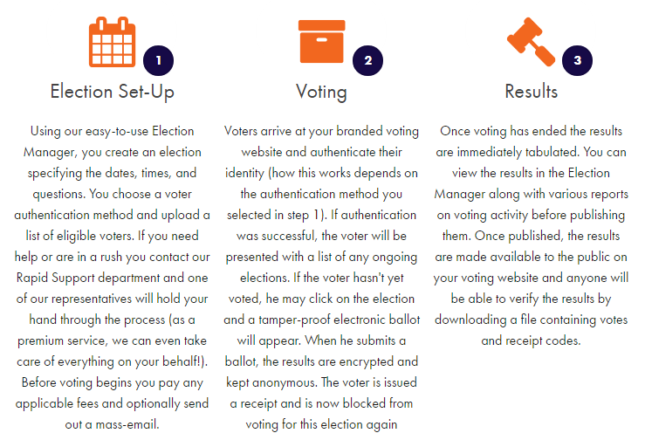
What is Simply Voting?
Simply Voting is a cloud-based voting system that makes managing elections easy and secure.
Three-step process:

Slide 5
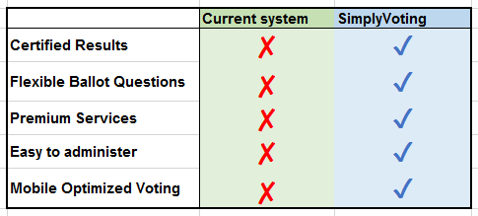
Comparison
Simply Voting offers a variety of great benefits that traditional voting systems don’t.
*Premium services include professional language translations, live tabulation of votes, and fully managed voting events.

Slide 6
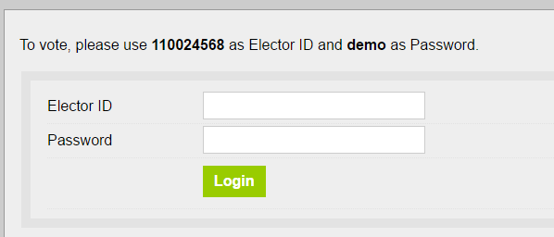
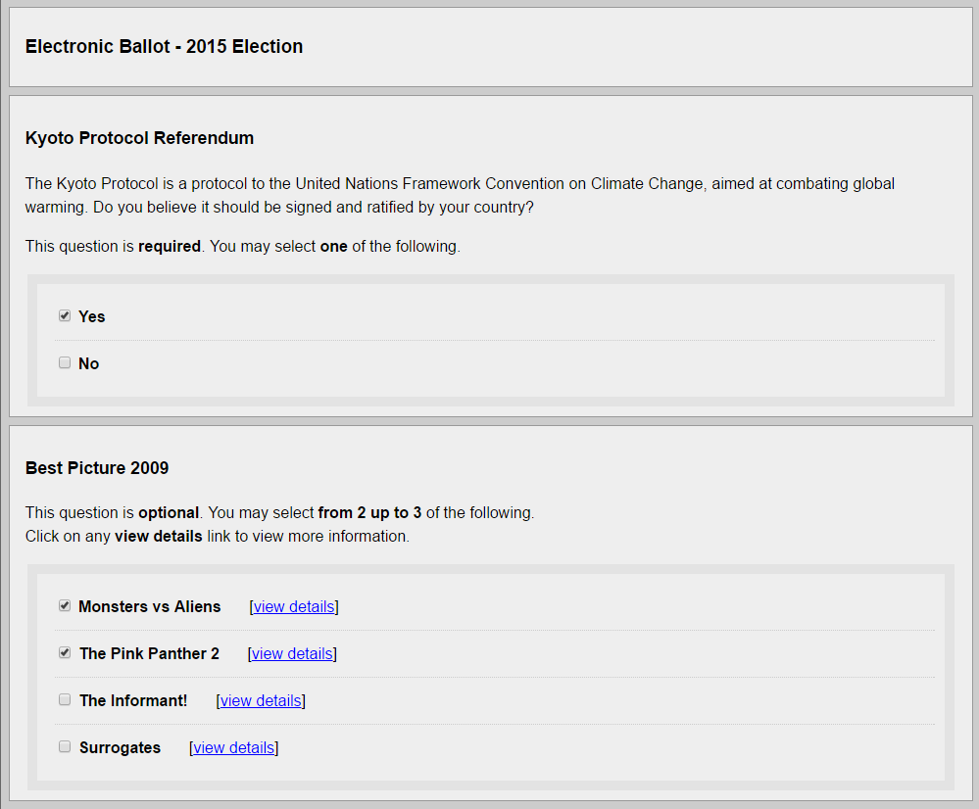
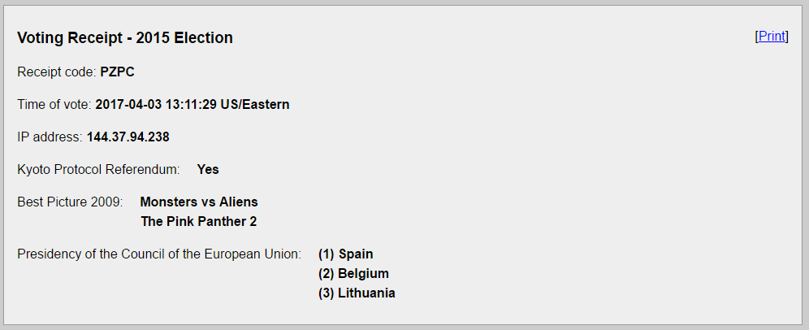
User Interface: voter’s view
Login
Voting Receipt
Ballot

Slide 7
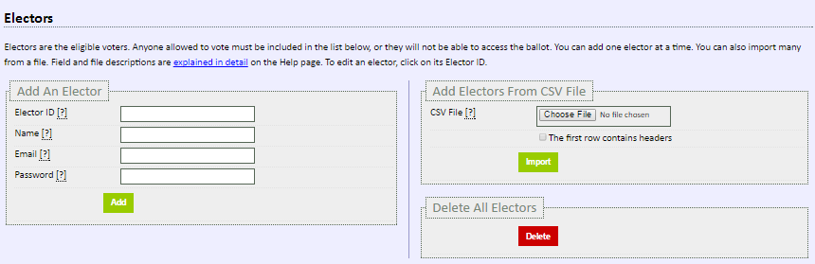
User Interface: organizer’s view
Add/Delete Electors
Question creation
Election creation

Slide 8
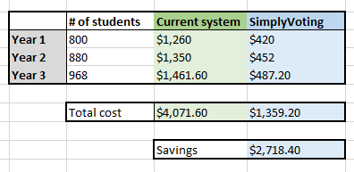
Budgeting
Switching to Simply Voting will save $2718.40 over the course of a three years period.

Slide 9
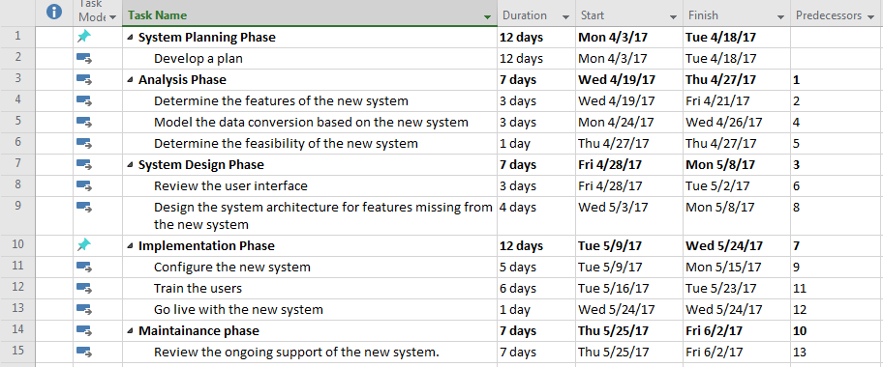
Planning
Transitioning to the new system will take two months to implement.

Slide 10
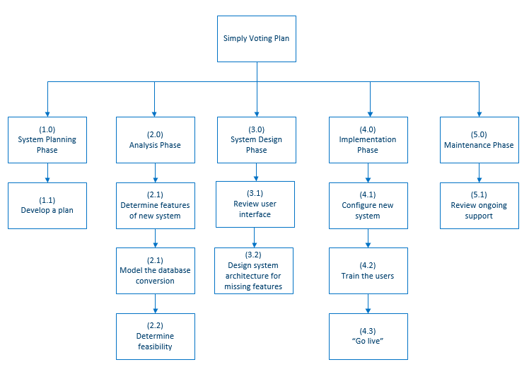
Work Breakdown Structure (WBS)

