Slide 1
91 drugs * 385 Features
Make initial population (50 * 385) randomly Each row is one model
Create Initial Velocity
Create initial local best matrix
Create initial Global best row
Set α = 0.5 to start with
Initial Population
Created randomly
50 * 385
Initial Velocity
Created randomly
50 * 385
Initial Local best matrix
(same as initial population)
Global best row – that is the row with the best fitness
Find the fitness of each row
Find new population
The best model will be the model that has the lowest fitness and its R² of training, Q² of training, R² of validation and R² of test are all greater than or equal to 0.5 and less than 1.
Update the local fitness
Update the global best row
Update the velocity matrix
Update the value α
α = α - 0.00017

Slide 2
Class BPSO (Binary Particle Swarm Optomization) has the following attributes:
AllDataX_Matrix (91 rows (drugs) by 385 features (properties)) – “independent variables X1 – X385”
AllDataY_Matrix (91 rows (drugs) by 1 column – Dependent variable y – PCI50
TrainingX_Matrix (55 rows (drugs) by 385 features (properties)) – “independent variables X1 – X385”
TrainingY_Matrix (55 rows (drugs) by 1 column – Dependent variable y – PCI50
ValidationX_Matrix (18 rows (drugs) by 385 features (properties)) – “independent variables X1 – X385”
ValidationY_Matrix (18 rows (drugs) by 1 column – Dependent variable y – PCI50)
TestingX_Matrix (18 rows (drugs) by 385 features (properties)) – “independent variables X1 – X385”
TestingY_Matrix (PCI50) (18 rows (drugs) by 1 column – Dependent variable y – PCI50)
=================================================================================================

Slide 3
Population: Matrix of 50 rows and 385 column. Each row represents one model
Fitness: Matrix of 50 rows and 1 column referring to fitness value of each model used to evaluate the goodness of each model. The closer the fitness is to zero, the better it is
R_SqrOfTrain: Matrix of 50 rows and 1 column used to evaluate the goodness of each model. The closer the R_SqrOfTrain is to 1, the better it is. R_SqrOfTrain greater than 1 or less than zero are no good
Q_SqrOfTrain: Matrix of 50 rows and 1 column used to evaluate the goodness of each model. The closer the closer Q_SqrOfTrain is to 1, the better it is. Q_SqrOfTrain greater than 1 or less than zero are no good
R_SqrOfValidate: Matrix of 50 rows and 1 column used to evaluate the goodness of each model – the closer the R_SqrOfValidate is to 1, the better it is. R_SqrOfValidate less than zero and greater than 1 are no good
R_SqrOfTest: Matrix of 50 rows and 1 column used to evaluate the goodness of each model – the closer the R_SqrOfTest is to 1, the better it is. R_SqrOfTest less than zero and greater than 1 are no good

Slide 4
Main Program:
// Create an object of a class called BPSO (Binary Particle Swarm Optimization (BPSO)
BinaryParticleSwarmOptimization BPSO;
// The following calls the FillData X and Y matrix to place all 91 rows with
// 385 column original data into the matrix
BPSO.FillDataX-Matrix ( );
BPSO.FillDataY-Matrix ( );
// The following calls the FillTraining X and Y matrices to place the first 61 data rows of
// the original data into the TrainingX_Matrix and TrainingY_Matrix
BPSO.FillTrainingX_Matrix ( );
BPSO.FillTrainingY_Matrix ( );
// The following calls the FillTesting X and Y matrices to place the last 30 data rows of
// the original data into the TestingX_Matrix and TestingY_Matrix
BPSO.FillTestingX_Matrix ( );
BPSO.FillTestingY_Matrix ( );

Slide 5
Main Program – Continue:
// Step 1: Create a population of 50 rows and 385 columns (features), where
// each row will represents a model – Set the entire 50 * 385 to zero to start with
BPSO.CreateInitialPopulation( );
// Step 2: For each row, randomly select 1.5% of the columns and set them equal to 1.
// This means each bit has a 1.5% chance of being selected
// If less than 3 features are selected redo the selection process of that row
BPSO.RandSelSomeFeatOfEachRowInThePop( );
// Step 3: Process Each Row: Create a Training Matrix From the selected features, use specific model
// like multiple linear regression to solve it, get the fitness value, get the R_square of train set,
// R_square of validation set, R_square of test set and Q_square of train set, and place them
// all in a file get the for each model and write their values into an output file.
// Q-Square and assign the values to appropriate locations in their associated arrays.
BPSO. ProcessInitialPopulation( );

Slide 6
Main Program – Continue:
// Step 4:
BPSO.CreateInitial Vecocity()
How to find the initial velocity:
for (i=0; i<50; i++)
for (j=0; j<385; j++)
{
V[i, j] = random number between 0 and 1; // this is not binary. It is between 0 and 1
}
// Step 5:
BPSO.CreateInitialLocalBest Matrix()
// The initial local best matrix is the same as the initial population
// Step 6:
BPSO.GlobalBestRow = BPSO.FindBestGlobalRow()
// The initial global best row is the one the row in the initial population with the best fitness
===============================================================================

Slide 7
Main Program – Continue:
// Step 7:
BPSO.NewPopulation = BPSO.FindingNewPopulation(….)
- If (velocity[i][j] <= α) then new-population [i][j] = old-population[i][j]
- else if (velocity[i][j] > α and velocity[i][j] <=p ) then new-population [i][j] = local-best matrix[i][j]
- else if (velocity [i][j] > p and velocity[i][j] <=1) new-population[i][j] = global-best[j]
- else new-population[i][j] = old-population[i][j]
==========================================================================
// Step 8: Updating the new local best Matrix:
BPSO.UpdateNewLocalBestMatrix(……)
// How to do that?
For each row “i” of the current population
If the fitness of the population[i] < fitness of local-best[i]
Local-best[i] = population[i]
==========================================================================

Slide 8
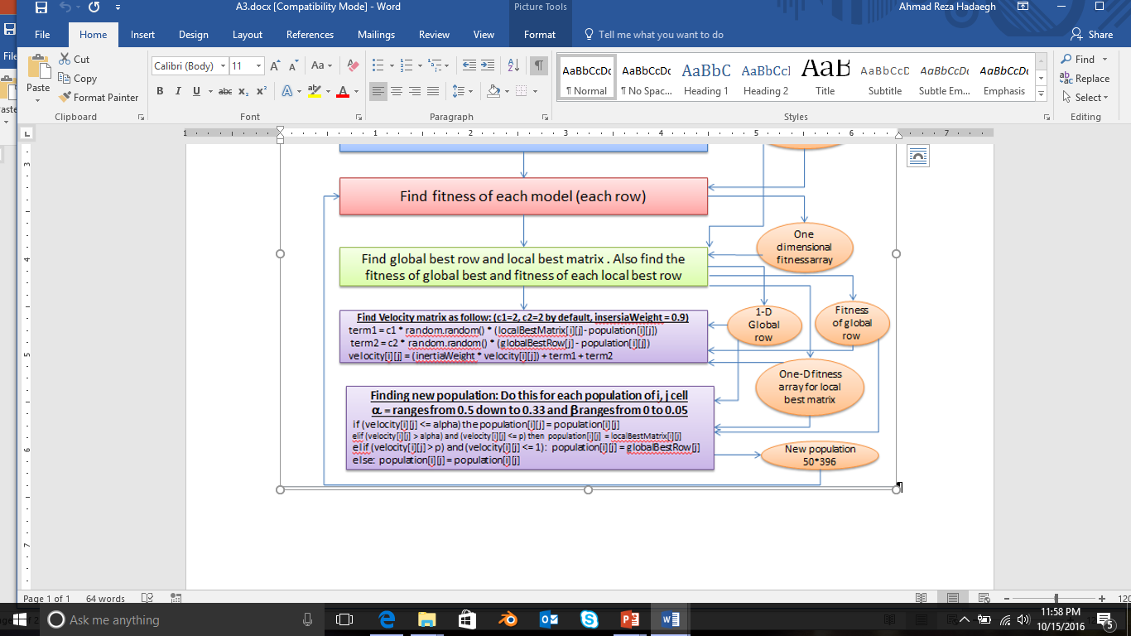
Main Program – Continue:
// Step 9: Updating the global row.
BPSO.UpdateGlobalRow(……)
// How to do that?
The global row is the row of the local best matrix with the best fitness
======================================================================
// Step 10: Update the velocity
BPSO.UpdateVelocityMatrix(……)
// How to do that?
======================================================================
// Go back to step 7

