Slide 1
SMART INDIA HACKATHON
WORLD’S BIGGEST HACKATHON

Slide 2

VISVESVARAYA NATIONAL
INSTITUTE OF TECHNOLOGY
NAGPUR, MAHARASHTRA

Slide 3
AUTOBOT
GOVERNMENT OF GOA
CATEGORY : SOFTWARE
PROBLEM CODE : #GGA2

Slide 4
PROBLEM STATEMENT
BACKGROUND
There are many cases wherein the traffic rule violators are not stopped on the scene and most
of the times only the vehicle number can be captured.
The police personnel then takes the notice to the house of the vehicle owner in person, and
the notice is served to the vehicle owner.
This process has to be completed within 7 DAYS of
the traffic rule violation.
The owner has to visit the Notice branch on a working day
(within 30 DAYS) where the traffic offence can the
compounded by paying the mentioned
compounding amount.

Slide 5
A LOT OF TIME WASTED, RIGHT?

Slide 6
SOLUTION
AUTOBOT
A system that can automatically
FIND the valid information, with respect to the owners of the defaulting vehicles,
SEND the information regarding the violation through SMS or email and facilitate
PAYMENT of the compounding amount to be online.

Slide 7



ADVANTAGES
SECURE PAYMENT
SAVE TIME
STAY UP TO DATE

Slide 8
USE CASE
HOW IT WORKS?

Slide 9
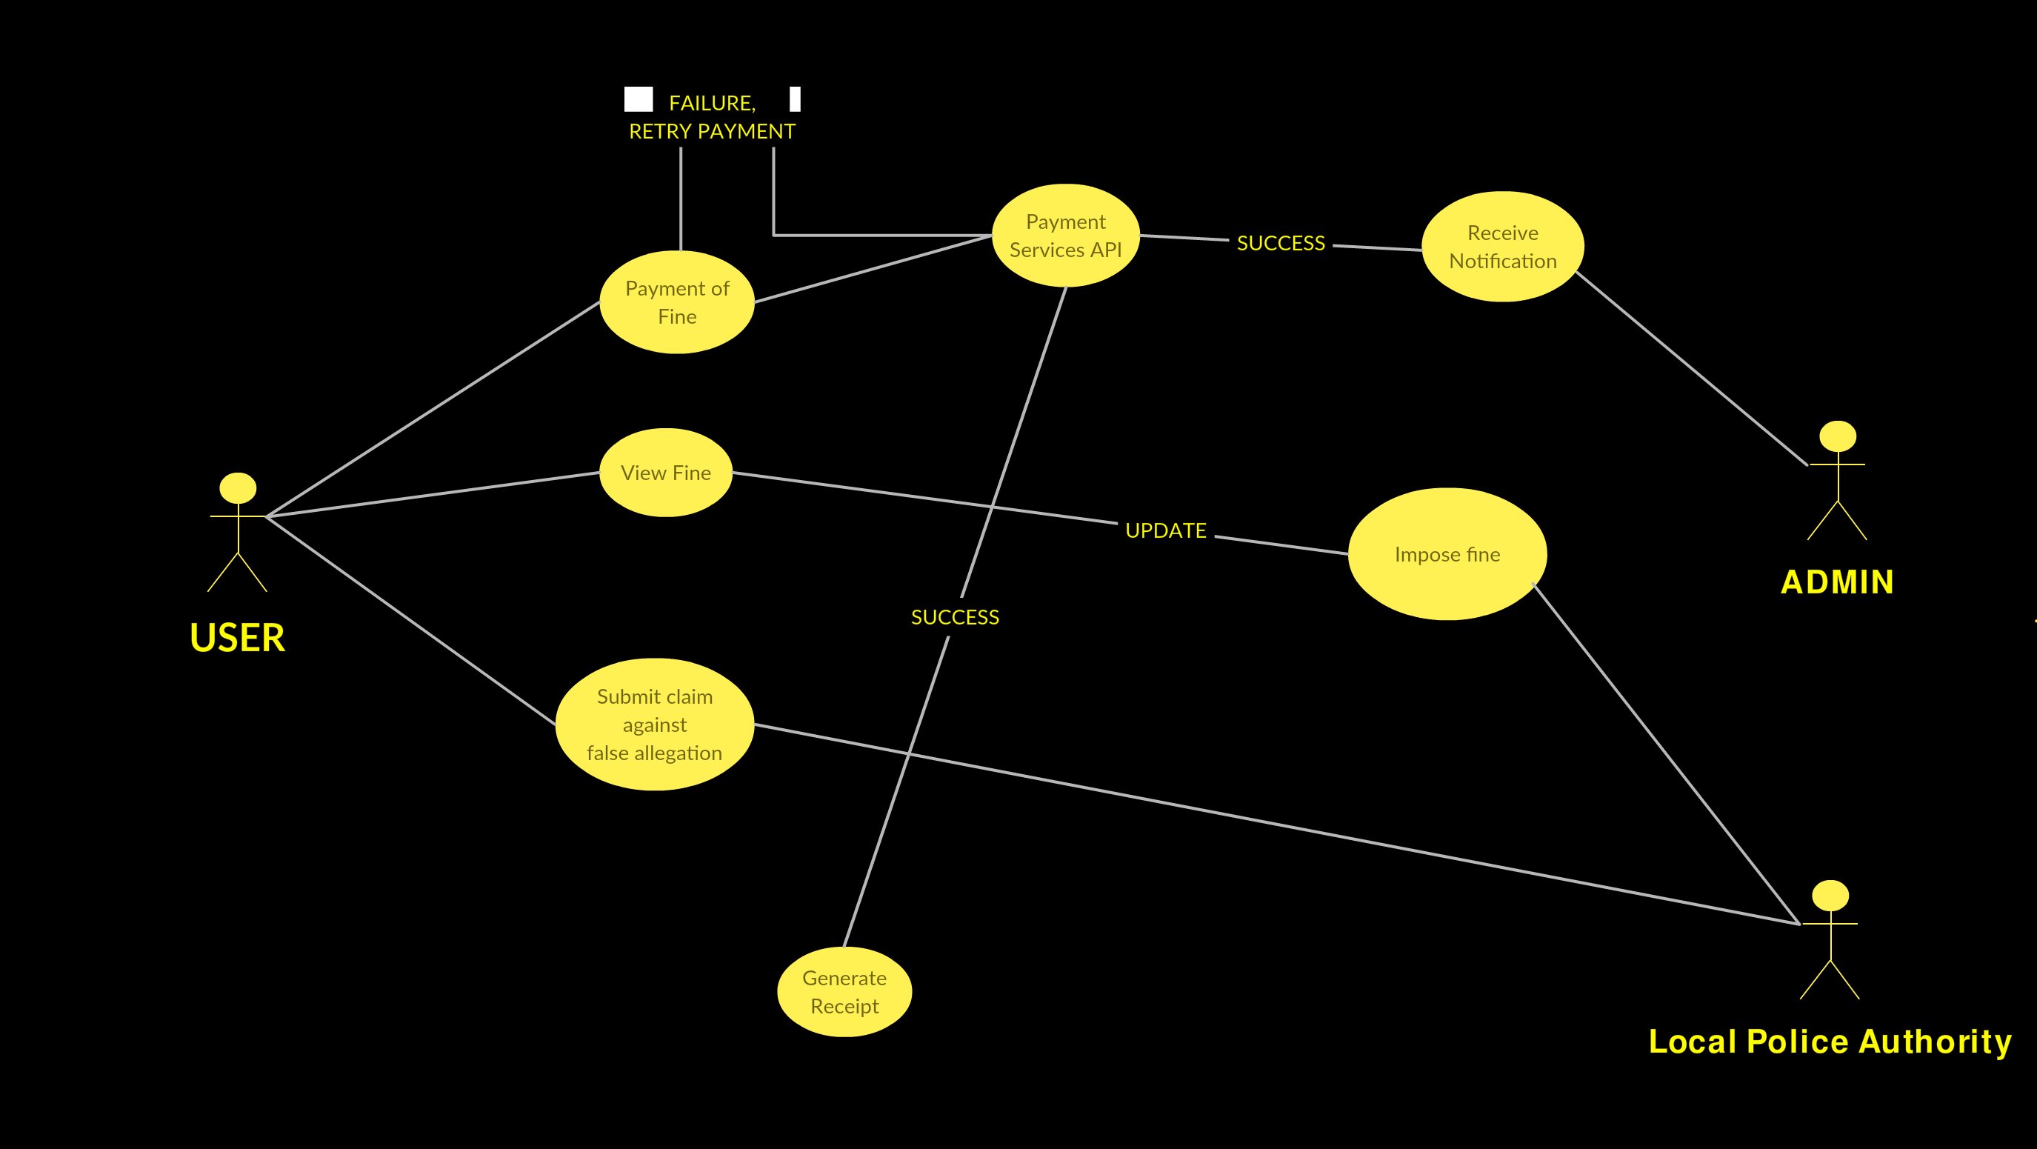

Slide 10
ENTITY RELATIONSHIP

Slide 11
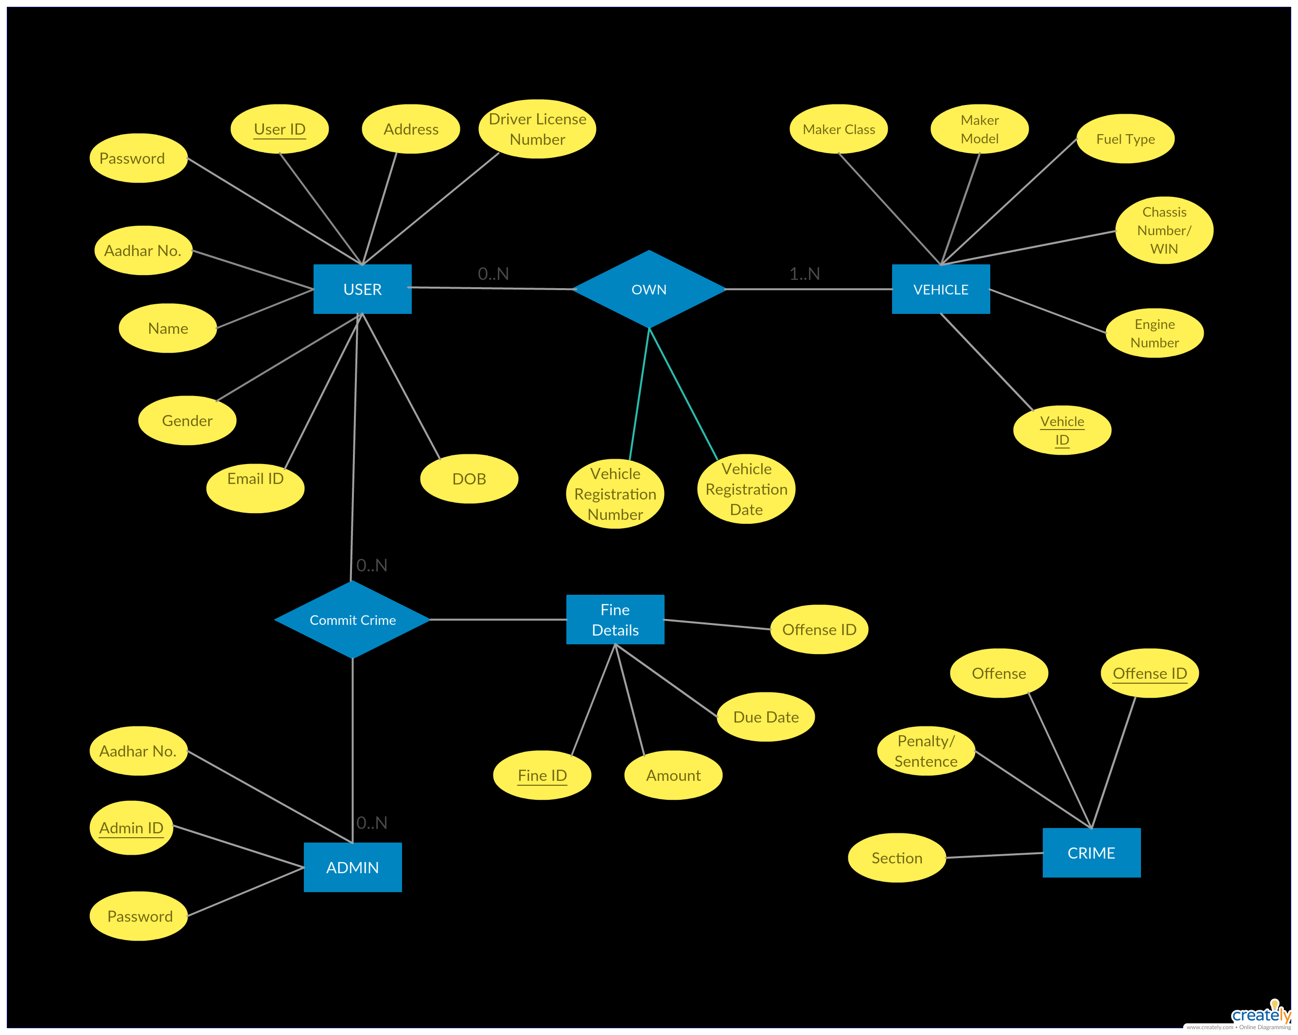

Slide 12
FRAMEWORKS, APIs
AND DATABASE

Slide 13


FRAMEWORKS
DJANGO
MATERIALIZECSS

Slide 14


APIs AND EXTERNAL LIBRARIES
PAYUMONEY
PAYMENT API
PYTESSERACT
OCR TOOL
FOR PYTHON

Slide 15

DATABASE
db SQLite

Slide 16
THE PLATFORM

Slide 17

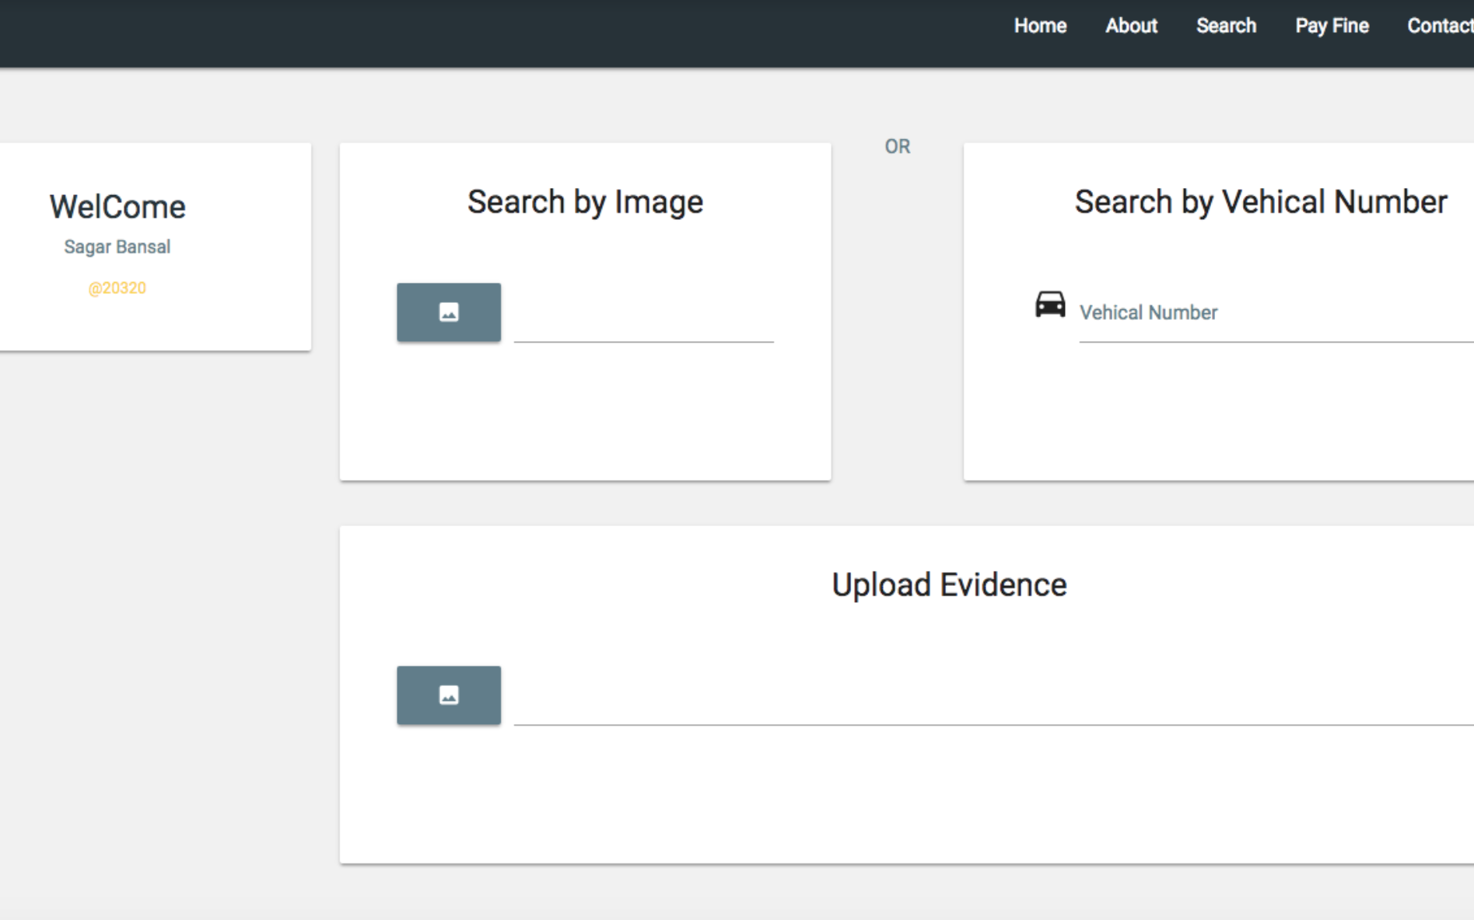
ADMIN DASHBOARD

Slide 18

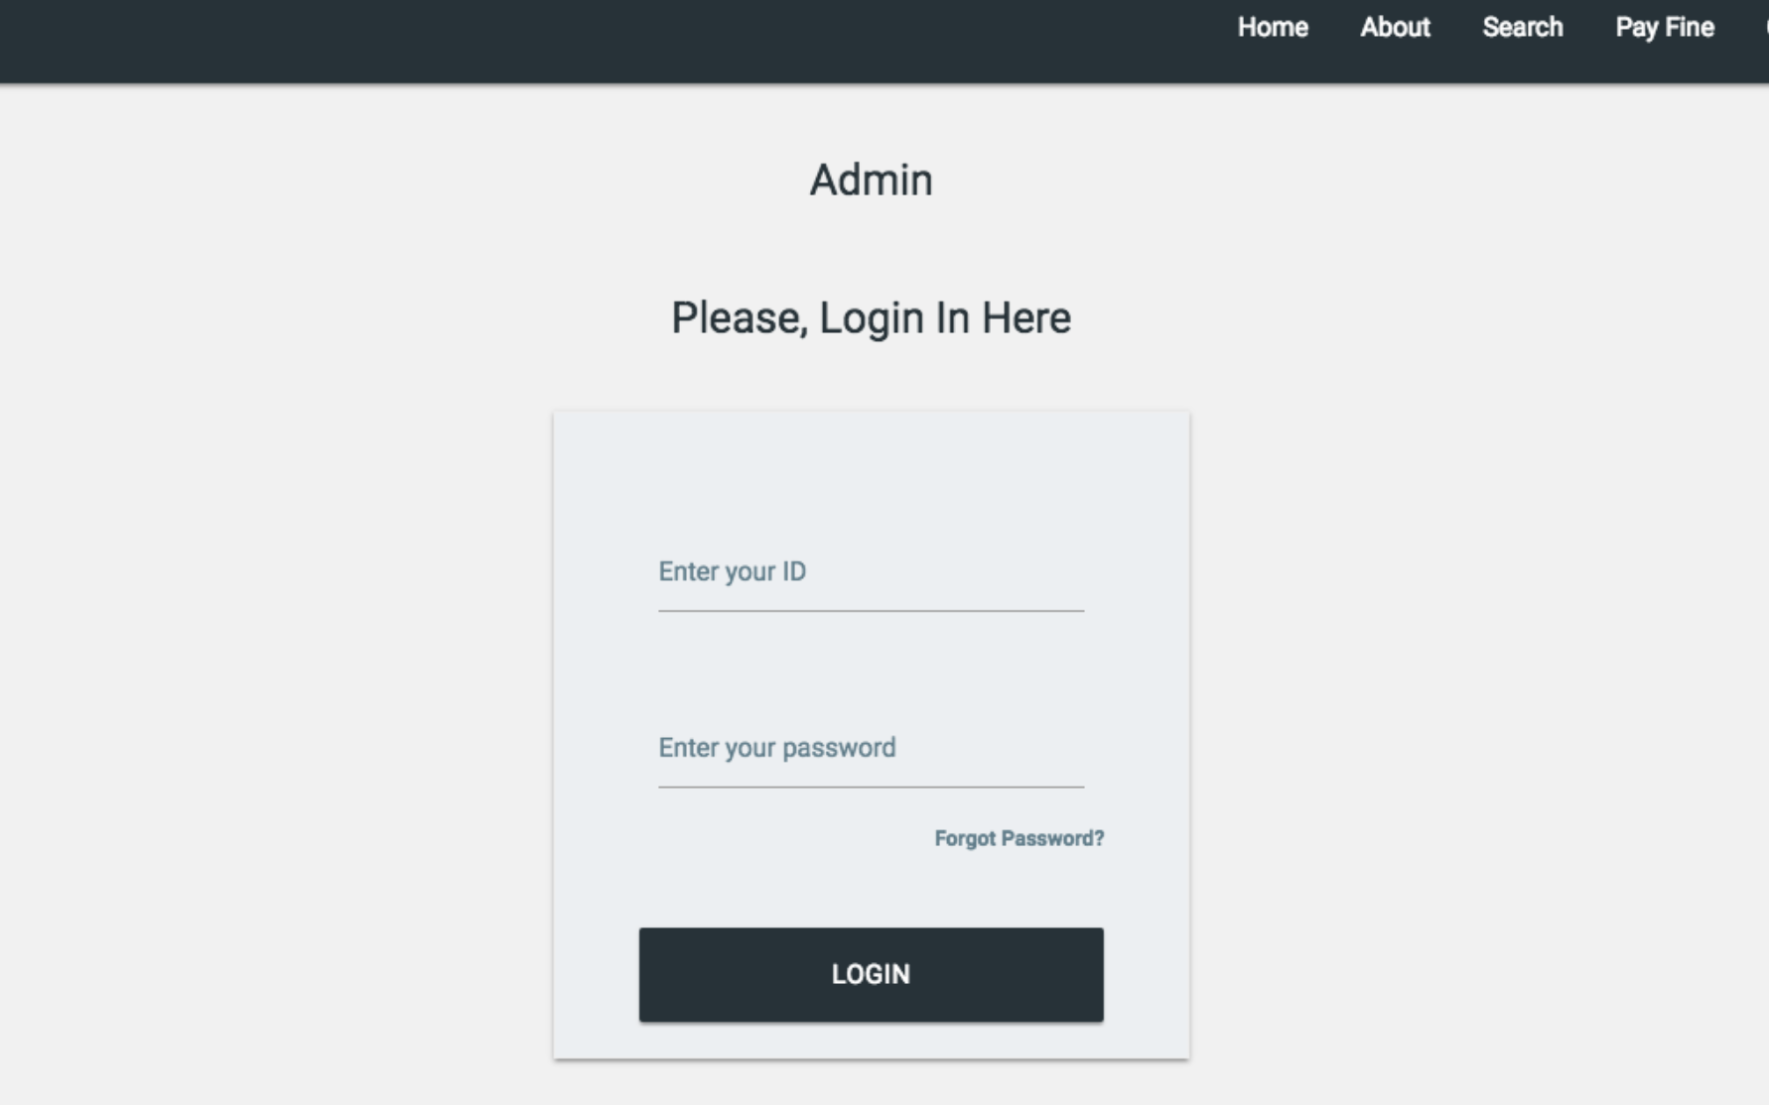
LOGIN

Slide 19
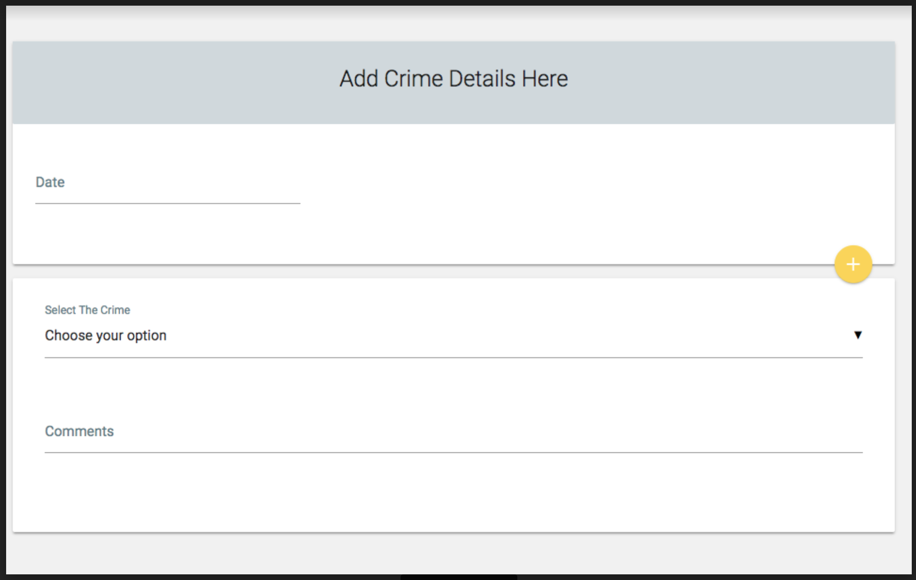
CRIME DETAILS

Slide 20
THE TEAM

Slide 21
TEAM MEMBERS - AUTOBOT
PRIYANK
SAGAR
ANUSHREE
VIPUL
AYUSH
SNIGHDHA

Slide 22
THANK YOU AND QUESTIONS
THANK YOU
QUESTIONS?

