Slide 1
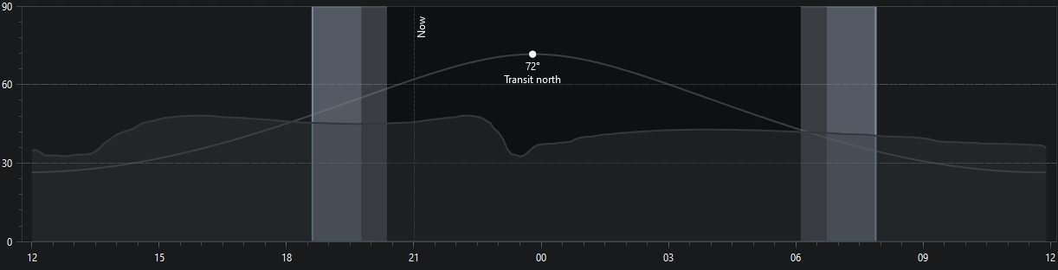
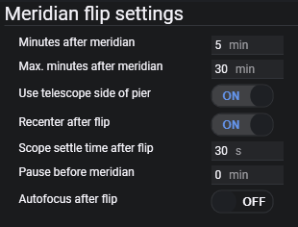
Meridian
Minutes after
Max Minutes after
0m
5m
30m

Slide 2
Meridian
Minutes after
Max Minutes after
Meridian Flip Zone
15 Minutes Exposure
15 Minutes Exposure
Flip
15 Minutes Exposure
0m
5m
30m

Slide 3
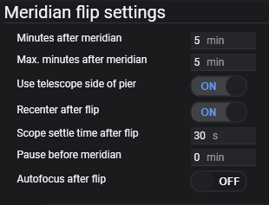
Meridian
Minutes after
15 Minutes Exposure
Pause
Flip
15 Minutes Exposure
0m
5m

Slide 4
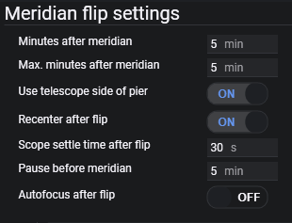
Pause before
Meridian
Minutes after
Obstruction Zone
15 Minutes Exposure
Pause
Flip
15 Minutes Exposure
-5m
0m
5m
30m

