Slide 1

AI-Powered Synthetic Medical Data Generator
Final Project Presentation
Daimond Hidris
Denise Lai
John Hart
Jolyon Smith
Notes:
Introduce the project and the team.
"Alright, so this is our final project. We’ve come up with something called an AI-Powered Synthetic Medical Data Generator. Sounds fancy, doesn’t it? Basically, it’s about making fake medical data—but in a good way. You know, for testing and demos, so you’re not messing about with real patient stuff. The team? Well, there’s Daimond, Denise, John, and Jolyon. We’ve all chipped in. So, let’s get into it and I’ll explain what this thing actually does."

Slide 2
The Why
Testing
Demonstration
Privacy
Notes:
Synthethic Medical Data Generation would be useful for Testing, Creating Demonstration while maintaining Patient’s Privacy.
Previously we would need to obtain data from site, which comes with issue with Patient’s Privacy and many approvals process which makes it difficult.
"Right, so here’s the thing—why bother with all this? Well, synthetic medical data is handy for loads of reasons. You can test systems, do demos, and keep patient privacy intact. You don’t want real patient details floating about, do you? That’s trouble waiting to happen. So, this way, you get realistic data without the compliance headaches. It’s like having a fake cake in a shop window—looks the part, does the job, but no one’s eating it. And let’s be honest, generating patient data manually can be quite cumbersome and time-consuming. Nobody wants to sit there typing out fake names and conditions all day, do they?"

Slide 3
Project Overview
Python app generating synthetic patient data based on prompts
AI RAG pipeline for contextual generation
Simple browser interface for interaction
Notes:
Project is about creating an AI agent to generate a synthetic medical data based on user prompt.
AI agent would use RAG based approach on generating the data, equipped with web tools to DuckDuckGo, Wikipedia, PubMed and Arxciv to be able to gather relevant medical information while creating medical data.
A simple web interface is given for demonstration purposes.
"Here’s what we’ve built: a Python app that generates synthetic patient data based on prompts. We’ve got an AI pipeline—fancy term, but basically it makes sure the data fits the context. And there’s a simple browser interface, so you don’t need to be a tech wizard to use it. Straightforward, really."

Slide 4
System Architecture
Web UI (Input)
System Prompt
AI Agent (RAG Processing)
Vector Store (Retrieval)
Web Tools
Synthetic Data Generator (Output)
Notes:
Technical Structure of the application, from getting user prompt to generating the output. Explain in details on how AI Agent would interact with User Prompt, Medical Context, the use of Vector and embeddings with the web tools.
"This is how it works: you type something into the web interface, the AI agent does its thinking using a RAG pipeline, grabs what it needs from a vector store, and then spits out synthetic data. Behind the scenes, there’s a bunch of web tools and prompts making sure it all runs smoothly. It’s like a little factory for fake medical info."

Slide 5
Technical Components
AI reasoning: rag_agent.py
Retrieval: vector_store.py
Data preparation: data_prep.py
Web UI: web.py
Main entry: main.py
Notes:
Highlight files and explain what each one contributes.
"Here are the main bits: rag_agent.py does the reasoning, vector_store.py handles retrieval, data_prep.py gets the data ready, web.py runs the interface, and main.py ties it all together. Each one’s got its job—like a team of tiny workers in your computer."

Slide 6
Challenges and Lessons Learned
Learned Data Preparation.
Learning how RAG models work.
Learned how to build AI Agent tools.
Managing token limits when uploading the context data.
Managing embeddings and vector storage.
Designing prompts for medical accuracy.
Building a simple functional UI.
Learned how Copilot can be used to help us.
Notes:
Describe what the team struggled with and how they resolved issues.
"We learned loads: how to prep data, how RAG models actually work, and how to build AI tools. Token limits were a pain—like trying to fit a sofa through a small door. Managing embeddings and vector storage was another tricky bit. And prompts? You’ve got to design them carefully for medical accuracy. Oh, and we built a simple UI that actually works. Plus, Copilot helped us along the way, which was handy."

Slide 7
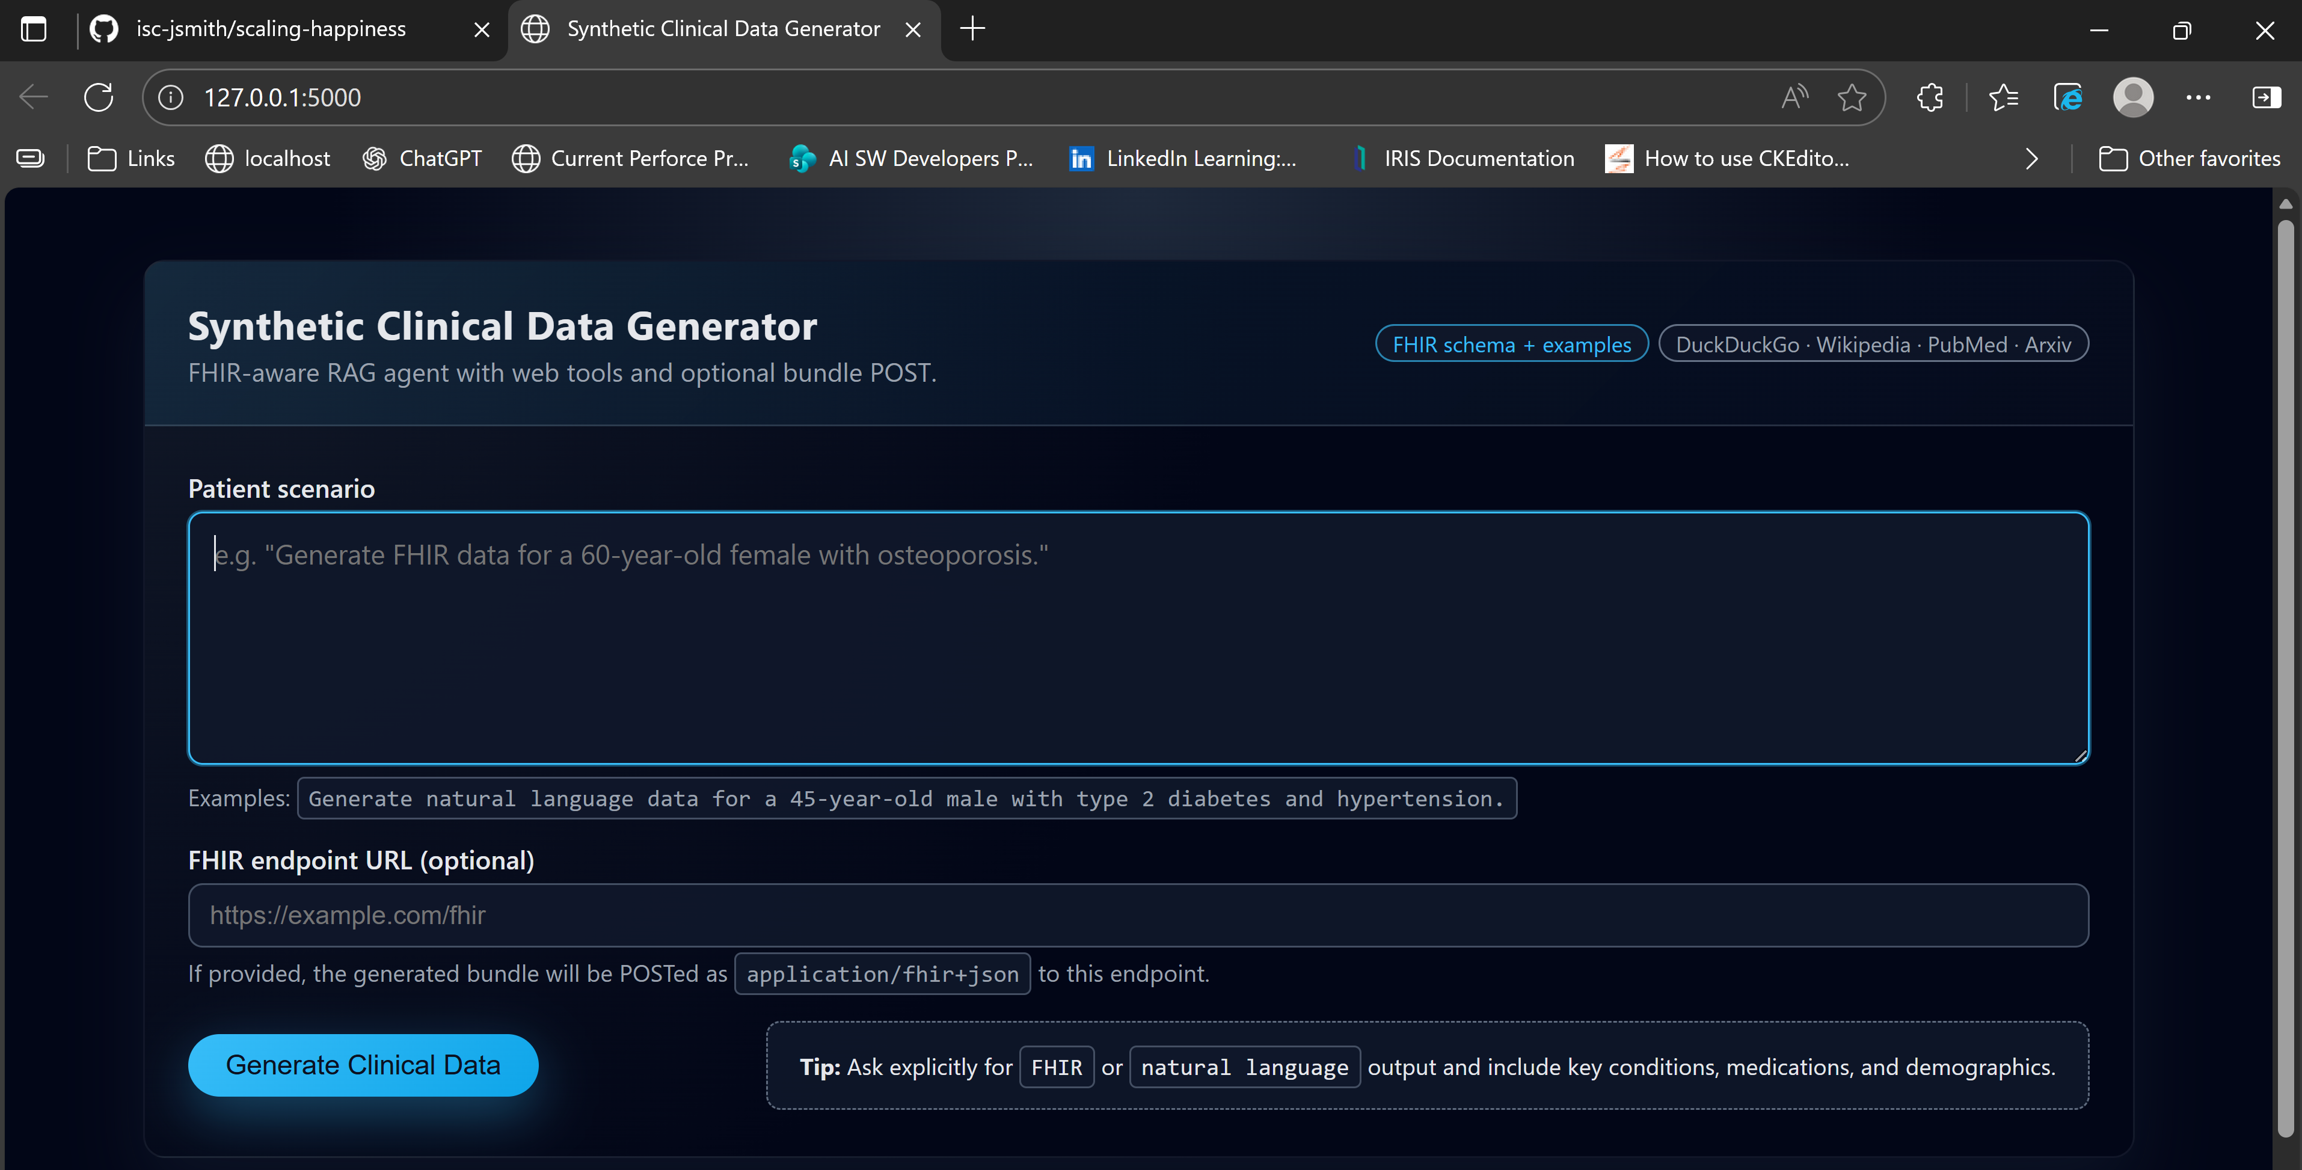
Demonstration
Notes:
"And now, the fun part—the demo. This is where you see it all come together. No smoke and mirrors, just the app doing its thing. Let’s have a look."

