Slide 1
AI-Powered Synthetic Medical Data Generator
Final Project Presentation
Daimond Hidris
Denise Lai
John Hart
Jolyon Smith
Notes:
Introduce the project and the team.

Slide 2
Project Overview
Python app generating synthetic patient data based on prompts
AI RAG pipeline for contextual generation
Simple browser interface for interaction
Notes:
Explain why synthetic data helps learning without privacy issues.

Slide 3
System Architecture
Web UI (Input)
System Prompt
AI Agent (RAG Processing)
Vector Store (Retrieval)
Web Tools
Synthetic Data Generator (Output)
Notes:
Explain why synthetic data helps learning without privacy issues.

Slide 4
Technical Components
AI reasoning: rag_agent.py
Retrieval: vector_store.py
Data preparation: data_prep.py
Web UI: web.py
Main entry: main.py
Notes:
Highlight files and explain what each one contributes.

Slide 5
Challenges and Lessons Learned
Learned Data Preparation.
Learning how RAG models work.
Learned how to build AI Agent tools.
Managing token limits when uploading the context data.
Managing embeddings and vector storage.
Designing prompts for medical accuracy.
Building a simple functional UI.
Learned how Copilot can be used to help us.
Notes:
Describe what the team struggled with and how they resolved issues.

Slide 6
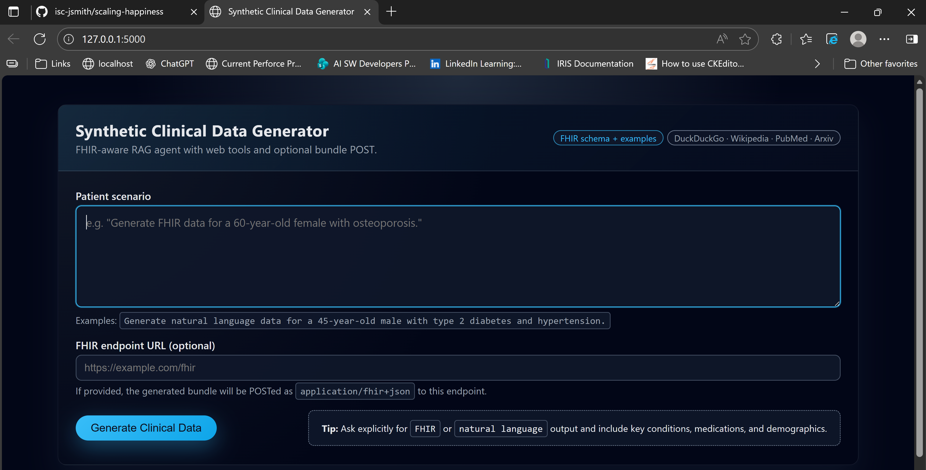
Demonstration

