Slide 2
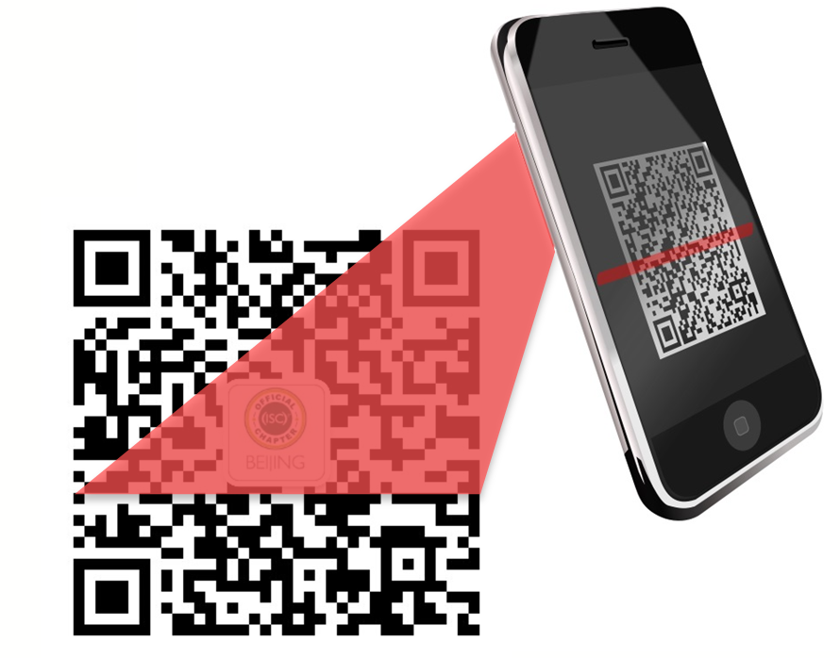

请先扫码
Notes:
Welcome
Pizza and Salad – feel free to get up and come and go
If you have any questions – please ask them
What this presentation is not

