Slide 1



5th Jointed Workshop between IEEE Standards Association and IEEE CAS - Secure Circuits and Systems: Standards for AI, Chiplets, and Healthcare

Slide 2
Workshop – 24th to 25th May at Shanghai
Increased awareness of IEEE hardware security, healthcare, and circuits-and-systems standards
Improved understanding of secure, interoperable design for AI and chiplet-based systems
Strengthened collaboration between academia, industry, and standards organizations
Expanded engagement in IEEE CASS and standardization activities

Slide 3
Abstract:
As AI acceleration, chiplet architectures, and next-generation healthcare technologies rapidly redefine the hardware landscape, mastering secure, interoperable design has never been more critical. We invite you to the IEEE Circuits and Systems Standards Workshop, co-hosted with the IEEE Standards Association, featuring a distinguished lineup of speakers from the IEEE SA, leading industry innovators, and current Working Group and Study Group chairs. These experts will deliver timely insights into the latest IEEE standards for hardware security, healthcare electronics, and advanced circuits, with a focused mission to elevate standards awareness across the IEEE Circuits and Systems Society. Through dynamic presentations and interactive discussions, you will deepen your understanding of secure, interoperable frameworks tailored for AI and chiplet-based systems, while forging stronger, actionable partnerships between academia, industry, and standards organizations. Your attendance will not only expand your engagement in IEEE CASS initiatives but also position you to directly influence and participate in the global standardization efforts shaping tomorrow’s technology. Join us to connect with pioneers, bridge the gap between innovation and compliance, and help architect a more secure, collaborative future for circuits and systems—register today and step into the forefront of standards-driven design.

Slide 4
Organizers
Yi(Estelle) Wang | SASD Chair-elect 26-27, Global head of product Cybersecurity consulting & engineering, AUMOVIO (Previous knows as Continental)
Yang Zhao | SASD Committee member, Shanghai Jiaotong university

Slide 5
24th May 2026
08:30 – 09:00am | Registration & Welcome Coffee | All
09:00 – 09:10am | Opening Remarks | Yi (Estelle) Wang (Global Head of Product Cybersecurity Consulting & Engineering, AUMOVIO)
09:10 – 10:00am | IEEE SA: Standardization Driven Technologies, | Sri Chandrasekaran (APAC Foundational Technologies Practice Lead, IEEE SA)
10:00 – 10:30am | Updates for P3468: Standard for Chiplet Interface Circuit | Qinfen Hao, Professor, Chinese Academy of Sciences, China
10:30 – 10:50am | Break
10:50 – 11:30pm | WG updates, SG updates | WG Chairs/SG Chair
11:30 – 12:10pm | Panelist: Bridging the Gap: Turning CAS Research into IEEE SA Standards | Shafi Syed (Senior Direction, GF), Sri Chandrasekaran(IEEE SA), Johann Knechtel (WG Chair), Ang Boon Chong (SASD Chair), Moderator: Yi(Estelle) Wang (Global head of CE, Aumovio)
12:10 - 02:00pm | Lunch
02:00 – 02:50PM | Minimally invasive implantable flexible BCI sensors and medical applications | Bowen Ji, Professor, Northwestern Polytechnical University
02:50 – 03:40PM | Key Circuit Design for Neural Modulation ICs | Xu Liu, Associate Professor, Beijing University of Technology
03:40 – 04:00PM | break
04:00 – 04:30PM | Brain-computer interface assisted visual restoration | Bing Liu, CEO of Mindrix
04:30 – 05:00PM | Progress update and call for participating： Wearable Implantable ExG Interface Circuits Working Group | Yang Zhao Secretary of CASS/FW-SC/WIExGICWG
05:00 – 06:00 | Panelist discussion

Slide 6
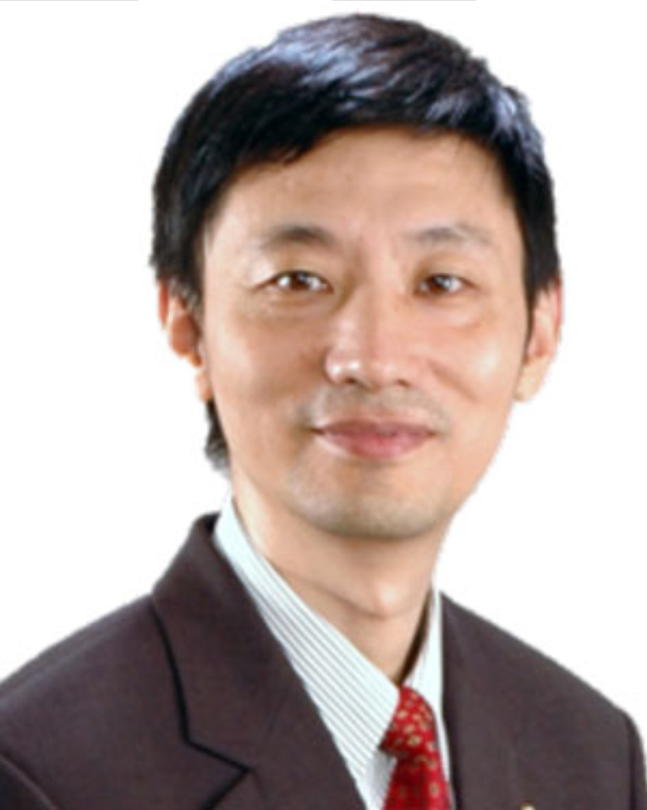
Organizer
ISCAS GC
Biography
Dr. Lian has authored or co-authored more than papers. His research interests include biomedical circuits and systems and signal processing. He was the recipient of many awards, including IEEE Circuits and Systems (CAS) Society’s Guillemin-Cauer Award (1996), IEEE Communications Society Multimedia Communications Best Paper Award (2008), Singapore IES Prestigious Engineering Achievement Award (2011), CN Yang Award in Science and Technology for New Immigrant (2014), Design Contest Award of 20th ISLPED (2015).
Dr. Lian is a Member-at-Large of IEEE PSPB, the Chair of IEEE Periodicals Partnership Opportunities Committee, Chair of IEEE Ad Hoc Committee on Accelerating Partnership with Chinese Publications, Member of IEEE Periodicals Committee, Member of IEEE Periodicals Advisory and Review Committee, Member of IEEE Products and Services Committee, Member of IEEE PSPB Strategic Planning Committee, Member of IEEE PSPB Publishing Conduct Committee, and Member of IEEE Press Editorial Board. He was the President, VPfor Publications, and VP Region 10 of theIEEE Circuits and Systems Society. He was the Editor-in-Chief of IEEE TCAS-II, Member of IEEE Fellow Committee, Member of IEEE Biomedical Engineering Award Committee, and Member of IEEE Medal for Innovation in Healthcare Technology committee. He is the Founder of the IEEE BioCAS Conference and IEEE PrimeAsia Conference for postgraduate students. He is a Fellow of the Canadian Academy of Engineering, and Fellow of the Academy of Engineering Singapore.
Yong Lian
Professor
York University
Shanghai Jiaotong University China

Slide 7
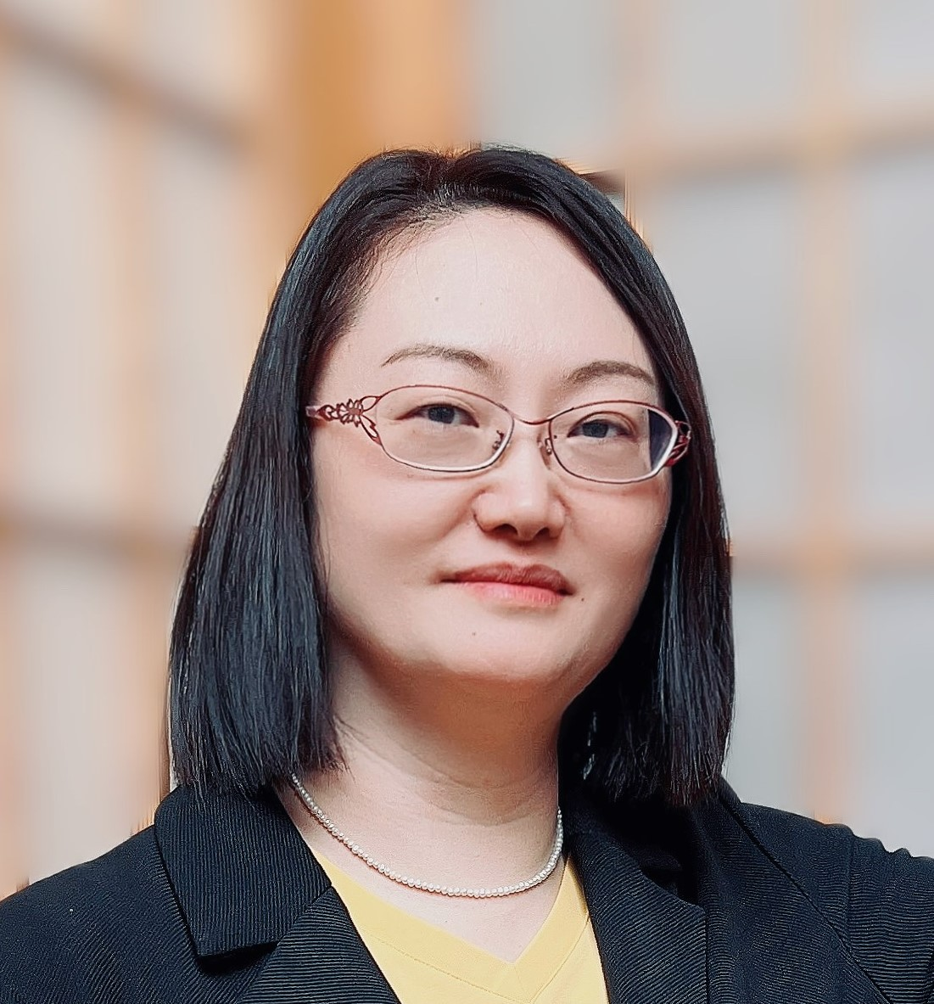
Organizer
IEEE CAS SASD
Biography
Dr. Yi (Estelle) Wang received the B.S and M.S degree from Northwestern Polytechnical University, Xi’an China in 2000 and 2003, and the Ph.D. degree from Nanyang Technological University, Singapore 2008. She has been working as Global Head of Consulting & Engineering, and Head of Product Cybersecurity & Privacy Office (PCSO) Singapore, at Aumovio Automotive since July 2016. Dr. Wang is leading three teams: the automotive advanced research and governance team, consulting and engineering team, and the security operations team. In addition, she is with deep knowledge of ISO/SAE 21434 and UNECE R155/R156 based on physically participating in working group meetings. She is an expert with cybersecurity industrial standards, e.g., ISO 2700x and ISO 26262. She is familiar with data protection and privacy regulations: GDPR and Asia regional regulations (Singapore PDPA and Chinese PIPL). Advanced leading research topics are including but not limited to applied post quantum cryptography, applied lightweight cryptography, cybersecurity for artificial intelligence (adversarial model), embedded security for IoTs, data anonymization for personal privacy.
Dr. Wang is honored with “Top Women in Security ASEAN 2021” 2021 and 2022 (Singapore, Phillips, Indonesia, Malaysia, Cambodia, and Thailand), “Top Women in Security – Singapore Country Award” and “Top 20 Women in Cybersecurity Singapore 2020” by Public Security Society. She brought the know-how to the Singapore Cybersecurity ecosystem through guest lectures with the Singapore Institute of Technology in 2019. With more than 20 years of experience in various embedded security topics, she is active in academic activities, has published more than 65 international top journal/conference papers, and holds 17 industrial patents. She was Chair of the IEEE Circuit and System Society (CASS) chapter Singapore 2022-2023, Associate Editor of IEEE Transactions on Circuit and System II 2020-2022, and Chair for IEEE Standard of Hardware Security under IEEE Circuits and Systems Society Standards Activities Subdivision and Chair-elect of SASD 2026-2027.
Photo
Yi (Estelle) Wang
Global Head of Consulting & Engineering
Head of Product Security & privacy Office Singapore
Automotive Singapore

Slide 8
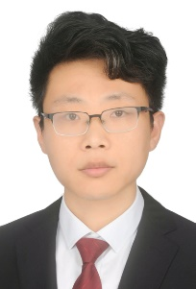
Organizer
IEEE CAS SASD
Biography
Dr. Zhao received the B.S. and M.S. degree in microelectronics from Xi’an Jiaotong University, Xi’an, Shaanxi, China, in 2015 and the Ph.D. degree in electrical engineering and computer science from York University, Toronto, Ontario, Canada, in 2019.
From 2019, he was a postdoc visitor with the Department of EECS, York University. In 2020, he joined the Department of Micro-Nano Electronics, Shanghai Jiao Tong University (SJTU) as an Assistant Professor. Since 2024 he has been an Associate Professor of SJTU, Shanghai, China. He was a recipient of the Ontario Postgraduate Scholarship, York Postdoctoral Fellowship and IEEE TBioCAS 2023 Best Paper Award. He is the author of more than 40 papers. His research interests include energy/power-efficient biomedical circuits and systems and SoCs. He served as the Financial Co-Chair of the IEEE APCCAS 2022 and the IEEE PrimeAsia 2022, Publication Co-Chair of IEEE BioCAS 2023 as well as a Guest Editor of the IEEE OJCAS and serves as Local Arrangement Co-Chair of IEEE BioCAS 2024. Dr. Zhao is currently a member of the IEEE Biomedical and Life Sciences Circuits and Systems Technical Committee, a member of the IEEE Circuits and Systems Society (CASS) Flexible Special Interest Group, the Secretary of the IEEE Flexible and Wearable Circuits and Systems Standards Committee an a voting member of IEEE Circuits and Systems Society Standards Activities Subdivision.
Yang Zhao
Shanghai Jiaotong University

Slide 9
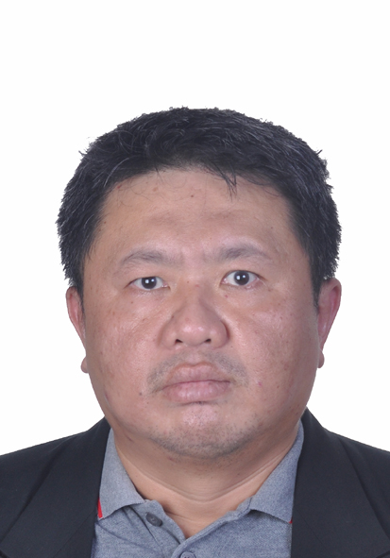
Speaker
IEEE SASD
Biography
Ang Boon Chong was born in Penang, Malaysia, in 1978. He received the B.E. degree in microelectronic engineering from the University Putra Malaysia, Malaysia, in 2002, and MBA from Open University Malaysia, Malaysia in 2014.
He is currently affiliated with Intel Malaysia, been engaged in a wide variety of advanced nodes and methodology evaluation. He has published over 40 papers as well as delivered 2 invited talks in 2 countries. He is currently a tech lead within the organization as well as IEEE senior member.
Boon Chong Ang
Intel Company

Slide 10
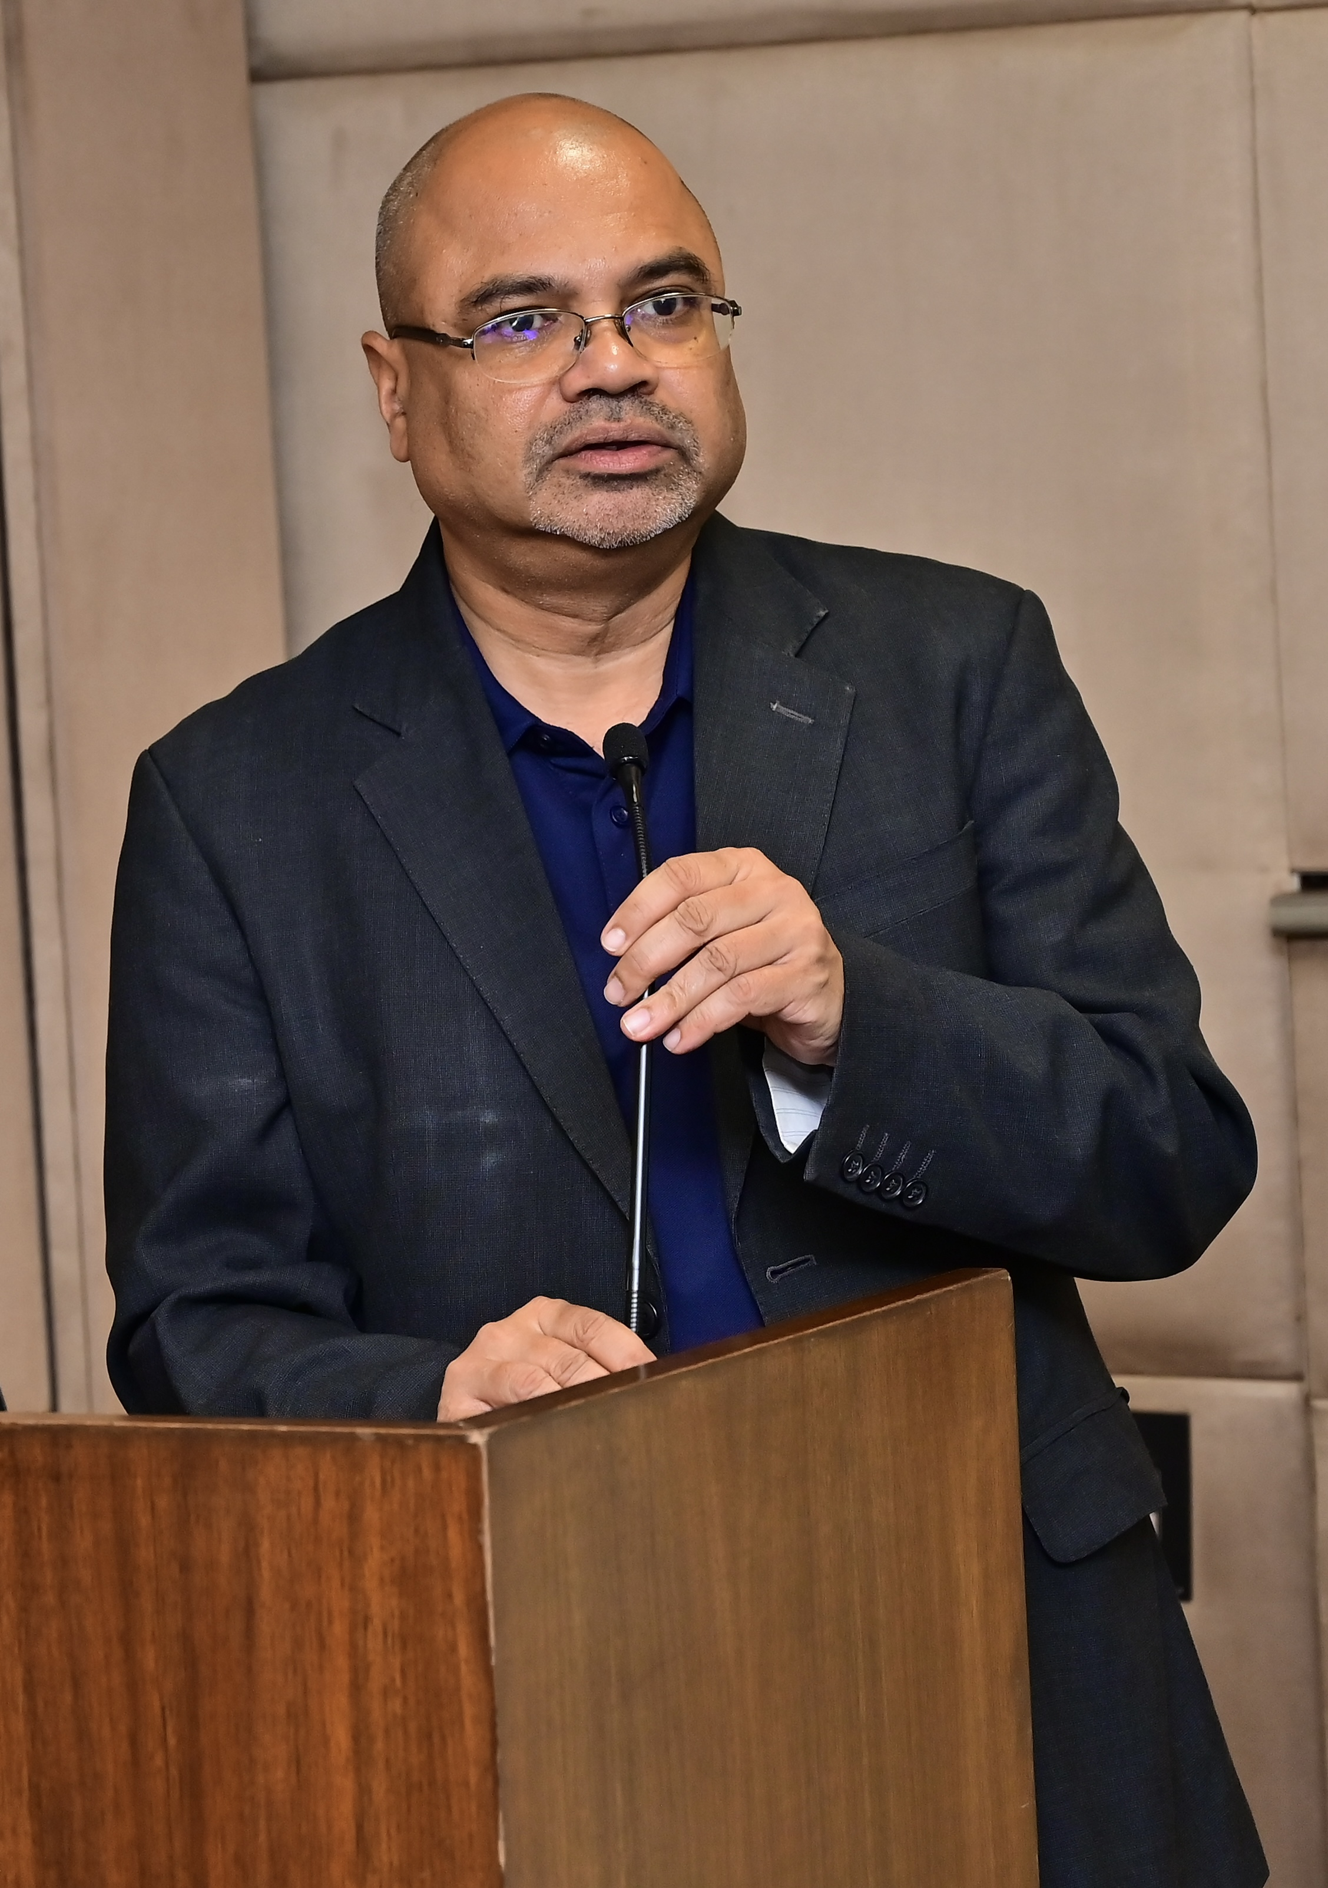
IEEE Standard
Speaker
Biography
Sri has been associated with the IEEE since 2012 and heads the business operations for IEEE in India. Through his practice Sri focus’s on developing key standardisation programs in emerging areas building end-to-end trustworthy devices and systems with emphasis on cybersecurity, identity and privacy. Sri also heads the standardization efforts for the Asia Pacific region. Sri and his team in India drive the IEEE Blended Learning Program (BLP) initiative, an eLearning platform, focused on bridging skills gap for students and lateral skilling of industry professionals.
Prior to joining IEEE, Sri was associated with Freescale Semiconductor Inc. (formerly Motorola Inc.) for 17 years, focused on Electronic Design Automation.
Sri received the Accellera Technical Excellence Award in 2009 for his leadership and contributions to design automation standardisation. Sri holds a Bachelor of Science degree in Physics from Madras University, India and Master’s degree in Electrical Communication from Indian Institute of Science, Bangalore, India.
Photo
Srikanth Chandrasekaran
Country Head & Senior Director – IEEE India
Global Practice Lead, Foundational Technologies, IEEE Standards Association

Slide 11
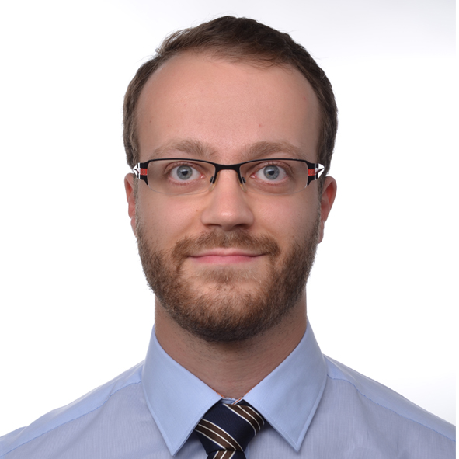
Speaker
Hardware Security
Biography
Dr. Johann Knechtel is a Senior Research Scientist at New York University Abu Dhabi (NYUAD). His primary research interests are in hardware security, electronic design automation (EDA), 3D integration, emerging technologies, and machine learning. He is deeply involved in professional activities, serving as a Senior Member of IEEE and as Chair of the Working Group IEEE Standard for Hardware Security: Attack Landscape and Protection Requirements (P3718).
Dr. Knechtel earned his Ph.D. in Electrical Engineering in 2014, with the highest honor (summa cum laude) from TU Dresden, Germany. He began his tenure at NYUAD in July 2016 as a Postdoctoral Associate and has progressed through several roles to his current senior position. Prior to his current role, he held several international research positions, including Postdoctoral Researcher at the Masdar Institute in Abu Dhabi, Research Assistant at The Chinese University of Hong Kong, and Visiting Research Student at the University of Michigan.
An active contributor to his field, Dr. Knechtel has a significant publication record with 104 total publications and an h-index of 25 as of June 2025. He is also a committed educator and mentor, having co-supervised or mentored 21 Ph.D. students, several graduate students, and post-doctoral associates across various institutions. He also has experience as a lab instructor for multiple engineering courses at NYUAD.
Photo
Johann Knechtel
Research Scientst
New York University Abu Dhabi

Slide 12
Speaker
IEEE CAS SASD
Biography
Dr. Zhao received the B.S. and M.S. degree in microelectronics from Xi’an Jiaotong University, Xi’an, Shaanxi, China, in 2015 and the Ph.D. degree in electrical engineering and computer science from York University, Toronto, Ontario, Canada, in 2019.
From 2019, he was a postdoc visitor with the Department of EECS, York University. In 2020, he joined the Department of Micro-Nano Electronics, Shanghai Jiao Tong University (SJTU) as an Assistant Professor. Since 2024 he has been an Associate Professor of SJTU, Shanghai, China. He was a recipient of the Ontario Postgraduate Scholarship, York Postdoctoral Fellowship and IEEE TBioCAS 2023 Best Paper Award. He is the author of more than 40 papers. His research interests include energy/power-efficient biomedical circuits and systems and SoCs. He served as the Financial Co-Chair of the IEEE APCCAS 2022 and the IEEE PrimeAsia 2022, Publication Co-Chair of IEEE BioCAS 2023 as well as a Guest Editor of the IEEE OJCAS and serves as Local Arrangement Co-Chair of IEEE BioCAS 2024. Dr. Zhao is currently a member of the IEEE Biomedical and Life Sciences Circuits and Systems Technical Committee, a member of the IEEE Circuits and Systems Society (CASS) Flexible Special Interest Group, the Secretary of the IEEE Flexible and Wearable Circuits and Systems Standards Committee an a voting member of IEEE Circuits and Systems Society Standards Activities Subdivision.
Yang Zhao
Shanghai Jiaotong University

Slide 13
Speaker
IEEE CAS SASD
Biography
Dr. Yi (Estelle) Wang received the B.S and M.S degree from Northwestern Polytechnical University, Xi’an China in 2000 and 2003, and the Ph.D. degree from Nanyang Technological University, Singapore 2008. She has been working as Global Head of Consulting & Engineering, and Head of Product Cybersecurity & Privacy Office (PCSO) Singapore, at Aumovio Automotive since July 2016. Dr. Wang is leading three teams: the automotive advanced research and governance team, consulting and engineering team, and the security operations team. In addition, she is with deep knowledge of ISO/SAE 21434 and UNECE R155/R156 based on physically participating in working group meetings. She is an expert with cybersecurity industrial standards, e.g., ISO 2700x and ISO 26262. She is familiar with data protection and privacy regulations: GDPR and Asia regional regulations (Singapore PDPA and Chinese PIPL). Advanced leading research topics are including but not limited to applied post quantum cryptography, applied lightweight cryptography, cybersecurity for artificial intelligence (adversarial model), embedded security for IoTs, data anonymization for personal privacy.
Dr. Wang is honored with “Top Women in Security ASEAN 2021” 2021 and 2022 (Singapore, Phillips, Indonesia, Malaysia, Cambodia, and Thailand), “Top Women in Security – Singapore Country Award” and “Top 20 Women in Cybersecurity Singapore 2020” by Public Security Society. She brought the know-how to the Singapore Cybersecurity ecosystem through guest lectures with the Singapore Institute of Technology in 2019. With more than 20 years of experience in various embedded security topics, she is active in academic activities, has published more than 65 international top journal/conference papers, and holds 17 industrial patents. She was Chair of the IEEE Circuit and System Society (CASS) chapter Singapore 2022-2023, Associate Editor of IEEE Transactions on Circuit and System II 2020-2022, and Chair for IEEE Standard of Hardware Security under IEEE Circuits and Systems Society Standards Activities Subdivision and Chair-elect of SASD 2026-2027.
Photo
Yi (Estelle) Wang
Global Head of Consulting & Engineering
Head of Product Security & privacy Office Singapore
Automotive Singapore

Slide 14
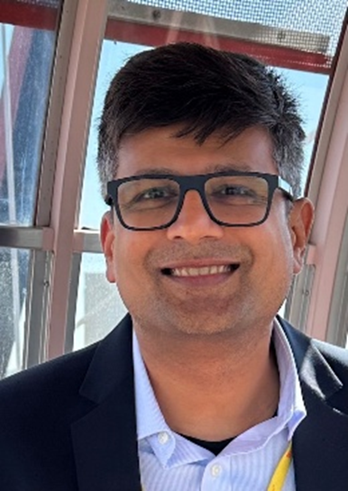
Speaker
IEEE CAS SASD
Biography
Shafi Syed is a seasoned Technical Leader with a strong background in Automotive, IoT and Smart Phone Integrated Circuit designs. With experience working at GLOBALFOUNDRIES, Motorola, and Qualcomm, he has successfully contributed to the launch of more than 3.5 billion ICs in various products over the last 25 years. Shafi holds an MBA in Management & Finance from the University of Florida, as well as an MS in Electrical Engineering from the same University. He holds over 15 design and technology patents and has published 20+ peer-reviewed Tier 1 conference papers. Shafi has also been working with eco-system partners and government research institutions on AI Driven Design Methodologies for RF ICs. Throughout his career, Shafi has demonstrated expertise in design, architecture and system analysis for applications including IoT protocols like Cat-M1, NB-IoT, BLE and WiFi, UWB, 5G mmWave and Automotive Radar applications. Currently, as a Senior Director, Design Engineering at Global Foundries, Shafi manages the global reference circuit design team working on Digital SoC, Analog and RF/mmWave applications for Automotive SoC, IoT edge AI, ADAS, SatCom and cellular subsystems.
In addition to his design accomplishments, Shafi has significant experience in engineering management, factory and manufacturing operations interface, RF test and certification processes, and risk assessment and communication. He brings an in-depth understanding of the wireless and RF semiconductor markets, blending deep technical expertise with strategic business insight.
Photo
Shafi Syed
Senior Director
Global Foundries
U.S.

