Slide 1
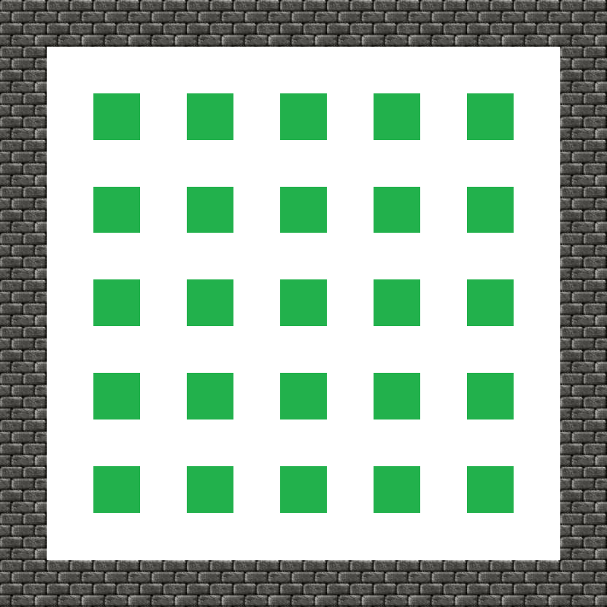
Game Board

Slide 2
Host
Game State (UDP)
Player Update (UDP)
Host Control (TCP)
Server
Game Logic
Get player info from client
Validate, forward to other clients
Client
Client
Client:
Listen for Server Status
Draw game Visual
Hold game state
Send any player action to server
MonoGame implementations used Here
Host:
All client functionality
Additional connection open to Server
Send host commands (start/play/kick)
Client

Slide 3
0
GameState Packet:
0
ClientEvent Packet:
0
HostControl Packet:

Slide 4
Server State
Last Known location of all players
Location of all dynamic blocks
Location of all bombs (with timers)
Location of all power-ups (both visible and not)
Location of all static blocks
Game Clock

Slide 5
Client State

Slide 6
Server Side Events
Player A was killed (by player B)

Slide 7
Client Side Events (w/ validation from Server)
Player A placed a bomb at location (X,Y)
Player A picked up Power-Up from location (X,Y)

Slide 8
Client Side Events (no validation)
Player A is moving in X direction
Player A is stopped

Slide 9
Player
Attributes
Lives
Bomb Power
Bomb Count
Placed Bomb Count
Speed
Can Kick
Auto Bomb Lay

Slide 10
Collision (Object Placement)

Slide 11
Events
Client Triggered Events
Player A placed B at (X,Y)
Player A started moving in [X|Y] Direction
Player A Stopped moving
Player A Picked up PowerUp at (X,Y)
Server Triggered Events
Player A Died
B detonated

