Slide 1
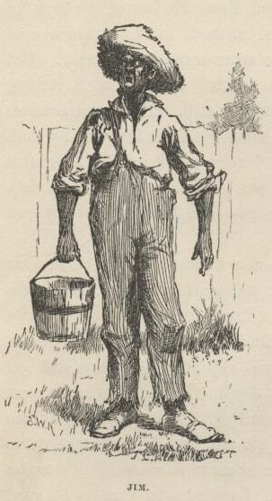
Violence And The Most Violent Word:
The Portrayal of the “Nigger” in Fiction
Isaac Scheinfeld
Adventures of Huckleberry Finn (Twain 1884)

Slide 2
“Nigger”

Slide 3
“[It] was fifteen minutes before I could work myself up to go and humble myself to a nigger; but I done it, and I warn't ever sorry for it afterwards, neither…”
2 of over 200 uses of “nigger” in Adventures of Huckleberry Finn (Twain 1884)

Slide 4
“Nigger”

Slide 5
nigger
noun
a contemptuous term for a black or dark-skinned person
origin
late 16th century: from earlier neger, after Latin niger ‘black’
usage
The word now ranks as almost certainly the most offensive and inflammatory racial slur in English, a term expressive of hatred and bigotry.
"Nigger." Merriam-Webster.com. Web. 7 Mar. 2018.

Slide 6
nigger
alternative usage
Its self-referential uses by and among black people are not always intended or taken as offensive (although many object to those uses as well)
"Nigger." Merriam-Webster.com. Web. 7 Mar. 2018.

Slide 7
“I was raised hearing black people using the N word, and I don't find it offensive at all. I do find it offensive when a nonblack person uses it.”
- Henry Louis Gates Jr.
10 Questions for Henry Louis Gates Jr.
Time, Feb. 05, 2009
“we taking it away from whoever use it to oppress us and applying it in a way that it’s almost saying brother or sister.”
- anonymized student
Hip-Hop, Language, and Difference: The N-Word as a Pedagogical Limit-Case
Bronwen E. Low

Slide 8
“I was raised hearing black people using the N word, and I don't find it offensive at all. I do find it offensive when a nonblack person uses it.”
- Henry Louis Gates Jr.
“Black leaders, including the Revs. Jesse Jackson and Al Sharpton, have challenged the entertainment industry and the American public to stop using the N-word and other racial slurs.”
- Corey Williams
10 Questions for Henry Louis Gates Jr.
Time, Feb. 05, 2009
“we taking it away from whoever use it to oppress us and applying it in a way that it’s almost saying brother or sister.”
- anonymized student
NAACP Symbolically Buries N-Word
The Associated Press, July 9, 2007
Hip-Hop, Language, and Difference: The N-Word as a Pedagogical Limit-Case
Bronwen E. Low

Slide 10
Anderson and Lepore
“Words become prohibited for all sorts of reasons, e.g., by a directive or edict of an authoritative figure.
“What’s clear is that no matter what its history, no matter what it means or communicates, no matter who introduces it, regardless of its past associations, once relevant individuals declare a word a slur, it becomes one. “
Slurring Words
Nous, March 2013

Slide 11
Butler
“If a performative provisionally succeeds [it is] only because that action echoes prior actions, and accumulates the force of authority through the repetition or citation of a prior and authoritative set of practices.
“The speaker who utters the racial slur is thus citing that slur, making linguistic community with a history of speakers.”
Burning Acts: Injurious Speech
University of Chicago Law School Roundtable, 1996

Slide 12
“Nigger”

Slide 13
Violence And The Most Violent Word:
The Portrayal of the “Nigger” in Fiction
Isaac Scheinfeld
Adventures of Huckleberry Finn (Twain 1884)

Slide 14
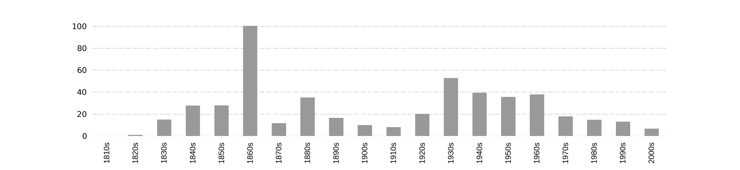
Usage of the “nigger” in COHA
The Corpus of Historical American English (COHA) is the largest structured corpus of historical English, containing more than 400 million words of text from the 1810s-2000s.
The Corpus of Historical American English (COHA): 400 million words, 1810-2009. Mark Davies
Notes:
Clarify this is from

Slide 15
Usage of the “nigger” in COHA
occurrences / million words
American Civil War
Beginning of Jim Crow
MLK Assassinated
Barack Obama elected
Huckleberry Finn
Montgomery Bus Boycott
Notes:
Clarify this is from

Slide 16
Usage by Decade
Notes:
Why books - only constant source since that time
drawbacks, miss lot of pop culture, recent young people usage

Slide 17


Usage by Decade: 1860s
“Niggers ain't worth half so much in the market with their backs newly scarred.”
Clotelle; or, the Colored Heroine, a tale of the Southern States
William Wells Brown
“I alluz thot also uv that gellorious star-spangled banner, under wich I hed whipped my niggers and sold their children.”
Swingin Round the Circle
David Ross Locke
11
1

Slide 18
Usage by Decade: 1960s
“The cop parted the melee with the use of his billy stick and finally cracked Grown Boy on the head as he struggled in terror. Few heard the blow, but Grown Boy limpened instantly and fell.”
Clock Without Hands
Carson McCullers
2
2
“Yes, burn him on the spot where he killed my little girl.”
Memphis
Marianna Leonard

Slide 19
“Nigger”

