Slide 1


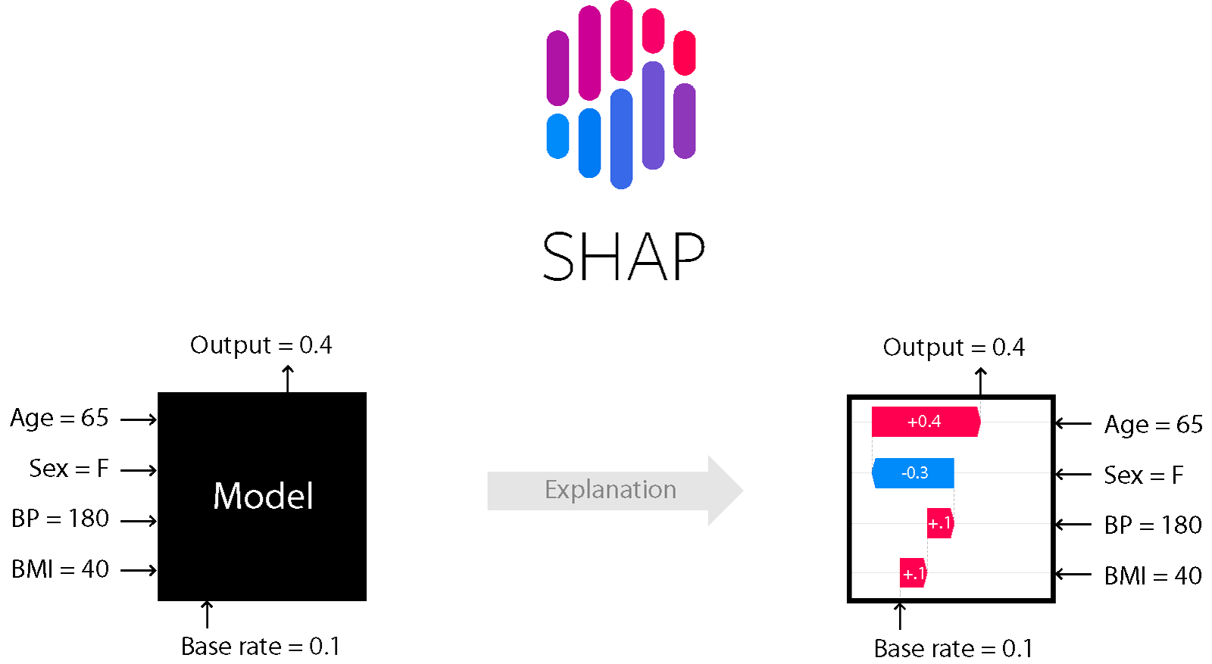


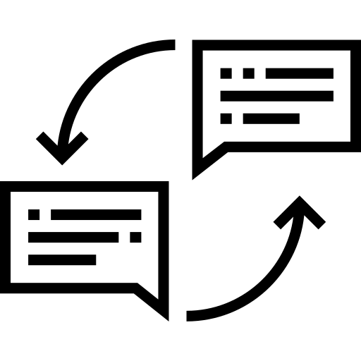
First Draft Preparation
Sentencewise Revision
Human Decision
Organization Revision
Source Text
First Draft Generation
Main Idea Revision
The First Draft for Abstract
Sentence Classification
Rephrase
ML
Huamn
Classfied Abstract

Slide 2

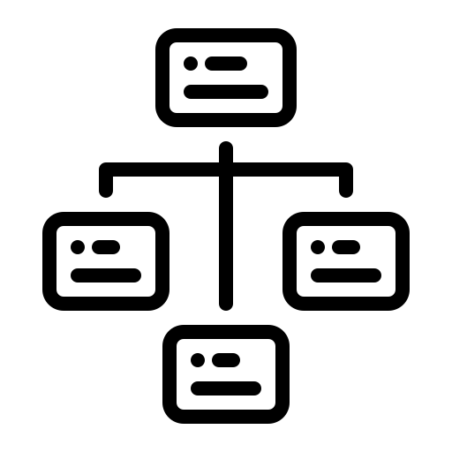
Draft Refinement
Evaluation
First Draft Preparation
Organization Revision
Semantic Analysis
Sentence Classification
Source Text
Rephrase
Classfied Abstract
ML
First Draft Generation
Main Idea Revision
Huamn
Rhetorical Structure Analysis
The First Draft for Abstract
Text Structure

