Slide 1
TOUR & TRAVEL AGENCY
Web-Application to Automate the Sytem

Slide 2



group members
Wali muhammad
Fayaz ahmed
Abdul hahi
BS(IT)-2017-E27
BS(IT)-2017-E05
BS(IT)-2017-E01
Full-Stack Developer
Database Designer
HTML Developer

Slide 3
TABLE OF CONTENTS
01
02
03
ABOUT THE PROJECT
MAJOR REQUIREMENTS
Introduction

Slide 4
TABLE OF CONTENTS
04
05
06
motivation
Problem statement
Study of system

Slide 5
TABLE OF CONTENTS
07
08
09
Proposed system
PROJECT modules
Qusetion & answer

Slide 6

ABOUT THE PROJECT
Tour and Travel System is a web-based application designed using HTML5/CSS and Python Flask Framework to automate the work of tour and travel agencies for managing their daily records.

Slide 7
MAJOR REQUIREMENTS
computer
xampp
Pycharm
ATOM
Web browser
A computer system is required to run this application
XAMPP Server is required to create database server
An IDE with extra features to run this application
Atom is a code editor for HTML Design
Web Browser is required to run the application

Slide 8
Introduction
The Tour and Travel Agency is a web-based application. The main purpose of “Tour and Travels System” is to provide a convenient way for a customer to book their tour packages of favorite places.

Slide 9
motivation
In this modern era of technologies internet and smart devices plays a very important role. Where manually work become so hard to retrieve and add data so in this era we need to work smart

Slide 10
Problem statement
In the existing system, each task is carried out manually and processing is also a tedious job. In previous system travelers were maintaining time table details manually in pen and paper, which was time taking and costly

Slide 11
Proposed system
The proposed system is a web based application and maintains a centralized repository of all related information.
The system allows one to easily access the relevant information and make necessary travel arrangements.
Users can decide about places they want to visit and make bookings online for travel and accommodation.

Slide 12
Study of the system
To provide flexibility to the users, the interfaces have been developed that are accessible through a browser. The GUI’S at the top level have been categorized as
Administrative user interface
The operational or generic user interface

Slide 13
Website modules
Admin
User (registered)
Registered user has limited sections to access.
Admin has all privilege to access and modify
user (guest)
Guest user can only view some of web pages on guest side

Slide 14
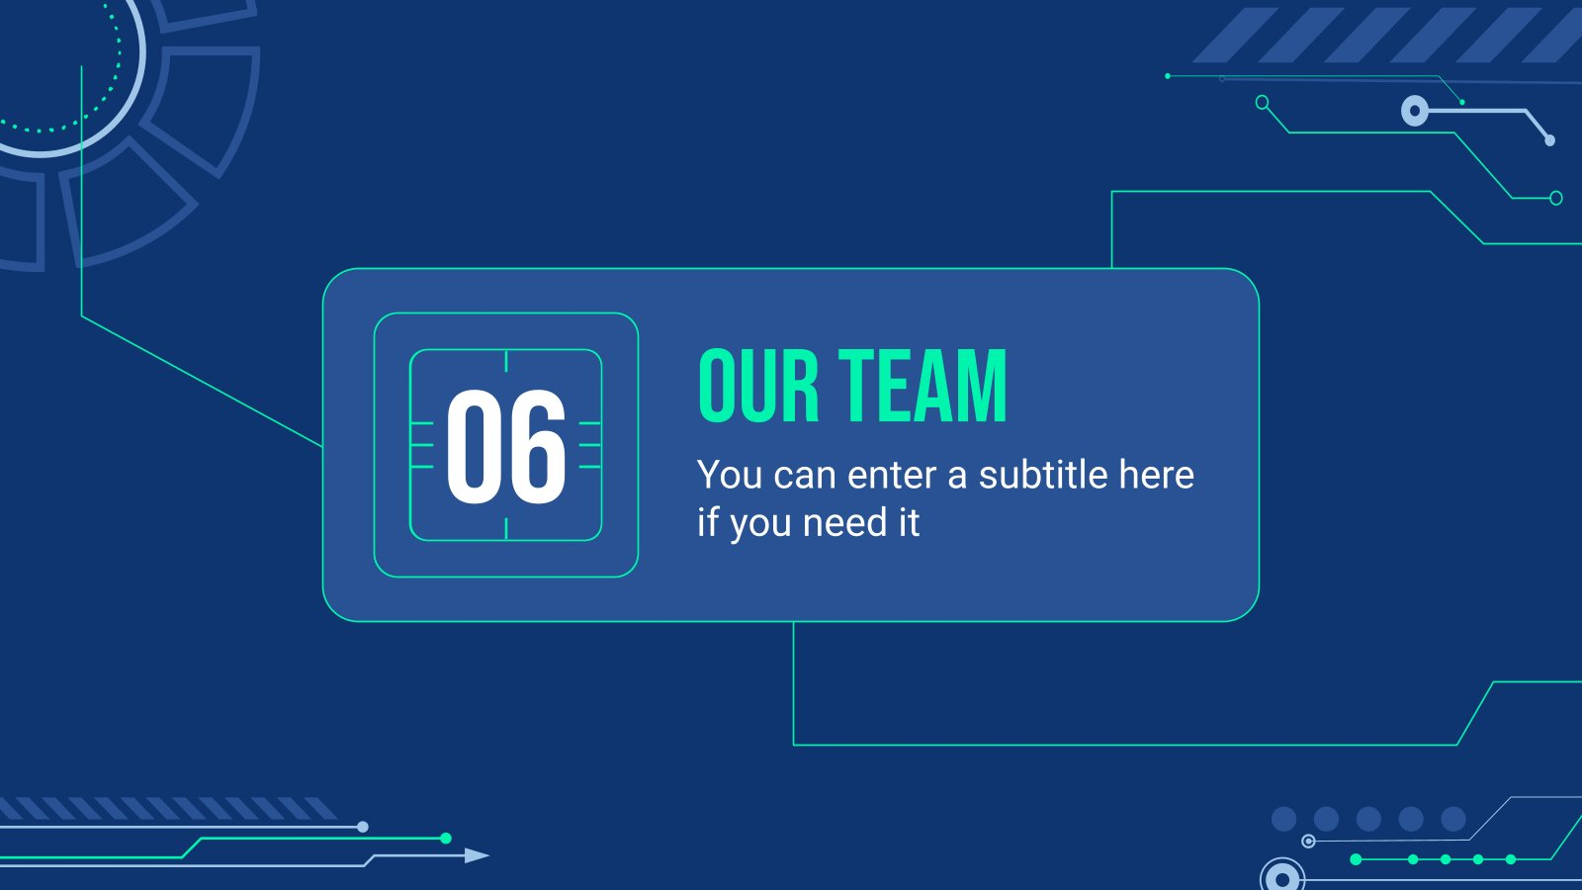
Thank you!
DO You Have Any Question?

