Slide 1


Beginner Guide to
Git and GitHub

Slide 2
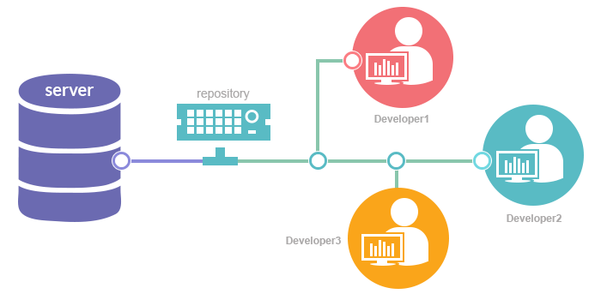
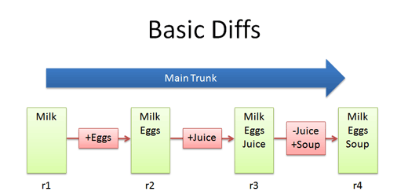
VCS
Understanding What Happened
Restoring Previous Versions
Storing Versions (Properly)
Collaboration
Backup

Slide 3

Git
Git is a version control system
Its fast, free and Open Source ☺
Learning git is easy and fun ☺

Slide 4

Importance of Git in Industries

Slide 5
Git Download
https://git-scm.com/downloads

Slide 6
Command we need to know to use Git
Commit
Push
Pull

Slide 7
Command we need to know to use Git
Init
Add
Status
Log
Show
Merge
stash

Slide 8
Git Commands
-> $ git init
Initialize git in your project
-> $ ls -la
to Show git files list

Slide 9
Three Tree Architecture
Working Directory
Staging Area
Repository

Slide 10
-> $ git add filename.extension Like : -> $ git add main.txt
-> $ git add .
add all file

Slide 11
-> $ git Status (to view current status )
-> $ git diff (to view the changes )
-> $ git commit –m “Your message here” (record a snapshot of staging area)

Slide 12
-> $ git log (to view the changes that we have made)
-> $ git Show hash_keyword (to view any particular changes )

Slide 13
Git Commit Check
-> git Log -> git show hash number
-> git checkout hash number -> cat filename.extension
-> git checkout master

Slide 14
Git Commit Individual Check
-> git log filename.extension
-> git checkout hash filename.extension
-> cat filename
-> git checkout master -f

Slide 15






Some Git Repository Hosting Service
Some Tech Giants Use Git

Slide 16
Create account
Go to: https://github.com/

Slide 17
Git Public key
ssh-keygen -t rsa -b 4096 -C "your_email@example.com"
clip < ~/.ssh/id_rsa.pub

Slide 18
Clone
Git clone /url/

Slide 19
clone
Git clone /url/

Slide 20
Push

Slide 21
Pull

Slide 22
Conflict management

Slide 23
commit

Slide 24
diff

Slide 25
reset

Slide 26
amend

Slide 27
Merge

Slide 28
Branching

Slide 29
Diff head

Slide 30
Origin Master Remote
-am
-u
.

