Slide 1
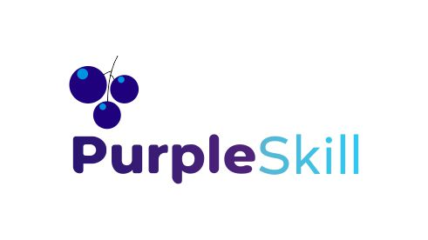
Streamlit and Chromadb
Build Smarter Autonomous AI Systems
Starting Date : December 4,2025
Time : 8:00 PM IST to 10:00 PM IST
Powered by PurpleSkill & SpanLabs

Slide 2
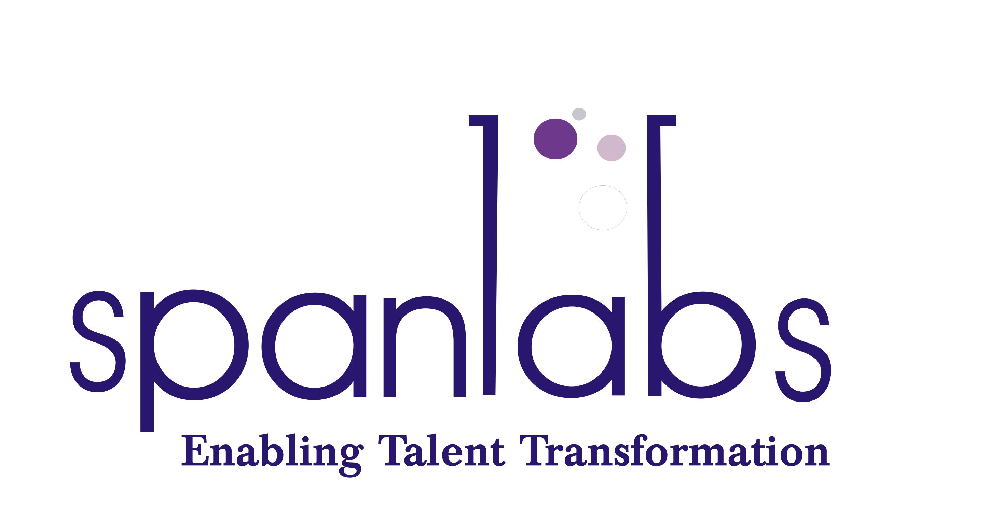
Streamlit UI and Agent integartion
Chromadb

Slide 3
ChromaDB for Agentic AI
Overview, Use Cases, and Comparison with FAISS

Slide 4
What is ChromaDB?
• Open-source embedding database.
• Designed for LLM apps, Agents, and RAG pipelines.
• Built-in support for metadata filtering and high-level operations.
• Provides local, persistent, and cloud-backed vector storage.

Slide 5
Why ChromaDB for Agentic AI?
• Agents require fast retrieval of relevant knowledge.
• Chroma enables semantic search with embeddings.
• Supports multi-agent memory structures.
• Easy integration with Python + Ollama.
• Real-time updates for dynamic agent memory.

Slide 6
ChromaDB Architecture
• Collections → Store embeddings, documents, metadata.
• Embedding Functions → OpenAI, Ollama, custom.
• Persistent storage (SQLite+Parquet).
• Query engine for similarity search.

Slide 7
What is FAISS?
• Facebook AI Similarity Search.
• High-performance vector search library.
• Optimized for large datasets.
• Supports GPU acceleration.
• Library only — No built-in metadata or DB layer.

Slide 8
ChromaDB vs FAISS
ChromaDB:
• Full vector database
• Metadata filtering
• Persistence out of the box
• Easy for agents and RAG
FAISS:
• Fast, low-level vector index
• No metadata or persistence
• Best for huge vector sets
• Requires custom wrapper for DB functionality

Slide 9
When to Use What?
Use ChromaDB When:
• You need metadata search
• You want persistent agent memory
• You are building Agentic/RAG apps quickly
Use FAISS When:
• You need speed at massive scale
• You can manage metadata + storage externally

Slide 10
Agentic AI with ChromaDB - Flow
1. Agent generates message
2. Message converted to embeddings (Ollama)
3. Stored in Chroma collection
4. Similar past contexts retrieved
5. Agent decides next action

