Slide 2
Dataset/Model | nlbse’22 nlbse’22 prepr. | MSc 3 labels bug – enhc – question nlbse’22 prepr. | MSc 3 labels bug – enhc – oos nlbse’22 prepr. | nlbse’22 MSc prepr. | MSc 3 labels bug – enhc – question MSc prepr. | MSc 3 labels bug – enhc – oos MSc prepr. | Llama3 8b instruct model bug – enhc – others
nlbse’22 nlbse’22 prepr. |  |  |  | - | - | - | -
MSc 3 labels bug – enhc – question nlbse’22 prepr. |  |  |  | - | - | - | -
MSc 3 labels bug – enhc – oos nlbse’22 prepr. |  |  |  | - | - | - | -
nlbse’22 MSc prepr. | - | - | - |  |  |  | -
MSc 3 labels bug – enhc – question MSc prepr. | - | - | - |  |  |  | -
MSc 3 labels bug – enhc – oos MSc prepr. | - | - | - |  |  |  | -
nlbse’22 test dataset without preprocessing | - | - | - | - | - | -
MSc 3 labels bug – enhc – question test dataset without preprocessing | - | - | - | - | - | -
MSc 3 labels bug – enhc – oos test dataset without preprocessing | - | - | - | - | - | -
1 - T | P | R | F1
bug | .89 | .90 | .90
enhc | .88 | .88 | .88
quest | .71 | .68 | .70
micro avg = .87
5 - E | P | R | F1
bug | .86 | .84 | .85
enhc | .82 | .87 | .84
quest | .54 | .44 | .48
micro avg = .82
8 - E | P | R | F1
bug | .89 | .70 | .78
enhc | .83 | .70 | .76
quest | .21 | .64 | .32
micro avg = .69
2 - E | P | R | F1
bug | .83 | .93 | .88
enhc | .85 | .78 | .81
quest | .70 | .49 | .58
micro avg = .83
4 - T | P | R | F1
bug | .90 | .92 | .91
enhc | .88 | .87 | .87
quest | .79 | .70 | .74
micro avg = .88
9 - E | P | R | F1
bug | .92 | .92 | .92
enhc | .94 | .86 | .90
quest | .63 | .81 | .71
micro avg = .88
3 - E | P | R | F1
bug | .53 | .93 | .68
enhc | .50 | .78 | .61
oos | .83 | .16 | .27
micro avg = .55
6 - E | P | R | F1
bug | .57 | .95 | .72
enhc | .56 | .91 | .69
oos | .92 | .21 | .34
micro avg = .60
7 - T | P | R | F1
bug | .83 | .88 | .85
enhc | .80 | .80 | .80
oos | .89 | .85 | .87
micro avg = .85
13 - T | P | R | F1
bug | .89 | .90 | .90
enhc | .88 | .88 | .88
quest | .71 | .67 | .69
micro avg = .87
17 - E | P | R | F1
bug | .85 | .86 | .85
enhc | .81 | .88 | .84
quest | .62 | .37 | .46
micro avg = .82
20 - E | P | R | F1
bug | .89 | .75 | .81
enhc | .82 | .74 | .78
quest | .24 | .59 | .35
micro avg = .73
14 - E | P | R | F1
bug | .84 | .92 | .88
enhc | .85 | .80 | .82
quest | .70 | .53 | .60
micro avg = .83
16 - T | P | R | F1
bug | .90 | .92 | .91
enhc | .88 | .87 | .88
quest | .78 | .71 | .74
micro avg = .88
21 - E | P | R | F1
bug | .93 | .91 | .92
enhc | .94 | .87 | .90
quest | .61 | .82 | .70
micro avg = .88
15 - E | P | R | F1
bug | .54 | .92 | .68
enhc | .50 | .80 | .62
oos | .83 | .18 | .29
micro avg = .55
18 - E | P | R | F1
bug | .57 | .96 | .72
enhc | .56 | .91 | .70
oos | .92 | .21 | .34
micro avg = .61
19 - T | P | R | F1
bug | .84 | .86 | .85
enhc | .80 | .80 | .80
oos | .88 | .86 | .87
micro avg = .85
10 - E | P | R | F1
bug | .84 | .88 | .86
enhc | .80 | .86 | .83
quest | .26 | .10 | .14
micro avg = .80
11 - E | P | R | F1
bug | .79 | .95 | .86
enhc | .80 | .79 | .79
quest | .53 | .08 | .14
micro avg = .79
12 - E | P | R | F1
bug | .50 | .95 | .66
enhc | .51 | .78 | .62
oos | .89 | .10 | .17
micro avg = .53

Slide 3
Dataset/Model | nlbse’22 nlbse’22 prepr. bug classifier | MSc 3 labels bug – enhc – question nlbse’22 prepr. | MSc 3 labels bug – enhc – oos nlbse’22 prepr. | nlbse’22 MSc prepr. bug classifier | MSc 3 labels bug – enhc – question MSc prepr. | MSc 3 labels bug – enhc – oos MSc prepr. | Llama3 8b instruct model bug classifier
nlbse’22 nlbse’22 prepr. |  |  |  | - | - | - | -
MSc 3 labels bug – enhc – question nlbse’22 prepr. |  |  |  | - | - | - | -
MSc 3 labels bug – enhc – oos nlbse’22 prepr. |  |  |  | - | - | - | -
nlbse’22 MSc prepr. | - | - | - |  |  |  | -
MSc 3 labels bug – enhc – question MSc prepr. | - | - | - |  |  |  | -
MSc 3 labels bug – enhc – oos MSc prepr. | - | - | - |  |  |  | -
nlbse’22 test dataset without preprocessing | - | - | - | - | - | -
MSc 3 labels bug – enhc – question test dataset without preprocessing | - | - | - | - | - | -
MSc 3 labels bug – enhc – oos test dataset without preprocessing | - | - | - | - | - | -
22 - T | P | R | F1
bug | . | . | .
enhc | . | . | .
quest | . | . | .
micro avg = .
26 - E | P | R | F1
bug | . | . | .
enhc | . | . | .
quest | . | . | .
micro avg = .
29 - E | P | R | F1
bug | . | . | .
enhc | . | . | .
quest | . | . | .
micro avg = .
23 - E | P | R | F1
bug | . | . | .
enhc | . | . | .
quest | . | . | .
micro avg = .
25 - T | P | R | F1
bug | . | . | .
enhc | . | . | .
quest | . | . | .
micro avg = .
30 - E | P | R | F1
bug | . | . | .
enhc | . | . | .
quest | . | . | .
micro avg = .
24 - E | P | R | F1
bug | . | . | .
enhc | . | . | .
quest | . | . | .
micro avg = .
27 - E | P | R | F1
bug | . | . | .
enhc | . | . | .
quest | . | . | .
micro avg = .
28 - T | P | R | F1
bug | . | . | .
enhc | . | . | .
quest | . | . | .
micro avg = .
31 - T | P | R | F1
bug | . | . | .
enhc | . | . | .
quest | . | . | .
micro avg = .
35 - E | P | R | F1
bug | . | . | .
enhc | . | . | .
quest | . | . | .
micro avg = .
38 - E | P | R | F1
bug | .88 | .74 | .81
not-bug | .78 | .90 | .84
micro avg = .82
32 - E | P | R | F1
bug | . | . | .
enhc | . | . | .
quest | . | . | .
micro avg = .
34 - T | P | R | F1
bug | . | . | .
enhc | . | . | .
quest | . | . | .
micro avg = .
39 - E | P | R | F1
bug | .94 | .91 | .92
not-bug | .90 | .93 | .91
micro avg = .92
33 - E | P | R | F1
bug | . | . | .
enhc | . | . | .
quest | . | . | .
micro avg = .
36 - E | P | R | F1
bug | . | . | .
enhc | . | . | .
quest | . | . | .
micro avg = .
37 - T | P | R | F1
bug | .85 | .85 | .85
not-bug | .93 | .93 | .93
micro avg = .90
40 - E | P | R | F1
bug | . | . | .
enhc | . | . | .
quest | . | . | .
micro avg = .
41 - E | P | R | F1
bug | . | . | .
enhc | . | . | .
quest | . | . | .
micro avg = .
42 - E | P | R | F1
bug | . | . | .
enhc | . | . | .
quest | . | . | .
micro avg = .
Notes:
NEXT: github roberta-0906/bug_clf_to_be_checked_issues_predicted_and_nlbse

Slide 4
Dataset/Model | nlbse’22 nlbse’22 prepr. enhc classifier | MSc 3 labels bug – enhc – question nlbse’22 prepr. | MSc 3 labels bug – enhc – oos nlbse’22 prepr. | nlbse’22 MSc prepr. enhc classifier | MSc 3 labels bug – enhc – question MSc prepr. | MSc 3 labels bug – enhc – oos MSc prepr. | Llama3 8b instruct model enhc classifier
nlbse’22 nlbse’22 prepr. |  |  |  | - | - | - | -
MSc 3 labels bug – enhc – question nlbse’22 prepr. |  |  |  | - | - | - | -
MSc 3 labels bug – enhc – oos nlbse’22 prepr. |  |  |  | - | - | - | -
nlbse’22 MSc prepr. | - | - | - |  |  |  | -
MSc 3 labels bug – enhc – question MSc prepr. | - | - | - |  |  |  | -
MSc 3 labels bug – enhc – oos MSc prepr. | - | - | - |  |  |  | -
nlbse’22 test dataset without preprocessing | - | - | - | - | - | -
MSc 3 labels bug – enhc – question test dataset without preprocessing | - | - | - | - | - | -
MSc 3 labels bug – enhc – oos test dataset without preprocessing | - | - | - | - | - | -
X - T | P | R | F1
bug | . | . | .
enhc | . | . | .
quest | . | . | .
micro avg = .
X - E | P | R | F1
bug | . | . | .
enhc | . | . | .
quest | . | . | .
micro avg = .
X - E | P | R | F1
bug | . | . | .
enhc | . | . | .
quest | . | . | .
micro avg = .
X - E | P | R | F1
bug | . | . | .
enhc | . | . | .
quest | . | . | .
micro avg = .
X - T | P | R | F1
bug | . | . | .
enhc | . | . | .
quest | . | . | .
micro avg = .
X - E | P | R | F1
bug | . | . | .
enhc | . | . | .
quest | . | . | .
micro avg = .
X - E | P | R | F1
bug | . | . | .
enhc | . | . | .
quest | . | . | .
micro avg = .
X - E | P | R | F1
bug | . | . | .
enhc | . | . | .
quest | . | . | .
micro avg = .
X - T | P | R | F1
bug | . | . | .
enhc | . | . | .
quest | . | . | .
micro avg = .
X - T | P | R | F1
bug | . | . | .
enhc | . | . | .
quest | . | . | .
micro avg = .
X - E | P | R | F1
bug | . | . | .
enhc | . | . | .
quest | . | . | .
micro avg = .
X - E | P | R | F1
bug | . | . | .
enhc | . | . | .
quest | . | . | .
micro avg = .
X - E | P | R | F1
bug | . | . | .
enhc | . | . | .
quest | . | . | .
micro avg = .
X - T | P | R | F1
bug | . | . | .
enhc | . | . | .
quest | . | . | .
micro avg = .
X - E | P | R | F1
bug | . | . | .
enhc | . | . | .
quest | . | . | .
micro avg = .
X - E | P | R | F1
bug | . | . | .
enhc | . | . | .
quest | . | . | .
micro avg = .
X - E | P | R | F1
bug | . | . | .
enhc | . | . | .
quest | . | . | .
micro avg = .
X - T | P | R | F1
bug | . | . | .
enhc | . | . | .
quest | . | . | .
micro avg = .
X - E | P | R | F1
bug | . | . | .
enhc | . | . | .
quest | . | . | .
micro avg = .
X - E | P | R | F1
bug | . | . | .
enhc | . | . | .
quest | . | . | .
micro avg = .
X - E | P | R | F1
bug | . | . | .
enhc | . | . | .
quest | . | . | .
micro avg = .

Slide 5
Datasets

Slide 6
OK
Dataset: nlbse’22
Train: https://tickettagger.blob.core.windows.net/datasets/github-labels-top3-803k-train.tar.gz
Test: https://tickettagger.blob.core.windows.net/datasets/github-labels-top3-803k-test.tar.gz
Initially: Train: 90% 722899 | Test: 10% 80518 | Total: 803417
Duplicate issues are removed only in the Train dataset, number of dropped issues: 26220
Final distribution is below:
Label/Dataset | Train | Train % | Test | Test % | Total
bug | 347678 | 50% | 40288 | 50% | 387966
enhancement | 290006 | 42% | 33203 | 41% | 323209
question | 58995 | 8% | 7027 | 9% | 66022
total | 696679 |  | 80518 |  | 777197

Slide 7
OK
Dataset: nlbse’22
Pre-processing steps:
Step | Train | Test | Train Issue Body | Train Issue Title | Test Issue Body | Test Issue Title
Removing duplicates based on issue URLs | +
Replacing functions |  |  | + |  | +
Replacing issue numbers |  |  | + | + | + | +
Converting to lower case |  |  | + | + | + | +
Removing punctuations |  |  | + | + | + | +
Removing non-ascii characters |  |  | + | + | + | +
Replacing fixed part of repo URL column | + | +
Replacing white spaces |  |  | + | + | + | +
Truncating columns |  |  | + | + | + | +
Concatenating issue columns into one | + | +

Slide 8
OK
Dataset: MSc bug – enhancement – question
The pre-processing steps of nlbse’22 study are applied to our dataset.
Test size is 10%.
Sampling is stratified based on labels.
Label/Dataset | Train | Train % | Test | Test % | Total
bug | 50995 | 54% | 5666 | 54% | 56661
enhancement | 32732 | 35% | 3637 | 35% | 36369
question | 11103 | 12% | 1234 | 12% | 12337
total | 94830 |  | 10537 |  | 105367

Slide 9
OK
Dataset: MSc bug – enhancement – out-of-scope (to-be-checked)
The pre-processing steps of nlbse’22 study are applied to our dataset.
Test size is 10%.
Sampling is stratified based on labels.
Label/Dataset | Train | Train % | Test | Test % | Total
out-of-scope | 70632 | 41% | 7848 | 41% | 78480
bug | 50995 | 30% | 5666 | 30% | 56661
enhancement | 32732 | 19% | 3637 | 19% | 36369
to-be-checked | 17033 | 10% | 1893 | 10% | 18926
total | 171392 |  | 19044 |  | 190436

Slide 10
OK
Dataset: MSc bug – enhancement – out-of-scope (to-be-checked)
The pre-processing steps of nlbse’22 study are applied to our dataset.
Test size is 10%.
Sampling is stratified based on labels.
Distribution without to-be-checked issues.
Label/Dataset | Train | Train % | Test | Test % | Total
out-of-scope | 70632 | 46% | 7848 | 46% | 78480
bug | 50995 | 23% | 5666 | 23% | 56661
enhancement | 32732 | 21% | 3637 | 21% | 36369
total | 154359 |  | 17151 |  | 171510

Slide 11
OK
Dataset: MSc
Pre-processing steps:
Step | Train | Test | Train Issue Body | Train Issue Title | Test Issue Body | Test Issue Title
Removing duplicates based on issue URLs | +
Replacing functions |  |  | + | + | + | +
Replacing issue numbers |  |  | + | + | + | +
Converting to lower case |  |  | + | + | + | +
Removing punctuations |  |  | + | + | + | +
Removing underscores |  |  | + | + | + | +
Removing new line character |  |  | + | + | + | +
Removing carriage return character |  |  | + | + | + | +
Removing non-ascii characters |  |  | + | + | + | +
Replacing fixed part of repo URL column | + | +
Replacing white spaces |  |  | + | + | + | +
Truncating columns |  |  | + | + | + | +
Concatenating issue columns into one | + | +

Slide 12
Model Results

Slide 13
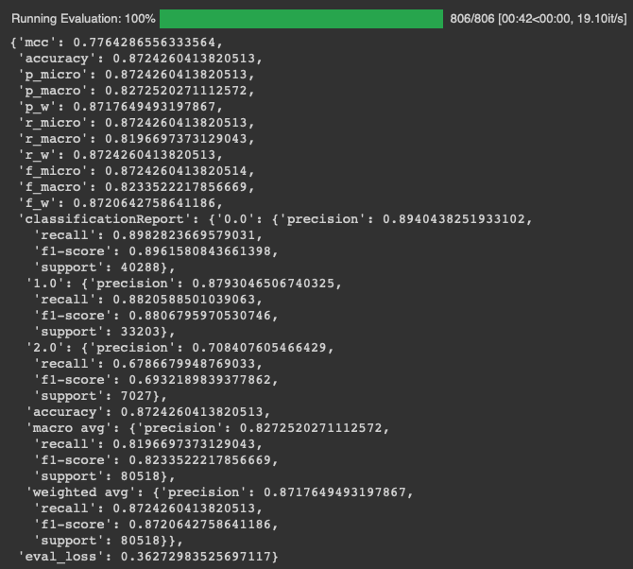
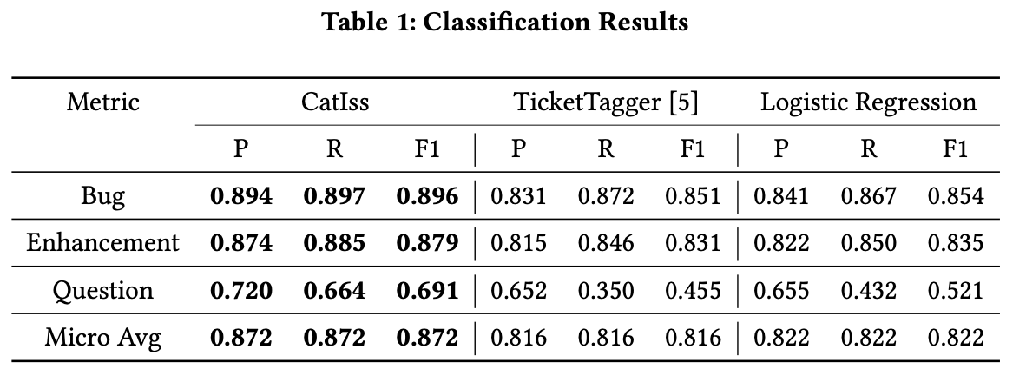
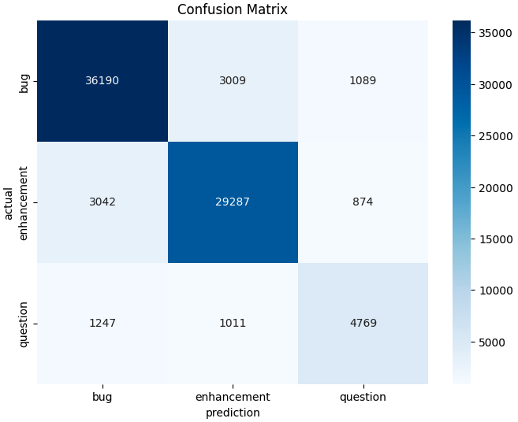
1 OK
Model: nlbse’22 & Dataset: nlbse’22

Slide 14
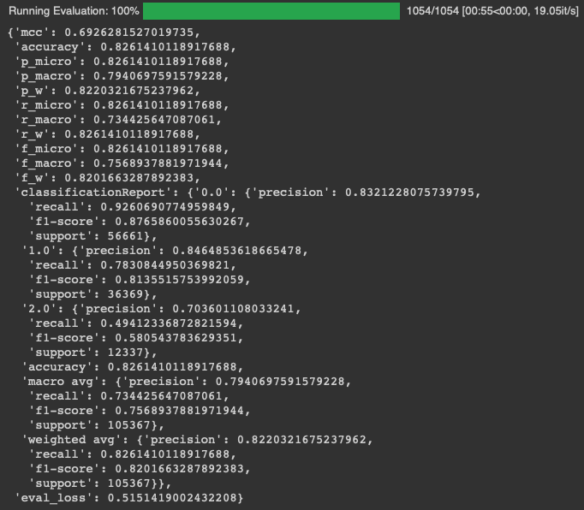
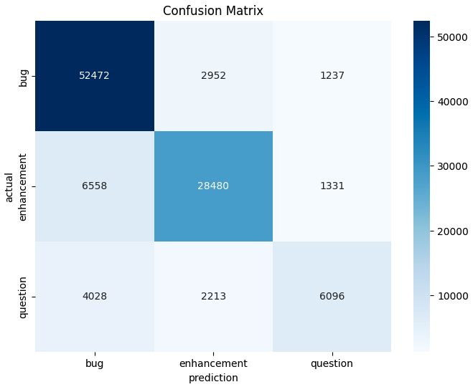
2 OK
Model: nlbse’22 & Dataset: MSc bug – enhancement – question

Slide 15
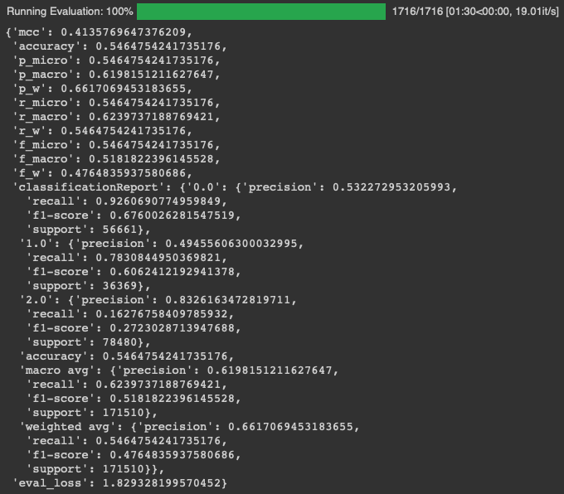
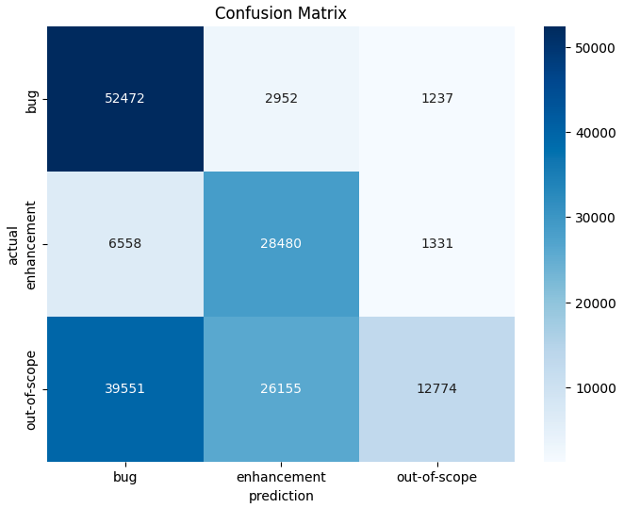
3 OK
Model: nlbse’22 & Dataset: MSc bug – enhancement – out-of-scope

Slide 16
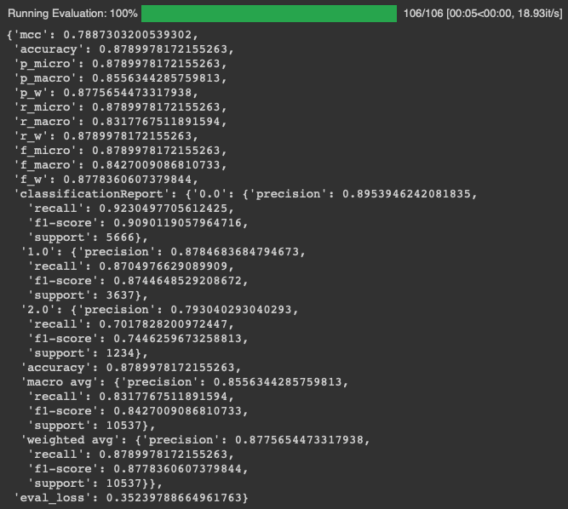
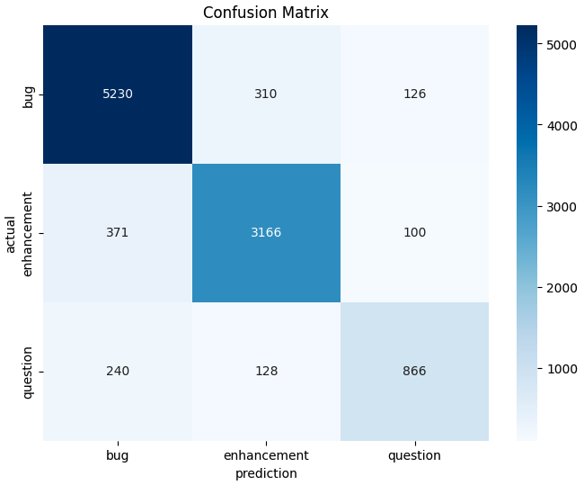
4 OK
Model: MSc bug – enhancement – question & Dataset: MSc bug – enhancement – question

Slide 17

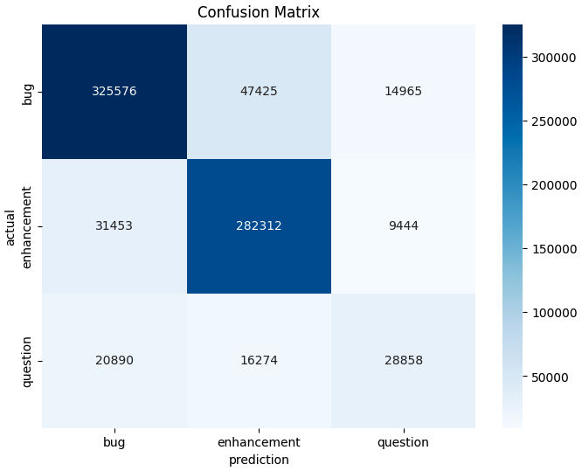
5 OK
Model: MSc bug – enhancement – question & Dataset: nlbse’22

Slide 18

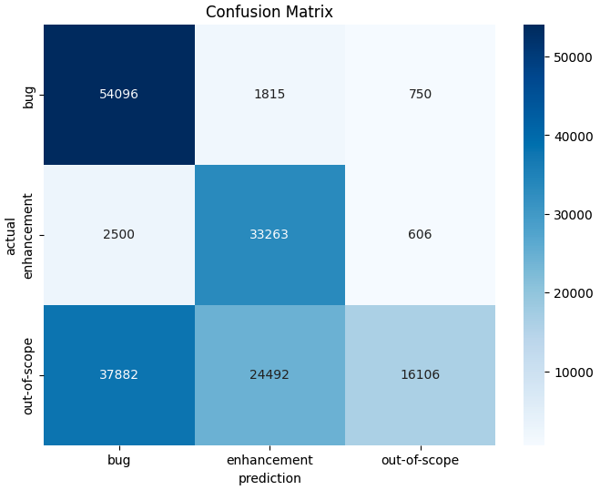
6 OK
Model: MSc bug – enhancement – question & Dataset: MSc bug – enhancement – out-of-scope

Slide 19

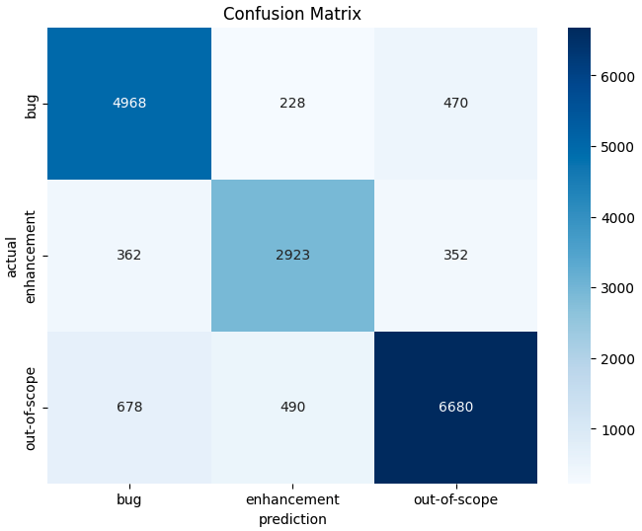
7 OK
Model: MSc bug – enhancement – out-of-scope & Dataset: MSc bug – enhancement – out-of-scope

Slide 20
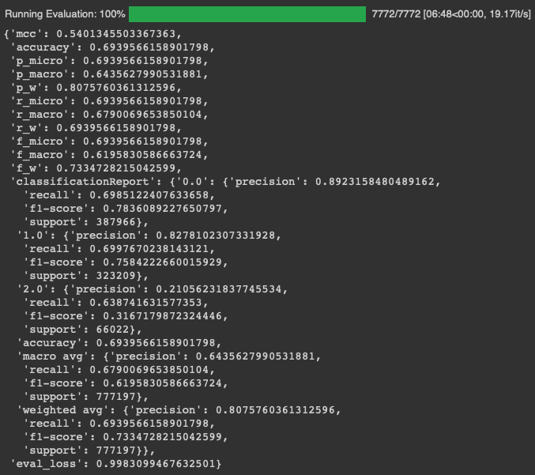
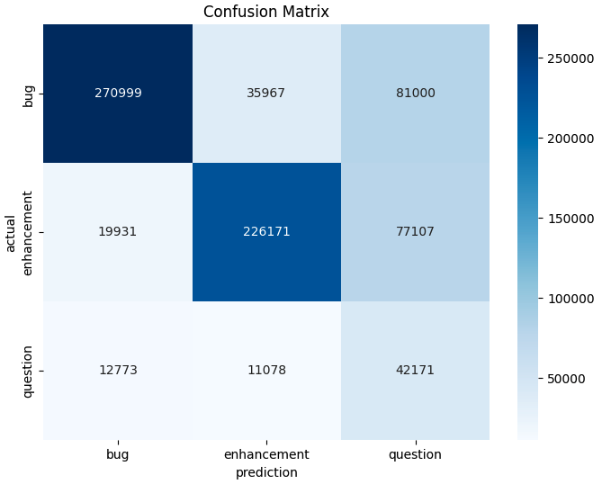
8 OK
Model: MSc bug – enhancement – out-of-scope & Dataset: nlbse’22

Slide 21
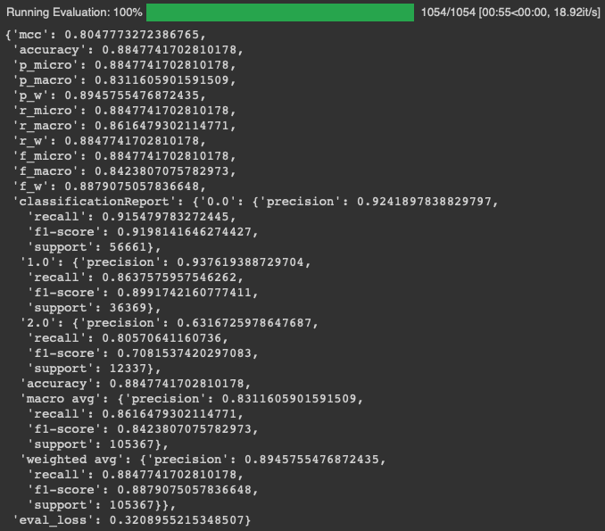
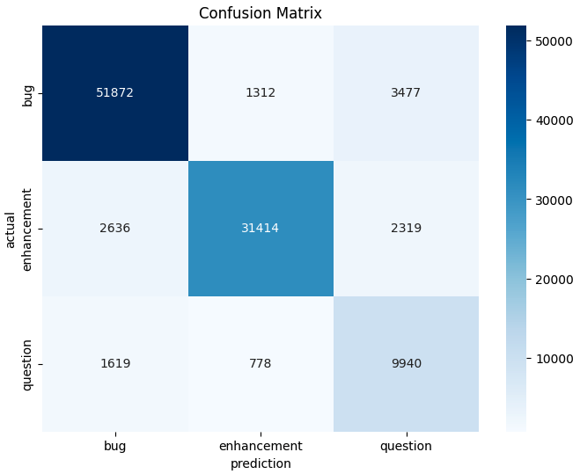
9 OK
Model: MSc bug – enhancement – out-of-scope & Dataset: MSc bug – enhancement – question

Slide 22
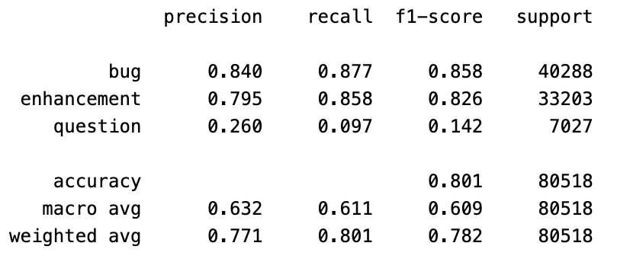
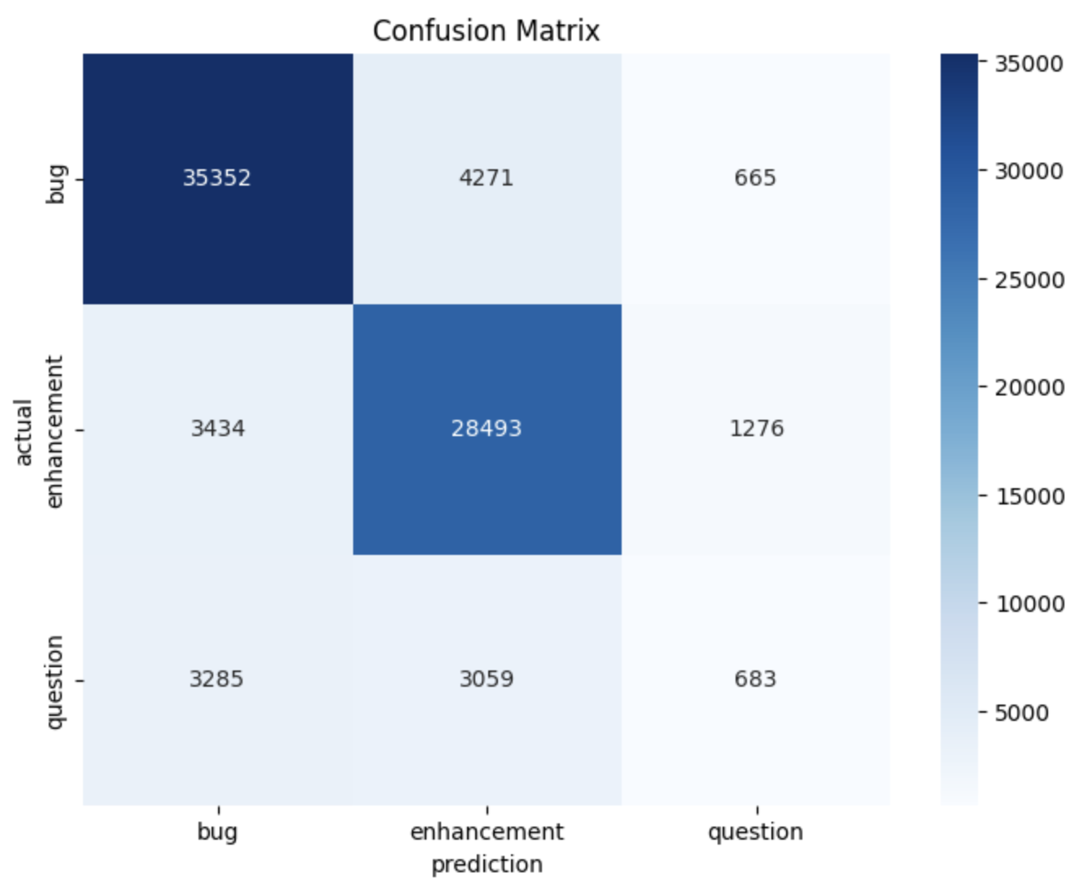
10 OK
Model: Llama3 bug – enhancement – other & Dataset: nlbse’22 test dataset without preprocessing

Slide 23
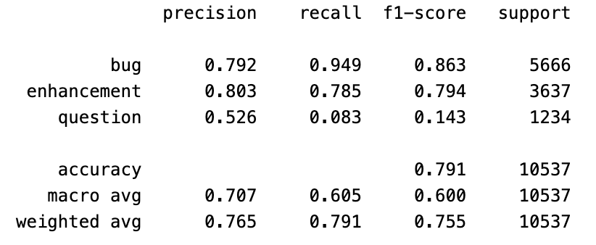
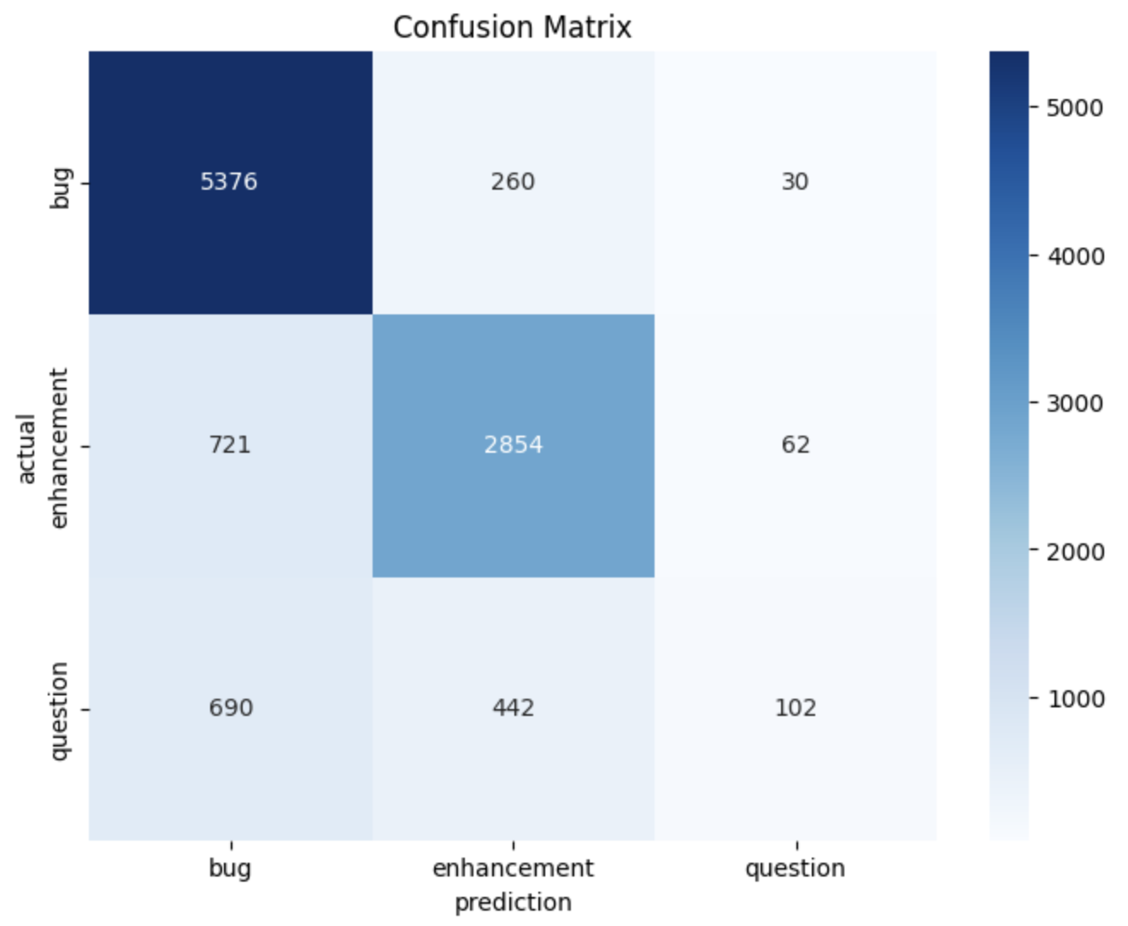
11 OK
Model: Llama3 bug – enhancement – other & Dataset: MSc bug – enhancement – question test dataset without preprocessing

Slide 24
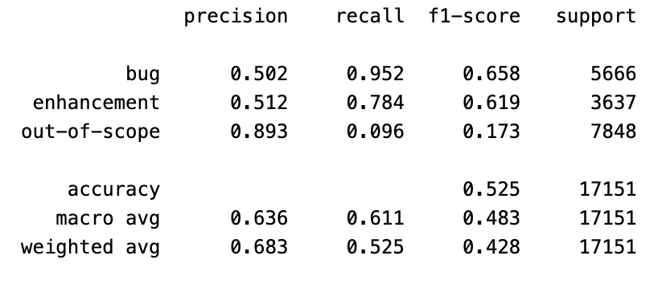
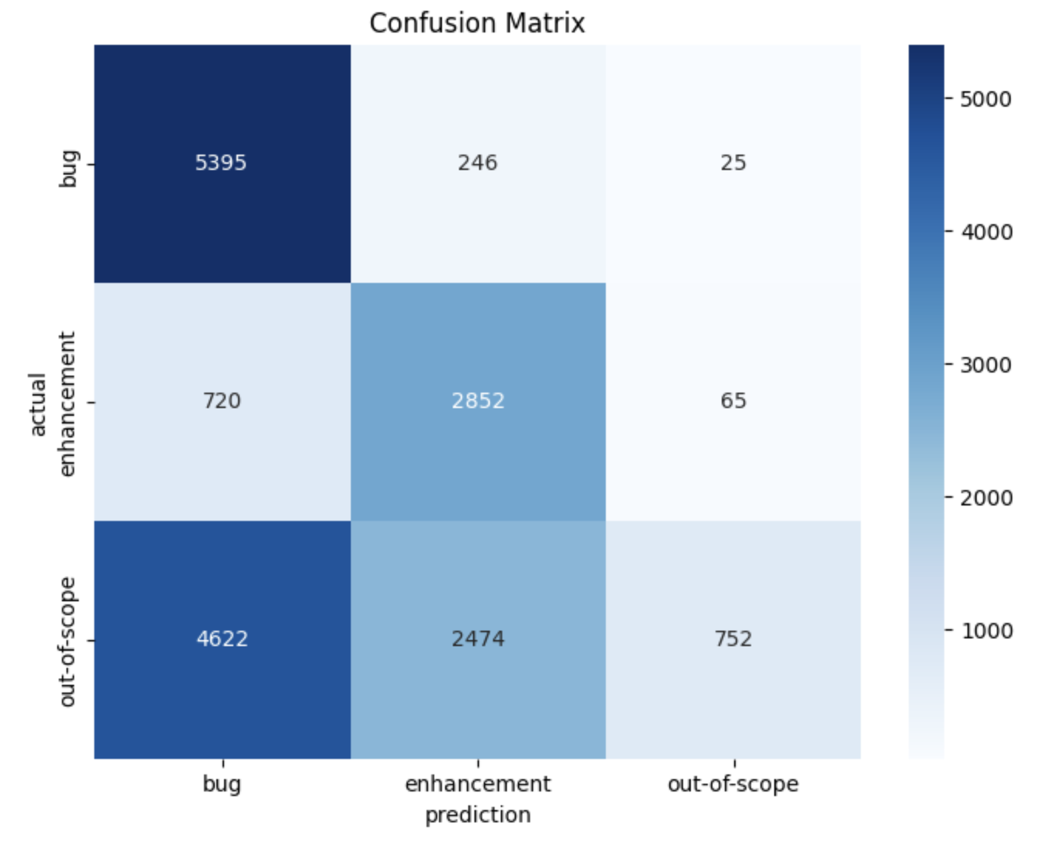
12 OK
Model: Llama3 bug – enhancement – other & Dataset: MSc bug – enhancement – out-of-scope test dataset without preprocessing

Slide 25
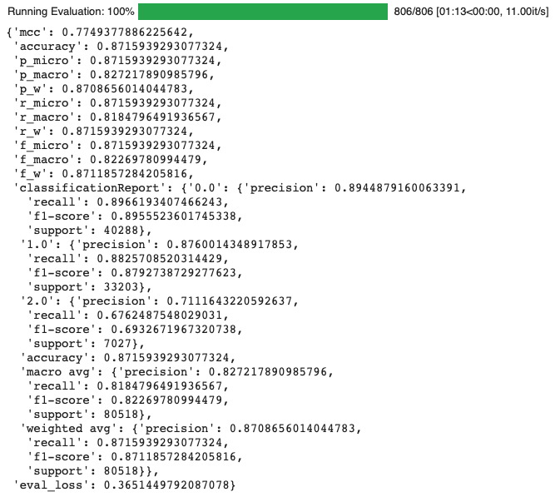

13 OK
Model: nlbse’22 & Dataset: nlbse’22 MSc Preprocessing

Slide 26
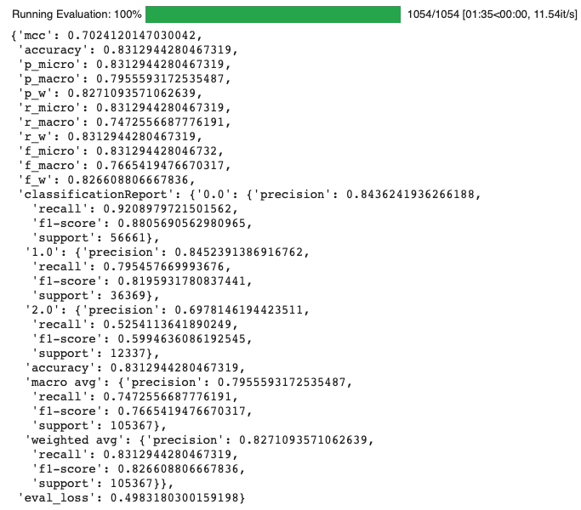
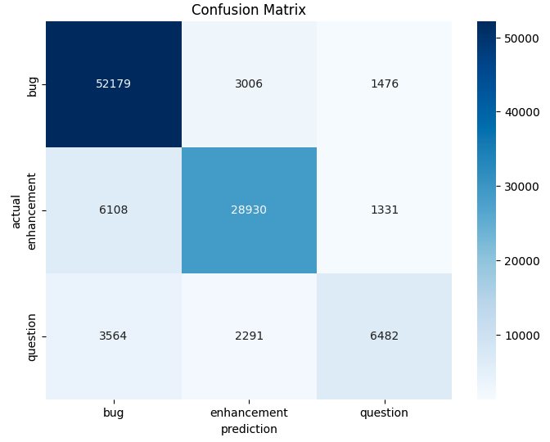
14 OK
Model: nlbse’22 & Dataset: MSc bug – enhancement – question MSc Preprocessing

Slide 27


15 OK
Model: nlbse’22 & Dataset: MSc bug – enhancement – out-of-scope MSc Preprocessing

Slide 28
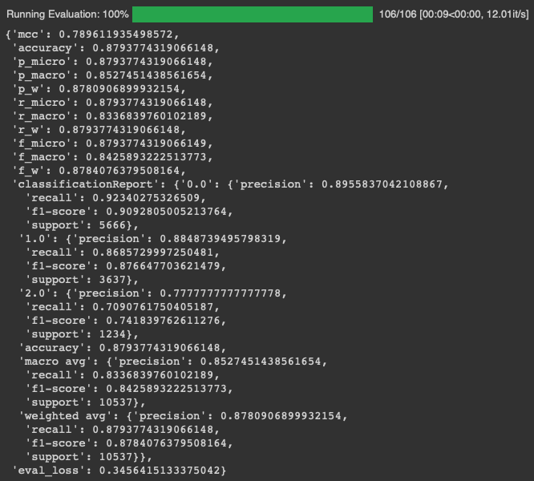
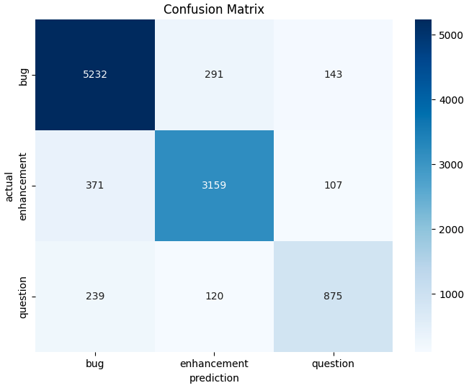
16 OK
Model: MSc bug – enhancement – question & Dataset: MSc bug – enhancement – question MSc Preprocessing

Slide 29

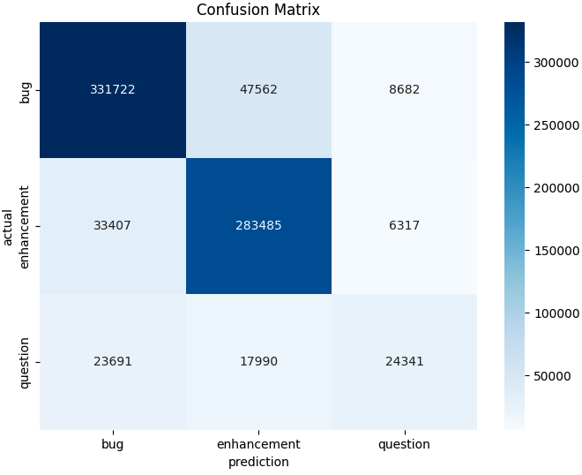
17 OK
Model: MSc bug – enhancement – question & Dataset: nlbse’22 MSc Preprocessing

Slide 30
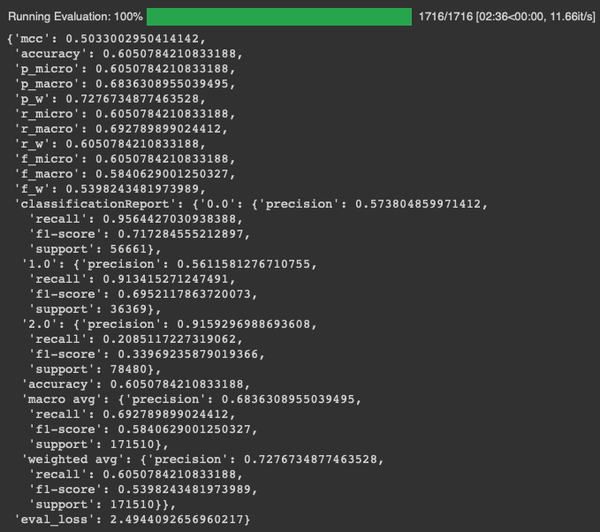
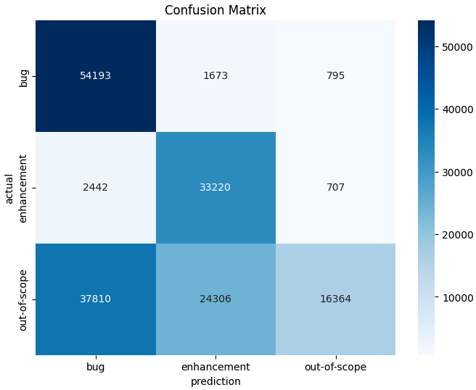
18 OK
Model: MSc bug – enhancement – question & Dataset: MSc bug – enhancement – out-of-scope MSc Preprocessing

Slide 31
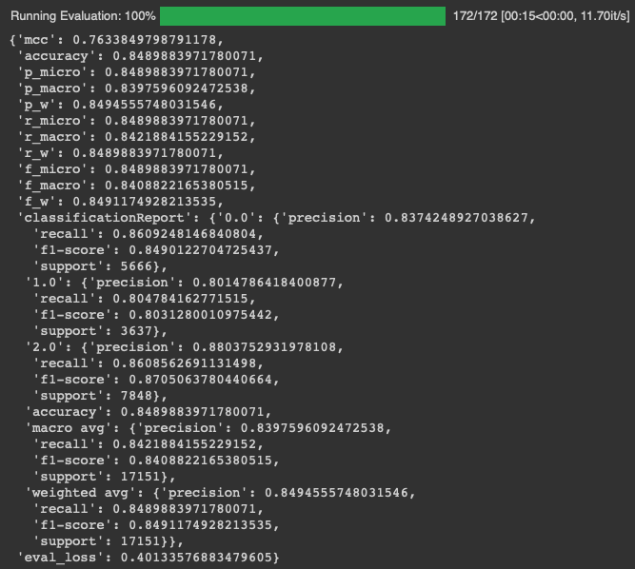

19 OK
Model: MSc bug – enhancement – out-of-scope & Dataset: MSc bug – enhancement – out-of-scope MSc Preprocessing

Slide 32
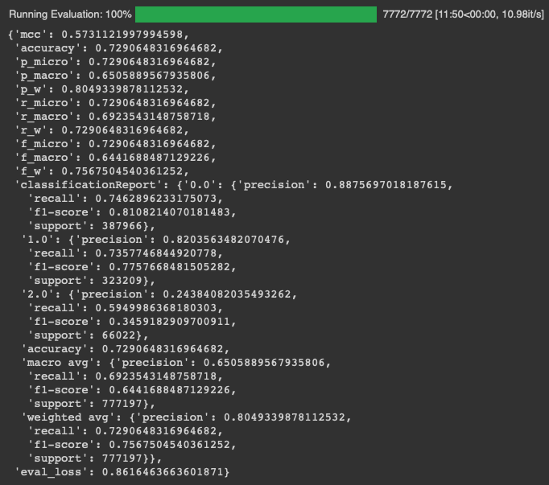
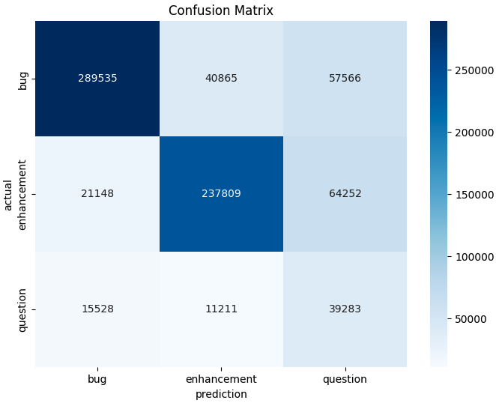
20 OK
Model: MSc bug – enhancement – out-of-scope & Dataset: nlbse’22 MSc Preprocessing

Slide 33
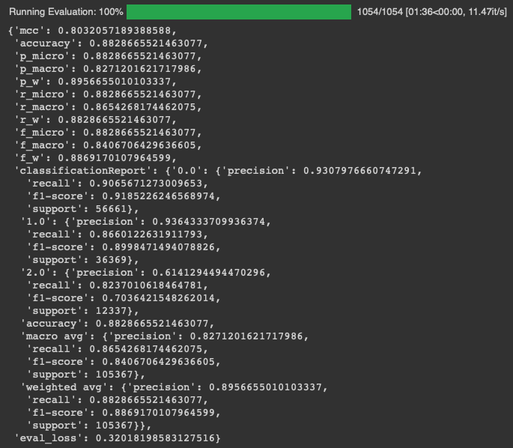
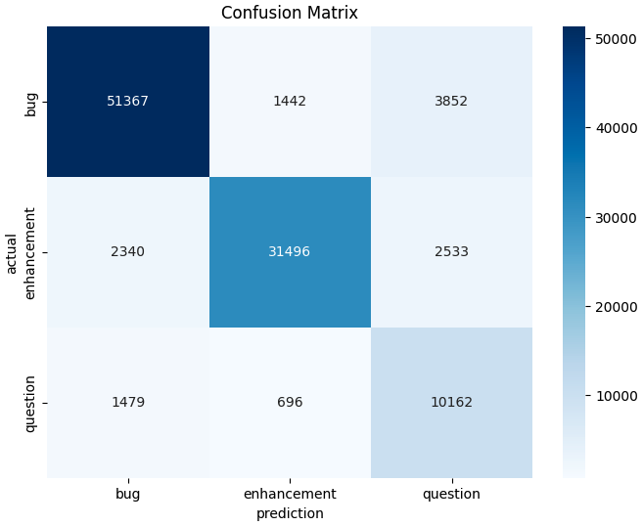
21 OK
Model: MSc bug – enhancement – out-of-scope & Dataset: MSc bug – enhancement – question MSc Preprocessing

Slide 34
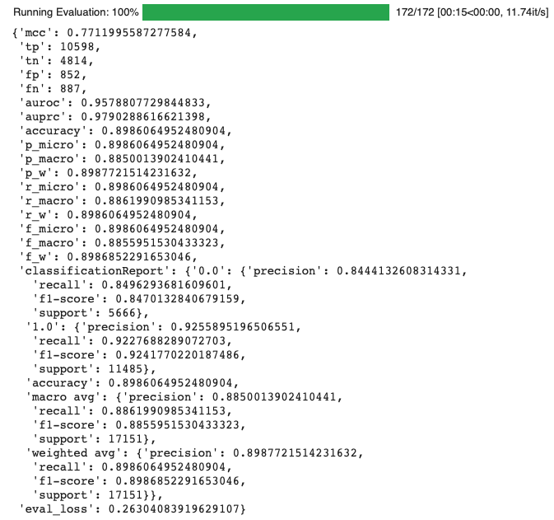
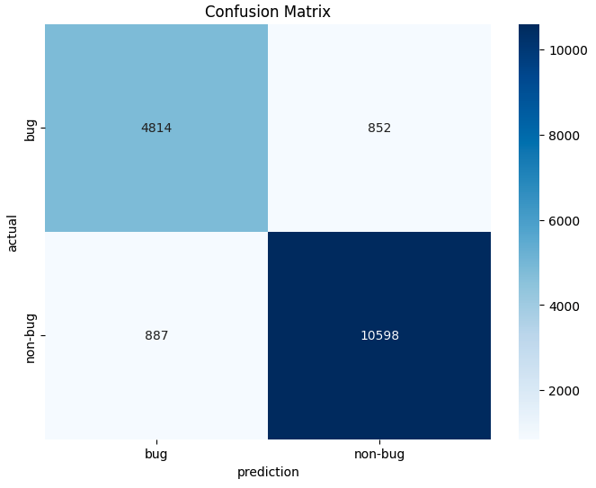
37 OK
Model: MSc bug – enhancement – out-of-scope & Dataset: MSc bug – enhancement – out-of-scope MSc Preprocessing BUG Classifier

Slide 35
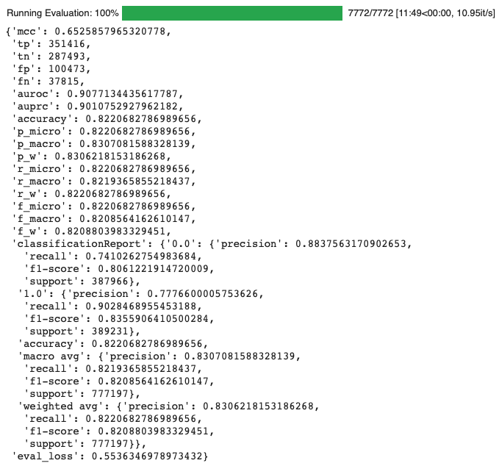
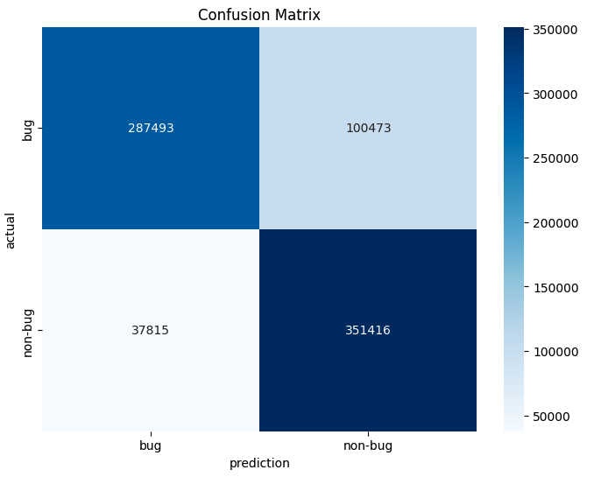
38 OK
Model: MSc bug – enhancement – out-of-scope & Dataset: nlbse’22 MSc Preprocessing BUG Classifier

Slide 36
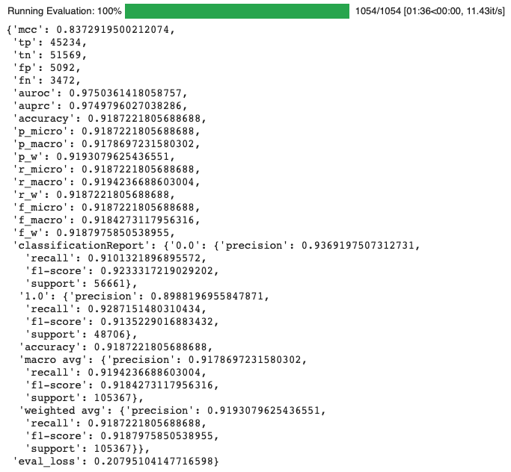
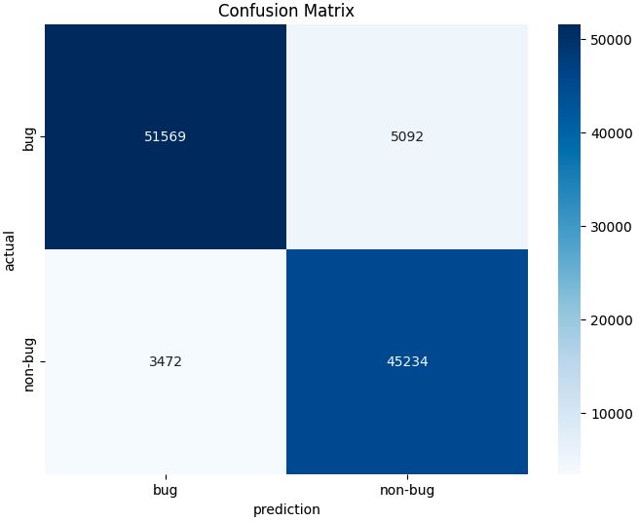
39 OK
Model: MSc bug – enhancement – out-of-scope & Dataset: MSc bug – enhancement – question MSc Preprocessing BUG Classifier

Slide 37
Dataset: MSc & Model: nlbse’22
https://medium.com/@erkajalkumari/how-to-run-llama-3-locally-0f9426708d83#:~:text=Running%20Llama%203%20Locally,-Llama%203%20with&text=If%20your%20system%20has%20enough,be%20on%20the%20slower%20side.

Slide 38
Dataset/Model | nlbse’22 nlbse’22 prepr. | MSc 3 labels bug – enhc – question nlbse’22 prepr. | nlbse’22 MSc prepr. | MSc 3 labels bug – enhc – question MSc prepr. | Llama3 8b instruct model bug – enhc – question
nlbse’22 nlbse’22 prepr. |  |  | - | - | -
MSc 3 labels bug – enhc – question nlbse’22 prepr. |  |  | - | - | -
nlbse’22 MSc prepr. | - | - |  |  | -
MSc 3 labels bug – enhc – question MSc prepr. | - | - |  |  | -
nlbse’22 test dataset without preprocessing | - | - | - | -
MSc 3 labels bug – enhc – question test dataset without preprocessing | - | - | - | -
1 - T | P | R | F1
bug | .894 | .897 | .896
enhc | .874 | .885 | .879
quest | .720 | .664 | .691
micro avg = .872
4 - E | P | R | F1
bug | .860 | .845 | .852
enhc | .801 | .889 | .842
quest | .593 | .341 | .433
micro avg = .820
2 - E | P | R | F1
bug | .845 | .921 | .881
enhc | .840 | .812 | .825
quest | .707 | .484 | .574
micro avg = .832
3 - T | P | R | F1
bug | .895 | .926 | .910
enhc | .888 | .867 | .877
quest | .792 | .724 | .756
micro avg = .882
5 - T | P | R | F1
bug | . | . | .
enhc | . | . | .
quest | . | . | .
micro avg = .
8 - T | P | R | F1
bug | . | . | .
enhc | . | . | .
quest | . | . | .
micro avg = .
6 - E | P | R | F1
bug | . | . | .
enhc | . | . | .
quest | . | . | .
micro avg = .
7 - E | P | R | F1
bug | . | . | .
enhc | . | . | .
quest | . | . | .
micro avg = .
9 - E | P | R | F1
bug | . | . | .
enhc | . | . | .
quest | . | . | .
micro avg = .
10 - E | P | R | F1
bug | . | . | .
enhc | . | . | .
quest | . | . | .
micro avg = .

Slide 39
Summary
Dataset/Model | nlbse’22 | MSc | Llama3 | bug MSc | enhc MSc

Slide 40
Datasets
nlbse’22 dataset & nlbse’22 preprocessing steps
/Users/isdeniz/Documents/github/Summary-2406/data/test_clean_concat_200.csv
/Users/isdeniz/Documents/github/Summary-2406/data/train_clean_concat_200.csv
nlbse’22 dataset & MSc preprocessing steps
MSc dataset & nlbse’22 preprocessing steps
/Users/isdeniz/Documents/github/Summary-2406/msc-dataset-bug-enhc-question-nlbse22-preprocessing/data/test_bug_enhc_ques_nlbse22_preprocessing_200.csv
/Users/isdeniz/Documents/github/Summary-2406/msc-dataset-bug-enhc-question-nlbse22-preprocessing/data/train_bug_enhc_ques_nlbse22_preprocessing_200.csv
bug-enhc-oos-tbc train
bug-enhc-oos-tbc test
MSc dataset & MSc preprocessing steps
https://ollama.com/library/llama3

