Slide 2
Dataset/Model | nlbse’22 nlbse’22 prepr. | MSc 3 labels bug – enhc – question nlbse’22 prepr. | MSc 3 labels bug – enhc – oos nlbse’22 prepr. | nlbse’22 MSc prepr. | MSc 3 labels bug – enhc – question MSc prepr. | MSc 3 labels bug – enhc – oos MSc prepr. | Llama3 8b instruct model bug – enhc – question
nlbse’22 nlbse’22 prepr. |  |  |  | - | - | - | -
MSc 3 labels bug – enhc – question nlbse’22 prepr. |  |  |  | - | - | - | -
MSc 3 labels bug – enhc – oos nlbse’22 prepr. |  |  |  | - | - | - | -
nlbse’22 MSc prepr. | - | - | - |  |  |  | -
MSc 3 labels bug – enhc – question MSc prepr. | - | - | - |  |  |  | -
MSc 3 labels bug – enhc – oos MSc prepr. | - | - | - |  |  |  | -
nlbse’22 test dataset without preprocessing | - | - | - | - | - | -
MSc 3 labels bug – enhc – question test dataset without preprocessing | - | - | - | - | - | -
MSc 3 labels bug – enhc – oos test dataset without preprocessing | - | - | - | - | - | -
1 - T | P | R | F1
bug | .894 | .897 | .896
enhc | .874 | .885 | .879
quest | .720 | .664 | .691
micro avg = .872
4 - E | P | R | F1
bug | .860 | .845 | .852
enhc | .801 | .889 | .842
quest | .593 | .341 | .433
micro avg = .820
X - E | P | R | F1
bug | . | . | .
enhc | . | . | .
quest | . | . | .
micro avg = .
2 - E | P | R | F1
bug | .845 | .921 | .881
enhc | .840 | .812 | .825
quest | .707 | .484 | .574
micro avg = .832
3 - T | P | R | F1
bug | .895 | .926 | .910
enhc | .888 | .867 | .877
quest | .792 | .724 | .756
micro avg = .882
X - E | P | R | F1
bug | . | . | .
enhc | . | . | .
quest | . | . | .
micro avg = .
X - E | P | R | F1
bug | . | . | .
enhc | . | . | .
quest | . | . | .
micro avg = .
X - E | P | R | F1
bug | . | . | .
enhc | . | . | .
quest | . | . | .
micro avg = .
X - T | P | R | F1
bug | . | . | .
enhc | . | . | .
quest | . | . | .
micro avg = .
X - T | P | R | F1
bug | . | . | .
enhc | . | . | .
quest | . | . | .
micro avg = .
X - E | P | R | F1
bug | . | . | .
enhc | . | . | .
quest | . | . | .
micro avg = .
X - E | P | R | F1
bug | . | . | .
enhc | . | . | .
quest | . | . | .
micro avg = .
X - E | P | R | F1
bug | . | . | .
enhc | . | . | .
quest | . | . | .
micro avg = .
X - T | P | R | F1
bug | . | . | .
enhc | . | . | .
quest | . | . | .
micro avg = .
X - E | P | R | F1
bug | . | . | .
enhc | . | . | .
quest | . | . | .
micro avg = .
X - E | P | R | F1
bug | . | . | .
enhc | . | . | .
quest | . | . | .
micro avg = .
X - E | P | R | F1
bug | . | . | .
enhc | . | . | .
quest | . | . | .
micro avg = .
X - T | P | R | F1
bug | . | . | .
enhc | . | . | .
quest | . | . | .
micro avg = .
5 - E | P | R | F1
bug | . | . | .
enhc | . | . | .
quest | . | . | .
micro avg = .
6 - E | P | R | F1
bug | . | . | .
enhc | . | . | .
quest | . | . | .
micro avg = .
X - E | P | R | F1
bug | . | . | .
enhc | . | . | .
quest | . | . | .
micro avg = .
Notes:
NEXT: github roberta-0906/bug_clf_to_be_checked_issues_predicted_and_nlbse

Slide 3
Dataset/Model | nlbse’22 nlbse’22 prepr. bug classifier | MSc 3 labels bug – enhc – question nlbse’22 prepr. | MSc 3 labels bug – enhc – oos nlbse’22 prepr. | nlbse’22 MSc prepr. bug classifier | MSc 3 labels bug – enhc – question MSc prepr. | MSc 3 labels bug – enhc – oos MSc prepr. | Llama3 8b instruct model bug classifier
nlbse’22 nlbse’22 prepr. |  |  |  | - | - | - | -
MSc 3 labels bug – enhc – question nlbse’22 prepr. |  |  |  | - | - | - | -
MSc 3 labels bug – enhc – oos nlbse’22 prepr. |  |  |  | - | - | - | -
nlbse’22 MSc prepr. | - | - | - |  |  |  | -
MSc 3 labels bug – enhc – question MSc prepr. | - | - | - |  |  |  | -
MSc 3 labels bug – enhc – oos MSc prepr. | - | - | - |  |  |  | -
nlbse’22 test dataset without preprocessing | - | - | - | - | - | -
MSc 3 labels bug – enhc – question test dataset without preprocessing | - | - | - | - | - | -
MSc 3 labels bug – enhc – oos test dataset without preprocessing | - | - | - | - | - | -
X - T | P | R | F1
bug | . | . | .
enhc | . | . | .
quest | . | . | .
micro avg = .
X - E | P | R | F1
bug | . | . | .
enhc | . | . | .
quest | . | . | .
micro avg = .
X - E | P | R | F1
bug | . | . | .
enhc | . | . | .
quest | . | . | .
micro avg = .
X - E | P | R | F1
bug | . | . | .
enhc | . | . | .
quest | . | . | .
micro avg = .
X - T | P | R | F1
bug | . | . | .
enhc | . | . | .
quest | . | . | .
micro avg = .
X - E | P | R | F1
bug | . | . | .
enhc | . | . | .
quest | . | . | .
micro avg = .
X - E | P | R | F1
bug | . | . | .
enhc | . | . | .
quest | . | . | .
micro avg = .
X - E | P | R | F1
bug | . | . | .
enhc | . | . | .
quest | . | . | .
micro avg = .
X - T | P | R | F1
bug | . | . | .
enhc | . | . | .
quest | . | . | .
micro avg = .
X - T | P | R | F1
bug | . | . | .
enhc | . | . | .
quest | . | . | .
micro avg = .
X - E | P | R | F1
bug | . | . | .
enhc | . | . | .
quest | . | . | .
micro avg = .
X - E | P | R | F1
bug | . | . | .
enhc | . | . | .
quest | . | . | .
micro avg = .
Next
X - E | P | R | F1
bug | . | . | .
enhc | . | . | .
quest | . | . | .
micro avg = .
X - T | P | R | F1
bug | . | . | .
enhc | . | . | .
quest | . | . | .
micro avg = .
X - E | P | R | F1
bug | . | . | .
enhc | . | . | .
quest | . | . | .
micro avg = .
X - E | P | R | F1
bug | . | . | .
enhc | . | . | .
quest | . | . | .
micro avg = .
X - E | P | R | F1
bug | . | . | .
enhc | . | . | .
quest | . | . | .
micro avg = .
X - T | P | R | F1
bug | . | . | .
enhc | . | . | .
quest | . | . | .
micro avg = .
Next
X - E | P | R | F1
bug | . | . | .
enhc | . | . | .
quest | . | . | .
micro avg = .
X - E | P | R | F1
bug | . | . | .
enhc | . | . | .
quest | . | . | .
micro avg = .
X - E | P | R | F1
bug | . | . | .
enhc | . | . | .
quest | . | . | .
micro avg = .
Notes:
NEXT: github roberta-0906/bug_clf_to_be_checked_issues_predicted_and_nlbse

Slide 4
Dataset/Model | nlbse’22 nlbse’22 prepr. enhc classifier | MSc 3 labels bug – enhc – question nlbse’22 prepr. | MSc 3 labels bug – enhc – oos nlbse’22 prepr. | nlbse’22 MSc prepr. enhc classifier | MSc 3 labels bug – enhc – question MSc prepr. | MSc 3 labels bug – enhc – oos MSc prepr. | Llama3 8b instruct model enhc classifier
nlbse’22 nlbse’22 prepr. |  |  |  | - | - | - | -
MSc 3 labels bug – enhc – question nlbse’22 prepr. |  |  |  | - | - | - | -
MSc 3 labels bug – enhc – oos nlbse’22 prepr. |  |  |  | - | - | - | -
nlbse’22 MSc prepr. | - | - | - |  |  |  | -
MSc 3 labels bug – enhc – question MSc prepr. | - | - | - |  |  |  | -
MSc 3 labels bug – enhc – oos MSc prepr. | - | - | - |  |  |  | -
nlbse’22 test dataset without preprocessing | - | - | - | - | - | -
MSc 3 labels bug – enhc – question test dataset without preprocessing | - | - | - | - | - | -
MSc 3 labels bug – enhc – oos test dataset without preprocessing | - | - | - | - | - | -
X - T | P | R | F1
bug | . | . | .
enhc | . | . | .
quest | . | . | .
micro avg = .
X - E | P | R | F1
bug | . | . | .
enhc | . | . | .
quest | . | . | .
micro avg = .
X - E | P | R | F1
bug | . | . | .
enhc | . | . | .
quest | . | . | .
micro avg = .
X - E | P | R | F1
bug | . | . | .
enhc | . | . | .
quest | . | . | .
micro avg = .
X - T | P | R | F1
bug | . | . | .
enhc | . | . | .
quest | . | . | .
micro avg = .
X - E | P | R | F1
bug | . | . | .
enhc | . | . | .
quest | . | . | .
micro avg = .
X - E | P | R | F1
bug | . | . | .
enhc | . | . | .
quest | . | . | .
micro avg = .
X - E | P | R | F1
bug | . | . | .
enhc | . | . | .
quest | . | . | .
micro avg = .
X - T | P | R | F1
bug | . | . | .
enhc | . | . | .
quest | . | . | .
micro avg = .
X - T | P | R | F1
bug | . | . | .
enhc | . | . | .
quest | . | . | .
micro avg = .
X - E | P | R | F1
bug | . | . | .
enhc | . | . | .
quest | . | . | .
micro avg = .
X - E | P | R | F1
bug | . | . | .
enhc | . | . | .
quest | . | . | .
micro avg = .
X - E | P | R | F1
bug | . | . | .
enhc | . | . | .
quest | . | . | .
micro avg = .
X - T | P | R | F1
bug | . | . | .
enhc | . | . | .
quest | . | . | .
micro avg = .
X - E | P | R | F1
bug | . | . | .
enhc | . | . | .
quest | . | . | .
micro avg = .
X - E | P | R | F1
bug | . | . | .
enhc | . | . | .
quest | . | . | .
micro avg = .
X - E | P | R | F1
bug | . | . | .
enhc | . | . | .
quest | . | . | .
micro avg = .
X - T | P | R | F1
bug | . | . | .
enhc | . | . | .
quest | . | . | .
micro avg = .
X - E | P | R | F1
bug | . | . | .
enhc | . | . | .
quest | . | . | .
micro avg = .
X - E | P | R | F1
bug | . | . | .
enhc | . | . | .
quest | . | . | .
micro avg = .
X - E | P | R | F1
bug | . | . | .
enhc | . | . | .
quest | . | . | .
micro avg = .

Slide 5
OK
Dataset: nlbse’22
Train: https://tickettagger.blob.core.windows.net/datasets/github-labels-top3-803k-train.tar.gz
Test: https://tickettagger.blob.core.windows.net/datasets/github-labels-top3-803k-test.tar.gz
Initially: Train: 90% 722899 | Test: 10% 80518 | Total: 803417
Duplicate issues are removed only in the Train dataset, number of dropped issues: 26220
Final distribution is below:
Label/Dataset | Train | Train % | Test | Test % | Total
bug | 347678 | 50% | 40288 | 50% | 387966
enhancement | 290006 | 42% | 33203 | 41% | 323209
question | 58995 | 8% | 7027 | 9% | 66022
total | 696679 |  | 80518 |  | 777197

Slide 6
OK
Dataset: nlbse’22
Pre-processing steps:
Step | Train | Test | Train Issue Body | Train Issue Title | Test Issue Body | Test Issue Title
Removing duplicates based on issue URLs | +
Replacing functions |  |  | + |  | +
Replacing issue numbers |  |  | + | + | + | +
Converting to lower case |  |  | + | + | + | +
Removing punctuations |  |  | + | + | + | +
Removing non-ascii characters |  |  | + | + | + | +
Replacing fixed part of repo URL column | + | +
Replacing white spaces |  |  | + | + | + | +
Truncating columns |  |  | + | + | + | +
Concatenating issue columns into one | + | +

Slide 7
OK
Dataset: MSc bug – enhancement – question
The pre-processing steps of nlbse’22 study are applied to our dataset.
Test size is 10%.
Sampling is stratified based on labels.
Label/Dataset | Train | Train % | Test | Test % | Total
bug | 50995 | 54% | 5666 | 54% | 56661
enhancement | 32732 | 35% | 3637 | 35% | 36369
question | 11103 | 12% | 1234 | 12% | 12337
total | 94830 |  | 10537 |  | 105367

Slide 8
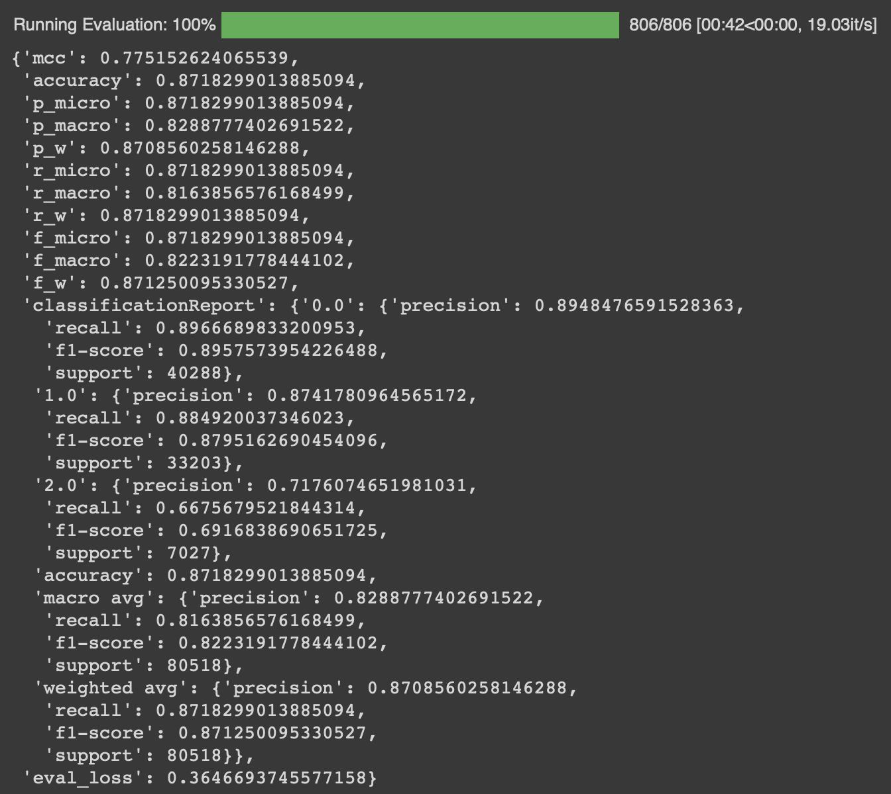
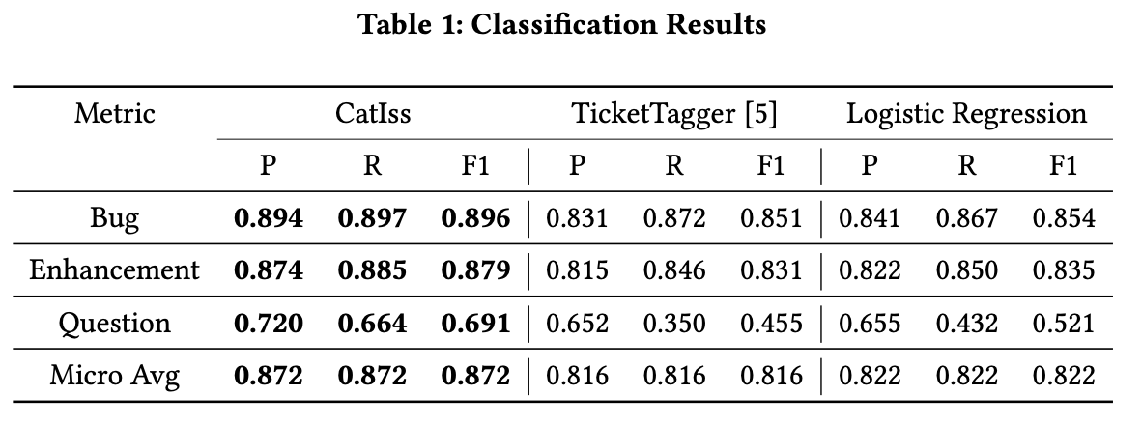
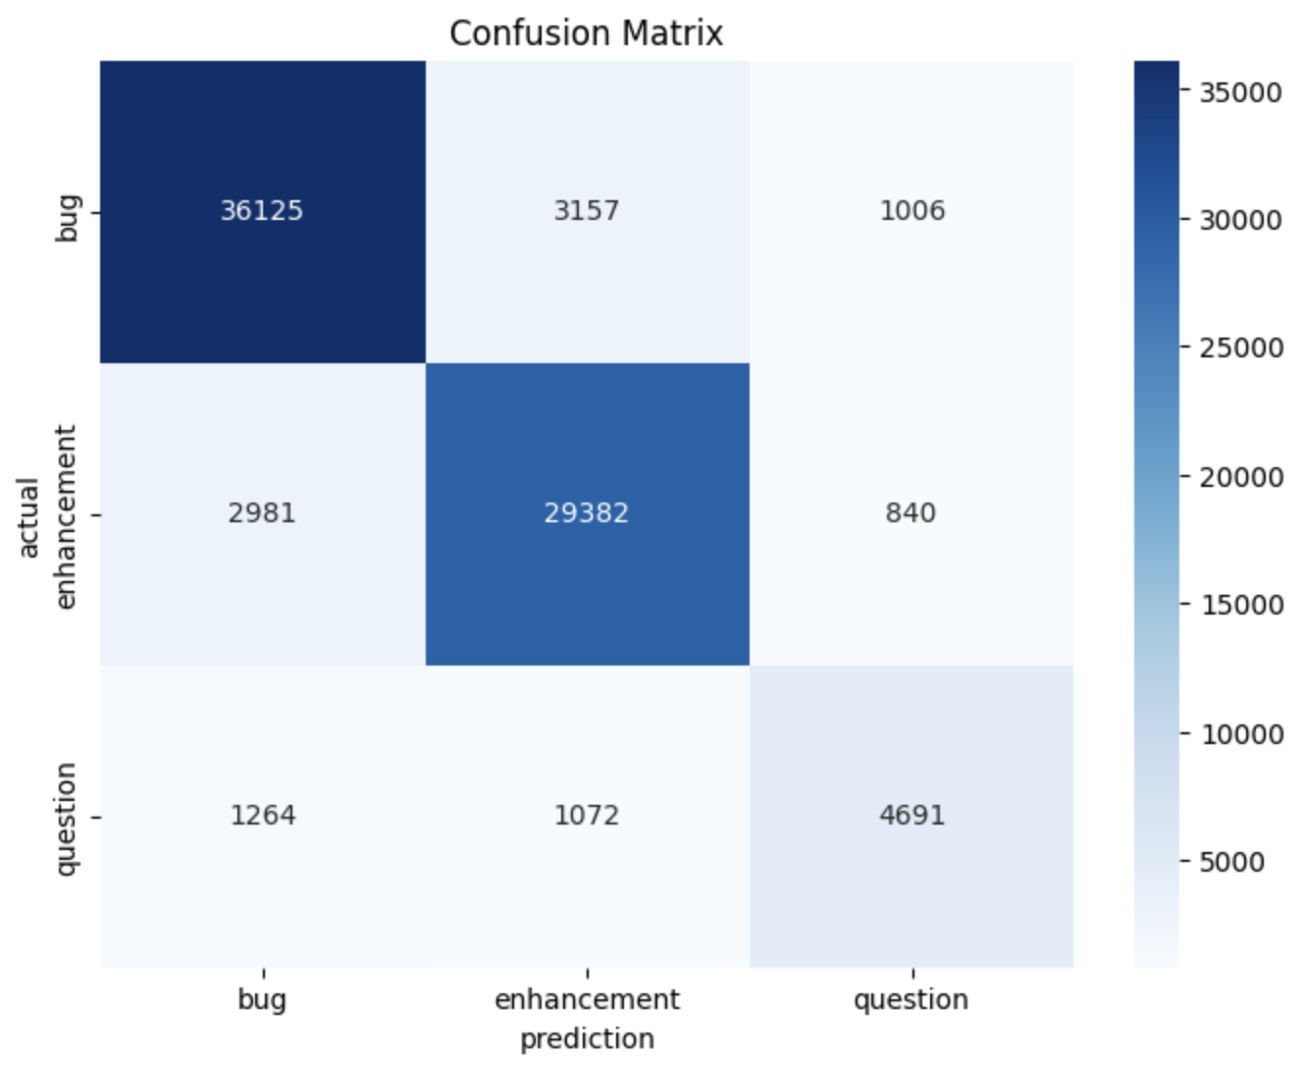
1 OK
Model: nlbse’22 & Dataset: nlbse’22

Slide 9
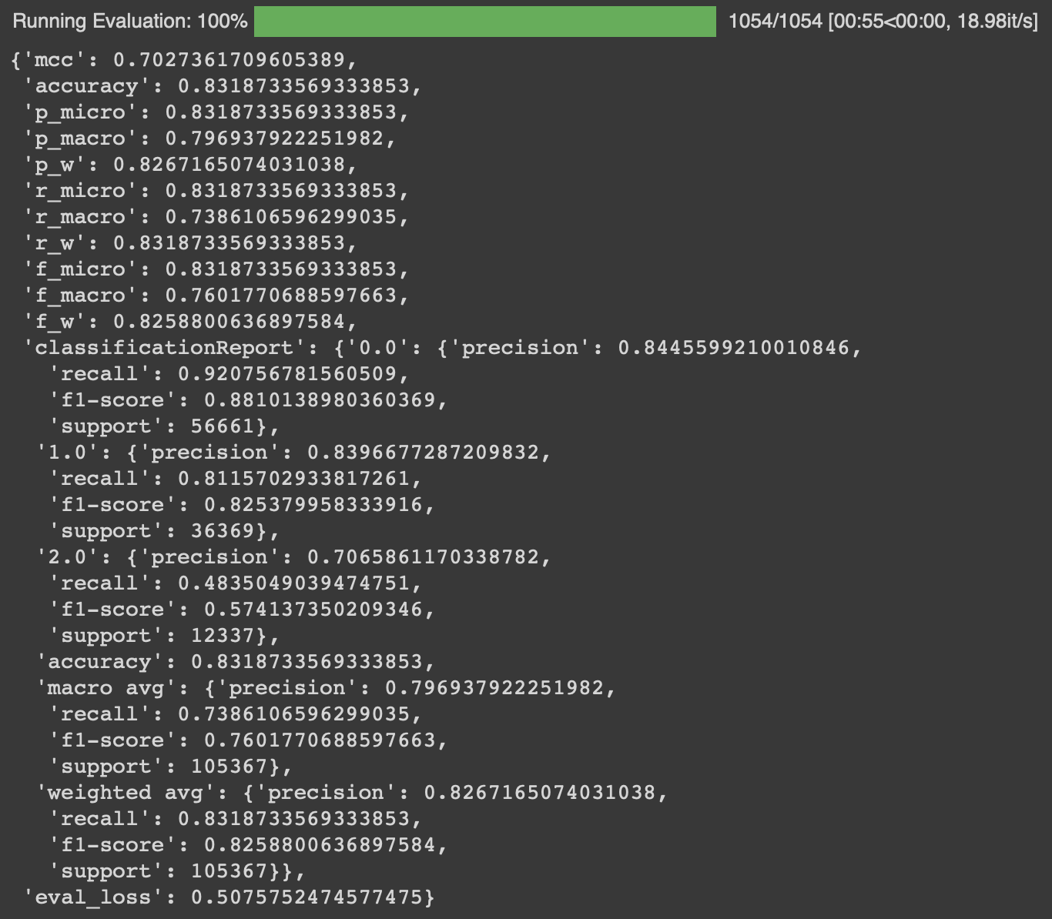
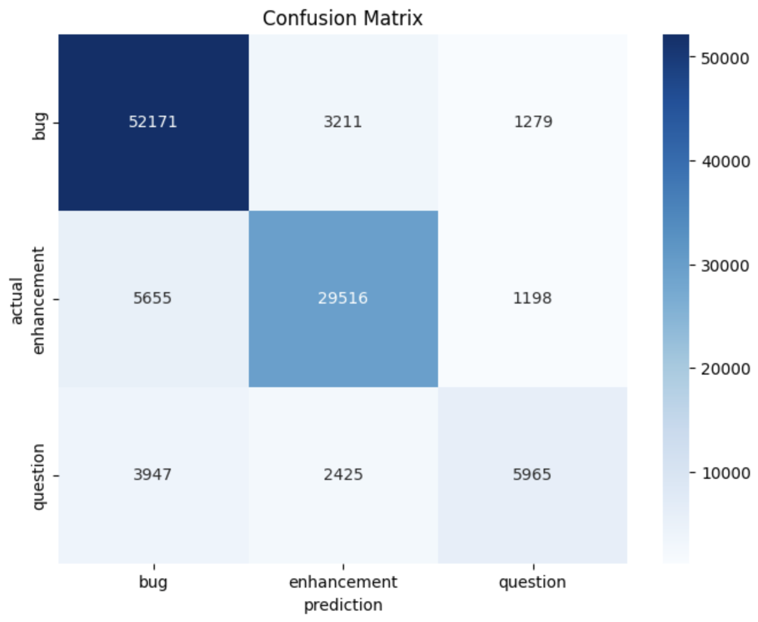
2 OK
Model: nlbse’22 & Dataset: MSc bug – enhancement – question

Slide 10
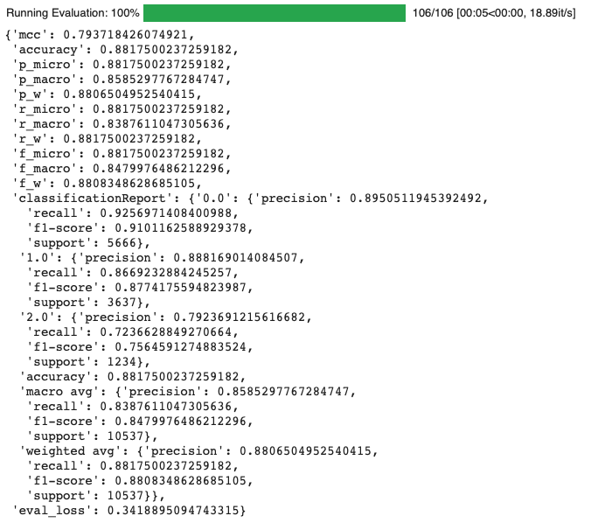
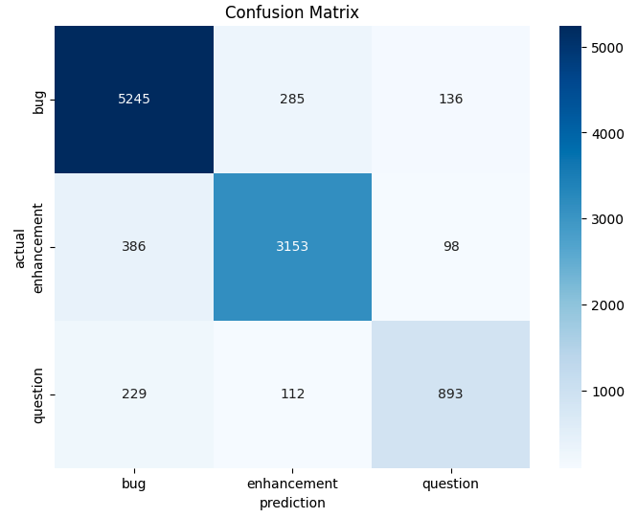
3 OK
Model: MSc bug – enhancement – question & Dataset: MSc bug – enhancement – question

Slide 11
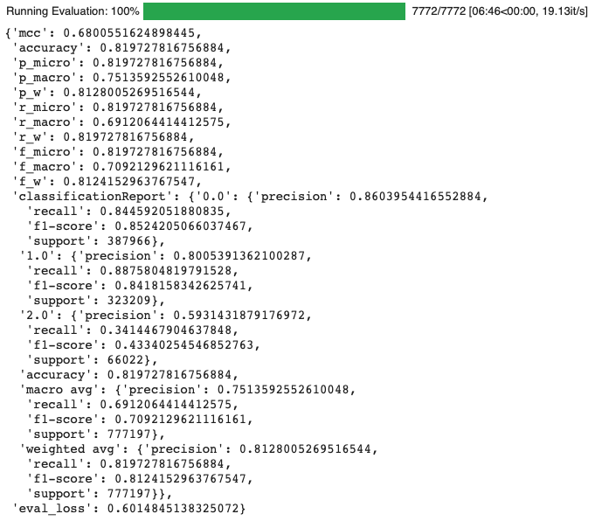
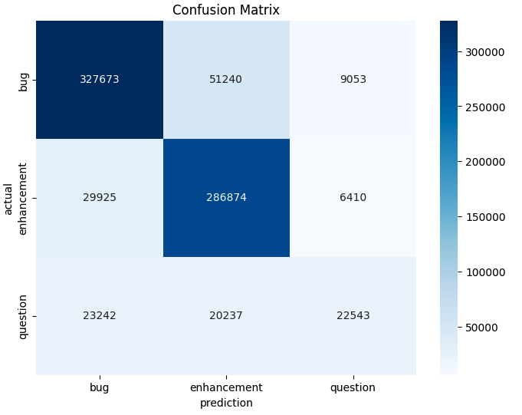
4 OK
Model: MSc bug – enhancement – question & Dataset: nlbse’22

Slide 12
5
Model: Llama3 bug – enhancement – question & Dataset: nlbse’22
accuracy:
classificationReport
0.0
precision:
recall:
f1-score:
1.0
precision:
recall:
f1-score:
2.0
precision:
recall:
f1-score

Slide 13
Model: Llama3 bug – enhancement – question & Dataset: MSc bug – enhancement – question
6
accuracy:
classificationReport
0.0
precision:
recall:
f1-score:
1.0
precision:
recall:
f1-score:
2.0
precision:
recall:
f1-score

Slide 14
Model: Llama3 bug – enhancement – others & Dataset: MSc bug – enhancement – others
7
accuracy:
classificationReport
0.0
precision:
recall:
f1-score:
1.0
precision:
recall:
f1-score:
2.0
precision:
recall:
f1-score

Slide 15
Dataset: MSc & Model: nlbse’22
https://medium.com/@erkajalkumari/how-to-run-llama-3-locally-0f9426708d83#:~:text=Running%20Llama%203%20Locally,-Llama%203%20with&text=If%20your%20system%20has%20enough,be%20on%20the%20slower%20side.

Slide 16
Dataset/Model | nlbse’22 nlbse’22 prepr. | MSc 3 labels bug – enhc – question nlbse’22 prepr. | nlbse’22 MSc prepr. | MSc 3 labels bug – enhc – question MSc prepr. | Llama3 8b instruct model bug – enhc – question
nlbse’22 nlbse’22 prepr. |  |  | - | - | -
MSc 3 labels bug – enhc – question nlbse’22 prepr. |  |  | - | - | -
nlbse’22 MSc prepr. | - | - |  |  | -
MSc 3 labels bug – enhc – question MSc prepr. | - | - |  |  | -
nlbse’22 test dataset without preprocessing | - | - | - | -
MSc 3 labels bug – enhc – question test dataset without preprocessing | - | - | - | -
1 - T | P | R | F1
bug | .894 | .897 | .896
enhc | .874 | .885 | .879
quest | .720 | .664 | .691
micro avg = .872
4 - E | P | R | F1
bug | .860 | .845 | .852
enhc | .801 | .889 | .842
quest | .593 | .341 | .433
micro avg = .820
2 - E | P | R | F1
bug | .845 | .921 | .881
enhc | .840 | .812 | .825
quest | .707 | .484 | .574
micro avg = .832
3 - T | P | R | F1
bug | .895 | .926 | .910
enhc | .888 | .867 | .877
quest | .792 | .724 | .756
micro avg = .882
5 - T | P | R | F1
bug | . | . | .
enhc | . | . | .
quest | . | . | .
micro avg = .
8 - T | P | R | F1
bug | . | . | .
enhc | . | . | .
quest | . | . | .
micro avg = .
6 - E | P | R | F1
bug | . | . | .
enhc | . | . | .
quest | . | . | .
micro avg = .
7 - E | P | R | F1
bug | . | . | .
enhc | . | . | .
quest | . | . | .
micro avg = .
9 - E | P | R | F1
bug | . | . | .
enhc | . | . | .
quest | . | . | .
micro avg = .
10 - E | P | R | F1
bug | . | . | .
enhc | . | . | .
quest | . | . | .
micro avg = .

Slide 17
Summary
Dataset/Model | nlbse’22 | MSc | Llama3 | bug MSc | enhc MSc

Slide 18
Datasets
nlbse’22 dataset & nlbse’22 preprocessing steps
/Users/isdeniz/Documents/github/Summary-2406/data/test_clean_concat_200.csv
/Users/isdeniz/Documents/github/Summary-2406/data/train_clean_concat_200.csv
nlbse’22 dataset & MSc preprocessing steps
MSc dataset & nlbse’22 preprocessing steps
/Users/isdeniz/Documents/github/Summary-2406/msc-dataset-bug-enhc-question-nlbse22-preprocessing/data/test_bug_enhc_ques_nlbse22_preprocessing_200.csv
/Users/isdeniz/Documents/github/Summary-2406/msc-dataset-bug-enhc-question-nlbse22-preprocessing/data/train_bug_enhc_ques_nlbse22_preprocessing_200.csv
bug-enhc-oos-tbc train
bug-enhc-oos-tbc test
MSc dataset & MSc preprocessing steps
https://ollama.com/library/llama3

