Slide 1
딥러닝입문 Assignment3
2021270660 이지원

Slide 2
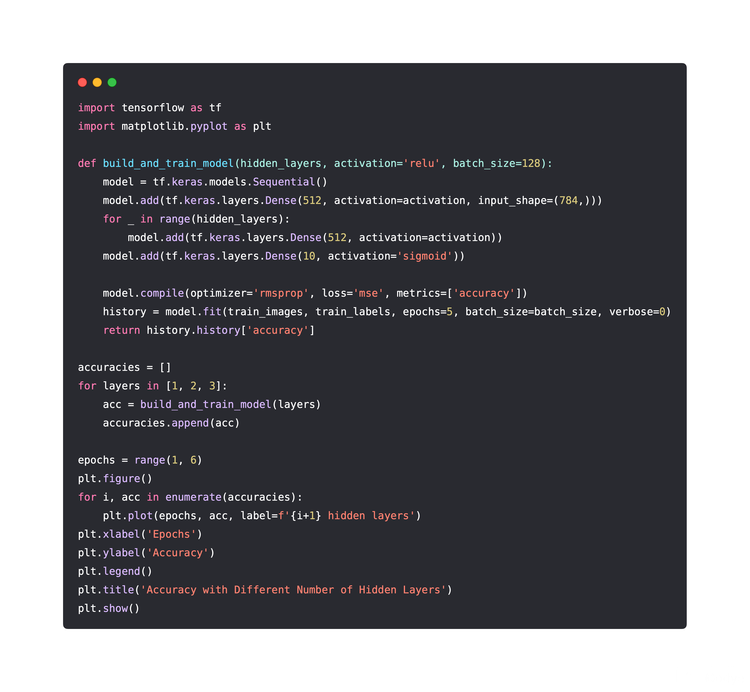
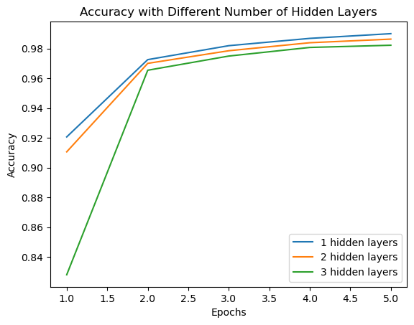
① Plot the accuracy when you have [1,2,3] hidden layers in DNN model

Slide 3
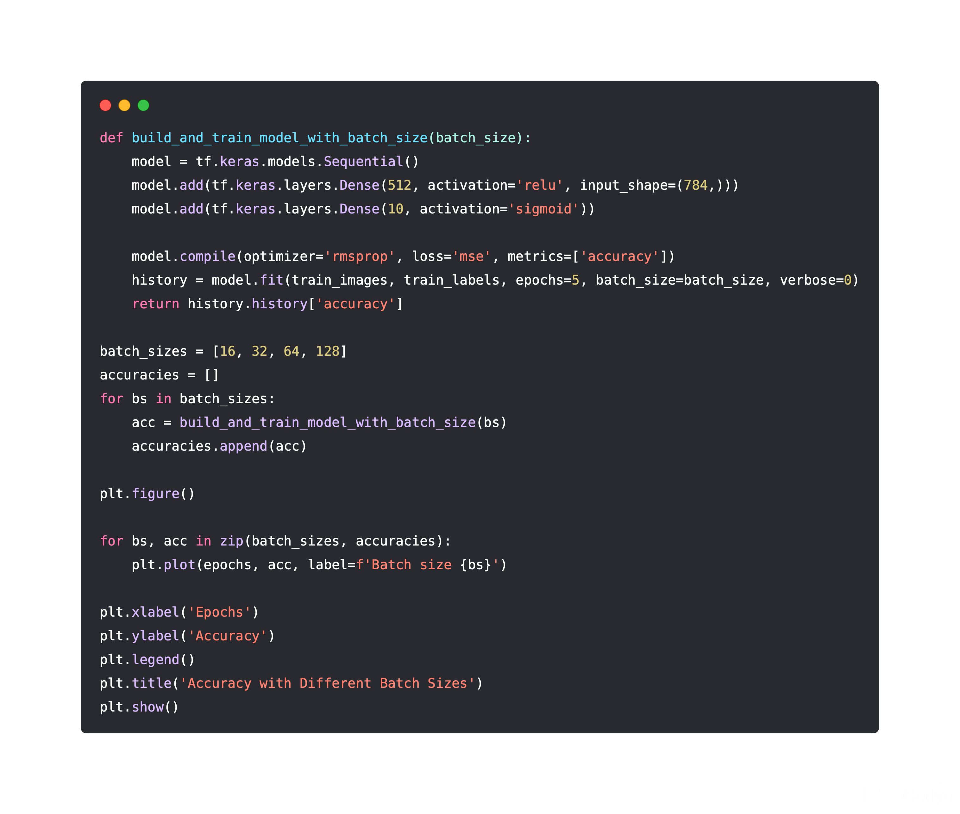
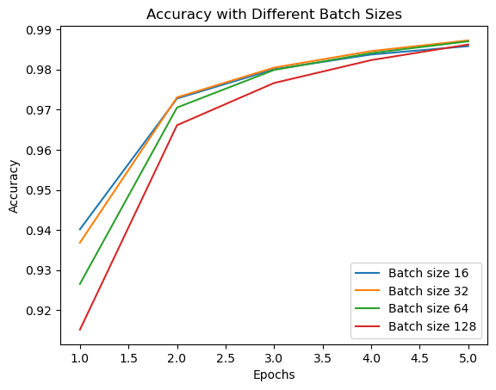
② Plot the accuracy when you change batchsize to 16, 32, 64, 128

Slide 4
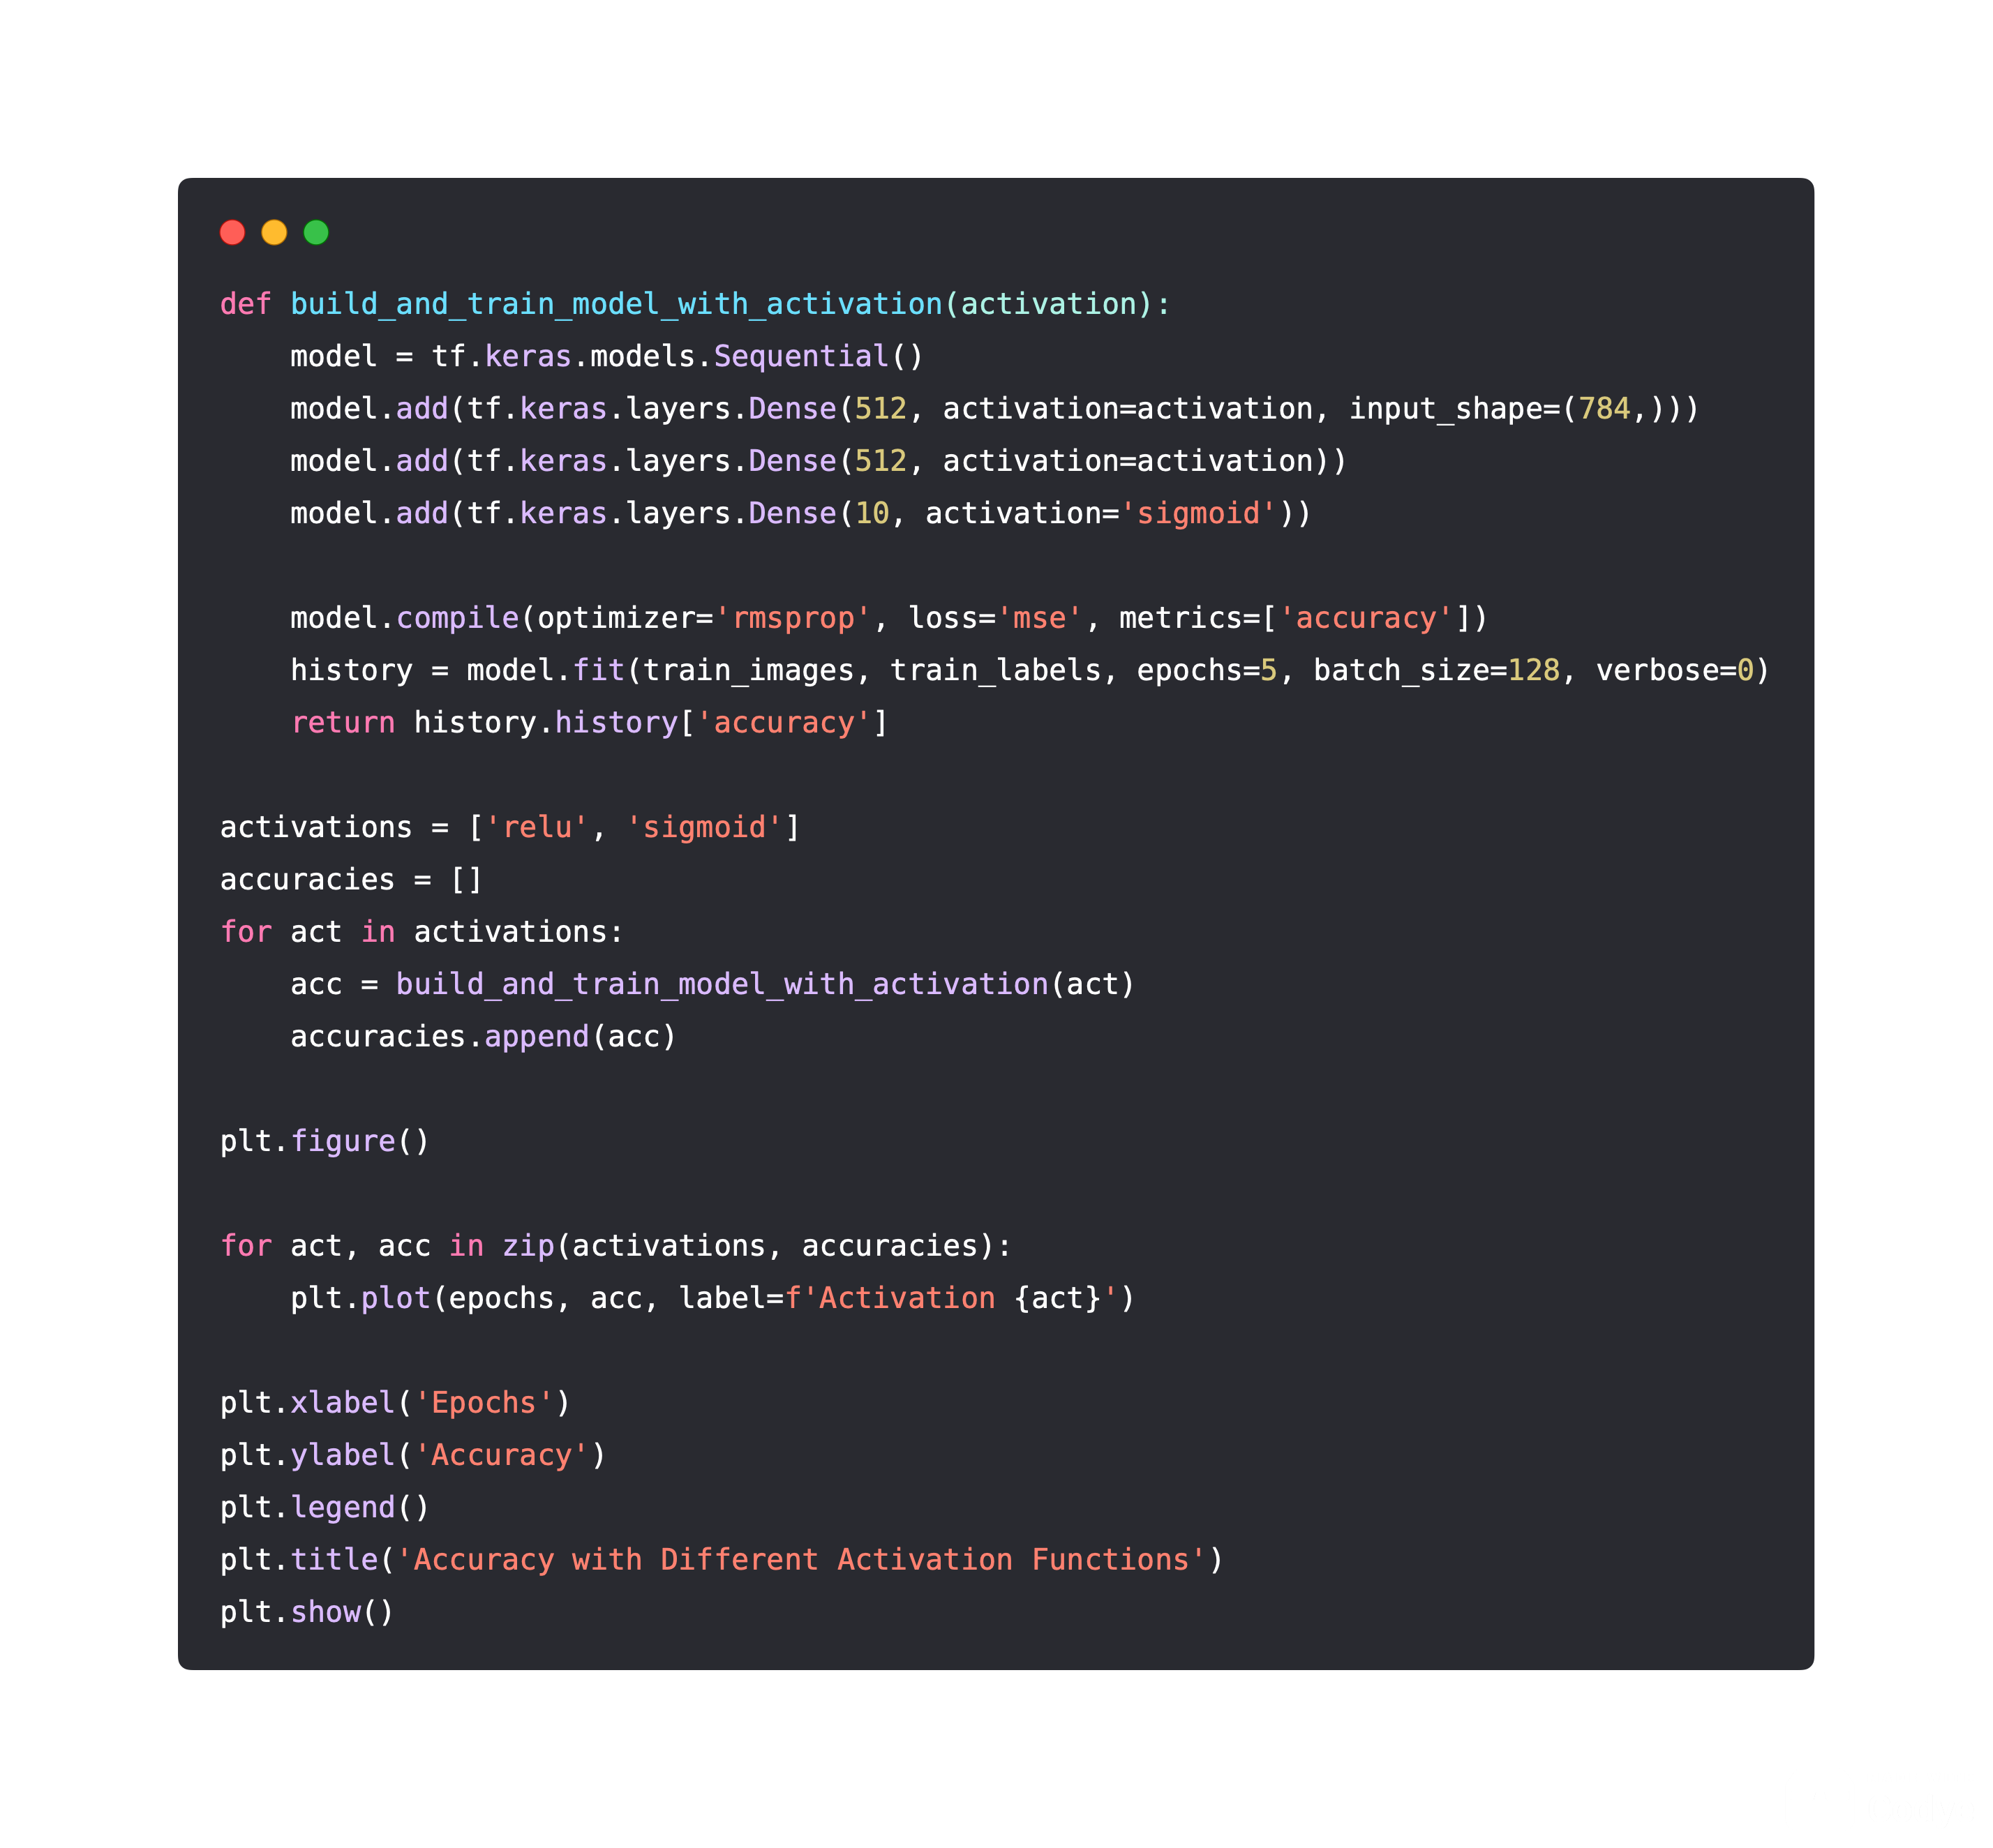
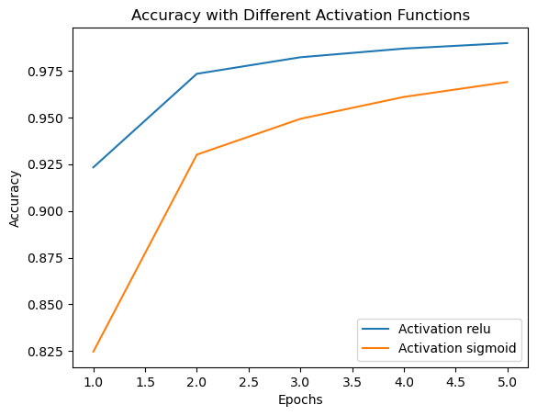
③ Plot the accuracy when you change the activation function from ReLU to sigmoid

