Slide 1
K - Maps
- Dr. Minavathi

Slide 2
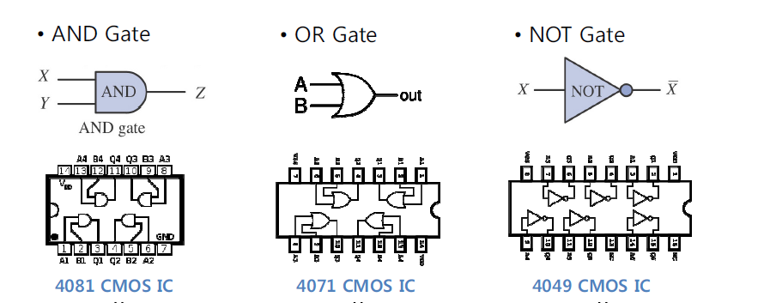

Slide 3
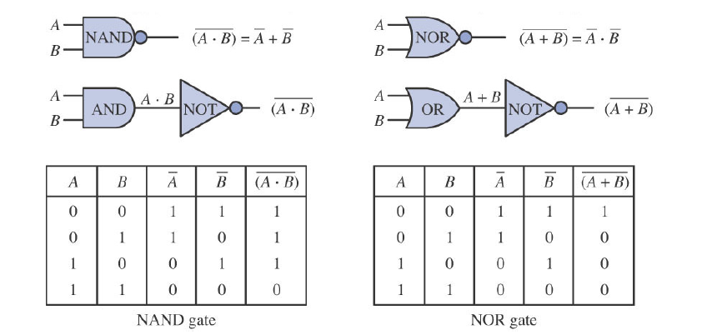

Slide 4
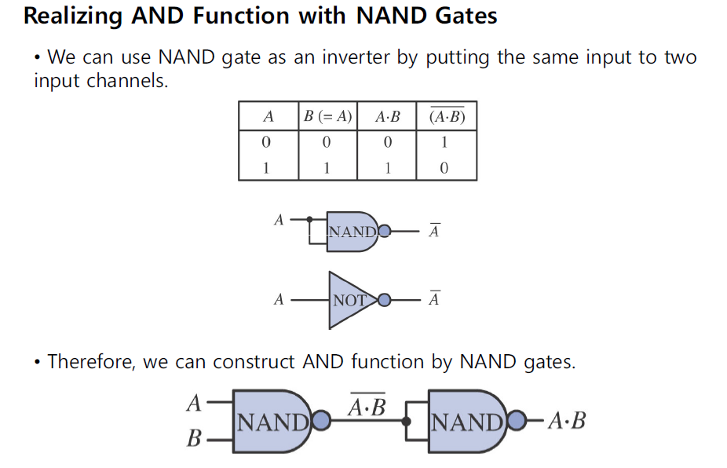

Slide 5
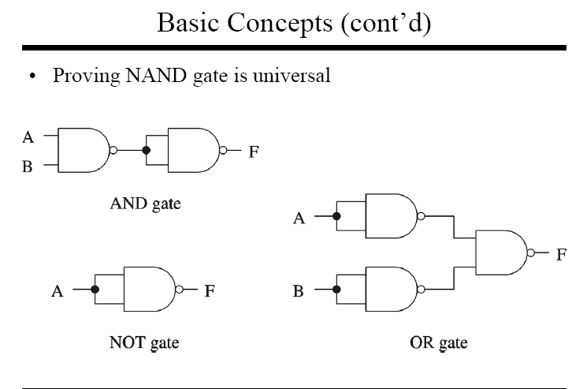

Slide 6
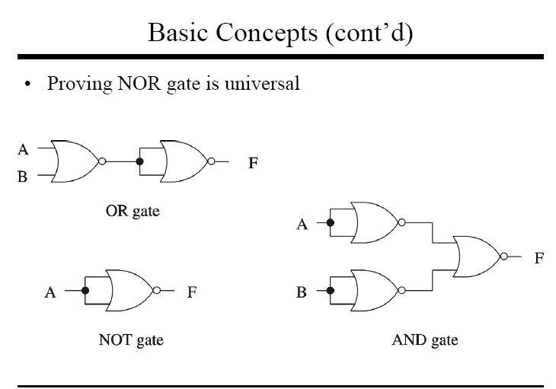

Slide 7
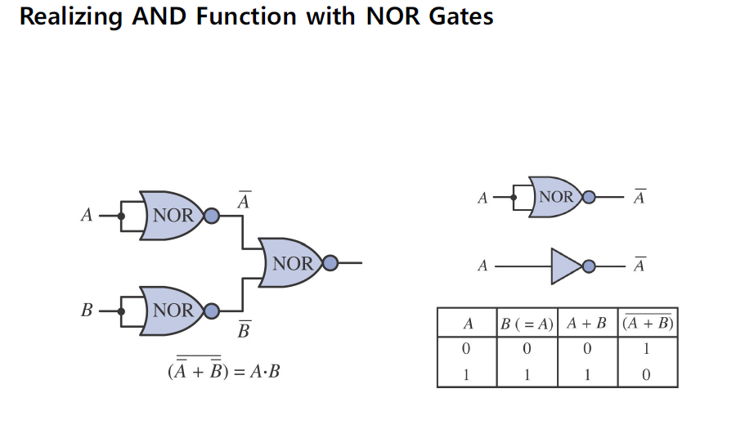

Slide 8
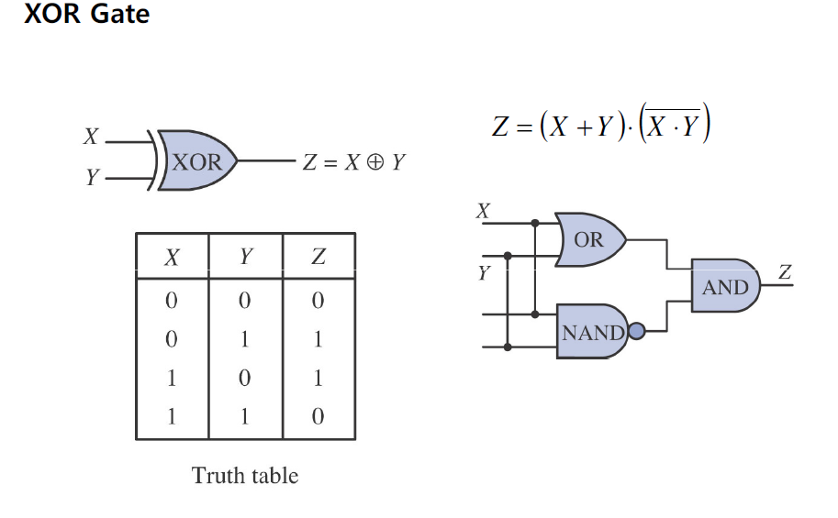

Slide 9
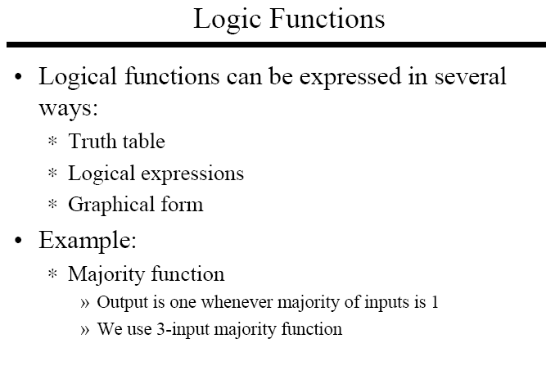

Slide 10
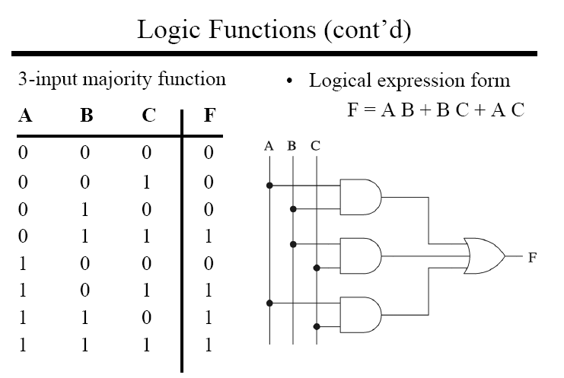

Slide 11
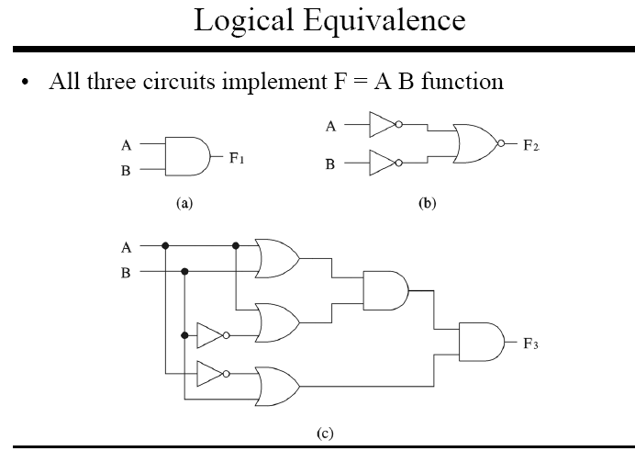

Slide 12
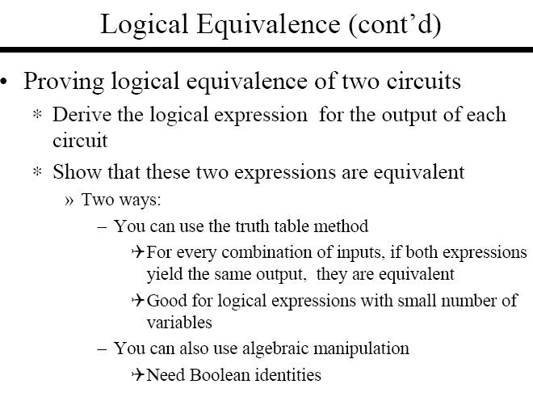

Slide 13
KARNAUGH -MAP
In 1953, Maurice Karnaugh was a telecommunications engineer at Bell Labs
He invented a graphical way of visualizing and then simplifying Boolean expressions
This graphical representation, now known as a Karnaugh map, or Kmap, is named in his honor

Slide 14
KARNAUGH MAPS
K – Maps are Graphical representation of logic function suitable for manual simplification and minimization
K - Map is an alternative way to Boolean Function Simplification
Simplification of Boolean functions leads to simpler (and usually faster) digital circuits
Simplifying Boolean functions using identities is time-consuming and/or error-prone
Look at systematic method for reducing Boolean expressions using K-map

Slide 15
DESCRIPTION OF KMAP & TERMINOLOGY
A Kmap - matrix consisting of rows and columns that represent the output values of a Boolean function
Kmap can be of two forms: Sum-of-Product (SOP) Form and Product-of-Sum POS) Form
K-MAP FOR SUM-OF-PRODUCT FORM
The output values placed in each cell of the matrix are derived from the “minterms” of a Boolean function
A minterm is a product term that contains all of the function’s variables exactly once, either complemented or not complemented

Slide 16
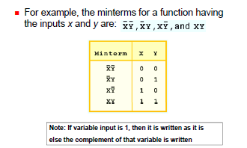
Minterm Example with Two variables

Slide 17
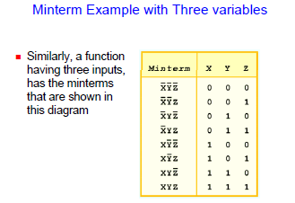

Slide 18
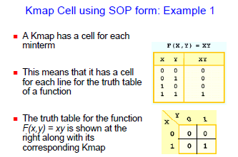

Slide 19
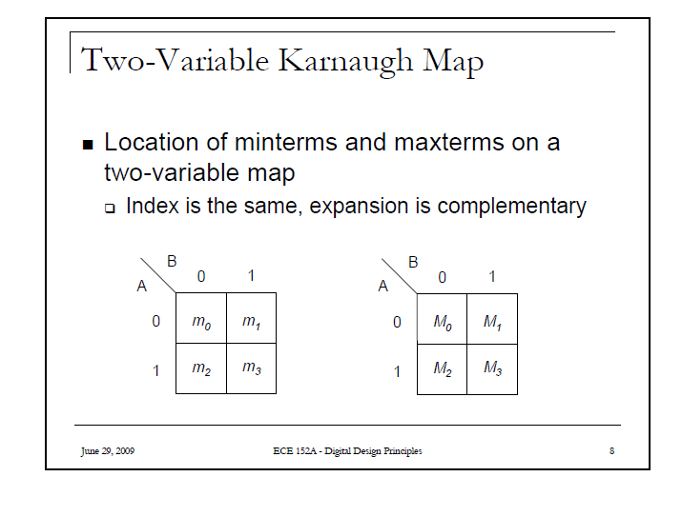

Slide 20
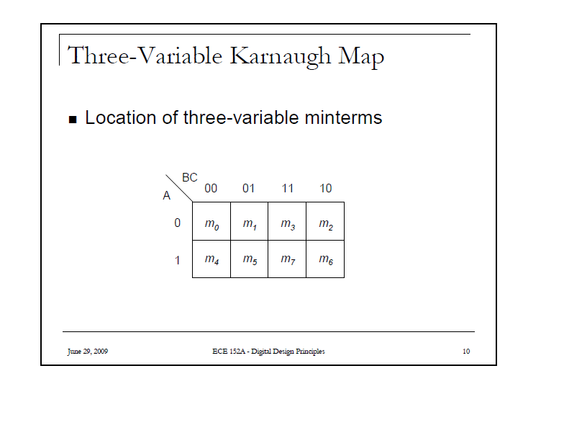

Slide 21
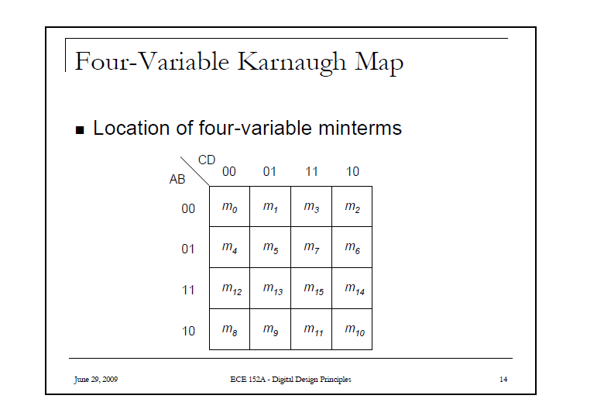

Slide 22
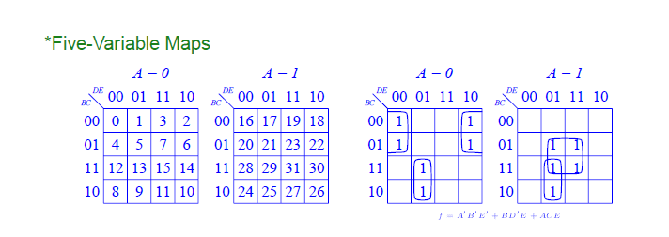

Slide 23
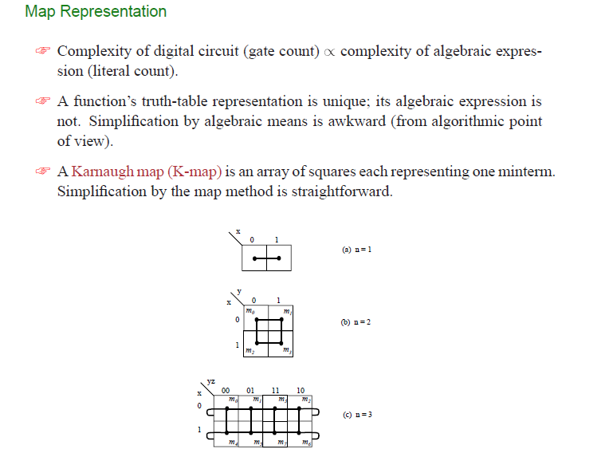
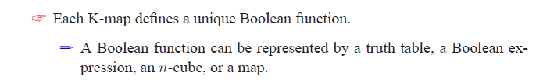

Slide 24
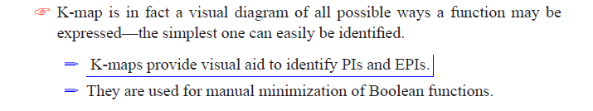
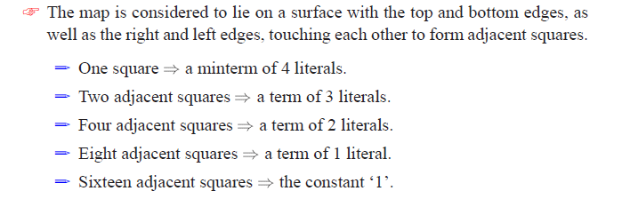

Slide 25
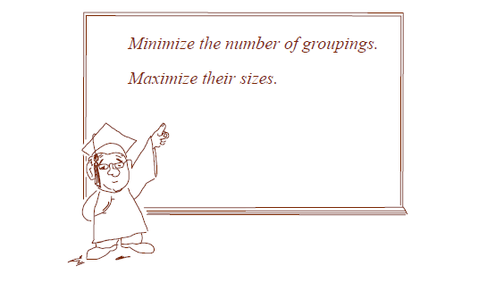

Slide 26
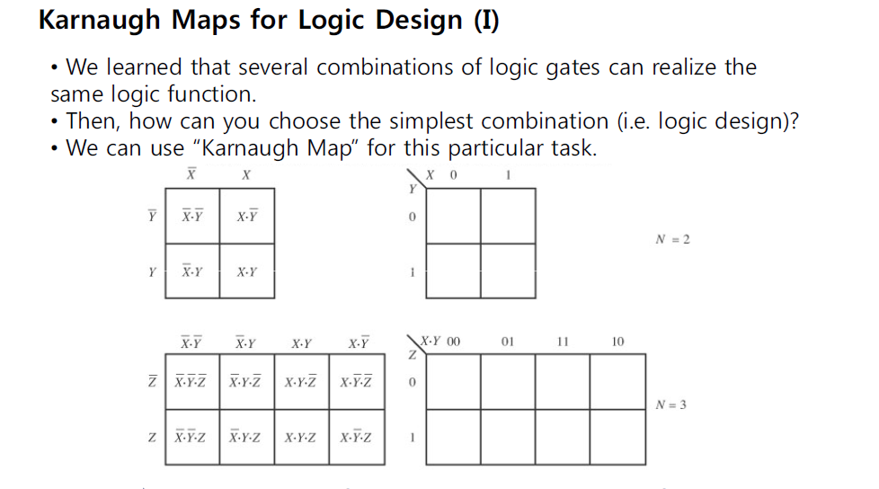


Slide 27
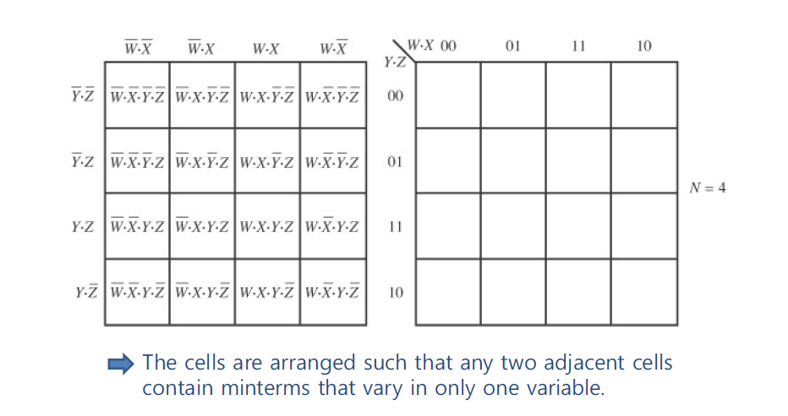

Slide 28
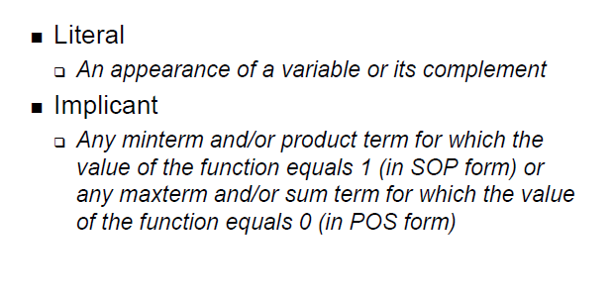
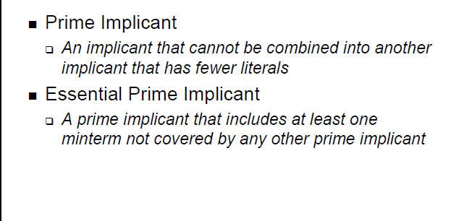

Slide 29
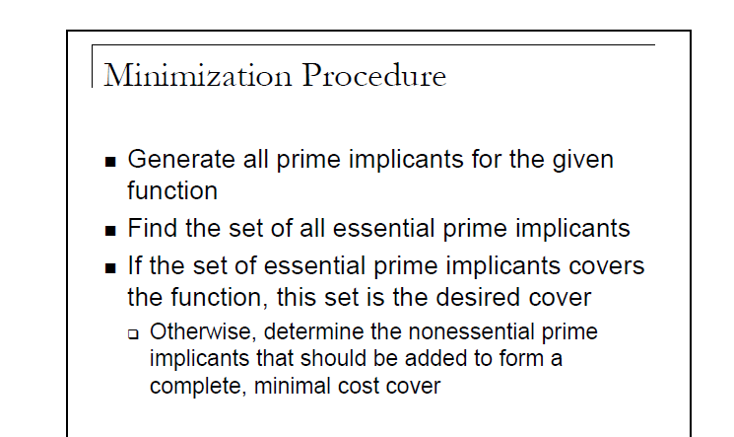

Slide 30
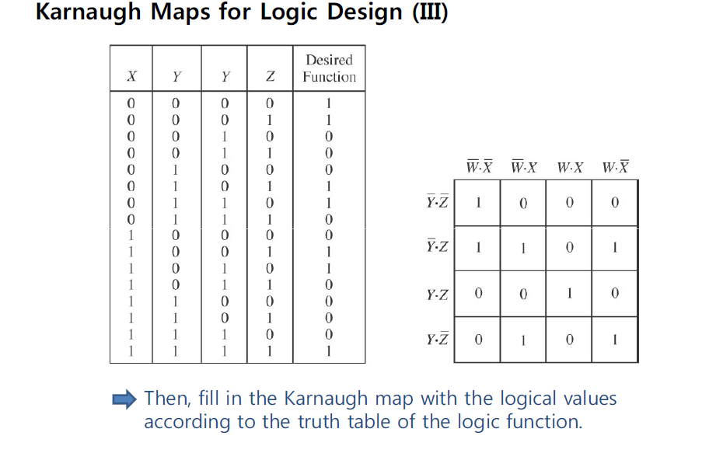

Slide 31
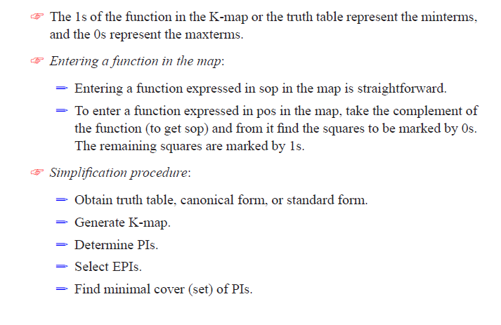

Slide 32
GROUPING OF MINTERMS AND MAX TERMS

Slide 33
Objectives
Define Karnaugh and establish the correspondence between
Karnaugh maps and truth tables and logical expressions.
Show how to use Karnaugh maps to derive minimal sumof-
products and product-of-sums expressions.
Introduce the concept of "don't care" entries and show how
to extend Karnaugh map techniques to include maps with
don't care entries.

Slide 34
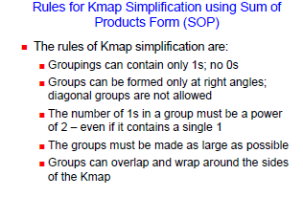

Slide 35
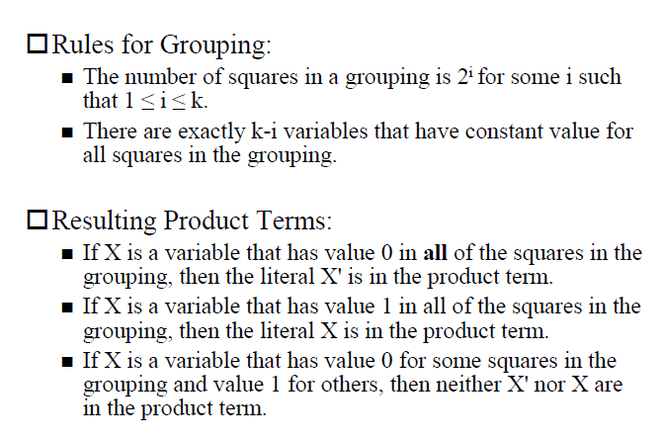

Slide 36
Summmary:
No zeros allowed.
No diagonals.
Only power of 2 number of cells in each group.
Groups should be as large as possible.
Every one must be in at least one group.
Overlapping allowed.
Wrap around allowed.
Fewest number of groups possible.

Slide 37
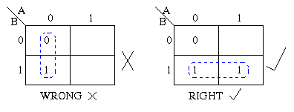
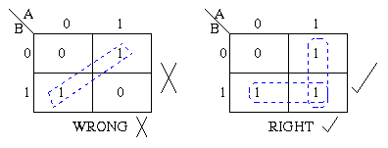
Groups may not include any cell containing a zero
Groups may be horizontal or vertical, but not diagonal.

Slide 38
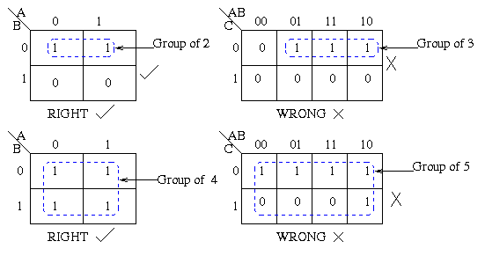
Groups must contain 1, 2, 4, 8, or in general 2^{n} cells. That is if n = 1, a group will contain two 1's since 2¹ = 2. If n = 2, a group will contain four 1's since 2² = 4.

Slide 39
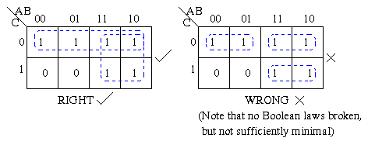
Each group should be as large as possible.

Slide 40
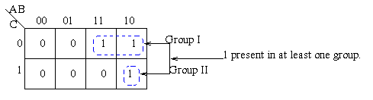
Each cell containing a one must be in at least one group.

Slide 41
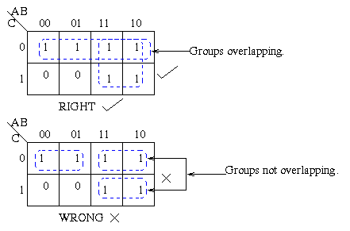
Groups may overlap.

Slide 42
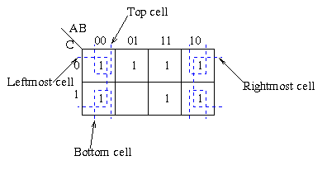
Groups may wrap around the table. The leftmost cell in a row may be grouped with the rightmost cell and the top cell in a column may be grouped with the bottom cell.

Slide 43
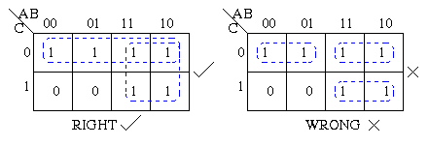
There should be as few groups as possible, as long as this does not contradict any of the previous rules.

Slide 44
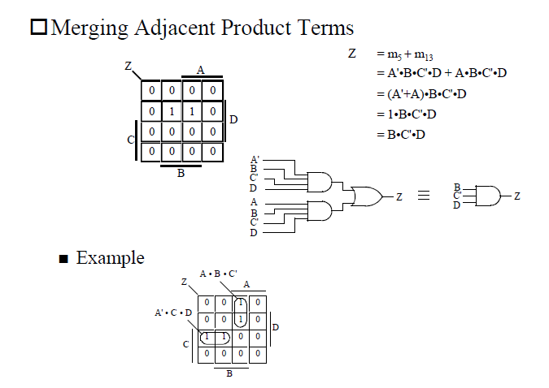

Slide 45
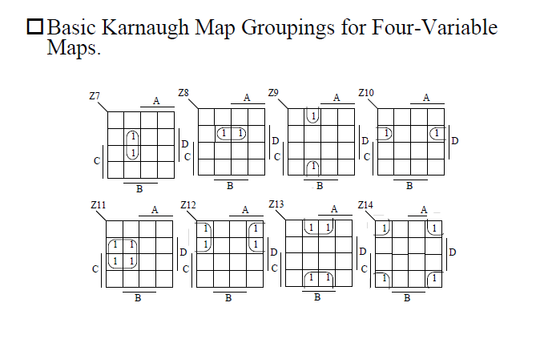

Slide 46
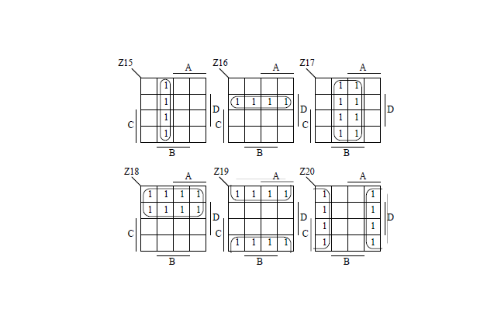

Slide 47
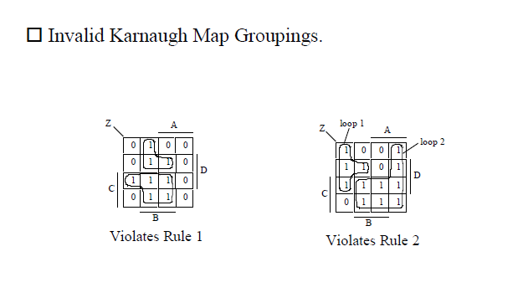

Slide 48
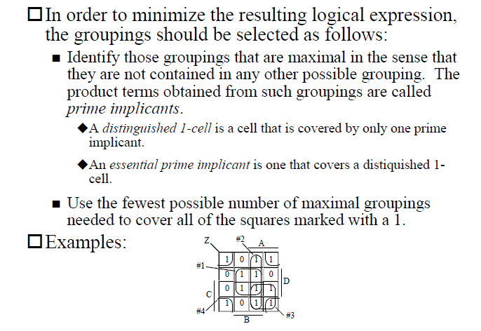

Slide 49
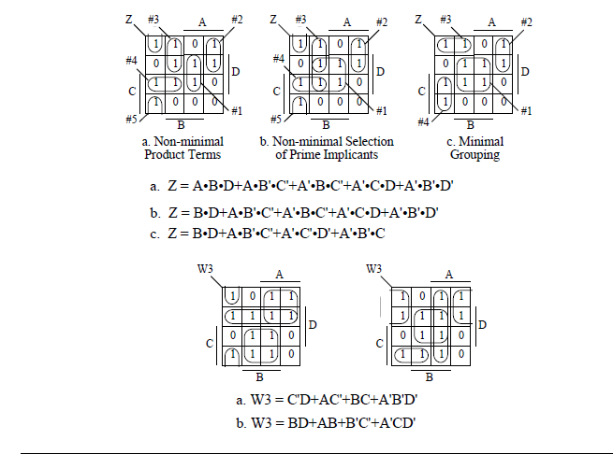

Slide 50
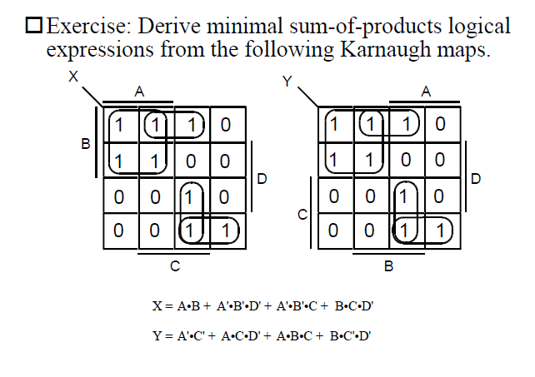

Slide 51
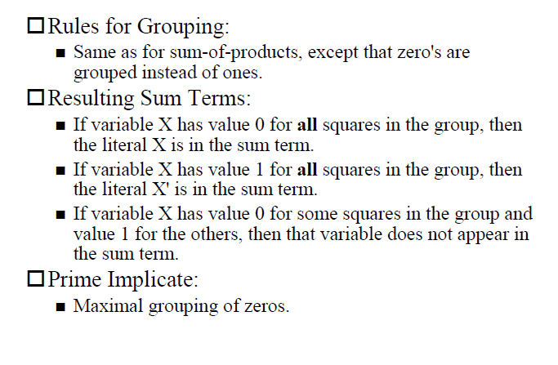
POS expressions

Slide 52
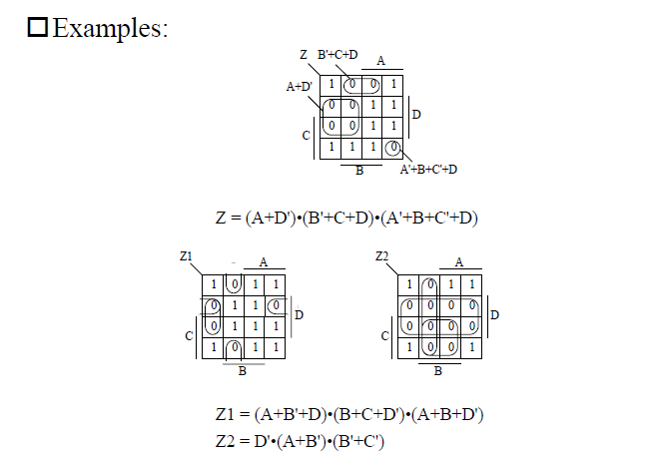

Slide 53
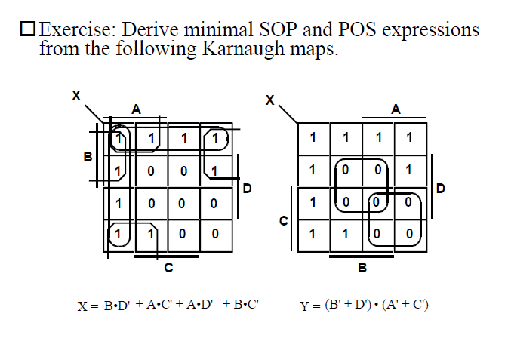

Slide 54


Slide 55


Slide 56


Slide 57


Slide 58


Slide 59


Slide 60


Slide 61


Slide 62


Slide 63


Slide 64


Slide 65


Slide 66


Slide 67



Slide 68


Slide 69


Slide 70


