Slide 1
PARITY GENERATORS AND CHECKERS

Slide 2
Even/odd parity (1)
Computers can sometimes make errors when they transmit data.
Even/odd parity:
is basic method for detecting if an odd number of bits has been switched by accident.
Odd parity:
The number of 1-bit must add up to an odd number
Even parity:
The number of 1-bit must add up to an even number

Slide 3
Even/odd parity (2)
The computer knows which parity it is using
If it uses an even parity:
If the number of of 1-bit add up to an odd number then it knows there was an error:
If it uses an odd:
If the number of of 1-bit add up to an even number then it knows there was an error:
However, If an even number of 1-bit is flipped the parity will still be the same. But an error occurs
The even/parity can’t this detect this error:

Slide 4
Even/odd parity (3)
It is useful when an odd number of 1-bits is flipped.
Suppose we have an 7-bit binary word (7-digits).
If you need to change the parity you need to add 1 (parity bit) to the binary word.
You now have 8 digit word.
However, the computer knows that the added bit is a parity bit and therefore ignore it.

Slide 5
Example (1)
Suppose you receive a binary bit word “0101” and you know you are using an odd parity.
Is the binary word errored?
The answer is yes:
There are 2 1-bit, which is an even number
We are using an odd parity
So there must have an error.

Slide 6
Parity Bit
A single bit is appended to each data chunk
makes the number of 1 bits even/odd
Example: even parity
1000000(1)
1111101(0)
1001001(1)
Example: odd parity
1000000(0)
1111101(1)
1001001(0)

Slide 7
Parity Checking
Assume we are using even parity with 7-bit ASCII.
The letter V in 7-bit ASCII is encoded as 0110101.
How will the letter V be transmitted?
Because there are four 1s (an even number), parity is set to zero.
This would be transmitted as: 01101010.
If we are using an odd parity:
The letter V will be transmitted as 01101011

Slide 8
Exercise 1
Suppose you are using an odd parity. What should the binary word “1010” look like after you add the parity bit?
Answer:
There is an even number of 1-bits.
So we need to add another 1-bit
Our new word will look like “10101”.

Slide 9
Exercise 2
Suppose you are using an even parity. What should the binary word “1010” look like after you add a parity bit?
Answer:
There is an even number of 1’s.
So we need to add another 0
Our new word will look like “10100”.

Slide 10
Symbols For XOR and XNOR
XOR symbol:
XNOR symbol:
Shaped symbols exist only for two inputs

Slide 11
Odd and Even Functions
The odd and even functions on a K-map form “checkerboard” patterns.
The 1s of an odd function correspond to minterms having an index with an odd number of 1s.
The 1s of an even function correspond to minterms having an index with an even number of 1s.
Implementation of odd and even functions for greater than four variables as a two-level circuit is difficult, so we use “trees” made up of :
2-input XOR or XNORs
3- or 4-input odd or even functions

Slide 12
Example: Odd Function Implementation
Design a 3-input odd function F = X Y Z with 2-input XOR gates
Factoring, F = (X Y) Z
The circuit:
+
+
+
+
X
Y
F
Z

Slide 13
Example: Even Function Implementation
Design a 4-input odd function F = W X Y Z with 2-input XOR and XNOR gates
Factoring, F = (W X) (Y Z)
The circuit:
+
+
+
+
+
+
W
X
F
Y
Z

Slide 14
Parity Generators and Checkers
In Chapter 1, a parity bit added to n-bit code to produce an n + 1 bit code:
Add odd parity bit to generate code words with even parity
Add even parity bit to generate code words with odd parity
Use odd parity circuit to check code words with even parity
Use even parity circuit to check code words with odd parity
Example: n = 3. Generate even parity code words of length four with odd parity generator:
Check even parity code words of length four with odd parity checker:
Operation: (X,Y,Z) = (0,0,1) gives (X,Y,Z,P) = (0,0,1,1) and C= 0. If Y changes from 0 to 1 between generator and checker, then = 1 indicates an error.
X
Y
P
Z
X
Y
C
Z
P

Slide 15
CODE CONVERTERS

Slide 16
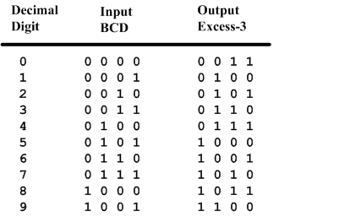
BCD-to-Excess-3 Code converter
BCD is a code for the decimal digits 0-9
Excess-3 is also a code for the decimal digits

Slide 17
Specification of BCD-to-Excess3
Inputs: a BCD input, A,B,C,D with A as the most significant bit and D as the least significant bit.
Outputs: an Excess-3 output W,X,Y,Z that corresponds to the BCD input.
Internal operation – circuit to do the conversion in combinational logic.

Slide 18
Formulation of BCD-to-Excess-3
Excess-3 code is easily formed by adding a binary 3 to the binary or BCD for the digit.
There are 16 possible inputs for both BCD and Excess-3.
It can be assumed that only valid BCD inputs will appear so the six combinations not used can be treated as don’t cares.

Slide 19
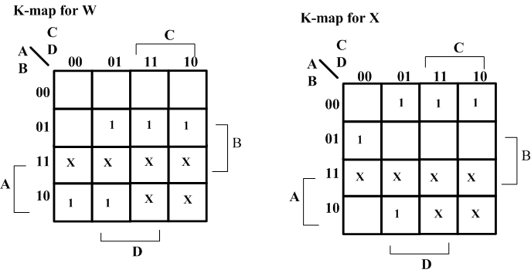
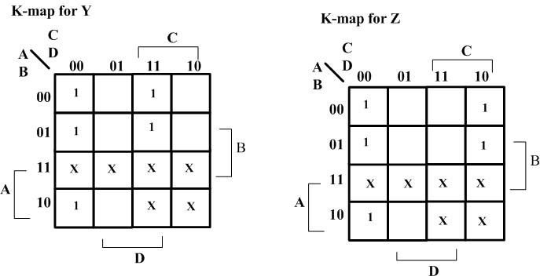
Optimization – BCD-to-Excess-3
Lay out K-maps for each output, W X Y Z
A step in the digital circuit design process.

Slide 20
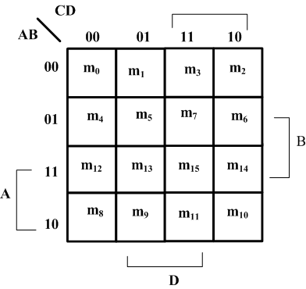
Placing 1 on K-maps
Where are the minterms located on a K-Map?

Slide 21
Expressions for W X Y Z
W(A,B,C,D) = Σm(5,6,7,8,9) +d(10,11,12,13,14,15)
X(A,B,C,D) = Σm(1,2,3,4,9) +d(10,11,12,13,14,15)
Y(A,B,C,D) = Σm(0,3,4,7,8) +d(10,11,12,13,14,15)
Z(A,B,C,D) = Σm(0,2,4,6,8) +d(10,11,12,13,14,15)

Slide 22
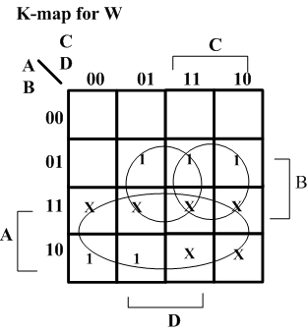
Minimize K-Maps
W minimization
Find W = A + BC + BD

Slide 23
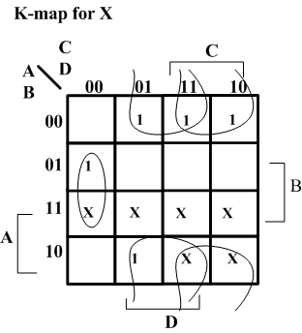
Minimize K-Maps
X minimization
Find X = BC’D’+B’C+B’D

Slide 24
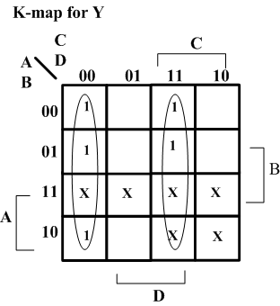
Minimize K-Maps
Y minimization
Find Y = CD + C’D’

Slide 25
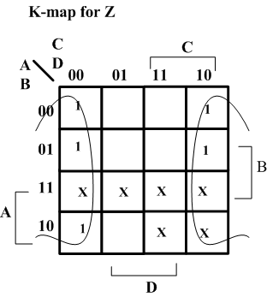
Minimize K-Maps
Z minimization
Find Z = D’

Slide 26
Two level circuit implementation
Have equations
W = A + BC + BD = A + B(C+D)
X = B’C + B’D + BC’D’ = B’(C+D) + BC’D’
Y = CD + C’D’
Z = D’
Factoring out (C+D) and call it T
Then T’ = (C+D)’ = C’D’
W = A + BT
X = B’T + BT’
Y = CD + T’
Z = D’

Slide 27
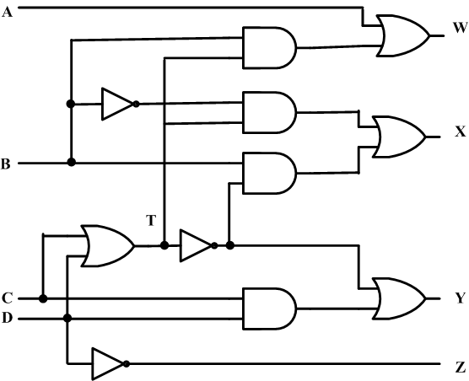
Create the digital circuit
Implementing the second set of equations where T=C+D results in a lower gate count.
This gate has a fanout of 3

Slide 28
Design a Gray Code to BCD converter by the following procedures:
Write down the truth table of the converter.
Binary Coded Decimal (BCD) is a way to store the decimal numbers in binary form. The number representation requires 4 bits to store every decimal digit (from 0 to 9). Since there are 10 different combinations of BCD, we need at least a 4-bit Gray Code to create sufficient number of these combinations.

Slide 29
Decimal Gray Code BCD
A B C D W X Y Z
0 0 0 0 0 0 0 0 0
1 0 0 0 1 0 0 0 1
2 0 0 1 1 0 0 1 0
3 0 0 1 0 0 0 1 1
4 0 1 1 0 0 1 0 0
5 0 1 1 1 0 1 0 1
6 0 1 0 1 0 1 1 0
7 0 1 0 0 0 1 1 1
8 1 1 0 0 1 0 0 0
9 1 1 0 1 1 0 0 1
10 1 1 1 1 D D D D
11 1 1 1 0 D D D D
12 1 0 1 0 D D D D
13 1 0 1 1 D D D D
14 1 0 0 1 D D D D
15 1 0 0 0 D D D D

Slide 30
Minimal Expression for W:
W = A
Minimal Expression for X:
X = A’B
Y = A’BC’ + B’C
Z = A’BC’D’ + B’C’D + AD + BCD + B’CD’
Draw the circuit for this simplified set of expressions

Slide 31
Encoder/Decoder Vocabulary
ENCODER- a digital circuit that produces a binary output code depending on which of its inputs are activated.
DECODER- a digital circuit that converts an input binary code into a single numeric output.

Slide 32
ENCODERS AND DECODERS
ONLY ONE INPUT ACTIVATED AT A TIME
BINARY CODE INPUT
ONLY ONE OUTPUT ACTIVATED AT A TIME
BINARY CODE OUTPUT

Slide 33
THE 8421 BCD CODE
BCD stands for Binary-Coded Decimal.
A BCD number is a four-bit binary group that represents one of the ten decimal digits 0 through 9.
Example:
Decimal number 4926 4 9 2 6
8421 BCD coded number 0100 1001 0010 0110

Slide 34
ELECTRONIC ENCODER -
DECIMAL TO BCD
BCD output
Decimal input
0 0 0 0
0 1 0 1
0 1 1 1
0 0 1 1
7
Decimal
to
BCD
Encoder
5
3
0
Encoders are available in IC form.
This encoder translates from decimal input to BCD output.

Slide 35
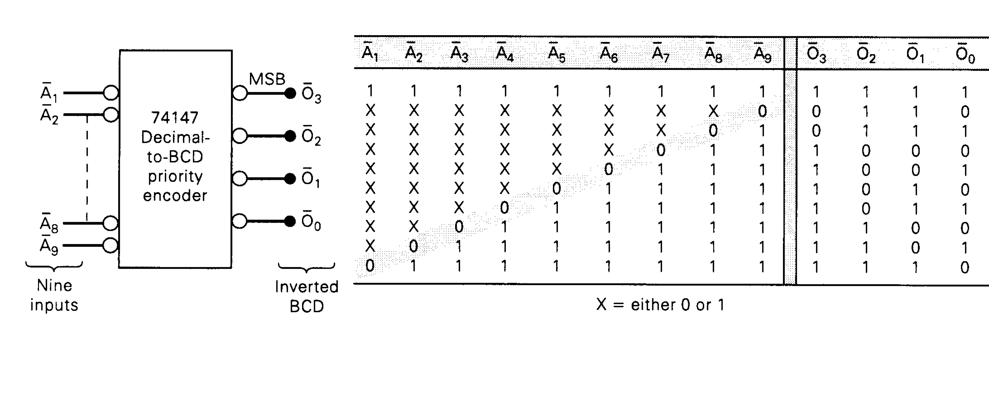
10 line to 4 line Encoder

Slide 36


Slide 37
10 line to 4 line Encoder

Slide 38
DECODER
A decoder is a logic circuit that accepts a set of inputs that represents a binary number and activates only the output that corresponds to the input number.
In other words, a decoder circuit looks at its inputs, determines which binary number is present there, and activates the one output that corresponds to that number ; all other outputs remain inactive

Slide 39
In its general form, a decoder has N input lines to handle N bits and form one to 2 ^{N} output lines to indicate the presence of one or more N-bit combinations.
The basic binary function
An AND gate can be used as the basic decoding element
because it produces a HIGH output only when all inputs are
HIGH
Refer next slide for example

Slide 40
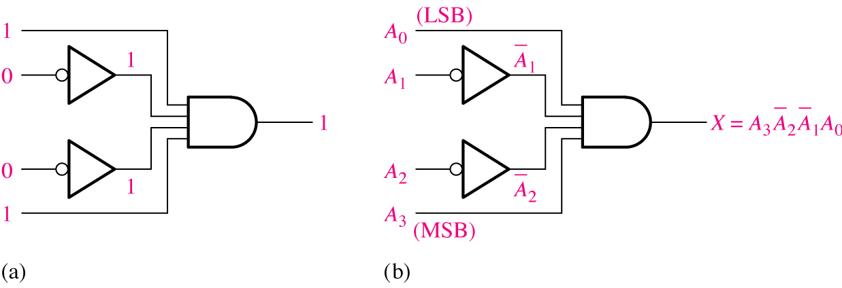
Decoding logic for the binary code 1001 with an active-HIGH output.

Slide 41
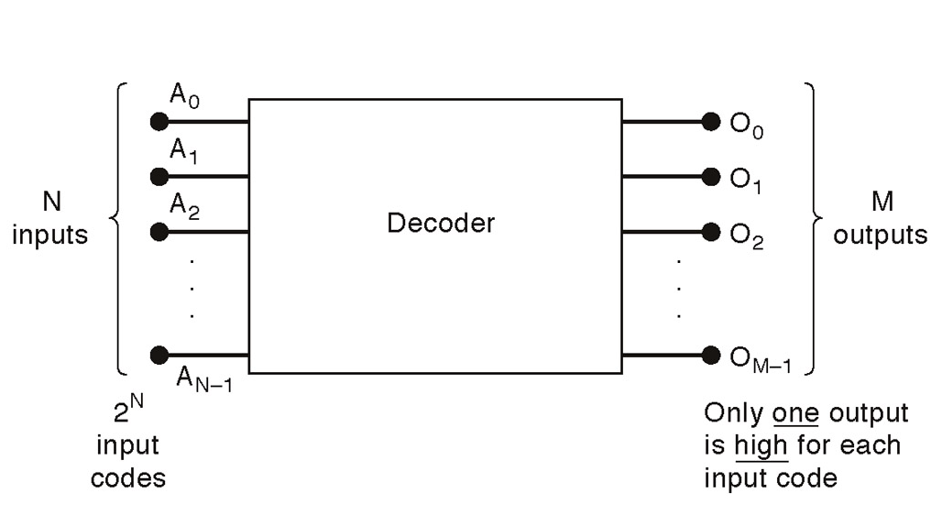
General decoder diagram
# There are 2^{N} possible input combinations, from A₀ to A_{N−1}.
For each of these input combinations only one of the M outputs will be active HIGH (1), all the other outputs are LOW (0).

Slide 42
If an active-LOW output (74138, one of the output will low and the rest will be high) is required for each decoded number, the entire decoder can be implemented with
NAND gates
Inverters
If an active-HIGH output (74139, one of the output will high and the rest will be low) is required for each decoded number, the entire decoder can be implemented with
AND gates
Inverters

Slide 43
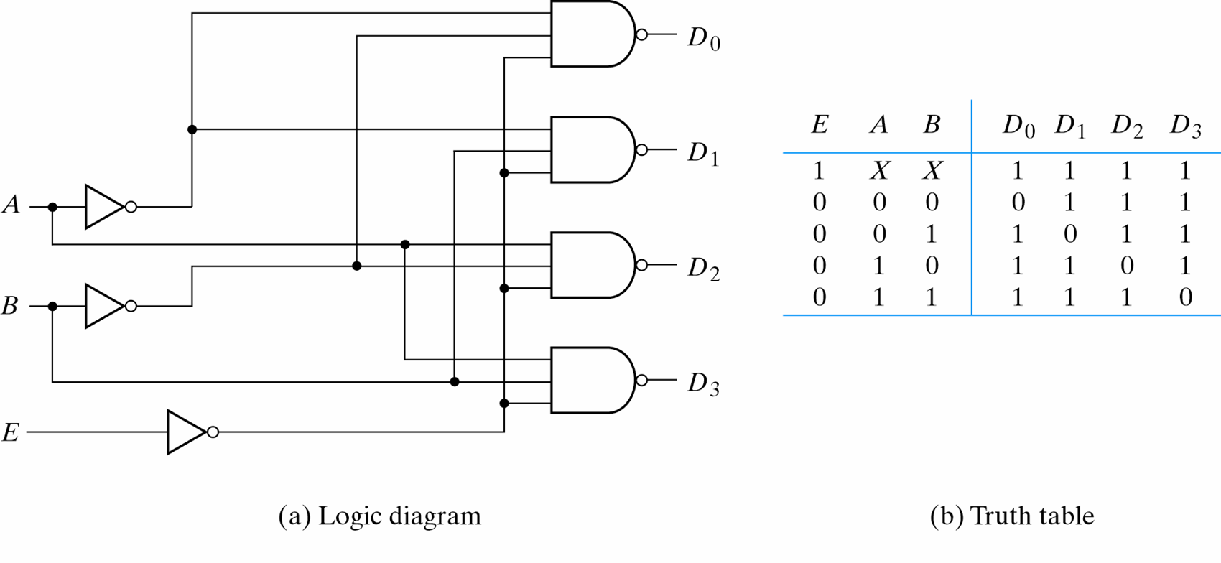
2-to-4-Line Decoder (with Enable input)-Active LOW output (1)...

Slide 44
2-to-4-Line Decoder (with Enable input)-Active LOW output (2)
The circuit operates with complemented outputs and a complement enable input. The decoder is enabled when E is equal to 0.
Only one output can be equal to 0 at any given time, all other outputs are equal to 1.
The output whose value is equal to 0 represents the minterm selected by inputs A and B
The circuit is disabled when E is equal to 1.

Slide 45
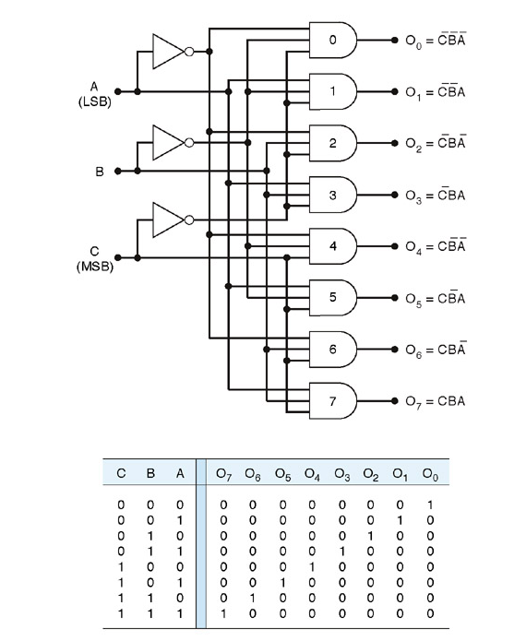
3-8 line decoder (active-HIGH)

Slide 46
This decoder can be referred to in several ways. It can be called a 3-line-to- 8-line decoder, because it has three input lines and eight output lines.
It could also be called a binary-octal decoder or converters because it takes a three bit binary input code and activates the one of the eight outputs corresponding to that code. It is also referred to as a 1-of-8 decoder, because only 1 of the 8 outputs is activated at one time.

Slide 47
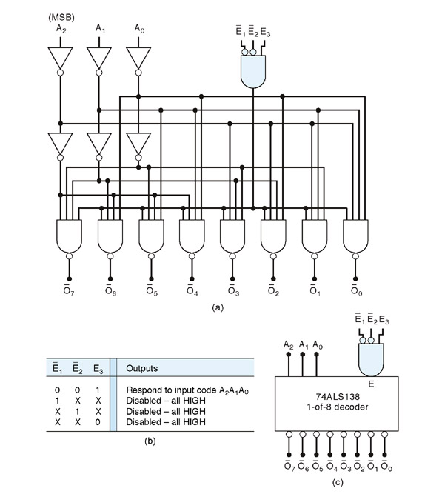
Logic diagram of 74138 (Example of a 3−Bit Decoder)

Slide 48
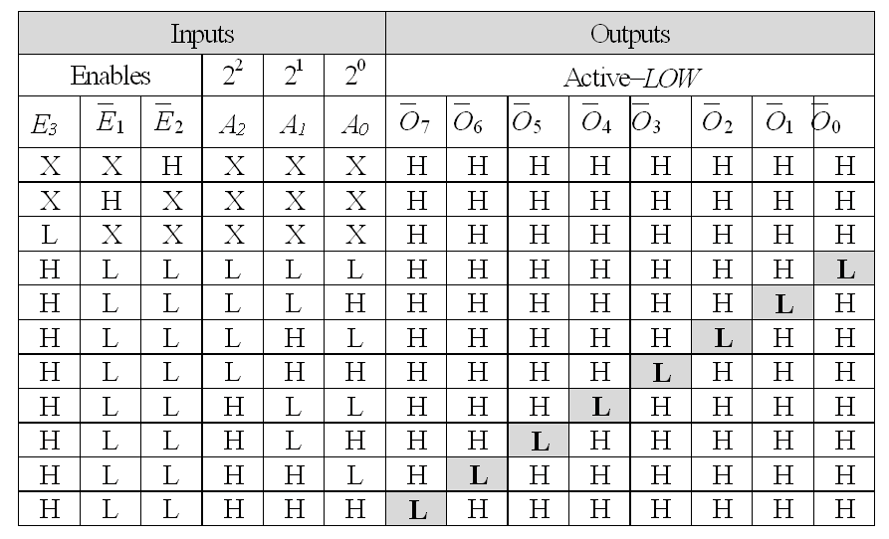
Truth table of 74138 (Example of a 3− 8 Bit Decoder) active-LOW

Slide 49
BCD -to- Decimal decoders
The BCD- to-decimal decoder converts each BCD code into one of Ten Positionable decimal digit indications. It is frequently referred as a 4-line -to- 10 line decoder
The method of implementation is that only ten decoding gates are required because the BCD code represents only the ten decimal digits 0 through 9.
Each of these decoding functions is implemented with NAND gates to provide active -LOW outputs. If an active HIGH output is required, AND gates are used for decoding

Slide 50
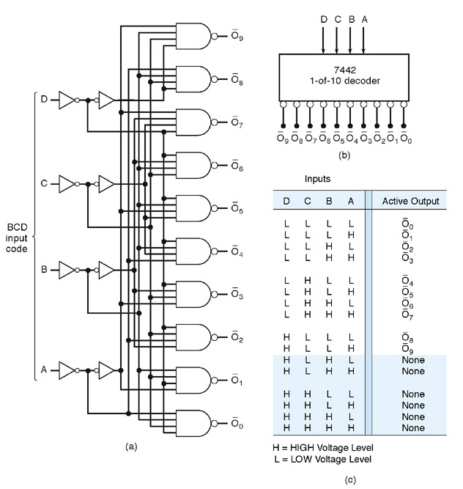
Logic diagram of BCD - decimal decoder (Active LOW output)

Slide 51
4 line to 10 line Decoder

Slide 52
DECODERS: BCD TO
7-SEGMENT DECODER/DRIVER
BCD input
Decimal output
LED
0 0 0 0
0 0 0 1
0 0 1 0
0 0 1 1
0 1 0 0
BCD-to-
7-Segment
Decoder/
Driver
Electronic decoders are available in IC form.
This decoder translates from BCD to decimal.
Decimals are shown on an 7-segment LED display.
This IC also drives the 7-segment LED display.

Slide 53
7-segment display
There are two types of 7−segment LED displays;
A) common - anode
B) common − cathode

Slide 54
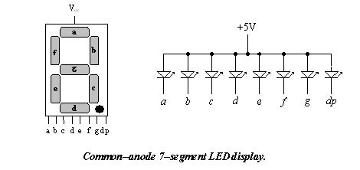
In common−anode, the anode of all of the LEDs are tied together to positive of the power supply (V_{cc}) as shown
Common Anode

Slide 55
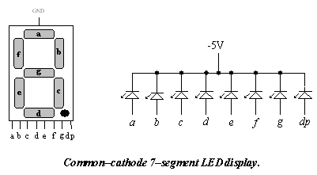
Common Cathode
In common−cathode, the cathode of all of the LEDs are tied together to ground as shown.
GND

Slide 56
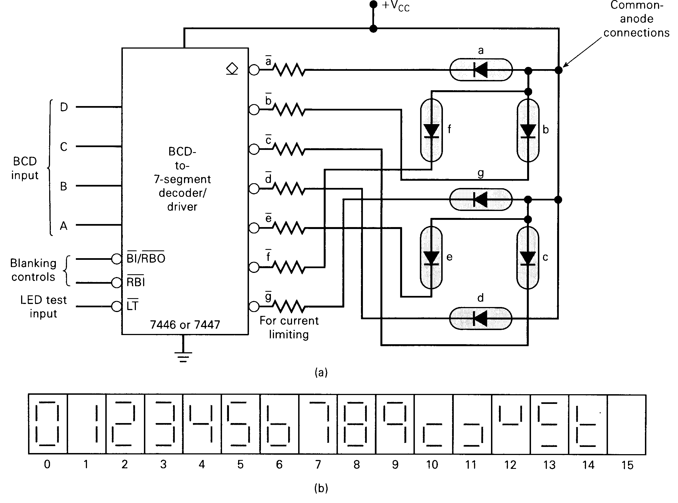

Slide 57
7-segment decoder
A BCD-7 segment decoder/driver is used to take four-bit BCD input and provide the outputs that will pass current through the appropriate segments to display the decimal digit.
The logic for this decoder is more complicated than the logic of decoders of earlier case, because each output is activated for more than one combination of inputs.

Slide 58
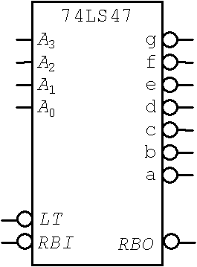
74LS47 ( BCD−to−Seven−Segment Decoder)

Slide 60
Decoders are used in many types of applications. One example is in computers for I/O selection as in previous slide
Computer must communicate with a variety of external devices called peripherals by sending and/or receiving data through what is known as input/output (I/O) ports
Each I/O port has a number, called an address, which uniquely identifies it. When the computer wants to communicate with a particular device, it issues the appropriate address code for the I/O port to which that particular device is connected . The binary port address is decoded and appropriate decoder output is activated to enable the I/O port
Binary data are transferred within the computer on a data bus, which is a set of parallel lines

Slide 61
COMPARATORS

Slide 62
Comparators (computer intelligence?)
Let's build a comparator circuit for two 4-bit positive binary numbers.
A3
A2
A>B
A1
Nine inputs, three outputs (three 512 entries truth tables?)
A0
A=B
A<B
B3
B2
B1
B0
ENABLE
So: A>B = A₃B₃' + (A₃B₃+A₃'B₃')(A₂B₂' + (A₂B₂+A₂'B₂')( A₁B₁' +(A₁B₁+A₁'B₁')A₀B₀') )
YUK!

Slide 63
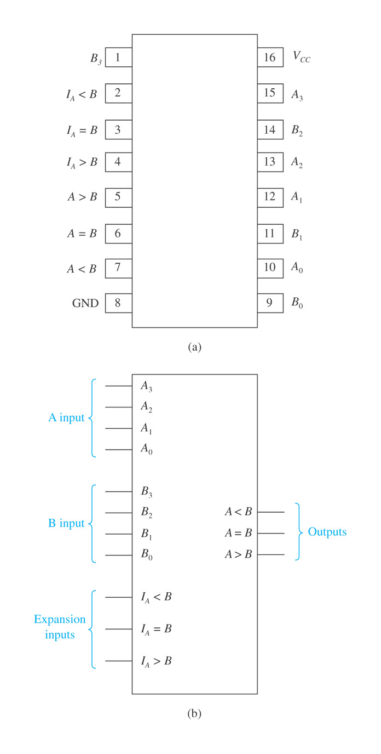
7485 4-bit magnitude comparator: (a) pin configuration and (b) logic symbol.
William Kleitz Digital Electronics: A Practical Approach, 7e
Copyright ©2005 by Pearson Education, Inc. Upper Saddle River, New Jersey 07458 All rights reserved.

Slide 64
Build a four-bit Comparator (from four one-bit ones)

Slide 65
Designing Comparators Functionally
1. Build a one-bit comparator
B 0 1
A
0 A=B A<B
1 A>B A=B
A>B : AB'
A=B : A'B' + AB
A<B : A'B
A
A>B
B
A=B
A<B

Slide 66
Designing Comparators Functionally
2. Add an enable line
A
A>B
A=B
B
Enable

Slide 67
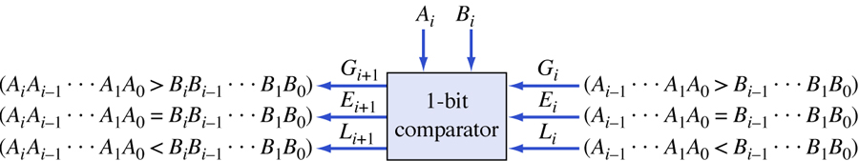
Organization of a 1-bit comparator.
Figure 5.15

Slide 68
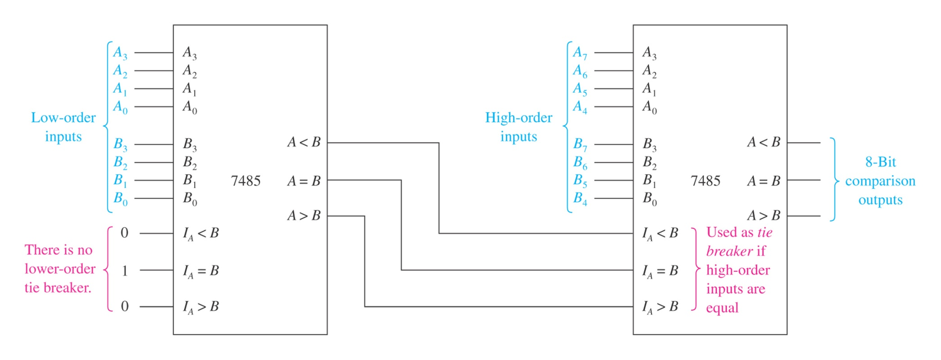
FIGURE 8–3 Magnitude comparison of two 8-bit binary strings (or binary words).
William Kleitz Digital Electronics: A Practical Approach, 7e
Copyright ©2005 by Pearson Education, Inc. Upper Saddle River, New Jersey 07458 All rights reserved.

Slide 69
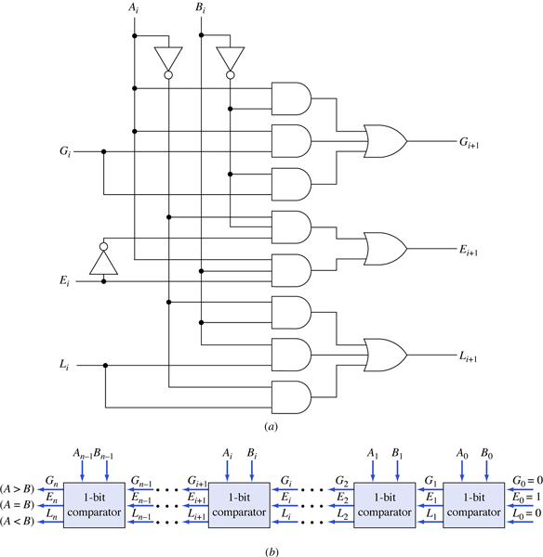
Comparing two binary numbers A and B. (a) 1-bit comparator network. (b) Cascade connection of 1-bit comparators.
Figure 5.16

