Slide 1
Regular expressions
The language accepted by DFA or NFA and ε-NFA is called regular language.
A regular language can be described using regular expressions consisting of the symbols such as alphabet in Σ, the operators such as ‘.’,’+’ and ‘*’.
The three operators used to obtain a regular expression are:
+ :union operator
.: concatenation operator
*: closure operator

Slide 2
Regular expression
Definition: A regular expression is recursively defined as follows.
1.ϕ is a regular expression denoting an empty language.
2. ε-(epsilon) is a regular expression indicates the language containing an empty string.
3. a is a regular expression which indicates the language containing only {a}
4. If R is a regular expression denoting the language L_{R} and S is a regular expression denoting the language L_{S}, then
a. R+S is a regular expression corresponding to the language L_{R}UL_{S}.
b. R.S is a regular expression corresponding to the language L_{R}.L_{S}..
c. R* is a regular expression corresponding to the language L_{R}*.
5. The expressions obtained by applying any of the rules from 1-4 are regular expressions.

Slide 3
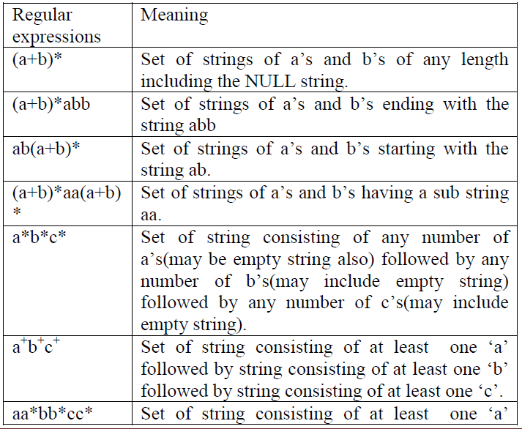
The table shows some examples of regular expressions and the language corresponding to these regular expressions.

Slide 4
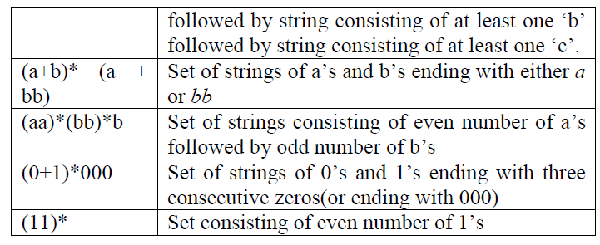

Slide 5
problem
Obtain a regular expression representing strings of a’s and b’s
having length 2.
Length<=2.
Length<=10.
Even length.
Odd length.
Alternate a’s and b’s.
At most one pair of consecutive 0’s.
Containing at least one a and atleast one b where Σ={a,b,c}
at least three consecutive 0’s.
Ending with b and has no substring aa.
No two consecutive zero’s
Second symbol from the right end is a.
Third symbol from right is a and fourth symbol from the right is b.

Slide 6
14 Two or more letters but beginning and ending with the same letter where Σ={a,b}.
Length is either even or multiple of 3 or both.

