Slide 1
Finite Automata and Formal Language
Text book:
John E Hopcroft, Rajeev Motwani, Jeffrey D. Ullman: Introduction to Automata theory, Languages and Computation, 3rd edition, Pearson education.
A.M. Padma Reddy, Finite Automata and Formal Languages.(Refer Problems )

Slide 2
Introduction to finite automata
Automata theory: It is the study of abstract machine or computing devices.
Abstract machine: Machine which are not implemented using some formal notations. It is a conceptual or theoretical model of a computer system which really does not exists.
Finite automata : It is the branch of automata theory.

Slide 3
Introduction to finite automata
Finite automata :
It is a mathematical model which is used to study the abstract machine or computing devices with the input chosen from Σ (set alphabet).
Finite automata are computing devices that accept/recognize regular languages and are used to model operations of many systems we find in practice.
Their operations can be simulated by a very simple computer program.

Slide 4
Introduction to finite automata
Example : Electric on/off switch
Consider an electric switch which has only two states “off” and “on”.
To start, if it is in off state, then pressing the button changes it to the on state.
If it is in on state, then pressing the button changes it to the off state.
Push
Start
off
on
Push

Slide 5
Introduction to finite automata
Example : lexical analyzer of compiler
Job of this automata is to recognize the keyword then.
Start
t
t
h
th
the
n
then
e

Slide 6

Introduction to finite automata
Symbols used in FA
Symbols | Meaning
 | A circle is used to represent a state. Here, q₀ is a state of the machine.
 | A circle with an arrow which is not originating from any node represent start state of machine.
 | Two circle are used to represent a final state. Here, q₀ is a final state of the machine.
 | An Arrow with label 1 goes from state q₀ to q₁. Indicates there is a transition from state q₀ to q₁ on input symbol 1. Represented as δ(q₀,1)=q₁
q₀
q₀
q₀
q₀
1
q₁

Slide 7
Introduction to finite automata
Symbols used in FA
Symbols | Meaning
 | An Arrow with label 0 starts and ends in q₀. Indicates the machine in state q₀ on reading a 0, it remains in same state q₀ .Represented as δ(q₀,0)=q₀
 | An Arrow with label 0,1 goes from state q₀ to q₁. Indicates the machine in state q₀ on reading a 0 or 1 enters into state q_{1.} Represented as δ(q₀,0)=q₁ δ(q₀,1)=q₁
q₀
0
q₀
0,1
q₁

Slide 8
The central concept of automata theory
The important definitions of terms:
Alphabets :An alphabet is a finite, nonempty set of symbols. The symbol Σ denotes the set of alphabet.
Example
Σ={0,1}, the binary alphabets.
Σ={a, b, …..z}, the set of all lower case letters.
String (or word): is a finite sequence of symbols chosen from alphabet(Σ).
Example
010101 is a string from the binary alphabet Σ={0,1}.

Slide 9
The central concept of automata theory
Empty string: is the string with zero occurrences of symbols. Denoted by ε (pronounced as epsilon), of is a string that may be chosen from any alphabet whatsoever.
Length of a string: is the number of symbol in the string. The length of a string u is denoted by |u|.
Example : i) if u=011 then |u|=3.
ii) |ε| =0.
iii) εw=wε =w
Concatenation of string: Let x and y be stings. Then xy denotes the concatenation of x and y ,i.e., the string formed by making a copy of x and followed it by a copy of y.
Example: let x=“PES” and y=“CE” then xy=“PESCE”.

Slide 10
The central concept of automata theory
Powers of an Alphabet: denoted by Σ^{k} to be the set of strings of length k, each of whose symbols is in Σ.
Example:
Note : Σ⁰ ={ε}, regardless of what alphabet Σ is. i.e., is the only string whose length is 0.
If Σ={0,1}, then
Σ¹ ={0,1}, set of string of length 1.
Σ² ={00,01,10,11}, set of string of length 2.
Σ³ ={000,001,010,011,100, 101, 110, 111}, set of string of length 3 and so on.

Slide 11
The central concept of automata theory
Σ* (kleene closure):The set of all strings over an alphabet Σ. Denoted by Σ* = Σ⁰ ᴜ Σ¹ ᴜ Σ² ᴜ......
Example 1: let Σ ={0,1}. Then
Σ* ={0,1}* ={ε ,0,1,00,01,10,11,000,001,100,……..}, which is the set of strings of 0’s and 1’s of any length.
Example 2: let Σ ={“a”, “bc”}. Then
Σ* ={“a”, “bc”}* ={ε , “a”, “bc”, “aa”, “abc”, “bcbc”,“bca”……..}, which is the set of strings of a’ s and bc’s of any length.
Σ⁺ (kleene Plus):The set of all strings except the null string i.e., Σ⁰ ={ε}over an alphabet Σ. Denoted by Σ⁺ = Σ¹ ᴜ Σ² ᴜ Σ³ ᴜ......
Example 1: let Σ ={0,1}. Then
Σ⁺ ={0,1}⁺ ={0,1,00,01,10,11,000,001,100,……..}, which is the set of strings of 0’s and 1’s of any length except the null string .
Note : Σ* = Σ⁺ + ε and Σ⁺ = Σ* - ε

Slide 12
The central concept of automata theory
Language : a set of all strings obtained from Σ* ,where Σ is a particular alphabet. In other words, a language is subset Σ* of which is denoted by L ⊆ Σ* .
Example :
1. A language of string consisting of equal number of 0’s and 1’s can be represented as
{ε ,01,10,0011,1010,001011,……..}
2. The language of all string consisting of “n” 0’s followed by “n” 1’s, for some n>=0:
{ε ,01,0011,000111,00001111……..}
3. The set of binary numbers whose value is a prime:
{10,11,101,111,1011,1001,…..}

Slide 13
The central concept of automata theory
4. Σ* is a language for any alphabet Σ.
5. ϕ, the empty language, is a language over any alphabet.
6. {ε}, the language consisting of only the empty string, is also a language over any alphabet.
Note : ϕ has no strings, ε has one string.

Slide 14
Difference between DFA, NFA and ε-NFA
DFA | NFA | ε-NFA
The DFA is a 5-tuple M= (Q, Σ, δ, q₀, F) Where Q is set of finite states. Σ is set of input alphabets δ :Q x Σ to Q q₀ is the start state. F⊆Q is set of final states | The NFA is a 5-tuple M= (Q, Σ, δ, q₀, F) Where Q is set of finite states. Σ is set of input alphabets δ :Q x Σ to 2^{Q} q₀ is the start state. F⊆Q is set of final states | The ε-NFA is a 5-tuple M= (Q, Σ, δ, q₀, F) Where Q is set of finite states. Σ is set of input alphabets δ :Q x (Σᴜε ) to 2^{Q} q₀ is the start state. F⊆Q is set of final states
There can be zero or one transition from a state on an input symbol. | There can be zero, one or more transition from a state on an input symbol. | There can be zero, one or more transition from a state with or without giving input .
More number of transitions. | Less number of transitions. | Relatively more transitions when compared with NFA
Difficult to construct | Easy to construct | Easy to construct using regular expression.
Less powerful since at any point of time it will be in only one state. | More powerful than DFA since at any point of time it will be in more than onestate | More powerful than NFA .at any point of time it will be in more than one state with or without giving any input.

Slide 15
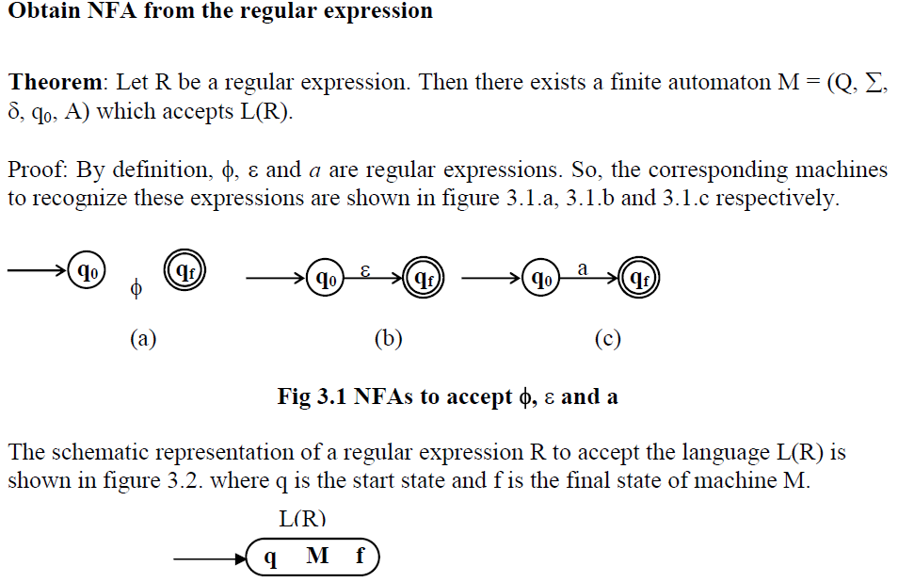

Slide 16
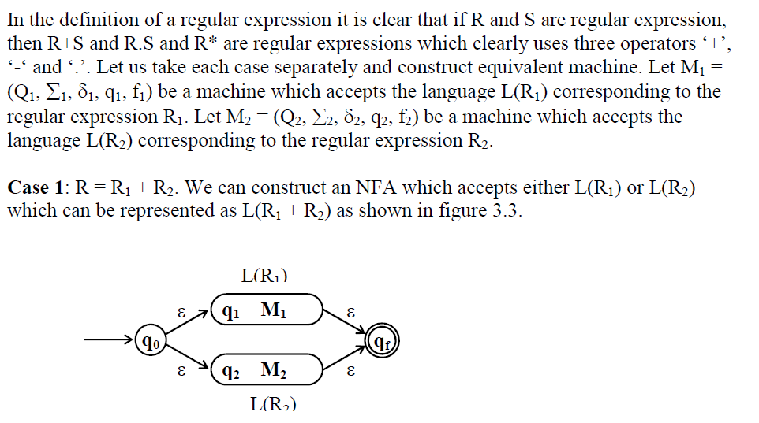


Slide 17
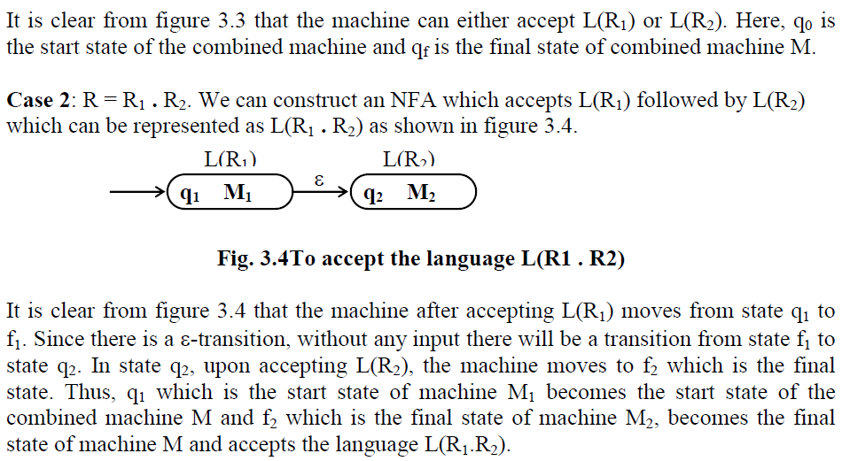

Slide 18
