Slide 1
Properties of regular language
1. Closure properties of regular languages
Used to build recognizers for languages that are constructed from other languages by certain operations.
Ex. Automata for intersection of two regular languages
2. Decision properties of regular languages
– Used to find whether two automata define the same language
– Used to minimize the states of DFA
-Eg. Design of switching circuits.

Slide 2
Closure properties of regular languages
1. The union of two regular languages is regular.
2. The intersection of two regular languages is regular.
3. The complement of a regular language is regular.
4. The difference of two regular languages is regular.
5. The reversal of a regular language is regular.
6. The closure (star) of a regular language is regular.
7. The concatenation of regular languages is regular.
8. A homomorphism (substitution of strings for symbols) of a regular language is regular.
9. The inverse homomorphism of a regular language is regular

Slide 3
Closure of regular languages under Boolean operations
Closure under Union
Theorem: If L and M are regular languages, then so is L ᴜ M.
Proof :
It is given that L and M are regular. So there exists regular expressions; say L=L(R) and M=L(S).
Then L ᴜ M = L(R+S) by the definition of the “+” operator for R.E

Slide 4
Closure of regular languages under Boolean operations
Ex1.
L1={a,a³,a⁵,-----}
L2={a²,a⁴,a⁶,-----}
L1 ᴜ L2 = {a,a²,a³,a⁴,----}
RE=a(a)*
Ex2.
L1={ ab,a² b², a³b³, a⁴b⁴,-----}
L2={ab,a³ b³,a⁵b⁵,-----}
L1 ᴜ L2 = {ab,a²b², a³b³, a⁴b⁴, a⁵b⁵----}
RE=ab(ab)*

Slide 5
Closure of regular languages under Boolean operations
Closure Under Complementation
Theorem : If L is a regular language over alphabet S, then L = Σ* - L is also a regular language.
Proof: - Let L =L(A) for some DFA. A=(Q, Σ, δ, q₀, F).
Then L = L(B), where B is the DFA (Q, Σ, δ, q₀, Q-F).
That is, B is exactly like A, but the accepting states of A have become non-accepting states of B, and vice versa, then w is in L(B) if and only if δ*( q₀, w) is in Q-F, which occurs if and only if w is not in L(A).
Ex1. L1={a,a3,a5,-----}
Σ* -L1={e,a2,a4,a6,-----}
RE=(aa)*

Slide 6
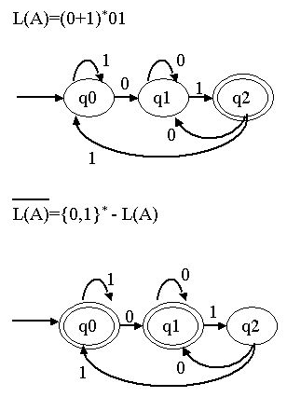
Ex2. Consider a DFA, A that accepts all and only the strings of 0’s and 1’s that end in 01. i.e L(A) = (0+1)*01. The complement of L(A) is therefore all string of 0’s and 1’s that do not end in 01

Slide 7
Closure Under Intersection
Theorem : If L and M are regular languages, then so is L ∩ M.
Proof :Let L and M be the language of automata A_{L} =(Q_{L}, Σ, δ_{L}, q_{L}, F_{L}) and A_{M} =(Q_{M}, Σ, δ_{M}, q_{M} , F_{M}).
Assume the alphabets of both automata are the same; i.e., Σ is the union of the alphabets of L and M. A_{L} and A_{M} are DFA’s.
For L ∩ M, we shall construct an automata A that simulate both A_{L} and A_{M} . Formally, we define
A =(Q_{L} x Q_{M}, Σ, δ, (q_{L} , q_{M} ) , F_{L} xF_{M} )
where δ ((p,q),a)=(δ_{L} (p,a), δ_{M}(q,a)).
“w” string is accepted by A if and only if both A_{L} and A_{M} accept w.
i.e δ_{L}*(q_{L},w) ϵ F_{L} and δ_{M}*(q_{M},w) ϵ F_{M}
Thus , A accepts the intersection of L and M.

Slide 8
Closure of regular languages under Boolean operations
Ex1.
L1={a,a²,a³,a⁴,a⁵,a⁶,-----}
L2={a²,a⁴,a⁶,-----}
L1∩L2 = {a²,a⁴,a⁶,----}
RE=aa(aa)*
Ex2
L1={ab,a³b³,a⁵b⁵,a⁷b⁷-----}
L2={a² b², a⁴b⁴, a⁶b⁶,-----}
L1∩L2 = ϕ
RE= ϕ

Slide 9

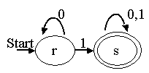
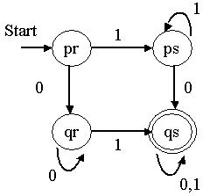
Closure of regular languages under Boolean operations
Ex3.
Consider a DFA that accepts all those strings that have a 0.
Consider a DFA that accepts all those strings that have a 1.
The product of above two automata is given below.

Slide 10
Closure of regular languages under Boolean operations
The Ex3 says:
This automaton accepts the intersection of the first two languages:
Those languages that have both a 0 and a 1.
Then pr represents only the initial condition, in which we have seen neither 0 nor 1.
Then state qr means that we have seen only once 0’s, while state ps represents the condition that we have seen only 1’s.
The accepting state qs represents the condition where we have seen both 0’s and 1’s.

Slide 11
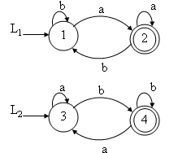
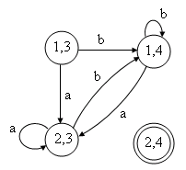
Ex 4
Write a DFA to accept the intersection of L1=(a+b)*a and L2=(a+b)*b that is for L1∩L2.
DFA for L1 ∩ L2 = ϕ (as no string has reached to final state (2,4))

Slide 12
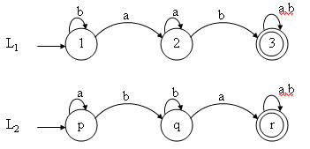
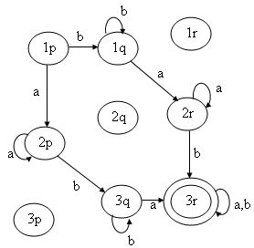
Ex5
Find the DFA to accept the intersection of L1=(a+b)*ab (a+b)* and L2=(a+b)*ba (a+b)* that is for L1 ∩ L2

Slide 13
Closure Under Difference
Theorem : If L and M are regular languages, then so is L – M.
Proof : observe that L-M= L∩M. by theorem closure under complement , M is regular, and by theorem closure under intersection L∩M is regular. Therefore L-M is regular.
Ex.
L1={a,a³,a⁵,a⁷,-----}
L2={a^{2,}a⁴,a⁶,-----}
L1-L2 = {a,a³,a⁵,a⁷----}
RE=a(a)*

Slide 14
Closure under Reversal
Closure under Reversal
Definition :
Reversal of a string:
The reversal of a string a₁a₂a₃…..a_{n} is the string written backward, i.e., a_{n}a_{n-1}……a₃a₂a₁. Denoted by w^{R}.
Ex: 0010^{R} is 0100 and ε^{R} is ε.
Reversal of a language:
It is a language consisting of the reversals of all its strings. Denoted by L^{R}
Ex.
L={001,10,111,01}
L^{R}={100,01,111,10}

Slide 15
Closure under Reversal
Theorem : If L is a regular language, then L^{R} is regular.
Proof based on automata:
As L is regular it can be defined by an FA, M = (Q, Σ , δ, q0, F), having only one final state.
If there are more than one final states, we can use ε- transitions from the final states going to a common final state.
Let FA, M^{R} = (Q^{R}, Σ ^{R} , δ ^{R},q₀^{R},F^{R}) defines the language L^{R}, Where Q^{R} = Q, Σ ^{R} = Σ, q₀^{R}=F,F^{R}=q₀, and δ ^{R} (p,a)-> q, iff δ(q,a) -> p.
Since M^{R} is derivable from M, L^{R} is also regular.

Slide 16
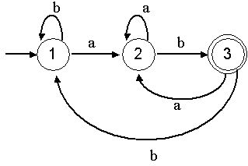
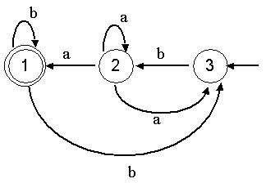
Closure under Reversal
The proof implies the following method
1. Reverse all the transitions.
2. Swap initial and final states.
3. Create a new start state p₀ with transition on ε to all the accepting states of original DFA.
Example:Let r=(a+b)* ab define a language L.
That is L = {ab, aab, bab,aaab, -----}. The FA is as given below
The FA for L^{R} can be derived from FA for L by swapping initial and final states and changing the direction of each edge. It is shown in the above right figure.

Slide 17
Closure under Reversal
Proof based on regular expression:
Let L is the language corresponding to regular expression E.
It is required to P.T there is another regular expression E^{R} such that L(E^{R})=(L(E))^{R} .
Which is read as “language of E^{R} is the reversal of language of E”.
Basis: By definition of R.E, we have ϕ, ε and a are R.E.
So, the reversal of regular expression E^{R} is given by:
{ε}^{R}={ε}
{ϕ}^{R} = ϕ
{a}^{R}={a}

Slide 18
Closure under Reversal
Induction: Again, by definition of R.E, if E1 and E2 are regular expressions, then: E1+E2 , E1.E2 and E1* regular expressions.
Case 1: E=E1+E2 is a R.E, then
E^{R}=E1^{R}+E2^{R}
Is a R.E denoting the languages:
L(E^{R})=L(E1^{R}) ᴜ L(E2^{R})
Case 2: E=E1.E2 is a R.E, then
E^{R}=E1^{R}.E2^{R}
Is a R.E denoting the languages:
L(E^{R})=L(E1^{R}).L(E2^{R})
Case 3: E=E1* is a R.E, then
E^{R}=E1^{R}
Is a R.E denoting the languages:
L(E^{R})=L(E1^{R})

Slide 19
Closure under Homomorphism
Homomorphism:
Definition : A string homomorphism is a function on strings that works by substituting a particular string for each symbol.
OR
Definition : Let Σ and Г are set of alphabets. The homomorphic function
h: Σ → Г*
is called Homomorphism i.e., a substitute where a single letter is replaced by a string. If w=a₁a₂a₃…..a_{n}, then h(w)=h(a₁)h(a₂)…….h(a_{n}).
If L is made of alphabets from Σ, then h(L)={ h(w) | w ϵ L} is called homomorphic image.

Slide 20
Closure under Homomorphism
Example 1: Let Σ={0,1} , Г ={0,1,2} and h(0)=01, h(1)=112. what is h(010)? If L={00,010}. What is homomorphic image of L?
Soln: By definition, h(w)=h(a₁)h(a₂)…….h(a_{n}).
So,
h(010)=h(0)h(1)h(0)
h(010)=0111201
L(00,010)=L ( h(00),h(010) )
=L( h(0)h(0), h(0)h(1)h(0) )
L(00,010)=L( 0101 , 0111201 )

Slide 21
Closure under Homomorphism
Example 2: Let Σ={0,1} , Г ={1,2,3} and h(0)=3122, h(1)=132. what is (0+1)*(00)*?
Soln: By definition, h(w)=h(a₁)h(a₂)…….h(a_{n}).
So,
(0+1)*(00)*=(h(0)+h(1))* (h(0)h(0))*
(0+1)*(00)*=(3122+132)* (31223122)*

Slide 22
Closure under Homomorphism
Theorem : If L is a regular language over alphabet Σ, and h is a homomorphism on Σ, then homomorphic image h (L) is also regular.
Proof : Let R be the regular expression and L(R) be the corresponding regular language.
We can easily find h(R) by substituting h(a) for each a in Σ .
By definition of regular expression , h(R) is a regular expression and so h(L) is regular language.
So, the regular language is closed under homomorphism.

Slide 23
Closure under Homomorphism
Inverse Homomorphism
Theorem : If h is a homomorphism from alphabet S to alphabet T, and L is a regular language over T, then h⁻¹ (L) is also a regular language.
Ex. Let L be the language of regular expression (00+1)*.
Let h be the homomorphism defined by h(a)=01 and h(b)=10. Then h⁻¹(L) is the language of regular expression (ba)*.

Slide 24
Decision properties of regular languages
1. Is the language described empty?
2. Is a particular string w in the described language?
3. Do two descriptions of a language actually describe the same language?
This question is often called “equivalence” of languages.

Slide 25
Converting Among Representations
Consider the time complexity of each of the conversions.
Converting NFA’s to DFA’s
Time taken for either an NFA or ε-NFA to DFA can be exponential in the number of states of the NFA.
Computing ε -Closure of n states takes O(n³) time.
Computation of DFA takes O(n³) time where number of states of DFA can be 2^{n}.
The running time of NFA to DFA conversion including ε transition is O(n³ 2^{n}).
Therefore the bound on the running time is O(n³s) where s is the number of states the DFA actually has.
DFA to NFA Conversion
Conversion takes O(n) time for an n state DFA.

Slide 26
Converting Among Representations
Automaton to Regular Expression Conversion
For DFA where n is the number of states,
Conversion takes O(n³4^{n}) by substitution method and
by state elimination method conversion takes O(n³) time.
If we convert an NFA to DFA and then convert the DFA to a regular expression it takes the time O(n³ 4^{n3} 2^{n}).
Regular Expression to Automaton Conversion
Regular expression to ε-NFA takes linear time – O(n) on a regular expression of length n.
Conversion from ε -NFA to NFA takes O(n³) time.

Slide 27
Testing Emptiness of Regular Languages
Suppose R is regular expression, then
1. R = R1 + R2. Then L(R) is empty if and only if both L(R1) and L(R2) are empty.
2. R= R1R2. Then L(R) is empty if and only if either L(R1) or L(R2) is empty.
3. R=(R1)* Then L(R) is not empty. It always includes at least ε
4. R=(R1) Then L(R) is empty if and only if L(R1) is empty since they are the same language.

Slide 28
Testing Membership in a Regular Language
Given a string w and a Regular Language L, is w in L.
If L is represented by a DFA, simulate the DFA processing the string of input symbol w, beginning in start state. If DFA ends in accepting state the answer is ‘Yes’ , else it is ‘no’. This test takes O(n) time
If the representation is NFA, if w is of length n, NFA has s states, running time of this algorithm is O(ns²)
If the representation is ε - NFA, ε - closure has to be computed, then processing of each input symbol , a , has 2 stages, each of which requires O(s²) time.
If the representation of L is a Regular Expression of size s, we can convert to an ε -NFA with almost 2s states, in O(s) time. Simulation of the above takes O(ns2) time on an input w of length n.

Slide 29
Applications of Context – Free Grammars
1. Grammars are used to describe programming language. Turning the language description as a CFG into Parser.
Parser: the component of the compiler that discover the structure of the source program and represent the structure by a parse tree.
2. Development of XML(Extensible Markup Language):- an essential part of XML is Document type Definition(DTD), which is essentially a CFG that describes the allowable tags and the way in which these tags may be nested.

Slide 30
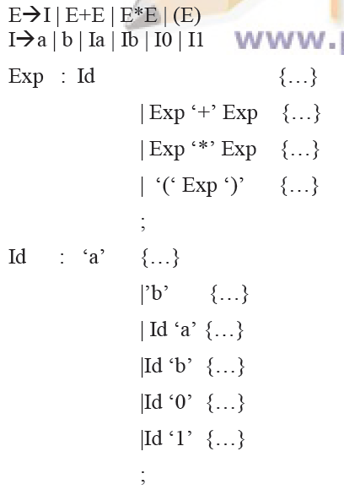
Applications of Context – Free Grammars
The YACC Parser Generation
The generation of a parser has been institutionalized in the YACC command that appears in all YACC system. The input to YACC is CFG.

Slide 31
Applications of Context – Free Grammars
Markup Language:
The string in these language are document with certain marks(tags),
Functions
•Creating links between documents
•Describing the format of the document

Slide 32
Example
The Things I hate
1. Moldy bread
2. People who drive too slow
In the fast lane
HTML Source
<P> The things I <EM>hate</EM>:
<OL>
<LI> Moldy bread
<LI>People who drive too slow
In the fast lane
</OL>

Slide 33
HTML Grammar
•Char a | A | …
•Text e | Char Text
•Doc e | Element Doc
•Element Text |
<EM> Doc </EM>|
<p> Doc |
<OL> List </OL>| …
5. List-Item <LI> Doc
6. List e | List-Item List Start symbol

