Slide 1
INTER PROCESS COMMUNICATION
PUTTASWAMY B.S
Assistant Professor

Slide 2
What is Process Communication ?
The sharing of meaningful information between two or more people with the goal of the receiver understanding the sender's intended message.
Communication is a process of exchanging verbal and non verbal messages.
The term communication process refers to the exchange of information (a message) between two or more people.

Slide 3
What is IPC ?
PROCESS : Running program is called a process.
Processes executing concurrently in the operating system.
PROCESS Types: independent processes or cooperate processes.

Slide 4
independent processes: A process is independent if it cannot affect or be affected by the other processes executing in the system. Any process that does not share data with any other process is independent.

Slide 5
cooperating processes: A process is cooperating if it can affect or be affected by the other processes executing in the system. Clearly, any process that shares data with other processes is a cooperating process.

Slide 6
Reasons for providing an environment that allows process cooperation(Advantages of process cooperation)
Information sharing: Several users may be interested in the same piece of information, we must provide an environment to allow concurrent access to such information.
Computation speedup: If we want a particular task to run faster, we must break it into subtasks, each of which will be executing in parallel with the others. Notice that such a speedup can be achieved only if the computer has multiple processing elements (such as CPUs or I/O channels).

Slide 7
Modularity: We may want to construct the system in a modular fashion, dividing the system functions into separate processes or threads.
Convenience: Even an individual user may work on many tasks at the same time. For instance, a user may be editing, printing, and compiling in parallel.

Slide 8
Dangers of process cooperation ( Disadvantages of process cooperation)
Data corruption,
Deadlocks,
increased complexity
Requires processes to synchronize their processing

Slide 9
Cooperating processes require an inter-process communication (IPC) mechanism that will allow them to exchange data and information.
IPC : Exchange of data between two or more
separate, independent processes
Operating systems provide facilities for
inter-process communications(IPC).

Slide 10
Inter Process Communication

Slide 11
Introduction
For two processes to communicate with each other, they must both agree to it, and the operating system must provide some facilities for the interprocess communication (IPC)
User process
User process
Kernel
IPC between two processes
on a single system

Slide 12
User process
User process
Kernel
Kernel
IPC between two processes on different systems

Slide 13
UNICAST AND MULTICAST IPC
When communication is from one process to a single other process, the IPC is said to be a unicast.
e.g. Socket communication.
When communication is from one process to a group of processes, the IPC is said to be a multicast. Ex: Publish/Subscribe Message model.

Slide 14
Unicast Vs. Multicast

Slide 15
Purposes for IPC
Data Transfer
Sharing Data
Event notification
Resource Sharing and Synchronization
Process Control

Slide 16
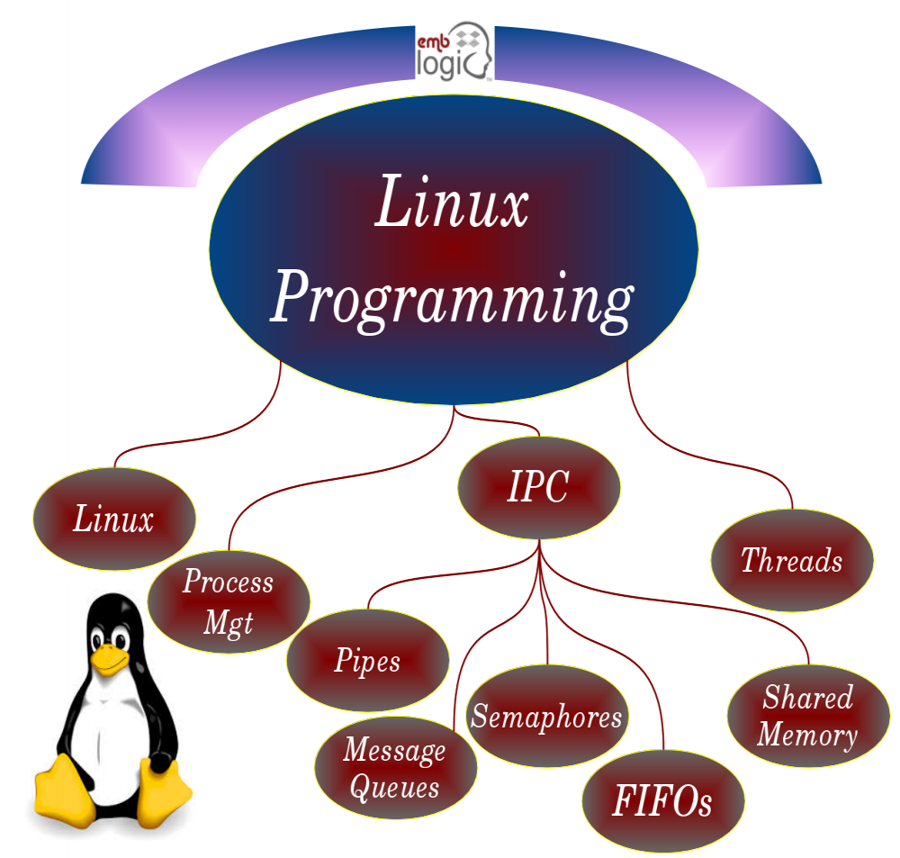
IPC Mechanisms
There are various ways in UNIX to share information.

Slide 17
Pipes
Pipes are the oldest form of UNIX System IPC and are provided by all UNIX systems

Slide 18


Slide 19
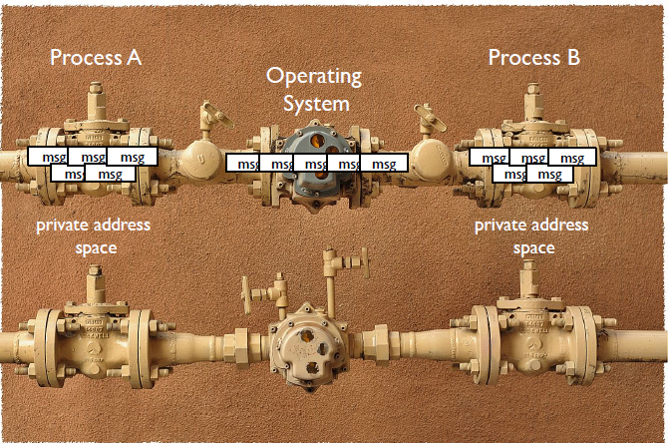

Slide 20
Pipes
Most basic form of IPC on all Unix systems
A unidirectional data channel.
Data written to the write end of the pipe is buffered by the operating system until it is read from the read end of the pipe.
A pipe provides a one-way flow(Half-Duplex) of data.
A pipe is created by the pipe system call.
Two file descriptors are returned- filedes[0] which is open for reading , and filedes[1] which is open for writing.

Slide 21
create pipes by using Pipe function, which returns two files (a read file and a write file) descriptor in an integer array format.
In C and C++ Programming Language, Interprocess Communications (IPC) Functions can be obtained from unistd.h

Slide 22
Characteristics of PIPE
Unix pipes only allow unidirectional communication.
Communication between parent-child.
Processes must be in the same OS.
Pipes exist only until the processes exist.
Data can only be collected in FIFO order.

Slide 23
Pipes have two limitations
Historically, they have been half duplex (i.e., data flows in only one direction).
Pipes can be used only between processes that have a common ancestor. Normally, a pipe is created by a process, that process calls fork, and the pipe is used between the parent and the child.

Slide 24
Pipes are used for unidirectional communication of related process only.
The main limitation of the data to be passed.
Yes, the capacity of data to be sent through pipes are limited.
standard communication the output of one pipe can be given as an input of another pipe.
It is not necessary to free them after the process has been finished.

Slide 25
Do we need to create pipes for child process separately?
the child process will automatically inherits it.
The process of sending and receiving the data are done in a linear fashion.
The pipes can be either blocked or unblocked.

Slide 26
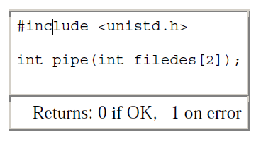
A pipe is created by calling the pipe function

Slide 27
Two file descriptors are returned through the fd argument:
fd[0] is open for reading,
fd[1] is open for writing.
The output of fd[1]is the input for fd[0].

Slide 28
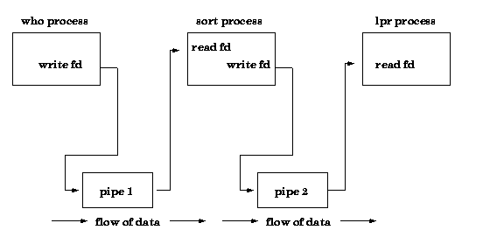
Example:- who | sort | lpr

Slide 29
Pipes commonly used in most Unix shells
output of one command is input to the next command
example: ls| more
create a pipe
create a process to run ls
create a process to run more
the standard output of the process to run ls is forwarded to a pipe streaming to the process to run more
the standard input of the process to run more is send to be the pipe from the process running ls

Slide 30
POSIX.1 allows for an implementation to support full-duplex pipes.
For these implementations, filedes[0] and
filedes[1] are open for both reading and writing.

Slide 31
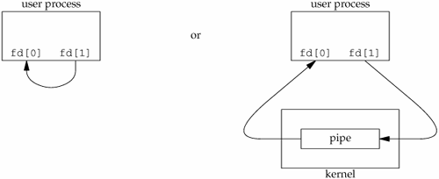
Two ways to picture a half-duplex pipe

Slide 32
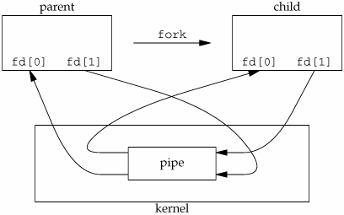
A pipe in a single process is useless.
Normally, the process that calls pipe then calls fork, creating an IPC channel from the parent to the child or vice versa

Slide 33
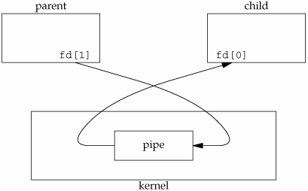
What happens after the fork depends on which direction of data flow we want.
For a pipe from the parent to the child, the parent closes the read end of the pipe (fd[0]), and the child closes the write end (fd[1]).

Slide 34
a pipe from the child to the parent, the parent closes fd[1], and the child closes fd[0].
When one end of a pipe is closed, the following two rules apply.
If we read from a pipe whose write end has been closed, read returns 0 to indicate an end of file after all the data has been read.
If we write to a pipe whose read end has been closed, the signal SIGPIPE is generated. If we either ignore the signal or catch it and return from the signal handler, write returns –1 with errno set to EPIPE.

Slide 35
writing to a pipe, the constant PIPE_BUF specifies the kernel's pipe buffer size.
Determine the value of PIPE_BUF by using pathconf or fpathconf

Slide 36
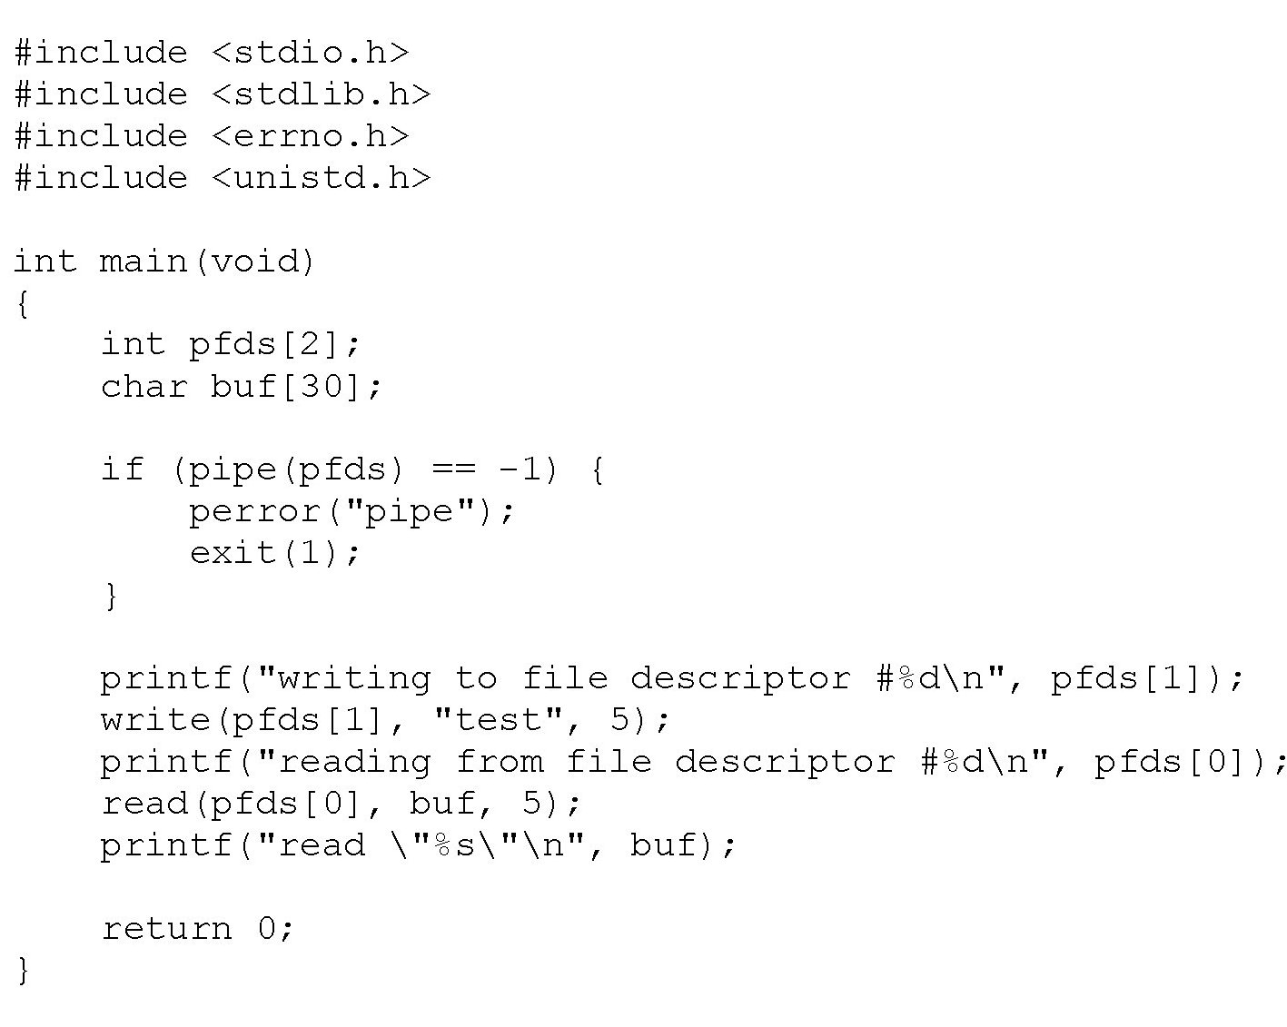
program creates, writes to, and reads from a pipe.

Slide 37
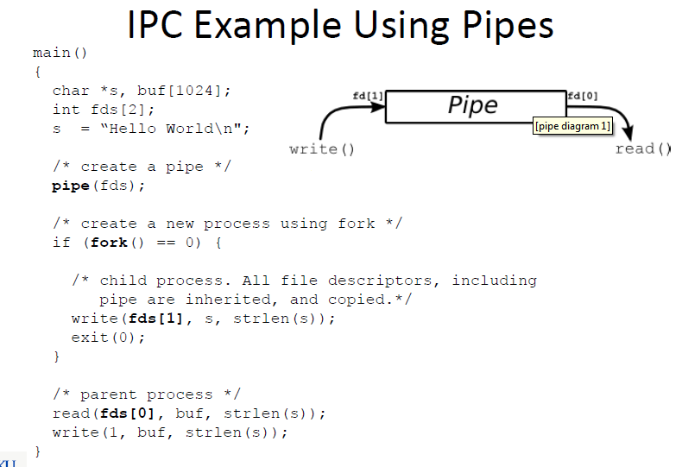

Slide 38
create a pipe between a parent and its child and to send data down the pipe.
First, we'll have the parent make a pipe. Secondly, we'll fork().
Now, the fork() man page tells us that the child will receive a copy of all the parent's file descriptors, and this includes a copy of the pipe's file descriptors.

Slide 39
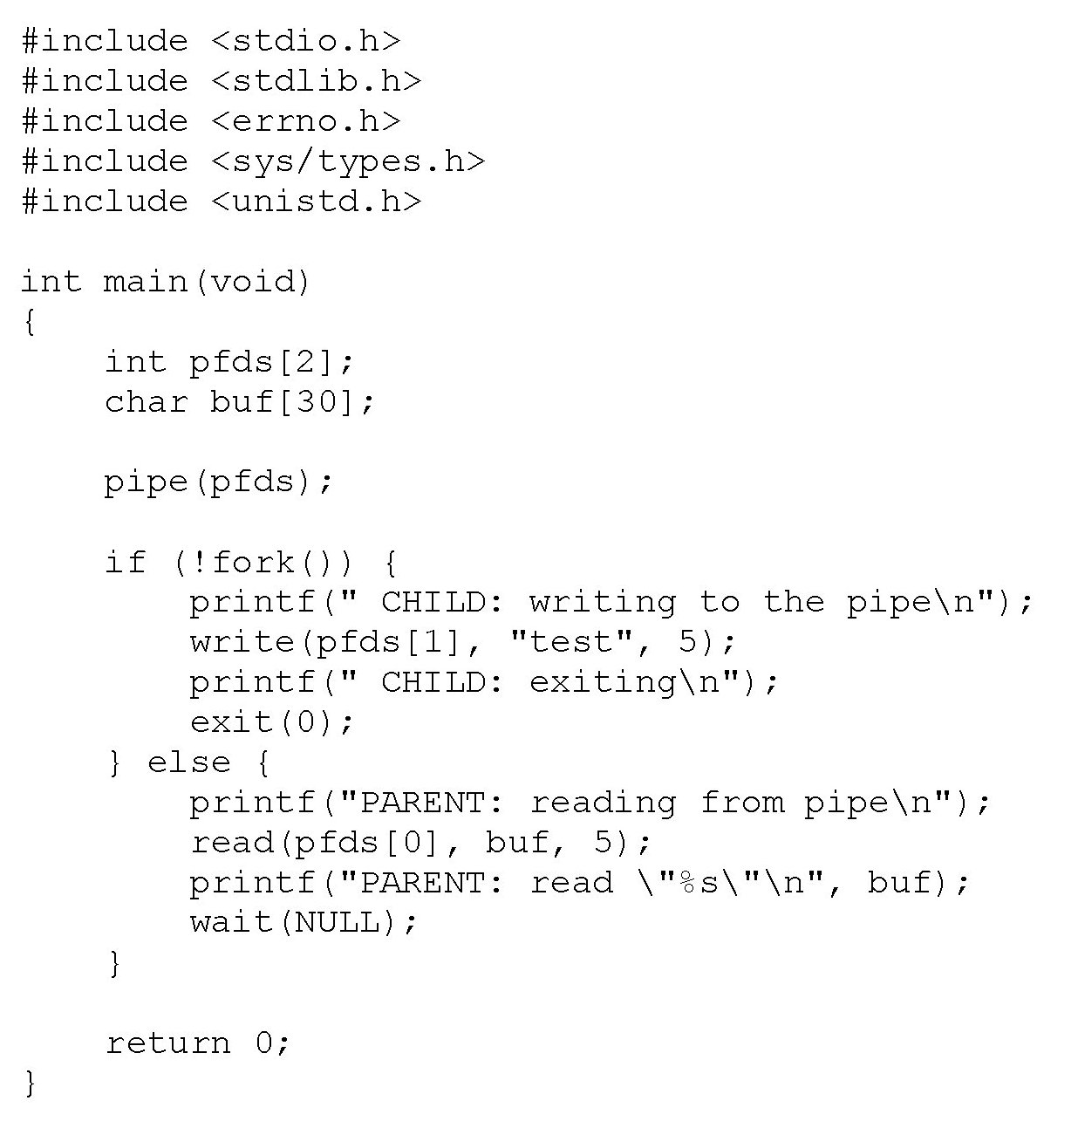

Slide 40
popen and pclose Functions
a common operation is to create a pipe to another process, to either read its output or send it input,
the two functions are: popen and pclose functions.
popen - start pipe streams to or from a process.
pclose – stop a pipe streams to or from a process.
These two functions handle all the unclean work that we've been doing ourselves: creating a pipe, forking a child, closing the unused ends of the pipe, executing a shell to run the command, and waiting for the command to terminate.

Slide 41
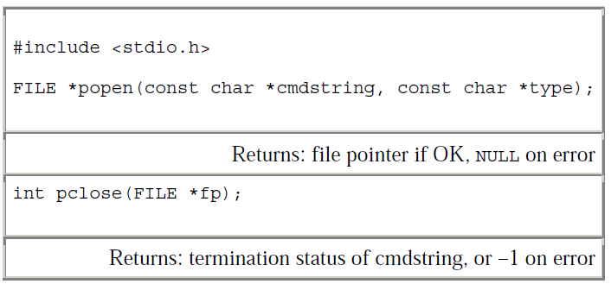
Syntax

Slide 42
The popen() function shall execute the command specified by the string command.
It shall create a pipe between the calling program and the executed command, and shall return a pointer to a stream that can be used to either read from or write to the pipe.

Slide 43
The mode argument to popen() is a string that specifies I/O mode
If mode is r, when the child process is started, its file descriptor STDOUT_FILENO shall be the writable end of the pipe, and the file descriptor fileno(stream) in the calling process,
If mode is w, when the child process is started its file descriptor STDIN_FILENO shall be the readable end of the pipe, and the file descriptor fileno(stream) in the calling process,
If mode is any other value, the result is undefined.
After popen(), both the parent and the child process shall be capable of executing independently before either terminates.

Slide 44

If type is "r", the file pointer is connected to the standard output of cmdstring

Slide 45

If type is "w", the file pointer is connected to the standard input of cmdstring.

Slide 46
RETURN VALUE
Upon successful completion, popen() shall return a pointer to an open stream that can be used to read or write to the pipe.
Otherwise, it shall return a null pointer and may set errno to indicate the error.

Slide 47
The pclose function closes the standard I/O stream, waits for the command to terminate, and returns the termination status of the shell.
If the shell cannot be executed, the termination status returned by pclose is as if the shell had executed exit.

Slide 48
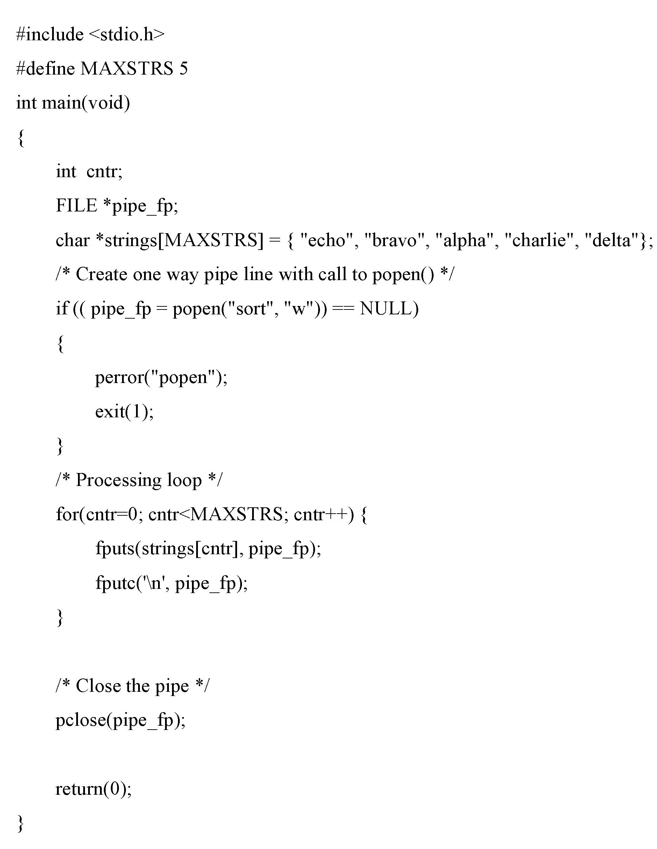

Slide 49
FIFOs
It is a type of Inter-process Communication method.
First In First Out.
It is also called Named Pipes.
FIFO used to exchange information between two processes.
Unrelated processes can exchange data.

Slide 50
Named pipes allow two unrelated processes to communicate with each other.
It is used to establish a one-way (half-duplex) flow of data.
Creating a Named Pipe:
The command line or from within a program.
Command line - use either the "mknod" or "mkfifo" commands.
The function "mkfifo" can be used to create a named pipe from within a program.

Slide 51
Synopsis:
#include <sys/types.h>
#include <sys/stat.h>
int mkfifo(const char *pathname, mode_t mode);
Description and Parameters:
mkfifo() makes a FIFO special file with name pathname.
mode specifies the FIFO's permissions.

Slide 52
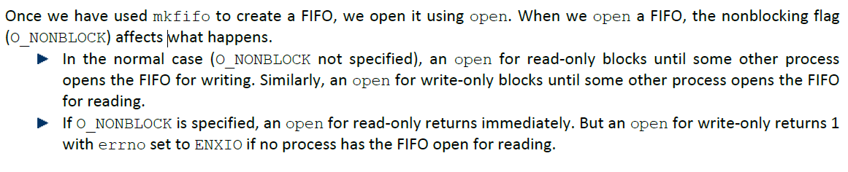
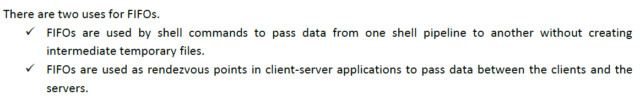

Slide 53
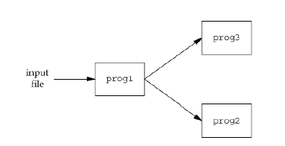
Example Using FIFOs to Duplicate Output Streams
FIFOs can be used to duplicate an output stream in a series of shell commands.
This prevents writing the data to an intermediate disk file.
Consider a procedure that needs to process a filtered input stream twice.

Slide 54
With a FIFO and the UNIX program tee(1), we can accomplish this procedure without using a temporary file.
The tee program copies its standard input to both its standard output and to the file named on its command line.
mkfifo fifo1
prog3 < fifo1 &
prog1 < infile | tee fifo1 | prog2
We create the FIFO and then start prog3 in the background, reading from the FIFO. We then start prog1 and use tee to send its input to both the FIFO and prog2.

Slide 55
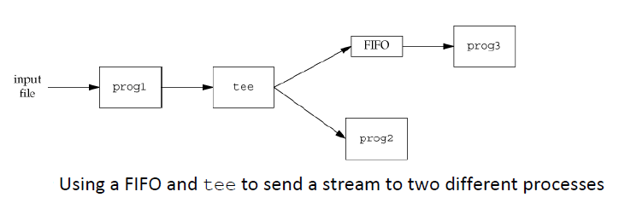

Slide 56
Example Client-Server Communication Using a FIFO
FIFO’s can be used to send data between a client and a server.
A server that is contacted(Connected) by numerous clients, each client can write its request to a well-known FIFO that the server creates.
well-known FIFO means pathname of the FIFO is known to all the clients that need to connect it.

Slide 58
There are multiple writers for the FIFO, the requests sent by the clients to the server need to be less than PIPE_BUF bytes in size.
prevents any interleaving of the client writes.
The problem in using FIFOs for this type of client server communication is how to send replies back from the server to each client.

Slide 59
A single FIFO can’t be used, as the clients would never know when to read their response versus responses for other clients.
One solution is for each client to send its process ID with the request.
The server then creates a unique FIFO for each client, using a pathname based on the client’s process ID.
▪ For example, the server can create a FIFO with the name /tmp/ serv1.XXXXX, where XXXXX is replaced with the client’s process ID.

Slide 61
Message Queue
What is Message Queue?
message queues is a method is used for inter-process communication (IPC).
use a queue for messaging – the passing of control or of content.
A message queue is a linked list of messages stored within the kernel.
Message Queue are identified by a message queue identifier.

Slide 62
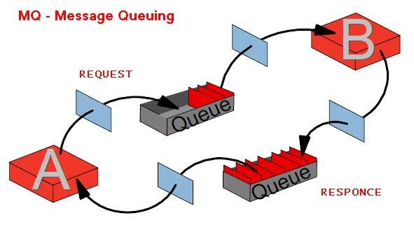
Message queues provide an asynchronous communications.
Asynchronous communications means the sender and receiver of the message do not need to interact with the message queue at the same time.
Messages placed onto the queue are stored until the recipient retrieves them.

Slide 63
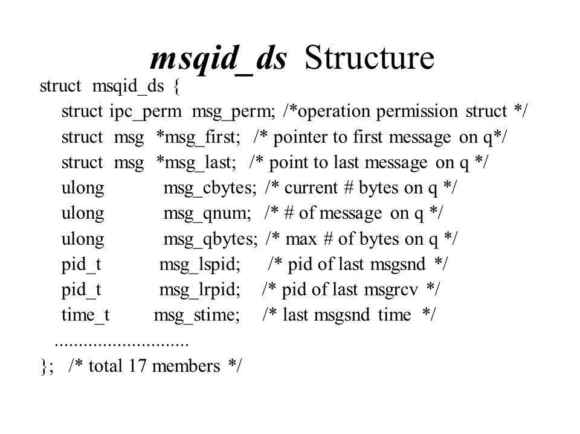
The sending process places message onto a queue which can be read by another process.
Each message is given an identification or type so that processes can select the appropriate message.
Before we start sending/receiving message, we have to initialize message queue.
Each queue contains the msqid_ds structure associated with it:

Slide 64
A new queue is created or an existing queue opened by calling msgget() function
msgget - get a message queue identifier.
Synopsis
#include <sys/types.h>
#include <sys/ipc.h>
#include <sys/msg.h>
int msgget(key_t key, int msgflg);

Slide 65
DESCRIPTION
The msgget() system call returns the message queue identifier associated with the value of the key argument.
A new message queue is created if key has the value IPC_PRIVATE .
msgflg specifies both IPC_CREAT and IPC_EXCL and a message queue already exists for key, then msgget() fails with errno set to EEXIST.
Return Value
If successful, return the message queue identifier, otherwise -1 with errno indicating the error.

Slide 66
On success, msgget returns the non-negative queue ID. This value is then used with the other three message queue functions.
msgctl - message control operations
SYNOPSIS
#include <sys/types.h>
#include <sys/ipc.h>
#include <sys/msg.h>
int msgctl(int msqid, int cmd, struct msqid_ds *buf);
RETURN VALUE
successful completion - msgctl() shall return 0; otherwise, it shall return -1 and set errno to indicate the error.

Slide 67
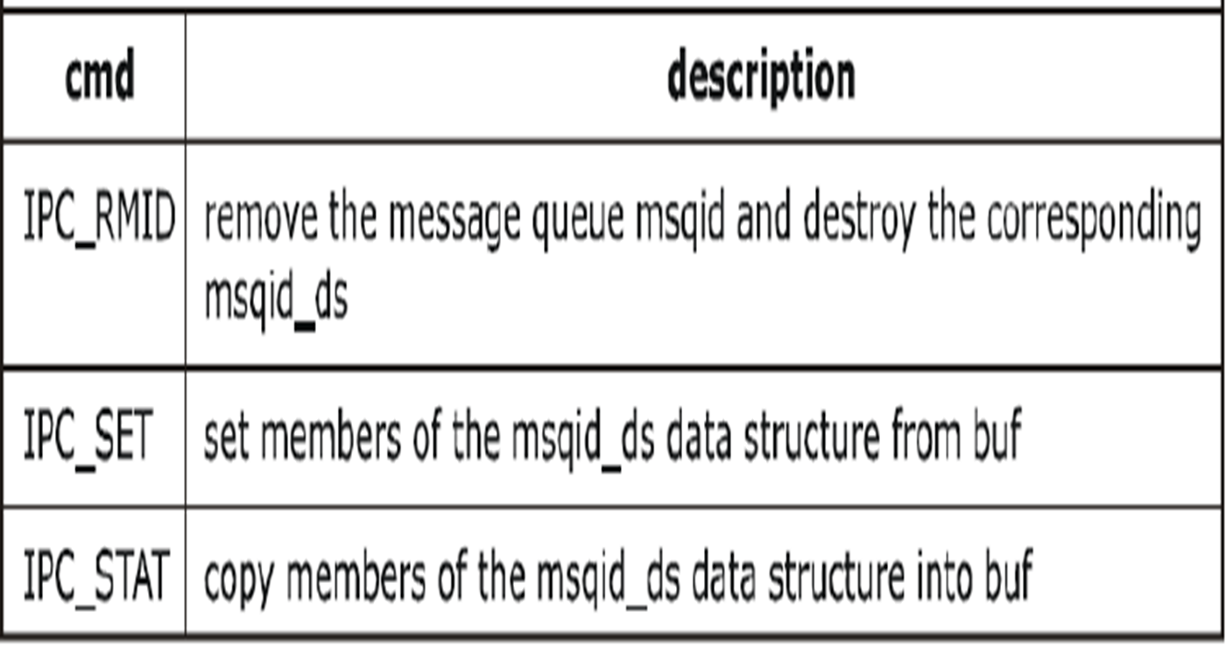
DESCRIPTION:
msgctl() performs the control operation specified by cmd on the message queue with identifier msqid.
The values for cmd, and the message control operations they specify, are:

Slide 68
Data is placed onto a message queue by calling msgsnd function
Synopsis
#include <sys/types.h>
#include <sys/ipc.h>
#include <sys/msg.h>
int msgsnd(int msqid, const void *ptr, size_t msgsz, int msgflg);
Return Value
On failure functions return -1 with errno indicating the error, otherwise msgsnd() returns 0

Slide 69
Description:
The msgsnd() function sends a message to the queue associated with message queue identifier msqid.
if the call completes successfully, the following actions are taken with respect to the data structure (msqid_ds) associated with msqid:
msg_qnum is incremented by 1.
msg_lspid is set to the process ID of the calling process.
msg_stime is set to the current time.

Slide 70
PARAMETERS
msqid Is a unique positive integer, created by msgget(), that identifies a message queue and its associated data structure.
ptr Points to a user-defined buffer.
msgsz Is the length of the message to be sent.
msgflg Specifies the action to be taken

Slide 71
msgrcv – messages are retrieved or read from a queue.
Synopsis
#include <sys/types.h>
#include <sys/ipc.h>
#include <sys/msg.h>
int msgrcv(int msqid, void *msgp, size_t msgsz, long msgtyp, int msgflg);

Slide 72
DESCRIPTION
The msgrcv() function reads a message from the queue associated with the message queue identifier that msqid specifies and places it in the user-defined structure that msgp points to.
When successfully completed, the following actions are taken with respect to the data structure associated with msqid:
msg_qnum is decremented by 1.
msg_lrpid is set to the process ID of the calling process.
msg_rtime is set to the current time.

Slide 73
PARAMETERS
msqid - it is a unique positive integer, created by a msgget() call, that identifies a message queue.
msgp - Points to a user-defined buffer.
msgsz - Specifies the size, in bytes, of mtext.
msgtyp Specifies the type of message requested. msgflg - Specifies the action to be taken if a message of the desired type is not in the queue.

Slide 74
Semaphore
semaphores are a technique for coordinating the activities in which multiple processes compete for the same operating system resources.
A semaphore is a counter used to provide access to a shared data object for multiple processes.

Slide 75
To obtain a shared resource, a process needs to do the following:
1. Test the semaphore that controls the resource.
2. If the value of the semaphore is positive, the process can use the resource. In this case, the process decrements the semaphore value by 1, indicating that it has used one unit of the resource.
3. Otherwise, if the value of the semaphore is 0, the process goes to sleep until the semaphore value is greater than 0. When the process wakes up, it returns to step 1.

Slide 76
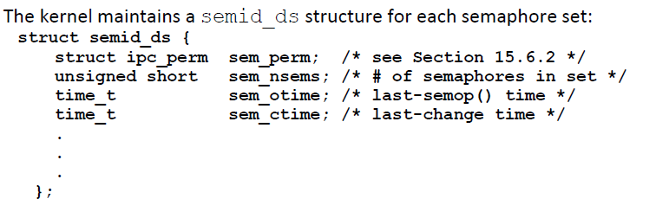
A common form of semaphore is called a binary semaphore. It controls a single resource, and its value is initialized to 1.
The kernel maintains a semid_ds structure for each semaphore set:

Slide 77
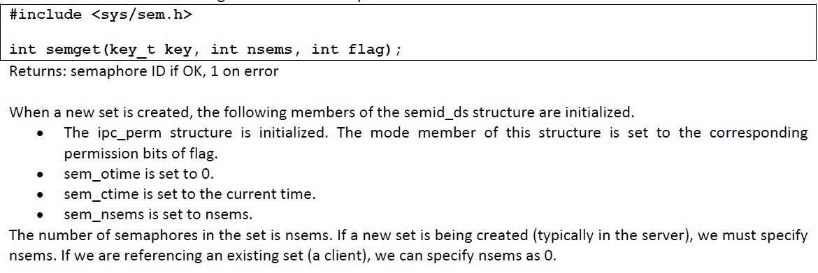
function to call is semget to obtain a semaphore ID

Slide 78
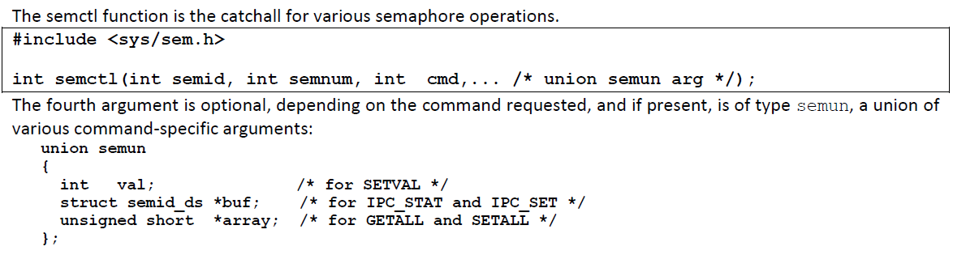

Slide 79
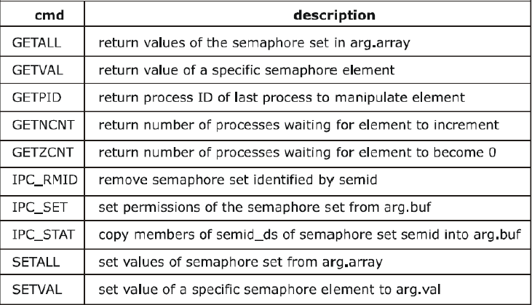

Slide 80
function semop automatically performs an array of operations on a semaphore set.
#include <sys/types.h>
#include <sys/ipc.h>
#include <sys/sem.h>
int semop(int semid, struct sembuf *sops, unsigned nsops);
Returns: 0 if OK, 1 on error.

Slide 81
Shared Memory
What is shared memory?
Shared memory (SHM) is one method of inter-process communication (IPC) whereby 2 or more processes share a single amount of memory to communicate.
Memory
Memory Segment
Process 1
Process 2
…
Process n

Slide 82
To obtain shared memory identifier
To create or get access to an already created shared memory we use the function shmget (shared memory get).
shmget - allocates a shared memory segment(identifier).
Synopsis:-
#include <sys/ipc.h> #include <sys/shm.h>
int shmget(key_t key, size_t size, int shmflg);

Slide 83
Arguments
key : The key used by the process to identify the shared memory, it is assigned by the process and the other processes which want to communicate with this shared memory need to know this key. size: The size of the shared memory that is allocated. flag: If the shared memory is being created then we can use the flag IPC_CREAT as the flag.
If we are trying the get access to a shared memory already created then we can pass the mode flag specifying the rights for owner, group.

Slide 84
shmctl - shared memory control operations
SYNOPSIS
#include <sys/shm.h>
int shmctl(int shmid, int cmd, struct shmid_ds *buf);
DESCRIPTION
The shmctl() function provides a variety of shared memory control operations as specified by cmd
The following values for cmd are available:
1. IPC_STAT: Place the current value of each member of the shmid_ds data structure associated with shmid into the structure pointed to by buf.
2. IPC_SET: Set the value of the following members of the shmid_ds data structure associated with shmid to the corresponding value found in the structure pointed to by buf.
3. IPC_RMID: Remove the shared memory identifier specified by shmid from the system and destroy the shared memory segment and shmid_ds data structure associated with it.
RETURN VALUE
successful -shmctl() returns 0. Otherwise, it returns -1 and errno will be set to indicate the error.

Slide 85
Once a shared memory segment has been created, a process attaches it to its address space by calling shmat.
SYNOPSIS
#include <sys/shm.h>
void *shmat(int shmid, const void *shmaddr, int shmflg);
DESCRIPTION
The shmat() function attaches the shared memory segment associated with the shared memory identifier shmid to the data segment of the calling process.

Slide 86
The segment is attached at the address specified by one of the following criteria:
If shmaddr is a NULL pointer, the segment is attached at the first available address as selected by the kernal.
If shmaddr is not a NULL pointer and SHM_RND is non-zero, the segment is attached at the address given by addr.
If addr is nonzero and SHM_RND is specified, the segment is attached at the address given by (addr - (addrmodulus SHMLBA)).
SHM_RND stands for "round."
SHMLBA stands for "low boundary

Slide 87
shmdt - shared memory detach operation
shmat() attaches the shared memory segment identified by shmid to the address space of the calling process.
The attaching address is specified by shmaddr .
shmdt() detaches the shared memory segment located at the address specified by shmaddr from the address space of the calling process.
SYNOPSIS
#include <sys/shm.h>
int shmdt(const void *shmaddr);

Slide 88
DESCRIPTION:
The shmdt() function detaches the shared memory segment located at the address specified by shmaddr. from the address space of the calling process.
Return Value:
On success shmdt() returns 0; on error -1 is returned, and errno is set to indicate the cause of the error.

Slide 89
Coprocesses
A co process is a special two-way pipeline.
A Coprocess is also called filter.
It allows shell scripts to write to the standard input of another command and to read from its standard output.
It provides a way to create a new interface for an existing program.

Slide 90
The append operator, & , is placed at the end of the command to initiate the command as a coprocess.
Normal redirection and background processing should not be used on coprocesses.

