Slide 1
SIGNALS

Slide 2
introduction
What is signal?
Signals are a limited form of inter-process communication used in UNIX, Unix-like, and other POSIX-compliant operating systems.
A signal is an asynchronous notification or software interrupt (disturbs) sent to a process or to a specific thread within the same process in order to notify it of an event that occurred.

Slide 3
The operating system uses signals to report exceptional situations to an executing program.
When a signal is sent, the operating system interrupts (disturbs) the target process' normal flow of execution to deliver the signal.

Slide 4
Signal is a notification, a message sent by either operating system or some application to your program (or one of its threads).
SIGABRT – abnormal termination.
SIGALRM – timer expired.
SIGBUS – Hardware fault.
SIGCHLD – change in status of child.
SIGILL – illegal instruction.

Slide 5
SIGIO – Asynchronous I/O.
SIGPIPE – write to pipe no readers.
SIGSYS – invalid system call.
SIGTERM – termination.
SIGQUIT – terminal quit character.
SIGPWR – power fail/restart.
Etc.

Slide 6
When a signal is sent to a process, it is pending on the process to handle it.
The process can react to pending signals in one of three ways:
Accept the default action of the signal, which for most signals will terminate the process.
Ignore the signal. The signal will be discarded and it has no affect whatever on the recipient process.
Invoke a user-defined function. The function is known as a signal handler routine and the signal is said to be caught when this function is called.

Slide 7
THE UNIX KERNEL SUPPORT OF SIGNALS
When a signal is generated for a process, the kernel will set the corresponding signal flag in the process table slot of the recipient process.
If the recipient process is asleep, the kernel will awaken the process by scheduling it.
When the recipient process runs, the kernel will check the process U-area that contains an array of signal handling specifications.

Slide 8
If array entry contains a zero value, the process will accept the default action of the signal.
If array entry contains a 1 value, the process will ignore the signal and kernel will discard it.
If array entry contains any other value, it is used as the function pointer for a user-defined signal handler routine.

Slide 9
SIGNAL() Function
All UNIX systems and ANSI – C support the signal API.
Signal API used to define the signal handling method.

Slide 10
argument of the API are:
sig_no argument is a signal identifier like SIGINT or SIGTERM.
It is defined in the <signal.h> header.
2. handler argument is the function pointer of a user-defined signal handler function.
Does not return any value.

Slide 11
#include<iostream.h>
#include<signal.h> /*signal handler function*/ void catch_sig(int sig_num)
{
signal (sig_num,catch_sig);
cout<<”catch_sig:”<<sig_num<<endl;
}
/*main function*/
int main()
{
signal(SIGTERM,catch_sig);
signal(SIGINT,SIG_IGN);
signal(SIGSEGV,SIG_DFL);
pause( ); /*wait for a signal interruption*/
}

Slide 12
attempts to catch the SIGTERM signal,
ignores the SIGINT signal, and
accepts the default action of the SIGSEGV signal.
The pause API suspends the calling process until it is interrupted by a signal and the corresponding signal handler does a return.
The SIG_IGN specifies a signal is to be ignored.
The SIG_DFL specifies to accept the default action of a signal.

Slide 13
Unix system V.3 and v.4 support the sigset API.
Syntax and use of sigset API same as signal API.
#include<signal.h>
void (*sigset(int signal_num, void (*handler)(int))(int);

Slide 14
SIGNAL MASK
The collection of signal that are currently blocked is called the signal mask.
Each process has its own signal mask.
Each process in a unix or POSIX.1 systems has a signal mask that defines which signals are blocked when generated to a process.
A blocked signal depends on the recipient process to unblock it and handle it accordingly.

Slide 15
A process initially inherits the parent’s signal mask when it is created.
But any pending signals for the parent process are not passed on.
A process may query or set its signal mask via the sigprocmask API:
Returns: 0 if OK, -1 on error

Slide 16
The new_mask argument defines a set of signals to be set or reset in a calling process signal mask.
The cmd argument specifies how the new_mask value is to be used by the API.
The possible values of cmd and the corresponding use of the new_mask value are:

Slide 17
The BSD UNIX and POSIX.1 define a set of API known as sigsetops functions:

Slide 18
The sigemptyset API clears all signal flags in the sigmask argument.
The sigaddset API sets the flag corresponding to the signal_num signal in the sigmask argument.
The sigdelset API clears the flag corresponding to the signal_num signal in the sigmask argument.
The sigfillset API sets all the signal flags in the sigmask argument.
[ all the above functions return 0 if OK, -1 on error ]
The sigismember API returns 1 if flag is set, 0 if not set and -1 if the call fails.

Slide 19
process can query which signals are pending - sigpending API:
#include<signal.h>
int sigpending(sigset_t* sigmask);
Returns: 0 if OK, -1 if fails.
The sigpending API can be useful to find out whether one or more signals are pending for a process and to set up special signal handling methods for these signals before the process calls the sigprocmask API to unblock them.

Slide 20
UNIX also supports following APIs for signal mask manipulation
#include<signal.h>
int sighold(int signal_num);
int sigrelse(int signal_num);
int sigignore(int signal_num);
int sigpause(int signal_num);

Slide 21
sigsetjmp AND siglongjmp APIs
Support for a non-local goto with signal handling.
Sigsetjmp - setjmp, siglongjmp - longjmp,
SYNOPSIS:-
#include <setjmp.h>
int setjmp(jmp_buf env); int sigsetjmp(sigjmp_buf env, int savemask); void longjmp(jmp_buf env, int val); void siglongjmp(sigjmp_buf env, int val);

Slide 22
functions are useful for dealing with errors and interrupts encountered in a program.
The setjmp() function saves its stack environment in env for later use by longjmp().
A call to sigsetjmp() saves the calling environment in its env argument for later use by siglongjmp().
The siglongjmp() function restores the environment saved by the most recent invocation of sigsetjmp() in the same thread, with the corresponding sigjmp_buf argument

Slide 23
Parameters
Env : An array type for holding the information needed to restore a calling environment.
Savemask : An indicator used to determine if the current signal mask of the thread is to be saved.

Slide 24
SIGACTION
It is a replacement for the signal API in the latest UNIX and POSIX systems.
what should be a program's behavior when receiving specific OS signals.
Detailed signal management.
Allows the calling process to examine or specify the action to be taken on delivery of a specific signal.
Setup a signal handling method for each signal it wants to deal with.

Slide 25
Synopsis
#include <signal.h>
int sigaction(int sig, const struct sigaction *restrict act, struct sigaction *restrict oact);
Return Values:
Successful completion, 0 is returned.
Otherwise, -1 is returned, errno is set to indicate the error.

Slide 26
sig argument :- specifies the signal.
If the argument act is not NULL, it points to a structure specifying the new action to be taken when delivering sig.
If the argument oact is not NULL, it points to a structure where the action previously associated with sig is to be stored on return from sigaction().

Slide 27
SIGCHLD SIGNAL and WAITPID API
When a child process terminates or stops,
the kernel will generate a SIGCHLD signal to its parent process.
Depending on how the parent sets up the handling of the SIGCHLD signal,
different events may occur:
Parent accepts the default action of the SIGCHLD signal.
Parent ignores the SIGCHLD signal
Process catches the SIGCHLD signal

Slide 28
kill() function
Process can send a signal to a related process or a group of processes via by calling kill() system call (API).
Kill() function is used for interprocess communication when sender process and receiver process are related to each other
Example: parent and child process can send signals to each other use kill() API.

Slide 29
Synopsis
#include <signal.h>
int kill(pid_t pid, int sig);
Arguments:
Pid : process ID you want to send a signal to.
Sig : signal you want to send.
Returns Value:
successful execution of kill() API returns : 0.
Failure of kill() API returns : -1 and errno set to indicate the error.

Slide 30
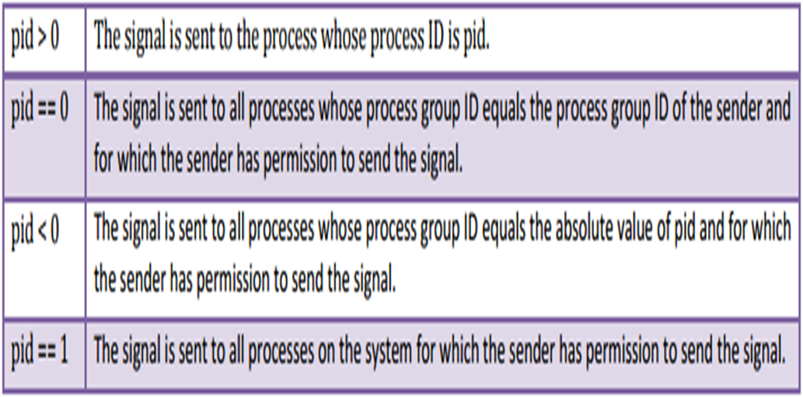
The sig argument is the integer value of a signal to be sent to one or more processes designated by pid.
The possible values of pid and its use by the kill API are:

Slide 31
Alarm() function
Alarm - set an alarm clock for delivery of a signal
The alarm API can be called by a process to request the kernel to send the SIGALRM signal after a certain number of real clock seconds.
Setting an alarm clock to remind someone to do something after a specified period of time.
The function prototype of the API is:
#include <unistd.h> #include<signal.h>
unsigned int alarm(unsigned int time_interval);
Time_interval=seconds

Slide 32
The alarm() function shall effect the system to generate a SIGALRM signal for the process after the number of real time seconds specified by seconds(time_interval) have elapsed.
If time_interval is 0, alarm clock is turned off.
Return Value:
Successful: the number of CPU seconds left in the process timer.
Failure: returns 0.

Slide 33
INTERVAL TIMERS
Sleep function that suspends a process for a fixed amount of time is only one use of the alarm API.
Use the alarm API is to set up an interval timer in a process.
The interval timer can be used to schedule a process to do some tasks at a fixed time interval, to time the execution of some operations.

Slide 34
In addition to alarm API,
UNIX also invented the setitimer API,
Settimer API is used to define up to three different types of timers in a process:
Real time clock timer.
Timer based on the user time spent by a process.
Timer based on the total user and system times spent by a process.
The getitimer API - query the timer values that are set by the setitimer API.

Slide 35
The function prototype of the API is:
#include<sys/times.h>
int setitimer(int which, const struct itimerval * val, struct itimerval * old);
int getitimer(int which, struct itimerval * old);
The which arguments specify which timer to process.
possible values and the corresponding timer types are:

Slide 36
The struct itimerval datatype is defined as:
struct itimerval
{
struct timeval it_value; /*current value*/
struct timeval it_interval; /* time interval*/
};
It_value – time to set the named timer.
It_interval – time to reload the timer when it expires.
It_interval is set to zero if the timer is to run once only.
It_value is set to zero it stops the named timer if it is running.
The setitimer and getitimer APIs return a zero value if they succeed or a -1 value if they fail.

Slide 37
POSIX.1b TIMERS
POSIX.1b defines a set of APIs for interval timer manipulations.
The POSIX.1b timers are more flexible and powerful than are the UNIX timers in the following ways:
Users may define multiple independent timers per system clock.
The timer resolution is in nanoseconds.
Users may specify the signal to be raised when a timer expires.
The time interval may be specified as either an absolute or a relative time.

Slide 39
Timer_create API is used to dynamically create a timer and returns its handler.
Clock argument specifies system clock the new timer should be based on.
Clock value may be CLOCK_REALTIME for creating a real time clock timer.

Slide 40
Spec argument defines what action to take when the timer expires.
The struct sigevent data type is defined as:
Struct sigevent
{
Int sigev_notify;
Int sigev_signo;
Union sigval sigev_value;
};
Timer_hdrp argument of the timer_create API is an address of a timer_t – typed variable to hold the handler of the newly generated timer.
Success : 0
Failure : -1

Slide 41
Timer_settime function starts or stops a timer running.
Timer_gettime API is used to query the current values of a timer.

