Slide 1
Data Base Application
PUTTASWAMY B. S.
Assistant Professor

Slide 2
Introduction to the course
This course is first (fundamental) course on database management systems.
The course discusses different topics of the databases.
In this course will covering both the theoretical and practical aspects of databases.
As a student to have a better understanding of the subject, it is very necessary that you concentrate on the concepts discussed in the course

Slide 3
COURSE OBJECTIVES
At the completion of this course, students should be able to do the following:
Understand the role of a database management system in an organization.
Understand basic database concepts, including the structure and operation of the relational data model.
Construct simple and moderately advanced database queries using Structured Query Language (SQL).

Slide 4
4. Understand and successfully apply logical database design principles, including E-R diagrams and database normalization.

Slide 5
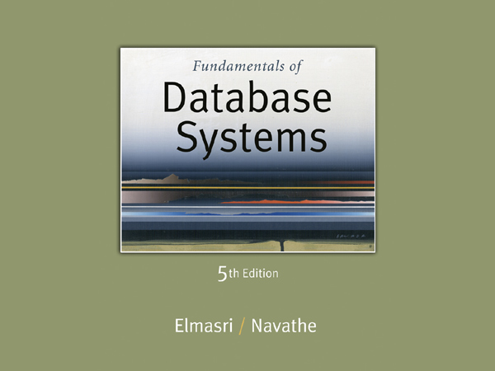
Text Books
1. Fundamentals of Database Systems – Elmasri and Navathe, 6th Edition, Addison-Wesley, 2011
2. Database Management Systems – Raghu Ramakrishnan and Johannes Gehrke – 3rd Edition, McGraw-Hill Education(India) Edition 2014.

Slide 6
Chapter 1 Databases and Database Users

Slide 7
Outline
Introduction.
An Example.
Characteristics of the Database Approach.
Actors on the Scene.
Workers behind the Scene.
Advantages of Using the DBMS Approach.
A Brief History of Database Applications.

Slide 8
introduction
What is data?
Data is meaningful known raw facts.
Known facts that can be recorded and have an implicit meaning.
Data can be any character, text, words, number, pictures, sound, or video and, if not put into context, means little or nothing to a human.
Example of Data:
Joe,Smith,1234 Circle,SLC,UT

Slide 9
What is information?
Facts, concerning a particular event or subject, which are refined by processing is called information.
information is useful and usually formatted in a manner that allows it to be understood by a human.
Example of Information
Joe Smith 1234 Circle Salt Lake City, UT 84084 (801)555-3211

Slide 10
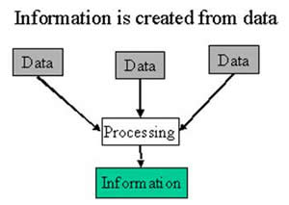

Slide 11
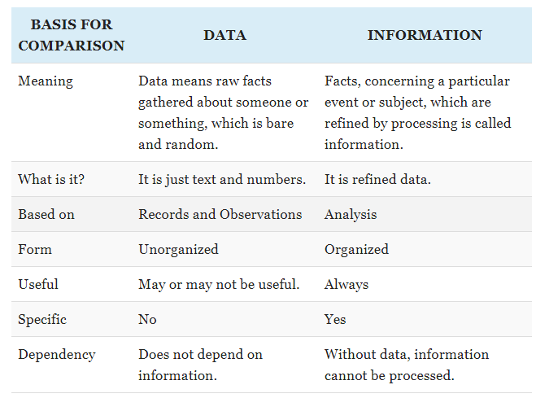

Slide 12
What is Database?
Database - Database is a collection of interrelated and organized data. It can be easily accessed, managed and updated.
In general, it is a collection of files (tables).
Example:
University Database: Data about students, faculty, courses, research-laboratories, course registration/ enrolment etc.

Slide 13
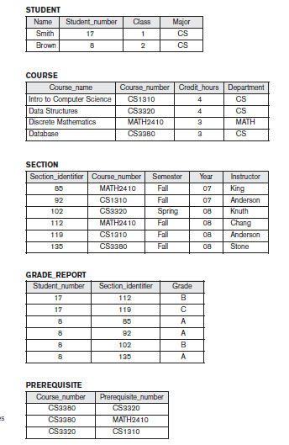

Slide 14
What is Database Management System?
It is a collection of programs that enables user to create and maintain a database.
The DBMS is hence a general-purpose software system the facilitates the purpose of defining, constructing, manipulating, and the sharing databases among various users and applications.
Database Management System (DBMS) provides….
well-organized, dependable, suitable, and safe
multi-user storage of and access to massive
amounts of persistent data.

Slide 15
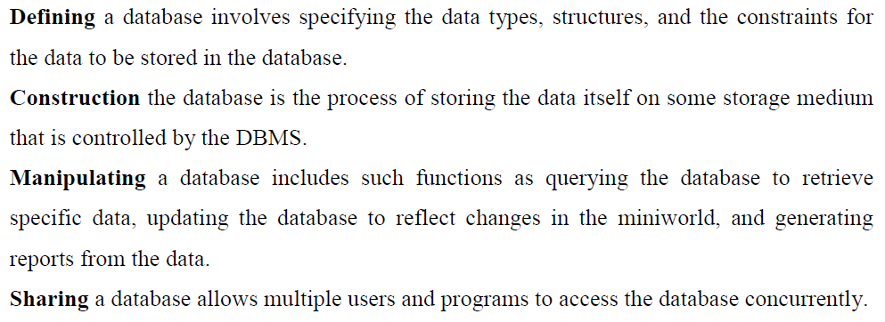
Defining a database involves specifying the data types, structures, and the constraints for the data to be stored in the database.

Slide 16
Database System Environment
Users/Programmers
Application Programs/Queries
DBMS
Software
Software to Process Queries/Programs
Software to Access Stored Data
Stored DB
Definition
(Meta-Data)
Stored
Database

Slide 17
Characteristics of the Database Approach

Slide 18
What is Traditional File Processing System?
Before the use of computer, a manual file system was used to maintain the records and files.
All the data was stored in files and it makes it easy to find any information.
This system was good only for small organizations having small number of items.
In this method have many disadvantages:
It was time consuming.
Inefficient to maintain the record of big firm having large number of items.
It requires a lots of labor work to do.
It becomes more complex when anyone requires changing the information.

Slide 19
To make the processing fast, File Processing System was introduced.
It was computer based system where all the information is store in different computer files.
Traditional files system stores data in a manner that all the departments of an organization have their own set of files.

Slide 20
Characteristics of File processing System
It is a group of files storing data of an organization.
Each file is independent from one another.
Each file is called a flat file as records.
Each file contained and processed information for one specific function.
Files are designed by using programs written in programming languages such as COBOL, C, C++.

Slide 21
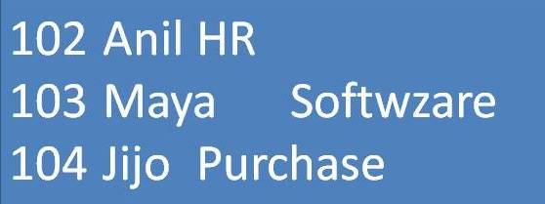
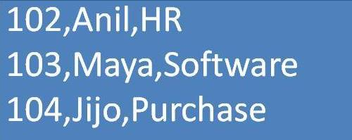
Records consist of various fields which are delimited by a space, comma, pipe, any special character etc.

Slide 22
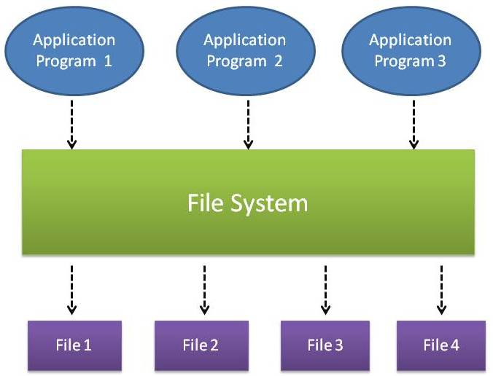
In traditional file processing,
Each user defines and implements the files needed for a specific software application as part of programming the application.

Slide 23
In traditional file processing:
information is stored in flat files which are maintained by the file system under the operating system’s control.
Application programs go through the file system in order to access these flat files

Slide 24
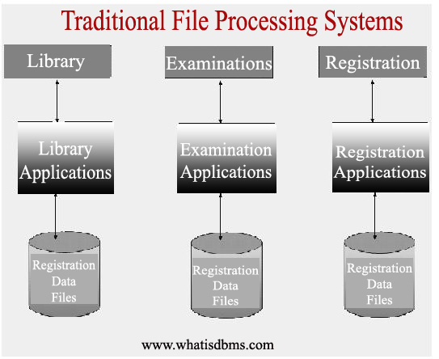

Slide 25
Disadvantage of File-oriented system
Data Redundancy:
The same information may be duplicated in different files.
This leads to data redundancy results in memory wastage.
Data Inconsistency:
Because of data redundancy, it is possible that data may not be in consistent state.
Difficulty in Accessing Data:
Accessing data is not suitable and efficient in file processing system.
Limited Data Sharing:
Data are scattered (stored) in various files. also different files may have different formats and these files may be stored in different folders may be of different departments.
So, due to this data separation, it is difficult to share data among different applications.

Slide 26
For example:
one user, the grade reporting office, may keep files on students and their grades.
Programs to print a student’s transcript and to enter new grades are implemented as part of the application.
A second user, the accounting office, may keep track of students’ fees and their payments.
Although both users are interested in data about students, each user maintains separate files - and programs to manipulate these files.
each requires some data not available from the other user’s files.
This redundancy in defining and storing data results in wasted storage space and in redundant efforts to maintain common up-to-date data.

Slide 27
In the database approach,
A single repository(storage area) maintains data that is defined once and then accessed by various users.
In file systems, each application is free to name data elements independently.
In a database, the names or labels of data are defined once, and used repeatedly by queries, transactions, and applications.

Slide 28
The main characteristics of the database approach versus the file-processing approach are the following:
■ Self-describing nature of a database system.
■ Insulation between programs and data, and data abstraction.
■ Support of multiple views of the data.
■ Sharing of data and multiuser transaction processing.

Slide 29
Self-describing nature of a database system
A fundamental characteristic of the database approach.
The database system contains not only the database itself but also a complete definition or description of the database structure and constraints.
DBMS catalog.
contains information such as the structure of each file, the type and storage format of each data item, and various constraints on the data.

Slide 30
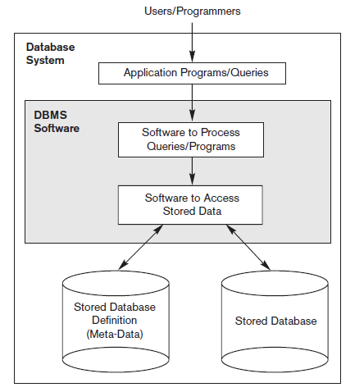
The information stored in the catalog is called meta-data, and it describes the structure of the primary database.

Slide 31
Insulation between programs and Data, and Data Abstraction
In traditional file processing,
The structure of data files is embedded in the application programs, so any changes to the structure of a file may require changing all programs that access that file.
By contrast, DBMS access programs do not require such changes in most cases. The structure of data files is stored in the DBMS catalog separately from the access programs.
We call this property program-data independence.

Slide 32
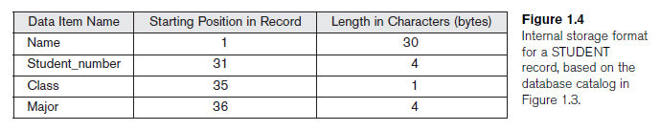
For example:
STUDENT records of the structure
Add another piece of data to each STUDENT record, say the Birth_date, such a program will no longer work and must be changed.

Slide 34
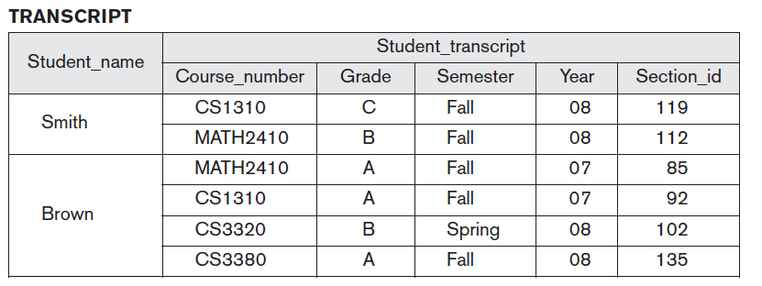
Multiple Views of Data
Different users have different "views" or perspectives on the database (e.g., in different departments of an organization).
in a database one user may be interested only in accessing and printing the transcript of each student;

Slide 35
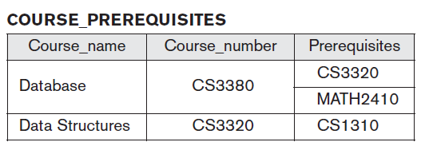
A second user, who is interested only in checking that students have taken all the prerequisites of each course for which they register.

Slide 36
Sharing of Data and Multiuser Transaction Processing
if data for multiple applications is to be integrated and maintained in a single database.
allow multiple users to access the database at the same time.
The DBMS must include concurrency control software to ensure that several users trying to update the same data do so in a controlled manner so that the result of the updates is correct.

Slide 37
several reservation agents try to assign a seat on an airline flight,
the DBMS should ensure that each seat can be accessed by only one agent at a time for assignment to a passenger.
These types of applications are generally called online transaction processing (OLTP) applications.

Slide 38
A transaction has become central to many database applications.
A transaction is an executing program or process that includes one or more database accesses, such as reading or updating of database records.

Slide 39
File Processing Systems
Billing
Program
Purchasing
Program
Customer
file
Accounts
receivable
file
Buyer
file
Inventory
file
Vendor
file
Accounts_Payable
Program
Sales Order Processing
Program
Payroll
Program
Vendor
file
Invoice
file
Customer
file
Inventory
file
Employee
file
Notes:
1

Slide 40
Database Approach
Order Dept.
Accounting
Dept.
Payroll
Dept.
Program
A
Program
B
Program
C
Ordering
filing
System
Invoicing
System
Payroll
System
Back
Orders
file
Inventory
Master
file
Customer
Master
file
Inventory
Pricing
file
Employee
Master
file
Notes:
1

Slide 41
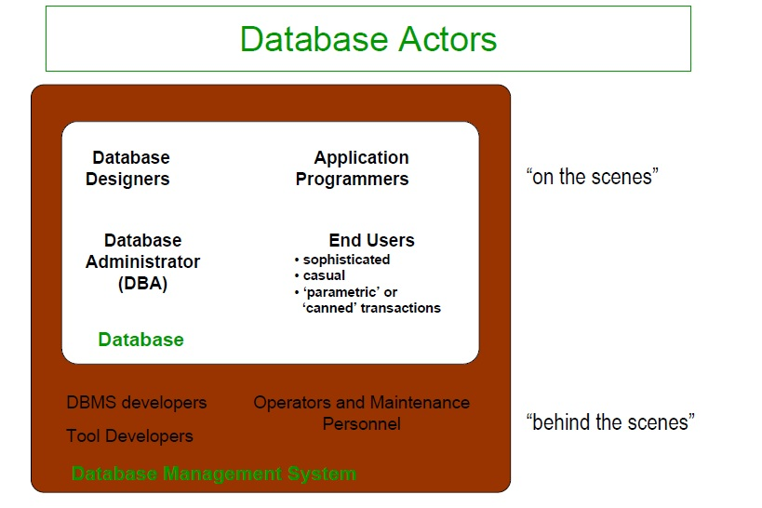
DBMS Users
DBMS is the software that understand and processes users request to retrieve information from a data base.
It is not only use for retrieving the information from the database but also do much more thing for its user.
The user of DBMS are classified in two categories: "Actor on the Scene“ and "Workers behind the scene“.

Slide 42
Actors on the Scene
Those who actually use and control the database content, and those who design, develop and maintain database applications.
Actors on the Scene classified into following categories:
Database administrator
Database designer
End users
System Analysts
Application programmers.

Slide 43
Database Administrator (DBA)
A person or group of persons responsible for over all control of database system.
whole or all the activities in a database system are controlled by DBA.
Database Administrators (DBA) are responsible for:

Slide 44
Database Administrators are responsible for:
1. Authorizing access to the database. 2.Coordinating and monitoring its use. 3.Acquiring software and hardware resources as needed. 4. Defining security and Integrity checks. 5. Monitoring performance and responding to changing requirements. 6. Communicate with users.

Slide 45
Database Designers
Responsible for identifying the data to be stored and for choosing an appropriate way to organize it.
Database designers task is carry out before the database is actually implemented.

Slide 46
Responsibilities of database designers are:
Schema definition i.e. the creation of the original database schema.
Storage Structure and Access Method definition: writing a set of definitions translated by the data storage and definition language compiler.
Schema and Physical Organization Modification i.e. writing a set of definitions to generate modifications to appropriate internal system tables (e.g. data dictionary). Hence, Database Designers are responsible for: 1.identifying the data to be stored in the database, and 2. choosing appropriate structures to represent and store this data.

Slide 47
End Users
The person who accesses the database in the course of their day-to-day work.
Persons who access the database for querying, updating, and report generation.
End users are categorized into :
Sophisticated end-users
Standalone end-users
Naive User
Casual end users
Naive/Parametric end users

Slide 48
Casual end users: Use database occasionally, needing different information each time.
Use query language to specify their requests.
middle- or high-level managers.
Sophisticated end users: engineers, scientists, business analysts who implement their own applications to meet their complex needs.

Slide 49
Naive/Parametric end users: Typically the biggest group of users; frequently query/update the database using standard canned transactions that have been carefully programmed and tested in advance.
Examples: Bank tellers check account balances, post withdrawals/deposits.
Reservation clerks for airlines, hotels, etc., check availability of seats/rooms and make reservations.

Slide 50
Stand-alone users: Use "personal" databases, possibly utilizing a special purpose (e.g., financial) software package.
Maintain personal databases using ready-to-use packaged applications.

Slide 51
System Analysts, Application Programmers, Software Engineers
System Analysts: Determine needs of end users, especially naive and parametric users, and develop specifications for canned transactions that meet these needs.
Application Programmers: Implement, test, document, and maintain programs that satisfy the specifications.

Slide 52
Workers behind the Scene
Those who design and develop the DBMS software and related tools, and the computer systems operators.
Others are associated with the design, development, and operation of the DBMS software and system environment.
These persons are typically not interested in the database content itself. We call them the workers behind the scene.

Slide 53
workers behind the scene classified into following categories:
DBMS system designers and implementers.
Tool developers.
Operators and maintenance personnel.

Slide 54
DBMS system designers and implementers
Design and implement the DBMS modules and interfaces is called as software package.
A DBMS is a very complex software system that consists of many components, or modules.
including modules for implementing the catalog, query language processing, interface processing, accessing and buffering data, controlling concurrency, and handling data recovery and security.
DBMS must interface with other system software such as the operating system and compilers for various programming languages.

Slide 55
Tool developers
Design and implement tools.
The software packages that facilitate database modeling and design, database system design, and improved performance.
Tools are optional packages that are often purchased separately.
They include packages for database design, performance monitoring, natural language or graphical interfaces, prototyping, simulation, and test data generation.
In many cases, independent software vendors develop and market these tools.

Slide 56
Operators and maintenance personnel
Also called as System administration personnel.
Responsible for the actual running and maintenance of the hardware and software environment for the database system.

Slide 57
Advantages of using the DBMS Approach
The database management system has a number of advantages as compared to traditional computer file-based processing approach. They are:
Controlling Redundancy.
Restricting Unauthorized Access
Providing Storage Structures for Efficient Query

Slide 58
Providing Backup and Recovery
Providing Multiple User Interfaces
Representing Complex Relationships among Data
Enforcing Integrity Constraints
Permitting Inference and Actions Using Rules
Flexibility
Availability of Up-to-Date Information

Slide 59
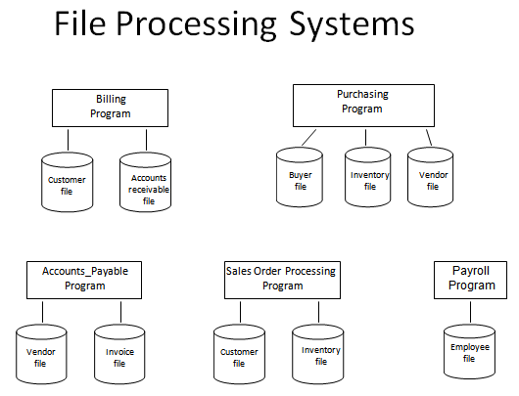
Controlling Redundancy

Slide 60
Redundancy means repetition.
In normal file system we use same thing again and again which increase the storage area and access cost of data.
In file system, each application has its own private files, which cannot be shared between multiple applications.
it lead to considerable redundancy in the stored data, which results in wastage of storage space.

Slide 61
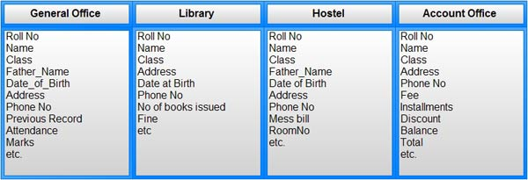

Slide 62
For example: In a college , the students names their classes and roll no. are used in many sections like in HR section , Account Section and T & P section.
So we used same data again and again in so many files. This type of redundancy is controlled in DBMS, In DBMS we make a database of these names, classes and roll no. and it can be shared among all the sections.

Slide 63
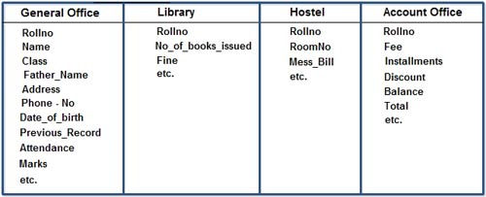
Having centralized database most of this can be avoided.

Slide 64
Backup and Recovery
Data loss is a very big problem for all the organizations.
In traditional file processing system, a user needs to backup the database after a regular interval of time that wastes lots of time and resources.
If the volume of data is large then this process may take a very long time.

Slide 65
DBMS provides facilities to recover from hardware and software failure.
DBMS solves this problem of taking backup again and again because it allows automatic backup and recovery of database.
For examples, if a system fails in the middle of any process then DBMS stores the values of that state in which database were before query execution.
DBMS responsible for making sure that the database is restored to the state it was in before the transaction started executing

Slide 66
Providing Multiple User Interfaces
lot of users who are used the database have different types of computer skills or knowledge .
Some users are technically strong and some are weak.
So to make easy to use a database to all type of users DBMS provides many type of interfaces.

Slide 67
Providing Multiple User Interfaces
query languages for casual users,
programming language interfaces for application programmers,
forms and command codes for parametric users,
menu-driven interfaces and natural language interfaces for standalone users.
forms-style interfaces and menu-driven interfaces are commonly known as graphical user interfaces (GUIs).

Slide 68
Easy to access the data
DBMS all data are stored in database in same format.
To retrieve the data from the database is easy because we use same application programs to retrieve data from database.
whereas in file system data are stored in files and each file has its own format. So each file need separate application programs to retrieve data. This is also called Data Isolation.

Slide 69
Restricted Unauthorized access
When multiple users use a database then it is not sure that every user have the permission to access that database.
Example: Financial data are always be confidential and only limited users can access that data . So in DBMS DBA(Database Administrator ) is responsible to restrict and authorized the users to use the database.

Slide 70
Use Specific Storage to easily processed the query
DBMS a specific storage medium is used to store the data because when we processed any query to retrieve data then its processed time is depend on ,how much time take data to be searched.
So to processed the query efficiently DBMS used special type of storage medium auxiliary file or index file .
By index file data searching can be fast.

Slide 71
Enforcing Integrity Constraints
Integrity constraints or consistency rules can be applied to database so that the correct data can be entered into database.
The constraints may be applied to data item within a single record or they may be applied to relationships between records.

Slide 72
Constraint Name
PRIMARY KEY: Designates a column or combination of columns as Primary Key and therefore, values of columns cannot be repeated or left blank.
FOREIGN KEY: Relates one table with another table.
UNIQUE: Specifies that values of a column or combination of columns cannot be repeated.
NOT NULL: Specifies that a column cannot contain empty values.
CHECK : Specifies a condition which each row of a table must satisfy.

Slide 73
Flexibility
It may be necessary to change the structure of a database as requirements change.
For example, a new user group may emerge that needs information not currently in the database.
In response, it may be necessary to add a file to the database or to extend the data elements in an existing file.
Modern DBMSs allow certain types of evolutionary changes to the structure of the database without affecting the stored data and the existing application programs.

Slide 74
Availability of Up-to-Date Information
A DBMS makes the database available to all users.
one user's update is applied to the database, all other users can immediately see this update.
This availability of up-to-date information is essential for many transaction-processing applications, such as reservation systems or banking databases,

Slide 75
Database System Concepts and Architecture

Slide 76
Data Models, Schemas, and Instances
A database model shows the logical structure of a database, including the relationships and constraints that determine how data can be stored and accessed.
The model describes the relationships between different parts of the data.
Historically, in database design, three models are commonly used. They are,
Hierarchical Model
Network Model
Relational Model

Slide 77
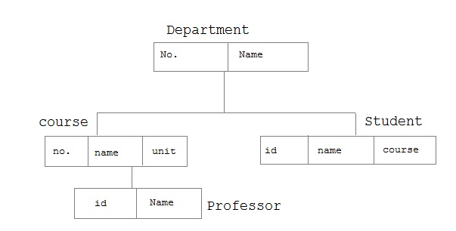
Hierarchical Model
Each entity has only one parent but can have several children . At the top of hierarchy there is only one entity which is called Root.

Slide 78
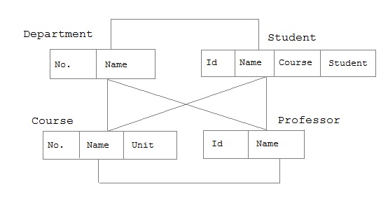
Network Model
Entities are organized in a graph, in which some entities can be accessed through several path.

Slide 79
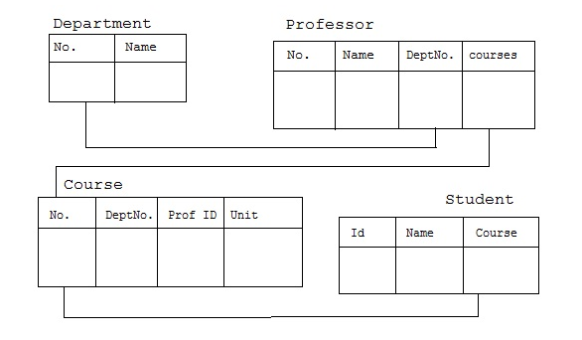
Relational Model
in this model, data is organized in two dimensional tables called relations. The tables or relation are related to each other.

Slide 80
Categories of Data Models
Many data models have been proposed, which we can categorize according to the types of concepts they use to describe the database structure.
High-level or conceptual data models
low-level or physical data models

Slide 81
Entity –Relationship Model
High-level or conceptual data models: provide concepts that are close to the way many users perceive data.
Provide a view close to the way users would perceive data uses concept such as Entity, attribute and Relationship.
An entity represents a real-world object or concept, such as an employee or a project.

Slide 82
An attribute represents some property of interest that further describes an entity, such as the employee’s name or salary.
A relationship among two or more entities represents an association among the entities.
for example, a works-on relationship between an employee and a project.

Slide 83
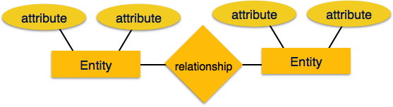

Slide 84
Representational or implementation data models are the models used most frequently
in traditional commercial DBMSs.
These include the widely used relational data model, as well as the so-called legacy data models—the network and hierarchical models—that have been widely used in the past.

Slide 85
low-level or physical data models provide concepts that describe the details of how data is stored on the computer storage media.

Slide 86
Schemas, Instances, and Database State
Database Schema:
A database schema is the skeleton structure that represents the logical view of the entire database.
It defines how the data is organized and how the relations among them are associated. It formulates all the constraints that are to be applied on the data.
a visual representation of a database, a set of rules that govern a database, or to the entire set of objects belonging to a particular user.

Slide 87
A database schema defines its entities and the relationship among them.
It contains a descriptive detail of the database, which can be depicted by means of schema diagrams.
It’s the database designers who design the schema to help programmers understand the database and make it useful.

Slide 88
The Purpose of a Schema
A relational database schema helps you to organize and understand the structure of a database.
This is particularly useful when designing a new database, modifying an existing database to support more functionality, or building integration between databases.

Slide 89
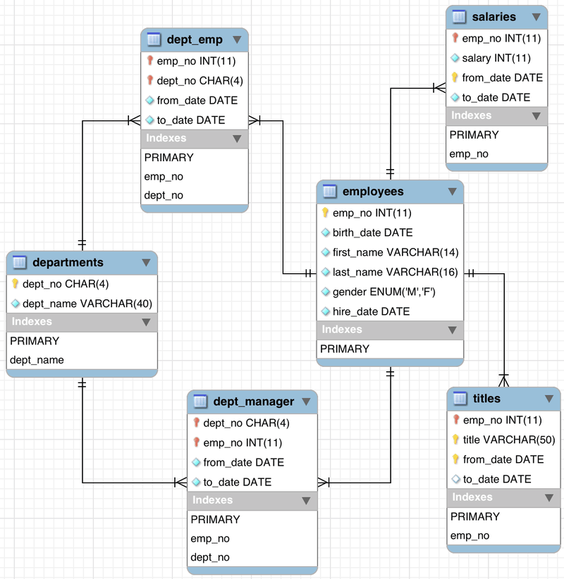

Slide 90
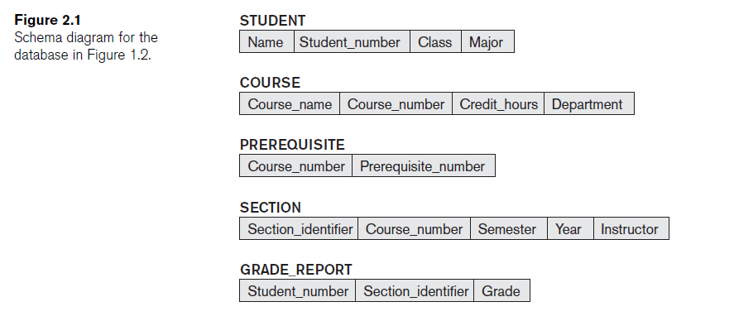

Slide 91
A DATABASE INSTANCE
A database instance describes a complete database environment, including the RDBMS software, table structure, stored procedures and other functionality.
Database administrators might create multiple instances of the same database for different purposes.

Slide 92
Three-Schema Architecture and Data Independence
The four important characteristics of the database approach
■ use of a catalog to store the database description (schema) so as to make it self-describing
■ insulation of programs and data (program-data and program-operation independence)
■ support of multiple user views.
an architecture for database systems, called the three-schema architecture, that was proposed to help achieve and visualize these characteristics.

Slide 93
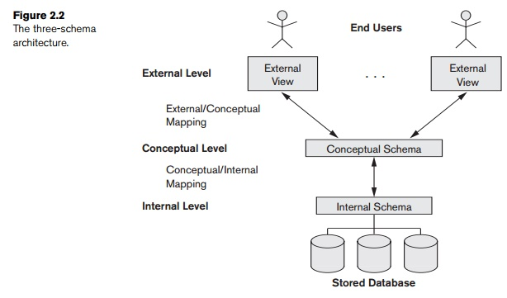
The Three-Schema Architecture
The goal of the three-schema architecture, is to separate the user applications from the physical database.

Slide 94
Three-schema architecture is an idea in relational database design that breaks a database down into three different categories according to its use and structure, and to the roles played by system administrators, designers and end users.

Slide 95
the three levels of database architecture, 1. Physical Level 2. Conceptual Level 3. External Level

Slide 96
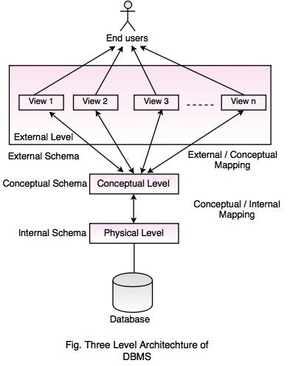

Slide 97
Physical Level
Physical level describes the physical storage structure of data in database.
It is also known as Internal Level.
This level is very close to physical storage of data.
At lowest level, it is stored in the form of bits with the physical addresses on the secondary storage device.
At highest level, it can be viewed in the form of files.
The internal schema defines the various stored data types. It uses a physical data model.

Slide 98
Conceptual Level
Conceptual level describes the structure of the whole database for a group of users.
It is also called as the data model.
Conceptual schema is a representation of the entire content of the database.
These schema contains all the information to build relevant external records.
It hides the internal details of physical storage.

Slide 99
External Level
External level is related to the data which is viewed by individual end users.
This level includes a number of user views or external schemas.
This level is closest to the user.
External view describes the segment of the database that is required for a particular user group and hides the rest of the database from that user group.

Slide 100
Data Independence
Data independence is ability to modify a schema definition in one level without affecting a schema definition in the next higher level.
Techniques that allow data to be changed without affecting the applications that process it.

Slide 101
Two types of Data Independence
Logical Data Independence
Physical Data Independence
Logical Data Independence:
A conceptual schema is an abstract definition of the whole database.
The capacity to change the conceptual schema without having to change external schemas or application programs.
change the conceptual schema to expand the database (by adding a record type or data item), to change constraints, or to reduce the database (by removing a record type or data item).

Slide 102
Physical data independence:
the capacity to change the internal schema without having to change the conceptual schema.
Hence, the external schemas need not be changed as well.
Changes to the internal schema may be needed because some physical files were reorganized.
For example, by creating additional access structures to improve the performance of retrieval or update.

Slide 103
Database Languages and Interfaces
The DBMS must provide appropriate languages and interfaces for each category of users.
The various languages are:
Data Definition Language (DDL)
Storage Definition Language (SDL)
View Definition Language (VDL)
Data Manipulation Language (DML)
Data Control Language (DCL)

Slide 104
Data Definition Language (DDL)
A data definition language (DDL) is a computer language used to create and modify the structure of database objects in a database.
Data Definition Language (DDL) is a part of SQL that is used to create, modify, and delete database objects such as table, view, and index.
Common DDL statements are:
CREATE (generates a new table)
ALTER (alters table)
DROP (removes a table from the database)

Slide 105
Data Manipulation Language (DML)
statements are used for managing data within schema objects.
Data manipulation language (DML) statements access and manipulate data in existing schema objects.
Common DDL statements are:
Insert
Update
Delete

Slide 106
Data Control Language(DCL)
Data Control Language(DCL) is used to control privilege in Database.
To perform any operation in the database, such as for creating tables, sequences or views we need privileges.
DCL defines two commands,
Grant : Gives user access privileges to database.
Revoke : Take back permissions from user.

Slide 107
Transaction Control Language(TCL)
used to manage the changes made by DML statements. It allows statements to be grouped together into logical transactions.
COMMIT - save work done
SAVEPOINT - identify a point in a transaction to which you can later roll back
ROLLBACK - restore database to original since the last COMMIT

Slide 108
SDL – Storage Definition Language – is used to specify the internal schema only.
VDL – View Definition Language – is used to specify user views and their mappings of the conceptual schema.

Slide 109
DBMS Interfaces
User-friendly interfaces provided by a DBMS:
Menu-Based Interfaces for Web Clients or Browsing.
Forms-Based Interfaces.
Graphical User Interfaces
Natural Language Interfaces
Speech Input and Output
Interfaces for Parametric Users
Interfaces for the DBA

Slide 110
Menu-Based Interfaces for Web Clients or Browsing
These interfaces present the user with lists of options, called menus, that lead the user through the formulation of a request.
Menus do away with the need to memorize the specific commands and syntax of a query language; rather, the query is composed step by step by picking options from a menu that is displayed by the system.
Pull-down menus are a very popular technique in Web-based user interfaces.
They are also often used in browsing interfaces, which allow a user to look through the contents of a database in an exploratory and unstructured manner.

Slide 111
Forms-Based Interfaces
A forms-based interface displays a form to each user.
Users can fill out all of the form entries to insert new data, or they fill out only certain entries, in which case the DBMS will retrieve matching data for the remaining entries.
Forms are usually designed and programmed for naive users as interfaces to canned transactions.

Slide 112
Graphical User Interfaces
A graphical interface (CUI) typically displays a schema to the user in diagrammatic form.
The user can then specify a query by manipulating the diagram.
In many cases, GUIs utilize both menus and forms.
Most GUIs use a pointing device, such as a mouse, to pick certain parts of the displayed schema diagram.

Slide 113
Natural Language Interfaces
These interfaces accept requests written in English or some other language and attempt to "understand" them.
A natural language interface usually has its own "schema," which is similar to the database conceptual schema, as well as a dictionary of important words.
The natural language interface refers to the words in its schema, as well as to the set of standard words in its dictionary, to interpret the request.
If the interpretation is successful, the interface generates a high-level query corresponding to the natural language request and submits it to the DBMS for processing; otherwise, a dialogue is started with the user to clarify the request.

Slide 114
Interfaces for Parametric Users
Parametric users, such as bank tellers, often have a small set of operations that they must perform repeatedly.
Systems analysts and programmers design and implement a special interface for each known class of naive users.
Usually, a small set of abbreviated commands is included, with the goal of minimizing the number of keystrokes required for each request.

Slide 115
Interfaces for the DBA
Most database systems contain privileged commands that can be used only by the DBA's staff.
These include commands for creating accounts, setting system parameters, granting account authorization, changing a schema, and reorganizing the storage structures of a database.

Slide 116
Entity Types, Entity Sets, Attributes, and Keys

Slide 117
What is an ER diagram?
An entity-relationship diagram is a specialized graphic form that illustrates the relationships between entities in a database.
ER-Diagram is a visual representation of data that describes how data is related to each other.
ERD is an Entity Relationship Diagram which is a graphical representation of database entities (tables, table columns, table definitions, attributes) and inter-relationships between these entities (how the tables are connected).

Slide 118
The History of Entity Relationship Diagrams
Peter Chen developed ERDs in 1976.
Charles Bachman and James Martin have added some slight refinements to the basic ERD principles

Slide 119
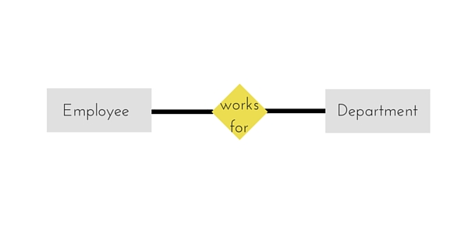
Common Entity Relationship Diagram Symbols
An Entity can be any object, place, person or class.
In E-R Diagram, an entity is represented using rectangles.
Example of an Organization. Employee, Manager, Department, Product and many more can be taken as entities from an Organization.

Slide 120
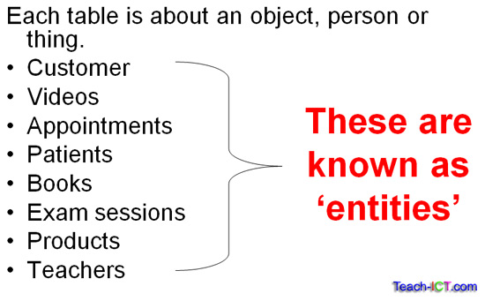
Common Entity Relationship Diagram Symbols
Entity:
A database contains one or more related tables.
Each table holds all of the information about an object, person or thing.

Slide 121
An entity represents a thing that can exist independently and that can be identified uniquely.
an entity often represents a class, group or category of similar objects.
Most often, an entity represents a real world object such as a car or an employee.
Entities are realized (understand) as tables,

Slide 122
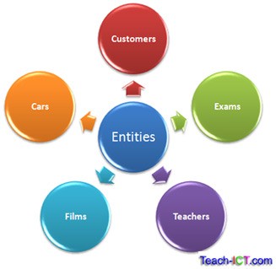

Slide 123
Strong entities: exist independently from other entity types. They always possess one or more attributes that uniquely distinguish each occurrence of the entity.
Weak entities depend on some other entity type. They don't possess unique attributes (also known as a primary key) and have no meaning in the diagram without depending on another entity. This other entity is known as the owner.

Slide 124
Attribute:
properties of entities are called attributes.
In other words, attributes represent a sub group of information of the object represented by the entity.
Attributes define the individual instances and help to differentiate between each instance by describing their characteristic.

Slide 125
each column represents the attributes of these entities.
For example: in the Employee table, columns such as department, rank and salary are examples of attributes of the employees.

Slide 126
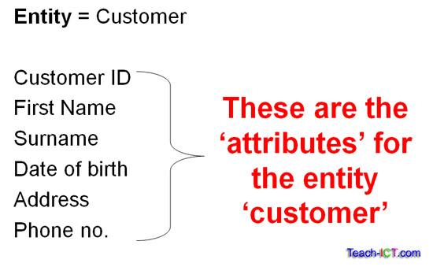

Slide 127
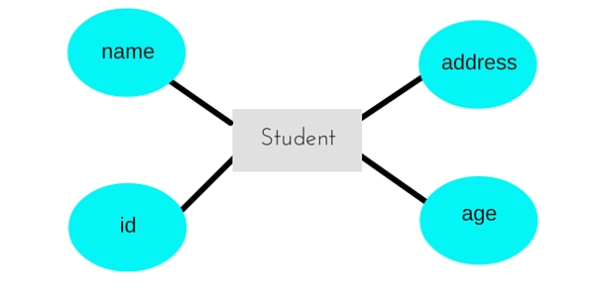

Slide 128
Types of Attributes
Composite versus Simple (Atomic) Attributes.
Single-Valued versus Multivalued Attributes.
Stored versus Derived Attributes.
NULL Values.
Complex Attributes

Slide 129
Single valued Attributes : An attribute, that has a single value for a particular entity is known as single valued attributes.
Attributes that can have single value at a particular instance of time are called single valued.
A person can’t have more than one age value.

Slide 130
Multi valued Attributes : An attributes that may have multiple values for the same entity is known as multi valued attributes.
For example colors of a car entity.
Compound Attribute/Composite Attribute :
Attribute can be subdivided into two or more other Attribute.
For Example, Name can be divided into First name, Middle name and Last name.

Slide 131
Simple Attributes/Atomic Attributes : The attributes which cannot be divided into smaller subparts are called simple or atomic attributes.
For example, age of employee entity
Stored Attribute : An attribute, which cannot be derived from other attribute, is known as stored attribute.
For example, Birth_Date of employee.

Slide 132
Derived Attribute : Attributes derived from other stored attribute.
For example age from Date of Birth and Today’s date.
Complex Attributes : If an attribute of an entity, is built using composite and multi_valued attributes, then these attributes are called complex attributes.
For example, a person can have more than one residence and each residence can have multiple phones, an address phone for a person entity can be specified as – {Addressphone (phone {(Area Code, Phone Number)}, Address(Sector Address (Sector Number,House Number), City, State, Pin))}
Here {} are used to enclose multivalued attributes and () are used to enclose composite attributes with comma separating individual attributes.

Slide 133
Key Attribute : represents primary key. (main characteristics of an entity).
It is an attribute, that has distinct value for each entity/element in an entity set.
For example, Roll number in a Student Entity Type.

Slide 134
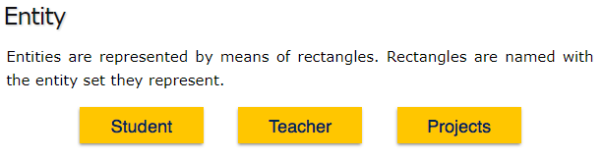

Weak Entity
Weak entity is an entity that depends on another entity. Weak entity doesn't have key attribute of their own. Double rectangle represents weak entity.

Slide 135
Attribute
An Attribute describes a property or characteristic of an entity. For example, Name, Age, Address etc can be attributes of a Student. An attribute is represented using eclipse.

Slide 136
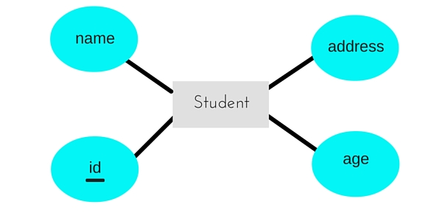
Key Attribute
Key attribute represents the main characteristic of an Entity. It is used to represent Primary key. Ellipse with underlying lines represent Key Attribute.

Slide 137
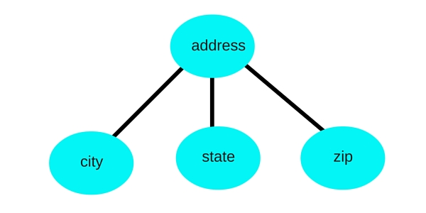
Compound Attribute/Composite Attribute :
Attribute can be subdivided into two or more other Attribute.

Slide 138
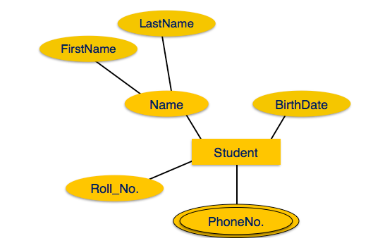
Multi valued Attributes : An attributes that may have multiple values for the same entity is known as multi valued attributes.

Slide 139
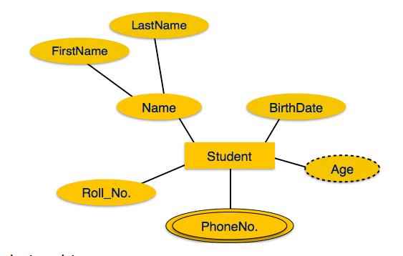
Derived Attribute : Attributes derived from other stored attribute.
Derived attributes are depicted by dashed ellipse.

Slide 140
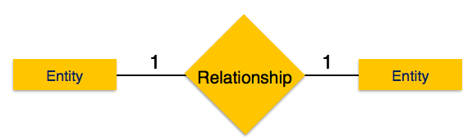
Relationship
A Relationship describes relations between entities. Relationship is represented using diamonds.
Name of the relationship is written inside the diamond-box. All the entities (rectangles) participating in a relationship, are connected to it by a line.

Slide 141
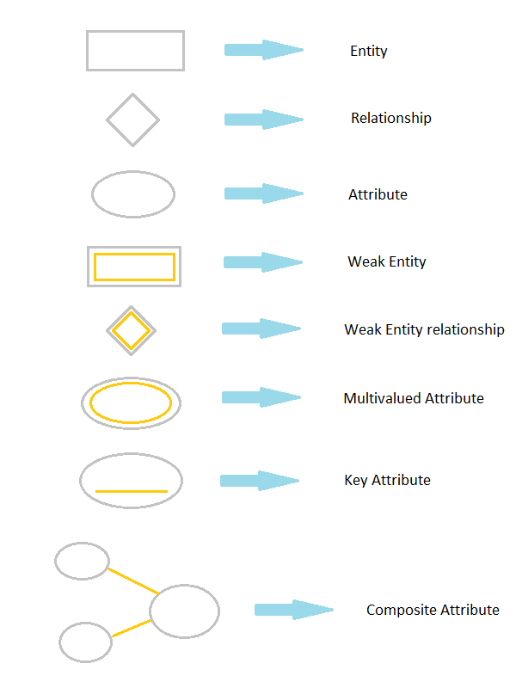

Slide 142
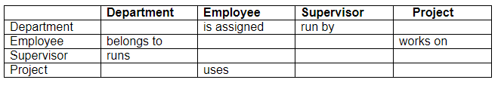
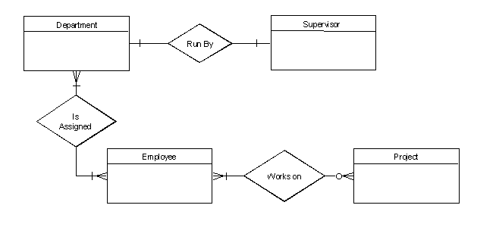

Slide 143
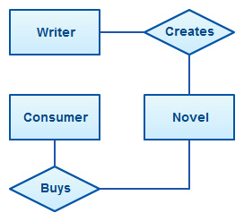

Slide 144
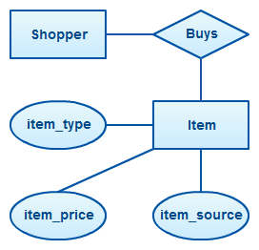

Slide 145
Entity Types, Entity Sets, keys and value sets
Entity Types:
STUDENT
ID | Name | AGE
1 | Ram | 12
2 | Sam | 13
A table called Student having 2 rows (1,Ram,12) and (2,Sam,13) .

Slide 146
What is entity?
Entity is a real existence or real world object.
Tuple1(Line1) contains information about Ram(id, name and Age) which has existence in real world .
So the tuple1 is an entity. So we may say each tuple is an entity.

Slide 147
What is Entity Type?
It is collection of entity having common attribute.
Student table each row is an entity and have common attributes.
So STUDENT is an entity type which contains entities having attributes id, name and Age.
Also each entity type in a database is described by a name and a list of attribute.
So a table is an entity type

Slide 148
What is an Entity SET?
The collection of all entities of a particular entity type in the database at any point in time is called an entity set.
The entity set is usually referred to using the same name as the entity type.
For example: EMPLOYEE refers to both a type of entity as well as the current set of all employee entities in the database.

Slide 149
Key Attributes of an Entity Type
Important constraint on the entities of an entity type is the key or uniqueness constraint on attributes.
An entity type usually has one or more attributes whose values are distinct for each individual entity in the entity set. Such an attribute is called a key attribute.
Its values can be used to identify each entity uniquely.
key attribute has its name underlined inside the oval symbol.

Slide 150
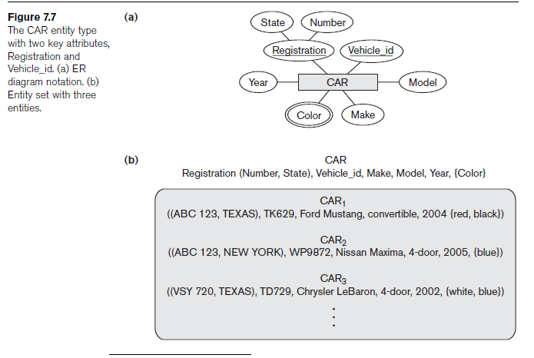

Slide 151
Initial Conceptual Design of the COMPANY Database
1. An entity type DEPARTMENT with attributes Name, Number, Locations, Manager, and Manager_start_date. Locations is the only multivalued attribute. We can specify that both Name and Number are (separate) key attributes because each was specified to be unique.
2. An entity type PROJECT with attributes Name, Number, Location, and
Controlling_department. Both Name and Number are (separate) key attributes.
3. An entity type EMPLOYEE with attributes Name, Ssn, Sex, Address, Salary, Birth_date, Department, and Supervisor. Both Name and Address may be composite attributes; however, this was not specified in the requirements. We must go back to the users to see if any of them will refer to the individual components of Name—First_name, Middle_initial, Last_name—or of Address.
4. An entity type DEPENDENT with attributes Employee, Dependent_name, Sex, Birth_date, and Relationship (to the employee).

Slide 152
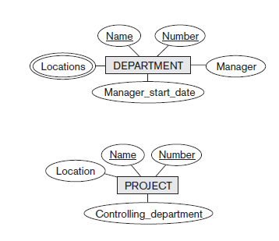

Slide 153
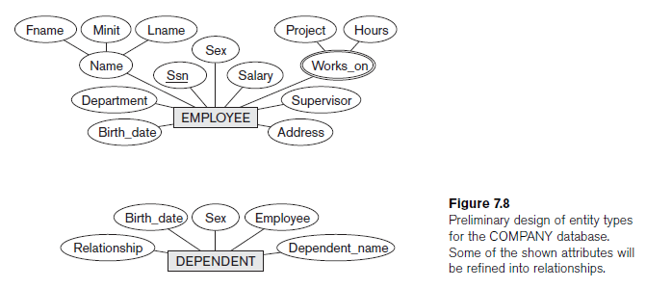

Slide 154
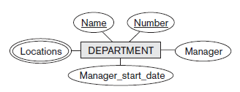
Relationship
The attribute Manager of DEPARTMENT refers to an employee who manages the department.
The attribute Controlling_department of PROJECT refers to the department that controls the project.

Slide 155
The attribute Supervisor of EMPLOYEE refers to another employee (the one who supervises this employee).
In the ER model, these references should not be represented as attributes but as relationships

Slide 156

Relationship
The association among entities is called a relationship.
Connect the entities and represent meaningful dependencies between them.
whenever an attribute of one entity type refers to another entity type, some relationship exists.
Relation types are represented as diamond shaped boxes.

Slide 157

Relationship types
Two or more entity types are related is called Relation type.
A relationship type represents the association between entity types.
For example:- ‘Enrolled in’ is a relationship type that exists between entity type Student and Course. In ER diagram, relationship type is represented by a diamond and connecting the entities with lines.

Slide 158
Relationships sets
Set of relationships of same type is known as relationship set.
It is a mathematical relation on entity sets (n>=2).
Relationship set R is a subset of –{(r1,r2,r3,....r_{n})| r1∈E1, r2∈E2, r_{n}∈E_{n}}
where r1,r2,….r_{n} are called relationships and E1,E2,….E_{n} are entity sets.

Slide 159
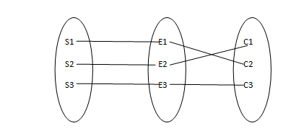
Relationship set represents S1 is enrolled in C2, S2 is enrolled in C1 and S3 is enrolled in C3.
The entities that participate in a relationship are called participants.

Slide 160
Relationship Degree, Role Names, and Recursive Relationships
Degree of a relationship set:
Also known as cardinality.
The number of different entity sets participating in a relationship set is called as degree of a relationship set.
The number of occurrences in one entity which are associated (or linked) to the number of occurrences in another entity.

Slide 161
Types of Relationship Type based on Degree
Unary Relationship
Binary Relationship.
Ternary Relationship
n-ary Relationship

Slide 162

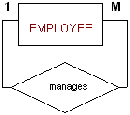
Unary Relationship
A relationship type of degree one is called unary relationship.
Only ONE entity set participating in a relation, these relationship is called as unary relationship.

Slide 163
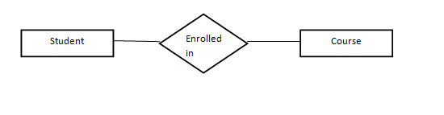
Binary Relationship
When there are TWO entities set participating in a relation, the relationship is called as binary relationship
Student is enrolled in Course.

Slide 164
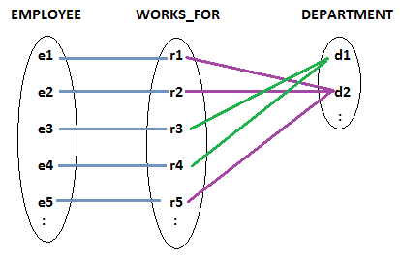

Slide 165
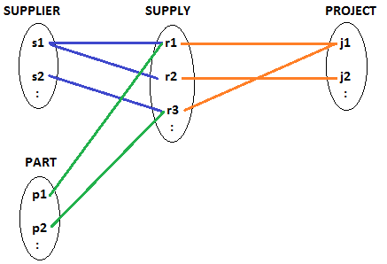
Ternary Relationship
A relationship type of degree three is a ternary relationship.
supply relationship connects three entities SUPPLIER, PART AND PROJECT.
To be read as – a supplier supplies the parts to projects

Slide 166

N-ary Relationship
When there are n entities set participating in a relation, the relationship is called as n-ary relationship.

Slide 167
Role Names
A relationship type has a name which signifies what role a participating entity plays in that relationship instance.
The role names helps to explain what the relationship means.
Example: WORKS_FOR relationship type, employee plays the role of worker and department plays the role of employee organization.

Slide 168

Recursive Relationship
If the same entity type participate more than once in a relationship type in different roles then such relationship types are called recursive relationship.
REPORTS_TO is a recursive relationship as the Employee entity type plays two roles – 1) Supervisor and 2) Subordinate.

Slide 169


Slide 170


Slide 171
Constraints on Binary Relationship Types(Relationship Constraints)
Relationship types usually have certain constraints that limit the possible combinations of entities that may participate in the corresponding relationship set.
These constraints are determined from the mini_world situation that the relationships represent.

Slide 172
Constraints on Binary Relationship Types(Relationship Constraints)
There are three Types of Relationship Constraints-
Structural Constraints
Participation Constraints
Cardinality Ratio
2. Overlap Constraints
3. Covering Constraints
Structural Constraints are applicable for binary relationships.
Overlap and Covering Constraints are applicable for EERD(Extended ER Diagrams).

Slide 173
Participation (or) Optionality Constraints
Participation concerns with the involvement of entities in a relationship.
It specifies whether the existence of an entity depends on another entity.
There are two types of Participation Constraints -
Total/Mandatory Participation
Partial/Optional Participation

Slide 174

Notations of Different Types of Participation In ER Diagram

Slide 175
Total/Mandatory Participation
Participation is said to be total if every entity in E participates in atleast one relationship in R (or) every entity in entity set must depend on another entity.
For example: Every department will have a start_up_ date as a department was created on that startup date (SINCE ATTRIBUTE of MANAGE relationship). and that department is being handled from that date through a Manager. So, the participation of DEPARTMENT entity in the "MANAGE" relationship type is total.
Total Participation is also known as Existence Dependency.
In ER Diagram, it is represented as a Double Line, connecting the participating entity to the relationship.

Slide 176
Partial/Optional Participation
Participation is said to be partial if only some entities in E participate in relationships in R (or) some entities in entity set are depend on some another entities in entity set.
For example: It is not necessary that all employees manage some department Because all employees may not be the Manager . So the participation of "EMPLOYEE" entity in the "MANAGES“ relationship type is partial.

Slide 177


Slide 178
Cardinality Ratios for Binary Relationships
Cardinality expresses the number of entities to which another entity can be associated via a relationship set.
It specifies the number of relationship instances that an entity can participate in a relation set.
There are 4 types of Cardinality Ratios :
One-to-One Cardinality (1:1)
One-to-Many Cardinality (1:m)
Many-to-One Cardinality (m:1)
Many-to-Many Cardinality (m:n)

Slide 179

Notations of Different Types of Cardinality In ER Diagram

Slide 180
One-to-one
When only one instance of an entity is associated with the relationship.
The number of times an entity of an entity set participates in a relationship set is known as cardinality.
One entity from entity set A can be associated with at most one entity of entity set B and vice versa.
One-to-one is marked as '1:1'.

Slide 181



Slide 182



Slide 183


Using Sets, it can be represented as:

Slide 184


A Principal Teacher manages one Department
Each Department is managed by one Principal Teacher

Slide 185


Slide 186


Slide 187

One to Many
An entity in A is associated with any number (0 or more) with an entity B, but a entity in B, however can be associated with atmost one entity in A.
it is marked as '1:N'.

Slide 188

Many-to-one
More than one entities from entity set A can be associated with at most one entity of entity set B, however an entity from entity set B can be associated with more than one entity from entity set A.
it is marked as 'N:1'.

Slide 189


Slide 190


Using Sets, it can be represented as:
In this case, each student is taking only 1 course
but 1 course has been taken by many students.

Slide 191

A Subject can be offered many times.
Each Offering belongs to one Subject

Slide 192


Slide 193

Many-to-many
One entity from A can be associated with more than one entity from B and vice versa.
More than one instance of an entity on the left and more than one instance of an entity on the right can be associated with the relationship.

Slide 194


Slide 195


student S1 is enrolled in C1 and C3 and
Course C3 is enrolled by S1, S3 and S4.
So it is many to many relationships.

Slide 196

A Teacher can teach many different Subjects.
Each Subject can be taught by many Teachers.

Slide 197


Slide 198
Attributes of Relationship Types
Relationship types can also have attributes, similar to those of entity types.
record the number of hours per week that an employee works on a particular project, we can include an attribute Hours for the WORKS_ON relationship type.
attributes of 1:1 or 1:N relationship types can be migrated to one of the participating entity types. For example, the Start_date attribute for the MANAGES relationship can be an attribute of either EMPLOYEE or DEPARTMENT, although conceptually it belongs to MANAGES.

Slide 199
Weak Entity Types
Entity types that do not have key attributes of their own are called weak entity types.
Regular entity types that do have a key.
it is also called strong entity types.
identifying relationship:
An identifying relationship is when the existence of a row in a child table depends on a row in a parent table.
Non-identifying relationship:
A non-identifying relationship is when the primary key attributes of the parent must not become primary key attributes of the child.

Slide 200
Identifying relationships exist when the primary key of the parent entity is included in the primary key of the child entity.
A non-identifying relationship exists when the primary key of the parent entity is included in the child entity but not as part of the child entity's primary key.

Slide 201


Slide 202
ER Diagrams, Naming Conventions, and Design Issues
Summary of Notation for ER Diagrams:
EMPLOYEE, DEPARTMENT, and PROJECT are shown in rectangular boxes.
Relationship types such as WORKS_FOR, MANAGES, CONTROLS, and WORKS_ON are shown in diamond-shaped boxes attached to the participating entity types with straight lines.

Slide 203
Attributes are shown in ovals, and each attribute is attached by a straight line to its entity type or relationship type.
Multivalued attributes are shown in double ovals.

Slide 204


Slide 205
Proper Naming of Schema Constructs
When designing a database schema, the choice of names for entity types, attributes, relationship types, and (particularly) roles is not always straightforward.
One should choose names that convey, as much as possible, the meanings attached to the different constructs in the schema.
We choose to use singular names for entity types, rather than plural ones, because the entity type name applies to each individual entity belonging to that entity type.

Slide 206
Another naming consideration involves choosing binary relationship names to make the ER diagram of the schema readable from left to right and from top to bottom.

Slide 207


