Slide 1
Inheritance

Slide 2
Introduction
What is Inheritance in C#:
one of the important pillar of Object Oriented Programming (OOP).
Creating a new class from existing class is called as inheritance.
parent-child relationship.
Main existing class is called as Base class, super class and parent class.
The new class created from existing class is called as sub class, child class and Derived class.

Slide 3
Inheritance comes in two Flavors:
classical inheritance (the “is-a” relationship).
The containment/delegation model (the “has-a” relationship).
Classical inheritance (the “is-a” relationship):
create a new class by using existing class code (i.e. reusing methods, properties and other variables).
Establish “is-a” relationships between classes, you are building a dependency between types.
The basic idea behind classical inheritance is that new classes may leverage the functionality of other classes.

Slide 4
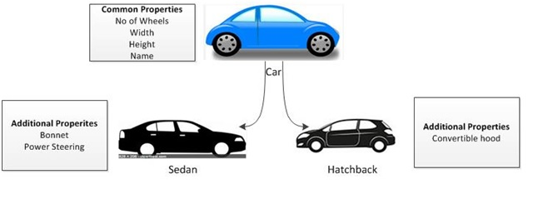

Slide 5
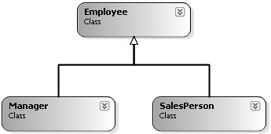
SalesPerson “is-a” Employee
Manager “is-a” Employee

Slide 6
Inheritance uses special character called ":" colon to make a relationship between parent and child.
[Access Modifier] class Class_Name : base_classname
{ //
}
When to Implement Inheritance:
we want to reuse some of the methods or properties from existing class.
Main advantage of inheritance is reusability of the code.

Slide 7
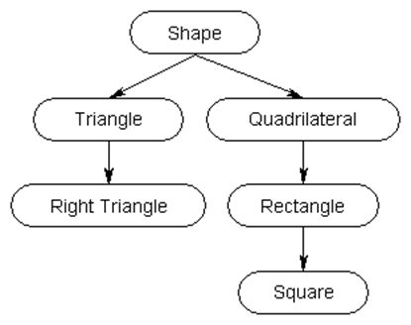

Slide 8
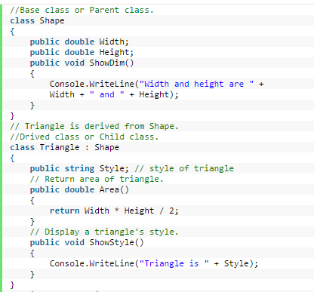

Slide 9
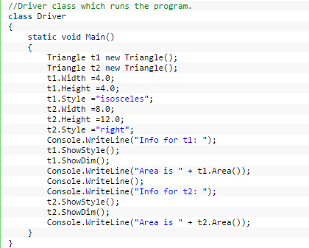

Slide 10
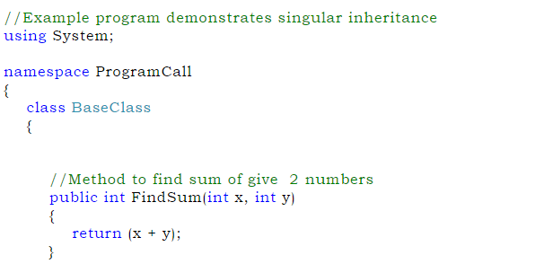

Slide 11
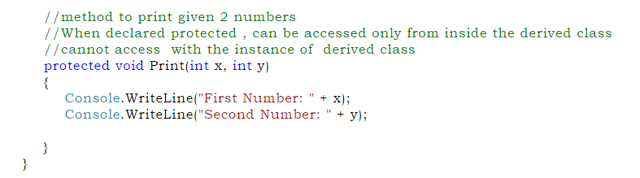
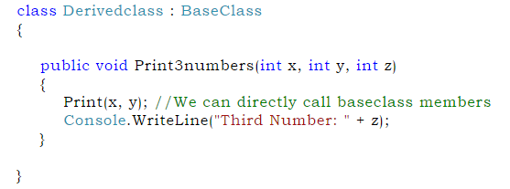

Slide 12
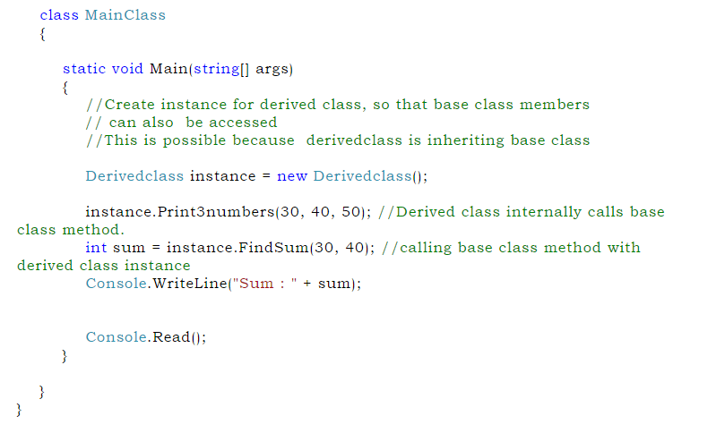

Slide 13
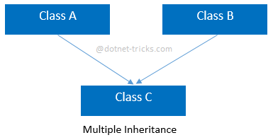
Regarding Multiple Base Classes
Derived class is created from more than one base class is called as Multiple inheritance or Multiple Base Class.

Slide 14
Multiple Inheritance is not supported in C#.
Multiple Inheritance can be achieved by using interface.
An interface looks like a class, but has no implementation.
The only thing it contains are declarations of events, indexers, methods and/or properties.

Slide 15
Keeping Family Secrets: The protected Keyword
Public: The class member defined as public can be accessed by other class member that is initialized outside the class. A public member can be accessed from anywhere even outside the namespace.
Private: The private access specifiers restrict the member variable or function to be called outside from the parent class.
C# takes the lead of many other modern object languages and provides an additional level of accessibility: protected.

Slide 16
Protected: The protected access specifiers hides its member variables and functions from other classes and objects.
This type of variable or function can only be accessed in child class.

Slide 17
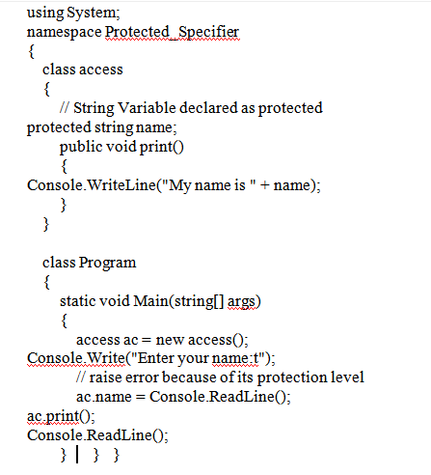

Slide 18
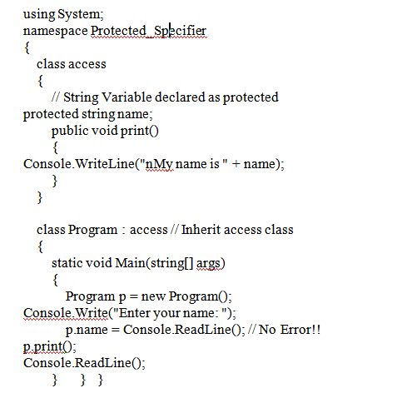

Slide 19
Preventing Inheritance: Sealed Classes
Sealed classes are used to restrict the inheritance feature of object oriented programming. Once a class is defined as a sealed class, the class cannot be inherited.
A sealed class is a class that cannot be extended by other classes.
Sealed classes provide security when you do not want other programmers to alter the implementation of a method.
In C#, the sealed modifier is used to define a class as sealed.

Slide 20
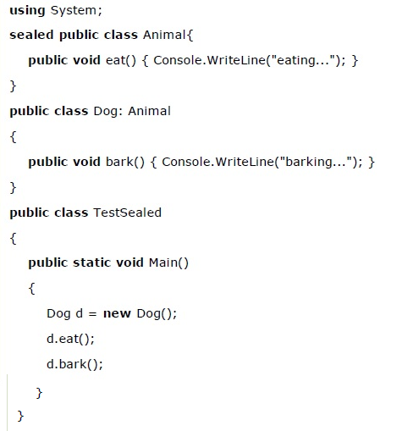
sealed class Sealed_Class
{
}
Compile Time Error: 'Dog': cannot derive from sealed type 'Animal'

Slide 21
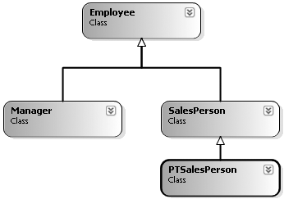

Slide 22
Programming for Containment/Delegation
The “has-a” relationship (also known as the containment/delegation model).
Consider:
Sales Manager is an employee of PQR Company
Sales Team are employees of PQR Company.
Sales Manager has an employee card to enter into PQR Company.
Sales Manager has got Sales Team to work under him.
Sales Manager has got responsibility to sell the products and to achieve the monthly target.

Slide 23
These relationship is based on "is-a" relationship, "has-a" relationship and "part-of" relationship.
Is-a Relationship:
Sales Manager is an employee of PQR Company.
Sales Team are employees of PQR Company
parent is a PQR Company.
Sales Manager is an employee works in PQR Company
Sales Team are working in the PQR Company.
So there is a parent-child relationship between PQR Company-Sales Manager and PQR Company-Sales Team,
because Sales Manager and Sales Team work under same company.

Slide 24
public class PQR_Company
{
//more code
}
public class Sales_Manager : PQR_Company
{
//more code
}
public class Sales_Team : PQR_Company
{
//more code
}

Slide 25
“has-a” relationship ( containment/delegation model)
Consider we have two different classes Class1 and a Class2
when both of these entities share each other’s object for some work and at the same time they can exists without each others dependency and there should be no single owner both have to be an independent from each other then type of relationship is known as "has-a" relationship.

Slide 26
Sales Manager has an employee card to enter in PQR Company.
extract association principle. Sales Manager uses an employee card to enter in the company.
Create two classes "Sales Manager" and "Employee Card“.
Because Sales Manager is an employee of a company and company uses an employee card to authorize their employees.
so both have to a different entities and at a same we should violate single responsibility principle.
Single responsibility principle says that every class should do their own job like Account class should do accounting work and Employee class should maintain employee details.

Slide 27
Nested Type Definitions
Define a type (enum, class, interface, struct, delegate) directly within the scope of a class.
the nested (or “inner”) type is considered a member of the nesting (or “outer”) class, and in the eyes of the runtime can be manipulated like any other member (fields, properties, methods, events, etc.).
Class C1
{
………………. // members of outer class
Class C2
{
……………..// members of inner class
}
}

Slide 28
Nested type appear like has-a relationship.
But in nested types, the inner class definition is within the body of out class and hence, inner class objects can not be created outside the outer class.

Slide 29
The Third Pillar: C#’s Polymorphic Support

Slide 30
Introduction
Polymorphism is derived from 2 Greek words:
poly
morphs.
The word "poly" means many and "morphs" means forms.
So polymorphism means many forms.
The process of representing one form in multiple forms is known as Polymorphism.

Slide 31
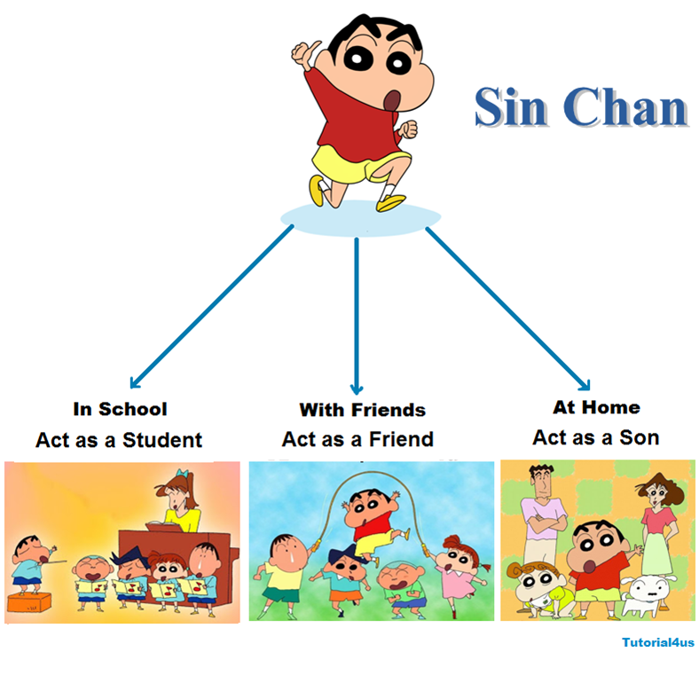
Example

Slide 32
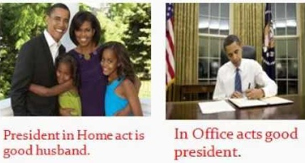

Slide 33
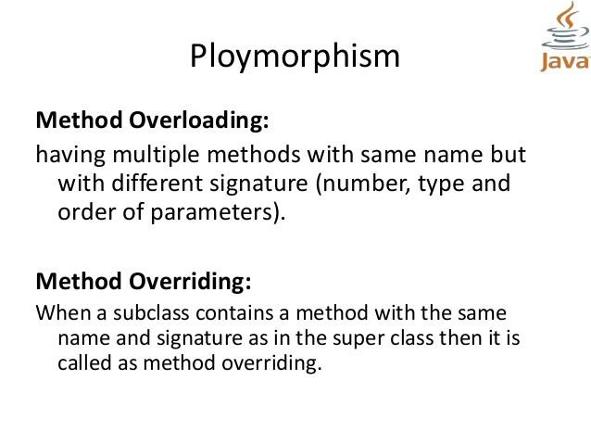

Slide 34
public class Calculation
{
public int Add(int a, int b)
{
return a + b;
}
public double Add(int z, int x, int c)
{
return z + x + c;
}
}

Slide 35
The virtual and override Keywords
class Employee
{
…….
public void Bonus(float b)
{
basicSal+=b;
}
}
class Manager:Employee
{
………..
}
class SalesMan: Employee
{
…………
}

Slide 36
classes Manager and SalesMan both contains the method Bonus(float).
call Bonus() function in main() through the objects of Manger and SalesMan
Manager m=new Manager();
m.Bonus(500);
SalesMan s=new SalesMan()
s.Bonus(300);

Slide 37
The Bonus() method works same for both the objects.
A SalesMan bonus should be calculated based on number of sales.
Manager can be given bonus based on his other performance like successful completion and delivery of a project etc.
we need a Bonus() method which works differently in two derived classes.

Slide 38
Use virtual and override keywords.
we can make same function to act differently in base-class and all the derived classes.
The Virtual keyword is used for generating a virtual path for its derived classes on implementing method overriding.
The Override keyword is used in the derived class of the base class in order to override the base class method.

Slide 39
class Employee
{
------------------
public virtual void Bonus(float b)
{
basicSal+=b;
}
}
class SalesMan:Employee
{
------------------
public override void Bonus(float b)
{
int salesBonus=0;
if(numOfSales<=100)
salesBonus=10;
elseif (numOfSales<=200)
salesBonus=20;
base.Bonus(b*salesBonus); //making use of base class method
}
}

Slide 40
class Test
{
public static void Main()
{
Employee e=new Employee();
e.Bonus(100); //base class Bonus() is called
SalesMan s=new SalesMan()
s.Bonus(300); /derived class Bonus() is called
}
}

Slide 41
NOTE: Any overridden method is free to call its corresponding base class method using the keyword base.

Slide 42
Revisiting the sealed Keyword
The sealed keyword can also be applied to type members to prevent virtual members from being further overridden by derived types.
This can be helpful when you do not wish to seal an entire class, just a few select methods or properties.

Slide 43
Abstract Class
Abstract class is defined using "abstract" keyword.
abstract class is a class which cannot be instantiated.
You can’t create object of an abstract class by simply using new keyword.
Abstract class only serves as a base class for its child classes.
An abstract is used to express a design concept or an abstract idea.
A vehicle is an abstract idea, but a car, jeep or a truck is a concrete form of a vehicle.

Slide 44
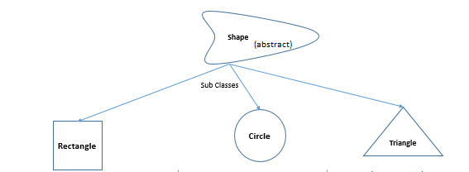

Slide 45
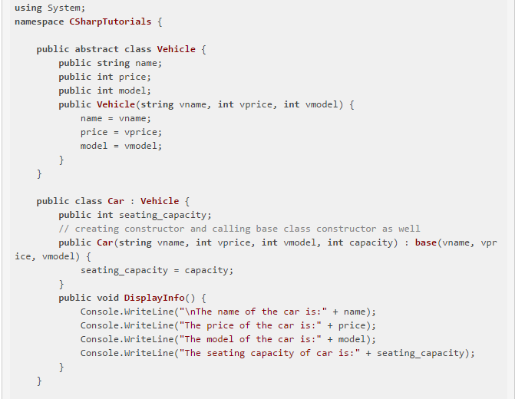

Slide 46
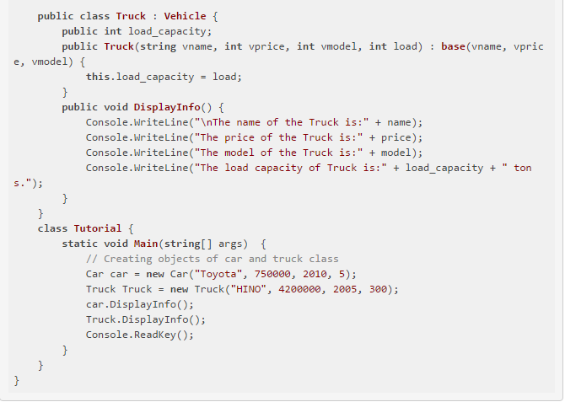

Slide 47
Abstract methods
abstract methods have no concrete implementation.
The Abstract method is declared via abstract keyword.
Abstract method do not have a body since the body is implemented by the classes that derive the method.
Derived class must provide definition for all the abstract methods of the class which they are inheriting.
This is done via override keyword.

Slide 48
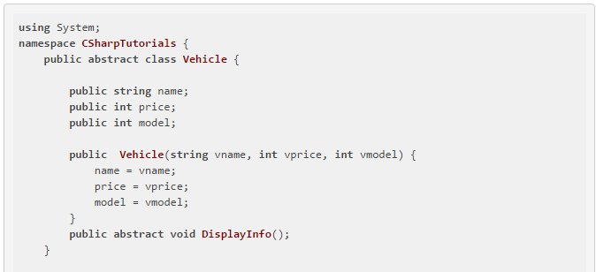

Slide 49
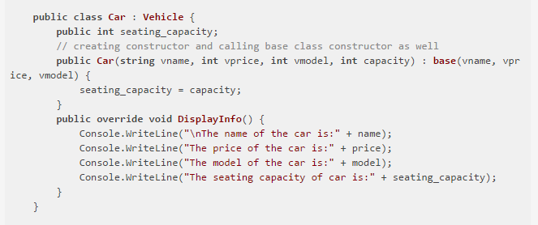

Slide 50
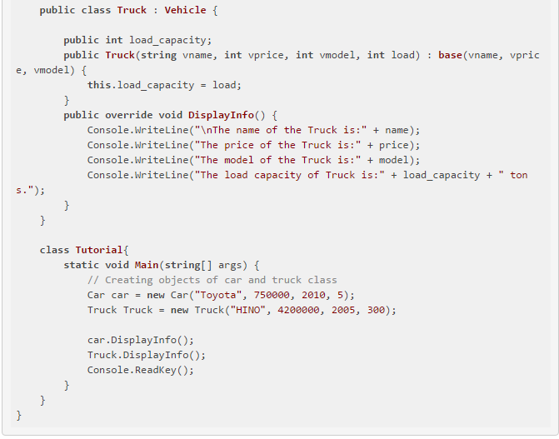

Slide 51
Member Hiding[ Method Hiding]
C# provides a facility that is the logical opposite of method overriding: member hiding.
If subclass (child class) has the same method as declared in the parent class, it is known as method overriding.
A derived class redeclares an identical member inherited from a base class, the derived class has hidden (or shadowed) the parent’s member.
predefine the method of parent class in child class by implementing the concept of method hiding.

Slide 52
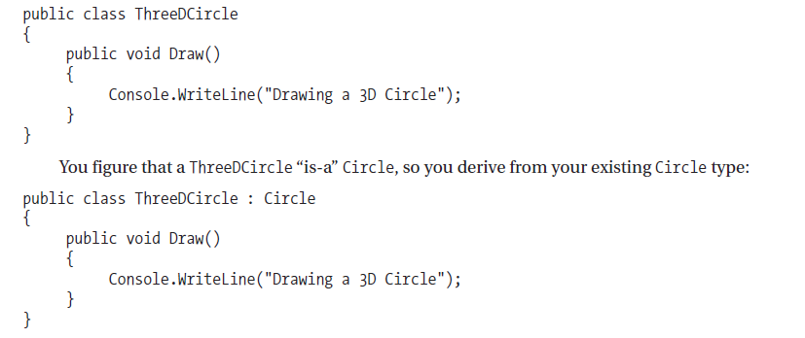
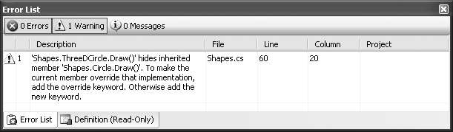
Once you recompile, you find the following warning

Slide 53
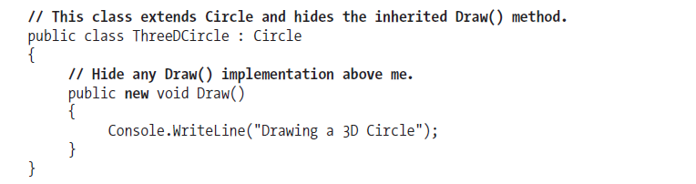
To solve method hiding in two ways:
update the parent’s version of Draw() using the override keyword.
The base(parent) class method is predefined in child class by specify new keyword.

Slide 54
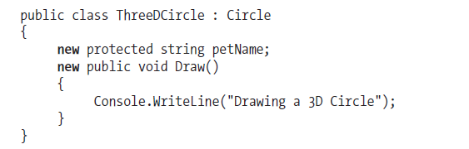
Also apply the new keyword to any member type inherited from a base class (field, constant, static member, property, etc.).

Slide 55
C# Casting Rules
Type Casting or Type Conversion is a mechanism to convert one data type value to another one.
Type conversion is possible if both the data types are compatible to each other; otherwise you will get an InvalidCastException.
Types of Type Casting:
Implicit conversion
Explicit conversion

Slide 56
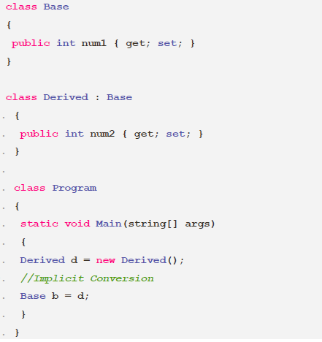
Implicit conversion
Implicit conversion is being done automatically by the compiler and no data will be lost. It includes conversion of a smaller data type to a larger data types and conversion of derived classes to base class.

Slide 57
Explicit conversion
Explicit conversion is being done by using a cast operator.
It includes conversion of larger data type to smaller data type and conversion of base class to derived classes.
In this conversion information might be lost or conversion might not be succeed for some reasons.
This is an un-safe type conversion.

Slide 58
long bigNum = 654667;
int smallnum = (int)bigNum; // Explicit conversion
class Base
{
public int num1 { get; set; }
}
class Derived : Base
{
public int num2 { get; set; }
}
class Program
{
static void Main(string[] args)
{
Base b = new Base();
Derived d = (Derived)b; //Explicit Conversion
}
}

