Slide 1
Domain Analysis

Slide 2
Overview of Analysis
During analysis, we build models and begin to understand the requirements
Successful analysis model states what must be done, without restricting how it is done
problem statement may be incomplete or informal, analysis makes it more precise and exposed ambiguities and inconsistences
Analysis model addresses the three aspects of objects: class model, interaction model and state model
Analysis is divided into two sub stages: Domain analysis, Application analysis

Slide 3
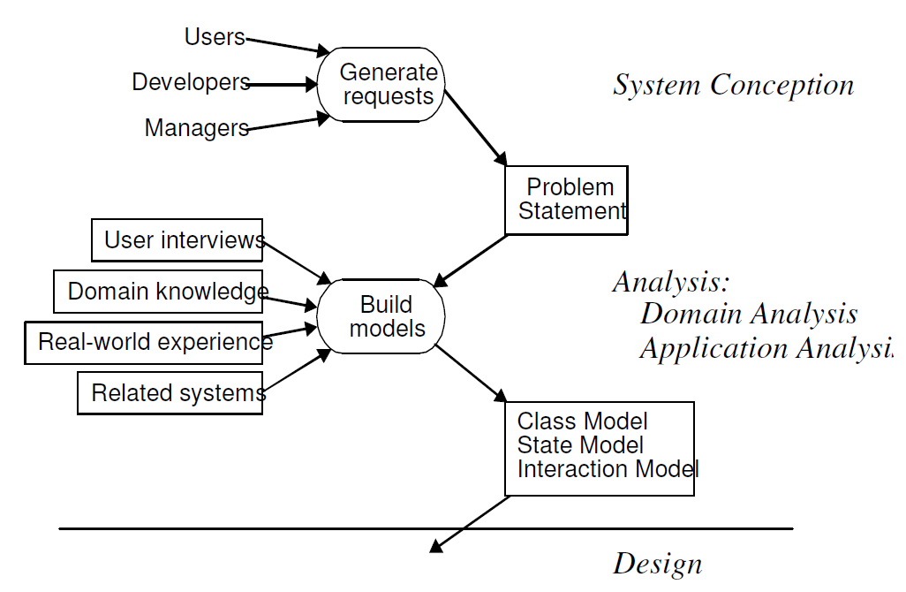
Overview of Analysis

Slide 4
Domain Class Model
First step in analyzing the requirements is to construct a domain model
The domain model describes real-world classes and their relationships to each other
Information for the domain model comes from the problem statement, artifacts from related systems, expert knowledge of the application domain and general knowledge of the real world

Slide 5
Domain Class Model
The steps to be performed to construct a domain class model:
Find Classes.
• Prepare a data dictionary.
• Find associations.
• Find attributes of objects and links.
• Organize and simplify classes using inheritance.
• Verify that access paths exist for likely queries.
• Iterate and refine the model.
• Reconsider the level of abstraction
• Group classes into packages

Slide 6
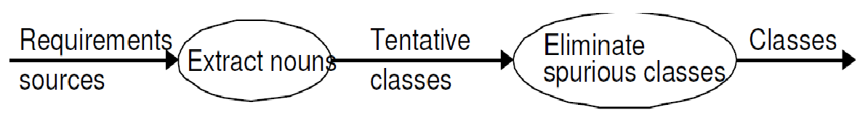
Domain Class Model
Finding classes
First step in constructing a class model is to find relevant classes for objects from application domain
ex: house, person ,machine etc.,
Classes often correspond to nouns.
Idea is to capture concepts. not all nouns are concepts, and concepts are also expressed in other parts of speech

Slide 7
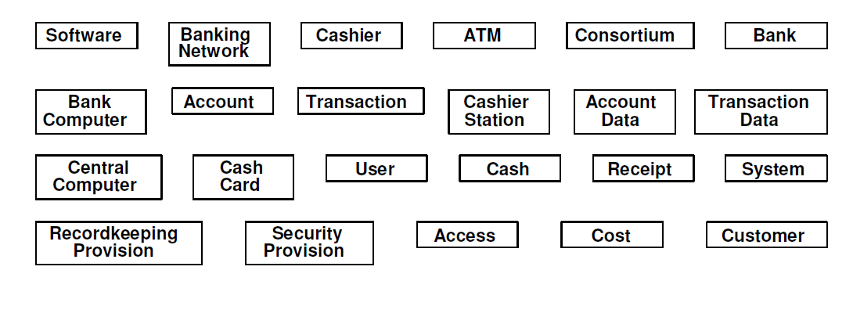
Domain Class Model

Slide 8
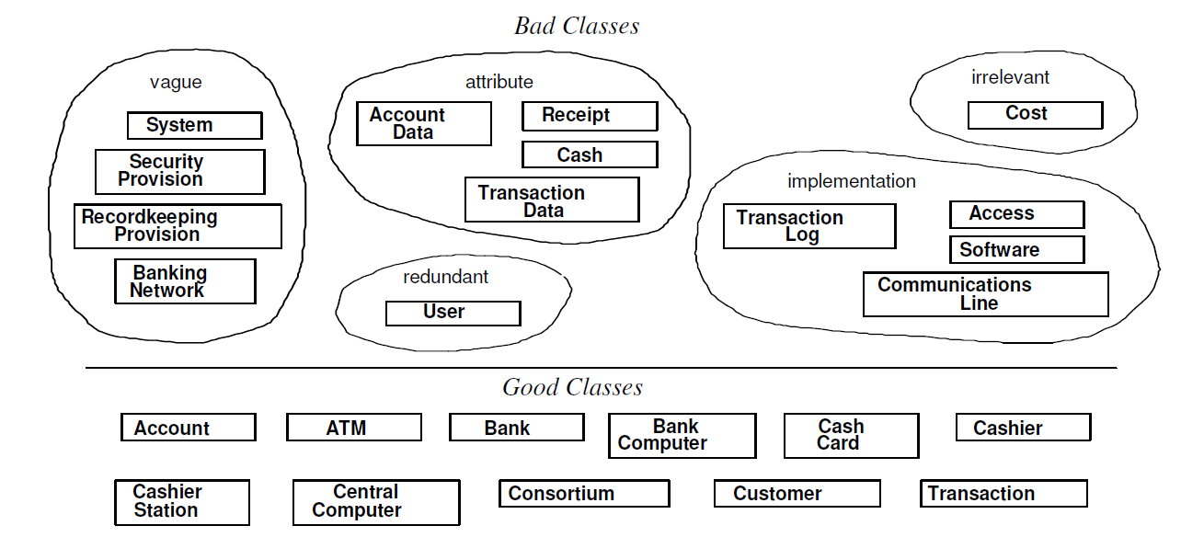
Domain Class Model
Keeping the right classes
Discard unnecessary and incorrect classes according to the following criteria

Slide 9
Domain Class Model
Preparing a Data Dictionary
Prepare a data dictionary for all modeling elements.
Describe the scope of the class within the current problem, including all assumptions or restrictions on its use
Data Dictionary for the ATM classes
Account ATM
Bank BankComputer
CashCard Cashier
cashierStation CentralComputer
Consortium Customer
Transaction

Slide 10
Domain Class Model
Finding associations
A structural relationship between two or more classes is an association
A reference from one class to another is an association
Associations often correspond to verbs or verb phrases
ex: physical locations(NextTo, partof, ContainedIn) directed action (Drives) communication(TalksTo) ownership(Has,partof)

Slide 11
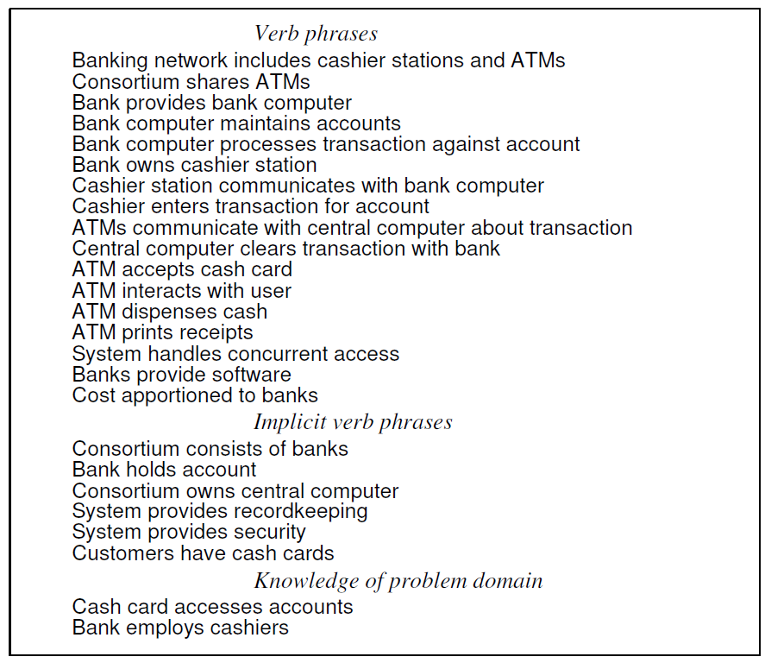
Domain Class Model

Slide 12
Domain Class Model
Keeping the Right Association
Discard unnecessary associations, using the following criteria
Associations between eliminated classes
Irrelevant or implementation association
Derived associations: Multiple paths between classes indicates derived associations
Misnamed association
Association end names

Slide 13
Domain Class Model
Qualified associations: usually a name identifies an object within some context, most names are not globally unique
Missing Association
Aggregation

Slide 14
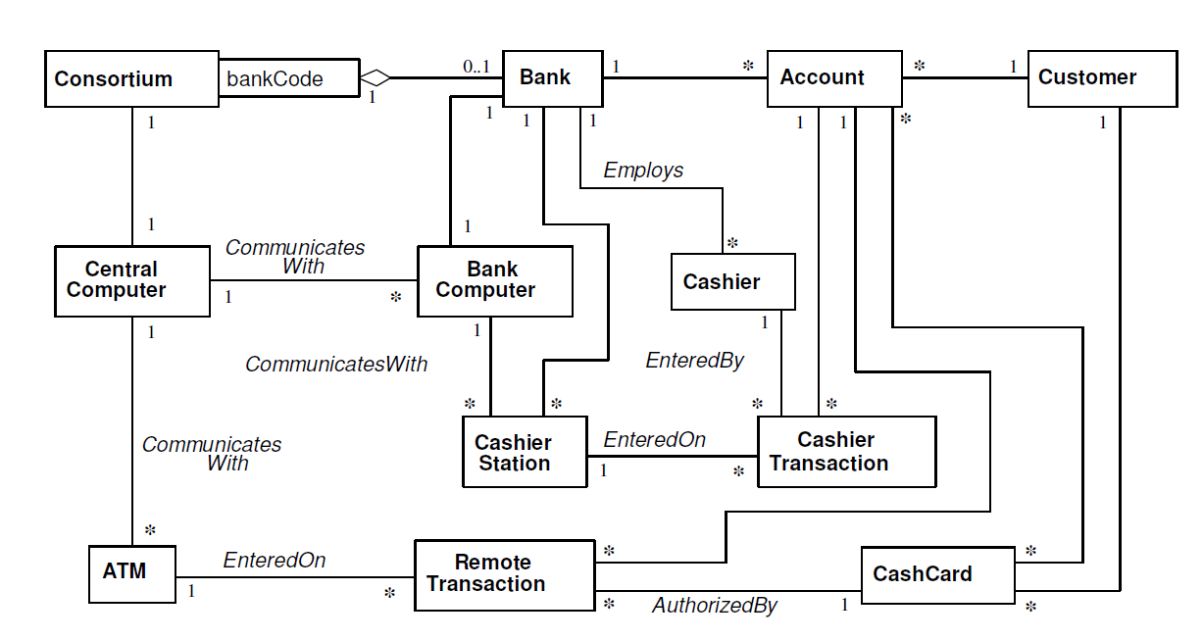
Domain Class Model

Slide 15
Domain Class Model
Find attributes
Attributes are data properties of objects
Attribute values should not be objects; use an association to show any relationship between objects
Attributes usually correspond to nouns followed by possessive phrases, such as “the color of the car”

Slide 16
Domain Class Model
Keeping the right attributes
Objects: if the independent existence of an element is important, rather than just its value, then it is an object
Qualifiers: if the value of an attribute dependents on a particular context, then consider restating the attribute as qualifier
Name: names are often quantified statements
Internal values: describes the internal state of an object that is invisible outside the object
Fine detail: omit attributes that are unlikely to affect most operations

Slide 17
Domain Class Model
Refining With Inheritance
Inheritance can be added in two directions
Buttom-up generalization:
generalizing common aspects of existing classes into a superclass
searching for classes with similar attributes, associations and operations
ex: central computer and Bank Computer in ATM
Top-Down specialization:
Specializing existing classes into multiple subclasses
looks for noun phrase composed of various adjectives on the class name
Ex: fluorescent lamp, incandescent lamp, fixed menu

Slide 18
Domain Class Model
Multiple inheritance:
to increasing sharing, but only if necessary
Increases both conceptual and implementation complexity
Similar associations
same association name appears more than once, try to generalize
Adjusting the inheritance level
Assign attributes and association to specific classes in class hierarchy

Slide 19
Domain Class Model
Testing Access Paths
trace access paths through the class model to see if they yield sensible results
acceptable to have classes that are disconnected from other classes
Ex: cash card and ATM machine

Slide 20
Domain Class Model
Iterating a class Model
A class model is rarely correct after a single pass
different parts of a model are often at different stages of completion
if there is any deficiency, go back to earlier stage if necessary
Several signs of missing class
Asymmetries in associations and generalization: add new classes
Disparate attributes and operations on a class: spilt the class
Difficulty in generalizing : one class may play two role
A role that substantially shapes the semantics of a class: converting an association into a class

Slide 21
Domain Class Model
Missing access paths for operations
Redundant information
Lack of attributes, operations and associations on a class

Slide 22
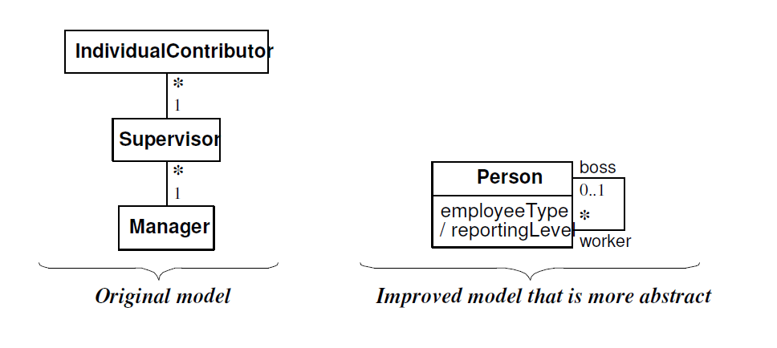
Domain Class Model
Shifting the level of Abstraction
Abstraction makes a model more complex but can increase flexibility and reduce the number of classes.

Slide 23
Domain Class Model
Group classes into packages
A package is a group of elements(classes, association, generalizations and lesser packages) with common theme
restrict each association to a single package, but repeat some classes indifferent package
Ex: Account: account, cash card, customer, transaction, update
bank: consortium,bank

Slide 24
Domain State Model
The Following steps are performed in constructing a domain state model
Identifying classes with states
Finding states
Finding Events
Building state diagrams
Evaluating state diagrams

Slide 25
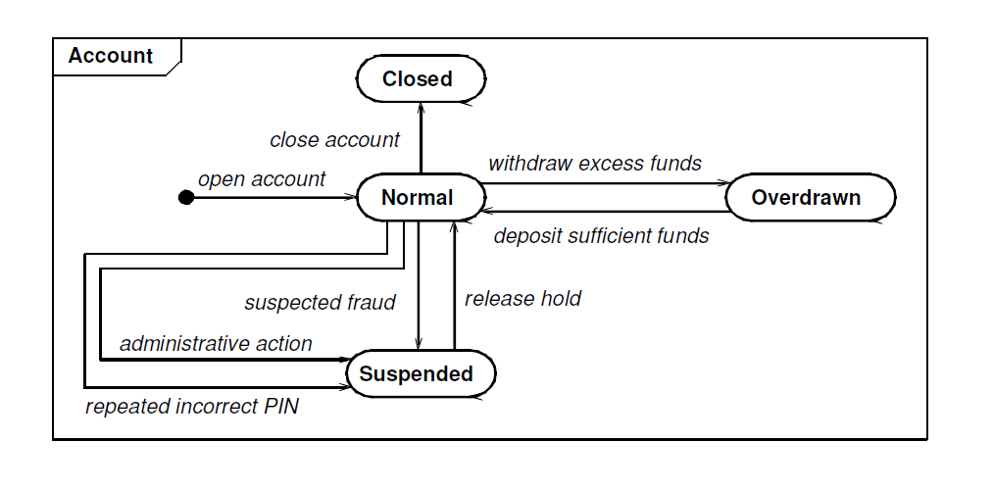
Domain State Model

Slide 26
Domain Interaction Model
Iterating the Analysis
The iteration to the analysis should ne done as follows:
Refining the Analysis Model
Restating the Requirements
Analysis and Design.

