Slide 1

Chapter 15
Connecting LANs, Backbone Networks, and Virtual LANs
Copyright © The McGraw-Hill Companies, Inc. Permission required for reproduction or display.

Slide 2
15-1 CONNECTING DEVICES
In this section, we divide connecting devices into five different categories based on the layer in which they operate in a network.
Topics discussed in this section:
Passive Hubs
Active Hubs or Repeater Bridges or Two-Layer Switches
Routers or Three-Layer Switches
Gateways

Slide 3
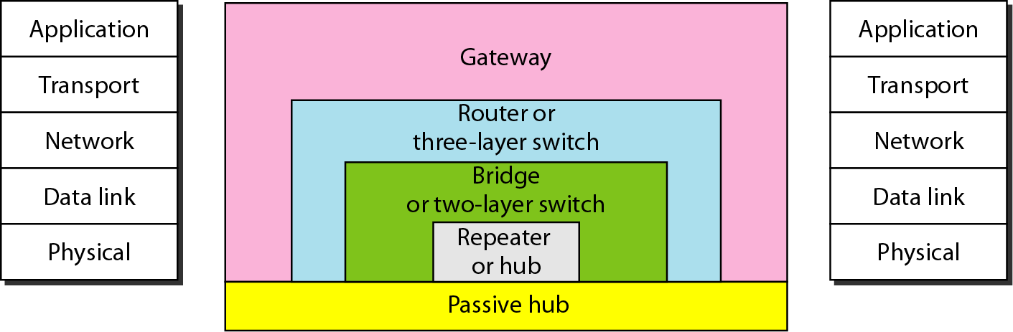
Figure 15.1 Five categories of connecting devices

Slide 4
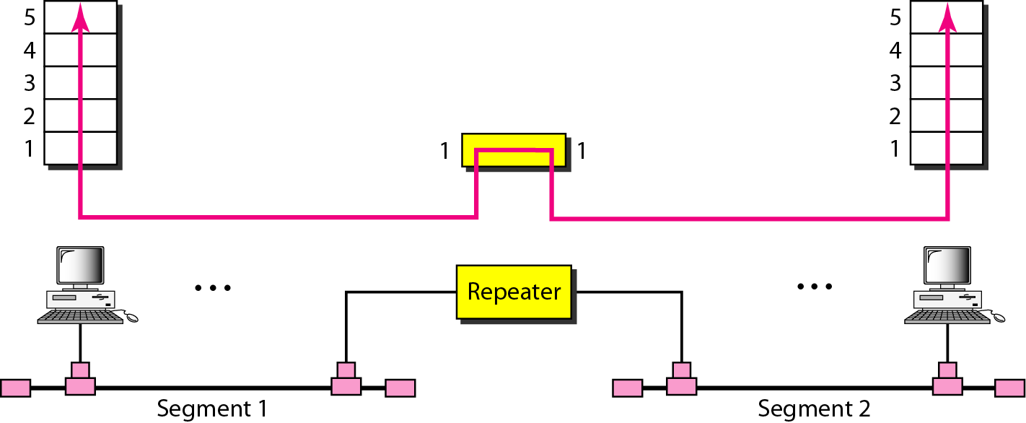
Figure 15.2 A repeater connecting two segments of a LAN

Slide 5

Note
A repeater connects segments of a LAN.

Slide 6
Note
A repeater forwards every frame; it has no filtering capability.

Slide 7
Note
A repeater is a regenerator, not an amplifier.

Slide 8
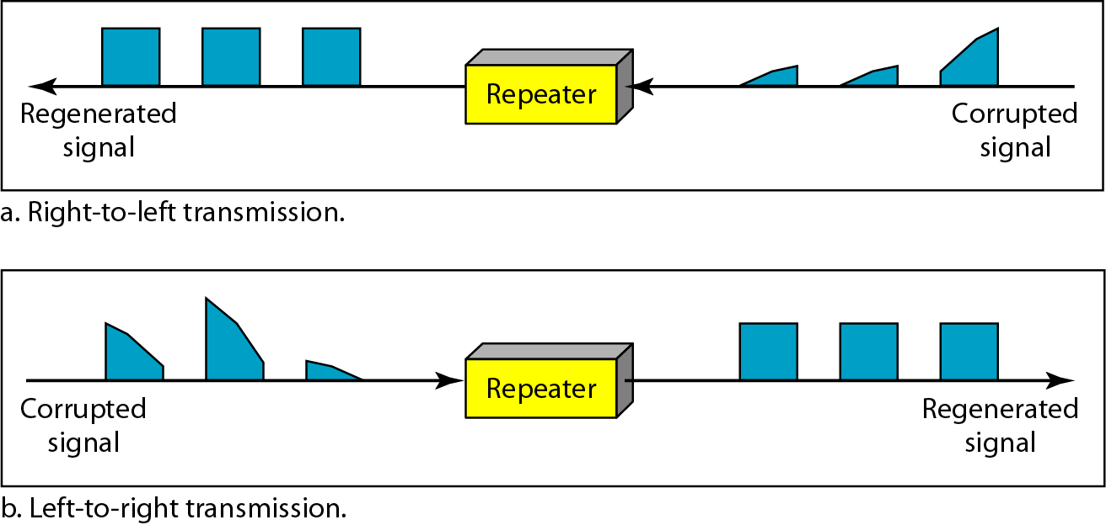
Figure 15.3 Function of a repeater

Slide 9
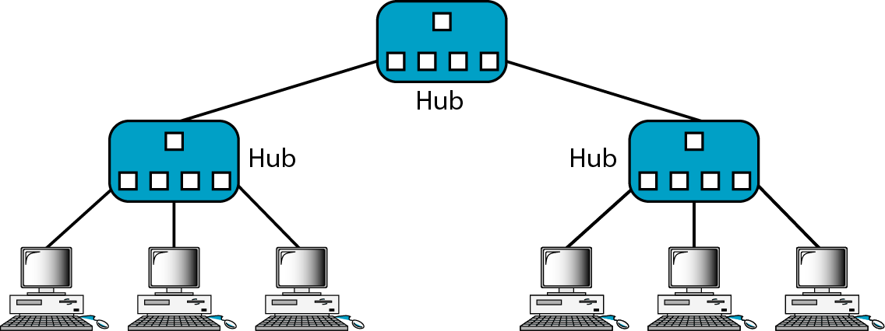
Figure 15.4 A hierarchy of hubs

Slide 10
Note
A bridge has a table used in filtering decisions.

Slide 11
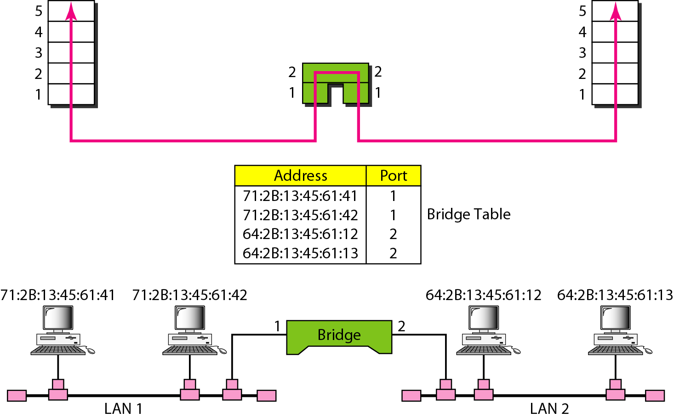
Figure 15.5 A bridge connecting two LANs

Slide 12
Note
A bridge does not change the physical (MAC) addresses in a frame.

Slide 13
Transparent Bridges
It is a bridge in which the stations are completely unaware of the bridge’s existence. According to IEEE 802.1d specification, a system with this type of bridge must meet 3 criteria:
Frames must be f/w from one station to other.
Forwarding table is automatically made by learning frame movements in a n/w.
Loops in the system must be prevented.

Slide 14
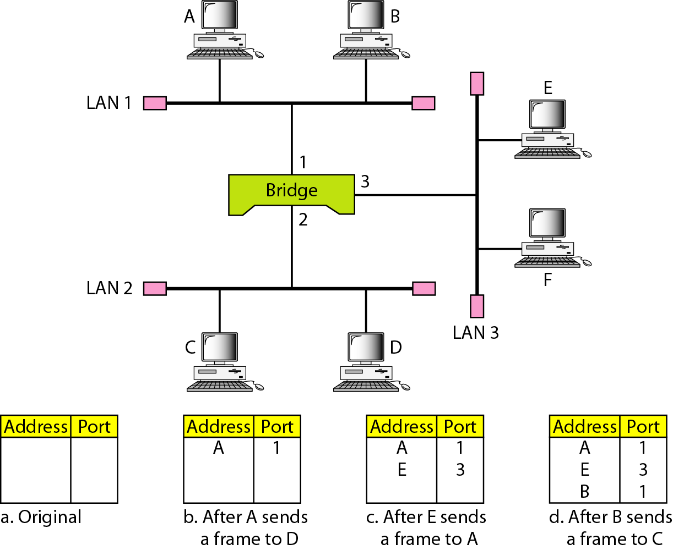
Figure 15.6 A learning bridge and the process of learning

Slide 15
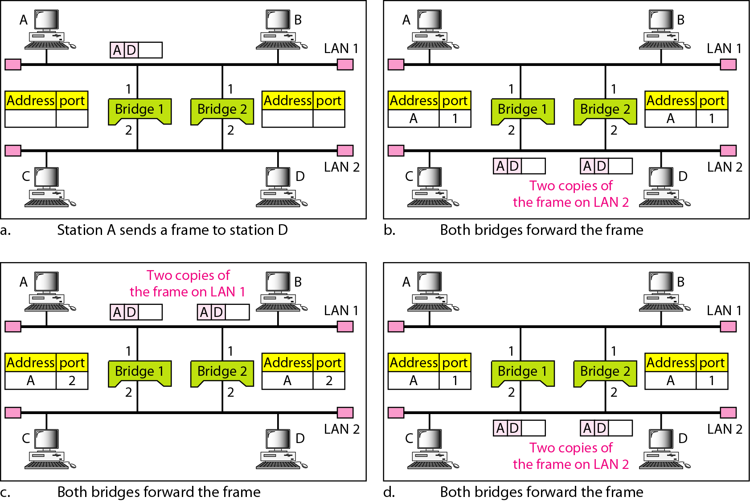
Figure 15.7 Loop problem in a learning bridge

Slide 16
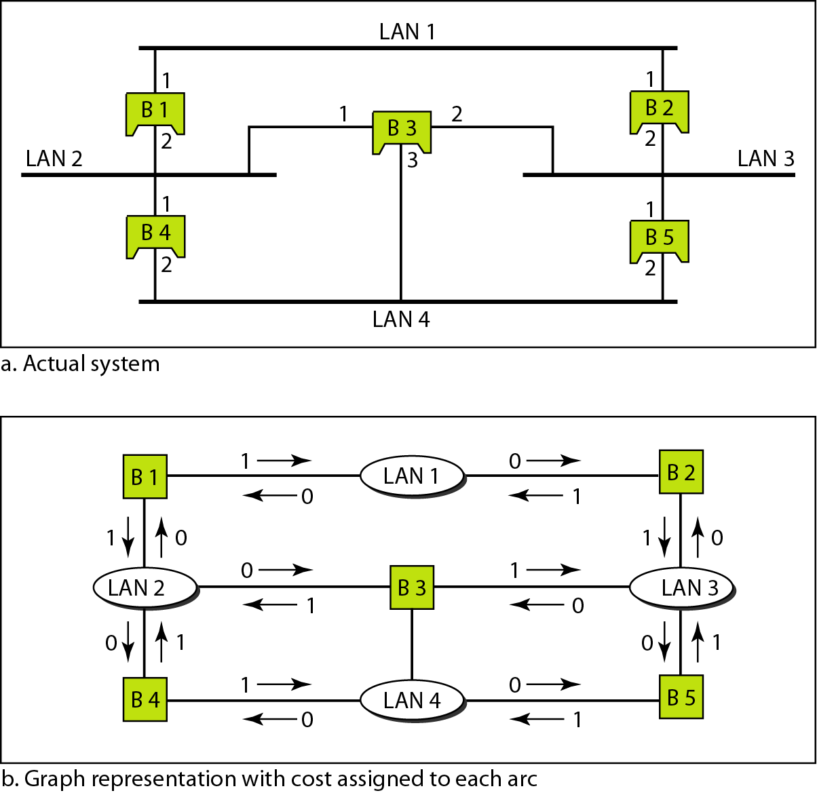
Figure 15.8 A system of connected LANs and its graph representation

Slide 17
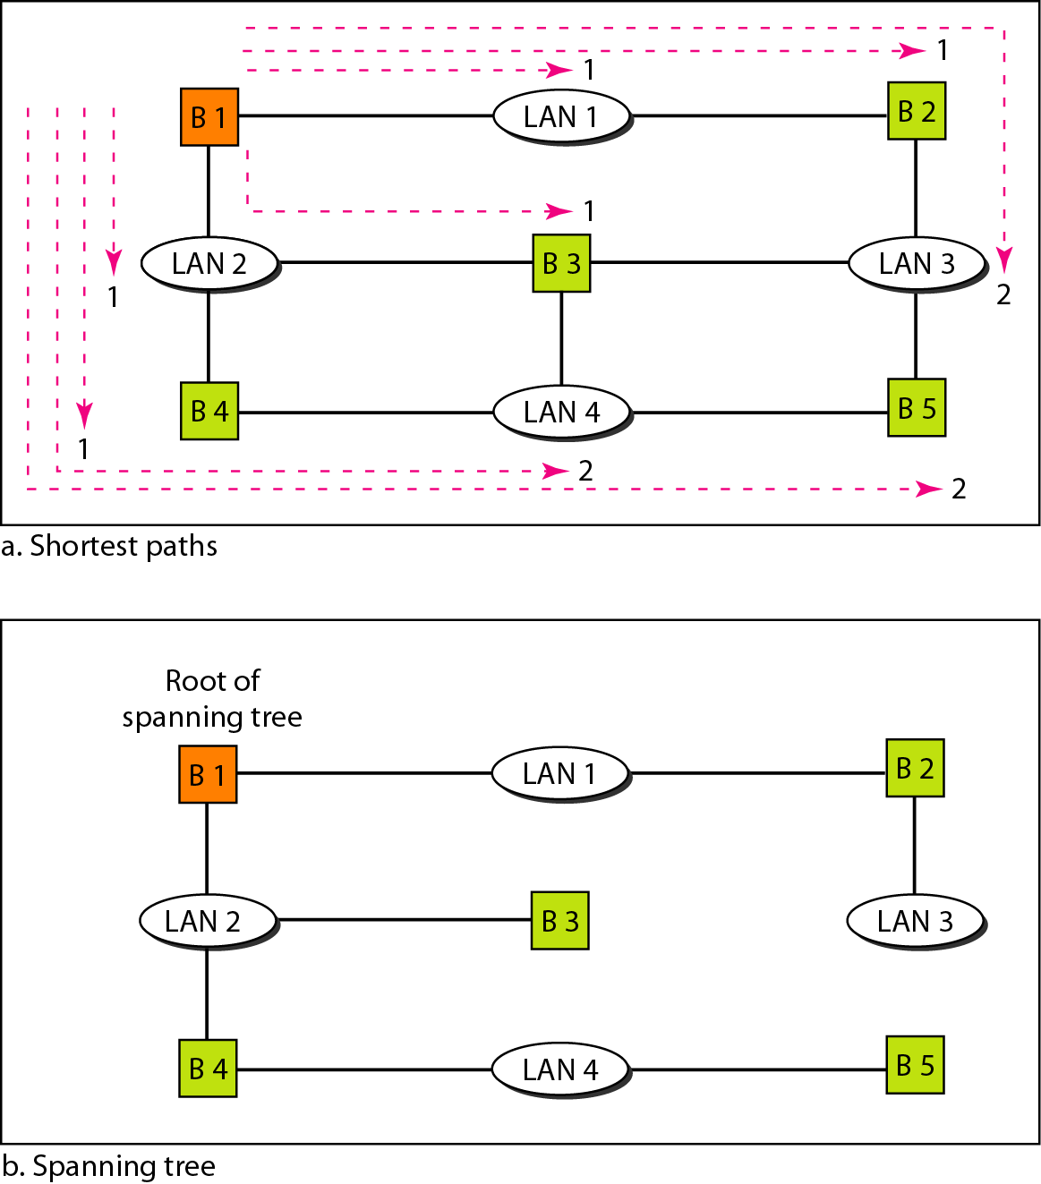
Figure 15.9 Finding the shortest paths and the spanning tree in a system of bridges

Slide 18
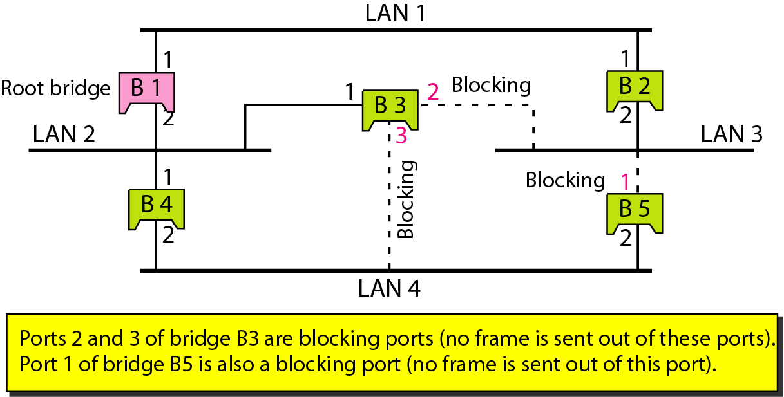
Figure 15.10 Forwarding and blocking ports after using spanning tree algorithm

Slide 19
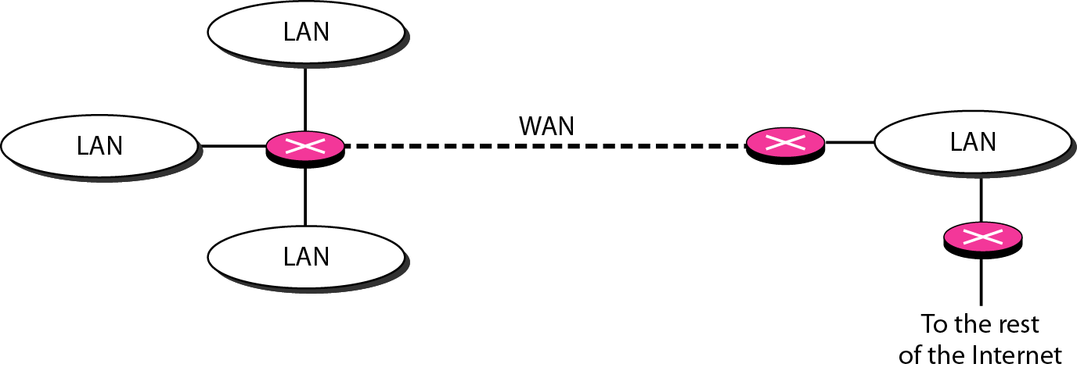
Bridges connecting different LANs
Two-layer switches
Routers
Figure 15.11 Routers connecting independent LANs and WANs
Three layer switches
Gateway

Slide 20
15-2 BACKBONE NETWORKS
A backbone network allows several LANs to be connected. In a backbone network, no station is directly connected to the backbone; the stations are part of a LAN, and the backbone connects the LANs.
Topics discussed in this section:
Bus Backbone Star Backbone Connecting Remote LANs

Slide 21
Note
In a bus backbone, the topology of the backbone is a bus.

Slide 22
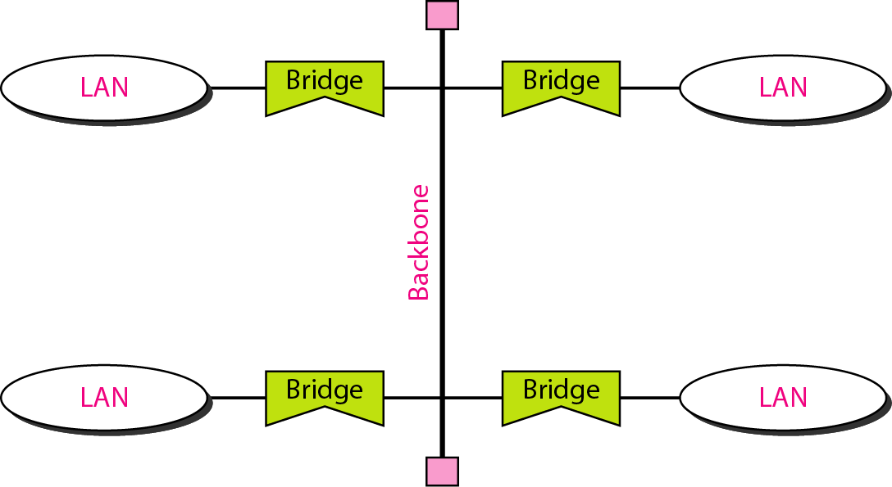
Figure 15.12 Bus backbone

Slide 23
Note
In a star backbone, the topology of the backbone is a star;
the backbone is just one switch.

Slide 24
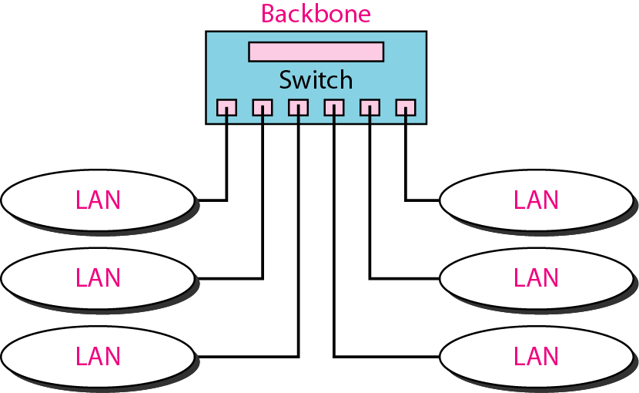
Figure 15.13 Star backbone

Slide 25
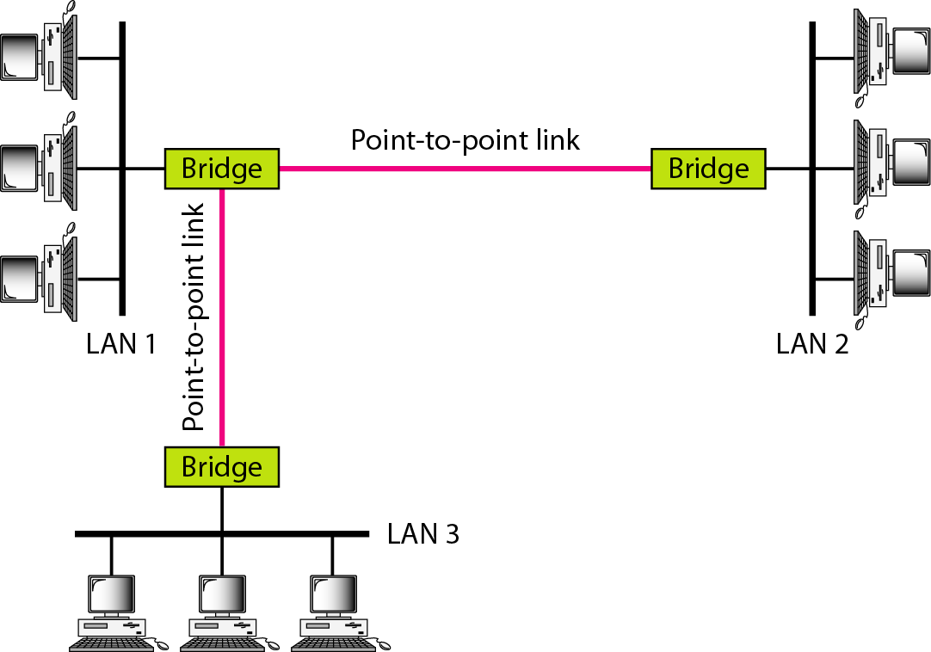
Figure 15.14 Connecting remote LANs with bridges

Slide 26
Note
A point-to-point link acts as a LAN in a remote backbone connected by remote bridges.

Slide 27
15-3 VIRTUAL LANs
We can roughly define a virtual local area network (VLAN) as a local area network configured by software, not by physical wiring.
Topics discussed in this section:
Membership Configuration
Communication between Switches
IEEE Standard
Advantages

Slide 28
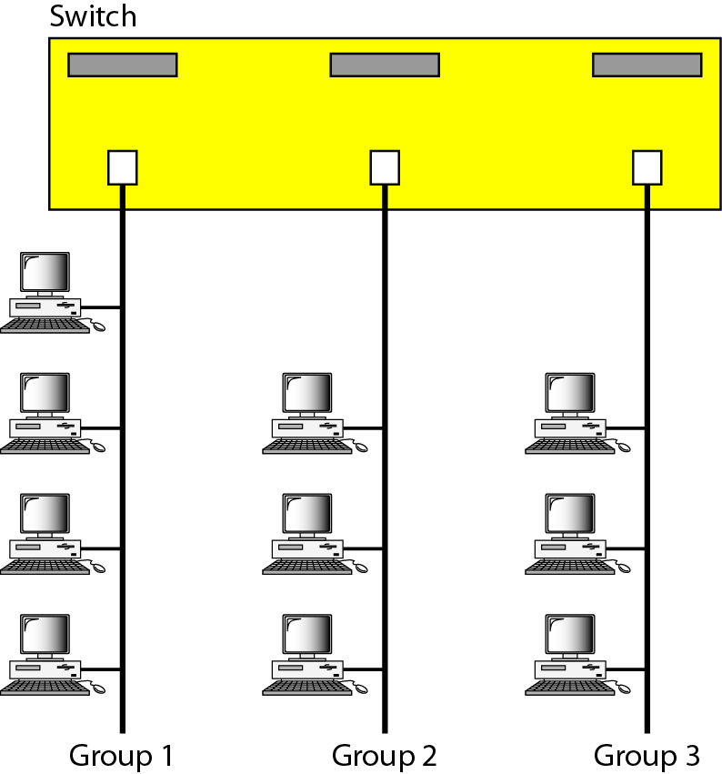
Figure 15.15 A switch connecting three LANs

Slide 29
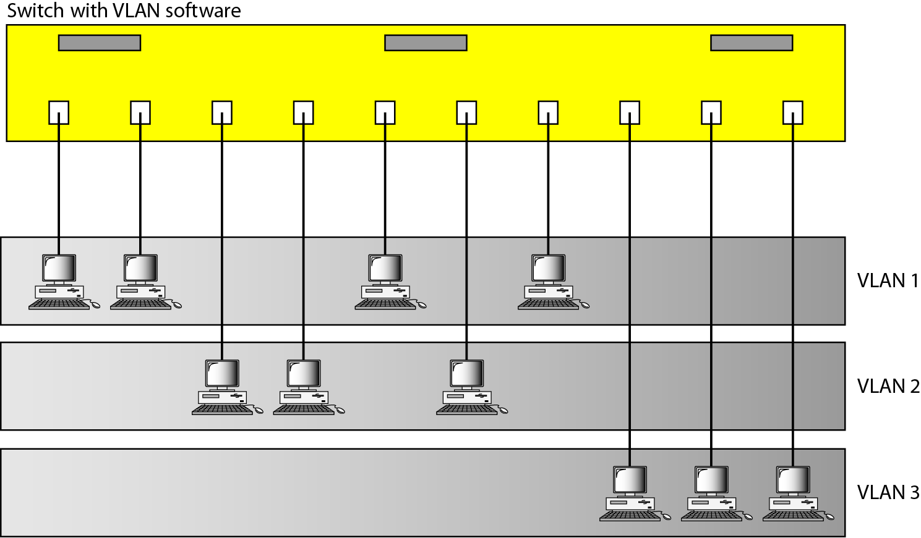
Figure 15.16 A switch using VLAN software

Slide 30
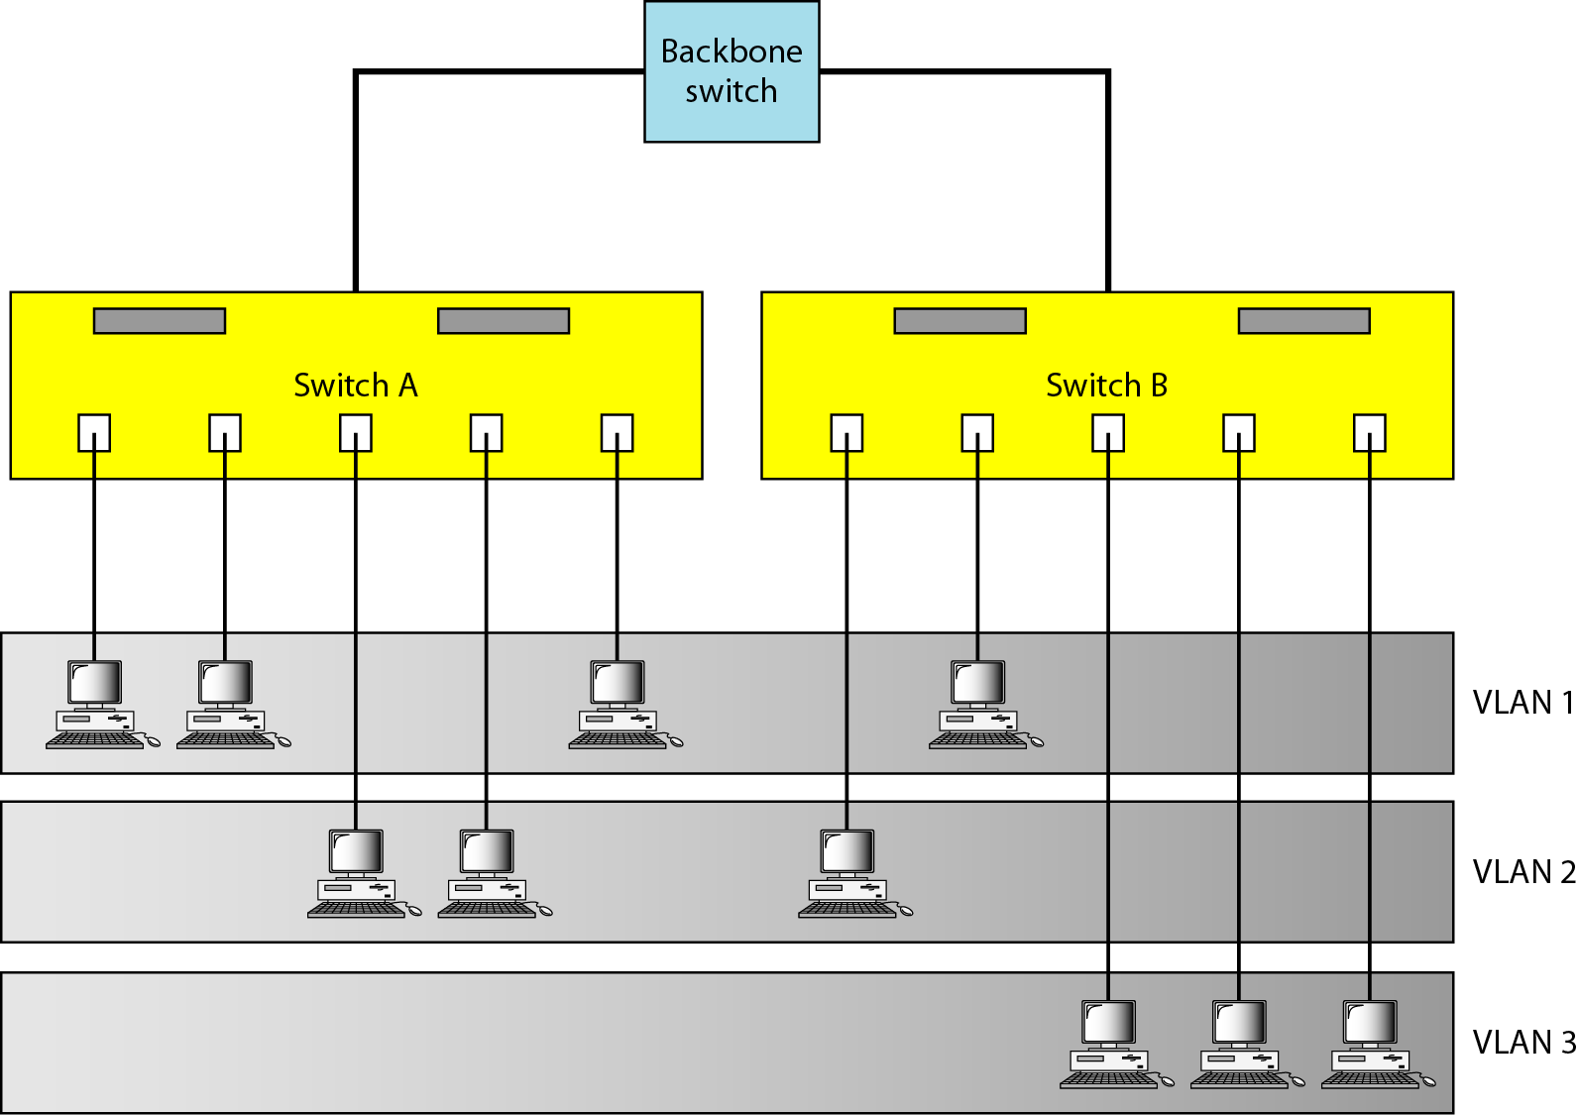
Figure 15.17 Two switches in a backbone using VLAN software

Slide 31
Note
VLANs create broadcast domains.

