Slide 1
Multimedia Computing
Text Books:
Ralf Steinmetz,Klara Narstedt::Multimedia Fundamental-Vol 1-Media coding and content Processing.
Prabhat K. Andleigh,Kiran Thakrar:Multimedia System Design.

Slide 2
Definition of Multimedia
It is composed of two parts:
Multi means numerous.
Media means “a mean to distribute and represent information”.
Ex: Text, Graphics, Picture, Voice, Sound and Music.
Multimedia from the user’s perspective
Enables information to be represented through text, audio, graphics, image, animation, and video
Multimedia in computer science
Computer‐based processing of the data includes at least two of the following elements: text, audio, graphic, image, animation, and video

Slide 3
Multimedia Elements
Facsimile
Document Images
Photographic images
Geographic information system maps
Voice commands and voice synthesis
Audio messages
Video messages
Full motion stored and live video
Holographic images
Fractals

Slide 4
Facsimile
Facsimile transmission were the first practical means of transmitting document images over a telephone line.[Fax]
Facsimile transmission was standardized to CCITT Group 3 compression standards or run length encoding.
Typical pixel densities used for facsimile are in the 100 to 200 dpi range. Some laser printers support at least 400dpi.

Slide 5
Document Images
Document images are used for storing business documents that must be retained for long periods of time or may need to be accessed by a large number of people. This removes the need for making several copies of the original for storage and distribution.
Storing document images in electronic form with adequate reproduction quality, the requirements start at 300dpi.

Slide 6
Photographic Images
Photographic images are used for a wide range of applications such as employee records for instant identification at security desk, real estate systems with house photos, medical case histories and so on.
Photographic images are used frequently for imaging systems that are used for identification.
A resolution of 600 dpi is required for reproducing a photographic images.

Slide 7
Geographic Information Systems Map[GIS]
Map created in a GIS system are being used widely for natural resources and wildlife management and urban planning.
GIS system store the graphical information of the map along with a database containing information relating highlighted map elements statistics or item information.
Two kinds of technologies used for storage and display of geographic maps are: Raster and combination of raster images and vector.
Raster storage allows a map to be displayed on a graphical display system. Ex. Road maps used by travel assistants and area maps used to track natural resources.
Combination of raster images and vector. Ex showing railroad or highways and other human made structures, and text display showing attributes of features in the map.

Slide 8
Voice Commands and Voice Synthesis
Both are used for hands-free operation of a computer program.
Voice commands
Voice commands allow the user to direct computer operation by spoken commands.
Voice commands are primarily an input voice recognition consideration.
It allow command entry via short voice commands rather than a keyboard or pointing device.
Recognition of command requires specialized techniques and powerful processing capabilities to compensate for differences in pitch, accent and voice modulation of user.

Slide 9
Voice Synthesis
Voice Synthesis is used for presenting the results of an action to the user in a synthesized voice. Ex. Patient monitoring system in a surgical theatre.
Voice Synthesis is easier to achieve than voice recognition.
The initial attempts used fully stored messages or actual voice clip that were strung together. In either approach, the cadence(isochronicity) of the composite output has to be good for message to be clear.
Another approach is to break down the message completely to a canonical forms based on phonetics.
Digital signal processor designed for the applications to perform computations and maintain correct cadence.

Slide 10
Audio Messages
Audio messages are substitute for text messages.
Computer equipped with microphones can record an audio message and embed it in or attach it to an e-mail message. Ex. Annotated(add note) voice mail uses audio or voice messages as attached to memos and documents.
Audio messages required large volume of storage so compression techniques attempts to manage the storage more effectively.
Speed of decompression and playback of audio messages with proper cadence is important.

Slide 11
Video Messages
Video messages are being used in a manner similar to annotated voice mail.
Video messages can be embedded in or attached to e-mail messages.
It can ranges from a single snapshots to full motion video clips. The storage and playback requirements are complex because of the storage for each video shot.
Video messages are almost always stored in a shared video data server and displayed at the receiver workstation at a later time.

Slide 12
Full motion stored and live video
CD-ROM technology has provided the basis for the development of full-motion video.
The primary applications are CD-ROM games, online training manuals and reference materials, video conferencing, multimedia e-mails, video karaoke systems and so on.
Full motion video needs large bandwidth for communications media, massive storage requirements and high density high performance compression technologies.
Full motion video requires isochronous playback.

Slide 13
Holographic Images
Holography is defined as the means of creating a unique photographic images without the use of lens.
Holographic Images extend the concept of virtual reality by allowing the user to get “inside” a part, such as, an engine and view its operation from the inside.
The photographic recording of the image is called a hologram.
A beam of coherent laser light is directed on an object in a darkened room. The beam is reflected, scattered and diffracted by the physical features of the object and arrives on a photographic plate at the same time that a part of the original beam also arrives at the photographic plate. The two beams cause interference, which results in a complex pattern of stripes and whorls. The developed plate is called Hologram.
When coherent light passes through hologram, the hologram acts as a diffraction grating and bending some of light beams.

Slide 14
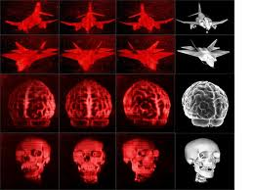
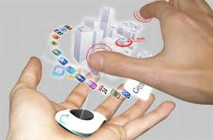
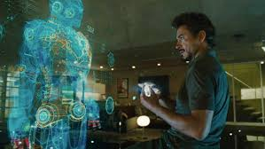
Holographic images

Slide 15
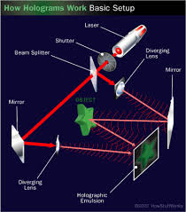
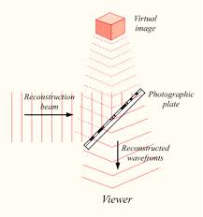

Slide 16
Fractals
Fractals are regular objects with a high degree of irregular shape. This technology is based on synthesizing and storing algorithms that describe the information(defines repeated pattern in the image ).
In fractal compression, a digitized image is broken into segments. A segment can be a fern or leaf. After breaking up the image into segments, the individual segments are checked against a library of fractals. The library contains a compact set of numbers called iterated function system codes, which will reproduce the corresponding fractals.

Slide 17
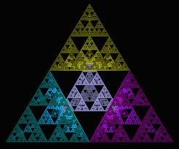
Fractals Images

Slide 18
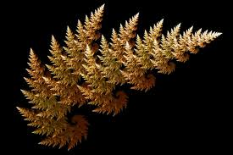

Slide 19
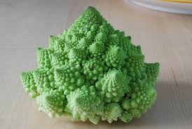


Slide 20
Multimedia Applications
Document Imaging
Image processing and Image Recognition
Full Motion Digital video Applications
Electronic Messaging
A Universal Multimedia Application

Slide 21
Multimedia System Architecture
Multimedia encompasses a large variety of technologies and integration of multiple architecture interacting in real time.
Another important aspect of multimedia system is that all of these multimedia capabilities must integrate with the standard user interfaces such as Microsoft windows, X windows or presentation manager.
Multimedia design should be such that system can operate with or without special hardware.
The applications should require absolutely no change to operate with a variety of hardware interfaces.
For application to function with a variety of hardware components, interface standards are necessary.
The application is designed to operate with any hardware or OS environment that supports the API.
Common file formats allow data files to be exchanged b/n different hardware architecture and operating environment.

Slide 22
The developers builds support for the drivers for the supported hardware. The APIs allow the applications to support large numbers of drivers.
Software compression and decompression drivers can replace hardware boards.
Use of common APIs allows application developers to develop applications that can work with h/w drivers as well as with s/w drivers.

Slide 23
Below figure describes the architecture of a multimedia Workstation environment.
In fig, Right side shows the new architectural entities required for supporting multimedia applications.
The add-on multimedia devices and peripherals include scanners, video cameras, VCRs, and sound equipment along with their associated device controllers and encoding hardware(such as DVI-JPEG- or MPEG-enabled boards).
Special devices needs a software device driver to provide the interface from an application to the device.
Graphical user interface(GUI) designed for windows managed by applications at fixed resolutions, require control extensions to support applications such as full motion video or remote desktop.
Multimedia operation places demands on the system hardware , in terms of both computing performance and storage.

Slide 24
APPLICATIONS
Graphical user interface Multimedia Extensions [GUI]
Operating System Software Drives Multimedia Driver Support
System Hardware Add-On Multimedia Device and (Multimedia-Enabled) peripherals
Fig. Multimedia Workstation Architecture

Slide 25
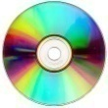

Application
Application
Application Compatibility Layer
Systems Compatibility Layer
Hardware Layer
Application Compatibility Layer
Systems Compatibility Layer
Hardware Layer
Analog Devices
Analog Devices
Multimedia Interface Bus
Object File Server
CD-ROM
Jukebox
WAN
Network File Server
LAN
Fig. Multimedia Architecture based on Interface Bus

Slide 26
The IMA architectural framework
The Interactive Multimedia Association(IMA) has a task group to define architectural framework for multimedia to provide interoperability for multimedia products.
The task group has two areas of concentration: desktop(or client) and servers.
Desktop: define the interchange formats that allow multimedia objects to be displayed on any workstation or PC.
Servers: define the class libraries for multimedia objects that distribute multimedia application across multivendor platforms.
The task groups role is to provide technological specifications rather than product.
IMA approach is based on defining interfaces to a multimedia interface bus.
Interface b/n system and multimedia sources and provide streaming I/O services.

Slide 27
Network Architecture for Multimedia Systems
Multimedia systems have special networking requirement because, rather that just small volumes of data, large volumes of images and video messages are being transmitted.
More and more applications become server based and attempts to transmit complex graphics that leads to network congestion.
The increasing demand on the network, the distinct requirements of different applications and the need to optimize network resources point to a task based approach to networking.

Slide 28
Task based Multi-level networking:
The task can be broken down into the following types on the basis of the nature of their requirement for volume of data, potential source of data and transfer speeds:
Data transfer for Text
Data transfer for Images
Data transfer for Audio and Video clips
Data duplication to user Workstations
Data replication among servers
High speed server-to-server links

Slide 29
Networking standards
ATM
FDDI
ATM vs. FDDI II

Slide 30
Defining Objects for Multimedia Systems
Basic types of data for multimedia are
Text
Text is simplest of data types and requires the least amount of storage.
Text data types can be made field in a database that can be indexed, searched and sorted.
Text fields are used for names, addresses, descriptions, definitions, and a variety of data attributes.
The major attributes of text include paragraph styling, character styling, font families and sizes, and relative location in a document.
Text is the building block of a document. It is the basic element of a relational database.

Slide 31
Images
The image object includes all data types that are not coded text(ASCII text) and don’t have a temporal property (i.e., changing with time) associated with them. All objects that are represented in (nontext) graphics or encoded form.
Images includes data types such as document images, facsimile systems, fractals, bitmaps, metafile, and still pictures.
Images divided into
Visible images
Nonvisible images
Abstract images

Slide 32
objects
Images
Visible images
Nonvisible images
Abstract images
(Math Functions)
Temp.
Gauge
Pressure
Gauge
Drawings
Documents
Discrete
Continuous
Photographs
Paintings

Slide 33
Images
Visible images: includes
Drawings: blueprints, engineering drawings, space map for offices, town layout.
Documents : scanned as images.
Paintings : both scanned or created from a computer based paint applications.
Photographs : scanned or entered directly by an electronic camera.
Still frames captured from a video camera.
NonVisible images: not stored as images but are displayed as images. Example includes
Pressure gauge, temperature gauge and other metering display.

Slide 34
Abstract images: computer generated images based on some arithmetic calculations.
Example : Fractals.
Discrete functions: results in still images that remain constant on a temporal scale.
Continuous functions: used to show animated images. Such operation as an image fading or dissolving into another image. Ex: land transformation over a period of time.

Slide 35
Audio and voice
Stored audio and voice objects contain compressed audio information.
Consists of music, speech, voice commands, telephone conversation and so on.
Audio objects have a time dimension associated with them.
Audio to sound normal to human ear, it should maintain the frequency and pitch which was originally recorded.
Playing audio faster or slower than the recorded speed, makes it sound higher pitched, abnormal and comprehensible.
Audio objects: store information like length of the sound clip, its compression algorithm, playback characteristics.

Slide 36
Full motion and live video
Full motion refers to pre stored video clips.
Live video is live and must be processed while it is being captured by the camera.
Full motion and Live video are most processing and storage intensive components.
From a storage perspective, it is important to have the information about the coding algorithm used for compression that required for decoding.
From a processing perspective, it is important that the video is smooth with no unanticipated breaks.
Many technologies , including database storage, network media and protocols, decompression and display engines come into playback of compressed video stored on a server.

Slide 37
Multimedia Databases
Multimedia system provide the following benefits:
Significant reduction of time and space needed to file, store and retrieve documents in electronic form rather than paper form.
Increased productivity by eliminating lost file conditions using automatically maintained indexing provided by a data management system.
Providing simultaneous document access to multiple users for display on screen as well as hardcopy print.
Reduction of time and money spent on photocopies by reducing the need for distributing multiple paper copies.
Facilitation of rapid and correct responses to requests for information through stored visual interaction.
Conversion of paper based information into a manageable, strategic asset that allow easy inclusion in other repots and documents.

Slide 38
Multimedia Storage and Retrieval
Massive data volumes
Storage technologies
Multimedia object storage
Multimedia document retrieval
Database management system for multimedia systems
RDBMS Extensions for Multimedia
Object oriented databases for multimedia

Slide 39
Database organization for Multimedia applications
The following are some key issues of the data organization for Multimedia system
Data independence
Common distributed database architecture
Distributed database servers
Multimedia object management
Transaction management for multimedia systems

Slide 40
Evolving Technologies for Multimedia Systems
Hypermedia Documents
HDTV and UDTV
3-D Technologies and Holography
Fuzzy Logic
Digital Signal Processing(DSP)

