Slide 1
Multimedia Computing
Text Books:
Ralf Steinmetz,Klara Narstedt::Multimedia Fundamental-Vol 1-Media coding and content Processing.
Prabhat K. Andleigh,Kiran Thakrar:Multimedia System Design.

Slide 2
Introduction, Media and Data Streams, Audio Technology

Slide 3
Multimedia:
It is composed of two parts:
Multi means numerous.
Media means “a mean to distribute and represent information”.
Ex: Text, graphics, picture, voice, sound and music.

Slide 4
Perception media
It refers to the nature of information perceived by humans, which is not strictly identical to the sense that is stimulated.
Ex. A still image and movie convey information of a different nature, though stimulating the same sense.
Question: How do humans perceive information?
what we see?
what we hear?

Slide 5
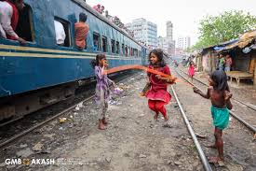

Slide 6
Representation media
It refers to how information is represented internally to the computer.
Question: How is information encoded in the computer?
Character---ASCII.
Picture or Graphics ---- CEPT or CAPTAIN,GSK graphics standard.
Audio --- PCM encoding and linear quantization of 16 bit per
sampling value.
Image ---Group-3 facsimile or JPEG.
Combined audio and video---TV standards (PAL,SECAM orNTSC),
CCIR-601 standard or MPEG format.

Slide 7
Presentation Media
It refers to the physical means used by systems to reproduce information for humans.
Ex. TV sets uses a cathode ray tube and loudspeaker.
Question: Which media is used to output information from the computer or input in the computer?
output media--- paper, computer monitor, loudspeakers.
input media—keyboards, camera and microphones.

Slide 8
Storage Media
It refers to various physical means for storing computer data.
Question: Where is information stored?
magnetic tapes, magnetic disks, or digital optical disks, paper.
Transmission media
It refers to the physical means that allow the transmission of telecommunication signals.
Question: Which medium is used to transmit data?
cables of various types, radio tower, satellite or ether(the
medium that transmit radio waves).

Slide 9
Information Exchange media
It include all data media used to transport information e.g., all storage and transmission media.
Information can be exchanged by storing it on a removable medium and transporting the medium from one location to another.
Question: Which data medium is used to exchange information between different locations?
storage media – paper, microfilms, floppy disc.
Transmission media – coaxial cables, optical fibers or radio waves.

Slide 10

Characterizing Continuous Media Data Streams
First characteristics: relates to the time interval between fully completed transmissions of consecutive information units or packets.
Strongly periodic data streams:
Time intervals have the same duration between consecutive packets or information units.

Slide 11
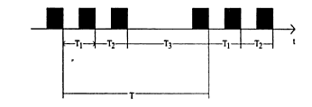
Weakly periodic data streams:
Time intervals between consecutive packet are periodic.
The duration of time interval between neighboring packet is described as a function with finite period duration.

Slide 12

Aperiodic data stream
All other possibilities of transmission with respect to time interval are known as aperiodic data streams.
The time interval sequence is neither constant nor weakly periodic.

Slide 13
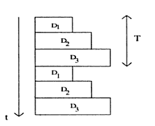
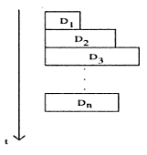
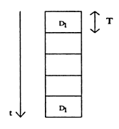
Variation of the data volume of consecutive information units.
Strongly regular data stream
Weakly regular data
stream
irregular data stream

Slide 14
Variation of the data volume of consecutive information units.
Second characteristics: how data quantity of consecutive information units or packets varies.
Strongly regular data steam
IF the quantity of data remains constant during the entire lifetime of a data stream is called a strongly regular data steam.
Ex. Full-image encoded data stream delivered by camera or an audio sequence originating from an audio CD.

Slide 15
Weakly regular data steam
if the quantity of data varies periodically(over time), is called a weakly regular data steam.
Irregular data steam
Data steams are called irregular when the data quantity is neither constant nor changing by a periodic function.
Weakly regular data stream
Irregular data stream

Slide 16
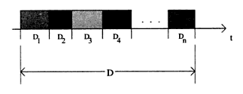
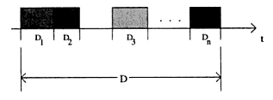
Interrelationship of Consecutive Packets
Third characteristic: relate to the continuity or the relationship between consecutive packets.
Interrelated data stream
Packets are transmitted without gap in between.
Non-Interrelated data stream
There are gap between packets.
Interrelated data stream
Non-Interrelated data stream

Slide 17
Audio Technology

Slide 18
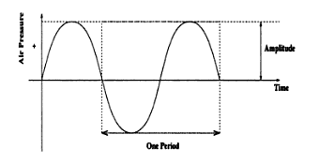
Sound
It is a physical phenomenon caused by vibration of materials, such as violin string etc.
This type of vibration triggers pressure wave fluctuations in the air around the material.
The pressure wave propagate in the air. The pattern of this oscillation is called wave form.
We hear a sound when such a wave reaches our ears.
Periodic sound or music: musical instrument, vocal sound, wind sound.
Non periodic sound: coughing, sneezing, murmur of water.

Slide 19
Frequency
It represents the number of periods per second and is measured in hertz(Hz).
Sound processes that occur in liquid, gases and solids are classified by frequency range:
Infrasonic: 0 to 20Hz
Audio sonic: 20Hz to 20kHz
Ultrasonic: 20kHz to 1GHz
Hypersonic: 1GHz to 10THz
Amplitude
The amplitude of a sound is a measuring unit used to deviate the pressure wave from its mean value(idle state).
It is which human perceive subjectively as loudness or volume.

Slide 20
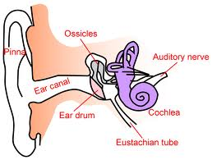
Sound perception and Psychoacoustics
The way human perceive sound

Slide 21
Sound perception and Psychoacoustics
The way human perceive sound can be summarized as a sequence of events:
Sound enters the ear canal. At the ear drum, sound enery(air pressure changes) are transformed into mechanical energy of ear drum movement.
The outer ear comprises the pinna, which is composed of cartilage and that allow us to localize the source of sound from the front versus the back.
the cochlea is a snail shaped structure that is the sensory organ of hearing.
The vibrational patterns that are initiated by vibration set up a travelling wave pattern within the cochles.
This wave pattern causes a shearing of the cilia of the outer and inner hair cells.
This shearing causes hair cell depolarization resulting in on\off neural impulses that the brain interprets as sound.

Slide 22
Psychoacoustics
It is a discipline that studies the relationship between acoustics waves at the auditory ossicle and the spatial recognition of the auditor.
Two main perspectives
The physical acoustic perspective
The Psychoacoustics perspective.

Slide 23
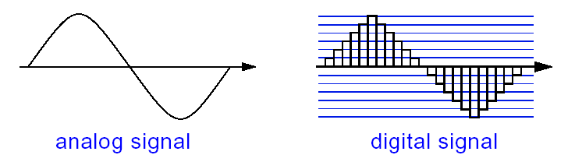
Audio representation on computer
Before the continuous curve of a sound wave can be represented on a computer , it has to measure the wave’s amplitude in regular time intervals.
It then takes the result and generates a sequence of sampling values.
The mechanism that converts a audio signal into a sequence of digital samples is called Analog to digital conversion (ADC).

Slide 24
Sampling rate
The rate at which a continuous wave is sampled is called the sampling rate.
Sampling rate is measured in hertz (Hz).
Quantization
The digitization process requires 2 steps.
First the analog signal is sampled i.e only discrete set of values are retained
The second step is Quantization where converting the sampled signal into a signal that can take only a limited number of values. Ex – An 8 bit quantization provides 256 possible values

Slide 25
Three dimensional sound projection
Spatial sound
The shortest path between the sound source and the auditor is called the direct sound path.
This path carries the first sound waves towards the auditor’s head.
All other sound paths are reflected , which means they are temporally delayed before they arrive at the auditor’s ear.
The direct sound path contains the highest energy.
All subsequent paths contains less energy.

Slide 26
Reflection systems
Spatial sound systems are used in many different applications and each of these have different requirements.
A rough classification groups these applications into a scientific and a consumer oriented approach.
Approach | Attribute | Applications
Scientific | Simulation, precise, complex, offline | Research, architecture, computer music
Consumer – oriented | Imitation, not precise, impressive, real time | Cinema, music, home movies, computer games
Scientific approach uses simulation options that enable architects to predict the acoustics of a room when they plan a building.
Consumer systems concentrate mainly on applications that create a spatial or a virtual environment. Ex- in cinemas , a special multi-channel sound is used to create special sound effects.

Slide 27
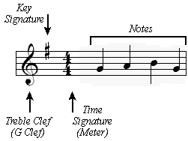
Music and the MIDI standard
Music can be described in a symbolic way. On paper, we have full score(a written form of music composition).
Computers and electronic instruments use MIDI (Musical Instrument Digital Interface ) standard for describing the music.
The MIDI standard defines how to code all the elements of musical scores, such as sequences of notes , timing conditions, and the instrument to play each note.

Slide 28
Introduction to MIDI
MIDI represents a set of specifications used in instrument development, so that musical info can be easily exchanged.
MIDI protocol is an entire music description language in binary form.
A MIDI interface composed of 2 different components
Hardware to connect the equipment. It specifies the physical connection of musical instruments. It adds a MIDI port to an instrument.
A data format that encodes information to be processed by the hardware. It uses specific data format for each instrument describing things like start and end of scores, the basic frequency and loudness.
The MIDI data formats is digital and data are grouped into MIDI messages.
When a musician plays a key, the MIDI interface generates a MIDI message that defines the start of each score and its intensity.
This message is transmitted to machines connected to the system.
As soon as the musicians releases the key, another signal(MIDI message) is created and transmitted.

Slide 29
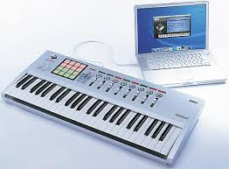
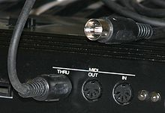
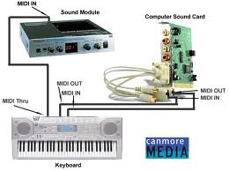

Slide 30
MIDI Devices
An instrument that compiles with both components defined by the MIDI standard is a MIDI Device. Ex- synthesizer.
A MIDI device can communicate with other MIDI devices over channels.
A MIDI standard specifies 16 channels. A MIDI device is mapped on to the channel.
Musical data transmitted over a channel are reproduced in the synthesizer at the receiver end.
The MIDI standard identifies 128 instruments by means of numbers. For ex. 0 specifies a piano, 40 a violin and 73 a flute.
A computer uses the MIDI interface to control instruments for play out. The computer can use the same interface to receive, store and process encoded musical data.

Slide 31
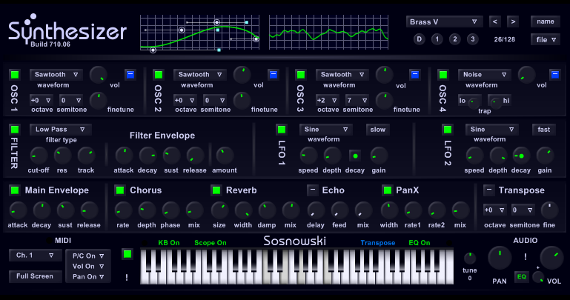
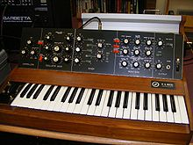

Slide 32
The MIDI and SMPTE Timing standards
The MIDI clock is used by a receiver to synchronize itself to the sender‘s clock. To allow synchronization ,24 identifiers for each quarter note are transmitted.
The SMPTE (Society of motion picture and television engineers) timing code be sent to allow receiver-sender synchronization.
SMPTE defines a frame format by hours : minutes : seconds.

Slide 33
Speech signals
Speech can be processed by humans or machines, although it’s the dominant form of communication of human beings.
The field of study of the handling of digitized speech is called digital speech processing.
Human speech
Speech is based on spoken languages, which means that it has a semantic content.
Speech understanding means the efficient adaptation to speakers and their speaking habits
The brain is capable of achieving a very good separation between speech and interference using signals received by both ears.

Slide 34
Speech signals have two important characteristics
Voiced speech signals have almost periodic structure.
The spectrum of some sounds have characteristics maxima that normally involve up to 5 frequencies. These frequency maxima, generated when speaking, are called formants.
A formant is a characteristic component of the quality of an utterance(A spoken word, statement, or vocal sound)
Speech synthesis
Computers can translate an encoded description of a message into speech. This scheme is called speech synthesis.
A particular type of synthesis is text-speech conversion.
Speech recognition is normally achieved by drawing various comparisons.
The problems in speech recognition affecting the recognition quality include dialects, emotional pronunciations and environmental noise.

Slide 35
Speech output
The important technical terms are
Speech basic frequency
A phoneme – smallest unit of speech
Allophones – variants of phoneme
A morpheme- meaningful linguistic unit
A voiced sound- as generated by vocal chords Ex –M,L
Unvoiced sounds- generated with vocal chords open Ex-F,S
Reproducible speech playout
Is a straight forward method of speech output.
The speech is spoken by a human and recorded. To output the info , the stored sequence is to be played out.
The speech can be PCM –coded and stored.

Slide 36
Sound concatenation in the time range
It puts together speech units like building block. Such a composition can occur on various levels.
Individual phoneme are understood as speech units.fig. represents phoneme of the word “strolch”.
It is possible to generate unlimited vocabulary with few phonemes. The problem is that there are transition b/n the phonemes.

Slide 37
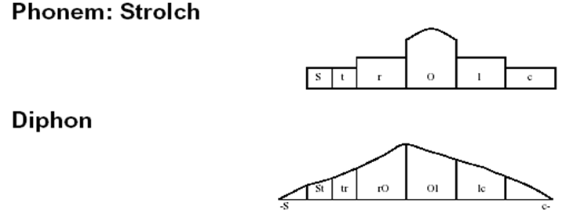
Sound concatenation in the time range

Slide 38
Two problems: due to transition b/n speech sound unit.
Coarticulation: It means mutual sound effects across several sounds. This effect is caused by the influence of the relevant sound environment or by the idleness of our speech organ.
Prosody: It describes the accentuation and melody curves of a sentence.
ex. Words are stressed totally differently depending on whether want to state or ask something.
prosody depends on the semantics of a language.

Slide 39
Sound concatenation in the frequency range
As an alternative to concatenating sound in the time range, we can affect sound concatenation in the frequency range. Ex, by formant synthesis.
Formant synthesis uses filters to simulate the vocal tract.
Characteristics values are the central filter frequencies and the central filter bandwidths.
All voiced sounds are excited by a pulse signal with a frequency corresponding to the speech basic frequency.

Slide 40
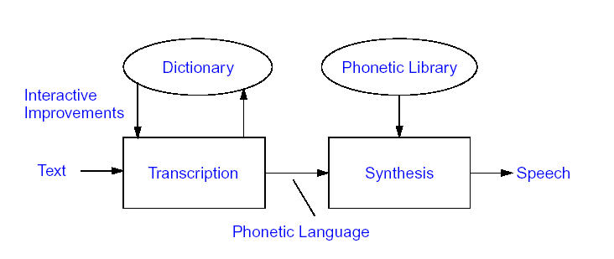
Speech synthesis
First step involves transcription or translation of text into phonetic transcription.
The second step converts the phonetic transcription into an acoustic speech signal, where concatenation can be in the time or frequency range
Speech recognition has to address pronunciation ambiguities to avoid generating misinterpretations like “the glass is fool” instead of the phrase “the glass is full”.

Slide 41
Speech input
Speech input deals with various application:
In the Speech input context, we need to ask three questions.
Who?
What?
How?
Who?
Human speech has certain speaker dependent characteristics, which means that speech input can serve to recognize a speaker.
The computer is used to recognize an acoustic fingerprint of the speaker.
Applications : Personal identification, Verification.

Slide 42
What?
The central issue of speech input is to detect the speech contents themselves.
A speech sequence is input to generate a piece of text.
Applications : speech controlled typewriter, language translation systems, or accessibility options for users with special needs.
How?
Related to how a speech sample should be studied.
Application :lie detector.

Slide 43
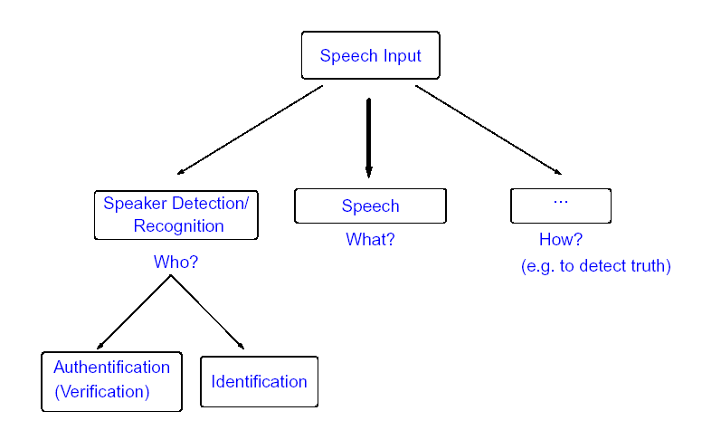
Speech input

Slide 44
Speech recognition
Speech recognition ,in combination with speech synthesis, it enables us to implement media transformation.
The primary characteristics of each speech recognition session is determined by a probability of ≤ 1 to recognize a word correctly.
A word is always recognized only with a certain probability.
A poor recognition rate is 0.95, which corresponds to 5% wrongly recognized words.
With a sentence of only 3 words, the probability that the system will recognize all triples correctly drops to p=0.05x0.95x0.95=0.86.
The above example shows that a speech recognition system should have a very high single word recognition rate.

Slide 45
Speech recognition
Reference storage
Properties of learned meterial
Special chip Main processor
speech
Speech analysis
Parameters, response, property extraction
Pattern recognition
Comparison with reference
Recognized speech
Fig :3.13 Speech recognition basic principle: “extract characteristics to reduce data”

Slide 46
The speech recognition principle compares special characteristics of individual utterances with a sentence of previously extracted speech elements.
These characteristics are normally quantized for the speech sequence to be studied.
The result is compared with the existing references to allocate it to one of the existing speech elements.
Identified utterances can be stored , transmitted, 0r processed as a parameterized sequence of speech element.
Practical implementations:
Use dedicated components or a signal processor to extract characteristics properties.
The comparison and the decision are generally handled by the system’s main processor
The lexicon with references characteristics normally resides in the computer’s secondary memory.

Slide 47
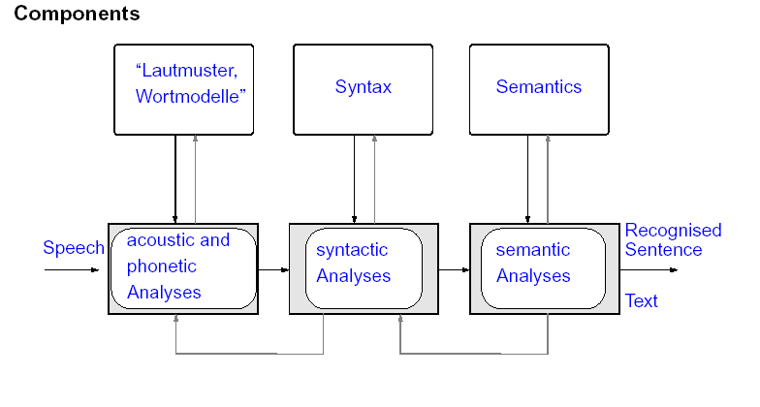
The application of the principle shown in fig.3.13 can be divided into steps shown in fig.3.14
The method applied in the time and frequency ranges are:
Acoustic and phonetic analysis
Syntactic analysis
Semantic analysis
Sound pattern,
word model
Fig3.14 : speech recognition components

Slide 48
Speech dependent and speech independent speech input systems
Speaker dependent systems can recognize many more words that speaker independent system, but at the cost of “training” the system in advance.
Speaker dependent systems can recognize 25,000 words and more.
Speaker independent systems can recognize 1,000 words and more.

Slide 49
Speech transmission
This is a field relating to high efficient encoding of speech signals to enable low-rate data transmission, while minimizing noticeable quality losses.
Pulse code modulation
A straight forward technique for digitizing an analog signal is PCM[telephone– 64Kbits/s]
DPCM[56Kbits/s],APCM[32Kbits/s] are also widely used
Source encoding
Alternate method to PCM, where some transformations depend on the original signal type. Ex- Audio signal has certain characteristics that can be exploited in compression.
Suppression of silence in speech is a typical example of a transformation that depends entirely on the signal semantics.

Slide 50
Components of a speech transmission system using source coding
A/D
Analog speech signal
Speech analysis
Coded speech signal
Reconstruction
Analog speech signal
D/A

Slide 51
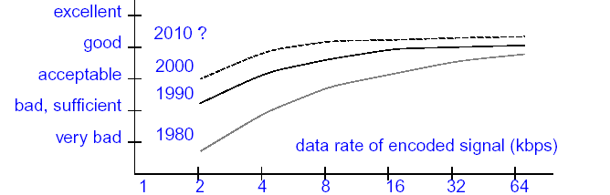
Recognition – synthesis methods
Speech recognition
Analog speech signal
Coded speech signal
Speech synthesis
Analog speech signal
Achievable quality

