Slide 1
Optical Storage Media

Slide 2
History of optical storage
1973 Video Long Play (VLP) - published
1983 Compact Disc Digital Audio (CD-DA) - available:
Red Book Standard
1985 Compact Disc Read Only Memory (CD-ROM):
• Yellow Book Standard for physical format
• High Sierra Proposal
• ISO 9660 Standard for logical file format
1986 Compact Disc Interactive (CD-I) - announcement:
• Green Book
1987 Digital Video Interactive (DVI) - first presentation
1988 CD-ROM Extended Architecture (CD-ROM-XA) announcement
1990 CD Write Once (CD-WO), CD Magneto Optical (CD-MO):
• Orange Book
1996 Digital Video Disk DVD

Slide 3
Basic Technology
The principle is that information is represented by using the intensity of laser light reflected during reading.
A laser beam having a wave length of about 780nm can be focused to a resolution of approximately 1microm.
In a polycarbonate substrate layer, there are depression, called pits, corresponding to the data to be encoded.
The area between the pits are called lands.
The substrate layer is smooth and coated with a thin, reflective layer.
The laser beam is focused at the height of the reflective layer from the substrate level.
The reflected beam has a strong intensity at the lands and weaker intensity at the pits(because laser light hitting pits will be lightly scattered).

Slide 4
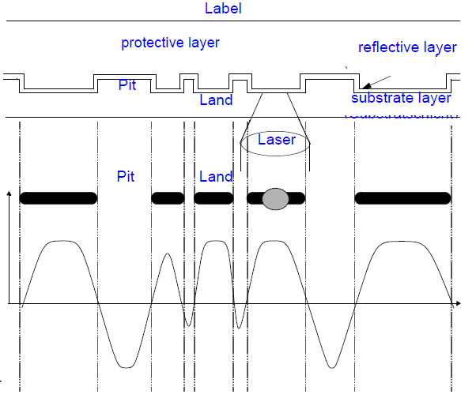
Intensity of reflected laser light

Slide 5
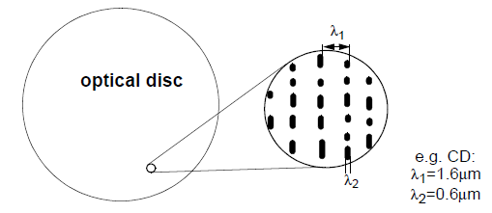
Fig. Track with “lands” and “Pits”

Slide 6
Compact Disc(CD) consists of:
the label
the protective layer
the reflective layer
the substrate
An optic disc consists of a sequential arrangement of pits and lands with a track.
The pits and lands represent data on the surface.
Track pitch- 1.6µm and pit width- 0.6µm
The most important advantage of a CD is over magnetic storage media is that 1.66 data bits / μm can be stored resulting in a storage density of 1,000,000 bits / mm².
i.e. 16000 tracks/inch as compared to the floppy disk’s 96 tracks/inch.
Another advantage is that magnetization can decrease over time while optical storage is not subject to such effects.

Slide 7
Video Discs and Other WORMs
WORM: Write Once Read Many system
Laser Vision video discs were used for the reproduction of motion picture and audio data
Data is stored in an analog-coded format
Excellent audio/video picture quality
Has a diameter of ≈ 30cm
Stores ≈ 2.6 Gbytes.
Video discs were originally called Video Long Play when introduced in 1973 in the Philips Technical Review
Audio signal is mixed with frequency-modulated motion pictures
A zero-transition, i.e. a change between a pit and a land, can occur at any time.
Pit length is not quantized, hence it is time-continuous (analog)

Slide 8
Many different WORMS, with incompatible formats, were introduced
Interactive Video Disc
Operates at constant angular velocity (CAV)
describes the motion of a body rotating at a constant velocity because as it rotates it moves through a constant angle per unit time.
revolution per minute (rpm).
On each side
Up to 36 minutes of audio and video data at 30 frames/sec
54,000 studio-quality images can be stored
By 1992, many WORM systems were introduced with capacities 600 Mbytes to 8 Gbytes.
Jukeboxes use multiple discs to increase the capacities to up to 20 Gbytes.
Advantage of WORMs over rewriteable mass storage is security against alteration.

Slide 9
WORMs special properties
Media Overflow
Refers to problems occurring when a WORM disc is almost full
Check if data to be stored can fit on the disc
Determine whether data can be split into 2 discs and at what point in time
Packaging
Refers to problems arising from the fixed block structure of WORMS
E.g. if the block size is 2,048 bytes and only one byte is written, 2,047 bytes are recorded with “empty content”
Revision
Refers to the problem of subsequently making areas as invalid.
E.g. document edits (deleted portions are marked invalid).

Slide 10
CD-DA[Compact Disc Digital Audio]
Compact Disc Digital Audio
Developed by both N.V.Philips and Sony for storing audio data.
Basic technology of the CD-DA was developed by N.V.Philips .
Technical Basics
Physical characteristics:
Diameter: 120 mm
Constant linear velocity (CLV),i.e. number of rotations/s depends on position of head relative to disc centres.
Track shape: One spiral with appr. 20000 turns (LP: 850 turns)

Slide 11
CD-DA[Compact Disc Digital Audio] cont….
Information is stored based on:
Length of pits is always a multiple of 0.3 μm.
A change from pit to land or from land to pit corresponds to the coding of a 1 in the data stream.
If there is no change, a 0 is coded.
Therefore, it is discrete time, discrete value storage

Slide 12
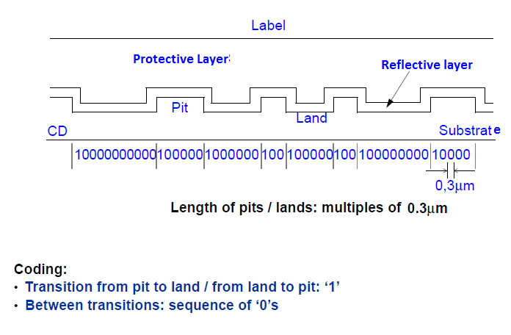

Slide 13
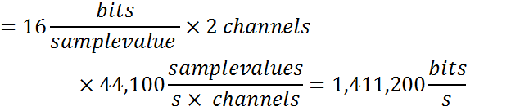
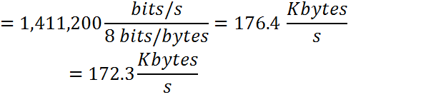
Audio Data Rate
Sampling frequency: 44,100Hz
16 bit linear quantization
Pulse code modulation (PCM)
Audio data rate=(# quantization bits /sample) * (# channels) * (sampling rate)

Slide 14
S/N _{CD-DA} =6 dB/bit * 16bit=96dB
SNR = 98 dB, compared to that of 50-60 dB for LP records and cassette tapes.
Capacity (storage of audio data only)
The play time of a CD-DA is at least 74 minutes
Capacity = # minutes * Audio Data Rate (in bits/s)
=74 min * 1,411,200 bit/s=6,265,728,000 bits
=6,265,728,000 bits*(1/8 bits/byte) * (1/1024bytes/kbyte)
* (1/1024 bytes/kbyte)
= 747 Mbytes.

Slide 15
Eight-to-Fourteen Modulation
Since the resolution of the laser would not suffice to correctly read direct pit-land-pit-land...sequences, (i.e.1 1 1 1 1 ) , it was agreed that at least two lands and two pits must occur consecutively.
Since a phase-correct synchronization signal (clock) cannot be derived from long lands and pits, the maximum length of pits and lands was limited to ten consecutive zeros as channel bits.
As a result, bits written on CD-D do not correspond directly to actual information.
Before writing, Eight-to-Fourteen modulation is applied.
In addition, filler bits are needed to avoid situations where the minimum/maximum limits are exceeded.
8 bit value is encoded using 14 bits
267 combinations possible
256 are used
(criterion: efficient implementation with small number of gates)

Slide 16
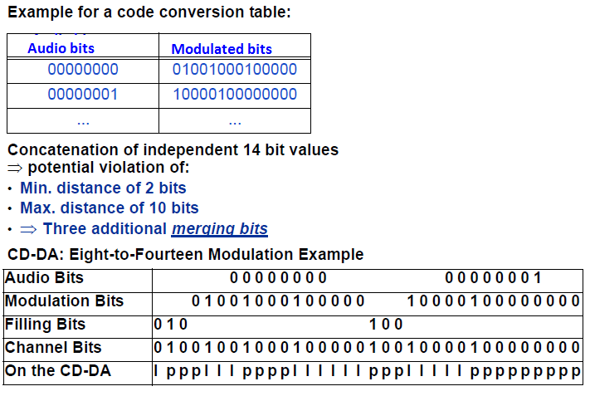

Slide 17
CD-DA
Error Handling
Usually a result of scratches or dirt (called burst error)
Two levels of error handling
2-stage error correction based on Reed-Solomon Algorithm
For every 24 audio bytes, two groups, four bytes each, of correction bytes are included.
First group corrects single byte errors
Second group corrects double byte errors
Real consecutive data bytes are distributed over multiple frames
A frame consists of 588 channel bits corresponding to 24 audio bytes. The audio data are stored interleaved on the CD-DA.
Burst errors will only damage part of the data.
An error rate of 10⁻⁸ is achived.
the method described above for error correction is know as cross interleaved Reed-Solomon code

Slide 18
Frames, tracks, Areas and block of a CD-DA
Frame consist of:
Audio data: It is divided into two groups of 12 bytes each. It contains high and low bytes of the left and right channels.
Error detection and correction bytes: are appended to each frame in two groups of 4 bytes each.
Control and display bytes: consists of 8bits,designated P , Q ,R ,S ,T ,U ,V and W(subchannels).
Synchronization pattern: it determines the beginning of each frame. It consists of 12 x “1s” + 12 x “0s” + 3 filler bits = 27 bits

Slide 19
 | Audio bits | Modulated bits | Filler bits | Channel bits
Synchronization |  |  | 3+ | 24= | 27bits
Control and display |  | 14 | 3 |  | 17
12 Data | 128 | i.e. 12 (14+3) |  |  | 204
4 Error handling |  | i.e. 4(14+3) |  |  | 68
12 Data | 128 | i.e. 12 (14+3) |  |  | 204
4 Error handling |  | i.e. 4(14+3) |  |  | 68
Frame total |  |  |  |  | 588

Slide 20
Different data stream with corresponding data rates can be distinguished as
Audio bit stream ~ 1.41 x 106 bit/s:
-44,1 kHz sampling frequency~ 1411200 bit/s.
-16-bit quantized sample values.
Data bit stream ~ 1.94 x 106 bit/s:
-Audio bit stream.
-control & display byte.
-bytes needed for error handling.
Channel bit stream ~ 4.32 x 106 bit/s:
-Data bit stream
- EFM
- filler bits
-synchronization bits

Slide 21
CD-DA consists of 3 areas
Lead-in : It contains the directory and beginning of the individual tracks are registered here.
Program: It includes all tracks; actual data are stored here.
Lead-out: This is used to help CD player should it inadvertently read beyond the program area.
CD-DA Tracks
The program area can consists of up to 99 tracks of different length.
Each track corresponds to a song or sentence of symphony.
Track can accessed randomly .
Tracks contains several index points.
Index points are used for direct positioning of the laser
Two index points are mandatory:
• IP0: start of track
• IP1: start of audio data.
-Track pregap: part between IP0 and IP1(2 0r 3 sec per piece)
CD-DA Blocks: It contains 98 frames (2,352 bytes).

Slide 22
Advantages of CD-DA
For uncompressed audio, CD-DA is very insensitive to read errors.
Additional advantage is that there is no mechanical wear and tear.
All CD-DAs are identical in terms of digital technology (leading to compatibility)
8-14 modulation and Cross-Interleaved Reed-Solomon Code are always used.
Achievable error rate is too high for general computer data
Necessitated CD-ROM extension.

Slide 23
CD-ROM
Compact Disc- Read Only Memory
Specified by N.V.Philips and Sony in the yellow book.
For general computer data as well as uncompressed audio data
CD-ROM tracks are divided into audio and data types, each carrying only one type of data
Mixed Mode Disc:
Data tracks are usually located at the beginning of the CD-ROM , followed by audio tracks.

Slide 24

Blocks
CD-ROM data unit is called a block.
Blocks
Has similar properties to sectors of other media and file systems.
Consists of 2,352 bytes of CD-DA block
User data: 2,048 bytes(computer data) or 2,336 bytes(Audio data).
Remaining bytes are used for identification for random access and for another error correction layer.
75 blocks per second are played back.

Slide 25
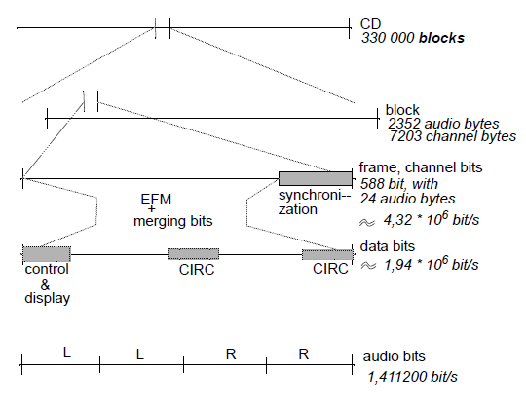
[Cross interleaved Reed-Solomon coding]
Fig : CD-ROM data hierarchy. Audio blocks as on a CD-DA

Slide 26
Modes
Two CD-ROM Modes exist
CD-ROM Mode 1
CD-ROM Mode 2
CD-ROM Mode 1
An additional mode 0, where all 2,336 bytes user data bytes are set to zero, serves to separate storage areas.
CD-ROM Mode 1 is used to Stores computer [user] data.
Sync
12
Header
4
User Data
2,048
EDC
4
Blanks
8
ECC
276
2,352 bytes
Fig : CD-ROM mode 1 block layout

Slide 27
CD-ROM Mode-1 cont….
The 2,352 bytes can broken into the following groups:
12 bytes-synchronization as the start-of-block indicator.
4 bytes- header: first two bytes=minute and seconds respectively, the third byte=block number, fourth byte=identifies mode.
2,048 bytes= user data
4 bytes = error detection
8 unused bytes
276 bytes = error correction, error rate of 10⁻¹² achieved.

Slide 28


Capacity: Mode 1
Given: playtime=74min, CD-ROM can store 3,33,000 blocks.
Capacity-CD-ROM mode-1
Data rate in mode1

Slide 29
CD-ROM Mode 2
Stores other media (error correction is left out).
Sync
12
Header
4
User Data
2,336
2,352 bytes
Fig : CD-ROM mode 2 block layout

Slide 30



Capacity: Mode 2
Given: playtime=74min, CD-ROM can store 3,33,000 blocks.
Capacity-CD-ROM mode-1
Data rate in mode1

Slide 31
Logical File Format
Logical file format and directory structure are missing from the Mode-1 specification.
High Sierra standard served as the basis for ISO 9660 standard describing the format.
It defines a directory tree, which includes information about all files.
In addition, there is a table that lists all directories in a compressed form called path table. It allows direct access to files at any level.
First track:
-16 blocks (sectors 0 to 15): system area
-Volume descriptors in subsequent blocks with e.g. length of file system and path table.
Logical block size:
-Between 512 byte and 2048 byte (in steps of 2i)
-Blocks of 512 byte, 1024 byte, and 2048 byte are used
-Files begin at logical block start
De facto maximum is max block size is 2048 bytes.

Slide 32
Logical File Format cont…
Extensions to ISO 9660 that support long file names, extended access rights, bootability and special features of specific file system are
Rockridge Extensions
Suitable for Unix file system with long filenames, links and access rights
Joliet file system
Microsoft’s adaptation to Windows 95/NT file systems
El Torito
Allows PC systems to boot directly from a CD-ROM.

Slide 33
Limitations of CD-ROM technology.
The following effects contribute to the time it takes to position to a desired block on CD:
Higher access time than hard disc due to(time values may not be up to date):
Synchronization time:
-The internal clock must be synchronized to the CD signal.
-Time needed: some milliseconds.
Constant linear velocity playback
-Reading inner part of a CD requires about 530rps(revolutions per second)where as reading of outer part needs200rps. Adjustment is required.
-Rotation delay is the maximum duration to position the laser above the desired sector and to adjust the rotation speed. Rotation delay: 200ms.
Seek Time
-for random access with the laser beam the correct radius has to be adjusted and the block has to be found.
-time needed: at most 1s.

Slide 34
No simultaneous playback of e.g. audio and data is possible.
-Audio streams on a CD must be sequentially stored.
-thus many multimedia applications are impossible.

Slide 35
CD-ROM Extended Architecture(CD-ROM/XA)
Compact Disc Read Only Memory Extended Architecture
Established by Philips, Sony and Microsoft
Addresses concurrent output of multiple media: Blocks of different media can be stored on one track, unlike CD-DA or CD-ROM.
Many features of CD-ROM/XA and CD-I are identical.
CD-ROM/XA uses CD-ROM mode 2 to define its own blocks and additionally defines a sub-header that describes each block.
Interleaving of blocks of different media within the same track
Two forms
Form 1, mode 2: Better error correction for user data
Form 2, mode 2: More capacity to store compressed media including audio and video

Slide 36
CD-ROM Mode 2,form 1
Fig: Sector layout(1) for CD-ROM/XA. Data layout of a CD-ROM block in mode 2,form 1
CD-ROM Mode 2,form 2
Fig: Sector layout(2) for CD-ROM/XA. Data layout of a CD-ROM block in mode 2,form 2
Sync
12
Header
4
Sub-Header
8
User Data
2,048
EDC
4
ECC
276
2,352 bytes
Sync
12
Header
4
Sub-Header
8
User Data
2,324
EDC
4
2,352 bytes

Slide 37
Form 1 and Form 2
CD-ROM/XA differentiates blocks with form 1 and form 2 formats:
XA format form 1 provides improved error detection and correction. Like CD-ROM mode 1, 4 bytes: error detection and 276 bytes: error correction. Unlike CD-ROM mode 1, 8 bytes: sub header.
XA format form 2 allows 13% increase in actual data capacity, 2,324 bytes per block. Form 2 blocks: to store compressed data of various media, including audio and video data.

Slide 38
Compare CD-ROM and CD-ROM/XA
On a CD-DA, CD-ROM, or mixed mode disc, a track always consists of homogeneous data, meaning audio or computer data. It is thus not possible for the computer to, for example, concurrently read audio and computer data.
Advantage of CD-ROM/XA: the blocks of different media can be stored in one track since they are all coded in CD-ROM mode 2, thus allowing interleaved storage and retrieval.

Slide 39
CD-I(compact disc interactive)
Announced in 1986 by Philips and Sony
Capable of concurrent media output.
Designed for consumer electronics as an addition to TV sets.
Appropriate devices that use CD-I were available commercially in 1991
Disappeared entirely from the market in 1997.
It specifies an entire system.
It includes a CD-ROM based formats with interleaving of various media and definition of compression for different media.
CD-I defines system software based on the CD-RTOS(CD-Real Time OS ) operating system and output hardware for multimedia data.
CD-I hardware is called decoder.
Decoder consists of a main processor from the Motorola 68000 family together with special video and audio chips.
It also includes a CD player with a controller and mouse interface and there is provision for a connection to a RGB monitor or TV.

Slide 40
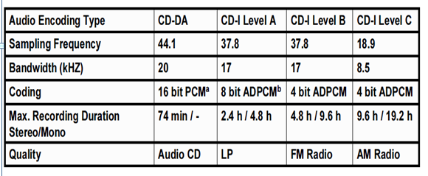
Audio coding
CD-I audio coding includes different quality levels with differing capacity and data rate.
Coding of Animations
Animations are run length encoded (10,000 to 20,000 bytes per image.)
Use MPEG to code video.

Slide 41
Coding of images
CD-I can be used to code images at different quality levels and resolutions.
Image encoding type | YUV mode | Color look up table(CLUT) | RGB mode
Image Type | High quality natural pictures, many colors. | Simple pictures, requires preloaded color table. | High quality normal pictures.
Bits /pixel | 18 bpp | 4 | 16
Colors per image | 262,144(=2¹⁸) | 16 | 65,536
Image resolution | 360 x 240 | 720 x 240 | 360 x 240
Image size | (360*240*18)/8= 194,400 bytes | (720*240*4)/8= 86,400 bytes | (360*240*16)/8= 172,800 bytes

Slide 42
Compact disc interactive ready format (CD-I ready format )
It is not possible to play a CD-I disc on CD-DA device.
Compact disc interactive ready format is an optical disc format specification that can be played on traditional CD-DA devices as well as on CD-I devices.
Track pregap area b/n the index point IP₀ and IP₁ at the beginning of each track is increased from two to three seconds to a minimum of 182 sec.
CD-I specific info is stored in this area. For ex, individual pieces, images, or biographies of the composer and the conductor.
It can played in three different ways.

Slide 43
Compact Disc Bridge Disc (CD Bridge Disc )
CD Bridge Disc specifies a disc format to allow output on either a CD-ROM/XA or on a CD-I device.
CD Bridge Disc must satisfy both the CD-I and the CD-ROM/XA specifications, though it does not exploit all their capabilities.
A common subset is defined that holds for both formats.
First mode: with CD-DA playback, the CD-I information in the track pregap is ignored and only audio will be played.
Second mode: it uses only CD-I data in the track pregap. CD-DA audio data are not played.
Third mode: during the audio playback, the CD-I data from the track pregap are presented concurrently. First CD-I data are read and stored. Then the audio data is output with data from pregap.

Slide 44
Photo Compact Disc
Storage of photos of high quality
Photo Compact Disc from Eastman Kodak and N.V. Philips Company is an example of a CD Bridge Disc
1990 announcement of Kodak Photo CD system
Characteristics: Based on CD Write Once (CD-WO)
• Readable with:
Photo CD players
CD-I players
CD-ROM / XA players
Written by:
Special Photo CD writers and CD-WO writers
Capabilities:
New professional and private application areas
Simultaneous display of several images
Image editing
Integration in documents

Slide 45
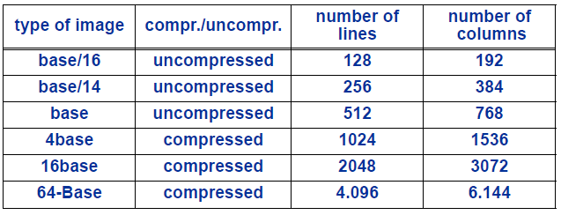
Photo CD is based on the following process:
• Photos are taken with conventional cameras
• Digitized with 8 bit for luminance component and 8 bit for each chrominance component
• Written on CD
Image resolution of a Photo CD:
Each photo is then coded in upto six resolution as an ImagePac
• ImagePac at six different resolutions: hierarchical coding
• About 3 to 6 MByte storage per ImagePac

Slide 46
Digital Video Interactive(DVI)
Digital Video Interactive
Consists of
Compression and decompression algorithms
Highly integrated, dedicated h/w components for [de]compression in real time
User interface
Fixed data format
Therefore, emphasis on compression and decompression algorithms, not CD technology.
Uses CD-ROM mode 1 in addition to ISO 9660 as a basis for audio/video support system interleaved file format.
Uses interchange level 1.
Filenames are limited to 8-point-3 characters from a predefined character set

Slide 47
CDTV
Commodore Dynamic Total Vision
Uses CD-ROM mode 1 and ISO 9660
Uses interchange level 2
Filenames of up to 30 characters.
None of DVI and CDTV is currently in reasonable commercial use.

Slide 48
CD-R (Compact Disc Recordable)
Compact Disc Recordable(CD-R) is specified in the second part of orange book, allows the user to write a CD once and then read repeatedly.
Principle of the CD-R
It Has a pre-engraved track
In CD-R, there is an absorption layer between the substrate and reflective layer.
A CD reader sees a track consisting of lands.
Using a laser beam, the absorption layer in the pre-engraved track is heated to above 250⁰ C.
This alters the materials such that the reflected laser light now corresponds to a pit.

Slide 49
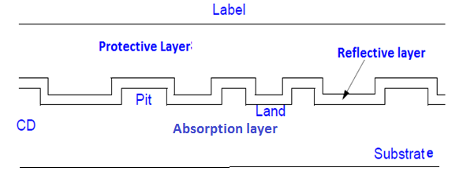

Slide 50
Sessions
All CD systems assume that a lead-in area precedes the actual data and is followed by a lead-out area
Lead in area contains a table of contents for correct positioning
This would necessitate all data to be copied in one atomic action, during which the cd is inaccessible.
To solve the above problem, multiple sessions were allowed.
Each session has its own lead-in and lead-out areas.
In each write procedure, all the data for a session with its table of contents is written.
Specified Max: 99 sessions Achievable Max: 46 sessions
Lead in
Information
Lead out
Lead in
Information
Lead out

Slide 51
CD-R cont…
Until 1992, available devices could read only one session.
One-session CD-R are called regular CD-R, rest re called hybrid CD-R
CD recoding
Recorders operate at 8x the player data rate.
To produce a CD-R, the data rate must be sustained through the write procedure
E.g., CD-R Data is first stored on a hard disk

Slide 52
CD-MO(Compact Disc Magneto-Optical)
Introduced 1988. Has high storage capacity
Can be written multiple times
Based on the principle that at higher temperatures, a weak magnetic field is needed to polarize the dipoles in certain materials
The blocks to be written is heated to above 150⁰ c. At the same time, a magnetic field about ten times the strength of the earths magnetic field is applied.
Pit: coded with a downwards facing magnetic north pole
Land: opposite to pit.
Read: Changes in the polarization of the light upon application of laser illumination enables reading the CD.
Erase: area around the block is subjected to a constant magnetic field while it is heated.
Areas of a CD-MO
A CD-MO consists of an optical read-only area and the actual rewritable area.

Slide 53
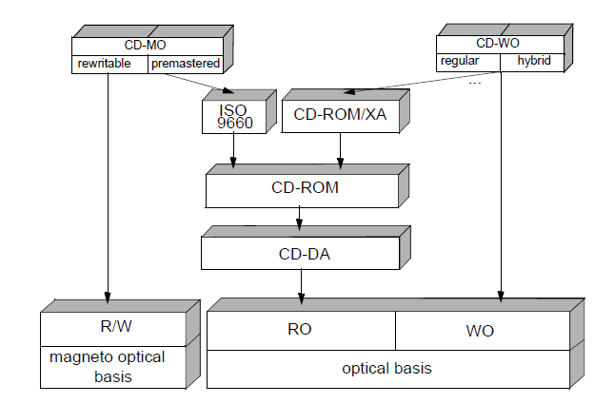

Slide 54
CD-RW(Compact disc ReWriteable)
CD-RW can be repeatedly rewritten.
This is achieved by using the reversible changeability structures.
Like the CD-R, phase changes are made by heating the crystal layer using the laser.
Cannot read CD-RW discs on every CD player since the reflectivity is lower than that of a CD–DA or CD-R.
The newer CD systems automatically amplifies the signal as necessary.
Type | Reflectivity
CD-DA | 70%
CD-R/CD-WO | 65%
CD-RW | 15-20%

Slide 55
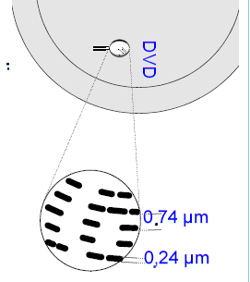
Track pitch=0.74µm
Pit width=0.24µm

Slide 56
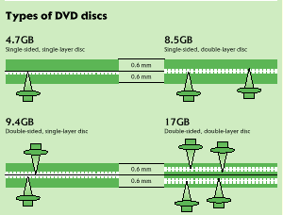
DVD
Digital Video Disk (Digital Versatile Disk)
Backward compatible with current CDs
Logical refinement of CD-ROM/CD-R/CD-RW technologies
The disc can have 1 or 2 layers and one or two sides
SLSS DVD can hold 4.38 GB
DLSS DVD can hold 7.95 GB
SLDS DVD can hold 8.75 GB
DLDS DVD can hold 15.9 GB
High capacity is achieved thru
Smaller pits → + track density
Larger data area
More efficient coding of bits
More efficient error correction
Lower sector overhead

Slide 57
DVD[Digital Versatile Disc]
It has large storage space and it is logical refinement of the CD-ROM/CD-R/CD-RW technologies.
DVD standards:
DVD consortium set down the specification for DVD in the publications “Book A-E”. Each book defines a standard
DVD Read Only specification(DVD-ROM, BOOK A)
DVD video specification(DVD-Video, BOOK B)
DVD Audio specification(DVD-Audio, BOOK C)
DVD Recordable specification(DVD-R, BOOK D)
DVD Rewritable specification(DVD-RW, BOOK E) also known as DVD-RAM.

Slide 58
Track pitch=0.74µm
Pit width=0.24µm

Slide 59
Technical basics
It achieves a higher capacity than CD-ROM by using smaller pits, combined with a large data area, more efficient coding of bits and error correction and lower sector overhead.
Each blocks: 37,856 bytes, 16 sectors plus addition data for error detection and correction .
Each sector: 2,064 bytes divided into 12 rows.
1st 12 bytes in the first row contain sector header(sector ID, sector ID error correction and 6 reserved bytes).
Row | Contents
0 | 12 bytes sector header and 160 bytes of user data
1 | 172 bytes of user data
… | …
… | …
10 | 172 bytes of user data
11 | 168 bytes user data and 4 byte error detection code

Slide 60
DVD interleaves 16 sectors together.
Resulting in a block of 192 rows(16 sectors * 12 rows/sector=192 rows ).
End of each row 10 bytes are added for further error correction.
This results in addition of 16 rows at the end of each block.
DVD-video :decoder
The decoder provides for the following six layers to transfer MPEG data:
Layer 1: Synchronization,8/16 demodulation, sector detection.
Layer 2: Error detection(EDC) and correction(ECC).
Layer 3: Descrambling and decryption.
Layer 4: EDC verification.
Layer 5: Track buffer.
Layer 6: Transfer of data to MPEG system decoder.

Slide 61
Eight-to-Fourteen + Modulation(EFM+)
The lowest layer of communication channel performs EFM+.
It is mainly intended to reduce the DC components of the data stream.
Like EFM, EFM+eliminates certain sequence of bits(many zeroes).
Advantage: no filler bits are necessary and simpler decoding mechanisms.
Logical file format:
The DVD file format(ISO 13490) is based on the ISO 9660 format.
The ISO 13490 file format incorporates multisession capabilities specifically adapted to the features of the DVD technology.

Slide 62
CD vs. DVD
 | CD | DVD
Media Diameter | ≈ 120 mm | 120 mm
Media Thickness | ≈ 1.2 mm | ≈ 1.2 mm
Track Pitch | 1.6μm | 0.74μm
Min Pit/Land Length | 0.6 μm | 0.24 μm
Data Layers | 1 | 1 or 2
Sides | 1 | 1 or 2
Capacity | ≈ 650 MB | 4.38, 7.95, 8.75, 15.9 GB
Video Data Rate | ≈ 1.5 Mbits/s | 1-10 Mbits/s
Video Compression std | MPEG-1 | MPEG-2
Video Capacity | ≈ 1 hour | ≈ 2 – 8 hours
Sound Tracks | 2-channel MPEG | 2-channel PCM 5.1-channel AC-3 Optional (up to 8 streams)
Subtitles |  | Up to 32 languages

