Slide 1
DESIGNING DISTRIBUTION NETWORKS AND APPLICATIONS TO E-BUSINESS

Slide 2
THE ROLE OF DISTRIBUTION IN THE SUPPLY CHAIN
Supply Chain consists of all the parties, vendors, manufacturers, suppliers involved directly or indirectly in fulfilling all the customer needs and changing demands.
Distribution is a key driver of the overall profitability of a firm, because it affects both the supply chain cost and the customer experience directly.
Distribution occurs between every pair of stages in the supply chain. Raw materials and components are moved from suppliers to manufacturers, whereas finished products are moved from the manufacturer to the end consumer.

Slide 3
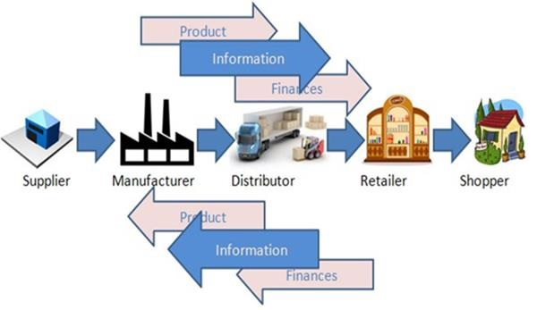

Slide 4
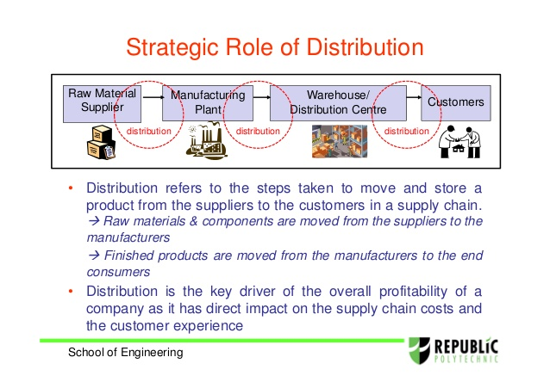

Slide 5
Producers produce goods and finally make them ready for the market.
Routes to be adopted to bring the products to the market—to the ultimate consumers and industrial users, must be determined.
Distribution system has two components:
1. Channels of Distribution
2. Physical Distribution.

Slide 6
Channels of Distribution
Physical Distribution
The intermediaries or the process through which the products are transferred from the producers to ultimate users. They are distributors, retailers, agents, bankers etc
Physical Distribution is concerned with the flow of goods to the ultimate consumers which includes transportation, warehousing and inventory management.

Slide 7
Functions of Distribution
Transport services for a timely and safe physical movement of goods.
Warehousing facilities that irons out the market fluctuations and make the goods available to the customer’s when/where needed.
Sorting/grading of goods thus facilitating customers choice in selection of goods.

Slide 8
Different Channels of Distribution
Direct Selling/ Direct marketing:
Manufacturer to ultimate customer
Manufacturer of machinery may directly contact the user firms.
A sales person sell on door-to-door basis.
Selling through Intermediaries (Middlemen):
Consumer Products
Industrial Products
Channel-Mix

Slide 9
Consumer Products
(i) Manufacturer—Broker or Agent—Wholesaler—Retailer-Consumer. Sometimes the product may flow direct from the agent to the retailers.
(ii) Manufacturer—Own Stores—Consumer.
(iii) Manufacturer-Mail Order—Consumer.
(iv) Manufacturer-Wholesaler—Retailers-Consumer.
(v) Manufacturer-Own Branches/Depots—Retailers—Consumer.

Slide 10
Industrial Products
i) Manufacturer—Broker or Agent-Distributor/Wholesaler-Industrial, Institutional or Commercial user.
ii) Manufacturer—Distributor/Wholesaler-Industrial, Institutional or Commercial user.
iii) Manufacturer—Own Branches/Depots-Industrial, Institutional or Commercial user.

Slide 11
Channel-Mix
An organization using a number of channels of distribution and not just one channel adopts a channel-mix.

Slide 12
FACTORS CONTROLING DISTRIBUTION NETWORK DESIGN
Distribution refers to the steps taken to move and store a product from the supplier stage to the customer stage in the supply chain.
Performance of a distribution network is evaluated along two dimensions:
customer needs that are met.
cost of meeting customer needs.

Slide 13
A firm must evaluate the impact on customer service and cost as it compares different distribution network options.
The customer needs that are met influence the company‘s revenues, which along with cost decide the profitability of the delivery network.
customer service consists of many components, we focus on those measures that are influenced by the structure of the distribution network.

Slide 14
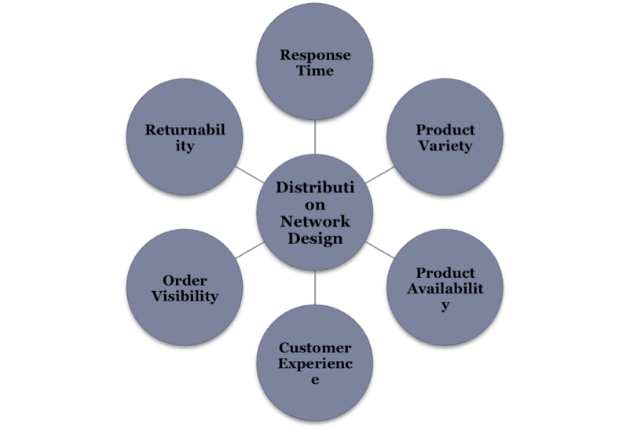

Slide 15
Response time is the time between customer order placement and when customer receives the order.
Product variety is the number of different products/configurations that a customer desires from the distribution network.
Product availability is the probability of having a product in stock when a customer order arrives.
Customer Experience includes the ease with which the customer can place and receive their order.
Order visibility is the ability of the customer to track their order from placement to delivery.
Returnability is the ease with which a customer can return unsatisfactory merchandise and the ability of the network to handle such situations

Slide 16
Changing the distribution network design affects the following supply chain costs.
Inventory cost
Transportation cost
Facilities and handling related cost
Information system cost
The number of facilities in a supply chain increases, the inventory and resulting inventory costs also increase.
Example:

Slide 17
inbound transportation costs to warehouses are kept the same, increasing the number of facilities decreases total transportation cost.
if the number of facilities is increased to a point where there is a significant loss of economies of scale in inbound transportation (as full truck loads are not employed), increasing the number of facilities increases total transportation cost.

Slide 18
DESIGN OPTIONS FOR A DISTRIBUTION NETWORK
There are two key decisions when designing a distribution network: 1. Will product be delivered to the customer location or picked up from a predetermined site?
2. Will product flow through an intermediary (or intermediate location)?

Slide 19
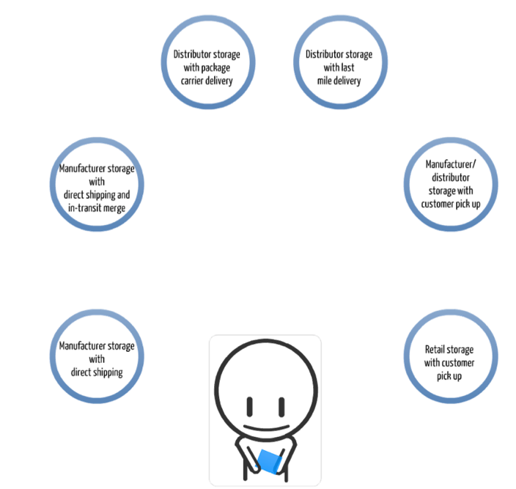
six distinct distribution network designs may be used to move products from factory to customer, which are classified as follows:

Slide 20
1. Manufacturer storage with direct shipping
2. Manufacturer storage with direct shipping and in-transit merge
3. Distributor storage with package carrier delivery
4. Distributor storage with last-mile delivery
5. Manufacturer/distributor storage with costumer pickup
6. Retail storage with customer pickup

Slide 21
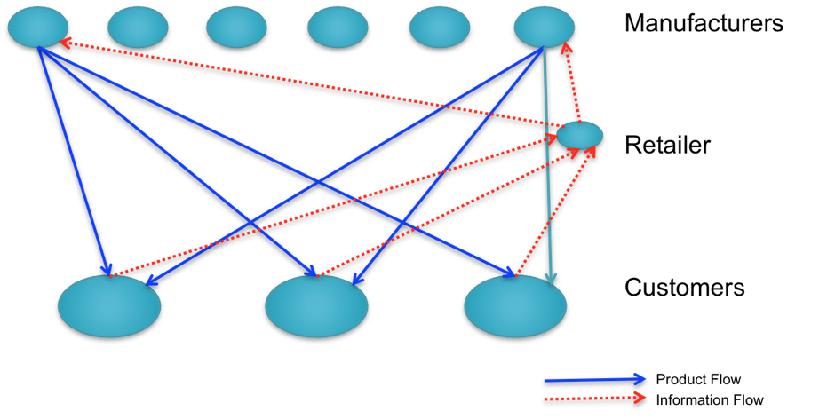
Manufacturer storage with direct shipping

Slide 22
Product is shipped directly from the manufacturer to the end customer, bypassing the retailer ( who takes the order and initiates the delivery request).
This option is also referred to as drop shipping, with product delivered directly from the manufacturer to the customer.
It is best suited for a large variety of low-demand, high-value items for which customers are willing to wait for delivery and accept several partial shipments.

Slide 23
Performance Characteristics of Manufacturer Storage with Direct Shipping Network
Cost Factor | Performance
Inventory | Lower costs because of aggregation. Benefits of aggregation are highest for low demand, high value items. Benefits are very large if product customization can be postponed ate manufacturer.
Transportation | Higher transportation costs because of increased distance and disaggregate shipping.
Facilities and handling | Lower facility costs because of aggregation. Some saving on handling costs if manufacturer can manage small shipments or ship from production line.
Information | Significant investment in information infrastructure to integrate manufacturer and retailer.

Slide 24
Service Factor | Performance
Response Time | Long response time of one to two weeks because of increased distance and two stages for order processing. Response time may vary by product, thus complicating receiving.
Product Variety | Easy to provide a very high level of variety.
Product Availability | Easy to provide a high level of product availability because of aggregation at manufacturer.
Customer Experience | Good in terms of home delivery but can suffer if order from several manufacturers is sent as partial shipments.
Time to market | Fast, with the product available as soon as the first unit is produced.
Order visibility | More difficult but also more important from a customer service perspective.
Returnability | Expensive and difficult to implement.

Slide 25
Drop shipping is a supply chain management method in which the retailer does not keep goods in stock but instead transfers customer orders and shipment details to either the manufacturer, another retailer, or a wholesaler, who then ships the goods directly to the customer.
drop shipping, store owners can sell products to their customers without actually stocking the items.

Slide 26
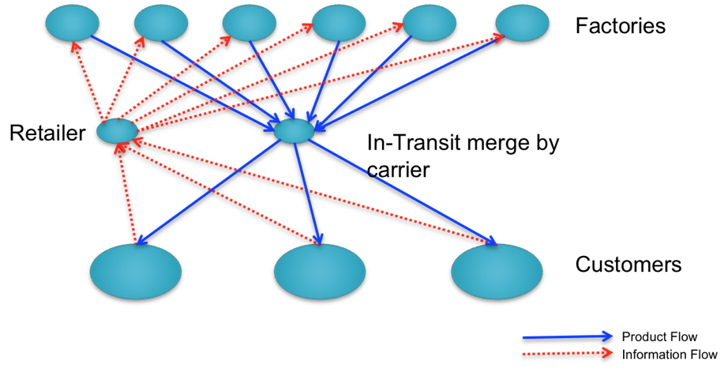
Manufacturer storage with direct shipping and in-transit merge

Slide 27
Unlike pure drop-shipping, under which each product in the order is sent directly from its manufacturer to the end customer, in-transit merge combines pieces of the order coming from different locations so that the customer gets a single delivery.
For ex, when a customer orders a PC from Dell along with a Sony monitor, the package carrier picks up the PC from the Dell factory and the monitor from the Sony factory; it then merges the two together at a hub before making a single delivery to the customer.
It is best suited for low-to medium demand, high value items the retailer is sourcing from a limited number of manufacturers.

Slide 28
Performance Characteristics of In-Transit Merge
Cost Factor | Performance
Inventory | Similar to drop shipping.
Transportation | Somewhat lower transportation costs than drop shipping.
Facilities and handling | Handling costs higher than drop shipping at carrier; receiving costs lower at customer.
Information | Investment is somewhat higher than for drop shipping.
Service Factor | Performance
Response Time | Similar to drop-shipping; may be marginally higher.
Product variety | Similar to drop shipping.
Product Availability | Similar to drop-shipping.
Customer experience | Better than drop-shipping because a single order has to be received.
Time to market | Similar to drop-shipping.
Order visibility | Similar to drop-shipping.
Returnability | Similar to drop-shipping.

Slide 29
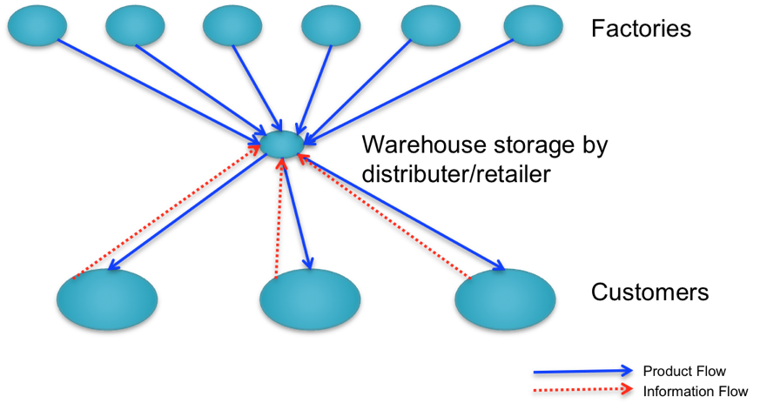
Distributor storage with package carrier delivery

Slide 30
inventory is not held by manufacturers at the factories but is held by distributors/ retailers in intermediate warehouses, and package carriers are used to transport products from the intermediate location to the final customer.
It is well suited for medium-to-fast moving items. It also makes sense when customers want delivery faster than is offered by manufacturer storage but do not need it immediately.

Slide 31
Performance Characteristics of Distributor storage with Carrier Delivery
Cost Factor | Performance
Inventory | Higher than manufacturer storage. Difference is not large for faster-moving items.
Transportation | Lower than manufacturer storage. Reduction is highest for faster-moving items.
Facilities and handling | Somewhat higher than manufacturer storage. The difference can be large for very slow-moving items.
Information | Simpler infrastructure compared to manufacturer storage.
Service Factor | Performance
Response Time | Faster than manufacturer storage.
Product variety | Lower than manufacturer storage.
Product availability | Higher cost to provide the same level of availability as manufacturer storage.
Customer experience | Better than manufacturer storage with drop-shipping.
Time to market | Higher than manufacturer storage.
Order visibility | Easier than manufacturer storage.
Returnability | Easier than manufacturer storage

Slide 32
Distributor Storage with Last-Mile Delivery-
Last-mile delivery refers to the distributor/retailer delivering the product to the customer’s home instead of using a package carrier.
In areas with high labor costs, it is very hard to justify distributor storage with last mile delivery on the basis of efficiency or improved margin. It can only be justified if there is a large enough customer segment willing to pay for this convenience.
An effort should be made to couple last-mile delivery with an existing distribution network to exploit economies of scale and improve utilization.

Slide 33
Distributor Storage with Last-Mile Delivery
Customers
Factories
Distributor/
Retailer Warehouse
Product Flow
Information Flow

Slide 34
Performance Characteristics of Distributor Storage with Last-Mile Delivery
Cost Factor | Performance
Inventory | Higher than distributor storage with package carrier delivery.
Transportation | Very high cost given minimal scale economies. Higher than any other distribution option.
Facilities and handling | Facility costs higher than manufacturer storage or distributor storage with package carrier delivery, but lower than a chain of retail stores.
Information | Similar to distributor storage with package carrier delivery.

Slide 35
Service factor | Performance
Response time | Very quick. Same day to next-day delivery.
Product variety | Somewhat less than distributor storage with package carrier delivery but larger than retail stores.
Product availability | More expensive to provide availability than any other option except retail stores.
Customer experience | Very good, particularly for bulky items.
Time to market | Slightly higher than distributor storage with package carrier delivery.
Order traceability | Less of an issue and easier to implement than manufacturer storage or distributor storage with package carrier delivery.
Returnability | Easier to implement than other options. Harder and more expensive than a retail network.

Slide 36
Manufacturer or Distributor Storage with Customer Pickup
Inventory is stored at the manufacturer or distributor warehouse but customers place their orders online or on the phone and then travel to designated pickup points to collect their merchandise.
Orders are shipped from the storage site to the pickup points as needed.
Such a network is likely to be most effective if existing locations such as coffee shops, convenience stores, or grocery stores are used as pickup sites, because this type of network improves the economies from existing infrastructure.

Slide 37
Manufacturer or Distributor Warehouse Storage with Consumer Pickup
Retailer Cross-Dock DC
Pickup Sites
Customers
Customer Flow
Information Flow
Product Flow
Factories

Slide 38
Performance Characteristics of Network with Consumer Pickup sites
Cost Factor | Performance
Inventory | Can match any other option, depending on the location of inventory.
Transportation | Lower than the use of package carriers, especially if using an existing delivery network.
Facilities and handling | Facility costs can be very high if new facilities have to be built. Costs are lower if existing facilities are used. The increase in handling cost at the pickup site can be significant.
Information | Significant investment in infrastructure required.

Slide 39
Service Factor | Performance
Response time | Similar to package carrier delivery with manufacturer or distributor storage. Same day delivery possible for items stored locally at pick-up sites.
Product variety | Similar to other manufacturer or distributor storage options.
Product availability | Similar to other manufacturer or distributor storage options.
Customer experience | Lower than other options because of the lack of home delivery. In areas with high density of population, loss of convenience may be small.
Time to market | Similar to manufacturer storage options.
Order visibility | Difficult but essential.
Returnability | Somewhat easier given that pickup location can handle returns.

Slide 40
Retailer storage with Customer Pickup
Inventory is stored locally at retail stores.
Customers walk into the retail store or place an order online or by phone and pick it up at the retail store.
It is best suited for fast-moving items or items for which customers value rapid response.

Slide 41
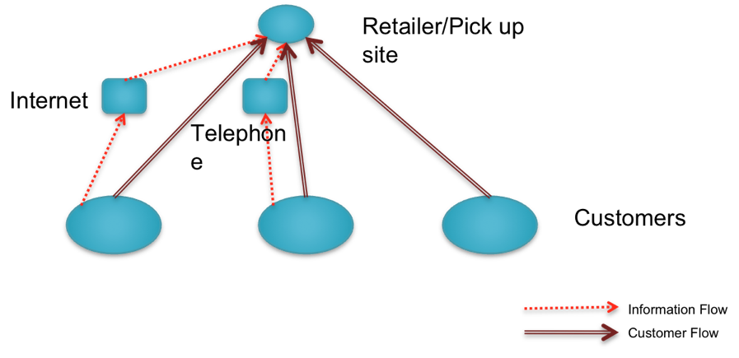

Slide 42
Performance Characteristics of Local storage at Consumer Pickup sites
Cost Factor | Performance
Inventory | Higher than all other options.
Transportation | Lower than all other options.
Facilities and handling | Higher than other options. The increase in handling cost at pickup site can be significant for online and phone orders.
Information | Some investment in infrastructure required for online and phone orders.
Service Factor | Performance
Response time | Same-day pickup possible for items stored locally at pickup site.
Product variety | Lower than all other options.
Product availability | More expensive to provide than all other options.
Customer experience | Related to whether shopping is viewed as a positive or negative experience by customer.
Time to market | Highest among distribution options.
Order visibility | Trivial for in-store orders. Difficult, but essential, for online & phone orders.
Returnability | Easier than other options given that pickup location can handle returns.

Slide 43
E-Business and the Distribution Network
Impact of E-Business on Customer Service
Impact of E-Business on Cost
Using E-Business: Dell, Amazon, Peapod, Grainger

Slide 44
E-BUSINESS AND THE DISTRIBUTION NETWORK
IMPACT OF E-BUSINESS ON CUSTOMER SERVICE:
Response Time to Customers:
In selling physical products that cannot be downloaded, an e-business without a physical retail outlet takes longer to fulfill a customer request than a retail store because of the shipping time involved.
Product Variety:
An e-business finds it easier to offer a large selection of products than a bricks and- mortar store.
Example: Amazon.com offers a much larger selection of books than a typical bookstore.

Slide 45
Product Availability:
An e-business also allows for aggregation of inventory that improves product availability.
Customer Experience:
An e-business affects customer experience in terms of access, customization, and convenience.
most retail stores that are open only during business hours, an e-business allows access to customers who may not be able to place orders during regular business hours.

Slide 46
Faster Time to Market:
A firm can use e-business to introduce new products much more Quickly than a firm that uses physical channels.
A firm that sells PCs through physical channels must produce enough units to stock the shelf at its distributors and retailers before it starts to see revenue from the new product.

Slide 47
Order Visibility:
The Internet makes it possible to provide visibility of order status.
From a customer‘s perspective, it is crucial to provide this visibility because an online order has no physical equivalent to a customer shopping for an item at a retail store.
Returnability:
Returnability is harder with online orders, which typically arrive from a centralized location.
It is much easier to return a product purchased at a retail store.
The proportion of returns is also likely to be much higher for online orders because customers are unable to touch and feel the product before their purchase. Going online thus increases the cost of reverse flows.

Slide 48
Direct Sales to Customers
An e-business allows manufacturers and other members of the supply chain that do not have direct contact with customers in traditional channels to enhance revenues by bypassing intermediaries and selling directly to customers, thereby collecting the intermediary‘s incremental revenue.
For example, Dell sells PCs online direct to customers.
Dell is able to increase revenue and enhance margins because it shares no part of the revenue with a distributor or retailer.
In contrast, HP, which sells through retailers, must share some of the product revenue with the distributor and Retailer, resulting in lower revenue and margins for HP.

Slide 49
Flexible Pricing, Product Portfolio, and Promotions
An e-business can easily alter prices by changing one entry in the database linked to its Web site.
This ability allows an e-business to maximize revenues by setting prices based on current inventories and demand.
airlines provide a good example of this ability-they make last-minute, low-cost fares available on the Web on routes with unsold seats.
Dell also changes prices for different PC configurations regularly, based on demand and component availability.

Slide 50
Efficient Funds Transfer
An e-business can enhance revenues by speeding up collection.
An excellent example shows how e-business affects areas even outside the business world.

Slide 51
IMPACT OF E-BUSINESS ON COST
On the cost side, e-business affects inventory, facilities, transportation, and information costs.
It is important to observe that the impact in each case is not necessarily positive.
Inventory:
An e-business can lower inventory levels and inventory cost by improving supply chain coordination and creating a better match between supply and demand.
Additionally, e-business enables a firm to aggregate inventories far from customers if most customers are willing to wait for delivery of online orders.

Slide 52
Facilities:
Two basic types of facilities costs must be included in the analysis: costs related to the number and location of facilities in a network, and costs associated with the operations that take place in these facilities.
ongoing operating costs, customer participation in selection and order placement allows an e-business to lower its resource costs.
For example, when a customer goes to the Lands' End Web site, she makes the effort to check on product availability and then place her order.
When the same customer phones in an order, the firm incurs the additional cost of its employees checking product availability and placing the order.

Slide 53
An e-business can lower its order fulfillment costs because it does not have to fill an order as soon as it arrives.
A retail store or supermarket must staff its sales counters so that more cashiers are available when more customers are shopping.
As a result, these stores require greater staffing during weekends and at times when people are not at work.
At an e-business, if a reasonable buffer of unfilled orders is maintained, the rate of order fulfillment can be made significantly smoother than the rate at which orders arrive, which reduces the peak load for order fulfillment and thus reduces resource requirements and cost.

Slide 54
Additionally, operating costs can be decreased for a manufacturer using e-business to sell direct to customers because fewer supply chain stages touch the product as it makes its way to a customer, thereby reducing handling costs.
some products, such as groceries, an e-business has to perform tasks currently performed by the customer at retail stores, affecting both handling costs and transportation costs.

Slide 55
In such situations, an e-business will incur higher handling and delivery costs than a retail store.
For example, whereas a customer picks out the required items at a grocery store, an e-business such as Peapod incurs higher handling costs because its employees must pick- a customer's order from the warehouse shelves and deliver it to the customer's home.

Slide 56
Transportation:
If a firm can put its product in a form that' can be downloaded, the Internet will allow it to save on the cost and time for delivery.
For example, downloadable music and software offer an opportunity to eliminate all costs associated with transporting compact discs.
For non-digital products, aggregating inventories increases outbound transportation relative to inbound transportation.
Compared to a business with many retail outlets, an e-business with aggregated inventories tends to have higher transportation costs (across the entire supply chain) per unit because of the increased outbound costs.

Slide 57
Information:
An e-business can share demand information throughout its supply chain to improve visibility.
The Internet may also be used to share planning and forecasting information within the supply chain, further improving coordination.
This helps reduce overall supply chain costs and better match supply and demand.
An e-business incurs additional information costs, however. The cost of software and hardware to set up an e-business can often be significant.
These costs need to be weighed against the benefits that will be derived.

Slide 58
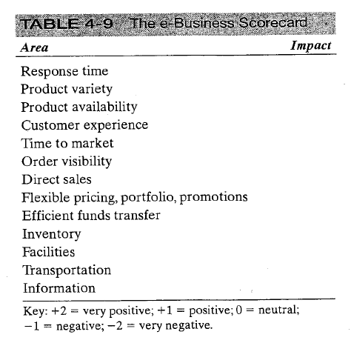
The blank B2C e-business scorecard

Slide 59
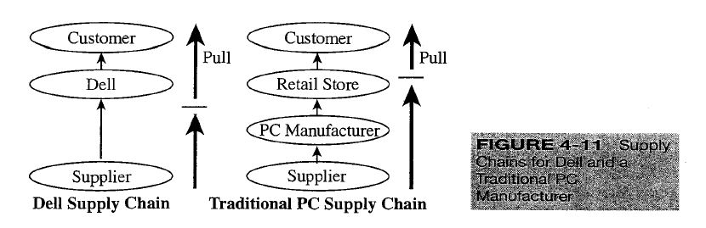
USING E-BUSINESS TO SELL PCs: DELL
The PC industry in general-and Dell in particular-has used e-business effectively to improve performance of supply chain networks.

Slide 60
Dell sells PCs directly to customers, both companies and consumers, and starts assembly after receiving a customer order.
Traditional PC manufacturers, in contrast, assemble the PC in the push phase of the supply chain because they must maintain assembled products available for purchase at a retail store.

Slide 61
Impact of e-Business on Customer Service in the PC Industry
The main disadvantage for Dell of selling PCs over the Internet is that customers who are unwilling to wait five to 10 days to receive their order cannot be attracted.
A PC, however, is usually a planned purchase; most people are willing to wait for its delivery.
Dell also does not attract customers who need a lot of help when selecting a PC.
However, the segment of people who are comfortable selecting their own PC and are willing to wait for its delivery is quite large and still growing.
Dell and other PC manufacturers who sell over the Internet target this group of customers.

Slide 62
Dell is able to exploit most of the responsiveness-enhancing opportunities offered by an e-business.
The company uses the Internet to offer a very wide variety of different PC configurations.
Customers are allowed to select recommended PC configurations or customize them to have the desired processor, memory, hard drive, and other components.
Customization allows Dell to satisfy customers by giving them a product that is close to their specific requirements.
The customization options are very easy to display over the Internet, allowing Dell to attract customers who value this choice.
Dell also uses customized Web pages to enable large business customers to place orders.

Slide 63
The Internet allows Dell to bring new products to market more quickly than competitors who sell through retail stores.
Competing firms that sell through distributors and retailers need to fill shelves at their distributors and retailers before a product reaches the customer.
Dell, in contrast, introduces a new product to customers on the Internet as soon as the first PC of that model is ready to be assembled.

Slide 64
Dell also uses the price flexibility the Internet offers to increase revenues.
The salespeople at Dell change prices and delivery time daily, based on demand and supply of components, in order to maximize the revenue that can be extracted from available resources.

Slide 65
Impact of e-Business on Cost in the PC Industry
Inventory Costs:
Its e-Business offers Dell the ability to reduce its inventories by aggregating them in a few geographic locations, whereas a chain of retail stores selling computers must carry inventory in each store.
Dell is able to further reduce inventories by exploiting the time that elapses from the point at which an online order arrives to the point at which it must be shipped.
Dell products and assembly lines are designed so that all components on which customers are offered customization can be assembled in a very short period of time.

Slide 66
This allows Dell to postpone assembly until after the customer order has been placed. As a result, Dell holds all inventories in the form of components that are common across multiple finished products. Postponement, coupled with component commonality, allows Dell to reduce inventories significantly.

Slide 67
Facility Costs:
Its e-Business allows the Dell supply chain to lower facility costs because the company has no physical distribution or retail outlets.
Dell incurs only the cost of the manufacturing facility and warehousing space for components.
A PC supply chain selling through retail stores must pay for the distribution warehouses and retail stores as well.
Its e-Business also allows Dell to take advantage of customer participation in order placement and thus decrease processing costs at its facility.
Dell saves on the cost of call center representatives because customers do all the work when they place an order online.

Slide 68
Transportation Costs:
Result of e-business, total transportation costs in the Dell supply chain are higher than in a supply chain selling PCs through distributors and retailers.
Dell sends individual PCs to customers from its factories, whereas a manufacturer selling through distributors and retailers sends large shipments on trucks to warehouses and to retailers.
The Dell supply chain thus has higher outbound transportation costs.
Relative to the price of a high-end PC, however, the outbound transportation cost is low (typically 2 to 3 percent) and thus it does not have a major impact on the overall cost.

Slide 69
Information Costs:
Dell has made a significant investment in information technology to implement its build-to-order model.

Slide 70
Impact of e-Business on Performance at Dell
Dell to significantly improve its performance in terms of both responsiveness and cost.
As a result, customers are happier while Dell is able to reduce costs. Dell, to the delight of its shareholders, has exploited every advantage that the Internet offers to improve performance.

Slide 71
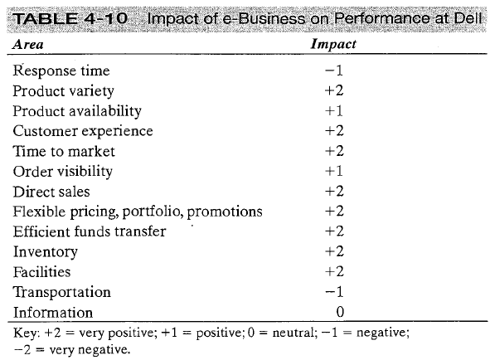

Slide 72
DISTRIBUTION NETWORKS IN PRACTICE
The ownership structure of the distribution network can have as big an impact as the type of distribution network:
Different types of physical networks and subsequent flows to distribute products successfully.
However, equally important is who owns each stage in the distribution network.
Distribution networks that have exactly the same physical flow but different ownership structures can have vastly different performance.

Slide 73
For example, a manufacturer that owns its distribution network can control the network's actions.
However, if the manufacturer does not own the distribution network, as is more often the case, a wide variety of issues need to be taken into account to optimize over the network.
Obviously, an independent distributor wants to optimize its own enterprise, not necessarily the entire supply chain.

Slide 74
The choice of a distribution network has very long-term consequences
The structure of the distribution network is one of the most difficult decisions to change.
The impact often lasts for decades, amplifying the importance of the choice.
For example, in the United States, auto manufacturers sell virtually all of their vehicles to consumers through a network of independent dealers set up decades ago. Because dealers are the interface between the consumer and the automotive supply chain, auto manufacturers are very interested in influencing dealers to ensure that this is a positive relationship.

Slide 75
Consider whether an exclusive distribution strategy is advantageous
Another important choice is whether to distribute exclusively or not.
For instance, a manufacturer of consumer electronics such as Sony could choose to have relationships with many distributors such as Best Buy, Circuit City, and Wal-Mart.
In this case, Sony would be interested in increasing the availability of its products to customers and would certainly not mind if its distributors competed with each other to sell Sony products to customers.

Slide 76
Product price, commoditization, and criticality affect the type of distribution system preferred by customers.
Interactions between a buyer and a seller take time and resources.
Many buyers would like to establish a relationship with a single enterprise that can deliver a full line of products.

Slide 77
Integrate the Internet with the existing physical network
To extract maximum benefit from e-business, firms should integrate it with their existing supply chain networks.
Separating the two networks often results in inefficiencies within the supply chain.
This coupling of e-business with the existing physical network has been referred to as clicks-and-mortar.

