Slide 1
SUPPLY CHAIN MANAGEMENT

Slide 2
Outline
What is a Supply Chain?
Decision Phases in a Supply Chain
Process View of a Supply Chain
The Importance of Supply Chain Flows
Examples of Supply Chains

Slide 3
What is a Supply Chain?
A supply chain consists of all parties involved, directly or indirectly, in fulfilling a customer request
Suppliers, manufacturers, transporters, warehouses, retailers, and customers
A supply chain includes all functions involved in receiving and filling a customer request
New product development, marketing, operations, distribution, finance, and customer service
A supply chain is the entire process of moving a product or service from suppliers to customers

Slide 4
What is Supply Chain?
Network of organizations and business processes for:
obtain raw materials
Transforming them into intermediate and finished products
Distributing finished products to customers
Includes secondary and tertiary suppliers
Upstream portion: Suppliers
Downstream portion: Distributors

Slide 5
Supply Chain Management
“Supply Chain Management (SCM) is the integration of business processes from end user through original suppliers that provides products, services, and information that add value for customers”.
SCM includes all key business activities across all members of the supply chain
SCM is an all-inclusive process that is dynamic, complex and interactive

Slide 6
What is supply chain management?
Supply chain management (SCM) is the flow of materials, information, and finances as they move in a process from supplier to manufacturer to wholesaler to retailer to consumer.
Supply chain management involves coordinating and integrating these flows both within and among companies.
The ultimate goal of any effective supply chain management system is to reduce inventory (with the assumption that products are available when needed)

Slide 7
Stakeholders in the Supply Chain
Includes manufacturers, suppliers, transporters, warehouses, retailers, customers
Within each company, the supply chain includes all functions involved in fulfilling a customer request including:
product development
Marketing
Operations
Distribution
Finance
customer service

Slide 8
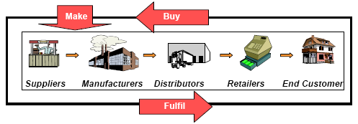
Key Activities in a Supply Chain
Buy - purchasing of goods and services required to make your product
Make – producing your finished product
Fulfil – ensuring your customer receives your product
At every stage of the Supply Chain, goods are made (or provided) by a Stakeholder; this involves items being bought from the previous Stakeholder, and orders being fulfilled to the next Stakeholder

Slide 9
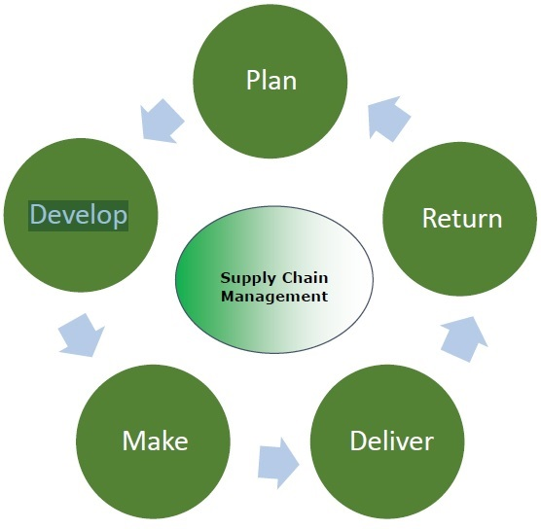
Supply Chain Management - Process
Supply chain management is a process used by companies to ensure that their supply chain is efficient and cost-effective.
A supply chain is the collection of steps that a company takes to transform raw materials into a final product.
The five basic components of supply chain management are:

Slide 10
Plan:
initial stage of the supply chain process.
Need to develop a plan or strategy in order to address how the products and services will satisfy the demands and necessities of the customers.
The planning should mainly focus on designing a strategy that yields maximum profit.
For managing all the resources required for designing products and providing services, a strategy has to be designed by the companies.
Supply chain management mainly focuses on planning and developing a set of metrics.

Slide 11
Develop:
The next step of Supply Chain Management is developing or sourcing.
Mainly concentrate on building a strong relationship with suppliers of the raw materials required for production.
This involves not only identifying dependable suppliers but also determining different planning methods for shipping, delivery, and payment of the product.
Companies need to select suppliers to deliver the items and services they require to develop their product.
So in this stage, the supply chain managers need to construct a set of pricing, delivery and payment processes with suppliers and also create the metrics for controlling and improving the relationships.

Slide 12
Make:
The third step in the supply chain management process is the manufacturing or making of products that were demanded by the customer.
In this stage, the products are designed, produced, tested, packaged, and synchronized for delivery.
Here, the task of the supply chain manager is to schedule all the activities required for manufacturing, testing, packaging and preparation for delivery.

Slide 13
Deliver:
The fourth stage is the delivery stage.
The products are delivered to the customer at the destined location by the supplier.
This stage is basically the logistics phase, where customer orders are accepted and delivery of the goods is planned.
The delivery stage is often referred as logistics, where firms collaborate for the receipt of orders from customers, establish a network of warehouses, pick carriers to deliver products to customers and set up an invoicing system to receive payments.

Slide 14
Return:
The last and final stage of supply chain management is referred as the return.
In the stage, defective or damaged goods are returned to the supplier by the customer. Here, the companies need to deal with customer queries and respond to their complaints etc.
This stage often tends to be a problematic section of the supply chain for many companies.
The planners of supply chain need to discover a responsive and flexible network for accepting damaged, defective and extra products back from their customers and facilitating the return process for customers who have issues with delivered products.

Slide 15
Supply Chain Stages
in a globalized world where everyone is competing with everyone else. Organizations today are realizing the importance of an effective Supply Chain Management.
supply chain may involve a variety of stages. These supply chain stages include:
Customers
Retailers
Wholesalers/distributors
Manufacturers
Component/raw material suppliers

Slide 16
Supply Chain Stages
A typical supply chain involves a variety of stages
Supplier
Manufacturer
Distributor
Retailer
Customer
Notes:
The term supply chain may imply that only one player is involved at each stage.
A manufacturer may receive material from several suppliers and the supply to several distributors, who may supply several retailers.
Thus, most supply chains are actually networks

Slide 17
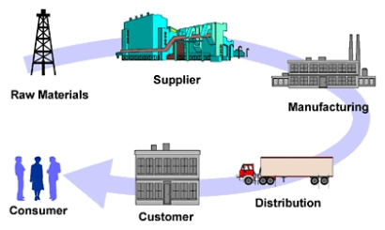

Slide 18
Raw Material Suppliers:
A supplier plays a critical link in supply chain.
Forming the right partnership with right terms and polices helps develop a good relationship with the suppliers that will prove beneficial to all the parties involved.
Manufacturer:
After acquiring the right raw material, the organization has to make careful decision on the manufacturing of the product.
The demand for the product, technologies required and other important decisions have to be carefully managed at this stage.

Slide 19
Distributors:
The distributors could include wholesalers and retailers.
They are one of the important links between the organization and customers.
Customers:
They are the most important and also the end-link in the chain.
An organization should identify their customers and make sure that the product they produce is what is required.

Slide 20
Each stage need not be present in all supply chain model.
The appropriate design of the supply chain will depend on both the customer’s needs and the roles of the stages involved.
In some cases, such as Dell, a manufacturer may fill customer orders directly. Dell builds-to-order: that is, a customer order initiate manufacturing at Dell. Dell does not have a retailer, wholesaler, or distributor in its supply chain.

Slide 21
the mail order company L.L. Bean, manufacturers do not respond to customer orders directly.
In this case, L.L.Bean maintains an inventory of product form which they fill customer orders. Compared to the Dell supply chain, the L.L.Bean supply chain contains an extra stage (the retailer. L.LBean itself) between the customer and the manufacturer.
In the case of other retail stores. The supply chain may also contain a wholesaler or distributor between the store and the manufacturer.

Slide 22
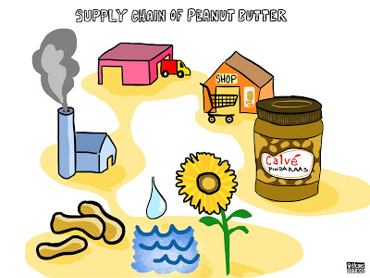

Slide 23
The objective of a supply chain
The objective of every supply chain is:
Maximize the overall value generated.
The value of a supply chain generates is the difference between what the final product is worth to the customer and the effort of the supply chain expands in filling the customer’s request.
For most commercial supply chains, the value will be strongly correlated with supply chain profitability, the difference between the revenue generated from the customer and the overall cost across the supply chain.

Slide 24
Example:
a customer purchasing a computer from Dell pays $2,000, which represents the revenue the supply china receives.
Dell and other stages of the supply chain gain costs to convey information, produce components, store them, transport them, transfer funds, and so on.

Slide 25
Supply Chain Management - Advantages
In this era of globalization where companies compete to provide the best quality products to the customers and satisfy all their demands, supply chain management plays a very important role.
All the companies are highly dependent on effective supply chain process.
The key benefits of supply chain management are:
Develops better customer relationship and service.
Creates better delivery mechanisms for products and services in demand with minimum delay.
Improvises productivity and business functions.

Slide 26
4. Minimizes warehouse and transportation costs.
5. Minimizes direct and indirect costs.
6. Assists in achieving shipping of right products to the right place at the right time.
7. Enhances inventory management, supporting the successful execution of just-in-time stock models.
8. Assists companies in adapting to the challenges of globalization, economic disturbance, expanding consumer expectations, and related differences.
9. Assists companies in minimizing waste, driving out costs, and achieving efficiencies throughout the supply chain process.

Slide 27
Supply Chain Management - Process Flow
Supply chain management can be defined as a systematic flow of materials, goods, and related information among suppliers, companies, retailers, and consumers.
There are three different types of flow in supply chain management −
Material flow
Information/Data flow
Money flow

Slide 28
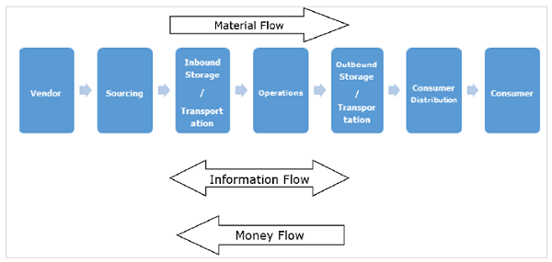
Flows in a Supply Chain

Slide 29
Supply Chain Flows
Value-Added Services
Supplier
Manufacturer
Distributor
Retailer
Customer
Material/Product Flow
Funds/Demand Flow
Information Flow
Returns/Recylcing

Slide 30
Material (Product) Flow:
Flow of the physical product from supplier all the way down to the customer.
This flow is usually uni-directional. that is, it only flows one direction from supplier to customer.
Some certain instances, when the customer returns the product, the flow occasionally goes in the other direction.
A typical flow of materials usually begins with the raw materials suppliers to manufacturers to warehouses and distribution to the final customer.

Slide 31
Information Flow:
It is the flow of information from supplier to customer and from customer back to supplier.
This flow is bi-directional, that is, it goes both direction in the supply chain.
The type of information that flows between customers and suppliers include quotations, purchase orders, delivery status, invoices, customer complaints and so on.

Slide 32
For supply chain to be successful there has to be constant interaction between supplier and Customer.
In many cases, other partners like distributors, dealers, retailers, logistic service providers are involved in the information network.

Slide 33
Financial Flow
Financial flow involves the movement of money from the customer to the supplier.
when the customer receives the product and verifies it, the customer pays and the money travels back to the supplier.
Sometimes the finances flow the other direction (from supplier to customer) in form of debit.
For an efficient and effective supply chain, it is important that all three flows are managed properly with minimal effort.

