Slide 1

SYNCHRONIZATION

Slide 2
Synchronization
Key concepts
Introduction
Clock synchronization
Event ordering
Mutual exclusion
Deadlock
Election algorithms

Slide 3
Synchronization
Introduction
Distributed system consists of a collection of distinct processes that are spatially separated and run concurrently
The rules for enforcing correct interaction among concurrently executing processes are implemented in form of synchronization mechanisms
In Distributed System, Synchronization related issues are
Clock synchronization
Event ordering
Mutual exclusion
Deadlock
Election algorithms

Slide 4
Clock Synchronization
Every computer needs a timer mechanism to keep track of current time and also for various accounting purposes
In distributed systems an application may have processes that concurrently run on multiple nodes
For correct results, several distributed applications require that the clocks of the nodes be synchronized with each other
Ex. An online reservation system
Synchronized clocks also enable us to measure the duration of distributed activities that start at one node and terminate on other node

Slide 5
Clock Synchronization
How computer clocks are implemented?
A computer clock usually consists of 3 components
A quartz crystal which oscillates at a well-defined frequency
A counter register which keeps track of oscillations of the quartz crystal. Value of this register is decremented by one for each oscillation of the quartz crystal
A constant register which stores constant value based on frequency of oscillations of quartz crystal

Slide 6
Clock Synchronization
When value of the counter register becomes 0, an interrupt is generated and its value is reinitialized to the value in the constant register
Each interrupt is called a clock tick
To make computer clock function as ordinary clock
The value in the const register is chosen so that 60 clock ticks occur in a second
The computer clock is synchronized with real time (external clock)

Slide 7
Clock Synchronization
Drifting of clocks
Clock always runs at a constant rate because its quartz crystal oscillates at a well-defined frequency
However due to difference in crystals, the rates at which clock run are normally different from each other
The difference in oscillation period is extremely small, but difference accumulated over a period of time is significant
This drift is approximately 10⁻⁶ which gives difference of 1 second for every 10,00,000 seconds i.e., for 11.6 days
Hence computer clock must be periodically re-synchronized with real-time clock to keep it non faulty

Slide 8
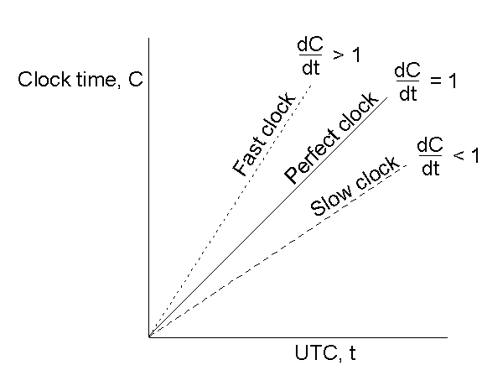
Clock Synchronization
Drifting of clocks
t - real time
C – time of a clock
The relation between clock time and UTC( Coordinated Universal time ) when clocks tick at different rates

Slide 9
Clock Synchronization
2 types of clock synchronization
External synchronization
Synchronization of computer clocks with real time clocks
Internal (Mutual) synchronization
Synchronization of the clocks of different nodes of the system

Slide 10
Clock Synchronization
Clock synchronization issues
No two clocks can be perfectly synchronized
Two clocks are said to be synchronized if the difference in time values of 2 clocks is less than some specified constant
Difference in the time values of 2 clocks is called clock skew
Clock synchronization requires each node to read the other nodes clock values
An important issue is that the time must never run backward
During synchronization a fast clock has to be slowed down

Slide 11
Clock Synchronization
Clock synchronization algorithms
Centralized algorithms
Distributed algorithms
Centralized algorithms
One node called time server node has a real time receiver
Time server node has correct time and it is regarded as reference time
Goal of the algorithm is to keep the clocks of all other nodes synchronized with clock time of time server node

Slide 12
Clock Synchronization
2 types of centralized algorithms
Passive time server centralized algorithm
Active time server centralized algorithm
Passive time server centralized algorithm
Each node periodically (interval between 2 periods being less than / 2p. - Clock skew, p-maximum drift rate allowed) sends message ( “time = ?”) to the time server
Time =?
T0
Node 1
Time server
Time = T
T1
T

Slide 13
Clock Synchronization
Assume that when the client node sends a message “time = ? ”, it’s clock time is T0
Time server quickly responds with a message “ time=T”
Node receives the “ time = T ” message at time T1
So time required for propagation of message “time = T” is ( T1 – T0) / 2
Immediately after receiving the message “time=T”
Node clock is re-adjusted to T + ( T1 - T0 ) / 2
Problem with passive time server centralized algorithm
(T1-T0)/2 is not a good estimate of message propagation time

Slide 14
Clock Synchronization
Two methods to improve estimated value:
Assumes the availability of the approximate time taken by time server to handle the “time=?”. Let it be I
So the better estimate of time is T + ( T1 - T0 – I ) / 2
Cristian Method:
Several measurements of T1-T0 are made
T1-T0 which exceeds some threshold are discarded
Average of remaining measurements are calculated and Half of the calculated value is used as the value to be added to T

Slide 15
Clock Synchronization
Active time server centralized algorithm
Time server periodically broadcasts its clock time (“time=T”)
Each node has the a priori knowledge of approximate time (Ta) required for propagation of message “time=T” from time server node to its own node
Nodes clock is readjusted to time “T + Ta”, when broadcast message is received
Drawbacks of Active time server centralized algorithm
Not Fault tolerant
Broadcast facility is required

Slide 16
Clock Synchronization
Berkeley algorithm
overcomes the drawbacks of active time server algorithm
Time server periodically sends message “ time = ? ” to all nodes in the group
On receiving the message each computer sends back its clock value to time server
Time server has a priori knowledge of the approximate time required to propagate message from each node to time server
Based on this knowledge, it readjusts the clock values of reply messages of each member of the group

Slide 17
Node
A
(1) “Time=?”
(2) “Time=T_{a}”
(3) T_{A =} T_{a}+T_{A to Ts}
(1) “Time=?”
(1) “Time=?”
Time Server
(TS)
Node
C
Node
B
(3) T_{B =} T_{b}+T_{B to Ts}
(3) T_{C =} T_{c}+T_{C to Ts}
(2) “Time=Tc”
(2) “Time=Tb”
(3) T_{D =} T_{d}+T_{D to Ts}
(1) “Time=?”
(2) “Time=Td”
Node
D

Slide 18
Clock Synchronization
Then it finds fault-tolerant average of clock values of all computers including its own
To take fault-tolerant average, Time server chooses a subset of all clock values that does not differ from one another by more than a specified amount
Average of these values in the subset is taken
It eliminates readings from unreliable clocks whose clock values could have a significant adverse effect if the ordinary average is taken
Time server readjusts its own clock to the average value

Slide 19
Clock Synchronization
Time server sends the amount by which each individual computers clock requires adjustment ( can be +ve or -ve value ) including the propagation time
Drawbacks that centralized clock algorithm suffer are:
Single-point of failure
Not scalable
Distributed algorithms overcome these drawbacks

Slide 20
Clock Synchronization
Distributed algorithms
Externally synchronized clocks are also internally synchronized
That is, if each node’s clock is independently synchronized with real time, all the clocks of the system remain mutually synchronized
Equip each node of the system with a real-time receiver so that nodes clock can be independently synchronized with real time
2 approaches used for internal synchronization are :
Global averaging distributed algorithm
Localized averaging distributed algorithm

Slide 21
Clock Synchronization
Global averaging distributed algorithm
Each node broadcasts its local time in the form of special “resync” message when local time-equals T_{o} + i * R T_{o} is the fixed time in the past agreed upon by all nodes,
R depends on total number of nodes, maximum allowable drift rate, i – some integer
“resync” message is broadcast from each node at the beginning of every fixed length resynchronization interval
However, since the clock of different nodes are slightly different, the broadcast will not happen simultaneously from all nodes

Slide 22
Clock Synchronization
Each node waits for specified time “T” collecting “resync” messages broadcast from other nodes
“resync” message arrival time is recorded for each node
After wait period “T”, it calculates skew of its clock w.r.t. to other nodes (difference) based on received “resync” message
Then computes fault tolerant average of the estimated skews and uses it to correct its time before the start of next resynchronization interval

Slide 23
Clock Synchronization
Two commonly used Algorithms in Global averaging are:
Averaging All values
Taking average of the estimated skews and use it as the correction for the local clock
To limit the impact of faulty clocks on the average, estimated skew of each node is compared against a threshold
Skews greater than threshold are set to 0 before computing the average of estimated skews

Slide 24
Clock Synchronization
Averaging values after discarding
Limits the impact of faulty clocks by
Discarding m highest and m lowest estimated skews
Calculates the average of remaining skews
Localized averaging distributed algorithm
Nodes of are logically arranged in some pattern like ring or a grid
Periodically each node exchanges the clock time with its neighbors in the grid
Sets its clock to average of its clock and clock time of neighbors

Slide 25
Event Ordering
Keeping the clocks in DS synchronized to within 5 or 10 msec is expensive and nontrivial task
Lamport[1978] observed that, for most applications it is not necessary to keep clocks in DS synchronized
Rather ensure all events to occur in a ordered manner
Lamport defined new relation →happened-before
Introduced the concept of logical clocks for ordering of events

Slide 26
Event Ordering
Happened-before relation
Denoted by → on set of events
Satisfies following conditions
If a and b are events in same process and a occurs before b, then a → b
If a is the event of sending a message by one process and b is the event of the receipt of same message by another process, then a → b
Happened-before is transitive relation, i.e., If a → b and b→ c, then a →c

Slide 27
Event Ordering
2 events a and b are said to be concurrent if they are not related by the happened-before relation
Also known as the relation of casual ordering
Space diagram illustrates the happened-before relation and concurrent events
Vertical line denotes process
Dot on vertical line denotes an event in corresponding process
Wavy line denotes a message transfer

Slide 28
Event Ordering
Space diagram for three processes
E10 →E11
E20 → E24
E11 → E23
E21 → E13
E30 → E24
E11 → E32
E32
E24
E23
E13
E12
E22
E31
Time
E11
E21
E10
E20
E30
Process P1
Process P2
Process P3

Slide 29
Event Ordering
Logical clock
To determine that an event a happened before an event b, either a common clock or set of perfectly synchronized clocks is needed
Neither of these available in DS
Logical clock is a way to associate a timestamp( a number independent of clock time) with each system event so that events that are related by happened-before relation can be properly ordered in sequence
Each process P_{i} has a clock C_{i} associated with it that assigns a number C_{i}(a) to any event a in that process

Slide 30
Event Ordering
With each process having its own clock, the entire system of clocks is represented by function C, which assigns to any event b the number C(b), where C(b)=C_{j}(b) if b is an event in process P_{j}
Logical clocks of a system can be considered correct if the events of the system that are related to each other by the happened-before relation can be properly ordered using these clocks
Time stamp assigned to the events by the system of logical Clock must satisfy the clock condition
if a → b , then C(a) < C(b) for any 2 events a and b

Slide 31
Event Ordering
Implementation of logical clocks
Clock condition is satisfied if following conditions hold
C1: if a and b are 2 events within the same process P_{i} and a occurs before b, then C_{i}(a) < C_{i}(b)
C2: if a is the sending of a message by process P_{i} and b is the receipt of that message by process P_{j}, then C_{i}(a) < C_{j}(b)
Condition for the correct functioning of the system
C3: a clock C_{i} associated with a process P_{i} must always go forward, never backward
Correctness is made by adding positive value not negative

Slide 32
Event Ordering
To meet conditions C1,C2 and C3, Lamport algorithm uses following implementation rules
IR1: Each process P_{i} increments Ci between any two successive events
IR2: If event a is the sending of a message m by the process P_{i}, the message m contains a timestamp Tm=C_{i}(a), and upon receiving the message m a process P_{j} sets C_{j} greater than or equal to its present value but greater than T_{m}

Slide 33
Event Ordering
Implementation of logical clocks using counters
C₁=8 e₀₈
C₁=7 e₀₇
C₁=6 e₀₆
C₁=5 e₀₅
C₁=4 e₀₄
C₁=3 e₀₃
C₁₌2 e₀₂
C₁=1 e₀₁
C₁=0
Timestamp = 6
e₁₄ C₂=6
e₁₃ C₂= 5 (not 3 since 3 < 4)
T
I
M
E
Timestamp = 4
e₁₂ C₂=2
e₁₁ C₂=1
C₂=0

Slide 34
Implementation of Logical Clocks using Physical clocks
Physical clock times without corrections
Physical clock times after corrections
120 |  |  | 96 | 101
110 |  |  | 88 | 93
100 |  |  | 80 | 85
90 |  |  | 72 | 77
80 |  |  | 64 | 69
70 |  |  | 56 | 61
60 |  |  | 48
50 |  |  | 40
40 |  |  | 32
30 |  |  | 24
20 |  |  | 16
10 |  |  | 08
0 |  |  | 0
Timestamp = 85
e14
e13
e12
e11
T
I
M
E
Timestamp = 60
Process P1
Process P2

Slide 35
Mutual Exclusion
Exclusiveness of access to a shared resource is called Mutual Exclusion
Sections of programs that need exclusive access to shared resources are referred as critical sections
Algorithm for implementing mutual exclusion must satisfy
Mutual exclusion
Process that is granted a resource must release it before it can be granted to another process
No starvation
Every process that is granted the resource should eventually releases it

Slide 36
Mutual Exclusion
Approaches for implementing ME in DS are
Centralized approach
Distributed Approach
Token passing Approach
Centralized approach
One of the processes in the system is elected as the coordinator and coordinates the entry to the critical sections
Process that wants to enter CS must seek permission from coordinator
Coordinator grants permission to only one process at a time, when 2 or more process ask for permission
Uses some scheduling algorithms
Process must notify the coordinator after it exits the CS

Slide 37
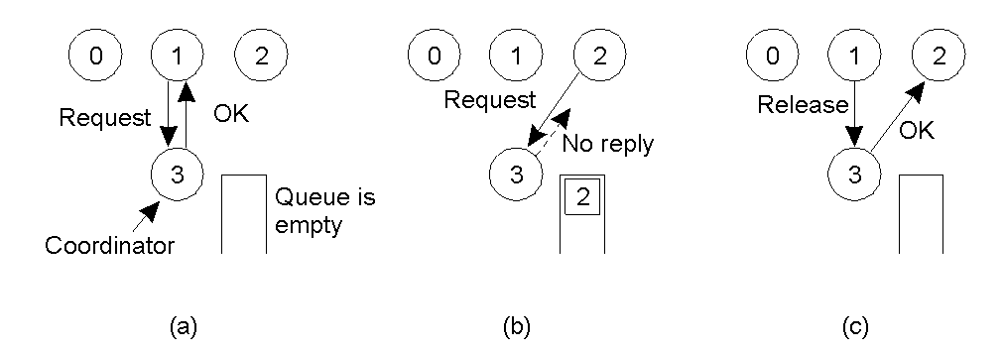
Mutual Exclusion
Process 1 asks the coordinator for permission to enter a critical section. Permission is granted
Process 2 then asks permission to enter the same critical section. The coordinator does not reply
When process 1 exits the critical section, it tells the coordinator, then coordinator replies to process 2

Slide 38
Mutual Exclusion
Distributed approach
Decision making for ME is distributed across the entire system
Ricart and Agrawala algorithm for mutual algorithm
Requires total ordering of all events in the system
When a process wants to enter a CS, it sends a request message to all other processes
Message contains the following information
Process identifier of the process
Name of the CS that process wants to enter
Unique timestamp generated by the process for the request message

Slide 39
Mutual Exclusion
On receiving request message, a process either sends back reply immediately or defers sending a reply to sender based on following rules
If the receiver process is currently executing in the CS, it simply queues the request message and defers sending a reply
If the receiver process is currently not executing in the CS but is waiting for its turn, it compares the timestamp
If timestamp of the received request message is lower, it means sender process made a request before the receiver process to enter CS. So the receiver process immediately sends back reply message to the sender

Slide 40
Mutual Exclusion
If timestamp of receiver process's request message is lower, the receiver queues the received request message and defers sending reply message
If the receiver process neither is in CS nor is waiting for its turn to enter CS, it immediately sends back the reply message

Slide 41
Mutual Exclusion
P1 wants to enter CS
Time stamp = 6
P1
Time stamp = 4
P2
P2 wants to enter CS
Time stamp = 4
Time stamp = 6
Time stamp = 6
Time stamp = 4
P4 already in CS
P4
P3
P1’s timestamp is higher, so Queue it
P2’s timestamp is lower, so sends OK
OK
P1
P2
 | P1
OK
OK
P4 already in CS, so Queue them
P3 is neither inside CS nor wants to enter CS
 | P2 | P1
P4
P3

Slide 42
Mutual Exclusion
P1
P2
Enters CS
 | P1
OK
OK
Exits CS, sends OK
P4
P3
 | P2 | P1
P1
OK
Exits CS, sends OK
Enters CS
P2
 | P1
P4
P3

Slide 43
Mutual Exclusion
Token-passing approach
ME is achieved by using single token that is circulated among the processes in the system
Token is a special type of message that entitles its holder to enter CS
Processes in the system are logically organized in a ring structure, for fairness
Token is circulated from one process to another around the ring always in same direction (clockwise or anticlockwise)

Slide 44
Mutual Exclusion
When a process receives the token, it checks if it wants to enter a CS and acts as follows
If it wants to enter CS, it keeps the token, enters the CS, and exits from CS after finishing and passes the token to its neighbor process
If it does not want to enter CS, it just passes the token along the ring to its neighbor process
If none of the processes is interested in entering CS, the token simply keeps circulating around the ring

Slide 45
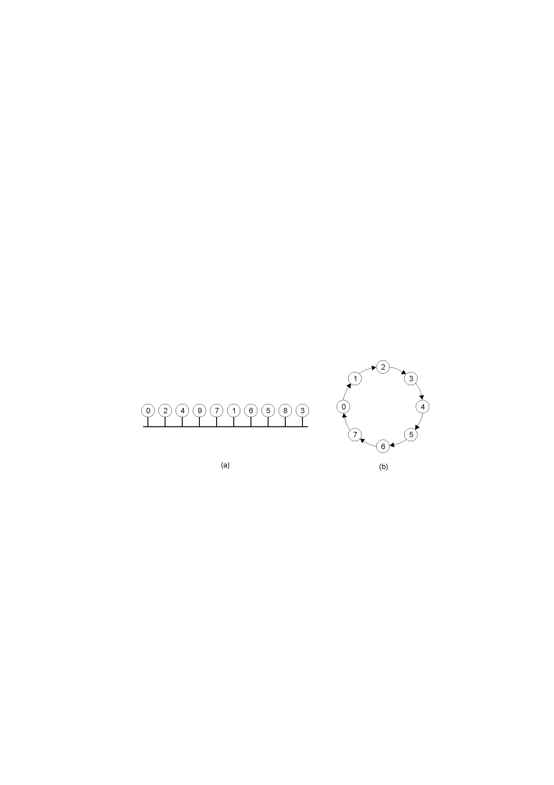
Mutual Exclusion
Token-passing approach
An unordered group of processes on a network.
A logical ring constructed in software

Slide 46
Mutual Exclusion
In Token-passing approach, following failures need to be handled
Process failure. Causes logical ring to break
Detection of the failed process and dynamic reconfiguration of the logical ring
Using acknowledgements – After receiving the token every process need to send and acknowledgement to its predecessor in the logical ring
Lost token. If the token is lost, a new token must be generated
One( or more) process in the ring monitors the token by periodically circulating the message “who has the token?” on the ring

Slide 47
Deadlock
Sequence of events required to use a resource by a process is
Request
Allocate
Release
The request and release of resources are system calls, such as request and release for devices, open and close files
Allocate and free for memory space
Allocate is the only operation that system can control
Other two are initiated by process
Deadlock is the state of permanent blocking of a set of processes each of which is waiting for an event that only another process in the set can cause.

Slide 48
Deadlock (Contd…)
Necessary conditions for deadlock
Mutual exclusion condition
Hold and wait condition
No-preemption condition
Circular-wait condition
All 4 conditions must hold simultaneously in a system for a deadlock to occur

Slide 49
Deadlock (Contd…)
Deadlock modeling
Modeled using directed graphs ( called as resource allocation graph)
Necessary and sufficient conditions for deadlock
In a resource allocation graph, a cycle is a necessary condition for a deadlock to exist
The sufficient condition for a deadlock are
a cycle in the graph is both necessary and a sufficient condition for deadlock

Slide 50
Deadlock (Contd…)
Necessary and sufficient conditions for deadlock (Contd…)
A cycle in the graph is a necessary but not a sufficient condition for deadlock if one or more of the resource types requested by the process forming the cycle have more than one unit.
A knot is sufficient condition for deadlock
P1
P1
R2
R1
R3
R2
R1
R3
P2
P2
P3
Fig: a cycle representing a deadlock
Fig: a knot representing a deadlock

Slide 51
Deadlock (Contd…)
Wait for graph
Simplified form of resource allocation graph
Obtained by removing the resource nodes and collapsing the appropriate edges
It clearly shows which processes are waiting for which processes
Cycle is both necessary and sufficient condition for deadlock in a WFG
Since WFG is constructed only when each resource type has only a single unit

Slide 52
Deadlock (Contd…)
Wait for graph (Contd…)
Conversion from a resource allocation graph to a WFG
P1
P1
R2
R1
Simplified to
P3
P2
P3
P2
Fig a: resource allocation graph
Fig b: corresponding WFG

Slide 53
Deadlock
Handling deadlocks in distributed systems
Deadlocks in DS are similar to deadlocks in centralized systems
Handling of deadlocks in DS is more complex than in CS
Because of resources, processes, and other relevant information scattered on different nodes of the system
3 strategies to handle deadlocks are:
Avoidance
Prevention
Detection and recovery

Slide 54
Deadlock
Deadlock avoidance
Uses advance knowledge of the resource usage of processes to predict the future state of the system for avoiding allocation that can lead to deadlock
Deadlock prevention
Designing the system in such a way that deadlocks become impossible
Differs from avoidance and detection in that no runtime testing of potential allocations need be performed

Slide 55
Deadlock
Three deadlock prevention methods are
Collective requests
Denies hold-and-wait condition by ensuring that whenever a process requests a resource, it does not hold any other resources
Ordered requests
Denies circular-wait condition
Preemption
Denies no-preemption condition

Slide 56
Deadlock
Deadlock detection
System does not make any attempt to prevent deadlocks and allows processes to request resources and wait for each other in an uncontrolled manner
Uses an algorithm that keeps examining the state of system to determine whether deadlock has occurred
The deadlock detection algorithms get simplified to maintaining WFG and searching for cycles in the WFG

Slide 57
Deadlock
Steps to construct the WFG for a DS:
Construct a separate WFG for each site in the system
Convert the resource allocation graph constructed in step1 to corresponding WFG
Take the union of WFGs of all sites and construct a single global WFG
Example : P1 is holding R1 and requesting for R3
P2 is holding R2 and requesting for R1
P3 is holding R3 and requesting for R2

Slide 58
Deadlock
P1
P3
P1
P3
R1
R2
P1
P3
P1
P3
P2
R3
P2
Site S2
Site S1
Site S1
Site S2
Resource allocation graphs of each site
WFG of each site
P1
P3
P2
global WFC by taking the union of the two local WFGs

Slide 59
Deadlock
3 techniques used for organizing the WFG in DS are
Centralized
Hierarchical
Distributed
Correctness of deadlock detection algorithm depends on
Progress property : Deadlock must be detected in a finite amount of time
Safety property : If deadlock is detected, it must indeed exist. Message delays and out-of-date WFGs sometimes cause false cycles to be detected

Slide 60
Deadlock
Centralized approach for deadlock detection
There is a local coordinator at each site that maintains a WFG for its local resources
There is a central coordinator (called as a centralized deadlock detector) responsible for constructing the union of all the individual WFGs
Deadlock detection is performed as:
If a cycle exists in the local WFG of any site, it represents a local deadlock
Deadlocks involving resources at 2 or more sites get reflected as cycles in the global WFG

Slide 61
Deadlock
Methods used to transfer information from local coordinators to central coordinator:
Continuous transfer
Periodic transfer
Transfer-on-request
Centralized approach simple but suffers from drawbacks
Vulnerable to failures of central coordinator
Performance bottleneck in large systems
Centralized coordinator may detect fault deadlocks

Slide 62
Deadlock
Hierarchical approach for deadlock detection
Uses a logical hierarchy (tree) of deadlock detectors
Deadlock detectors are called as controllers
Controller is responsible for detecting only those deadlocks that involve the sites falling within its range in the hierarchy
Global WFG is distributed over a number of different controllers

Slide 63
Deadlock
In the tree representing the hierarchy of controllers, the WFG to be maintained by a particular controller is decided according to the following rules
Each controller that forms a leaf of the hierarchy tree maintains the local WFG of a single site
Each nonleaf controller maintains a WFG that is the union of the WFGs of its immediate children in the hierarchy tree
The lowest level controller that finds a cycle in its WFG detects a deadlock and takes necessary action to resolve it
WFG that contains a cycle will never be passed as it is to a higher level controller

Slide 64
Deadlock
P1
P3
P4
P5
P2
P7
P6
Controller G
P1
P3
P4
P5
P5
P6
P7
P2
P7
Controller E
Controller F
P1
P3
P1
R3
P3
P4
R4
P5
P5
R3
P6
P6
R7
P7
R1
R2
P2
R5
P7
site S₁
Controller A
site S₂
Controller B
site S₃
Controller C
site S₄
Coordinator D

Slide 65
Deadlock
Fully distributed approaches for deadlock detection
Each site of the system shares equal responsibility for deadlock detection
2 algorithms
WFG based distributed deadlock detection algorithm
Probe based distributed deadlock detection algorithm

Slide 66
Deadlock
WFG-based distributed algorithm for deadlock detection
Each site maintains its own local WFG
To model waiting situations that involve external processes, a slightly modified form of WFG is used
In this modified form, an extra node P_{ex} is added to local WFG of each site
This node is connected to WFG of corresponding site :
An edge (P_{i}, P_{ex}) is added if process P_{i} is waiting for a resource in another site being held by any process
An edge (P_{ex}, P_{j}) is added if P_{j} is a process of another site that is waiting for a resource currently being held by a process of this site

Slide 67
Deadlock
P1
P3
P1
P3
P5
P4
P2
Site S1
Site S2
Pex
Pex
P1
P3
P1
P3
P5
P4
P2
Site S1
Site S2
Pex
Updated local WFG of S2 after receiving the deadlock detection message from S1
P1
P3
P5
P2

Slide 68
Deadlock
Probe-based distributed algorithm for deadlock detection
Also known as CMH(Chandy-Misra-Hass) algorithm
Best algorithm for detecting global deadlocks in DS
Allows a process to request for multiple resources at a time
when a process that request for a resource(s) fails to get the requested resource(s) and times out, it generates a special probe message and sends it to process(ess) holding the requested resource(s)
Probe message contains:
Identifier of process just blocked
Identifier of process sending this message
Identifier of the process to whom this message is sent

Slide 69
Deadlock
On receiving probe message
Recipient checks to see if itself is waiting for any resource(s), if not (that means the recipient is using resource requested by the process that sent the probe message) recipient ignores the probe message
If the recepient is waiting for any resource(s), it passes the probe message to the process holding the resource for which it is waiting
Before probe is forwarded, the recipient modifies its fields as
First filed is left unchanged
Second field is changed to its own process identifier
Third field is change to identifier of the process that will be new recipient of this message

Slide 70
Deadlock
Every new recipient of the probe message repeats this procedure
If the probe message returns back to the original sender (First field), a cycle exists and the system is deadlocked
Advantages of CMH algorithm
Easy to implement
Overhead is fairly low
No graph construction and information collecting involved
False deadlocks are not detected
Does not require any particular structure among processes

Slide 71
Deadlock
Example of CMH(Chandy-Misra-Hass) algorithm
Process P1 gets blocked when it requests for the resources held by P3
P1 generates probe message (P1,P1,P3) and sends it to P3
P3 receives the message and discovers that it is itself blocked on processes P2 and P5
P3 forwards the probe messages (P1,P3, P2) and (P1,P3, P5) to P2 and P5 respectively
P5 discards it and P2 sends (P1, P2, P1) to P1
The probe returns to the original sender P1, a cycle exists and the system is deadlocked

Slide 72
Deadlock
CMH(Chandy-Misra-Hass) algorithm
P1
(P1,P1,P3)
P3
(P1,P1,P3)
(P1,P1,P3)
(P1,P1,P3)
P4
P2
P5
Site S1
Site S2

Slide 73
Deadlock
Ways for recovery from deadlock
It is not sufficient to simply detect deadlocks. The system must also have some way to recover from a detected deadlock
Ways to recover from deadlock
Asking for operator intervention
Termination of process(es)
Rollback of process(es)

Slide 74
Deadlock
Issues in recovery from deadlock
2 important issues in the recovery action are
Selection of victim(s)
Major factors
Minimization of recovery cost
Prevention of starvation
Use of transaction mechanisms

Slide 75
Election algorithms
EAs are meant for electing a coordinator from among the currently running processes in such a manner that at any instance of time there is a single coordinator for all processes in the system
EAs are based on following assumptions
Each process in the system has a unique priority number
Whenever an election is held, the process having highest priority number is elected as the coordinator
On recovery, a failed process can take appropriate actions to rejoin the set of active processes

Slide 76
Election algorithms
The bully algorithm
Every process knows the priority number of every other process in the system
When a process P_{i} sends REQUEST message to coordinator and does not get reply within fixed time-out interval T, it assumes that coordinator has failed and P_{i} tries to elect itself as the new coordinator
P_{i} initiates the Election by sending an ELECTION message to all other processes with priority number higher than itself, P_{i} then waits for any of these processes to answer within fixed time-out interval T

Slide 77
Election algorithms
If P_{i} does not receive any reply to its ELECTION message within fixed time out period T, it assumes that all processes with priority numbers greater than the priority of itself (P_{i} ) have failed
P_{i} elects itself as the new coordinator and sends COORDINATOR message to all active processes having lower priority numbers than itself informing that from now on it is the new coordinator
If P_{i} receives a reply for its ELECTION message, P_{i} waits for the COORDINATOR message from the New coordinator
When a process recovers from crash, it initiates Election process

Slide 78
Election algorithms
If P_{i} is not the coordinator, then, at any time during execution, P_{i} may receive one of the following two messages from process P_{j}.
P_{j} is the new coordinator (j > i). P_{i}, in turn, records this information.
P_{j} started an election (j < i). P_{i} sends a response to P_{j} and begins its own election, provided that P_{i} has not already initiated such an election
If there are no active processes with higher numbers, the recovered process forces all processes with lower number to let it become the coordinator process, even if there is a currently active coordinator with a lower number

Slide 79
Bully algorithm
Message
C
P₁ sends a message to the coordinator
P₁
P₂
P₃
P₄
P₁ does not receive any reply from the coordinator till time T, so starts Election
ELECTION
C
P₁
ELECTION
P₂
P₃
P₄
Answer
P₂ and P₃ replies and starts Election
Answer
ELECTION
ELECTION
ELECTION
P₃ replies, but after the reply it crashes
P₁
P₂
P₃
P₄
Answer
P2 waits till T and restarts election
P₁
P₂
P₃
P₄
Eventually.....
COORDINATOR
P2 becomes the coordinator
C
P₁
P₂
P₃
P₄

Slide 80
Election algorithms
Ring algorithm
Applicable to systems organized as a ring (logically)
Assumes that the links are unidirectional, and processes send their messages to their right neighbor (clockwise) or left neighbor (anticlockwise)
Every process in the system knows the structure of the ring
If process P_{i} detects the coordinator failure, It initiates the election by sending an election message containing the priority number of P_{i} to its successor that is currently active
The successor appends its own priority number to the message and passes it to its active successor
Election message circulates over the ring and returns back to P_{i}

Slide 81
Election algorithms
P_{i} elects the process having the highest priority number as the new coordinator and circulates a coordinator message over the ring to inform all the other active processes about the new coordinator
When process P_{j} recovers from the failure it sends an enquiry message over the ring to know the current coordinator
Current coordinator sends the reply to P_{j}

Slide 82
A ring-based election in progress
3
17
17
4
24
9
17,24
1
15
28
17,24,1
17,24,1,28
Ring algorithm is more efficient and easier to implement

Slide 83
End of the chapter

