Slide 1

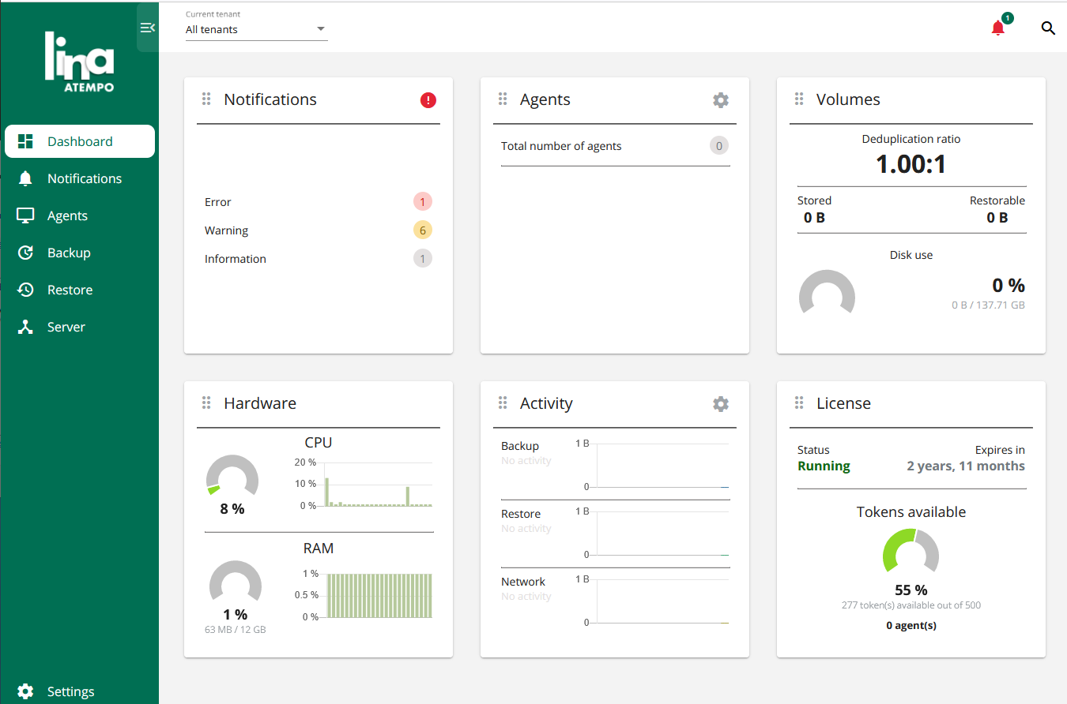



Multi-Server
Architecture
Agents to back up
Master Server
Single entry point to configure, administer, and monitor backups
Dispatch agents in tenants and nodes
Dataless
Data Transfer
Administration, Configuration, Monitoring
Nodes
Host the backup repository of the agents assigned to them

