Slide 1
Introduction to computer modeling
Jarosław Perkowski

Slide 2
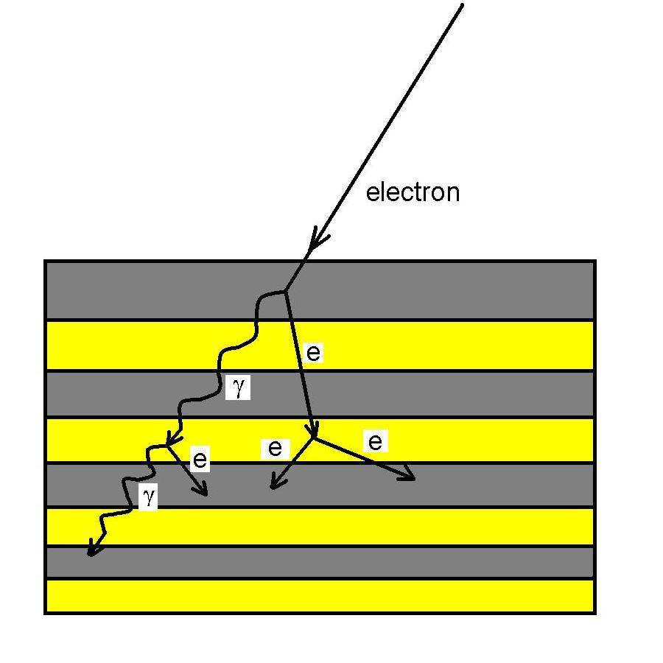
Stochastic methods
Monte Carlo method of simulation could be used for description of the cosmic bunches rays crated by electrons protons …

Slide 3
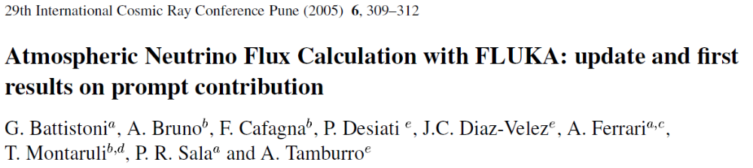
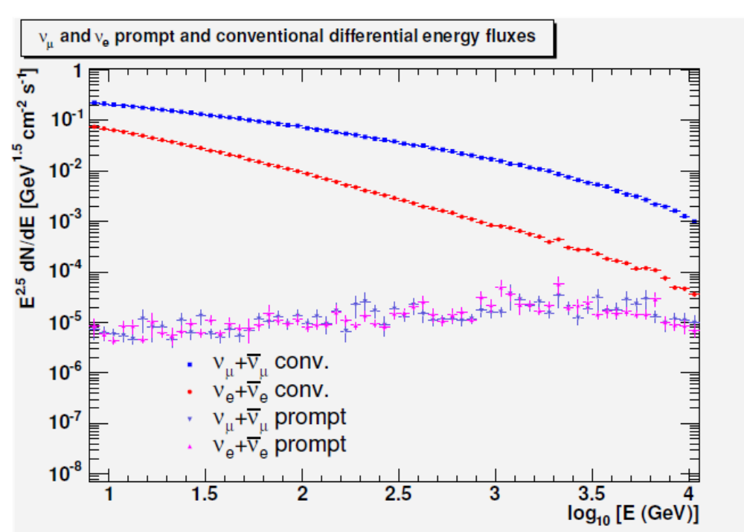
Stochastic methods

Slide 4
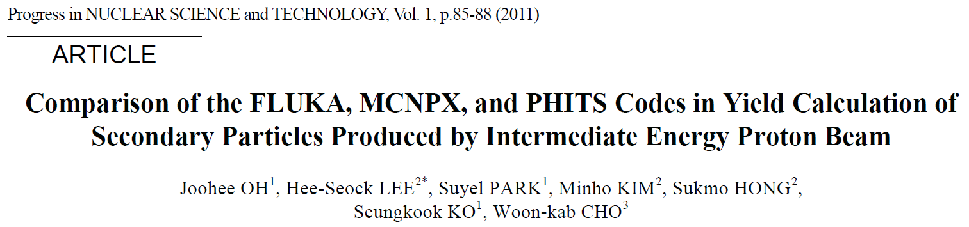
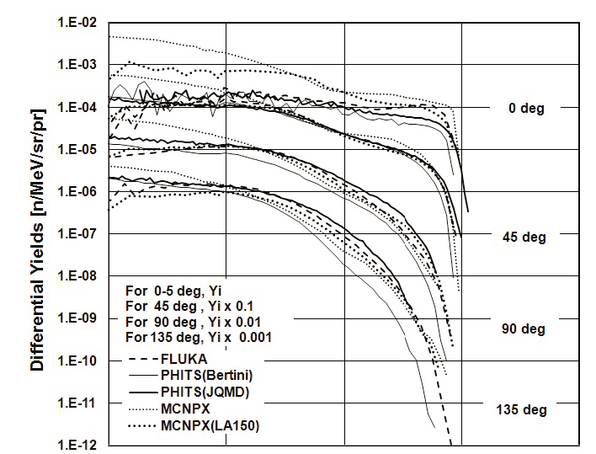
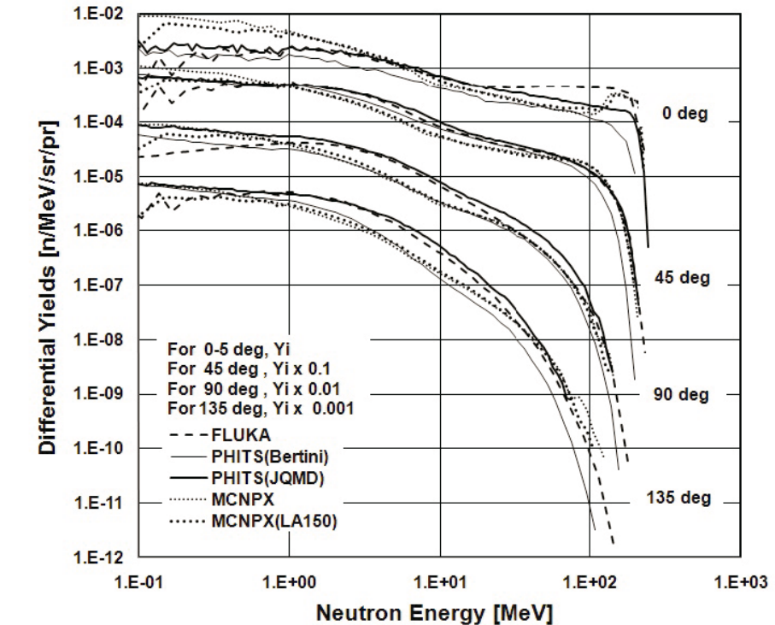
Stochastic methods

Slide 5
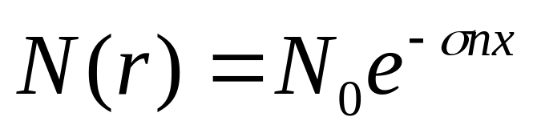
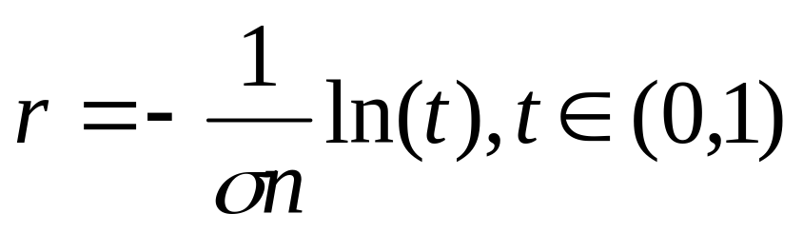
Stochastic methods
Let’s assume that we have a point monoenergetic neutron source at the centre of a ball with a given material and radius. Our goal is to determine the energy neutrons spectra outside this sphere. We take into account only the elastic interaction of neutron with the nuclei in the ball. The probability of any interaction is given by the formula:
As a result, the distance after a neutron will be scatter elastically could be determined from:

Slide 6
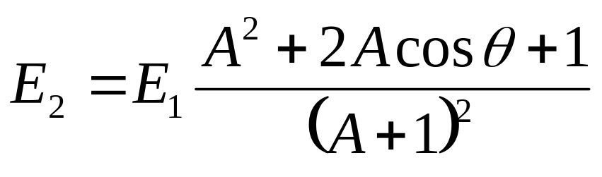
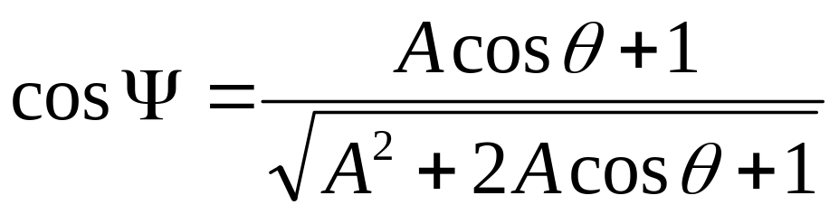
Stochastic methods
The energy of neutron after elastic scattering will be given by:
Where A is a mass of nucleus which scatter neutrons, and the angle θ in a centre of mass should be in range from 0 to 2π. The relationship between this angle and the angle in the laboratory coordinates (Ψ) is given as follows:

Slide 7
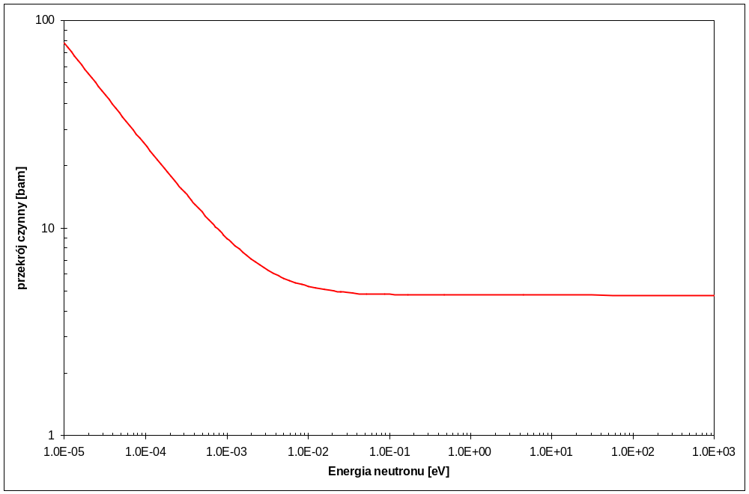
Stochastic methods

Slide 8
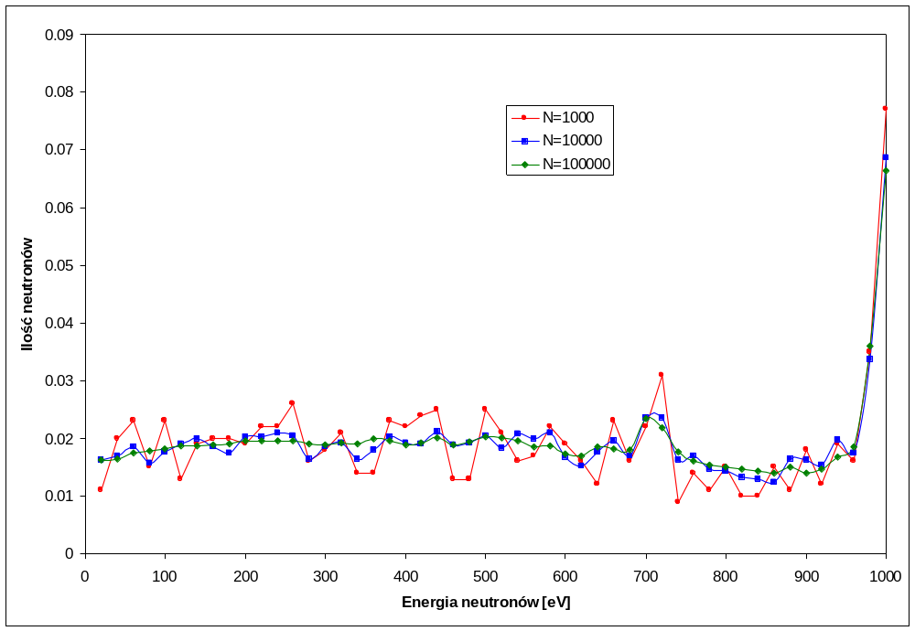
Stochastic methods

Slide 9
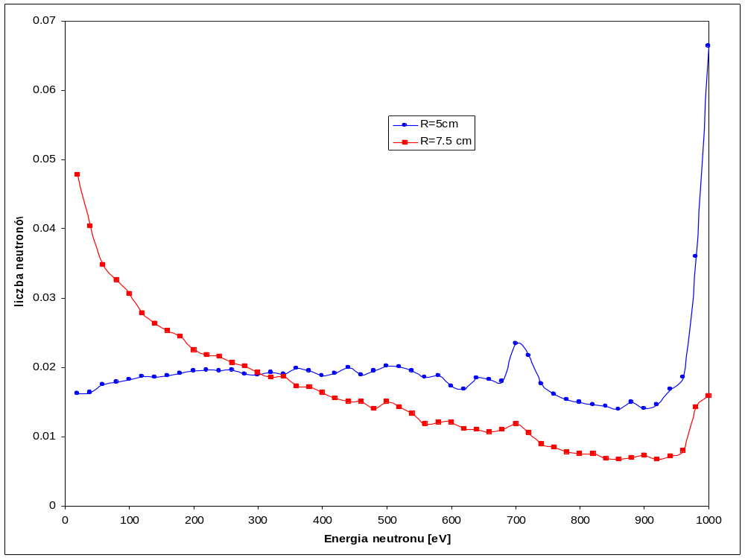
Metody stochastyczne

Slide 10
Stochastic methods
Monte Carlo simulation
This method allows to determine the value of the interesting observable only after reaching equilibrium.
Advantages:
Opportunity to resolve difficult problems,
The increasing computing power,
Simpler theoretical expressions used in the calculation,
Statistics allows us to bypass the problems with the theoretical description of the set-up,
Disadvantages:
The results are dependent on the number of samples,
The results are always an approximation,
The credibility of the results depends on the quality random number generator.

