Slide 1
Introduction to computer modeling
Jarosław Perkowski

Slide 2

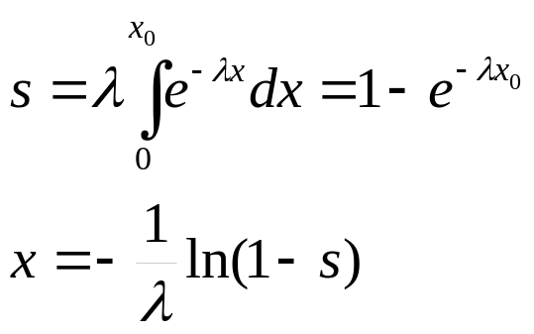
Stochastic methods
Generators of random numbers
The uniform distribution (flat) – generators are provided by compilers.
The exponential distribution:
All exponential distribution can be transformed to following general equation:
If „s” variable belongs to uniform distribution from range [0,1], then:
So, „x” variable belongs to exponential distribution.

Slide 3
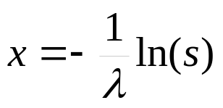
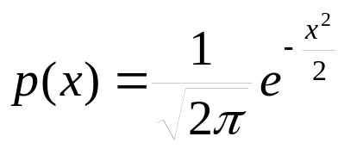
Stochastic methods
Because variable 1-s belongs also to uniform distribution, so previous equation could be transformed to:
This method is called: invers transform method.
3) Normal distribution
Lets assume that standard deviation (σ) is 1 and according this assumption we get:
From the uniform distribution could be get f(φ)=1 for φ ∈ [0,2π] and from exponential distribution p(t)=exp(-t) for t ∈ [0,∞ ]. Based on these two functions could be received two normal distribution of variable „x” and „y”.

Slide 4
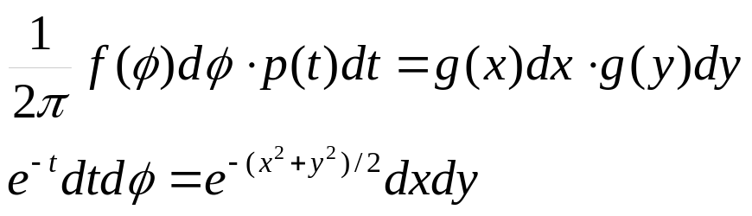

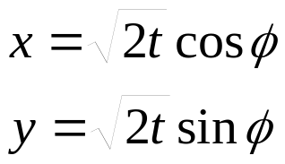
Stochastic methods
Product of these uniform and exponential distributions could be connect to product of two normal distribution by the following equations:
This equation could be understand as equation of transform polar coordinates (ρ,φ) to Cartesian coordinate (x,y):
The x and y variable are from the normal distribution.
b) The different approach: the variable from the normal distribution could be received by adding together required numbers (>12) from the uniform distribution.

Slide 5
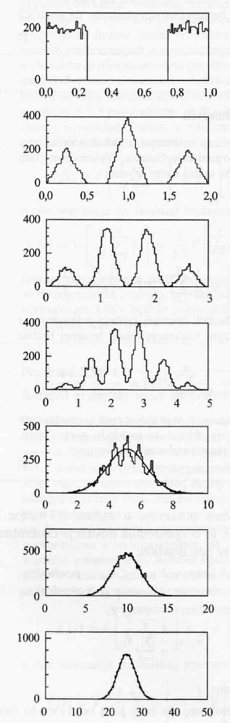
Stochastic methods
Histogram consist of 10 000 random numbers from uniform distribution. The first picture represents the initial histogram. The next ones are created by summing of 2, 3, 5, 10, 20 and 50 these numbers.

Slide 6
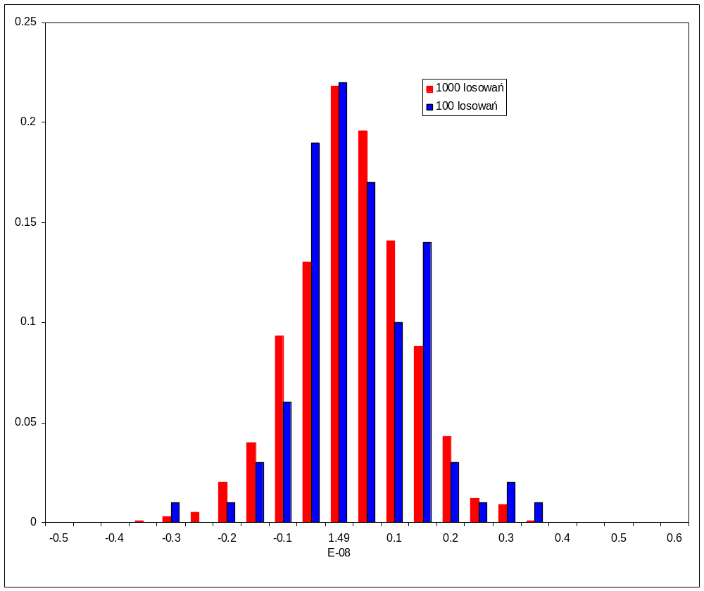
Stochastic methods

Slide 7
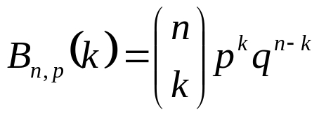
Stochastic methods
The algorithm received a random variable from the binomial distribution characterize by parameters p and n.
The procedure is valid for p< ½, if is not true the variable p and q=1-p could be replaced each other.
We start from k=0, A=0,
We calculate B=q^{n} and add to A value (calculation of value of the binomial distribution for k=0),
Generate random number „x” from uniform distribution,
if x < A, we end procedure by assuming k as random number from the binomial distribution,
If is not true, k should be increased by 1, and we come back to point 2,
If we not succeed until k = n we accept „n” as number from the binomial distribution.

Slide 8
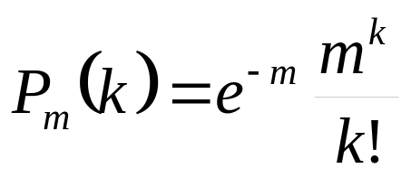
Stochastic methods
The algorithm received a random variable k from the Poisson distribution characterize by parameter m.
We start from k=0 and A=1,
We generate random number x and replaced A by product Ax,
If A < exp(-m), we end procedure taking k as a number from the Poisson distribution,
If this condition isn’t fulfilled we increased k by one and come back to point 2.

Slide 9
Stochastic methods
The invers transform method could be used only in situations where inversion of analytic function could procced. In more complicated situations, the acceptance-rejection method could be used. In this method, when we assume that the probability distribution is described by f(x) and it is limited from the top by some value „c”, and set of arguments are between values „a” and „b”, is following:
We get to two random numbers (x and y) from uniform distribution from range
x⊂[0,c] and y⊂[a,b],
If y<f(x) we assume that „x” is from required distribution.
This method could be also used to calculate integrals.

Slide 10
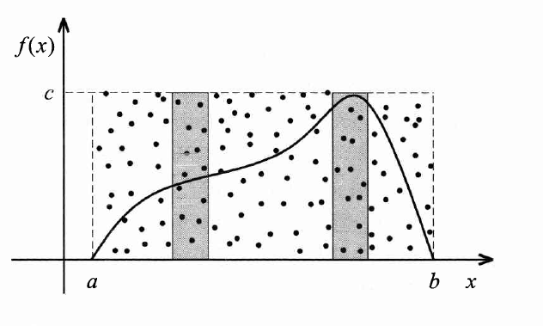
Stochastic methods

Slide 11
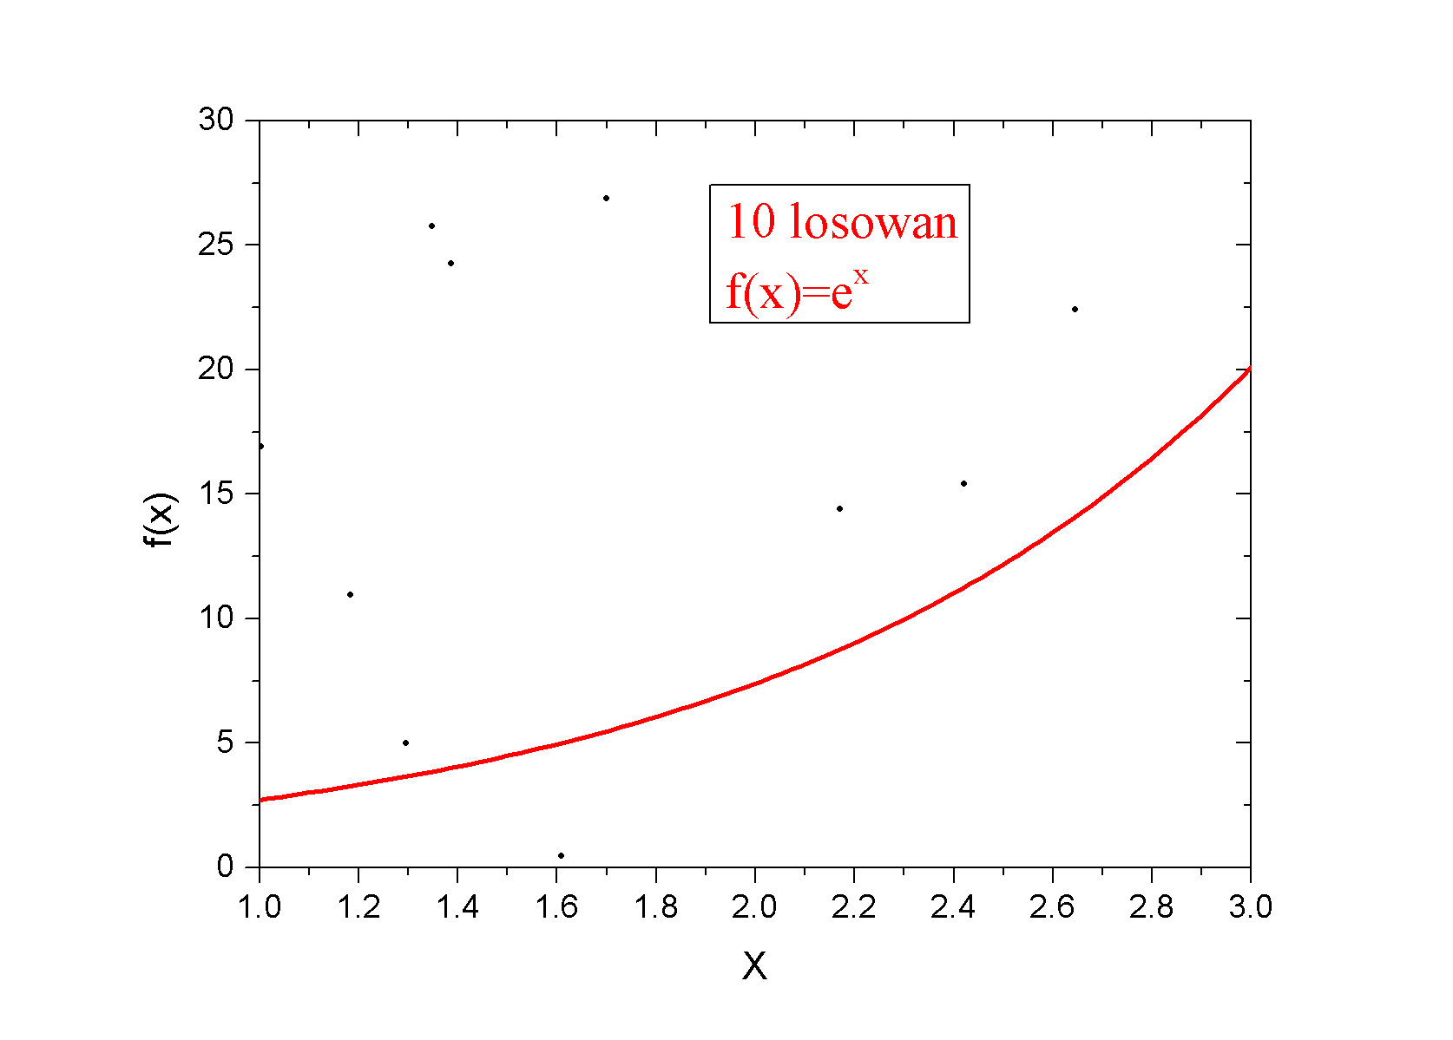
Stochastic methods

Slide 12
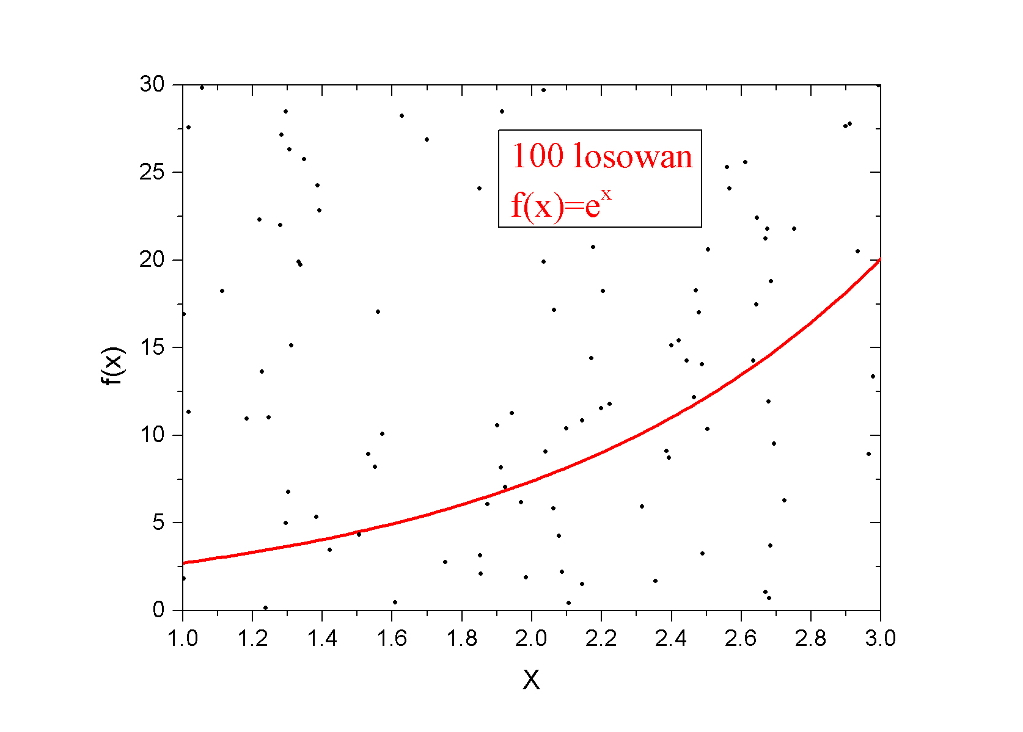
Stochastic methods

Slide 13
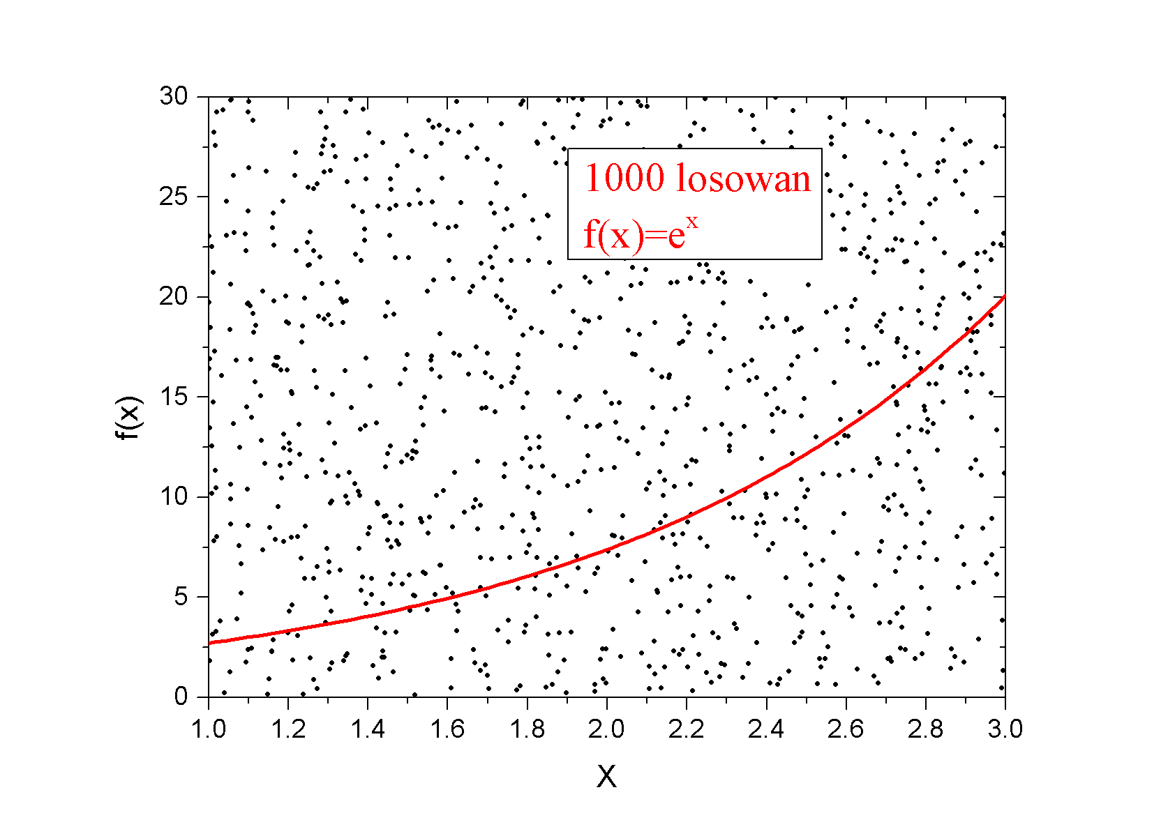
Stochastic methods

Slide 14
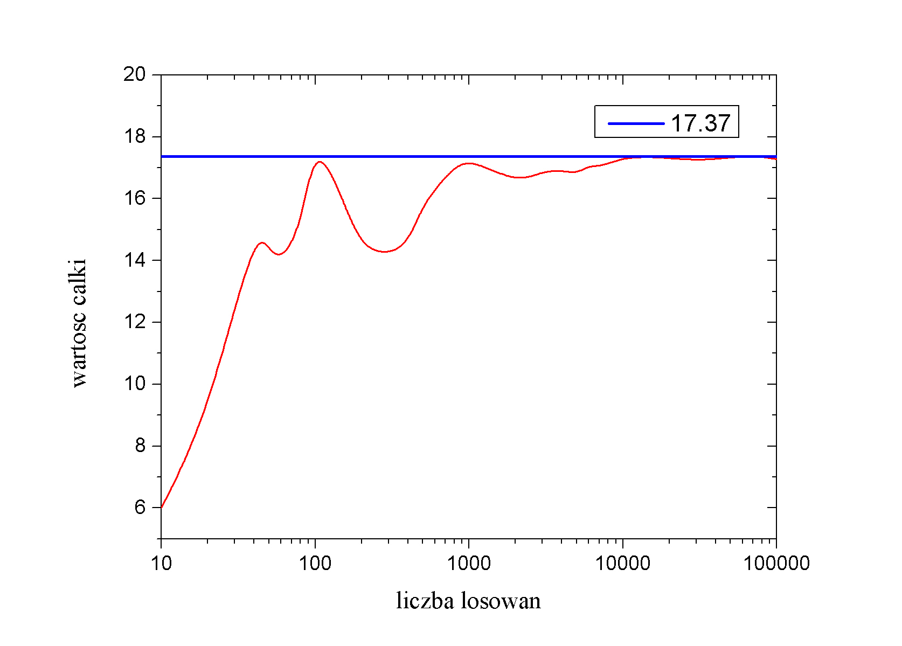
Stochastic methods

