Slide 1
ISE OPRA Holdback Timer
Functional Description v2.1.0.0
March 3, 2009

Slide 2
Overview
The OPRA Holdback Timer reduces the excessive amount of traffic received by the OMX feed handlers via timed delayed sampling techniques.
Utilizes proven and existing ISE OPRA Data Server infrastructure.
Smoothes out surges and spikes in the Quote traffic caused by opening quotes and news disseminations.
Provide significant cost savings.

Slide 3
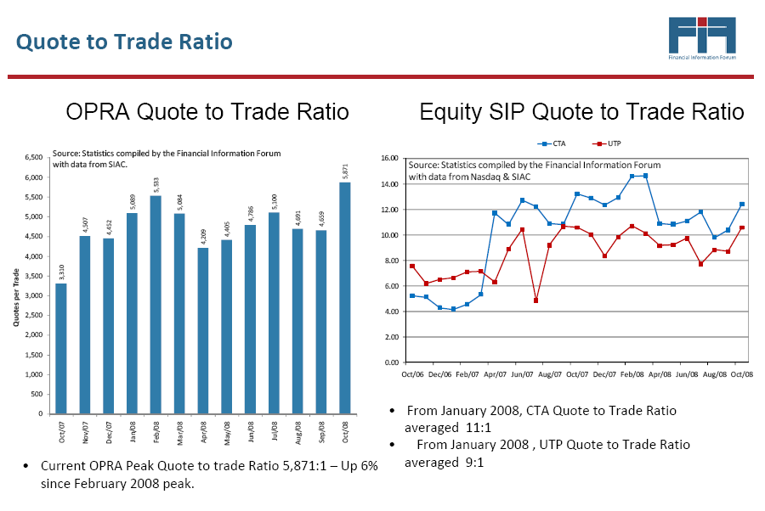
OPRA Traffic

Slide 4
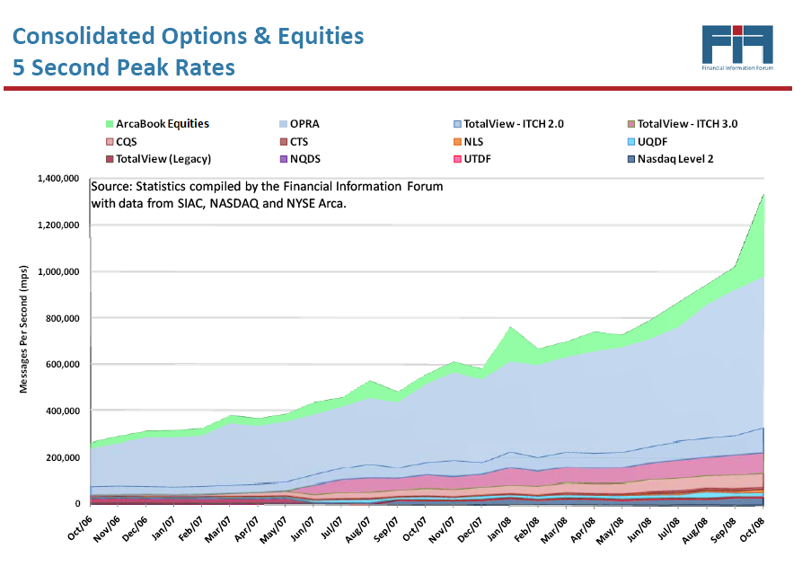
OPRA Message Rates

Slide 5
Messages
Quotes – variable holdback times based upon premium price
Trades – no holdback; triggers transmission of held back quotes
Open Interest – no holdback
Underlying Value Bid and Offer – no holdback
Underlying Value Last Sale – no holdback
Control – no holdback; filters out Reset Sequence Number

Slide 6
Supported Filter Modes
Orderbook Based – uses prod_underlying and series csv files to create filters and ODS underlying subscriptions. Orderbook based filters will provide for the optimum ability to scale horizontally.
OPRA Line Based – uses OPRAProductionLines_OSI, OCC_SecurityMaster, prod_underlying and series files to create filters and ODS underlying subscriptions. OPRA line based filters are a stop gap measure to be able to use the OHT with the current OM deployment.
Both modes of operation filter out incoming ISE traffic.

Slide 7
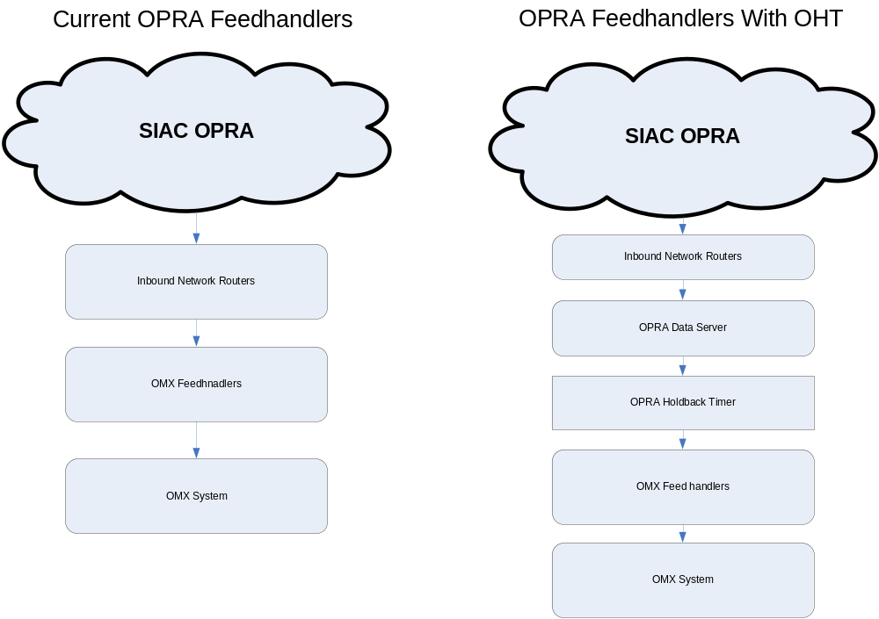
OHT Network Diagram

Slide 8
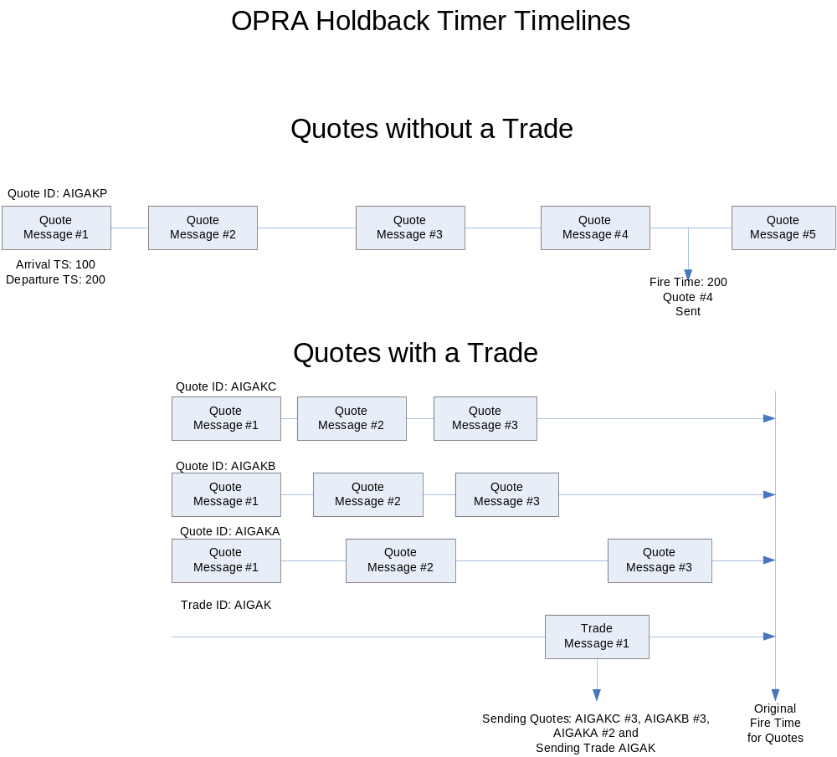
Holdback Timelines

Slide 9
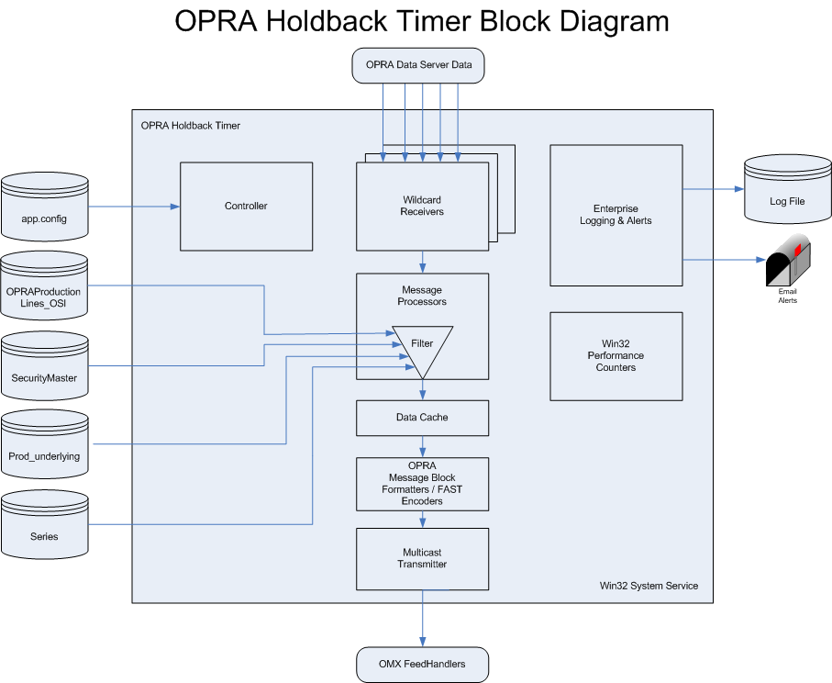
Block Diagram

Slide 10
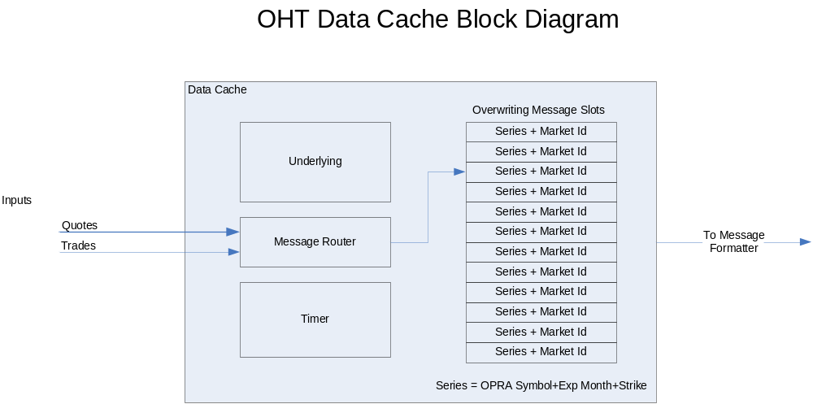
OHT Data Cache

Slide 11
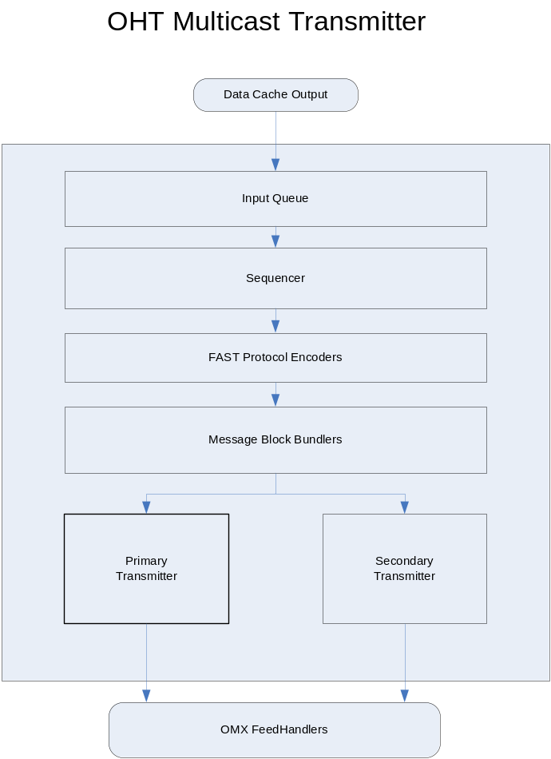
OHT Multicast Transmitter

Slide 12
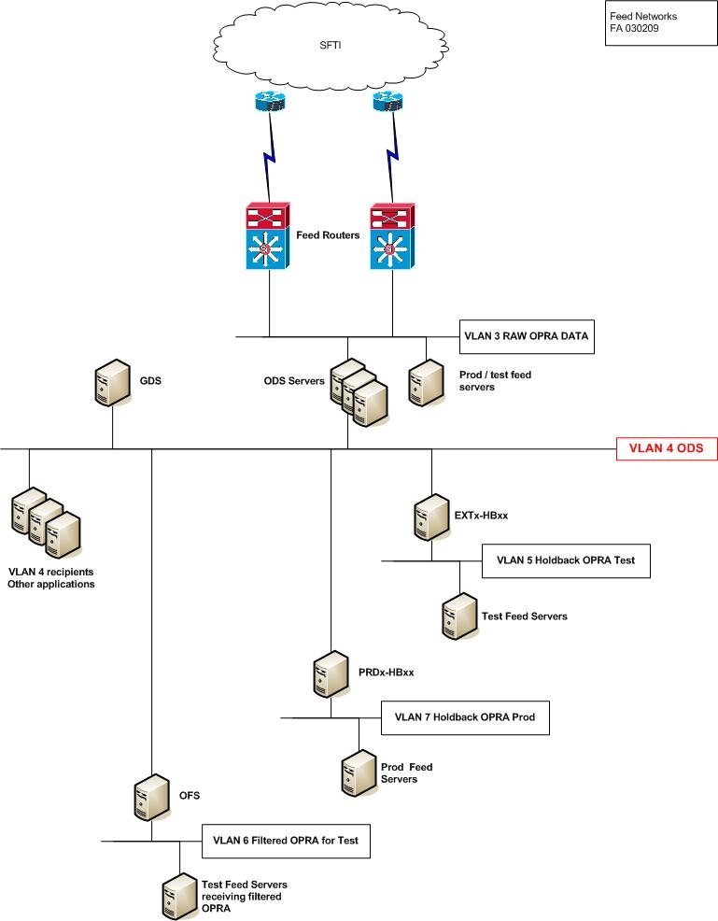
Network Implementation

