Slide 1

Tour Planner
plan tours, log them, see them on the map
Matej Krsteski · Iselin Magnussen
Angular + Spring Boot + PostgreSQL
github.com/iselinmag/SoftwareEngineering-TourPlanner
Notes:
Introduce yourselves. One sentence: Tour Planner lets a user plan bike, hike, running or vacation tours, see them on a real map, and keep logs of the tours they actually did. Two-tier app: Angular frontend, Spring Boot backend, PostgreSQL database.

Slide 2






What the app does
all features are live in the demo
Accounts and ownership
register, log in, everyone sees all tours, only the creator can edit or delete
Tours with real routes
distance, time and route come live from OpenRouteService
Map display
the route is drawn with Leaflet on OpenStreetMap
Tour logs + computed values + images
logs with rating and difficulty feed popularity and child friendliness
Full-text search
one search box covers tours, locations and log comments
Import and export
tours travel as a JSON file, plus an image gallery per tour
Notes:
Walk through the six feature groups quickly, do not demo yet. Mention the ownership model was confirmed with the professor: everyone can view and log, only the owner edits or deletes.

Slide 3

Live demo
register + login create a tour, watch the route appear on the map
add tour logs computed badges update upload a photo, flip the gallery
search across everything export to JSON and import it back
app is already running on this machine
Notes:
Demo order: 1) register a fresh user and log in. 2) create a tour Vienna to Graz, point at the distance and time arriving from OpenRouteService and the route drawn by Leaflet. 3) open details, add a log, show popularity and child friendliness updating. 4) upload an image, flip through the gallery. 5) search for a word that only exists in a log comment. 6) export, then import. 7) log in as a second user to show edit and delete are hidden and blocked on foreign tours.

Slide 4
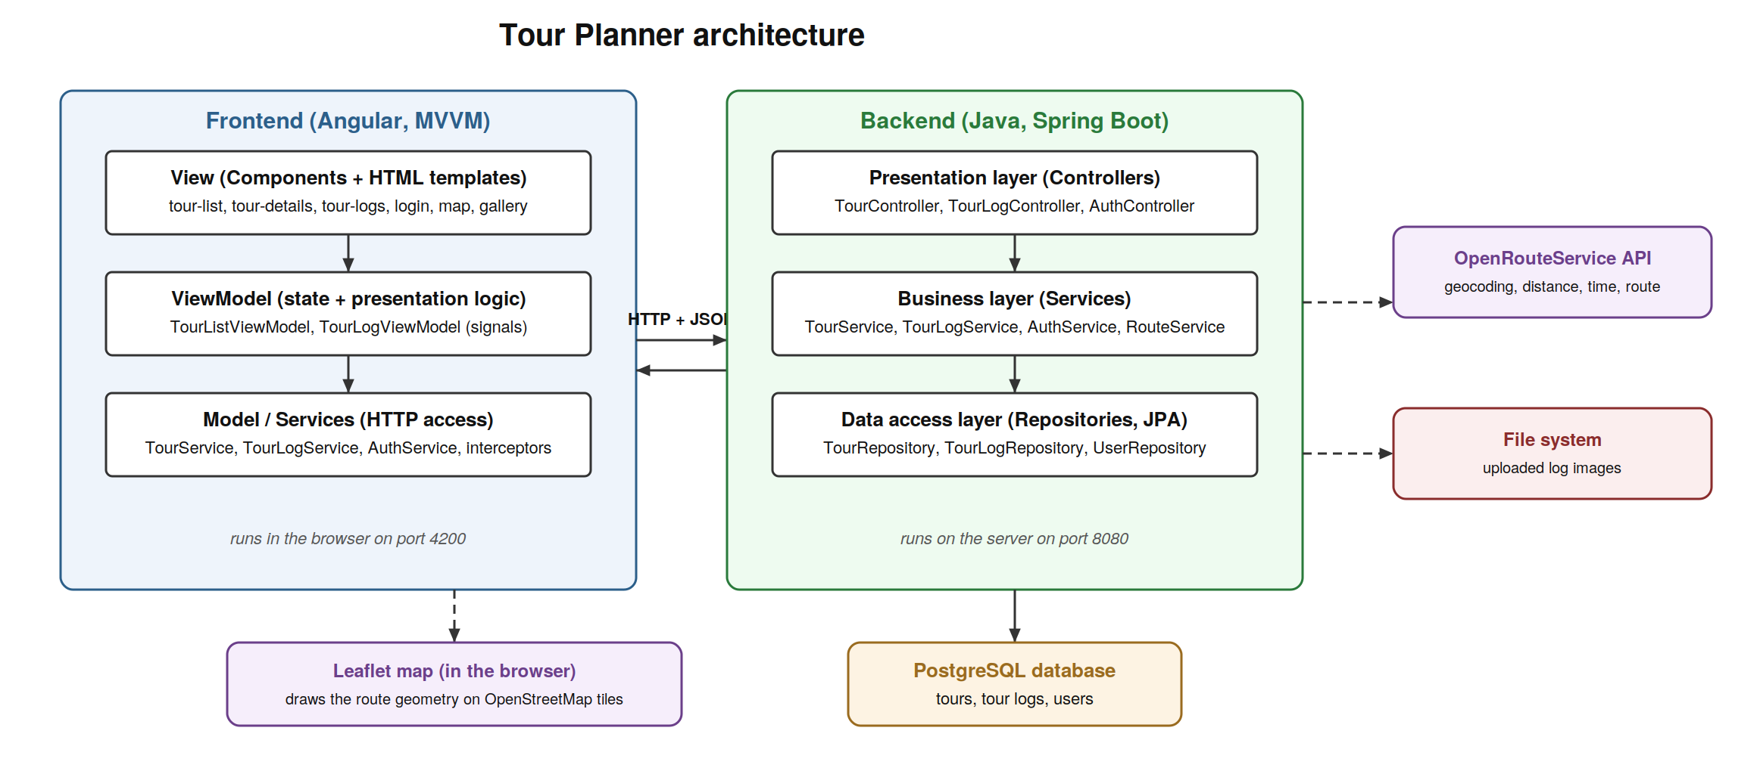
Architecture
two tiers, three layers on each side, one job per layer
each layer only talks to the layer directly below it
Notes:
Frontend follows MVVM: the view shows things, the viewmodel holds screen state in signals, the model services do the HTTP. Backend has controllers (receive requests), services (all the logic and ownership checks), repositories (only classes touching the database through JPA). Config lives outside the code, images live on the file system, everything else in PostgreSQL.

Slide 5
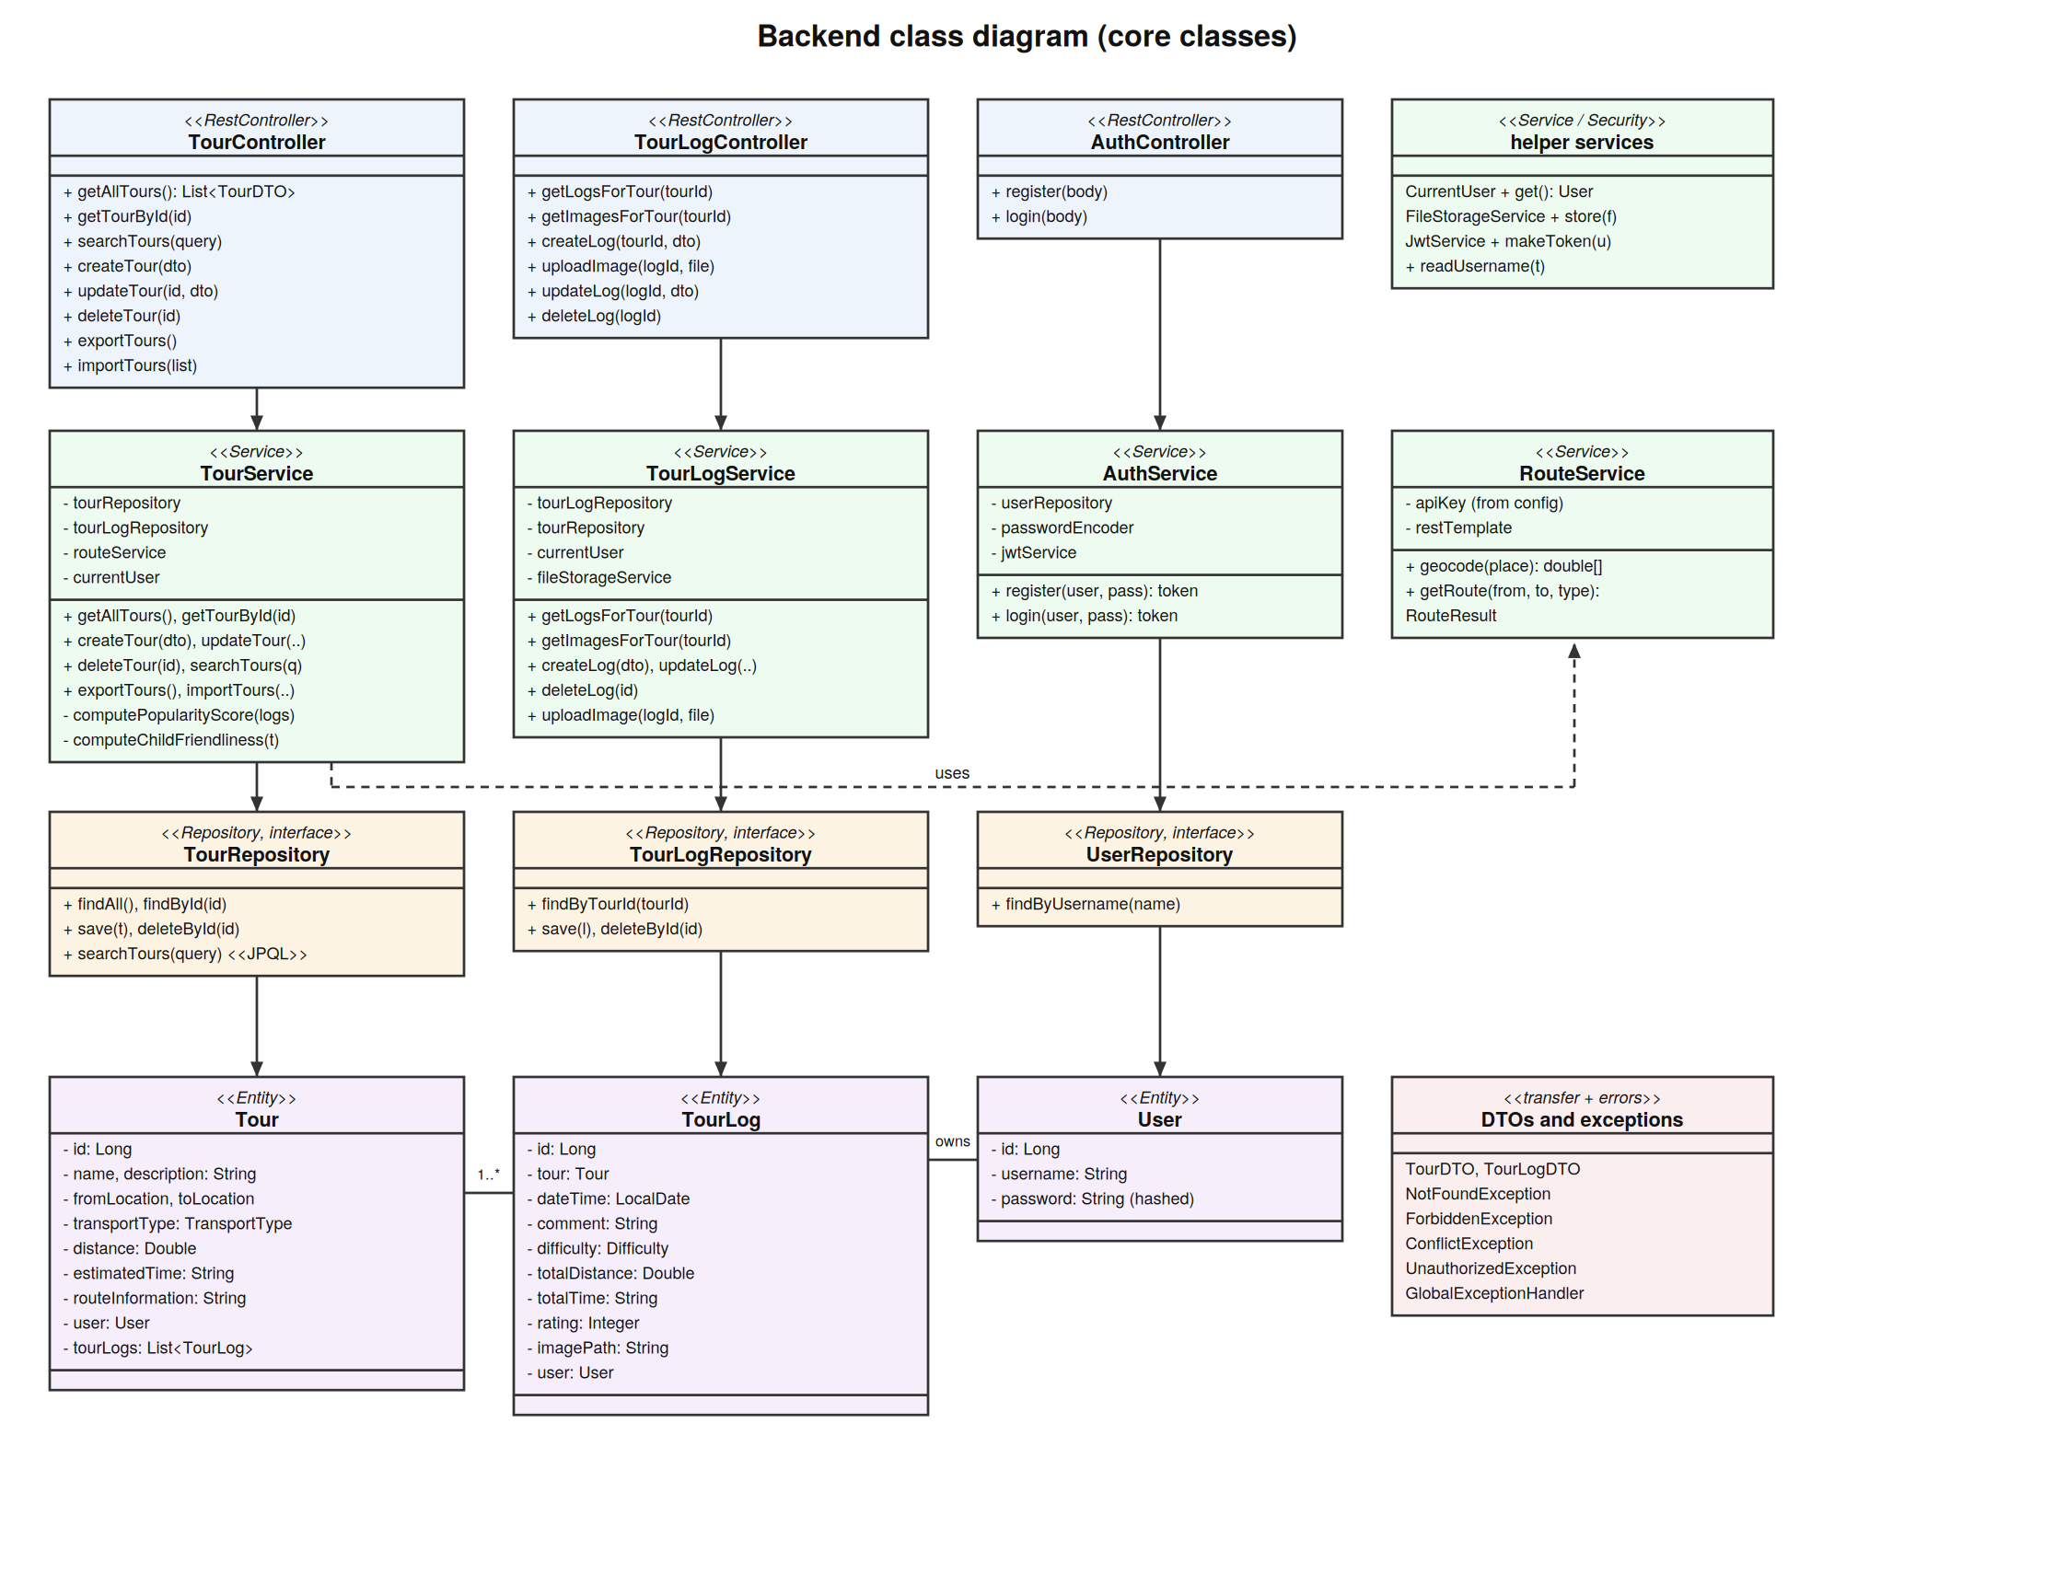




Backend up close
the class diagram mirrors the layer rule
controllers stay thin
they validate input and forward, no logic inside
services hold the rules
ownership checks, computed values, route calls
repositories are interfaces
Spring generates the queries, JPQL only, so no SQL injection
DTOs at the border
entities never leave the backend, JSON shapes do
Notes:
Point at the arrows: controller to service to repository to entity, never skipping a layer. Errors have their own classes per layer: NotFound gives 404, Forbidden 403, Conflict 409, Unauthorized 401, translated in one global handler.

Slide 6
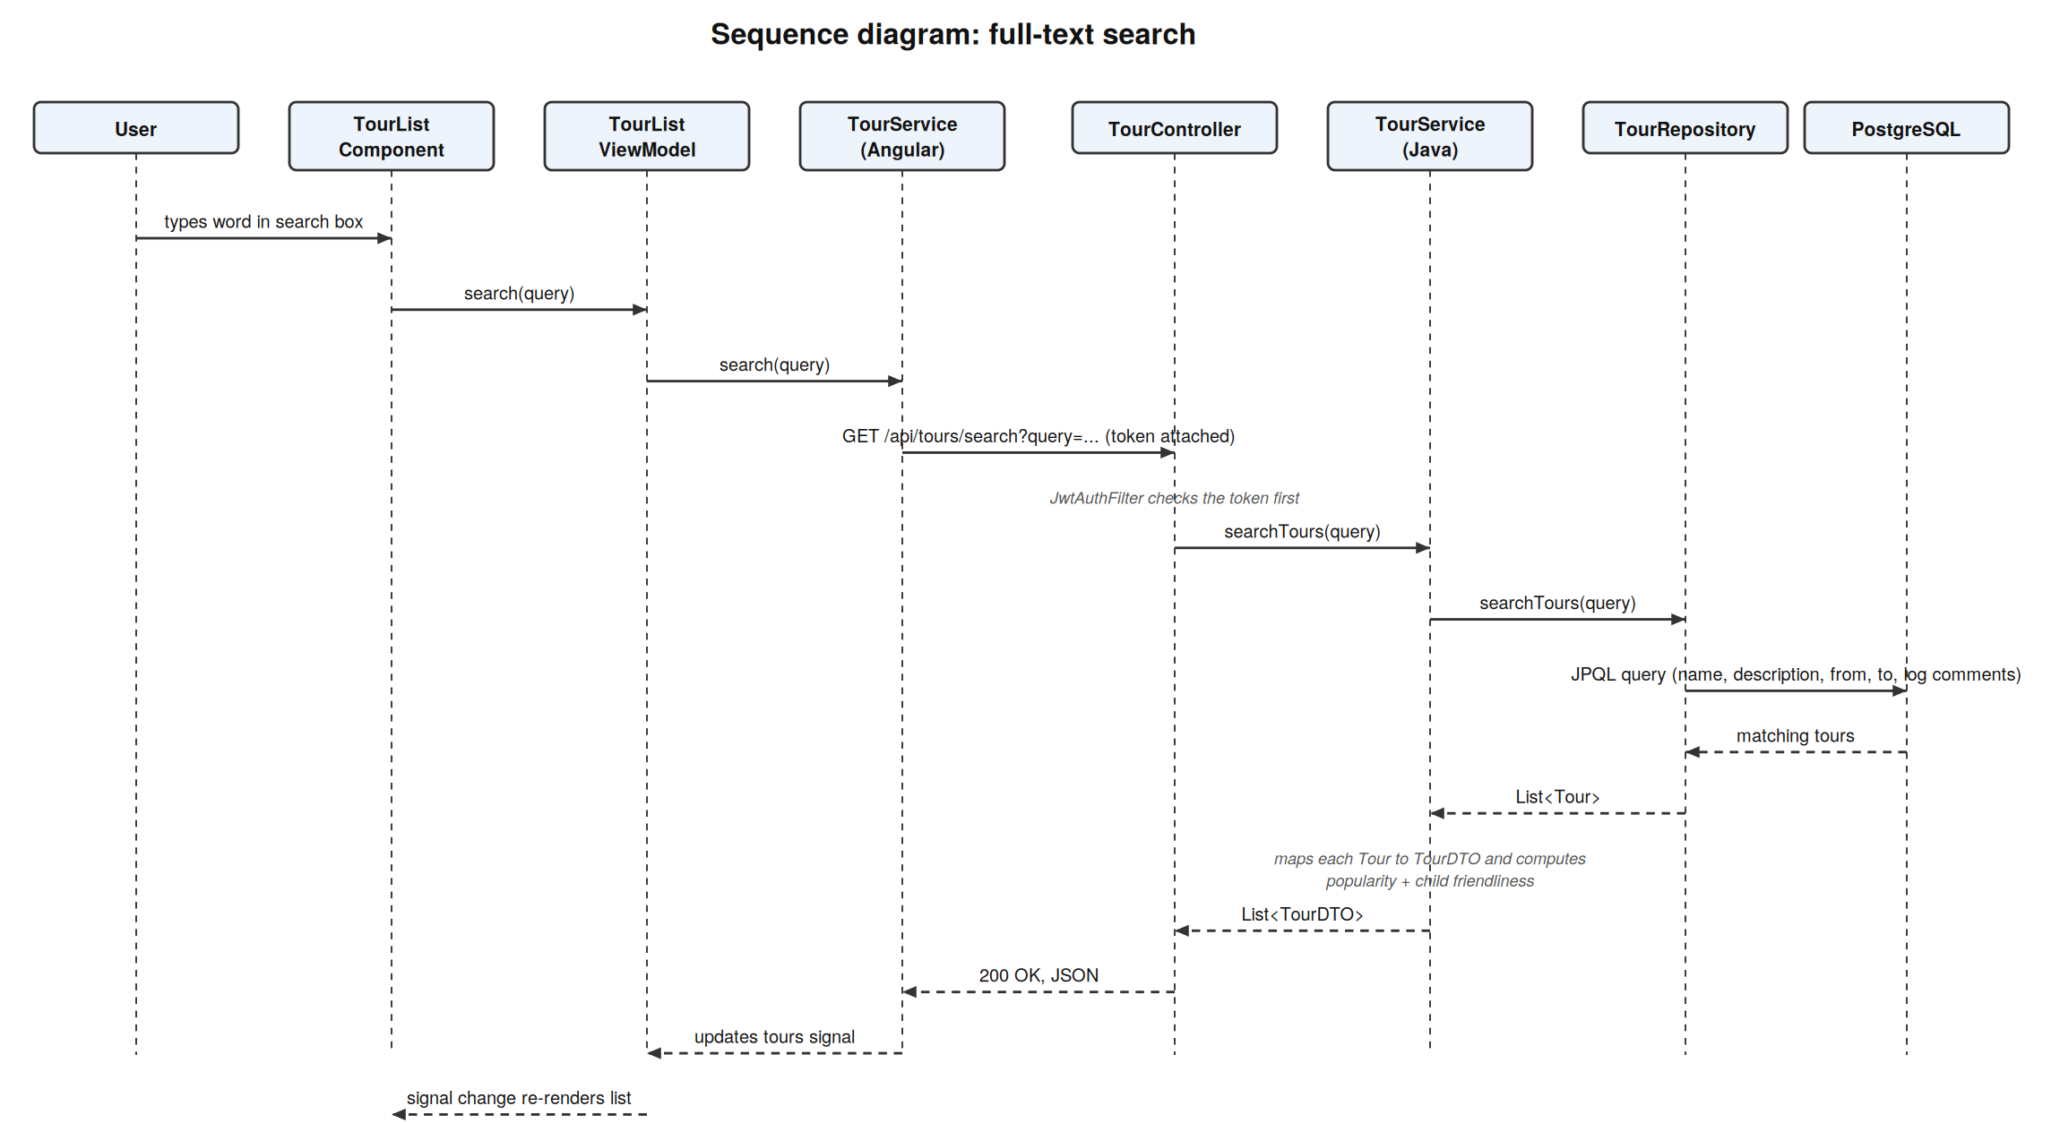
Full-text search, through every layer
the required sequence diagram, from keystroke to database and back
Notes:
One typed word travels through eight stations. A single JPQL query searches tour name, description, both locations and all log comments at once. On the way back the service computes popularity and child friendliness for every hit, so results carry the badges. Clarified with the professor: searching inside the computed values themselves is not needed.

Slide 7



Design patterns
confirmed as sufficient by the course instructor
Repository
Dependency injection
MVVM
all database access goes through repository interfaces. like a warehouse counter: the service hands in an order slip and gets goods back, it never walks into the warehouse itself.
no class builds its own helpers with new. each class states what it needs in the constructor and Spring delivers it. that is exactly what lets tests hand in mocks instead.
the view only talks to the viewmodel, the viewmodel only to the services. a waiter between dining room and kitchen: neither side needs to know the other.
Notes:
One sentence per pattern plus where it lives: Repository = the three JPA interfaces. DI = every constructor in backend and frontend. MVVM = TourListViewModel and TourLogViewModel with signals. If asked for more: the DTO pattern and the layered architecture itself also count.

Slide 8



Unit tests
we test where our own decisions live
happy paths CRUD and search return correctly mapped DTOs
32
error paths missing tours throw a clean not found, no crashes
backend unit tests
ownership editing foreign tours throws forbidden and never reaches save
20 required, all green,
run without database
or internet
API fallback if the route service is down the tour still saves with typed values
computed values every branch of popularity and child friendliness has its own test
Notes:
Why the service layer: controllers only forward and repositories are generated by Spring, so testing them tests the framework. The services hold our decisions, a bug there corrupts data. Mockito replaces the database and the route API with stand-ins, so tests run in seconds. The similar-looking computed attribute tests each hit a different branch, so none is a duplicate.

Slide 9

Running the tests, live
./mvnw test
what to point at: tests run 0 failures, and no database was needed because mocks stand in for it
Notes:
Switch to the terminal, run ./mvnw test, talk while it runs: JUnit runs the tests, Mockito plays the database and the route API, AssertJ writes the readable checks. When the summary appears, point at the zero failures and the test count.

Slide 10
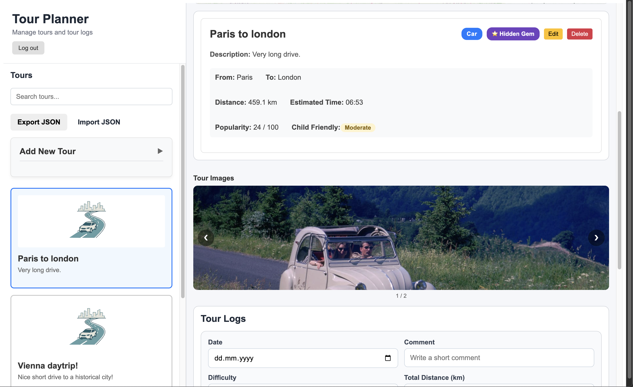




Unique feature: the tour image gallery
one visible feature that ties four requirements together
upload
every log can carry one validated photo
stored on disk
only the file name goes into the database, exactly as required
aggregated
one endpoint collects the images of all logs of a tour
reusable component
the gallery is its own Angular component with flip arrows
Notes:
The gallery shows file upload with validation, external image storage on the file system, an aggregation endpoint, and our reusable UI component, all in one demonstrable feature. Nice demo detail: images survive a backend restart because they live on disk.

Slide 11


What went wrong, what we learned
the honest part of the protocol
failures and fixes
lessons learned
auth errors returned 500
own exception classes now give a clean 409 and 401
security belongs in the backend, hidden buttons protect nothing
route API wants longitude first
geocode first, then hand coordinates over in its order
mock the outside world, tests then run in seconds and offline
browser blocked the frontend (CORS)
allowed origin configured centrally instead of per controller
decide early what happens when an external API is down
logs vanished on restart
rolling file appender writes logs/tourplanner.log
keep secrets out of git from the very first commit
Notes:
Pick two failures to tell as short stories, the 500 fix and the coordinate order are the best ones. Each failure maps to a lesson on the right.

Slide 12


Thank you
total time spent: 86 hours
full history: github.com/iselinmag/SoftwareEngineering-TourPlanner
questions welcome
protocol, wireframes and diagrams are in the hand-in pdf
Notes:
Fill in the real total hours before presenting. Close with: the git history documents the whole journey, the protocol has all diagrams, we are happy to take questions.

