Slide 1
CS1: Task 12
17.12.15, Gruppe Blau

Slide 2
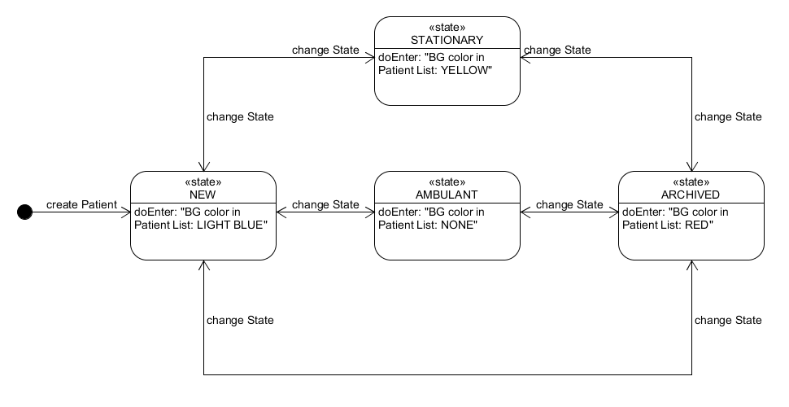
State Event Pattern

Slide 3
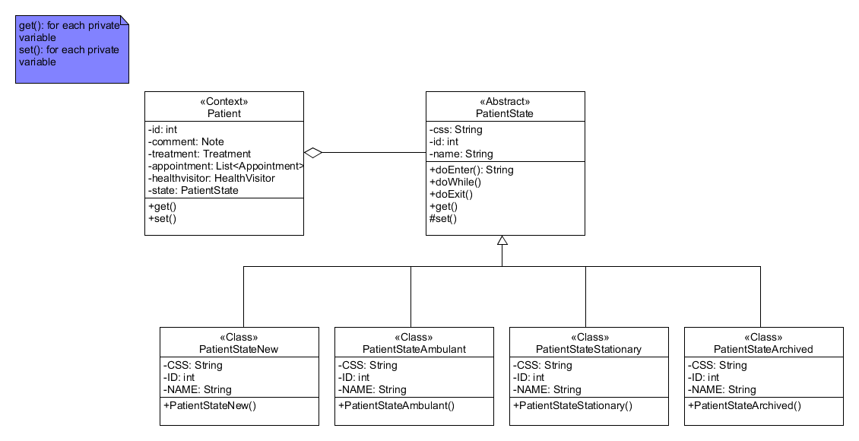
Class Diagram

Slide 4
Code Presentation

Slide 5
Live Demo

Slide 6
THX!

