Slide 2
Unit I

Slide 3
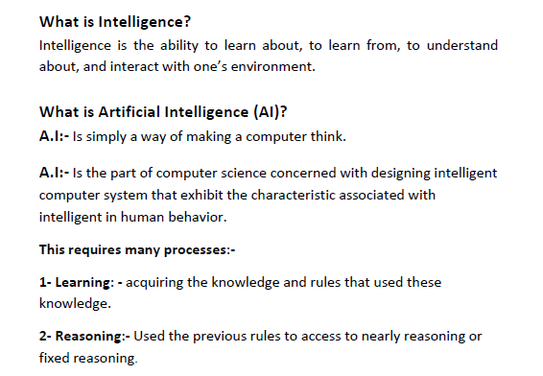
Introduction to AI

Slide 4
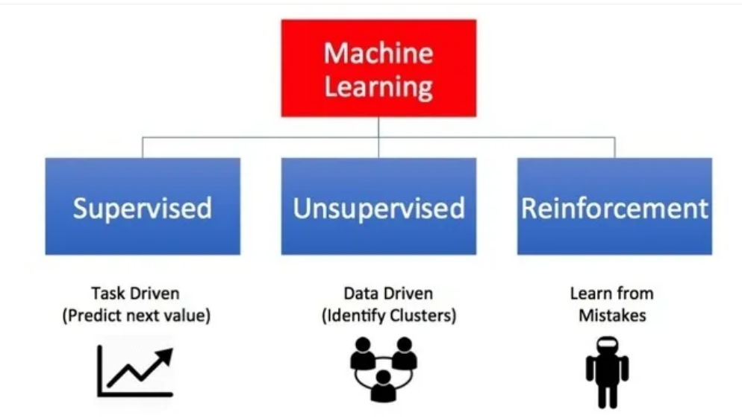
Learning types

Slide 5
LEARNING TYPES
Learning Problems
1.SUPERVISED LEARNING->
2 types
Classification - An example of a classification problem would be the MNIST handwritten digits dataset where the inputs are images of handwritten digits (pixel data) and the output is a class label for what digit the image represents (numbers 0 to 9).)
b) Regression-An example of a regression problem would be the Boston house prices dataset where the inputs are variables that describe a neighborhood and the output is a house price in dollars.
y = β0 + β1x+ e;
2. UNSUPERVISED LEARNING-In unsupervised learning, there is no instructor or teacher, and the algorithm must learn to make sense of the data without this guide.
Clustering: Unsupervised learning problem that involves finding groups in data.
Density Estimation: Unsupervised learning problem that involves summarizing the distribution of data.
3.REINFORCED LEARNING-Reinforcement learning is learning what to do — how to map situations to actions—so as to maximize a numerical reward signal. The learner is not told which actions to take, but instead must discover which actions yield the most reward by trying them.

Slide 6
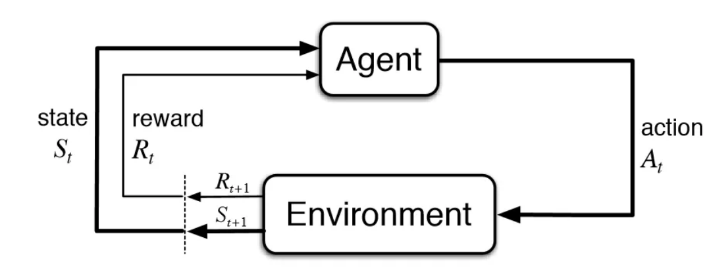
reinforcement learning the goal is to find a suitable action model that would maximize the total cumulative reward of the agent.
The figure below illustrates the action-reward feedback loop of a generic RL model.
Reinforcement Learning 101. Learn the essentials of Reinforcement… | by Shweta Bhatt | Towards Data Science

Slide 7
Hybrid Learning Problems
4. Semi-Supervised Learning
5. Self-Supervised Learning
6. Multi-Instance Learning
Statistical Inference
7. Inductive Learning
8. Deductive Inference
9. Transductive Learning
Learning Techniques
10. Multi-Task Learning
11. Active Learning
12. Online Learning
13. Transfer Learning
14. Ensemble Learning

Slide 8
Semi-supervised
Involves a small portion of labeled examples and a large number of unlabeled examples from which a model must learn and make predictions on new examples.
Semi-Supervised Learning, Explained | AltexSoft

Slide 9
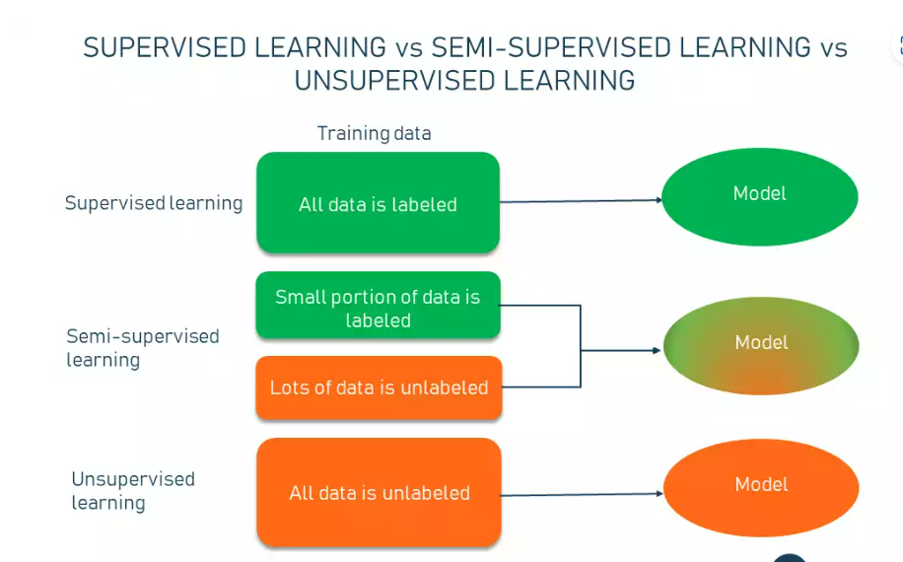

Slide 10
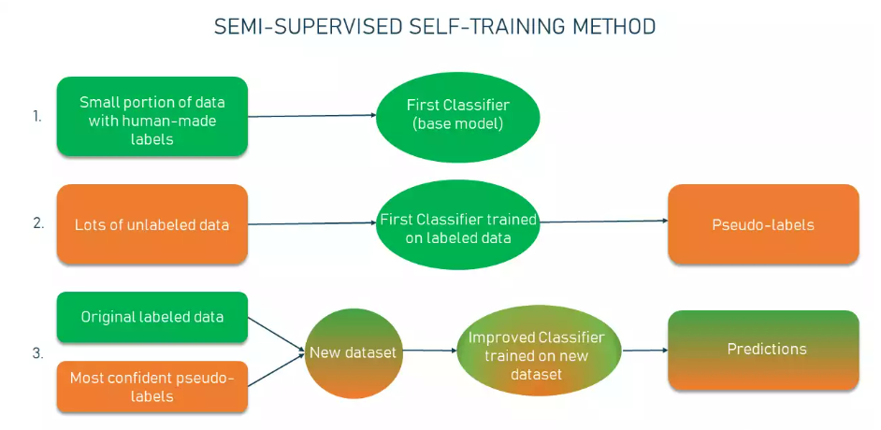

Slide 11
Reasoning
The reasoning is the mental process of deriving logical conclusion and making predictions from available knowledge, facts, and beliefs.
Or we can say, "Reasoning is a way to infer facts from existing data."
It is a general process of thinking rationally, to find valid conclusions.

Slide 12












What is AI
Definitions may be organised into four categories.
Systems that act like humans.
Systems that think like humans.
Systems that think rationally.
Systems that act rationally.

Slide 13
Acting humanly
The first proposal for success in building a program and acts humanly was the Turing Test.
To be considered intelligent a program must be able to act sufficiently like a human to fool an interrogator.
A human interrogates the program and another human via a terminal simultaneously.
If after a reasonable period, the interrogator cannot tell which is which, the program passes. To pass this test requires:
natural language processing
knowledge representation
automated reasoning
machine learning
This test avoids physical contact and concentrates on "higher level" mental faculties.
A total Turing test would require the program to also do: c
Computer vision
robotics

Slide 14
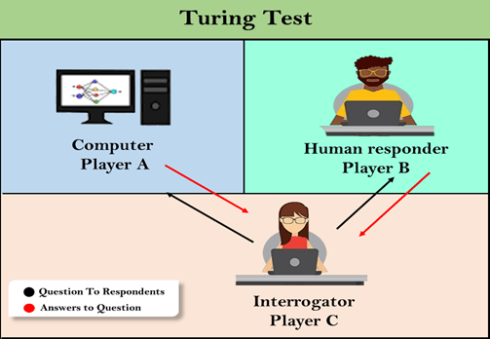

Slide 15
Thinking Humanly
This requires "getting inside" of the human mind to see how it works and then comparing our computer programs to this.
This is what cognitive science attempts to do.
There are two ways to do this: through introspection--trying to catch our own thoughts as they go by--or through psychological experiments.
Another way to do this is to observe a human problem solving and argue that one's programs go about problem solving in a similar way.
If the program's input/output and timing behaviour matches human behavior, that is evidence that some of the program's mechanisms may also be operating in humans
Example: GPS (General Problem Solver) was an early computer program that attempted to model human thinking. The developers were not so much interested in whether or not GPS solved problems correctly.
They were more interested in showing that it solved problems like people, going through the same steps and taking around the same amount of time to perform those steps.
Assignment :Give an example of GPS with steps

Slide 16
GPS-MEANS END ANALYSIS
We deliberate not about ends, but about means.
For a doctor does not deliberate whether he shall heal,
nor an orator whether he shall persuade, nor a
statesman whether he shall produce law and order, nor
does any one else deliberate about his end.
They assume the end and consider how and by what means it is attained; and if it seems to be produced by several means they consider by which it is most easily and best produced, while if it is achieved by one only they consider how it will be achieved by this and by what means this will be achieved,

Slide 17
EXAMPLE GPS
I want to take my son to nursery school.
What’s the difference between what I have and what I want?
One of distance. What changes distance?
My automobile.
My automobile won’t work.
What is needed to make it work?
A new battery. What has new batteries?
An auto repair shop. I want the repair shop to put in a new battery; but the shop doesn’t know I need one.
What is the difficulty? One of communication.
What allows communication? A telephone… and so on. — Newell and Simon’s example from their 1972 book Human Problem Solving

Slide 18
GPS
Basic structuring of a problem
define the goals
e.g., take my son to nursery school
define preconditions for the goals
e.g., the precondition for dropping my son off at nursery school is that my son is at home and the car works
define the means (“operators”) for turning one set of conditions into another
e.g., to ensure the car repair shop has my money, we can define an operator “give shop money” that changes the world so that “shop has money” is true and “I have money” is false.
We’ll say that an operator is made up of:
the action (e.g., “give shop money”)
the preconditions (e.g., “have money”)
the change of conditions resulting from taking the action; we specify this as conditions added and conditions deleted:
giving the shop money adds the condition “shop has money”
giving the shop money deletes the condition “have money” (which is also the precondition)
GPS can solve any problem that can be posed in this way. However, as we shall see, it employs a kind of search process that would require far too much time to solve complex problems (such as chess playing). It can suffer from a “combinatorial explosion” of possibilities.

Slide 19
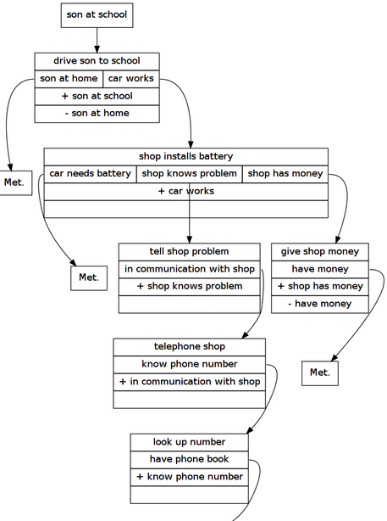

The driving to school problem Consider again the driving to school problem quoted above. Let’s write the goal, starting conditions, and some operators in a more symbolic form:
"start": ["son at home", "have money", "have phone book", "car needs battery"], "finish": ["son at school"],

Slide 20
MEANS –END SEARCH GPS
This algorithm is clearly a means-ends search process.
The ultimate goals are first considered; if they are already achieved, then we’re done.
Otherwise, one or more goals can only be achieved by applying some operators.
Appropriate operators are identified (those that achieve the goals), but each operator may itself require certain goals (preconditions) to be achieved first. So then those are investigated. Etc.

Slide 21



What are Agent and Environment?
An agent is anything that can
perceive its environment through sensors and
acts upon that environment through effectors.
A human agent has
sensory organs such as eyes, ears, nose, tongue and skin parallel to the sensors, and
other organs such as hands, legs, mouth, for effectors.
A robotic agent uses
cameras and infrared range finders for the sensors, and
various motors and actuators for effectors.
A software agent has
encoded bit strings as its programs and actions.

Slide 22
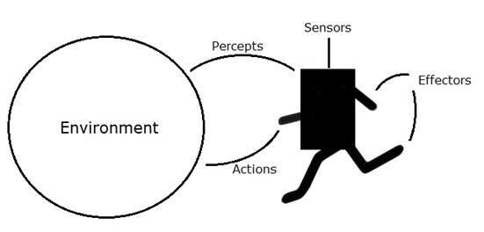
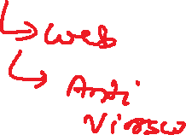





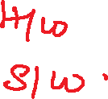

An agent is anything that can be viewed as perceiving its environment through sensors and acting upon that environment through effectors.
A human agent has eyes, ears, and other organs for sensors, and hands, legs, mouth, and other body parts for effectors.
A robotic agent substitutes cameras and infrared range finders for the sensors and various motors for the effectors.
A software agent has encoded bitstrings as its percepts and actions.

Slide 23
Actions
Actions may
change things in the environment, or
move the agent to a new part of the environment
Both of which alter what the sensors sense
Mine clearing robot moves from place to place, finds mines, detonates them, moves on to next
These actions change its local environment as it moves
They change the environment as they detonate mines
They change their own goals as they move to the next target
Or they may just transmit information, like a recommendation in a decision support system

Slide 24
HOW AGENTS SHOULD ACT
A rational agent is one that does the right thing.
Obviously, this is better than doing the wrong thing, but what does it mean?
that will cause the agent to be most successful.
That leaves us with the problem of deciding how and when to evaluate the agent’s success.
We use the term performance measure for the how—the criteria that determine how successful an agent is.
we will insist on an objective performance measure imposed by some authority

Slide 25
As an example, consider the case of an agent that is supposed to vacuum a dirty floor.
A plausible performance measure would be the amount of dirt cleaned up in a single eight-hourshift.
A more sophisticated performance measure would factor in the amount of electricity consumed and the amount of noise generated as well.
A third performance measure might give highest marks to an agent that not only cleans the floor quietly and efficiently, but also finds time to go windsurfing at the weekend.

Slide 26
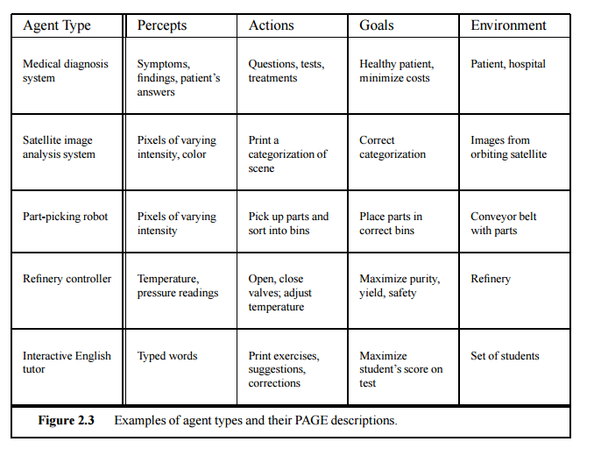

Slide 27







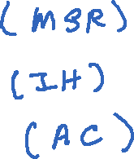


EXERCISE
1. mail sorting robot
2.intelligent house
3.automatic car.

Slide 28
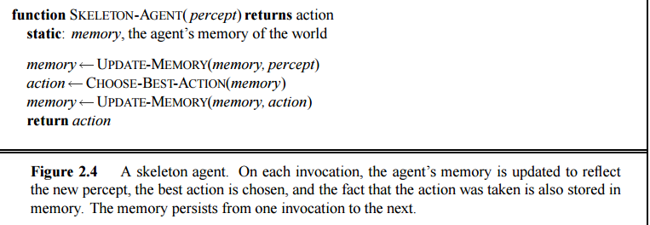



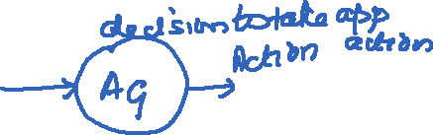


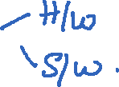
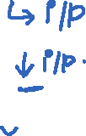

Agent programs
They will all have the same skeleton, namely, accepting percepts from an environment and generating actions.

Slide 29
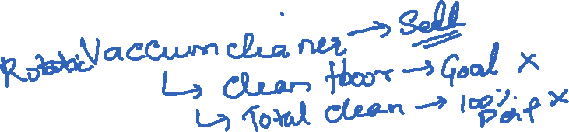
Second, the goal or performance measure is not part of the skeleton program.
This is because the performance measure is applied externally to judge the behavior of the agent, and it is often possible to achieve high performance without explicit knowledge of the performance measure

Slide 30





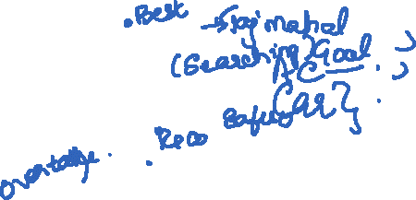




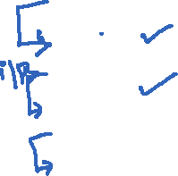




Now we have to decide how to build a real program to implement the mapping from percepts to action.
We will find that different aspects of driving suggest different types of agent program.
We will consider four types of agent program:
Simple reflex agents
Agents that keep track of the world
Goal-based agents
Utility-based agents

Slide 31
The key problem faced by an agent is
that of deciding which of its actions it should perform in order to best satisfy its design objectives
Agent architectures, of which we shall see several examples later in this article, are really software architectures for decision making systems that are embedded in an environment.
The complexity of the decision-making process can be affected by a number of different environmental properties.
Russell and Norvig suggest the following classification of environment properties

Slide 32
Episodic vs Sequential.
An agent’s action is divided into atomic episodes. Decisions do not depend on previous decisions/actions.

Slide 33



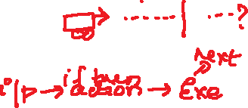







Environment types
Fully observable (vs. partially observable):
An agent's sensors give it access to the complete state of the environment at each point in time.
chess – the board is fully observable, as are opponent’s moves. Driving – what is around the next bend is not observable (yet).
Deterministic (vs. stochastic):
The next state of the environment is completely determined by
the current state and
the action executed by the agent.
If the environment is deterministic except for the actions of other agents, then the environment is strategic
Deterministic environments can appear stochastic to an agent (e.g., when only partially observable)
Non-deterministic environment: physical world: Robot on Mars Deterministic environment: Tic Tac Toe game

Slide 34







Environment types
Episodic (vs. sequential):
An agent’s action is divided into atomic episodes.
each episode consists of the agent perceiving and then performing a single action
Decisions do not depend on previous decisions/actions.
Examples of episodic are expert advice systems – an episode is a single question and answer
Sequential if current decisions affect future decisions, or rely on previous ones
Example-Chess game
Static (vs. dynamic):
The environment is unchanged while an agent is deliberating.
The environment is semidynamic if the environment itself does not change with the passage of time but the agent's performance score does
chess when played with a clock i
Dynamic if the environment may change over time.

Slide 35
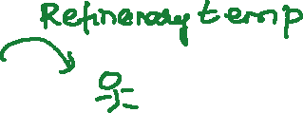


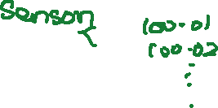


Environment types
Discrete (vs. continuous):
A discrete set of distinct, clearly defined percepts and actions.
Discrete = time moves in fixed steps, usually with one measurement per step (and perhaps one action, but could be no action). E.g. a game of chess
Continuous = Signals constantly coming into sensors, actions continually changing. E.g. driving a car
Single agent (vs. multi-agent):
An agent operating by itself in an environment.
Does the other agent interfere with my performance measure?
Other players in a football team (or opposing team), wind and waves in a sailing agent, other cars in a taxi drive

Slide 36











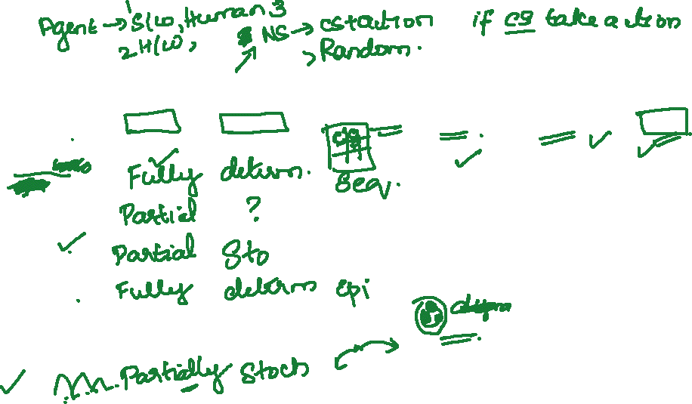


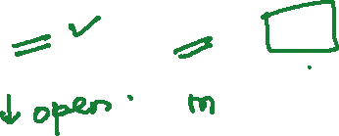







task environm. | observable | deterministic/ stochastic | episodic/ sequential | static/ dynamic | discrete/ continuous | agents
crossword puzzle | fully | determ. | sequential | static | discrete | single
chess with clock
poker
taxi driving
medical diagnosis
image analysis | fully | determ. | episodic | semi | continuous | single
partpicking robot
refinery controller | partial | stochastic | sequential | dynamic | continuous | single
interact. tutor

Slide 37
task environm. | observable | deterministic/ stochastic | episodic/ sequential | static/ dynamic | discrete/ continuous | agents
crossword puzzle | fully | determ. | sequential | static | discrete | single
chess with clock | fully | strategic | sequential | semi | discrete | multi
poker
taxi driving | partial | stochastic | sequential | dynamic | continuous | multi
medical diagnosis
image analysis | fully | determ. | episodic | semi | continuous | single
partpicking robot | partial | stochastic | episodic | dynamic | continuous | single
refinery controller | partial | stochastic | sequential | dynamic | continuous | single
interact. tutor | partial | stochastic | sequential | dynamic | discrete | multi

Slide 38
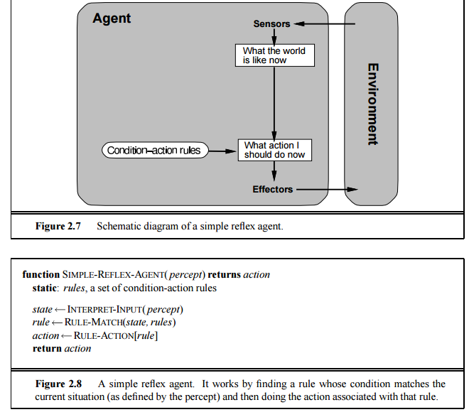
Simple reflex agents-simple reflex agent here will work only if the correct decision can be made on the basis of the current percept.
Condition –action rule
rain=true → carry umbrella

Slide 39
Agents that keep track of the world-REFLEX AGENTS
The simple reflex agent described before will work only if the correct decision can be made on the basis of the current percept.
structure of the reflex agent, showing how the current percept is combined with the old internal state to generate the updated description of the current state.
NEED BOTH CURRENT PERCEPT AND INTERNAL STATE →CURRENT STATE
Model-based reflex agents are made to deal with partial accessibility; they do this by keeping track of the part of the world it can see now.
It does this by keeping an internal wordl model that depends on what it has seen before so it holds information on the unobserved aspects of the current state.
Has only implicit goals

Slide 40
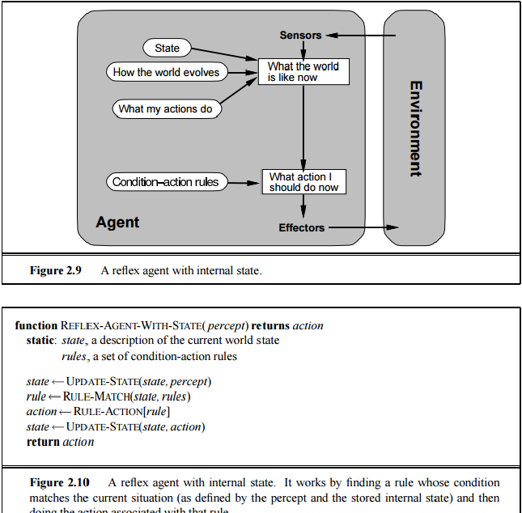

Slide 41
Goal-based agents
Knowing about the current state of the environment is not always enough to decide what to do.
For example, at a road junction, the taxi can turn left, right, or go straight on.
The right decision depends on where the taxi is trying to get to.
In other words, as well as a current state description, the agent needs some sort of goal information, which describes situations that are desirable— for example, being at the passenger’s destination.
The agent program can combine the goal
with information about the results of possible actions (the same information as was used to update internal state in the reflex agent) in order to choose actions that achieve the goal.

Slide 42
Goal based agents
Sometimes this will be simple, when goal satisfaction results immediately from a single action;
sometimes, it will be more tricky, when the agent has to consider long sequences of twists and turns to find SEARCH a way to achieve the goal.
Search and planning are the subfields of AI devoted to finding action sequences that do achieve the agent’s goals.
May have variable goals for the same agent

Slide 43
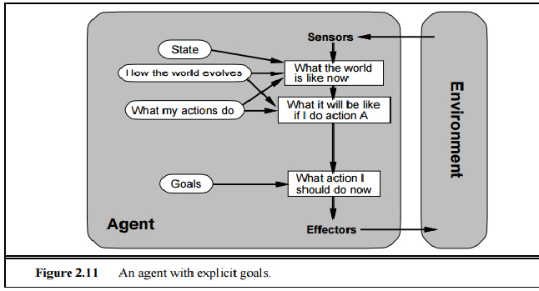

Slide 44
Utility-based agents-(measure of goodness)
Goals alone are not really enough to generate high-quality behavior.
For example, there are many action sequences that will get the taxi to its destination, thereby achieving the goal, but some are quicker, safer, more reliable, or cheaper than others.
if one world state is preferred to another, then it has higher utility for the agent

Slide 45
Utility based agents
An agent that possesses an explicit utility function therefore can make rational decisions, but may have to compare the utilities achieved by different courses of actions.
Some solutions to goal states are better than others.
Which one is best is given by a utility function.
Which combination of goals is preferred?

Slide 46
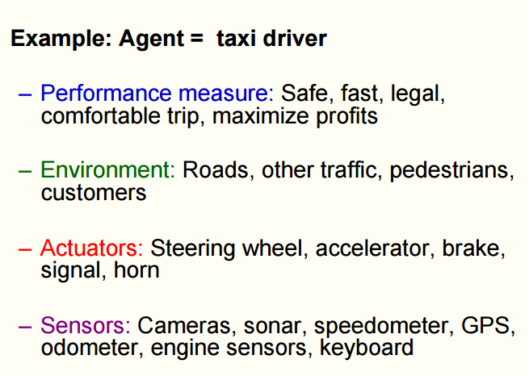
PEAS-The setting for intelligent agent design
REFER PEAS.PDF FILE

Slide 47
EXERCISE
USE THE GIVEN KEY WORDS AND IDENTIFY THE ITEMS FOR PEAS FOR EACH THE CASE
1.MEDICAL DIAGNOSIS SYSTEM
2. Internet shopping agent?
3.Part-picking robot

Slide 48
Problem Solving as Search
It is a kind of Goal-based Agents
4 general steps in problem-solving:
1. Goal Formulation
2. Problem Formulation
3. Search
4. Execute
Driving from Arad to Bucharest ...

Slide 49
Four general steps in problem solving:
Goal formulation- world states with certain properties
Problem formulation- What actions and states to consider to give the goal and follows goal formulation.
Given initial state
TASK:-TO REACH Goal state through execution of appropriate actions
Search- Determine the possible sequence of actions that lead to the states of known values and then choosing the best sequence.
Execute -Give the solution perform the actions.
Operators: blank moves left, right, up, or down

Slide 50
TERMINOLOGIES
State space of the problem: the set of all states reachable from the initial state by any sequence of actions.
A path in the state space is simply any sequence of actions leading from one state to another
The goal test, which the agent can apply to a single state description to determine if it is a goal state.
Sometimes there is an explicit set of possible goal states, and the test simply checks to see if we have reached one of them.

Slide 51
Well-defined problems and solutions
A problem is really a collection of information that the agent will use to decide what to do
We have seen that the basic elements of a problem definition are the states and actions. To capture these formally, we need the following:
The initial state that the agent knows itself to be in.
The set of possible actions available to the agent. The term operator is used to denote the description of an action in terms of which state will be reached by carrying out the action in a particular state

Slide 52
A path cost function is a function that assigns a cost to a path.
In all cases we will consider, the cost of a path is the sum of the costs of the individual actions along the path.
The path cost function is often denoted by g.
Together, the initial state, operator set, goal test, and path cost function define a problem

Slide 53
Problem
On holiday in Romania; currently in Arad
Flight leaves tomorrow from Bucharest (known value)
Formulate goal
Be in Bucharest
Formulate problem
States: various cities
Actions: drive between cities
Find solution
Sequence of cities; e.g. Arad, Sibiu, Fagaras, Bucharest, …

Slide 54
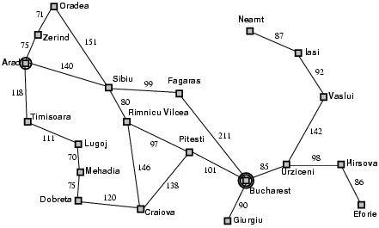
State-Space Problem Formulation
A problem is defined by four items:
initial state e.g., "at Arad“
actions or successor function
S(x) = set of action–state pairs e.g., S(Arad) = {<Arad → Zerind, Zerind>, … }
3. goal test (or set of goal states)
e.g., x = "at Bucharest”, Checkmate(x)
4. path cost (additive)
e.g., sum of distances, number of actions executed, etc.
c(x,a,y) is the step cost, assumed to be ≥ 0
A solution is a sequence of actions leading from the initial state to a goal state

Slide 55
Give a complete problem formulation for each of the following
problem1
Using only four colors, you have to color a planar map in such a way that no two adjacent regions have the same color.

Slide 56
solution
Initial State: All region are uncolored
Goal Test: All regions have color, and no two adjacent regions have the same color.
Formulate the problem:-
Actions: Assign color to an uncolored area.
states: The uncoloured area is now colored and cannot be colored again.
Cost Function: Number of areas.

Slide 57
Problem2
A 3-foot-tall monkey is in a room where some bananas are suspended from the 8-foot ceiling.
IT would like to get the bananas.
The room contains two stackable, movable, climbable 3-foot-high boxes.

Slide 58
Solution
Initial State: An 8-foot high room, 2 crates, 1 monkey, bananas.
Formulate the problem Actions: Monkey moving and stacking boxes to reach bananas. States : the boxes have either moved, been stacked, or both.
Goal Test: The monkey gets the bananas.
Cost Function: Number of actions

Slide 59
Tree-based Search
Basic idea:
Exploration of state space by generating successors of already-explored states (a.k.a. expanding states).
Every state is evaluated: is it a goal state?
In practice, the solution space can be a graph, not a tree
E.g., 8-puzzle
More general approach is graph search
Tree search can end up repeatedly visiting the same nodes
Unless it keeps track of all nodes visited
…but this could take vast amounts of memory

Slide 60
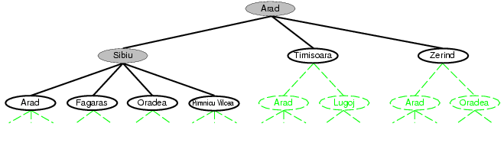
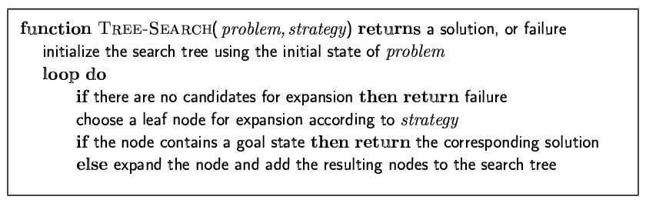
Tree search example

Slide 61
Tree search example
This “strategy” is what differentiates different search algorithms

Slide 62
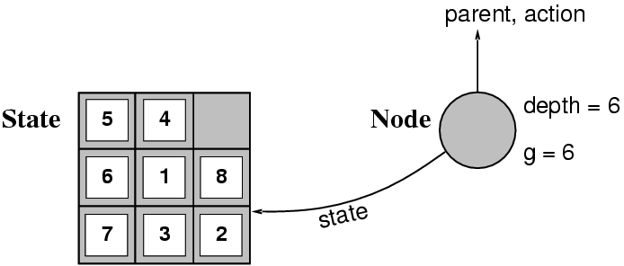
States versus Nodes
A state is a (representation of) a physical configuration
A node is a data structure constituting part of a search tree contains info such as: state, parent node, action, path cost g(x), depth
The Expand function creates new nodes, filling in the various fields and using the SuccessorFn of the problem to create the corresponding states.

Slide 63
There are three ways to deal with repeated states, in increasing order of effectiveness and computational overhead:
• Do not return to the state you just came from. Have the expand function (or the operator set) refuse to generate any successor that is the same state as the node's parent. • Do not create paths with cycles in them. Have the expand function (or the operator set) refuse to generate any successor of a node that is the same as any of the node's ancestors.
• Do not generate any state that was ever generated before. This requires every state that is generated to be kept in memory, resulting in a space complexity of O(bd ), potentially.
It is better to think of this as O(s), where s is the number of states in the entire state space.

