Slide 1
Battle of Neighborhoods Coursera Capstone Week 2

Slide 2
Diapositiva de análisis de proyecto 3
Coursera Capstone
Introduction
New York City's demographics show that it is a large and ethnically diverse metropolis. It is the largest city in the United States with a long history of international immigration. New York City was home to nearly 8.5 million people in 2014, accounting for over 40% of the population of New York State and a slightly lower percentage of the New York metropolitan area, home to approximately 23.6 million. Over the last decade the city has been growing faster than the region. The New York region continues to be by far the leading metropolitan gateway for legal immigrants admitted into the United States.
Throughout its history, New York City has been a major point of entry for immigrants; the term "melting pot" was coined to describe densely populated immigrant neighborhoods on the Lower East Side. As many as 800 languages are spoken in New York, making it the most linguistically diverse city in the world. English remains the most widely spoken language, although there are areas in the outer boroughs in which up to 25% of people speak English as an alternate language, and/or have limited or no English language fluency. English is least spoken in neighborhoods such as Flushing, Sunset Park, and Corona.
With it's diverse culture , comes diverse food items. There are many resturants in New york City, each beloning to different categories like Chinese , Sushi, Indian , French etc.
So as part of this project , we will list and visualize all major parts of New York City that has great sushi resturants.

Slide 3
Diapositiva de análisis de proyecto 3
Coursera Capstone
Data
For this project we need the following data:
New York City data that contains list Boroughs, Neighborhoods along with their latitude and longitude. Data source : https://cocl.us/new_york_dataset Description : This data set contains the required information. And we will use this data set to explore various neighborhoods of new york city.
Sushi resturants in each neighborhood of new york city.
Data source : Fousquare API Description : By using this api we will get all the venues in each neighborhood. We can filter these venues to get only sushi resturants.

Slide 4
Diapositiva de análisis de proyecto 3
Coursera Capstone
GeoSpace data
Data source : https://data.cityofnewyork.us/City-Government/Borough-Boundaries/tqmj-j8zm Description : By using this geo space data we will get the New york Borough boundaries that will help us visualize choropleth map.
Approach
Collect the new york city data from https://cocl.us/new_york_dataset Using FourSquare API we will find all venues for each neighborhood. Filter out all venues that are Indian Resturants. Find rating , tips and like count for each Indian Resturants using FourSquare API. Using rating for each resturant , we will sort that data. Visualize the Ranking of neighborhoods using folium library(python) Questions that can be asked using the above mentioned

Slide 5
Diapositiva de análisis de proyecto 3
Coursera Capstone
Datasets
What is best location in New York City for Indian Cuisine ? Which areas have potential Indian Resturant Market ? Which all areas lack Sushi Resturants ? Which is the best place to stay if I prefer Sushi Cuisine ?
Analysis
We will import the required libraries for python.
pandas and numpy for handling data. request module for using FourSquare API. geopy to get co-ordinates of City of New York. folium to visualize the results on a map

Slide 6
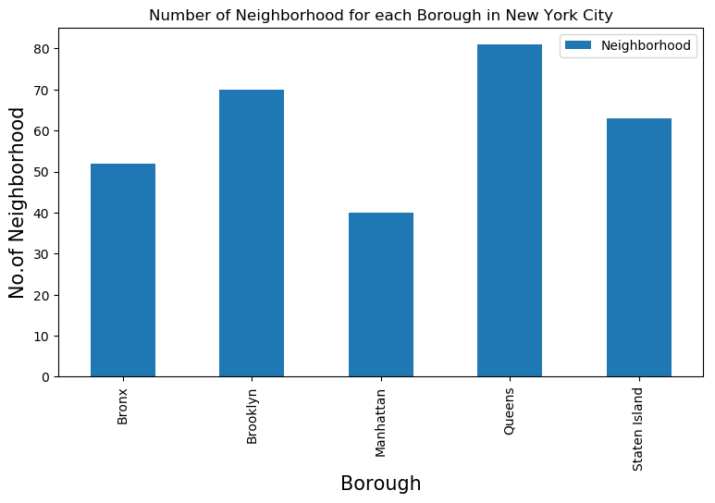
Diapositiva de análisis de proyecto 3
Coursera Capstone

Slide 7
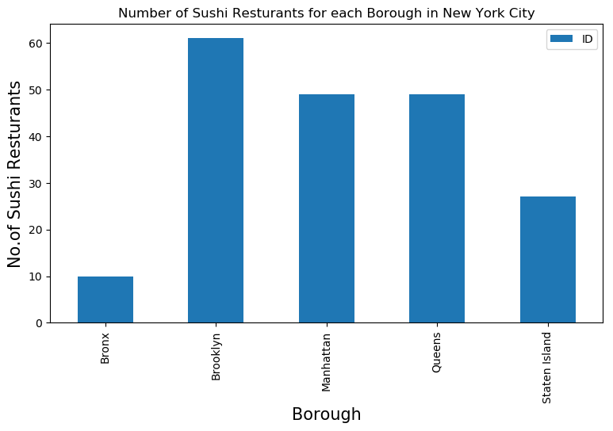
Diapositiva de análisis de proyecto 3
Coursera Capstone

Slide 8
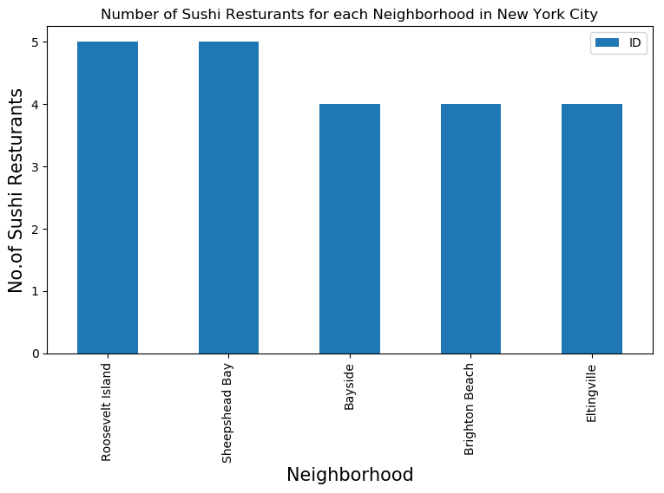
Diapositiva de análisis de proyecto 3
Coursera Capstone

Slide 9
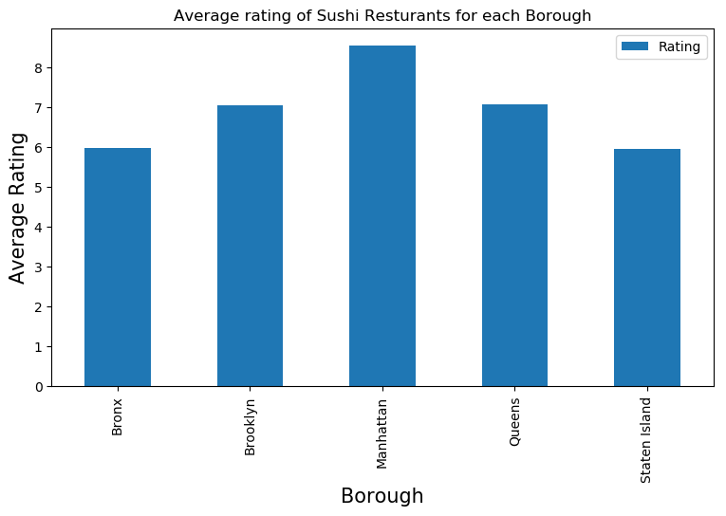
Diapositiva de análisis de proyecto 3
Coursera Capstone

Slide 10
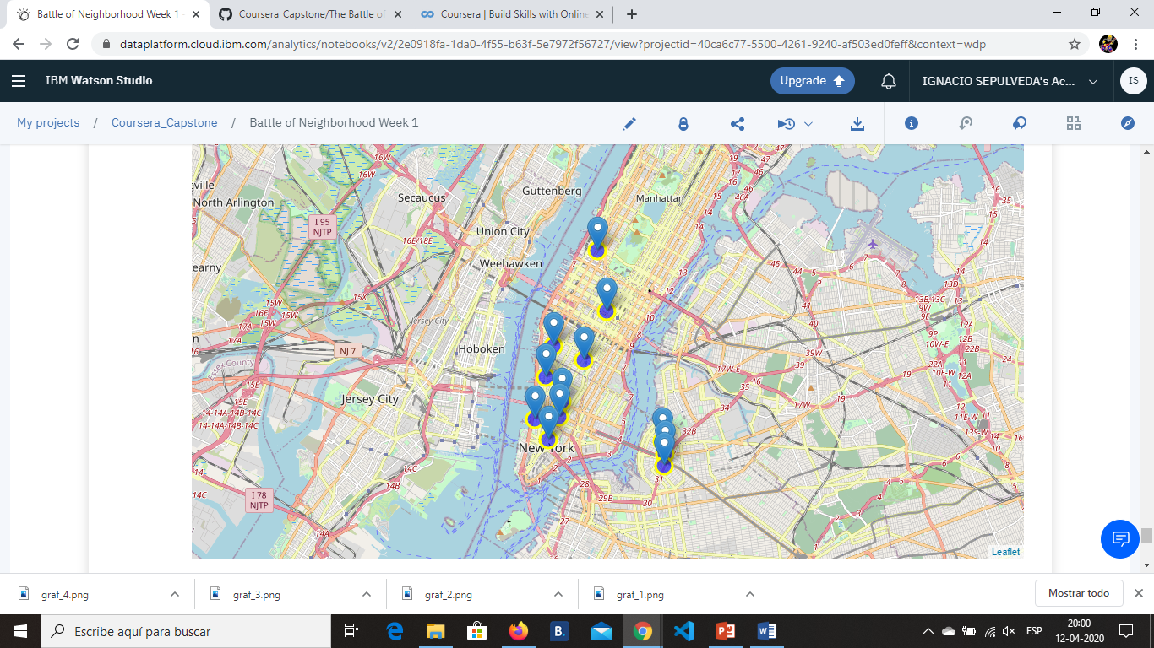
Diapositiva de análisis de proyecto 3
Coursera Capstone

Slide 11
Diapositiva de análisis de proyecto 3
Coursera Capstone
Conclusion¶
Manhattan are some of the best neighborhoods for Sushi cuisine. Manhattan have potential Sushi Resturant Market/ XXXXXXX ranks last in average rating of Sushi Resturants. Manhattan is the best place to stay if you prefer Indian Cuisine.
Limitations
The ranking is purely on basis of rating of resturants The accuracy of data depends purely depends on the data provided by FourSquare.

Slide 12
Thanks

