Slide 1
Wtracert

Slide 2
Introduction
Traceroute is a computer network diagnostic tool for displaying the route (path) and measuring transit delays of packets across an Internet Protocol (IP) network.

Slide 3
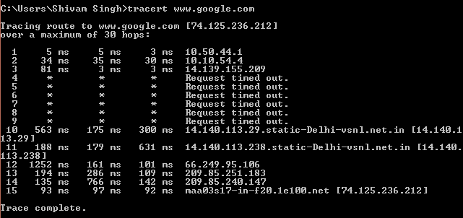
How to use..?

Slide 4
Problems
Less efficient in wireless Networks. Experiments show that the traceroute program, especially in wireless environments, takes too long to detect if a host is not reachable. In such environments, broken routes are frequent. This occurs because of the lossy wireless links and mobility of the nodes.

Slide 5
We have implemented a better variant of traceroute i.e. wtracert.

Slide 6
Idea: to terminate traceroute if a given hop is not reachable.

Slide 7
How ?

Slide 8
find an optimal timeout interval before reporting a broken route. Obviously, the timeout should be larger than a connection's round-trip time .

Slide 9
How much larger should it be?

Slide 10
We have implemented the well-known Exponential Weighted Moving Average (EWMA) based formulas to create a wireless version of the standard traceroute program.

Slide 11
Implementation

Slide 12
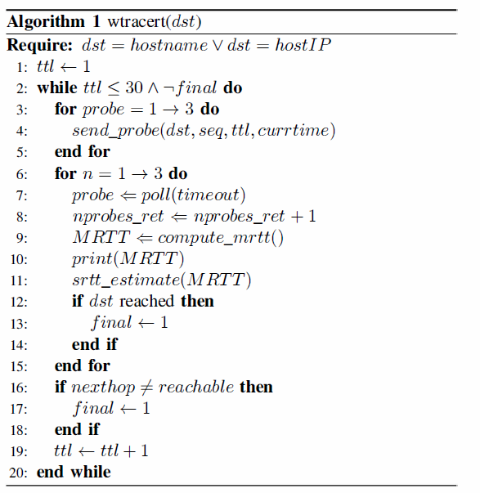
Algorithm

Slide 13
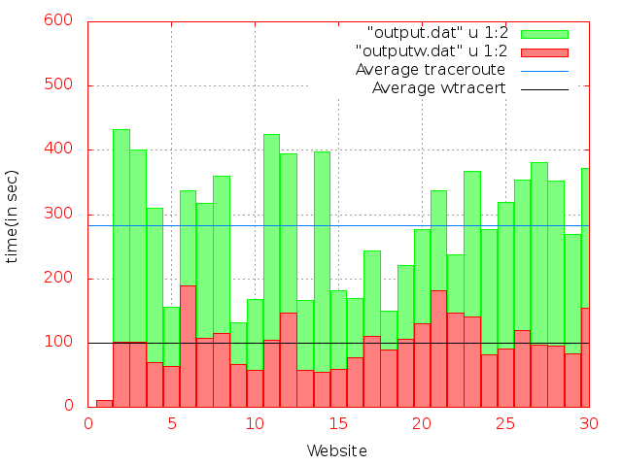
Analysis

Slide 14
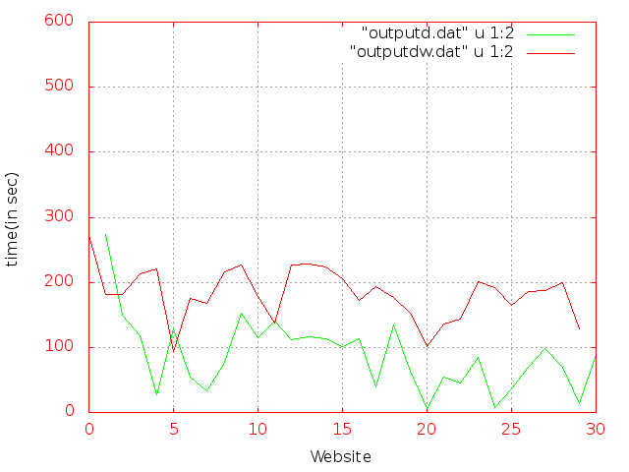

Slide 15
Conclusion
The classic traceroute is a critical tool in network administration and design. However, when a route is broken, it takes an inordinate amount of time to detect this condition.
In this project, a modification to the basic traceroute algorithm has been implemented based on. Coupled with early detection of broken route, wtracert overcomes suboptimal latency associated with the classic traceroute. The experimental results clearly demonstrate the superiority of wtracert over classic traceroute.

