Slide 1
Reactive
Paradigm
@isfaaghyth

Slide 2

Hai, I am Muh Isfahani Ghiyath
CEO Daeng Indonesia
CTO PT Startup Digital Indonesia
@isfaaghyth

Slide 3
Rx is …
“A programming paradigm oriented around
data flows and the propagation of change.”

Slide 4
Point
Data Flow Background Thread
Automatically Thread Compose Sequences
Low Level Threading Sync

Slide 5


Slide 6
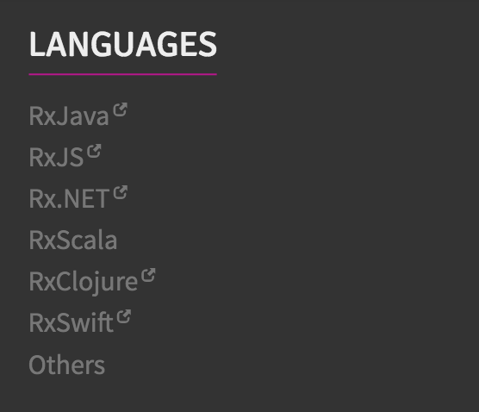

Slide 7
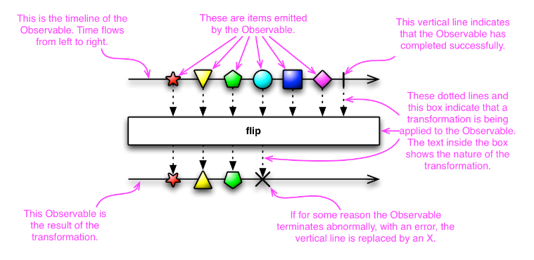

Slide 8
Observable is PowerRangers!

Slide 9
Why Observable?
Composable
Flexible
Less Opinionated

Slide 10
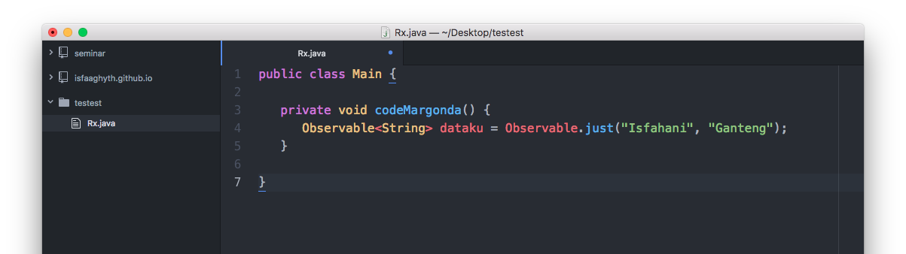
Example #1
First Implement

Slide 11
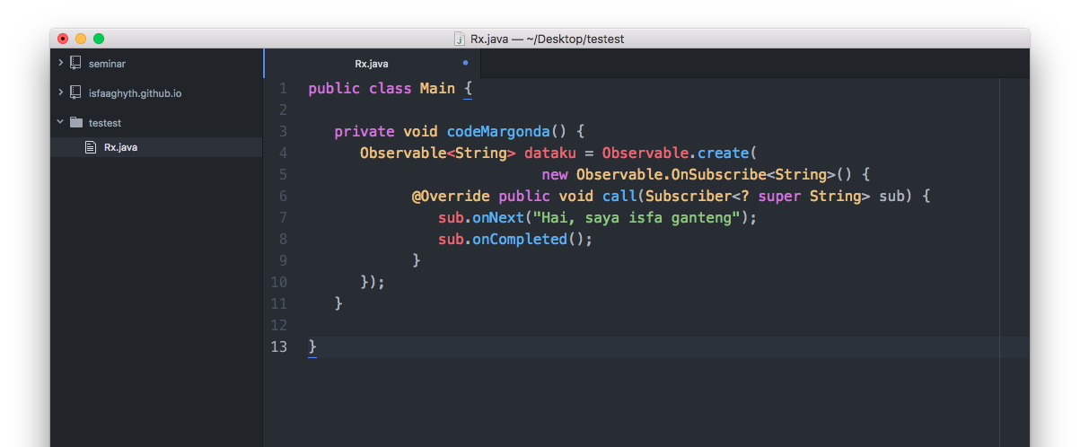
Example #2
Second Implement

Slide 12
Operators!

Slide 13
Map()
Map()
Filtering
Other mechanism

Slide 14
Schedulers

Slide 15
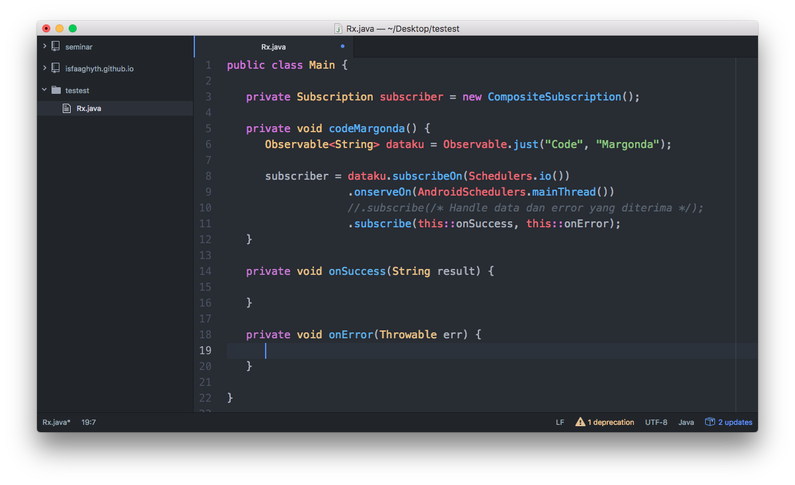

Slide 16
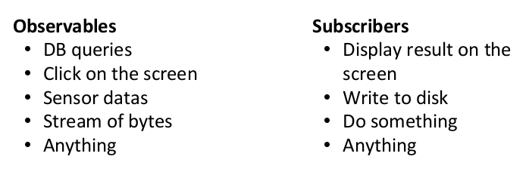

Slide 17
References
reactivex.io
Andrew Kurniadi
isfaa.me

Slide 18
Thankyou! Demo ?

